Slide 1
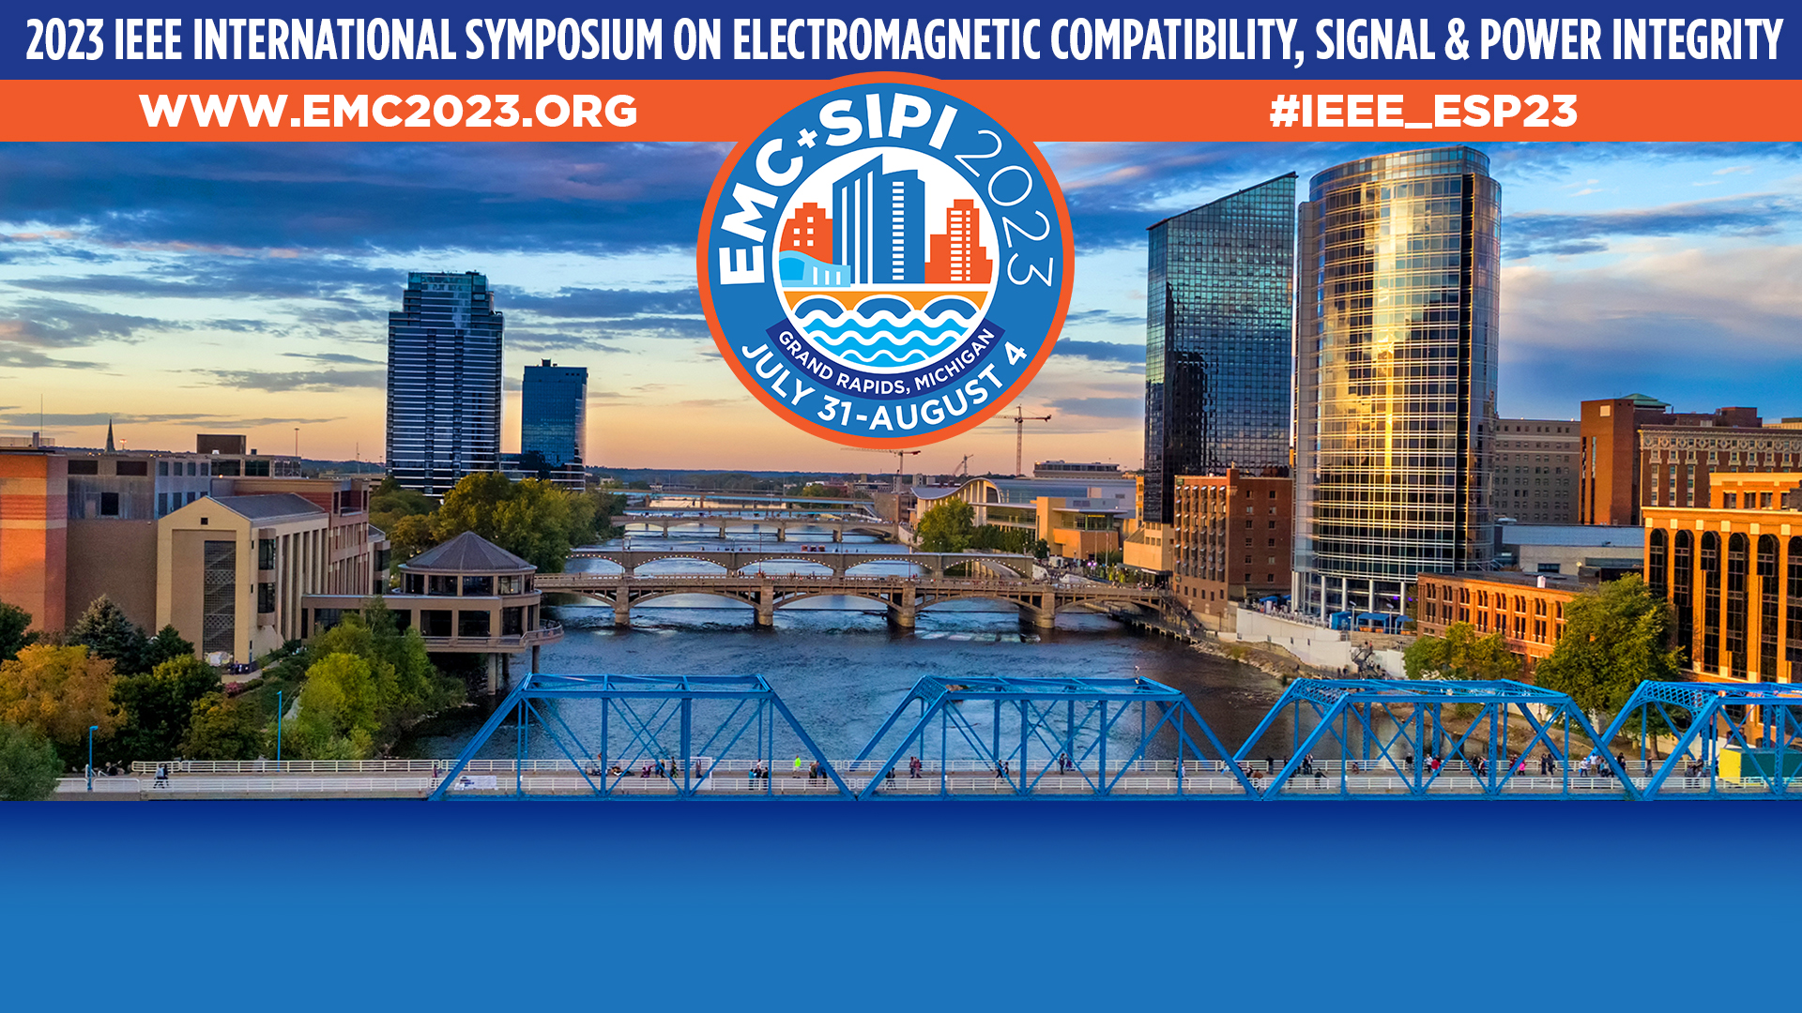
PACE – Adventures In Magnetics
Jen Dimov, NASA GSFC/Jacobs Technology

Slide 2
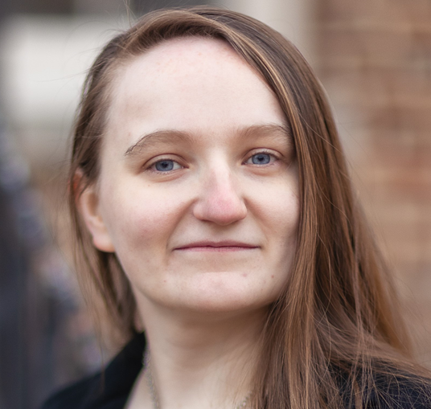
Jen Dimov
Jen has worked as an EMC engineer at NASA Goddard Space Flight Center since 2014, providing EMC and electrical systems support to large spacecraft programs like JWST, RST, and PACE as well as ISS payloads and small satellites. She has a BSc. Physics from the University of the Sciences in Philadelphia (now St. Joseph’s University).
She is the current chair of the EMC Society Technical Committee on Aerospace EMC (TC-8).
jennifer.dimov@nasa.gov

Slide 3
Lessons Learned from NASA EMC, Part 6
PACE – Adventures In Magnetics
Jen Dimov
NASA GSFC / Jacobs Technology

Slide 4
Acronyms
PACE | Plankton, Aerosols, Cloud & ocean Ecosystems
EMC | Electromagnetic Compatibility
GN&C | Guidance, Navigation & Control
GSFC | Goddard Space Flight Center
HARP2 | Hyper-Angular Rainbow Polarimeter 2
NASA | National Aeronautics and Space Administration
OCI | Ocean Color Instrument
RWA | Reaction Wheel Assembly
SPEXOne | Spectro-Polarimeter for Exploration
TAM | Tri-Axial Magnetometer
TVAC | Thermal Vacuum

Slide 5
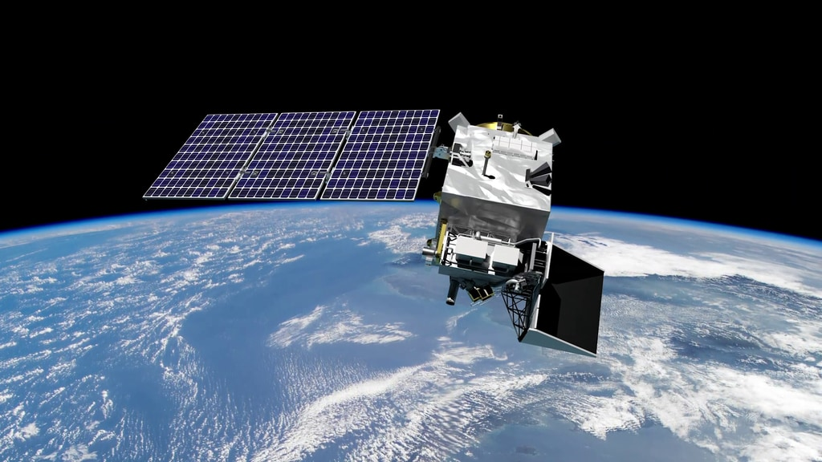
PACE Overview
Artist’s conception by NASA Conceptual Image Laboratory, svs.gsfc.nasa.gov
Environmental science satellite orbiting Earth
Spectrographic measurements of the ocean

Slide 6
“Well, unless we’re talking about really sensitive hardware…”
The fundamental technical problem underpinning a remarkable fraction of PACE problems is the Ocean Color Instrument.
The OCI gets very upset if you induce upon it even a few hundred μA
The OCI has a large spinning component that makes pointing harder
The OCI can’t safely handle launch RS103 level while powered
And so on.
Notes:
Talking points:
OCI-driven super low CMCE limit
Probe calibration failure analysis activity

Slide 7
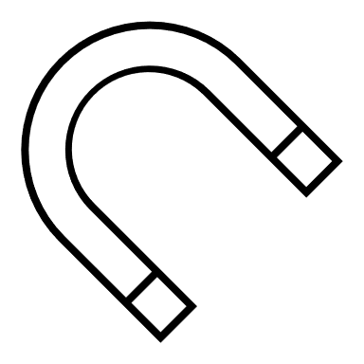

Why Magnetics?
The other problem is the TAM (Tri-Axial Magnetometer), which is also very sensitive.
  It and the OCI are, shall we say, not friends.
As a result, we needed to do magnetic screening of all the components
Fun and games in the clean room:
  No electronics near the observatory
  Degaussing metal tools before use
  Sign-offs from electrical before use of drills
Notes:
Talking points:
Do I know why our TAM is extra sensitive? I do not.
Magnetic moment requirements
Consider mentioning the valuableness of the magnetometers we got from Applied Physics Systems

Slide 8
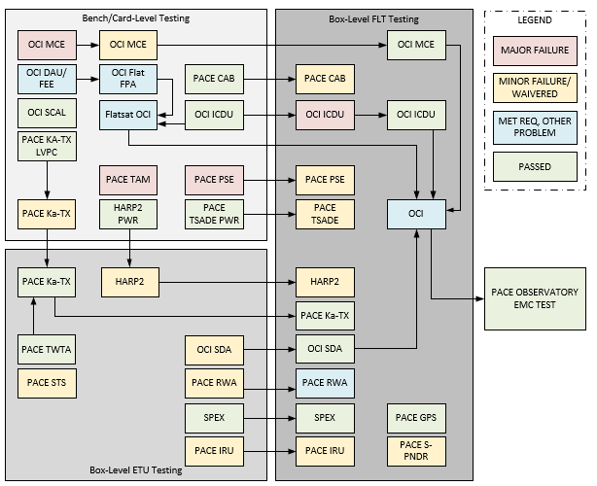
Test Campaign Overview
Notes:
Talking points:
Look at all these “minor” failures that got waivered (lesson learned: set your limits at what they REALLY ARE)
What happened with the ICDU? We missed a frequency range chunk at bench level
The “other problems” with the OCI – a sensitivity that “technically” wasn’t a “requirement”
Adventures in signal integrity with the RWA

Slide 9

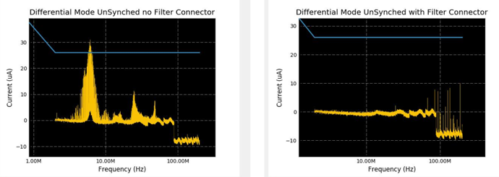
Early Testing Saves Money (& Time)
Highly, highly recommended
We had several cases where early bench-level CE and CS testing detected what would have been a very expensive failure to find later
Lesson learned:
McCloskey was right
Notes:
Talking points:
“Saves money, and time, which is money”
Official chamber testing of the pictured subsystem was over a year later! By then it would have been too late!

Slide 10


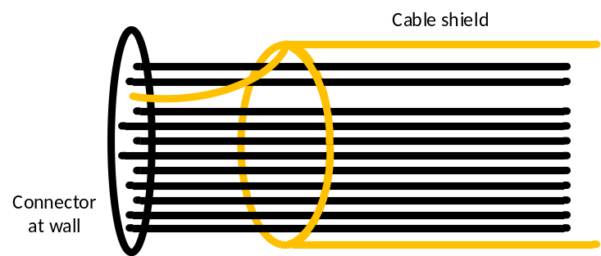
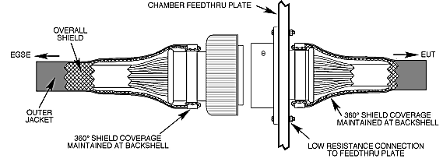
Terminating Cable Shields At Chamber Wall
“The connectors are the same, we can use the TVAC cables!”
Turns out TVAC cable shields were terminated to pins that go through the wall
Lesson learned: Trust but verify
(Recommended EGSE cable shield termination diagram from GSFC-STD-7000A)
Notes:
Talking points:
Hopefully, to an audience of EMC engineers, the badness of this is obvious
But really the lesson to be learned is that the TVAC guys don’t know or care about this! You can’t assume they do!

Slide 11
“Technically, that’s not a requirement…”
The official requirements document for OCI doesn’t specify a limit for signal cable susceptibility
We checked anyway
Would our lives have been a lot easier throughout I&T if we hadn’t bothered because it wasn’t required? YES, BUT…
Would the OCI have worked? NO
Lesson learned:
Signal cables are just as much a part of your system as power cables. Write your requirements accordingly.
Notes:
Talking points:
Related note about the RWA3’s weird behavior that got checked out on a scope even though it was technically passing
Just how sensitive was that thing before we fixed it? 50 dBuA of CS114 at the key frequency and they were out of tolerance!

Slide 12
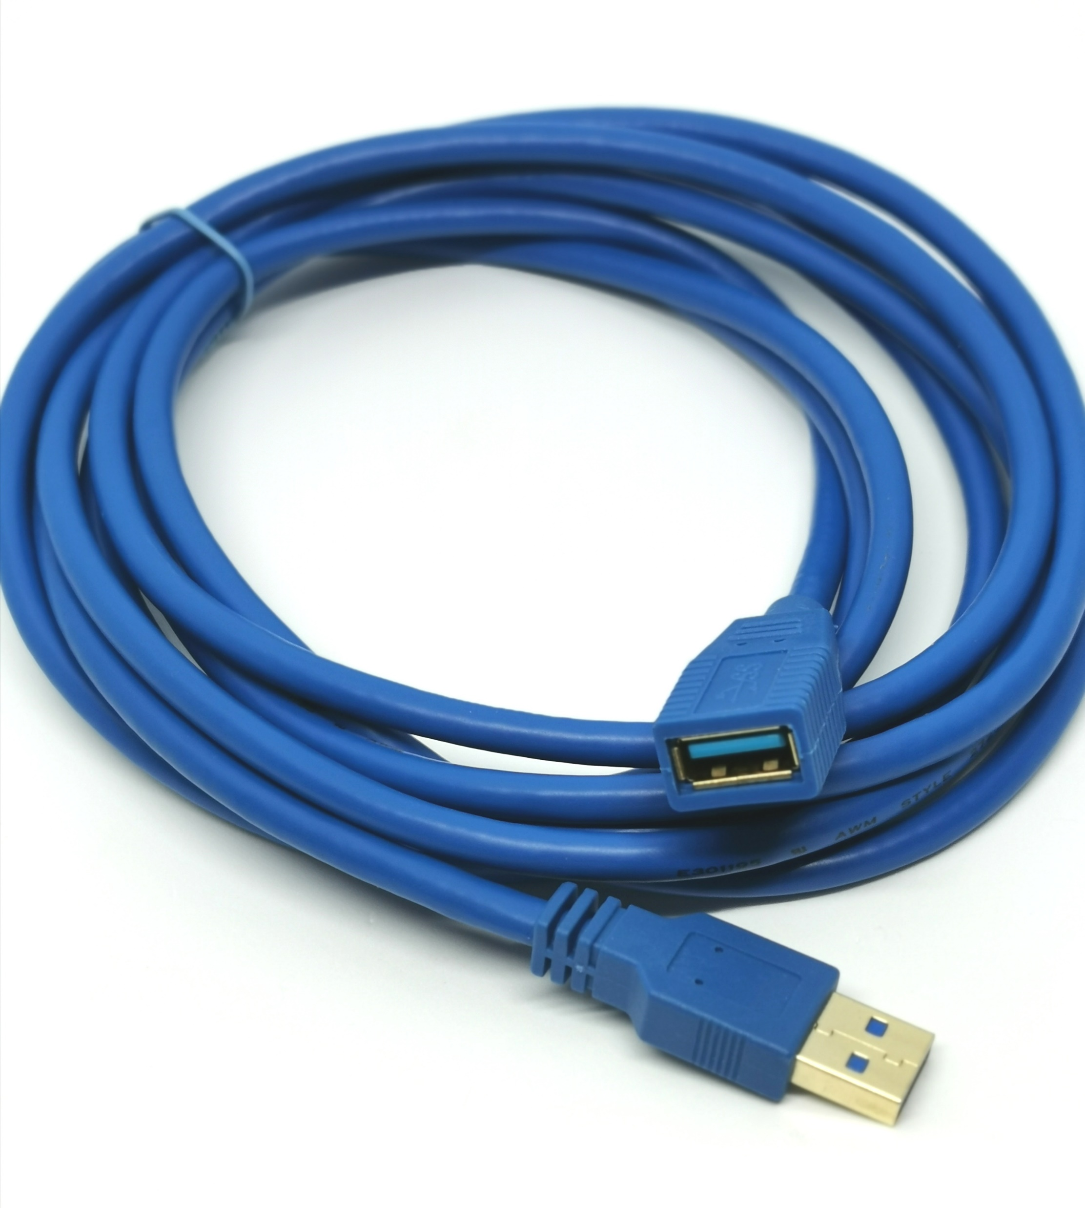
Always Have A Backup Plan
This is a minor lesson, but a fun one
You need more cable length for the chamber than the bench
For everything
Lesson learned:
Your original plan will not survive contact with reality.
(representative cable image courtesy of product listing for “6Ft USB 3.0 Gold Plate Type A Male to Female M/F Extension Cable Blue” @ Walmart.com)
Notes:
Talking points:
Explain why I needed a USB connector through the wall (for the mag GSE)
Funny story about how I had an extender cable handy via organizational magic
Mention the crawling under the observatory and then finding out it’s still not long enough bc that’s also very funny

Slide 13
The Smoking Gun Floating Battery
Shield terminated halfway across the observatory
Subsystem not EMC tested at lower level of assembly
Sensitive telemetry routed right near power distribution cables
Show of hands if you’re surprised we had a problem.
Lesson learned:
Tradeoffs exist, but that doesn’t mean you have to give up on incremental improvements.
(surprised-pikachu.jpg omitted here for reasons of copyright infringement)
Notes:
Talking points:
We had to open up the panel after what was supposed to be the last time to make this fix
This was the absolute last direction we expected to see a problem from
Shoutout to McCloskey who was the hero of this activity
We did get a substantial performance improvement on terminating the shield as close as we were allowed to get it
Another shoutout to our beloved clamp-on current injection probes, which were a huge help here

Slide 14

The Longest Day
Observatory RF self-compatibility and magnetic screening look so very similar to each other!
They’re scheduled to take about six hours each!
I had a terribly clever idea to be More Efficient
We were there from 6 AM to 2 AM
Lesson learned:
Be careful what you try to Optimize.
Notes:
Talking points:
Brief summary of self-compat and mag screening: so you turn on each component individually, and then you take some data, and you exercise it, and you take more data, and then you go to the next one.
Why were you there the entire time yourself, Jen? Well, you see, the guy who would normally have been taking shifts on this with me had a family emergency and was out all week, and obviously that’s more important, so I drank some coffee and collected some OT hours, I’m still young enough to do that for a few years more (pause for laughter,)

Slide 15
Observatory-Level Testing
Normally, observatory-level EMC testing consists of:
  RF self-compatibility
  Launch site RE/RS notches
We did a number of other things:
  Full range of RE/RS in launch mode
  Science RS for OCI
  Verify mag measurements between TAM and GSE magnetometers
Lesson learned:
Review your project requirements docs early and often.
Notes:
Talking points:
They originally wanted us to do a complete run of RE/RS in mission and launch mode in multiple antenna positions
This would have taken weeks
We didn’t actually have any launch site notches to test to! SpaceX just specified a flat level

Slide 16

But There’s Good News!
After all this varyingly metaphorical blood, sweat, and tears…
PACE Observatory self-compatibility went off without a hitch.
Absolutely every component was able to confirm that it worked perfectly in the presence of all the other components, including the TAM and the OCI.
Hats off to the GN&C lead and the systems engineer, who also both spent the whole agonizing twenty-hour shift there with me

Slide 17
Jen Dimov
NASA Goddard Space Flight Center / Jacobs Technology
jennifer.dimov@nasa.gov

