Slide 1
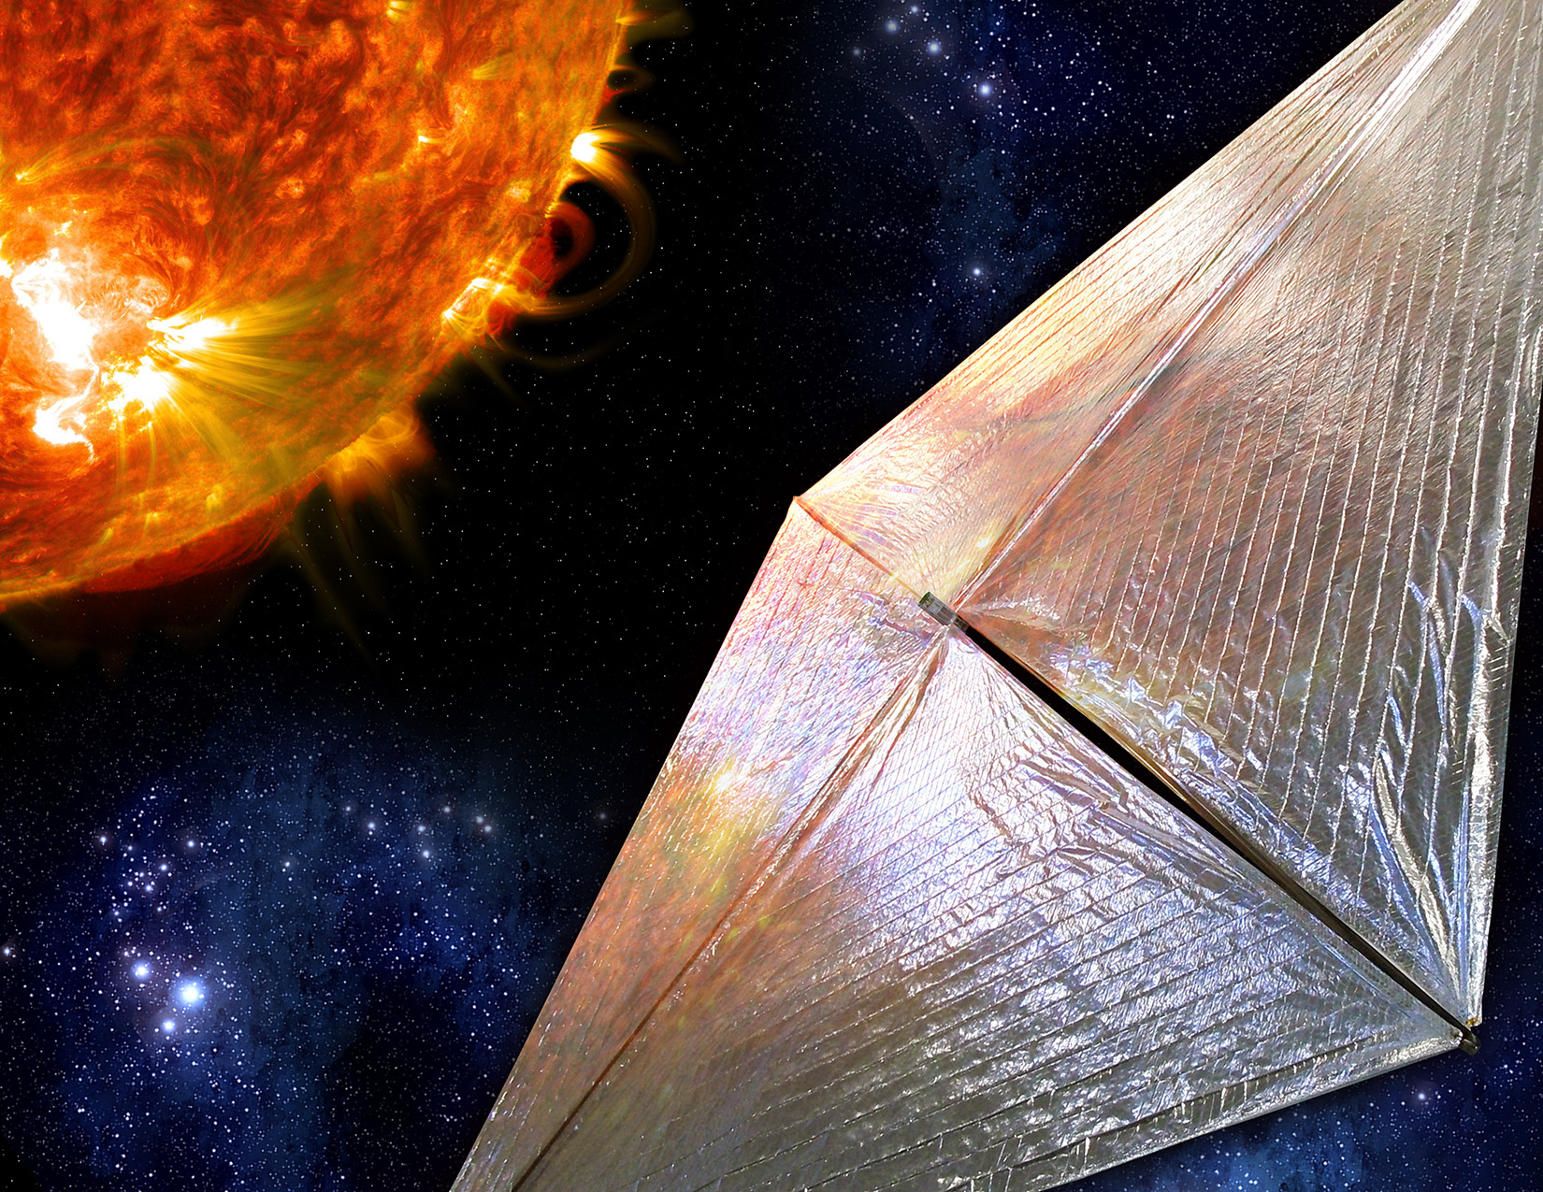

A Solar Sail Shape Modeling Approach for Attitude Control Design and Analysis
Benjamin M. Gauvain
Daniel A. Tyler
NASA Marshall Space Flight Center
The 6th International Symposium on Space Sailing
June 7, 2023

Slide 2
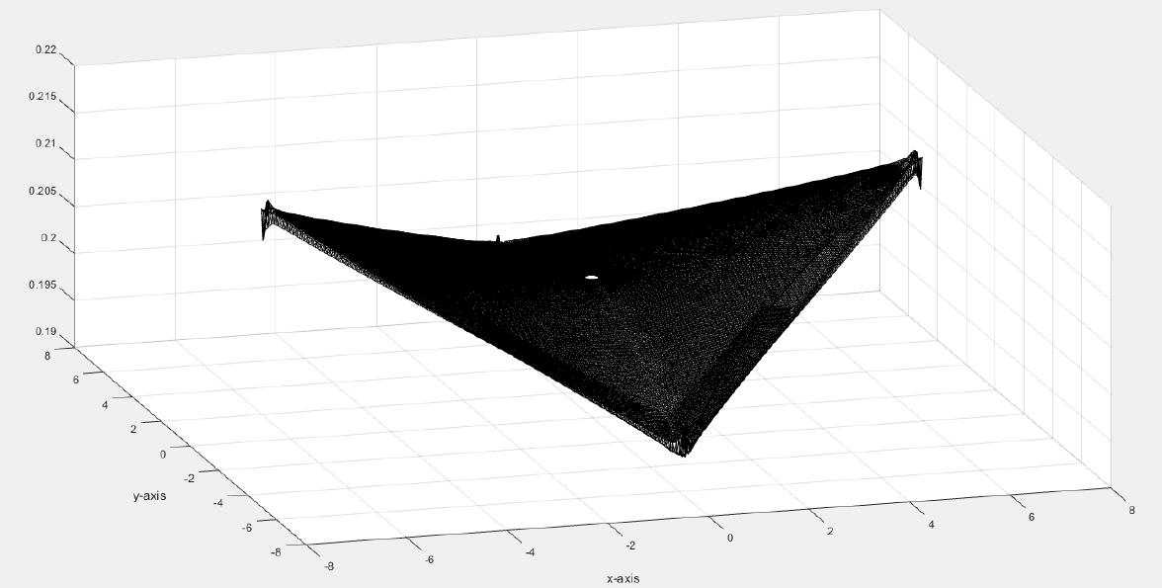
Introduction
Solar radiation pressure (SRP)-induced disturbance torques are a major design driver for solar sails, impacting all aspects of the attitude control system, including control and momentum management actuators
Traditionally, the center of mass (CM)/center of pressure (CP) offset of a flat sail has been the primary metric for predicting disturbance torques [2]
It was discovered during NEA Scout mission development that deformed sail shape effects were a significant contributor to the overall SRP-induced disturbance torques [3]
  The strongest determinant of the sail shape is the deflection of each of the four booms
  A significant known and predictable effect on boom deflections is the thermal distortion caused by the gradient across the booms from the sun-facing side to the space-facing side

Slide 3
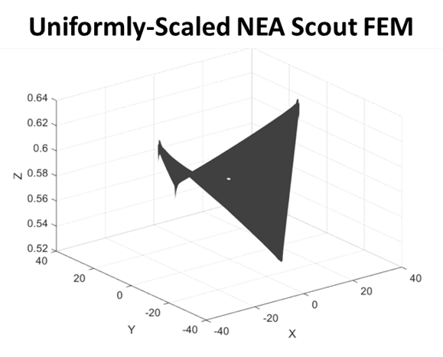
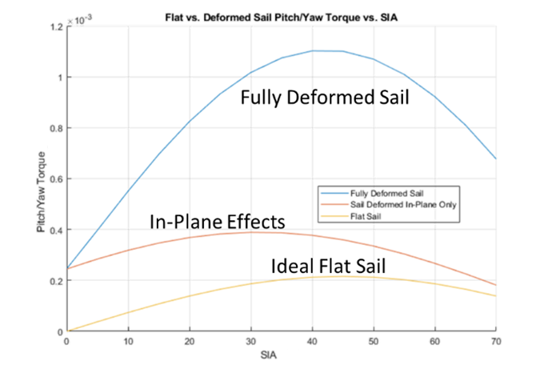
Background: NEA Scout and Solar Cruiser Modeling
The Solar Cruiser sail modeling methodology derives from NEA Scout [3]
  Structural FEM created including tension and thermal distortion effects
  Rios-Reyes/Sheeres generalized sail model [1] numerical implementation
    FEM with ~66,000 elements transformed into 39 tensor coefficients for force, 45 tensor coefficients for torque
    Computationally efficient force and torque calculation
The NEA Scout model was scaled and adapted for Solar Cruiser
Out-of-plane tip deflections were the biggest driver of disturbance torques
  Magnitudes >5x than a flat sail of identical dimensions, and >2x for an identical sail with in-plane tip deflections only
Simple scaling left a lot of uncertainty in its ability to bound the problem, so a higher fidelity methodology was developed for Solar Cruiser

Slide 4
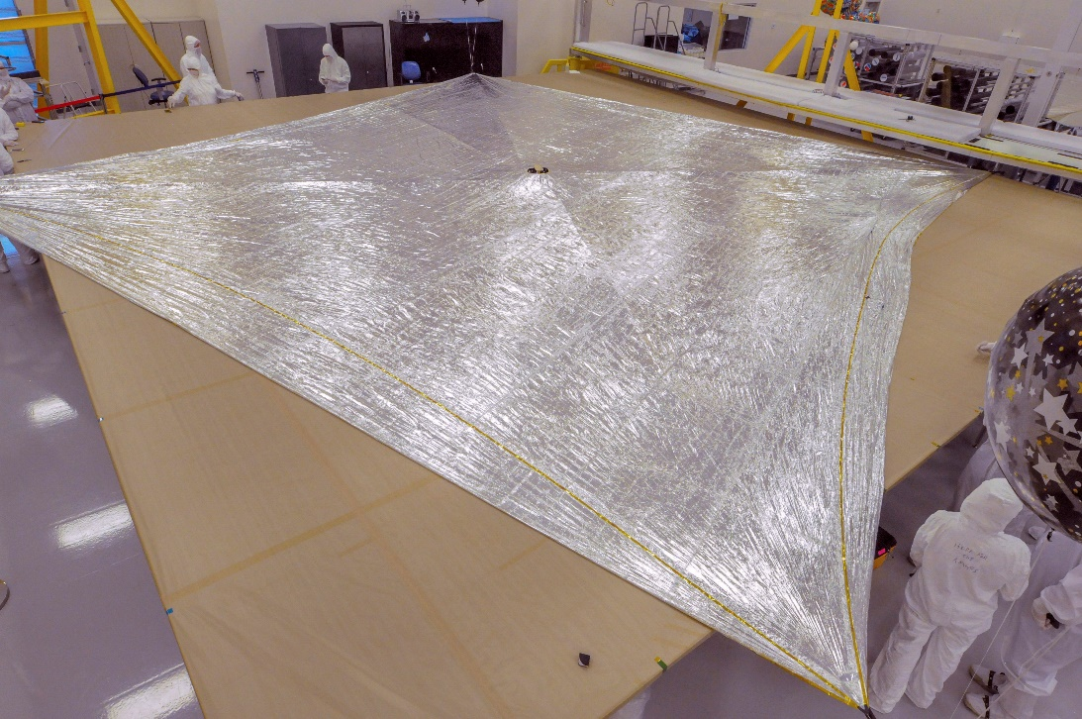
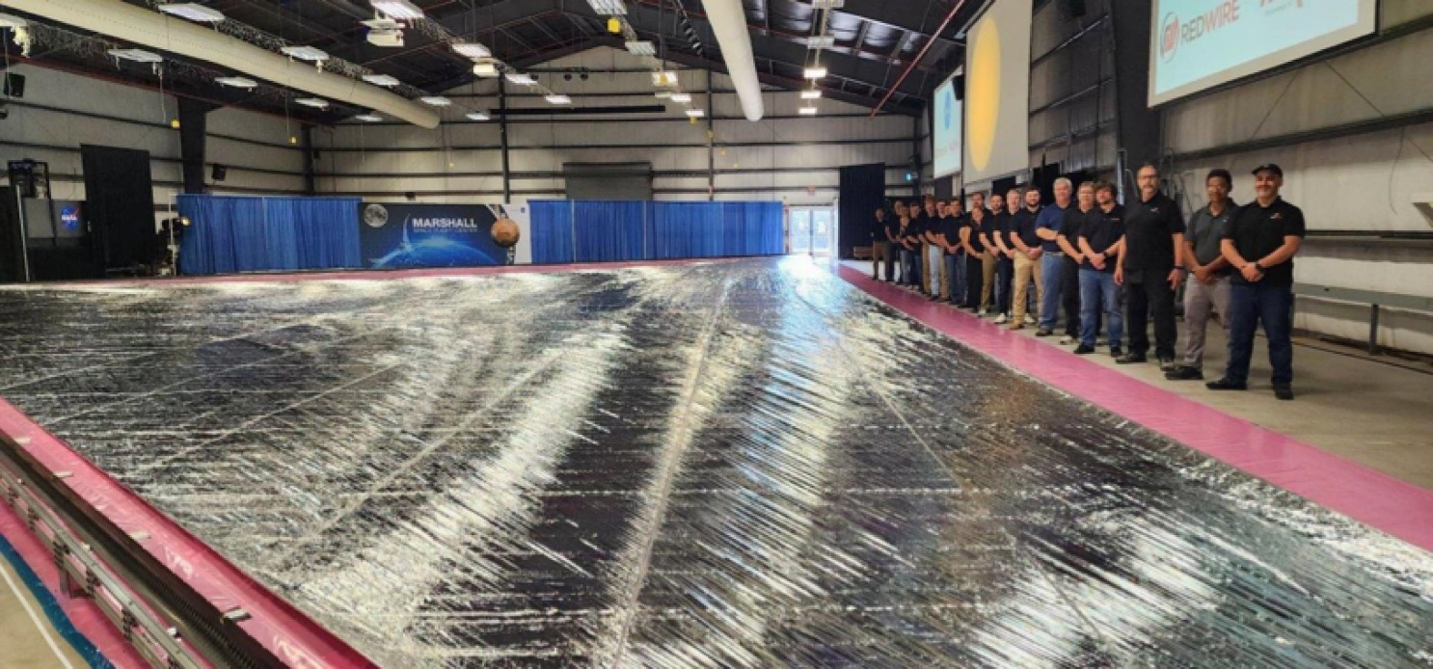
NEA Scout and Solar Cruiser Sail Comparison
NEA Scout (~86 m²)
Solar Cruiser (~1600 m²)

Slide 5
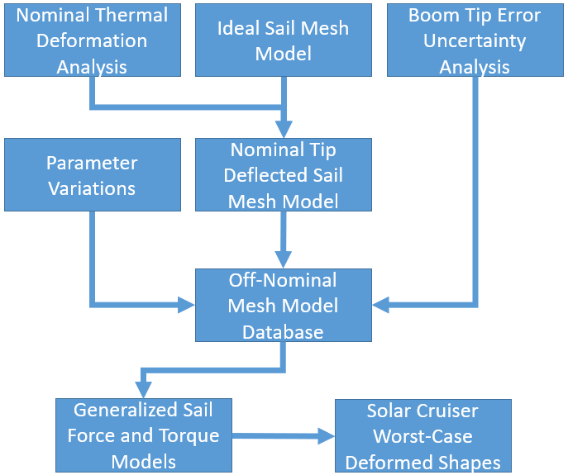
Solar Cruiser Methodology Overview
Thermal modeling results dictate boom deflections which define the “nominal” sail shape used as a starting point
Uncertainty/error terms are defined and varied across a large parametric sweep
The nominal shape is modified for each error term, producing a large database of shapes
Rios-Reyes/Scheeres generalized sail model [1] process is used to create sail tensors for each shape
Forces and torques are calculated for each shape across Solar Cruiser mission attitudes
Force and torque data is post-processed to select two bounding shapes: maximum pitch/yaw (in-plane) torque and maximum roll (out-of-plane) torque

Slide 6
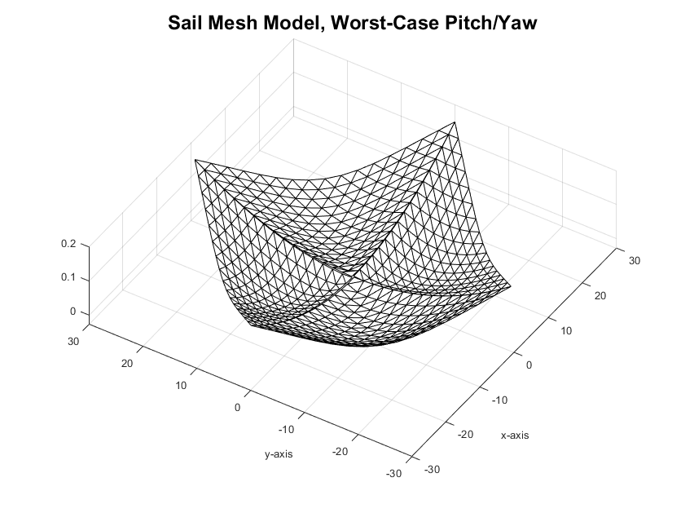
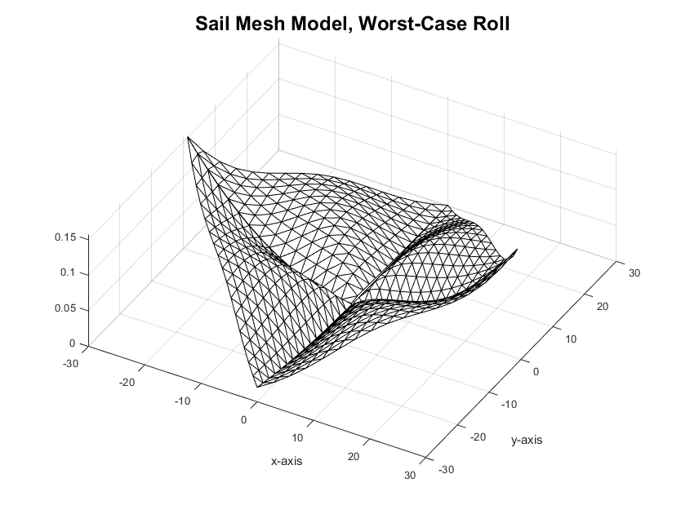
Solar Cruiser Deformed Sail Shapes

Slide 7
Assumptions and Boundary Conditions
Booms deflect parabolically, increasing from root to tip
Membranes deflect according to a “billowing” shape, captured using a 2D sinusoid with maximum deflection occurring at quadrant centroid
Non-sail membrane surfaces and in-plane deformations or asymmetries are neglected. Wrinkles are not directly modeled but effect is captured through optical properties [3]
Fixed-fixed boom/membrane interface at the roots and tips without any separation or interference
Boom tips and sail membranes can deflect out of plane in any arbitrary direction with respect to each other

Slide 8
Parameter Descriptions and Variations
Nominal Boom Tip Deflections
  Out-of-plane, increasing parabolically from root to tip. The magnitude and direction (out of the sail plane and toward the sun) were held constant.
Membrane Deflections
  Out-of-plane, billowing shape with peak/trough at the centroid of each quadrant. The magnitude was varied (0-5cm), and the direction varied in the sail out-of-plane axis.
Boom Tip Deflection Errors
  Random/uncertain out-of-plane boom tip deflections due to manufacturing and assembly tolerances, tension changes in the membrane, and thermal load uncertainties. The magnitude was varied (0-2x), and the direction varied in the sail out-of-plane axis.
Center of Mass Offsets
  The difference in the center of mass in-plane position relative to the designed geometric center, due to manufacturing and assembly tolerances (0-2cm).
Attitude
  SIA varied from 0 to 17 degrees (Plane Change Demonstration mission target) and clock angle varied from 0 to 360 degrees.

Slide 9
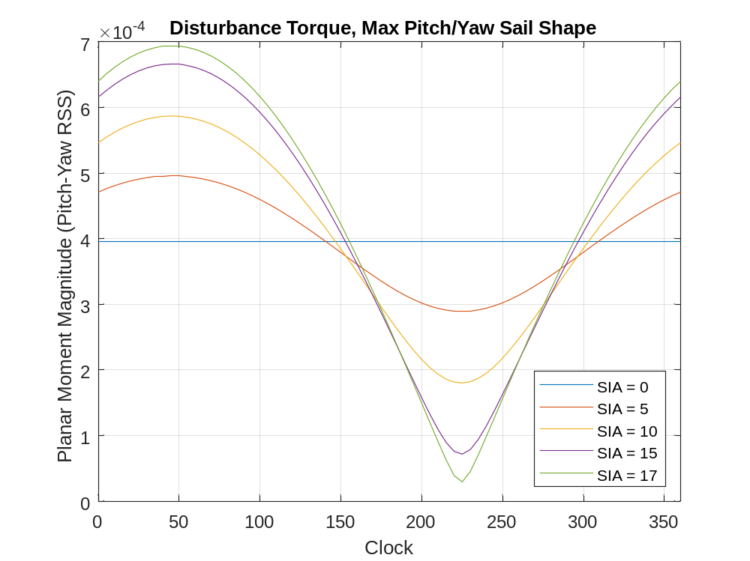
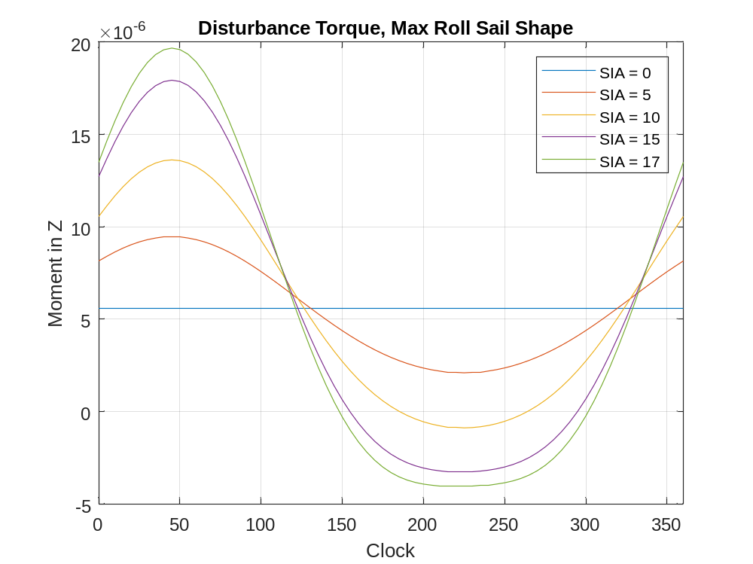
Resultant Torques, Solar Cruiser Deformed Shapes
Disturbance torque curves shown across range of mission attitudes

Slide 10
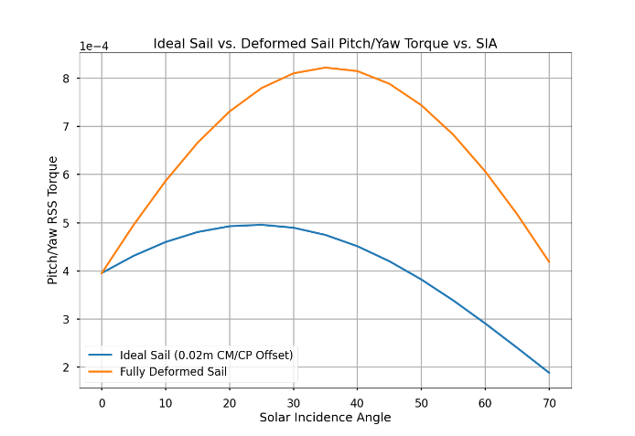
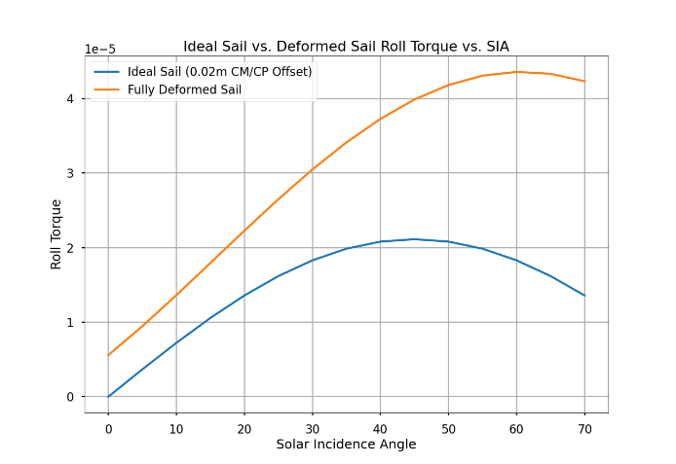
Solar Cruiser Deformed Shapes vs Ideal Sail
Deformed pitch/yaw shape: 1.66x maximum torque compared to flat sail
Deformed roll shape: 2.06x maximum torque compared to flat sail

Slide 11
Solar Cruiser Design Considerations
Disturbance torques from worst-case shapes were considered bounding for the purposes of requirements derivation
  Sail shape requirements specified to ensure the as-manufactured flight sail deformations would remain within the modeled deformations
    Tip deflections
    CM offsets
  Reaction wheel torque capability (including 100% margin, 2x control authority)
  Momentum management actuator design
The disturbances were accounted for in the integrated sailcraft model for requirements verification by analysis
  Plant dynamics, control system, flight software
  Sail tensors were integrated into the model, allowing computationally efficient force and torque calculation at simulated attitudes

Slide 12
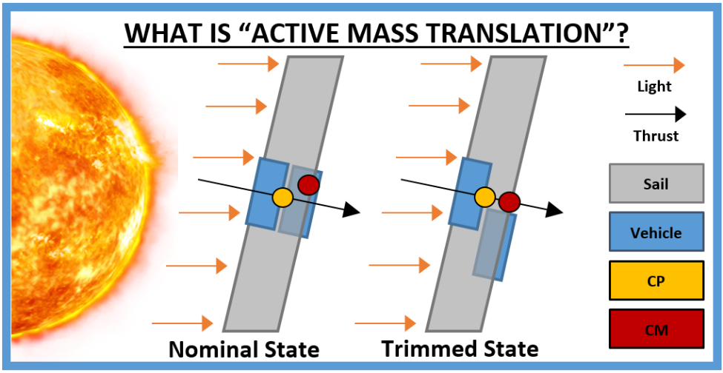
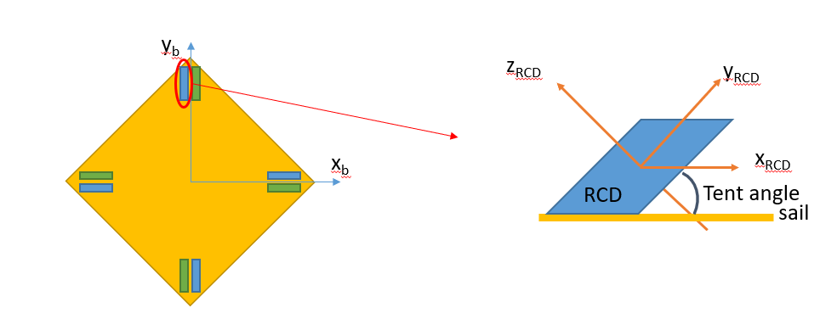
Solar Cruiser Design Considerations
Momentum management requirements
  To desaturate momentum in the pitch/yaw RSS (in-plane) axes, Solar Cruiser utilized an Active Mass Translator (AMT)
    The torque predictions drive design considerations such as AMT range of motion, rail orientation, and bus mass allocation
  For roll (out-of-plane) momentum management, Solar Cruiser utilized two actuator systems
    Reflectivity Control Devices (RCDs) (primary)
    Indium Field Emission Electric Propulsion Microthrusters (IFMs) (backup)
    Roll torque predictions drive requirements on RCD surface area, as well as IFM propellant mass needed

Slide 13
Conclusions
The deformed sail model results demonstrate considerably higher expected induced disturbance torques compared to the simplified assumption of a flat plate sail with a CM/CP offset
Accurate prediction of these disturbances is crucial when designing the spacecraft attitude control system
The disturbances drive all aspects of ADCS, ultimately impacting sailcraft characteristic acceleration and mission design as required masses grow
It is recommended to begin medium/high fidelity modeling as early as possible in the design cycle, even in the early mission concept phase

Slide 14
Forward Work
The current approach yields a medium-fidelity model where inputs and assumptions on local conditions (e.g., nominal boom tip deflection, tip error uncertainty, and membrane deflection) drive the global sail shape
Forward work is currently ongoing to improve modeling fidelity
  Cooperative effort including MSFC, LaRC, Redwire, and NeXolve
Iterative process where interactions between the boom deformations and the membrane deformations are increasingly refined
  Top-down approach - “global “boom thermal/structural modeling outputs computed, information used in “local” membrane quadrant models
Assumed membrane shapes will be replaced with more physically realistic models
Sail tensors will be regenerated and attitude control metrics reassessed with high-fidelity shapes

Slide 15
Questions

Slide 16
References
L. Rios-Reyes and D. J. Scheeres. Generalized Model for Solar Sails. Journal of Spacecraft and Rockets, 42(1):182–185, 2005. doi: 10.2514/1.9054.
B. Wie. Solar Sail Attitude Control and Dynamics, Part 1. Journal of Guidance, Control, and Dynamics, 27(4):526-535, 2004. doi: 10.2514/1.11134.
A. Heaton, N. Ahmad, and K. Miller. Near Earth Asteroid Scout Thrust and Torque Model. Kyoto, Japan, January 2017. International Symposium on Solar Sailing. Paper M17-5721.
D. Tyler, B. Diedrich et al. Attitude Control Approach for Solar Cruiser, A Large, Deep Space Solar Sail. Breckenridge, Colorado, February 2023. AAS Guidance, Navigation and Control Conference. Paper AAS-23-117.
J. Orphee, A. Heaton et al. Solar Torque Management for the Near Earth Asteroid Scout CubeSat Using Center of Mass Position Control. Kissimmee, Florida, January 2018. American Institute of Aeronautics and Astronautics Science and Technology Forum. Paper M17-6378.

Slide 17
Backup

Slide 18
Parameter Variations
Parameter | Tip Error Factor | Membrane Billow | CM Offset | Tip Direction Factor | Membrane Direction Factor
Variation | 0 | 0 cm | 0 cm | 1x | -1x
 | 1x | 1 cm | +/-1 cm X-axis | Tip A +/-1x | Membrane A +/-1x
 | 1.25x | 2 cm | +/-2 cm X-axis | Tip B +/-1x | Membrane B +/-1x
 | 1.5x | 3 cm | +/-1 cm Y-axis | Tip C +/-1x | Membrane C +/-1x
 | 1.75x | 4 cm | +/-2 cm Y-axis | Tip D +/-1x | Membrane D +/-1x
 | 2.0x | 5 cm | - | - | -

