Slide 1
NASA’s Atmosphere Observing System (AOS), From a Precipitation Perspective
Daniel J. Cecil, NASA MSFC, Deputy PS for Suborbital
Scott Braun, NASA GSFC, AOS Project Scientist (PS)
John Yorks, NASA GSFC, Deputy PS for Inclined
Tyler Thorsen, NASA LaRC, Deputy PS for Polar
Matt Walker McLinden, NASA GSFC
14th International Precipitation Conference
Norman, OK
June 7, 2023
Notes:
NASA’s Earth System Observatory is a constellation of satellite observing systems that addresses the five major designated observables from the 2017 NASA Earth Science Decadal Survey. The Atmosphere Observing System, or AOS, addresses two of these designated observables, aerosols and clouds, convection, and precipitation, or CCP. In this talk, I will provide a brief background on the decadal survey recommendations, the AOS science objectives, and the observing system.

Slide 2
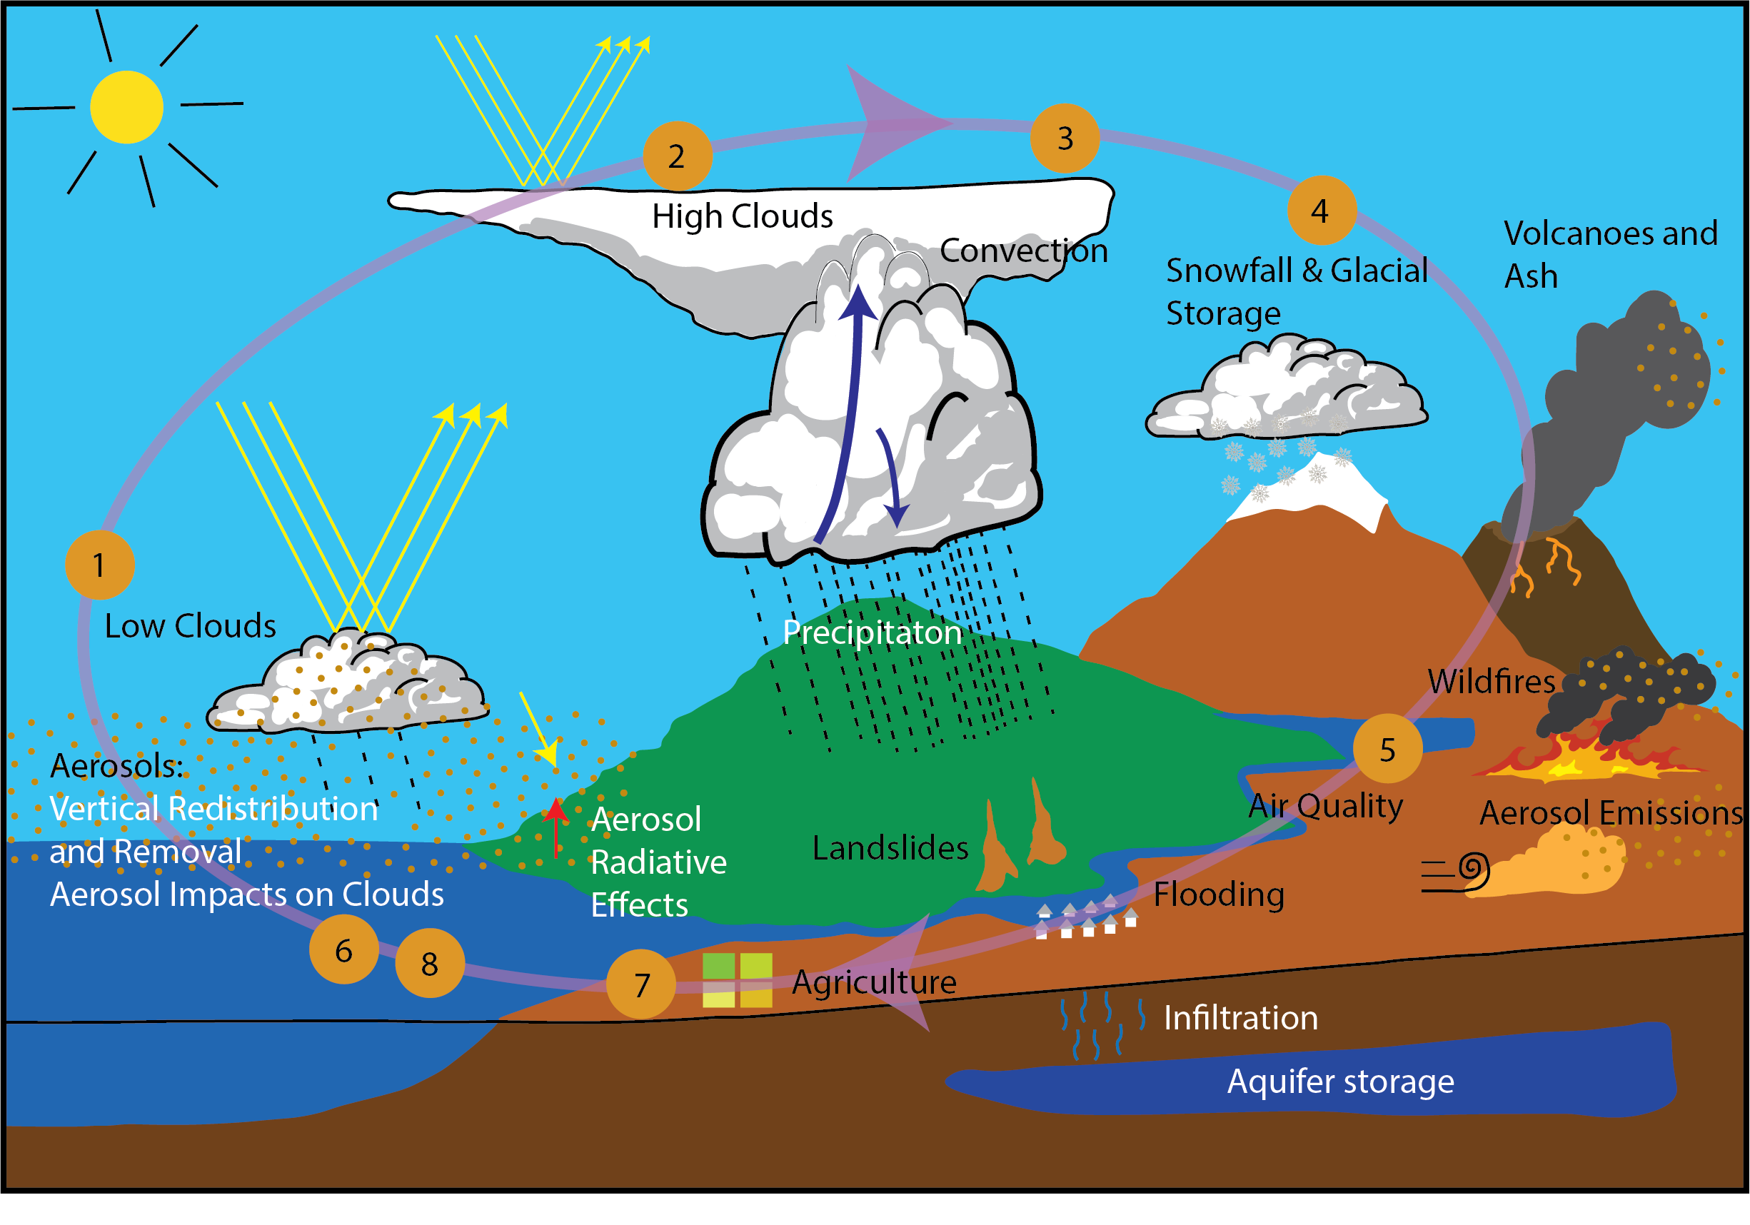
Major Science Priorities for AOS
AOS provides an observing system that focuses on measurements addressing major Decadal Survey (DS) science themes tied to coupled aerosol-cloud-precipitation processes (not a mapping mission)
AOS addresses priority science called out by multiple ESAS DS panels and related to three targeted observables
TO-1: Aerosol & Cloud Radiative Properties
TO-2: Aerosol Vertical Profiles
TO-5: Clouds, Convection, & Precipitation
AOS Science Objectives
1. Low cloud feedbacks 5. Aerosol attribution and air quality
2. High cloud feedbacks 6. Aerosol redistribution and removal
3. Convective storm processes 7. Aerosol direct effect
4. Cold clouds & precipitation 8. Aerosol indirect effect

Slide 3
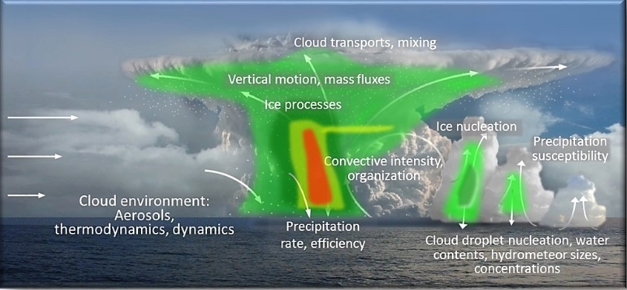

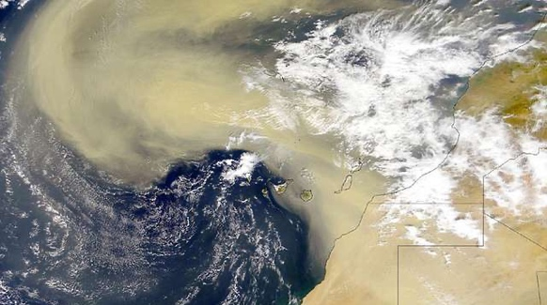
AOS Objectives Focus on Three Themes
IPCC AR6 Report
Chapter 4
Climate sensitivity and feedbacks
  Low and high cloud feedbacks
  Aerosol direct & indirect effects
  Cold clouds and precipitation
Absorption
(warming)
Scattering
(cooling)
Convective Storm Formation Processes
  Coupled storm dynamics and microphysics
  Importance of diurnal cycle
  High cloud properties
Aerosol processes and distributions
  Air quality and aerosol attribution
  Aerosol vertical redistribution and processing (from emission to removal)
Notes:
Third party images:
Figure from Chapter 4 of the IPCC AR6 Report (top left), Chapter 4, Figure 4.2. IPCC copyright policy is that the figure can be used for non-commercial purposes without permission (https://www.ipcc.ch/copyright/).
Aerosol skyline and Saharan dust images (bottom left and right, respectively) have CC Public Domain Mark 1.0 license.

Slide 4
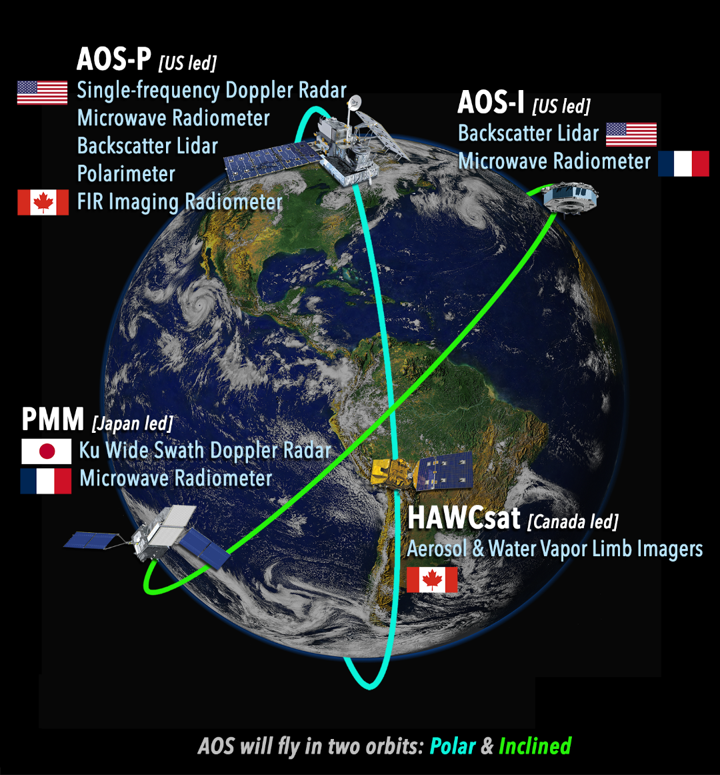
Current Architecture Plan
Inclined Orbit (55°): ~2029 Launch
  JAXA Ku-band Doppler Radar
  *CNES Tandem Microwave Radiometers (high freq, 89, 183, 325 GHz) a few minutes apart, for time-difference measurements
  *Backscatter lidar
Polar Orbit: ~late 2031 Launch
  *Cloud-profiling Doppler Radar (W, or Ka, or both)
  *Backscatter lidar
  Microwave Radiometer (high frequencies, ~89-700 GHz)
  Polarimeter
  CSA Far IR Imaging Radiometer
  CSA Aerosol and Water Vapor Limb Imagers
Red=current trade studies
* Substantial details remain TBD in trade studies
Notes:
The polar mission builds on the heritage of the A Train and is designed to optimize instrument synergies to obtain accurate information on processes relevant to climate sensitivity and feedback and aerosol forcing of climate, which requires globally distributed observations. It includes several advanced sensors provided by NASA and industry and contributed instruments from CSA. The next several slides will focus on the key capabilities within each orbit.

Slide 5
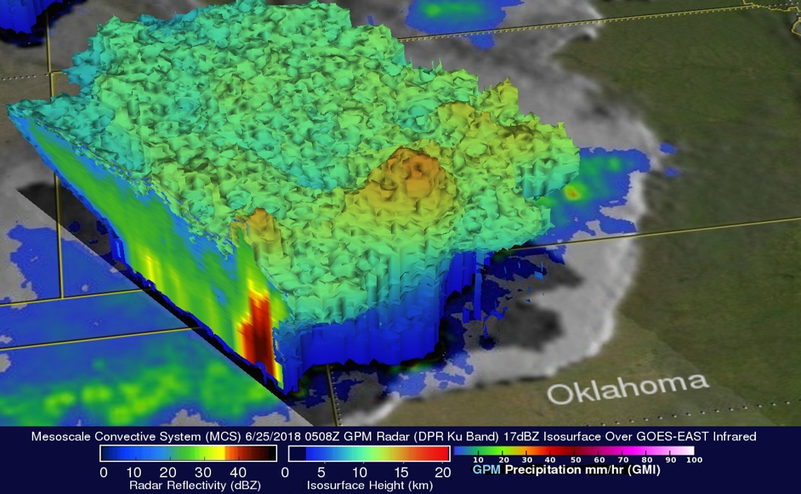

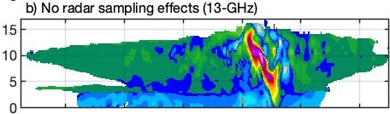

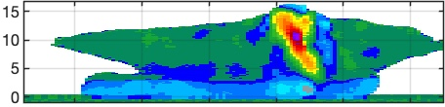
AOS-Inclined Precipitation Sensors
CNES Microwave Radiometers (89, 183, 325 GHz)
JAXA Wide Swath Ku-band Doppler Radar
Doppler obs.
176.3 GHz
Dense sampling obs.
x3
x3
Normal scan obs.
Truth
315 GHz
x49
・・・
Ku Doppler Velocity
Nadir direction of flight
Height (km)
55° Inclination: Compromise between NASA, JAXA, CNES
Notes:
The polar mission builds on the heritage of the A Train and is designed to optimize instrument synergies to obtain accurate information on processes relevant to climate sensitivity and feedback and aerosol forcing of climate, which requires globally distributed observations. It includes several advanced sensors provided by NASA and industry and contributed instruments from CSA. The next several slides will focus on the key capabilities within each orbit.

Slide 6
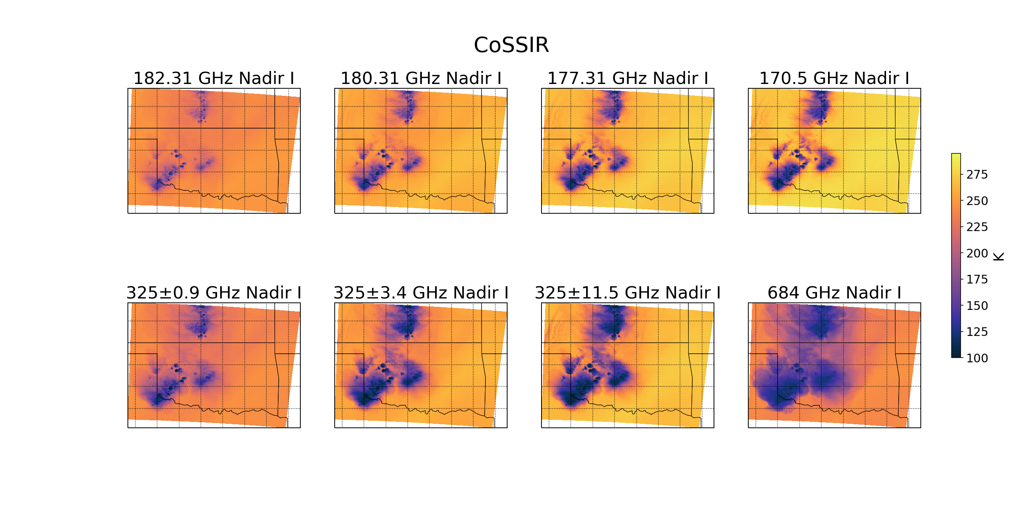
AOS-Polar Precipitation Sensors
Microwave Radiometer: 89-700 GHz
Cloud-capable Profiling Doppler Radar
Frequency TBD
Ka Doppler
W Reflectivity
Ka Reflectivity
89/113 (1), 183 (3), 325 (3), 640-700 (2, dual-pol) GHz
  Dual-pol near 166 or low-mid 200s GHz desired
Cross-track or conically scanning
Effective resolution ≤10 km
Swath > 750 km
Nyquist sampling
Left: Airborne radar cross sections from IMPACTS with resolution and sensitivity degraded to AOS requirements
Right: Brightness temperatures from numerical simulation of a deep convective system
Notes:
The polar mission builds on the heritage of the A Train and is designed to optimize instrument synergies to obtain accurate information on processes relevant to climate sensitivity and feedback and aerosol forcing of climate, which requires globally distributed observations. It includes several advanced sensors provided by NASA and industry and contributed instruments from CSA. The next several slides will focus on the key capabilities within each orbit.

Slide 7
Current Architecture Trades
Trades for polar lidar
  Target for industry: CALIOP-like capability with daytime SNR equivalent to CALIOP nighttime SNR
  Potential partnership with Italian Space Agency (ASI) for 3-wavelength lidar flying in formation with AOS-P
Trades for radar
  Single-frequency cloud-profiling radar with sensitivity equivalent to MCR measurement requirements
  Frequency agnostic; can be accomplished with either W or Ka band
    Ka provides less attenuation
    W required for cloud liquid water path
  Dual-frequency should still be in trade space since descope does not impact technical/cost risk
Red=current trade studies
Notes:
The polar mission builds on the heritage of the A Train and is designed to optimize instrument synergies to obtain accurate information on processes relevant to climate sensitivity and feedback and aerosol forcing of climate, which requires globally distributed observations. It includes several advanced sensors provided by NASA and industry and contributed instruments from CSA. The next several slides will focus on the key capabilities within each orbit.

Slide 8
Inclined Orbit Trades
Red=current trade studies
AOS Inclined Project
AOS-I spacecraft & payloads may not fit within revised budget
Exploring smallsat options to retain ALICAT and/or CNES radiometers
Threshold mission: JAXA Ku radar and single radiometer
AOS-I spacecraft and payloads contingent on adequate funds
Notes:
The polar mission builds on the heritage of the A Train and is designed to optimize instrument synergies to obtain accurate information on processes relevant to climate sensitivity and feedback and aerosol forcing of climate, which requires globally distributed observations. It includes several advanced sensors provided by NASA and industry and contributed instruments from CSA. The next several slides will focus on the key capabilities within each orbit.

Slide 9
AOS Precip Instruments compared to GPM
Mission | GPM | AOS-Inclined | AOS-Polar
Radar | Ku-Ka bands, ~245-km swath, ~5 km footprint (JAXA DPR) | Ku-band, ~250-km swath, ~5 km footprint (JAXA PMM) DPCA Doppler velocity at nadir | TBD band(s) Doppler radar, cloud profiling Likely narrow swath or nadir only
Passive Microwave Radiometer | 10-183 GHz, 785-km swath, ~5+ km footprint size Conical scan | 89, 183, 325 GHz, ~800-km swath, 3+ km footprint size, Cross-track scan Tandem measurements for Delta-t | 89-700 GHz, 750-km swath, ~10+ km footprint size Cross-track or conical scan TBD
AOS Doppler radars measure vertical velocity of particles. This adds a constraint on particle fallspeed (size, density), with information about air vertical velocity.
AOS Polar radar likely to suffer more from attenuation than GPM and TRMM radars
AOS radiometers are more sensitive to ice clouds, less sensitive to liquid rain. AOS is less suitable for rain mapping, maybe more suitable for snow mapping.
AOS Polar radar + radiometer may offer improved snowfall rates compared to GPM, CloudSat, AOS-Inclined…
AOS combines precipitation, cloud, and aerosol measurements for process studies.
Notes:
The polar mission builds on the heritage of the A Train and is designed to optimize instrument synergies to obtain accurate information on processes relevant to climate sensitivity and feedback and aerosol forcing of climate, which requires globally distributed observations. It includes several advanced sensors provided by NASA and industry and contributed instruments from CSA. The next several slides will focus on the key capabilities within each orbit.

Slide 10
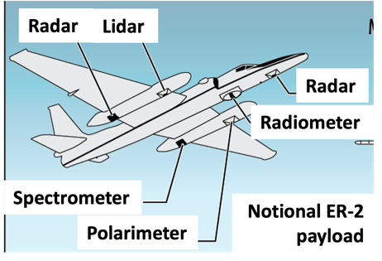
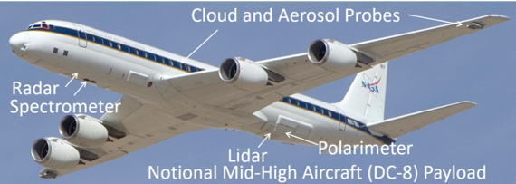
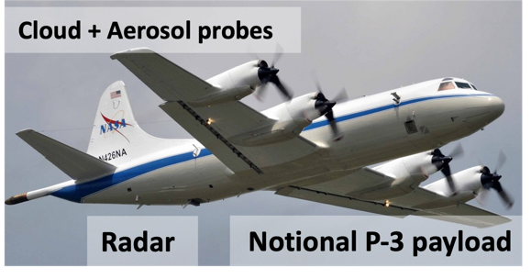
AOS Suborbital Element
Low Clouds: Microphysics, precipitation initiation
Convection/High Clouds: Microphysics and dynamics, anvil cirrus lifecycle.
Aerosol-Cloud-Radiation Interactions: Vertically resolved aerosol-cloud-radiation interaction processes and lifecycle.
Payloads depicted are notional… instruments to be prioritized / deconflicted for each campaign
Large airborne campaigns addressing all science themes
Mid-latitude continental, 2029 or 2030
Oceanic, 2032-2033
Campaigns after launch to enable cal-val
Notes:
AOS will implement a multi-year suborbital program that focuses on three core themes: low clouds, convection and associated high clouds, and aerosols and aerosol-cloud-radiation interactions. Campaigns are expected to begin after launch of the inclined and polar projects. While the implementation details are still to be defined, notional examples of aircraft and instrument suites are shown here and include high flying aircraft capable of serving as satellite simulators and lower flying aircraft capable of both remote sensing and in-situ sampling of aerosol and cloud and precipitation microphysics.

Slide 11
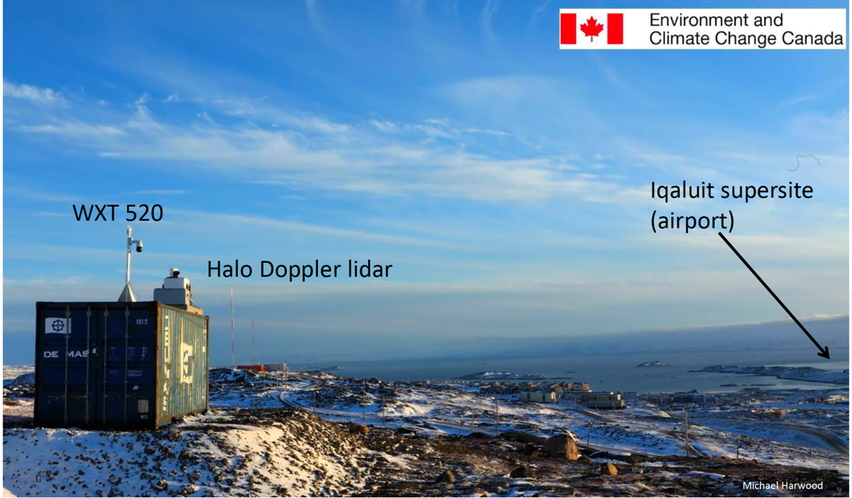



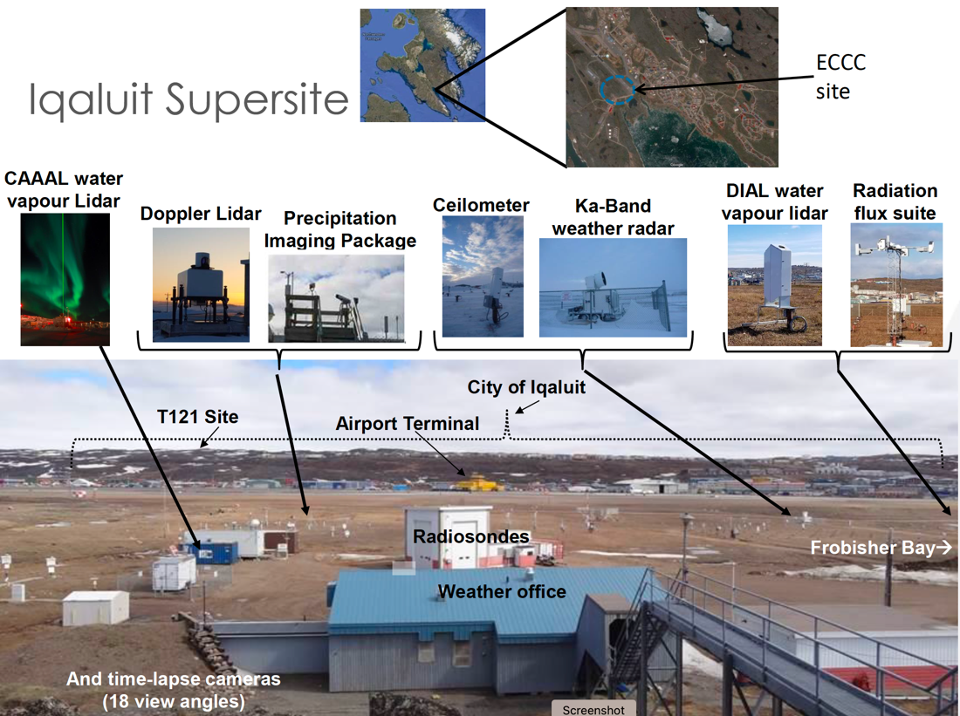
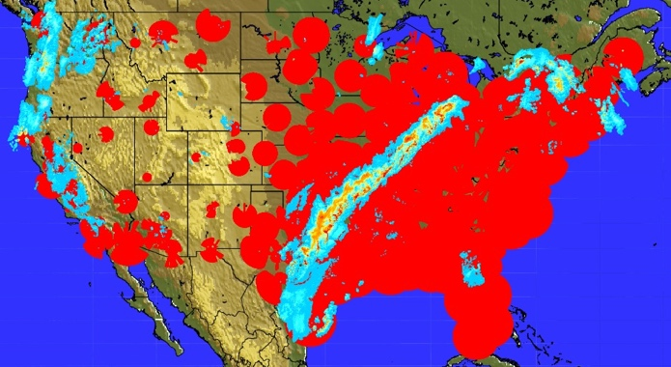
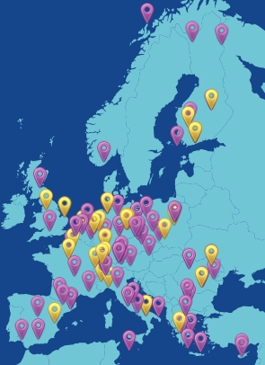
Leverage / augment existing sites and networks
Build up large sample sizes and measure temporal evolution of processes from a few fixed, well-instrumented sites and networks
Radar, profiler, or air quality networks
DOE ARM sites
ESA EarthCARE validation
Etc.
Iqaluit, Canada site as example that could potentially be augmented by an aircraft in situ campaign.
DOE ARM sites are also suitable.
NOAA radar network (lower left)
ACTRIS National Facilities (lower middle)
Notes:
AOS will implement a multi-year suborbital program that focuses on three core themes: low clouds, convection and associated high clouds, and aerosols and aerosol-cloud-radiation interactions. Campaigns are expected to begin after launch of the inclined and polar projects. While the implementation details are still to be defined, notional examples of aircraft and instrument suites are shown here and include high flying aircraft capable of serving as satellite simulators and lower flying aircraft capable of both remote sensing and in-situ sampling of aerosol and cloud and precipitation microphysics.

Slide 12

Key Take Aways
is a complex mission targeting aerosol-cloud-precipitation interactions
launches currently targeted for 2029 and 2032
Doppler radars offer new capabilities to constrain particle fall speed and related parameters and air vertical velocity
radiometers are less suited to rain rate mapping than prior missions, but high frequencies plus Doppler radars may improve snowfall estimation
  AOS Website: https://aos.gsfc.nasa.gov
Notes:
So in summary, AOS science and the architectural design flow directly from the recommendations of the Decadal Survey. We completed pre-formulation and successfully passed our Mission Concept Review back in May of this year. We are still waiting to have the Key Decision Point-A review at HQ next month that moves us into the formulation phase. HQ has formed an Independent Review Board to look at all of the DS designated observable missions to examine the scope of the proposed architectures and the costs. We expect to hear their recommendations this week and that could impact the architecture; hence the statement at the bottom of the slides.

Slide 13
Extra Slides
Extra slides

Slide 14
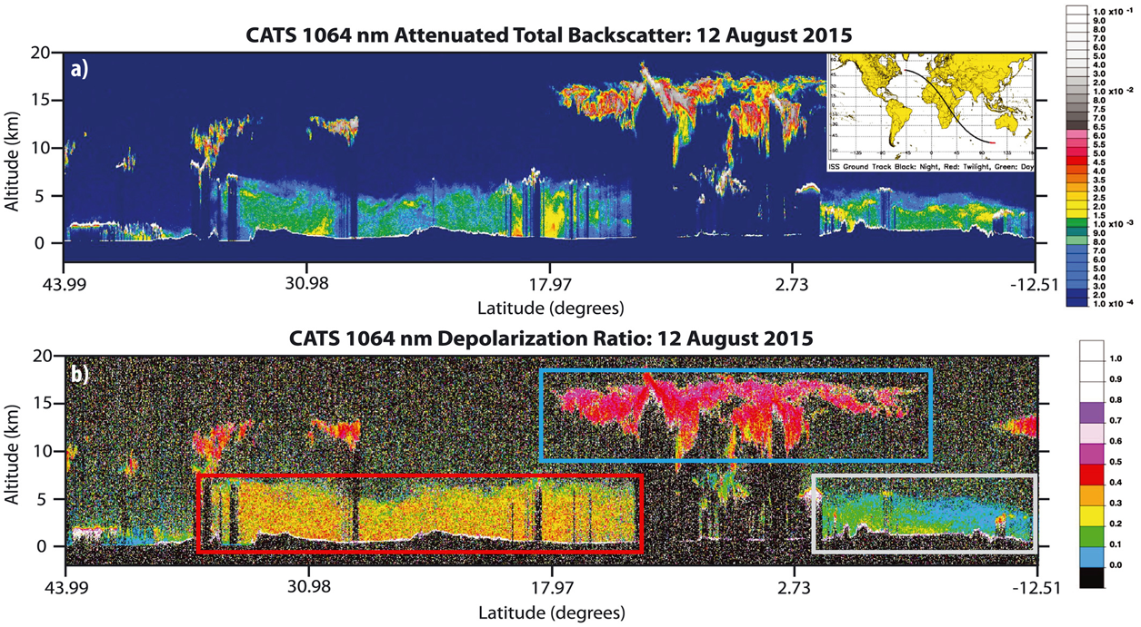
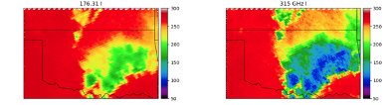
A Visual View of AOS-Inclined
ALICAT 532-, 1064-nm Backscatter Lidar
JAXA Wide Swath Ku-band Doppler Radar
Truth
CNES Microwave Radiometers (89, 183, 325 GHz)
Ku Doppler Velocity
Height (km)
55° Inclination: Compromise between NASA, JAXA, CNES
Notes:
The polar mission builds on the heritage of the A Train and is designed to optimize instrument synergies to obtain accurate information on processes relevant to climate sensitivity and feedback and aerosol forcing of climate, which requires globally distributed observations. It includes several advanced sensors provided by NASA and industry and contributed instruments from CSA. The next several slides will focus on the key capabilities within each orbit.

Slide 15
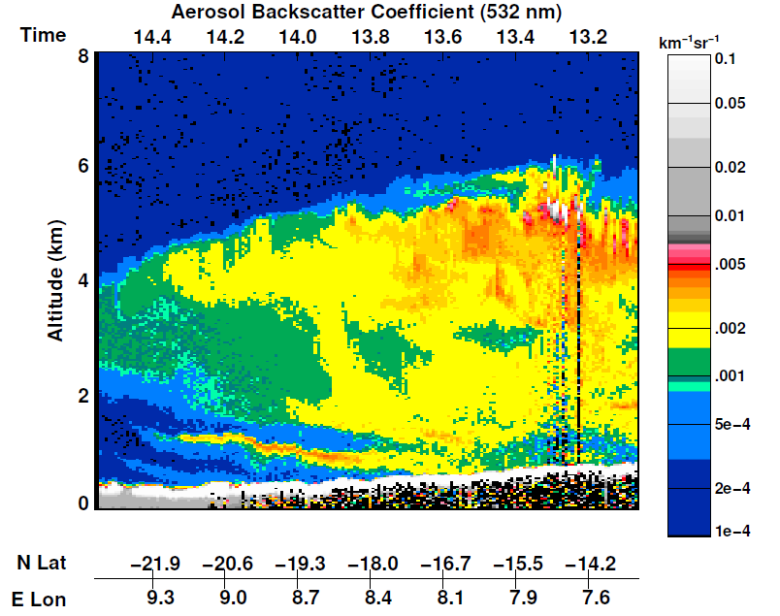
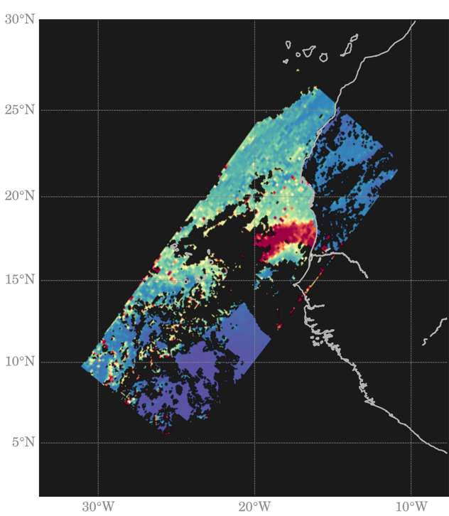
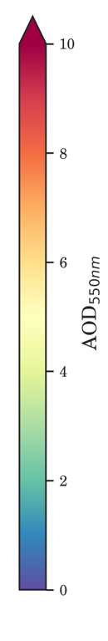
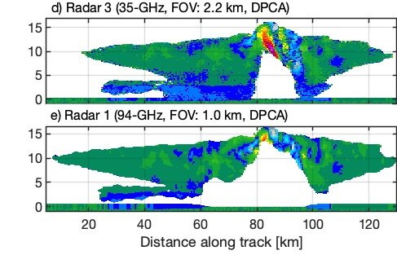

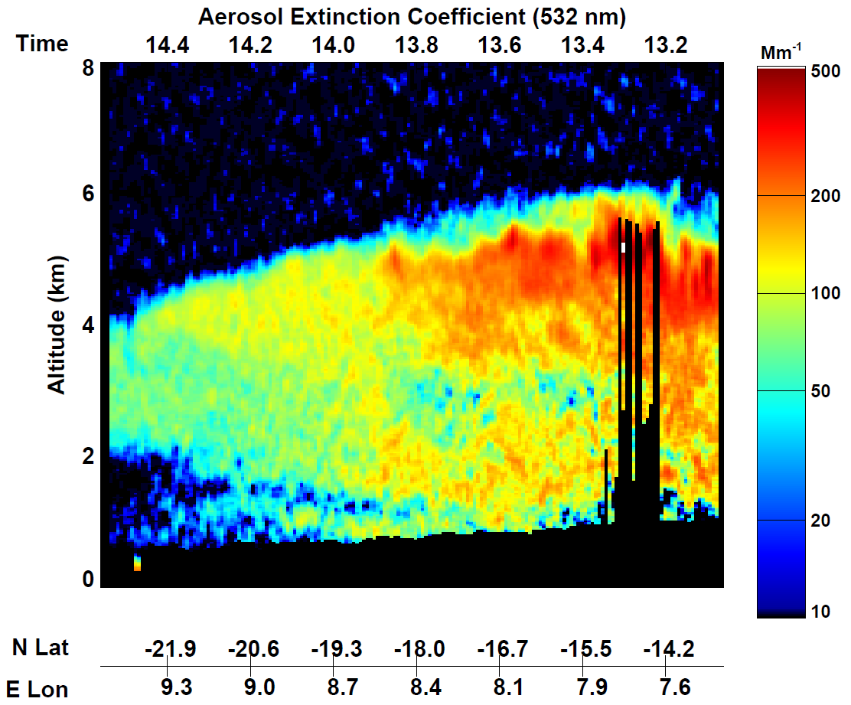
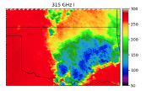
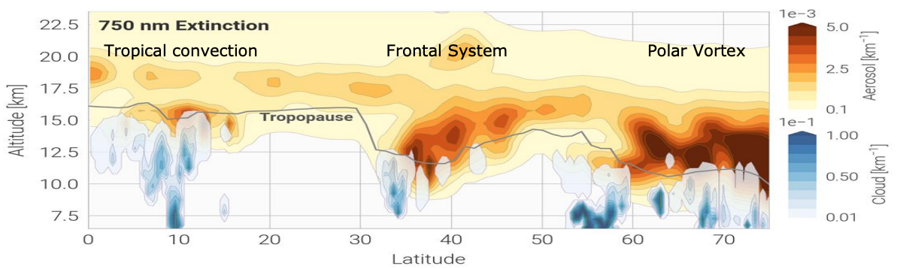
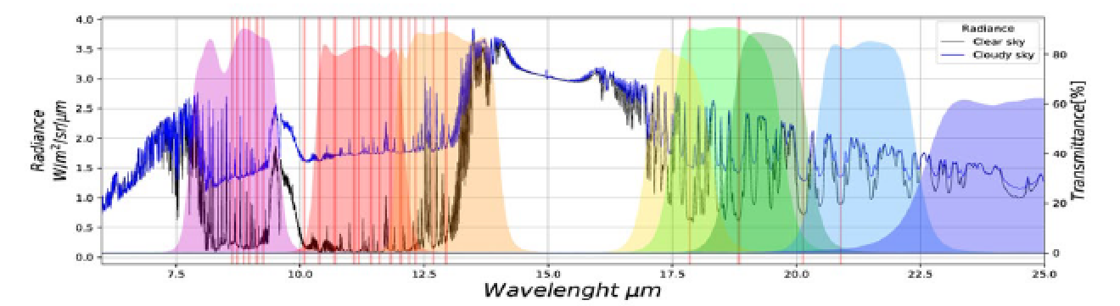
A Visual View of AOS-Polar
W- and/or Ka-band Doppler Radar
Simulated cross section through a deep convective system
Aerosol & cloud backscatter coefficient
Truth
AOD from HARP
Cloud-top properties available also
Polar lidar and radar details still very much TBD
Ka-band Radar (35-GHz, FOV: 2.2 km, DPCA)
Aerosol & cloud extinction coefficient
W-band Radar (94-GHz, FOV: 1 km, DPCA)
UV-VIS-NIR-SWIR
Multi-angle Polarimeter
CSA-Contributed LWIR-FIR Spectrometer 4-73 μm
Microwave Radiometer: 89-700 GHz
CSA Aerosol/Moisture Limb Sounding
Notes:
The polar mission builds on the heritage of the A Train and is designed to optimize instrument synergies to obtain accurate information on processes relevant to climate sensitivity and feedback and aerosol forcing of climate, which requires globally distributed observations. It includes several advanced sensors provided by NASA and industry and contributed instruments from CSA. The next several slides will focus on the key capabilities within each orbit.

