Slide 1

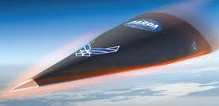
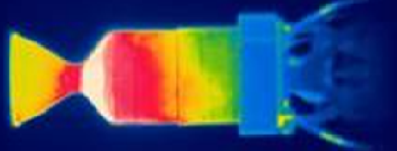
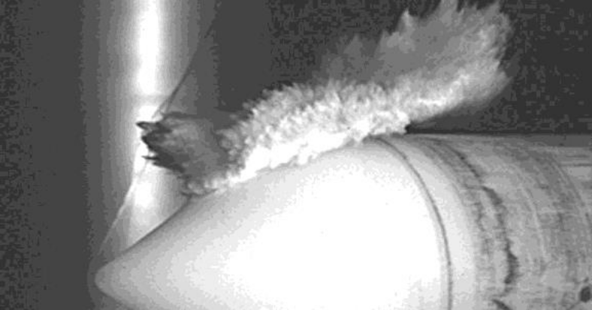
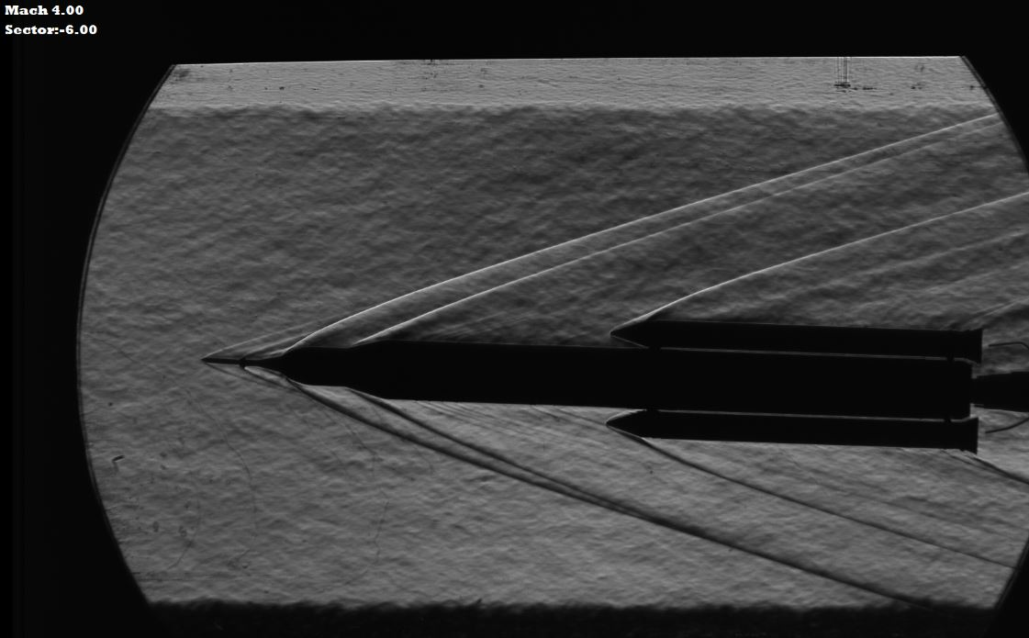
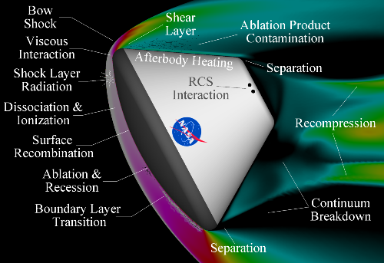
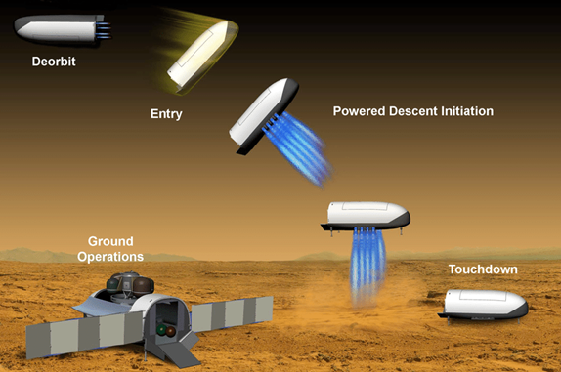
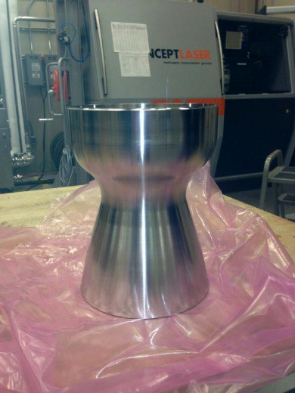
Marshall Space Flight Center
Capabilities and Testing
Supporting Hypersonic Missions
Distribution Statement A: Approved for public release. Distribution is unlimited.
Presented by: Savannah Metz
savannah.m.metz@nasa.gov

Slide 2
Overview
Marshall Space Flight Center Mission Areas
Capabilities
Testing Facilities
Partnering Opportunities
Points of Contact

Slide 3
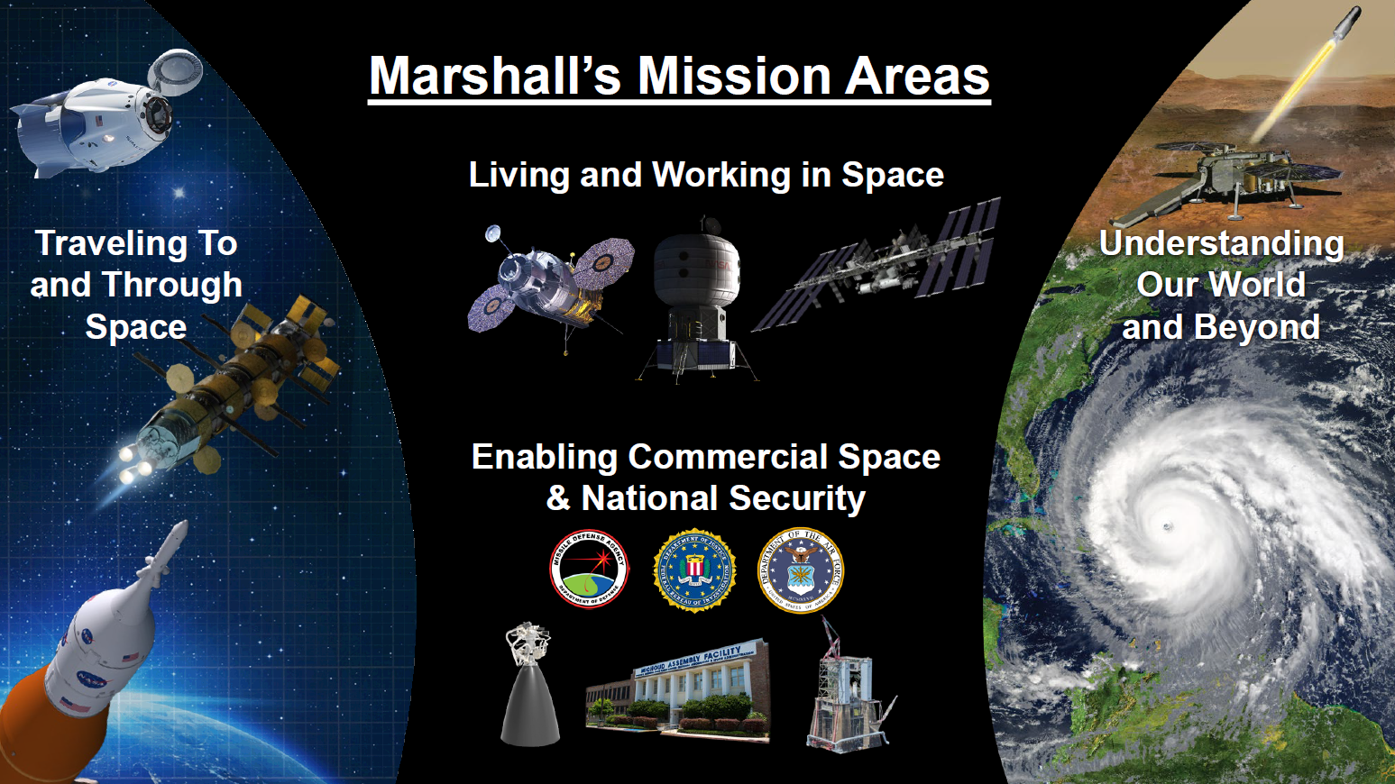

Slide 4
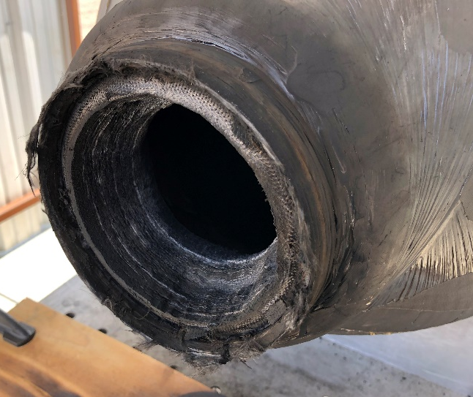
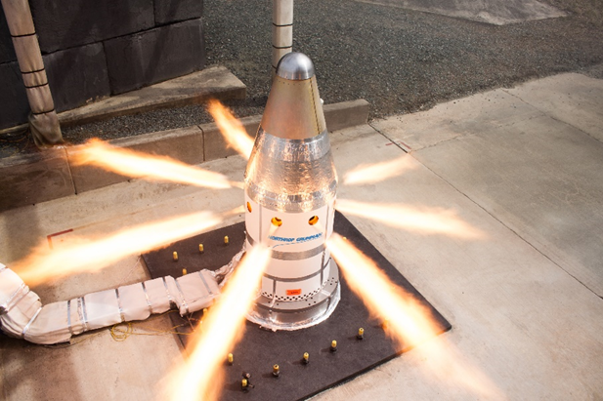
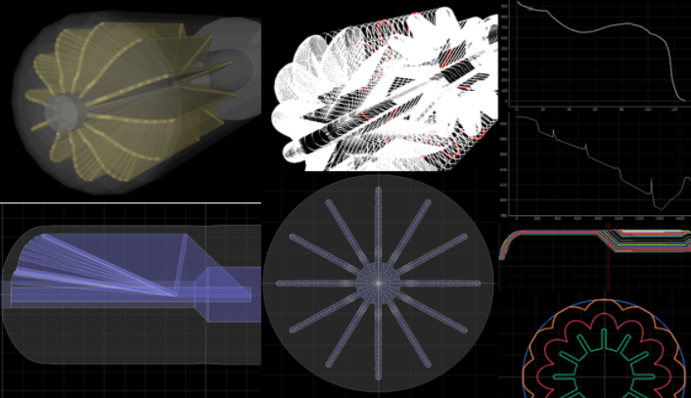
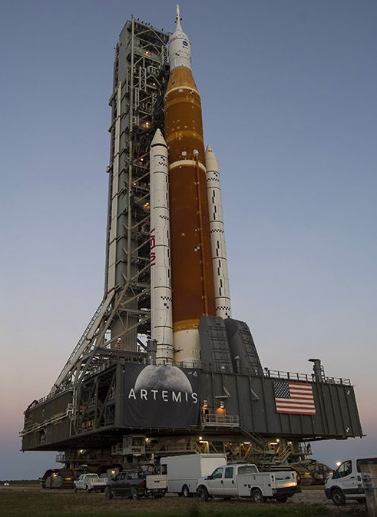
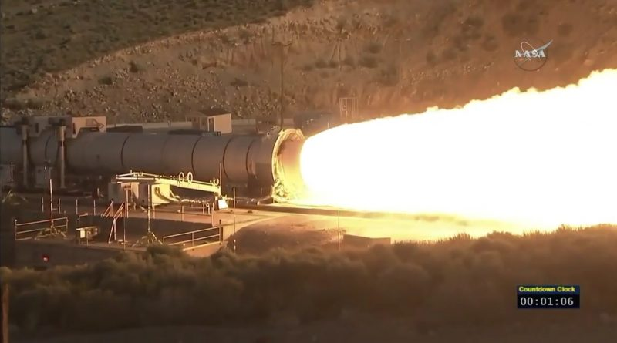
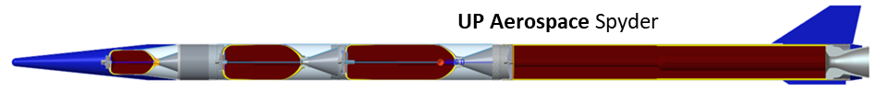
Propulsion Capabilities
Propulsion Related Testing Activities
Inert and Hybrid propellant mix and cast capability
  Mechanical testing of propellant samples
  Subscale motor testing
TVC systems simulation and test facility
Materials Environment Test Complex (METCO)
Ballistic Design and Analysis
Vehicle performance analysis, Statistical analysis
Pre-test predictions, Post-test/flight reconstruction
Propellant grain geometry design
Projects:
Space Launch System – Orion Launch Abort System –
Mars Ascent Vehicle – CCP – Europa Lander
Orion Launch Abort System
AC Motor
Thrust Vector Control
Liquid and Solid systems
Actuator work (hydraulic/mechanical)
Interface with prop, structures, trajectory, flight software
Design and Analysis Work:
TVC system development for MAV
SLS Electromechanical actuators
Data analysis post static tests/engine fire/flights
Projects: SLS–
MAV – CCP – Orion – HLS –
Separation System & Pyro Devices
SLS Booster (BSM/RSRMV Igniter/Ignition S&A/
FTS S&A/FTS LSC)
SLS Core Stage LSC Assembly/S&A
CCP Pyro Subsystem
SLS EUS Destruct Charge/S&A/Frangible Joint Assembly
MAV Pyro and Separation System
Europa DOS Pyro
SLS SPIE (Payload Adapter/Universal Stage Adapter
HIAD/LOFTID (solid-based gas generator projects)
SLS Booster Qualification Test
System Integration Activities
Identify, document, and track risks to program objectives
Contractor interface for hardware acceptance,
non-conformances, design reviews
Provide subject matter expertise for every sub-system
4

Slide 5
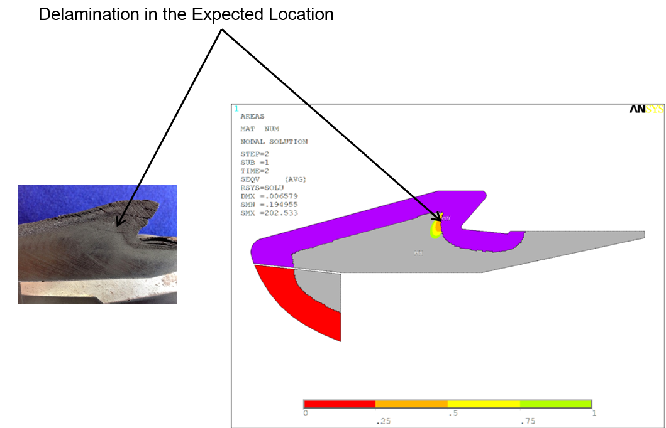
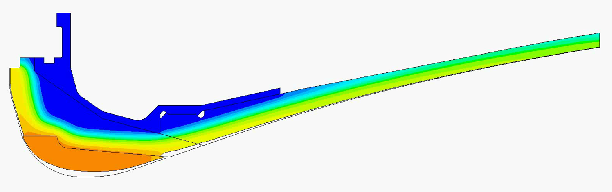
Analysis Capability
Structural Analysis
Material modeling and structural analysis of conventional and advanced composites
  Mechanical response of heated phenolics
  Fracture analysis/delamination prediction
  Nozzle materials: 3D C/C, C/C-SiC, CCP, SCP
Structural assessment of solid and liquid propulsion applications
  Low-cycle fatigue
  Fluid-structure interaction
  Solid propellant and internal insulation material modeling and structural response
Fluid Dynamics
  Computational fluid dynamics and fluid dynamics environment development for high temperature, supersonic propulsion (turbomachinery, combustors, engine thrust oscillations)
  Computational fluid dynamics for hypersonic flows (vibrational non-equilibrium/multiple temperature modeling)
  Plume acoustics and system identification
Thermal Analysis
Capable of performing analysis and design functions for thermal components and systems
Experienced with solid, liquid, and air-breathing propulsion applications, including integral rocket ramjets
Produces erosion, ablation, and temperature predictions for conventional and advanced composites
Engineering development, oversight, integration, and testing for a variety of propulsion systems
Thermal Model of Nozzle
5
5

Slide 6
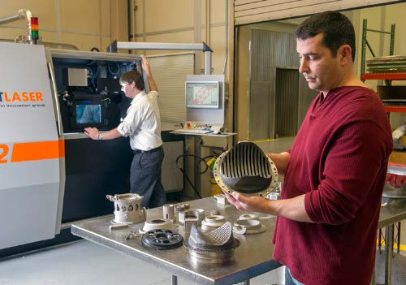
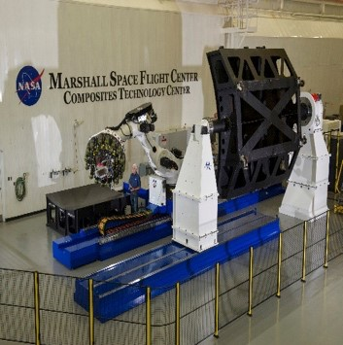
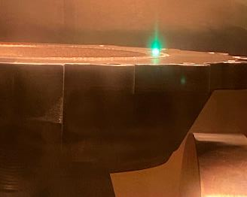
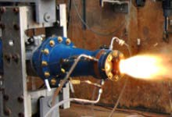
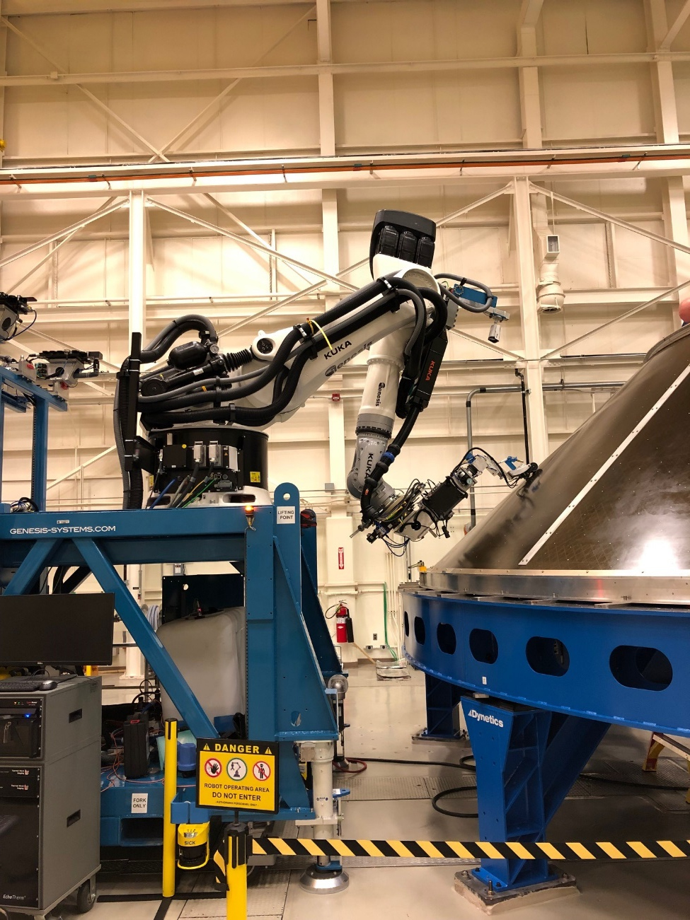
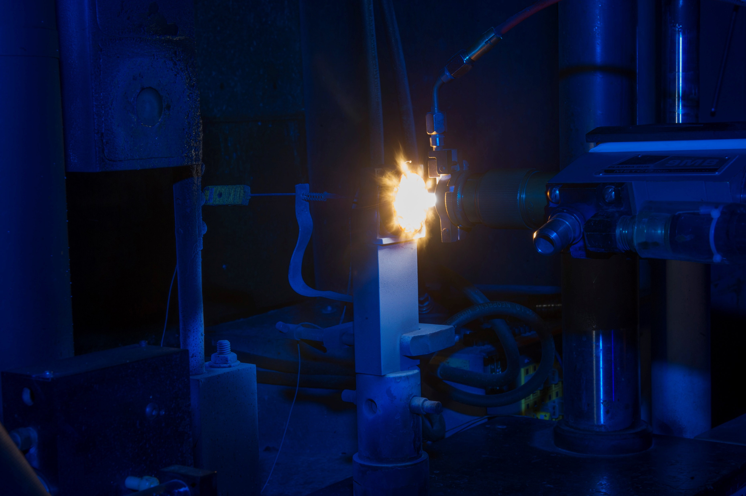
Materials and Process Capabilities
Materials
Damage Tolerance/Fracture Mechanics
Debris & Weather Encounter Impact Testing
Space Environmental Effects Testing
  High Intensity Solar Environment Testing
  Ionizing Radiation and UV Radiation Testing
  Plasma and Charging Testing
Biological and Physical Sciences - Flight Experiments
Mechanical, Tribological, and Chemical Materials Testing
  Hydrogen Testing
Electrostatic Levitation Laboratory
Processes
Materials Diagnostics & Failure Analysis
Advanced Metal Joining
Cryogenic Insulation & TPS Process Development
Manufacturing
Additive manufacturing and welding of refractory materials
Digital Manufacturing
Large Scale Process Development, Tooling & Manufacturing
Data Management
MAPTIS (Agency asset) & Database Management
Physical Sciences Informatics
Additive Manufacturing
Composite Manufacturing
Advanced Welding
Large-Scale 3D Printing for Rocket Engines
NDE and Process Development
Plasma Torch Testbed & Solid Fuel Torch

Slide 7
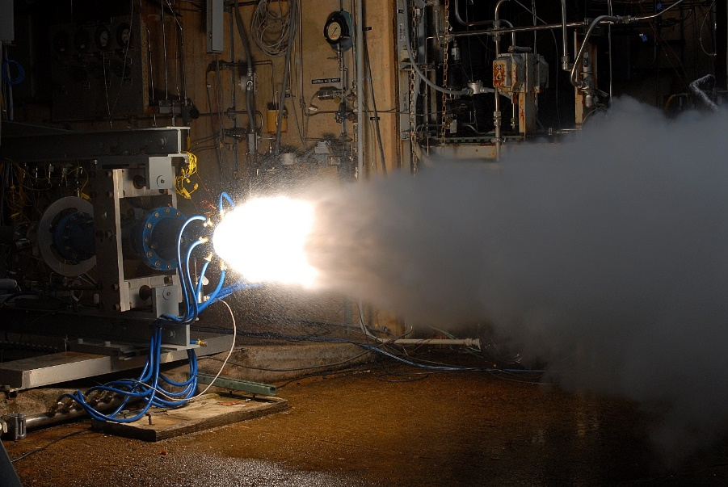
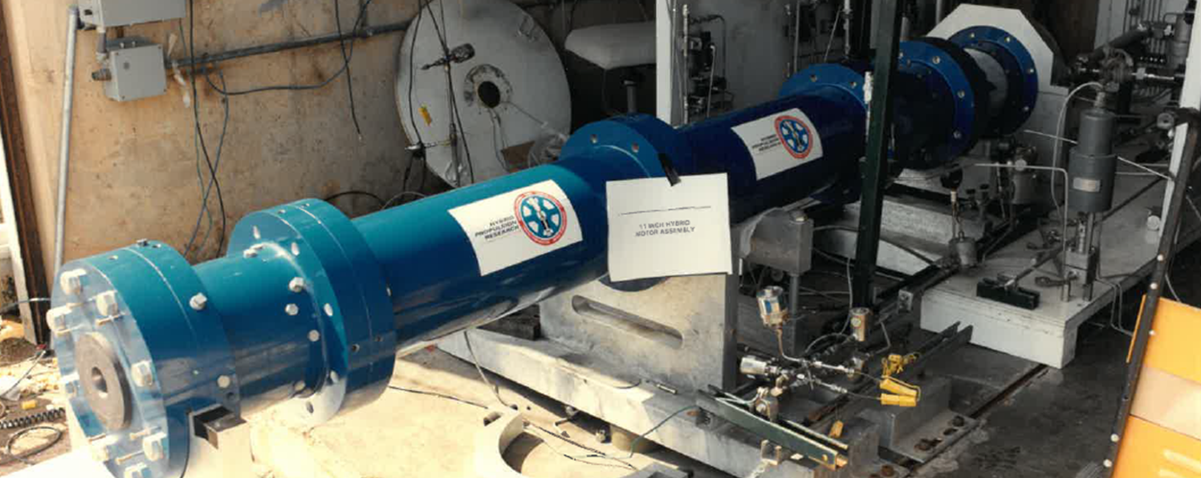
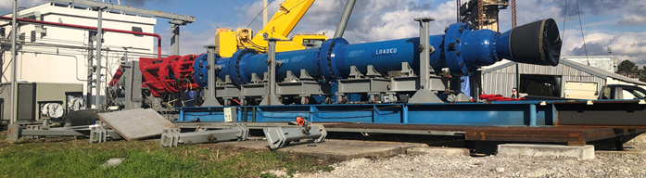
Subscale Motor Test Beds
Solid Fuel Torch
6” diameter hybrid motor, aluminized solid fuel and gaseous oxygen
150 to 1500 psi motor pressure
10 second duration test
11 in Hybrid Motor
Aluminized solid fuel and gaseous oxygen
Up to 1500 psi motor pressure
20 second duration test
Tapered grain, submerged nozzle, insulated aft dome region
24 in solid rocket motor
Live aluminized solid motor
Targets SLS Booster pressures
  Previous tests average pressures 967 psia – 1303 psia
Insulated live grain segments, insulated aft dome, submerged nozzle, significant instrumentation
Solid Fuel Torch
11 in hybrid motor
24 in solid rocket motor

Slide 8
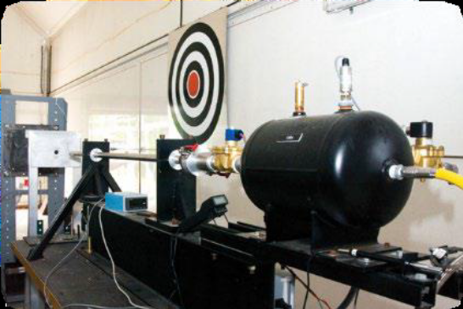
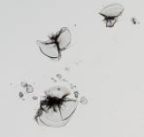
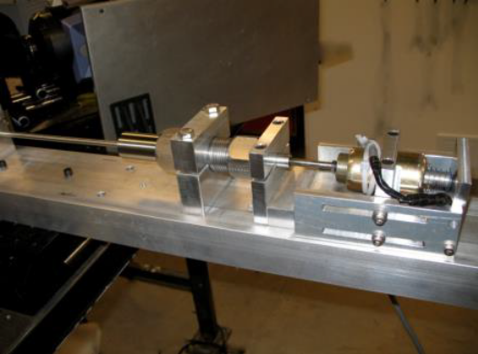
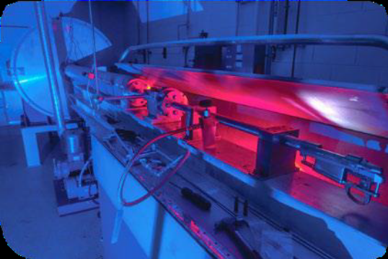
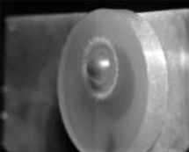
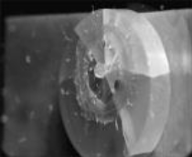
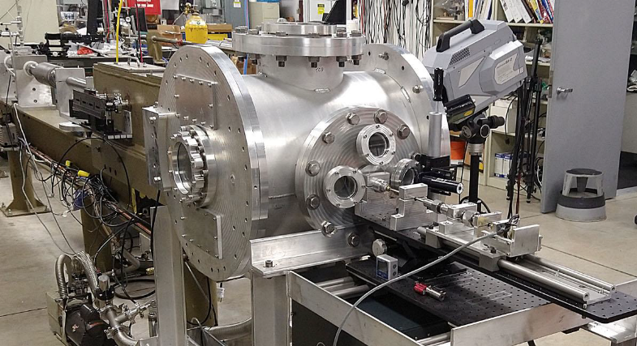
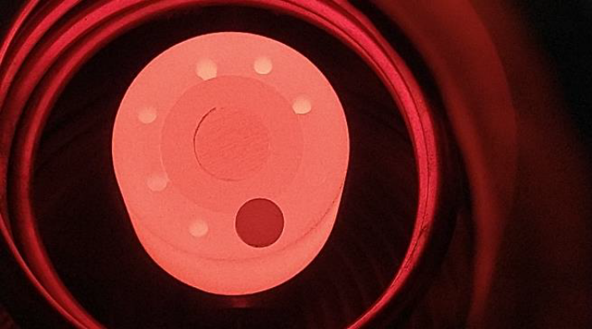
Impact Test Facilities
Hydrometeor Impact Gun (HIG)
The ITF ‘rain gun’ is the only hydrometeor impact gun in the United States that can provide single impact performance data with known water-drop sizes.
Velocity: 4,800 ft/s (Mach 4.2) and is material and mass dependent
Drop diameters: 2, 3 &4mm (0.079, 0.12, & 0.16in.) (normal rain drop size)
Specimen size: 19-mm (0.75-in.) diameter
Single Stage Gas Guns
Perform subsonic/transonic impacts from 50 –2000ft/s.
Velocity: < 2000ft/s projectile mass dependent
Projectile size: Up to 76mm (3-in) diameter, subsonic up to 8 x 8 in.
Engineering development, oversight, integration, and testing for a variety of propulsion systems
Sand Impact Gun
Subsonic launch and landing particle debris such as sand. High speed recording of particle velocities, sizes and locations on IR windows
Velocity: 1000 ft/s maximum
Particle size: 50–500 µm (0.004 –0.2in.)
Target Dimeter: 0.5 –1in Window Materials
Micro Ballistic Powder Gun (MBPG)
Simulates rain-drop impacts using 1.18, 2, 3 & 4mm (0.04-to 0.12-in.) polymeric beads.
Velocity: 6,000 ft/s (Mach 5.3)
Target size: 25mm (1in.) up to full-scale hardware
Angle of attack: variable
sand
Combined Effects Particle Impacts (CEPITF)
Simulates rain-drop impacts using 2, 3 & 4mm (0.04-to0.12-in.) Nylon beads
Target heating: 350 to 2000°C
Target chamber: 20in diameter
Target size: up to 2in diameter (50mm)
Velocity Range: 2000-10,000+ ft/s (Mach 1.8-9)
8
8
8

Slide 9
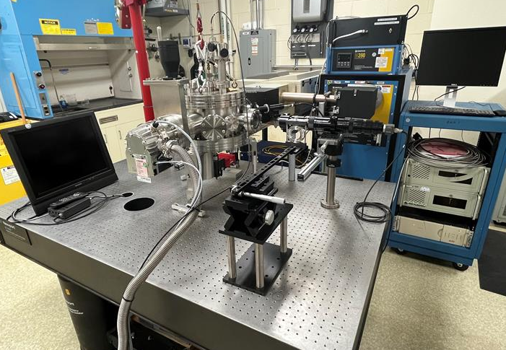
HiTEMS
High Temperature Emissivity Measurement System
Measures spectral and total near normal emittance at use temperature
Record supplemental data of laser power, blackbody and sample temperature, tolerance, and signal
Performance Characteristics
  Temperature Range: 600°C - 2,600°C
    Sample size dependent
  Vacuum: ~10⁻⁷ Torr
  Wavelength Range:
    2μm – 24.9 μm with KBr beam Splitter
    0.67 μm - 1.04 μm with quartz beam splitter
  Incident angles: 0° - 180°

Slide 10
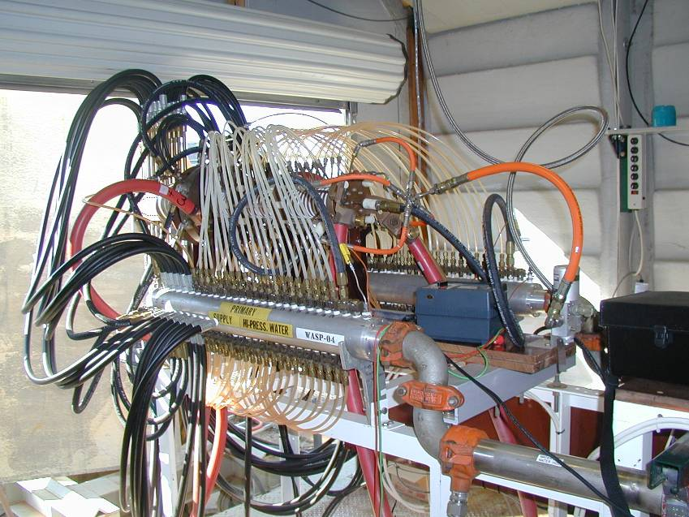
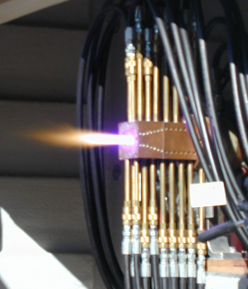
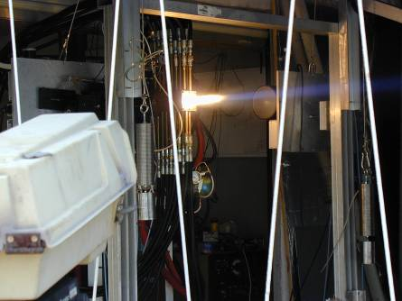
Hyper-Thermal Test Facility
A high-power gas discharge device that produces a steady, high enthalpy flow used for thermal and ablative characterization of TPS materials
Multiple gases can be used simultaneously to represent gas compositions in which the materials were designed to operate.
Design/Performance Characteristics
  Gas velocities range from subsonic to Mach 4.2
  1.0 MW_{e} (sustained) / 1.5 MW_{e} (maximum)
  ∼ 50% thermal efficiency
  15-atm stagnation pressure (extendable)
  0.35 in to 4 in diameter sample or 1x3 in to 3x3 in flat plate samples
    Stagnation, wedge, or flat plate configurations
Large database establishing safe operating envelopes
Located in East Test Area Materials Environmental Test Complex (METCO)

Slide 11
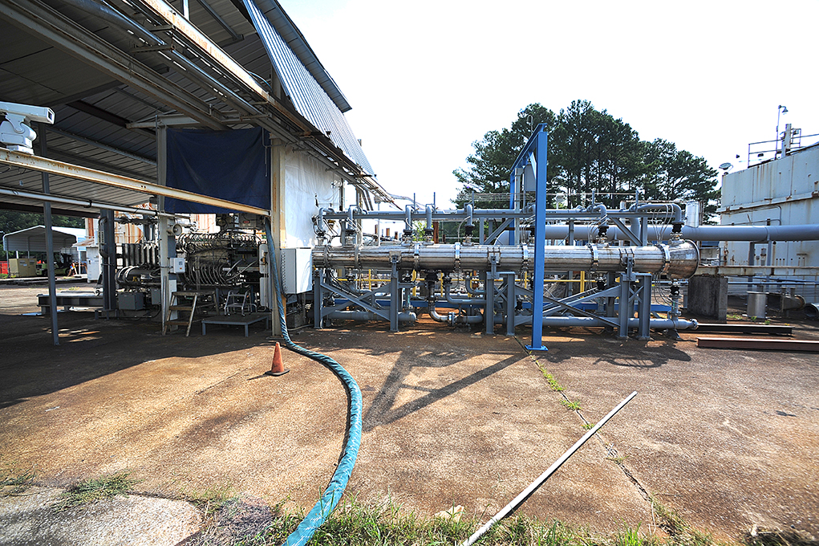
Hot Gas Facility
Flexible combustion-driven Mach 4 aero-thermal tunnel with capability to combine radiant heating (arc Lamp)
Performance Characteristics
  16” × 16” × 46” L test chamber
  lean combustion mix of gaseous hydrogen (GH2) and air
  temperatures up to 3000°F at
  total pressures up to 250 psia
  Test panel can be inserted into flow at inclination angles from 0 to 90 °
Conditions can be adjusted up to (5) times over the course of a single run to simulate changes in heating over a given flight trajectory.
Hot Gas facility (HGF) has been in service for 35+ years and has accomplished over 26,000 hot firings. It was built to develop, characterize, and qualify thermal protection system (TPS) materials for flight vehicles, but it has proven to be invaluable for addressing in-flight anomalies, and for performing material and instrumentation studies. It has qualified materials for NASA manned and unmanned flight vehicles and for DOD and Commercial vehicles.

Slide 12
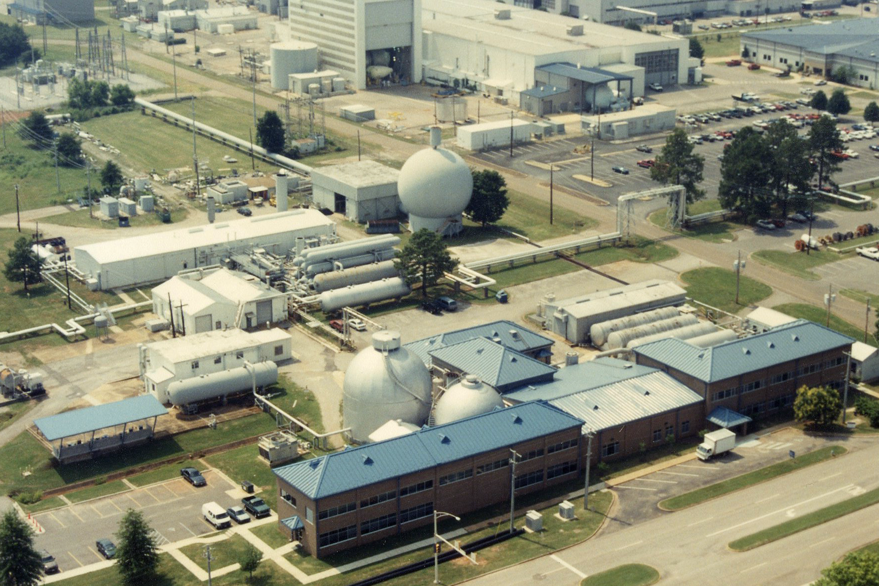
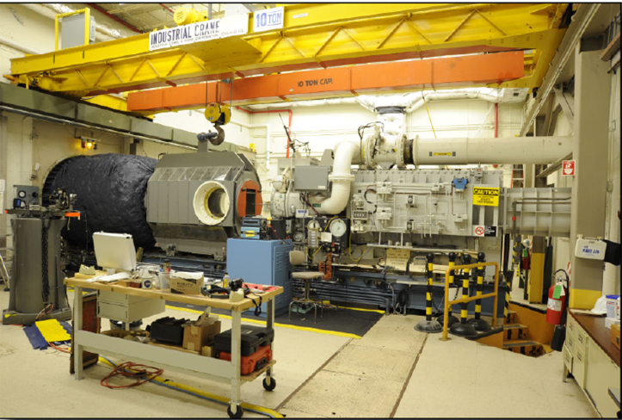
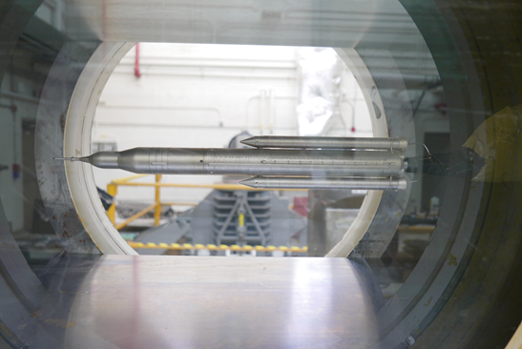
Aerodynamic Research Facility
Mach 0.25-6.0
High-speed data acquisition systems can record up to 250,000 samples per second. Schlieren imagery available (video & stills)
Rapid change of model configurations using additive manufacturing capabilities
Run time:
    60–90 sec (transonic)
    30–45 sec (supersonic)
Recharge time:
10–20 min nominally (transonic)
15–20 min (supersonic)
Run rate:
20–30 runs per 8-hr shift
14” × 14” Tri-Sonic Wind Tunnel

Slide 13
Partnering Opportunities
Systems Engineering
Science and technology
Vehicle Sensors
Advanced EDL
Advanced Aerocapture for Small Spacecraft
Environmental Testing
  Plasma Environment
  Impact Testing
Fluid Dynamics Testing
  Nozzle Test Facility (Solid Rocket Motor Air Flow Test Equipment)
  Inducer Test Loop
  Turbine Test Equipment
  Tri-sonic wind tunnel
Advanced Materials
  Carbon-Carbon
  Nano materials
Advanced Manufacturing
  3-D printing of high temperature metallic parts
Behavior of Solid Propellant in High Velocity, Dynamic Environment
For partnering opportunities, please contact Reggie Alexander reginald.alexander@nasa.gov

Slide 14
Points of Contact
Materials Development and Research
  POC Erin Richardson
  MandP@mail.nasa.gov
HiTEMS
  POC Mary Nehls
  mary.nehls@nasa.gov
Impact Test Facility
  POC Mary Nehls
  mary.nehls@nasa.gov
Hot Gas Test Facility
  POC Jacob Parton
  jacob.a.parton@nasa.gov
Hyper-Thermal Test Facility
  POC Jacob Parton
  jacob.a.parton@nasa.gov
Aerodynamic Research Facility
  POC Victor Pritchett
  victor.e.Pritchett@nasa.gov
Propulsion Capabilities
  POC Adrian Soler
  adrian.solerluna@nasa.gov

Slide 15
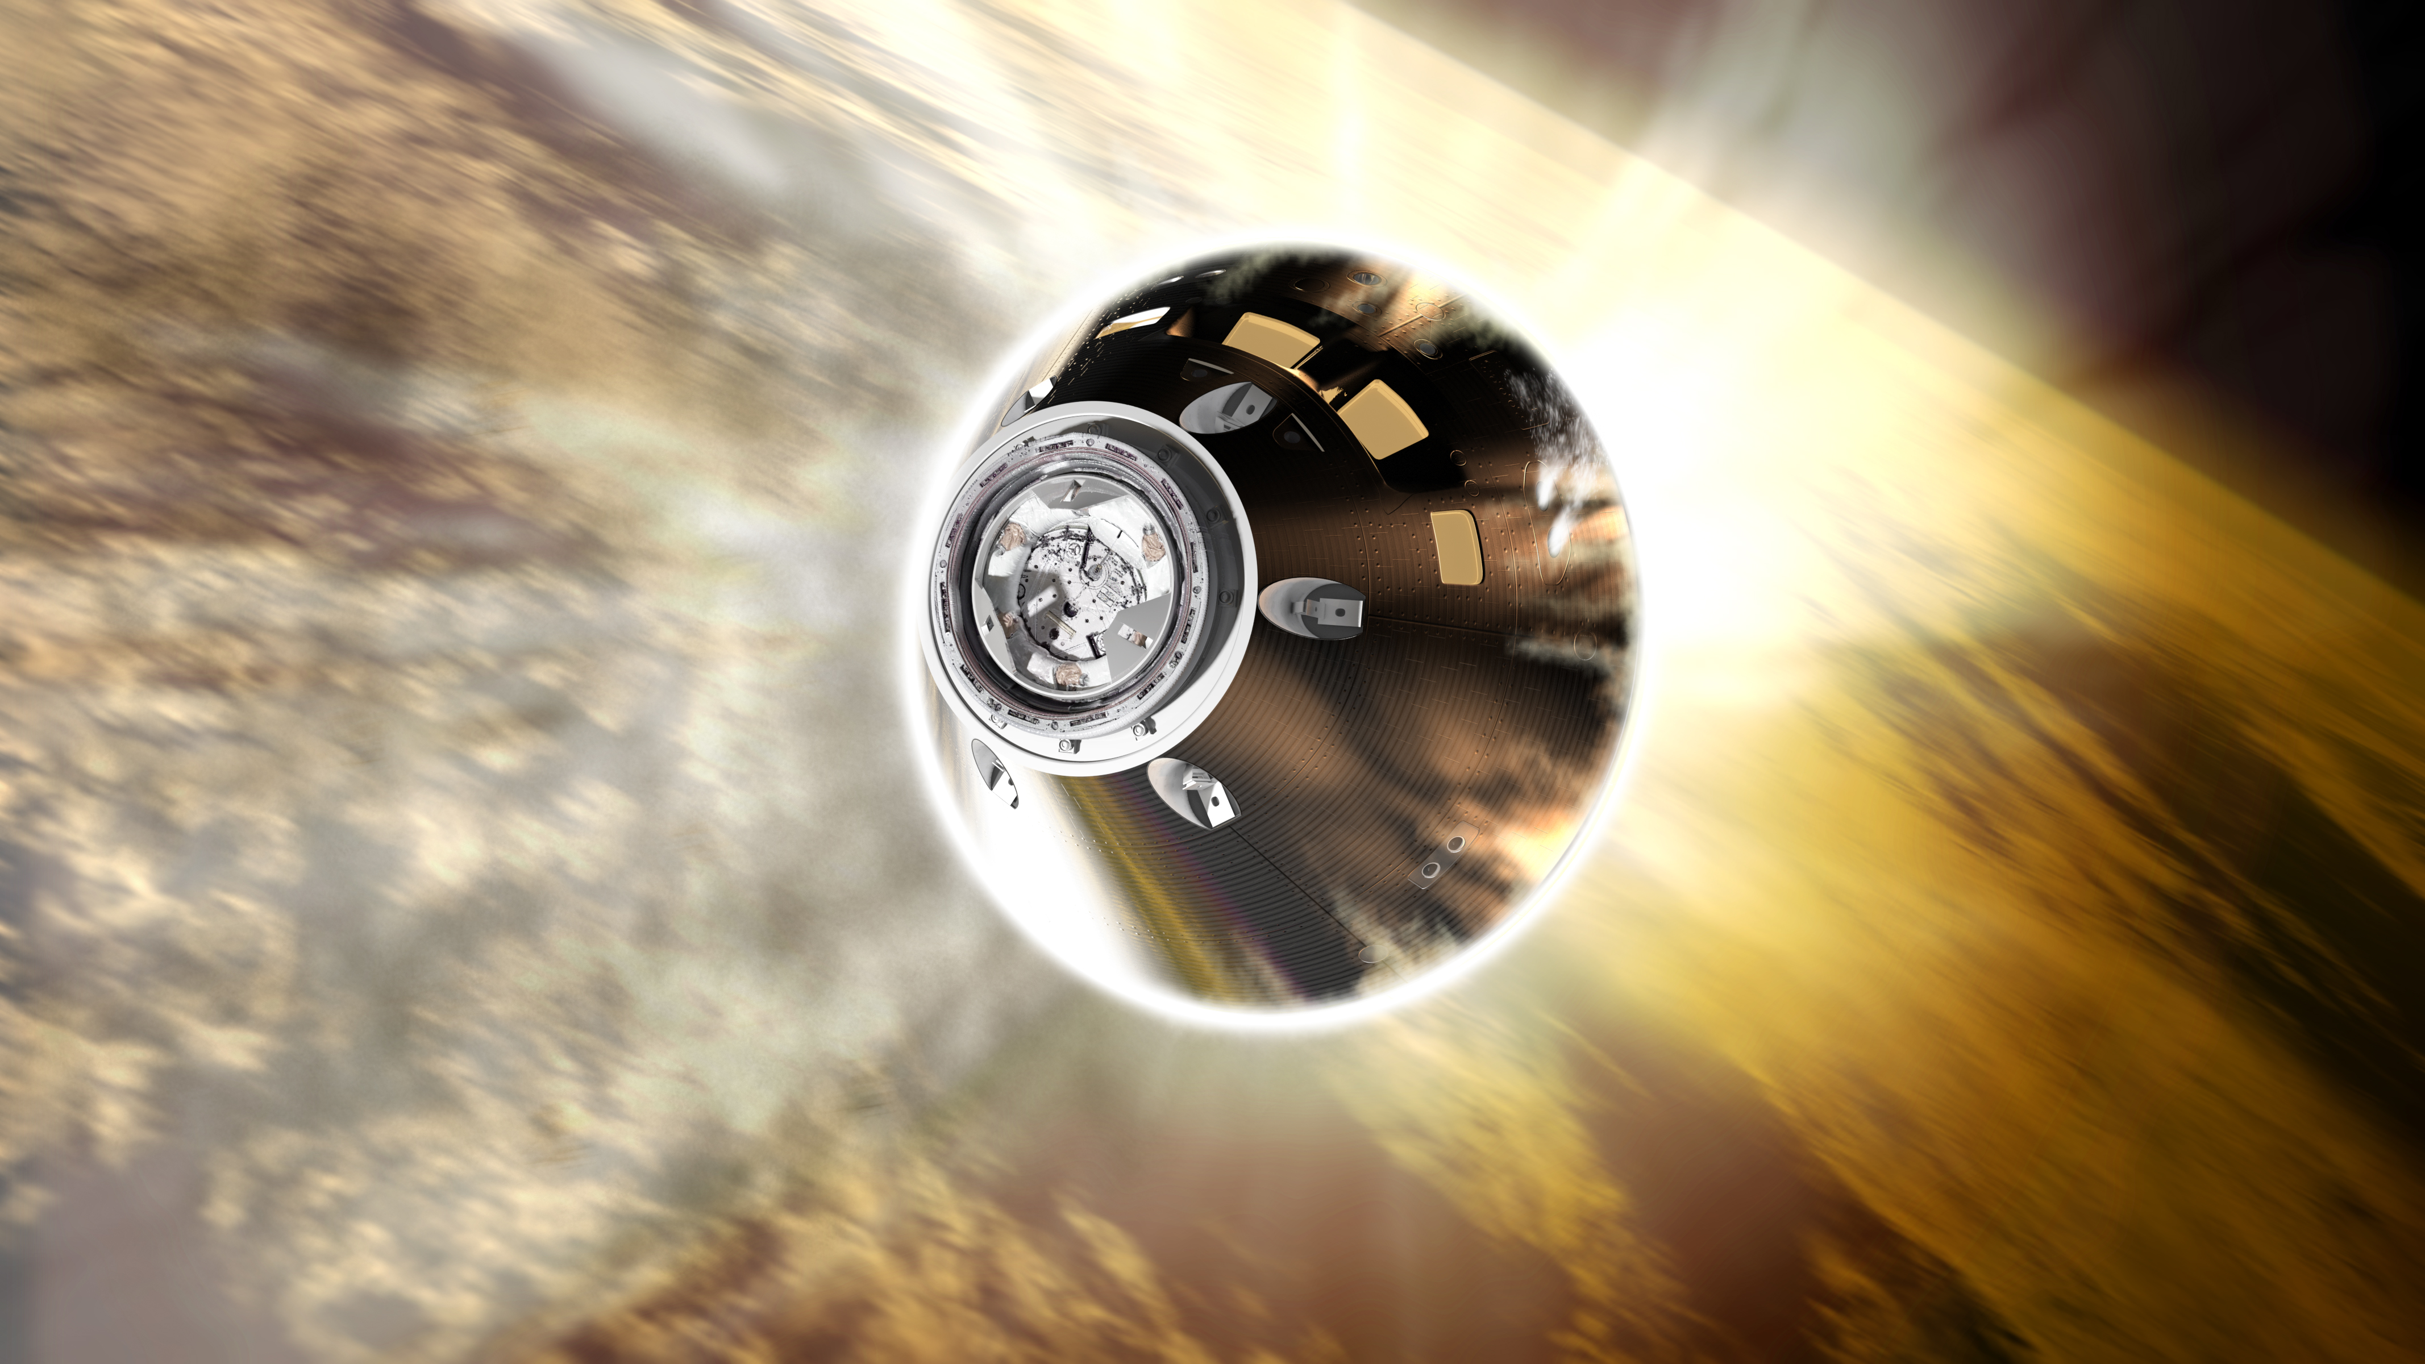
Backup
Notes:
NASA Presentation Sign-Off Page

Slide 16
Marshall Partnerships & Formulation Office
Name | Title | Email
Reggie Alexander | Manager | reginald.alexander@nasa.gov
Justin Jackson | Assistant Manager Formulation Manager – In-Space Servicing, Assembly, & Manufacturing | justin.r.jackson@nasa.gov
Laura Hardin | Integration Manager | laura.hardin@nasa.gov
Preston Schmauch | Center Agreement Manager | preston.b.Schmauch@nasa.gov
Chip Jones | Commercial Space Partnerships Manager | chip.jones@nasa.gov
Rip Nabors | Interagency & Commercial Industry Partnerships Manager | rip.nabors@nasa.gov
Whitney Young | Academia & International Partnerships Manager | whitney.young@nasa.gov
Dawn Turner | Industry Engagements | dawn.m.turner@nasa.gov
Joseph Casas | Formulation Manager – DOD, Small Spacecraft Missions | joseph.casas@nasa.gov
Zenia Garcia | Formulation Manager – Advanced Propulsion | zenia.a.garcia@nasa.gov
Carl Ise | Formulation Manager – Other Government Agencies and Space Situational Awareness | carl.a.ise@nasa.gov
Shawn Maynor | Formulation Manager – Exploration, Surface Systems | shawn.b.maynor@nasa.gov

