Slide 1

Development of Radioluminescent Tritium Polymeric Material for High Visibility Applications
Lauren Fisher (lauren.m.fisher@nasa.gov)
Polymeric Materials, NASA Marshall Space Flight Center (Huntsville, AL)
Meghan Carrico (meghan.carrico@nasa.gov)
Space Environmental Effects, NASA Marshall Space Flight Center (Huntsville, AL)
DISTRIBUTION A. Approved for public release; distribution unlimited.

Slide 2
Scientific Background
Tritium or hydrogen-three is a radioactive isotope of hydrogen that emits beta particles as it undergoes a process called beta decay.
  Half life of 12.3 years
A beta particle is a high-energy, high-speed electron (or positron) emitted from radioactive decay of an atomic nucleus.
Because it is a gas, tritium must be bound to a material or encapsulated in a sealed glass container.
The gaseous tritium can then be combined with a phosphor source which when struck with beta particles, fluoresces and emits light. Such a light source is referred to as a gaseous tritium light source (GTLS).
DISTRIBUTION A. Approved for public release; distribution unlimited.

Slide 3
Current Industry Applications
Tritium light sources are used in items such as emergency exit signs and watch faces, and as a very reliable source of low intensity light for items such as gun sites and navigational compasses
The current and future market for the light sources strongly implies that there is a potential for a patent and use for this material in commercial industries
DISTRIBUTION A. Approved for public release; distribution unlimited.

Slide 4
Potential In-Space and Lunar Surface Applications
Facilitate long term internal and external lighting needs for:
  Imaging
  Docking
  Tracking
  Color indicators
    Such as outside the ISS
  xEMU suits for lunar exploration on the moon
Polymeric material provides adhesion benefits and the potential to protect the tritium lights from degradation due to UV
DISTRIBUTION A. Approved for public release; distribution unlimited.

Slide 5
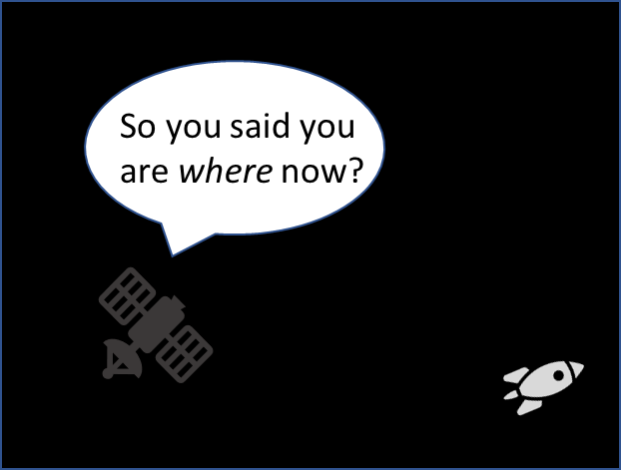
Project Background/Goals
A radioluminescent tritium polymer material capable of surviving multiple space environments could fulfill visibility requirements levied on space flight hardware and facilitate additional long term internal and external lighting needs for each mission.
Identify base material for coating.
Determine the best size, shape, amount, and color of lights for various lighting needs.
Run tests on the material/light combination to select the best candidate for further advanced testing.
DISTRIBUTION A. Approved for public release; distribution unlimited.

Slide 6
Current Testing Goals
Physical, mechanical, and optical properties will be observed/measured, including their durability in low earth orbit environment.
Mechanical and environmental testing will be performed to determine if GTLS can:
  survive in space
  be incorporated into a polymer material
  provide a sufficient amount of light for a given scenario
Tests will also allow examination of:
  Effects on material properties of the polymers
  Application, adhesion, robustness
  Brightness/radiant power
  effects of paint/optical enhancing coatings on brightness
DISTRIBUTION A. Approved for public release; distribution unlimited.

Slide 7
Purchased Lights
Light Type | Dimensions (mm) | Quantity
Hairlight, green | 0.3x2.0 | 2000
Hairlight, green | 0.3x8.0 | 2000
Rectangle, green | 1x0.5x3.5 | 400
Rectangle-yellow, orange, pink, blue, ice blue, white, green | 1.5x0.75x3.5 | 20
Disk, green | 4.75x20.5x15 | 20
Light Type | Dimensions (mm) | Quantity
Rectangle, green | 0.50 x 2.75 | 1000
Rectangle, green | 0.65 x 3.50 | 1000
Rectangular Type R, green | 48.0 x 9.0 x 4.0 | 5
Curved Dome Type CD, green | 12.8 x 21.5 | 5
Radial Disc Type D, green | 15.25 x 5.0 x 10 | 3
Full list is under development
DISTRIBUTION A. Approved for public release; distribution unlimited.

Slide 8
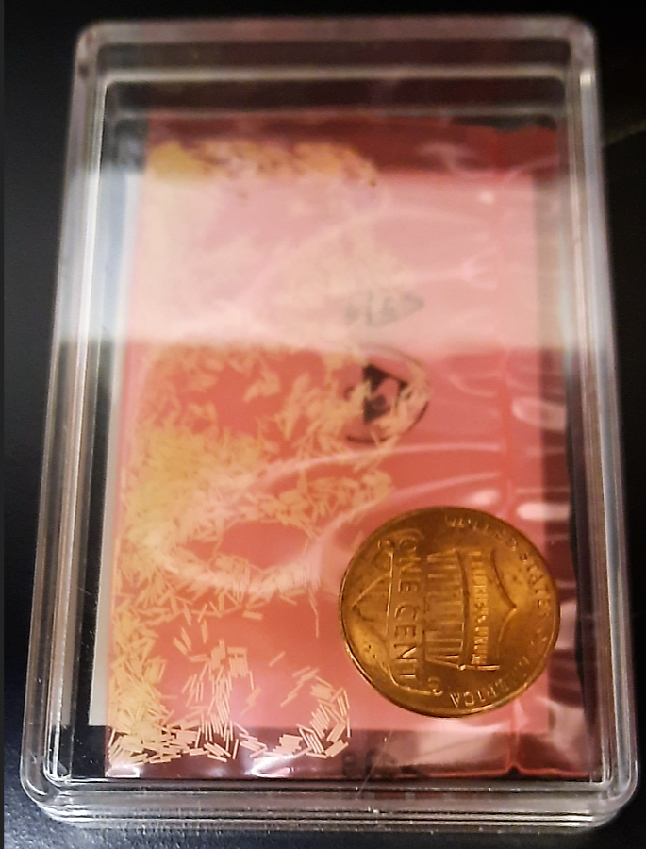
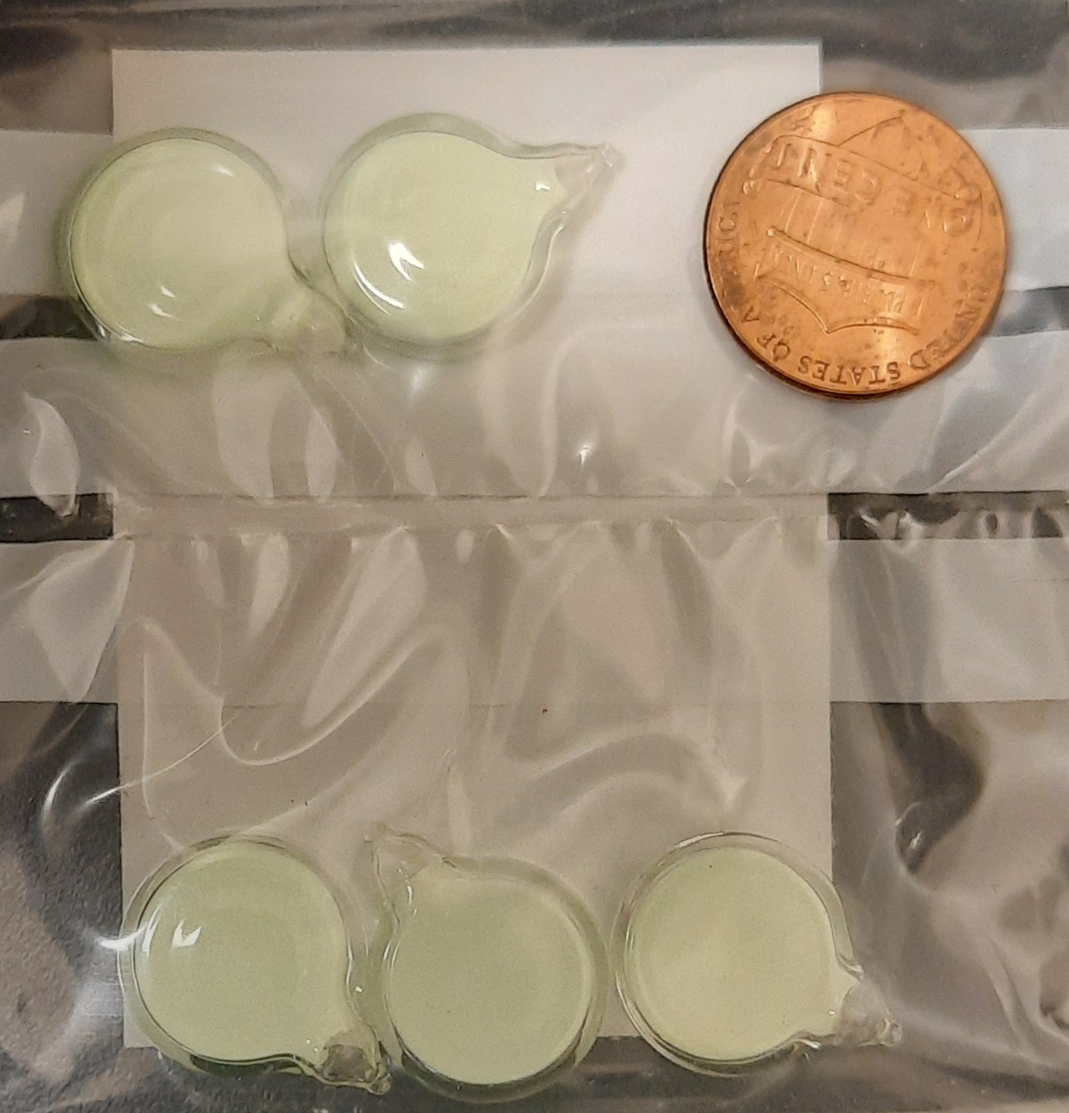
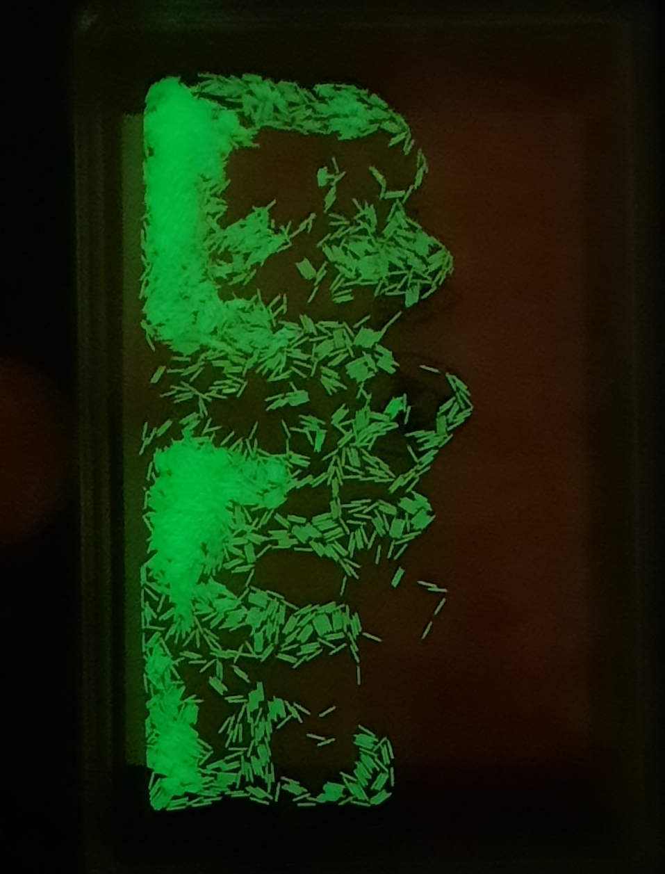
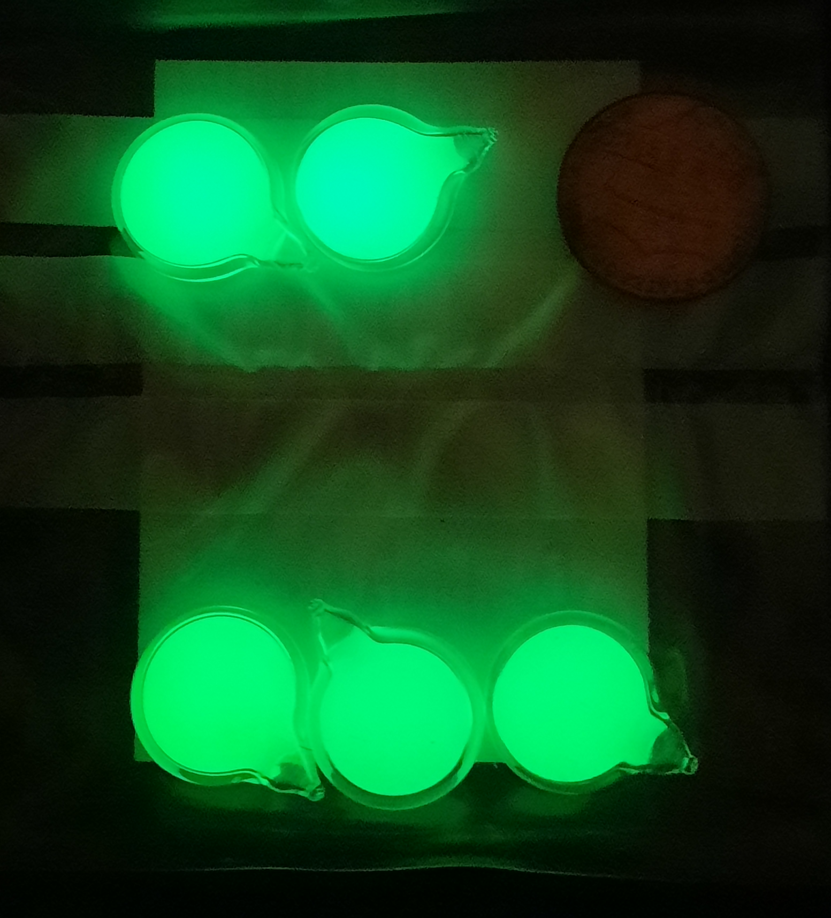
Hairlights
0.3mm x 2.0mm
Discs
4.75mm x 20.5 mm x 15mm
DISTRIBUTION A. Approved for public release; distribution unlimited.

Slide 9
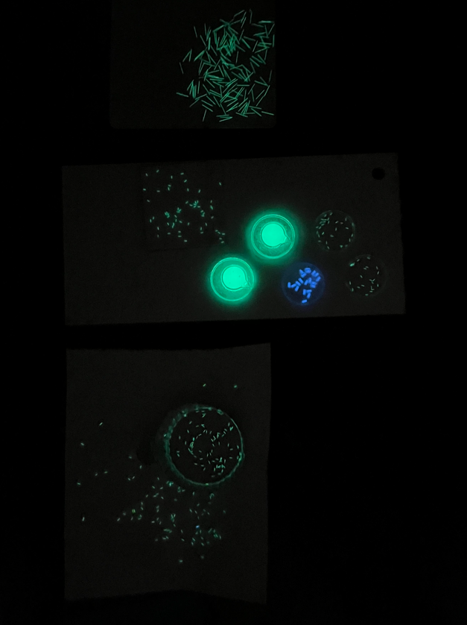
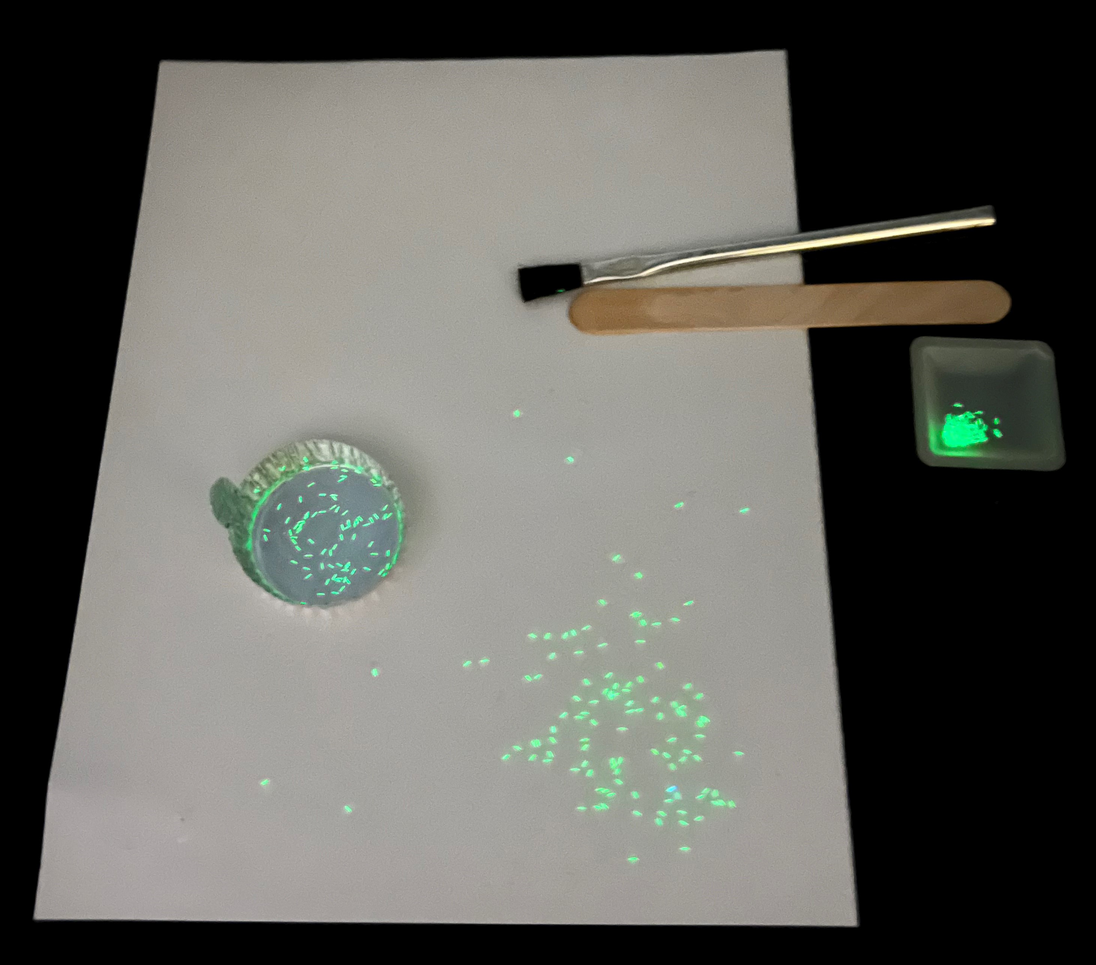
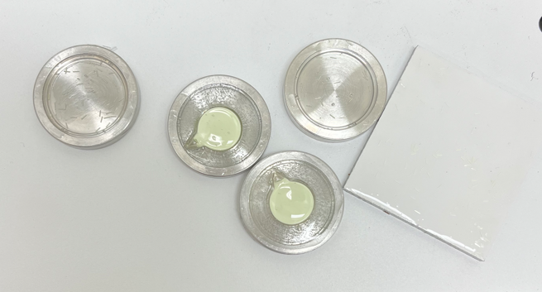
Fabricated Samples
Small and large hairlights were combined with the polymeric material and brushed on bare aluminum test panels and on white paint over aluminum test panels.
Circular molds were used to encapsulate the disk lights, small and large hairlights, and rectangular lights.
Films, larger aluminum “cure cup” samples, and colored lights were also produced
DISTRIBUTION A. Approved for public release; distribution unlimited.

Slide 10
Fabricated Samples
Sample types per polymer group:
  Small hairlight film
  Large hairlight film
  Circular samples
    Polymer encapsulated small hairlights
    Polymer encapsulated large hairlights
    Polymer encapsulated rectangular lights
    Polymer capsulated disk lights
    Polymer encapsulated different colored rectangular lights
  Large hairlight over Al Q-panel
  Small hairlight over white paint Al panel
  Cure cup samples
    Polymer encapsulated small hairlights
    polymer encapsulated large hairlights
DISTRIBUTION A. Approved for public release; distribution unlimited.

Slide 11
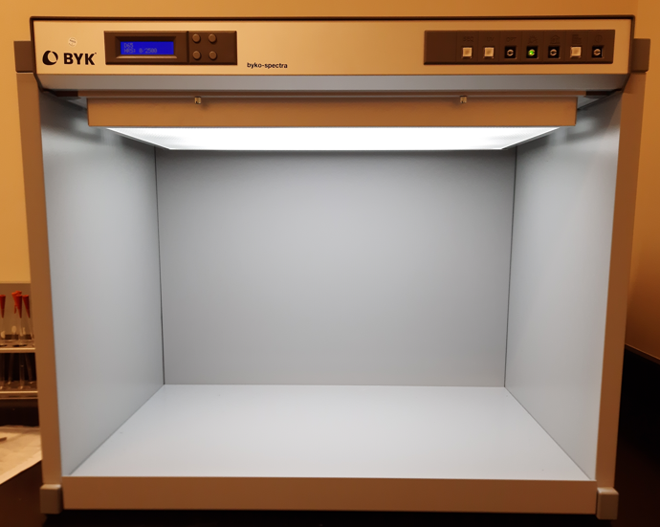
Light Box Comparison
Panel Options:
  Standard
  Dark
Light Choices:
  C-Store Light
  D-Daylight
  E-Home Light (Incandescent)
  F-Store Light (Cool White Fluorescent)
  Can include UV light with each setting
Note: Lights in room are off and external light from hall is blocked out with black out curtain for both light and dark photos.
Utilize different lighting conditions to observe the effects on color and brightness of the different types of tritium polymeric materials
  Analyzing differences in clarity and brightness of the encapsulating polymers
DISTRIBUTION A. Approved for public release; distribution unlimited.

Slide 12
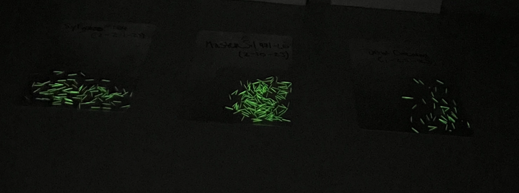
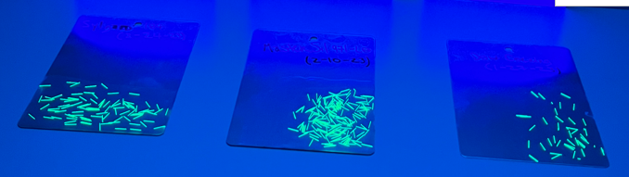
Large Hairlight Al Q-Panel
Standard panels used
DISTRIBUTION A. Approved for public release; distribution unlimited.

Slide 13
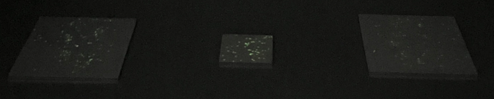
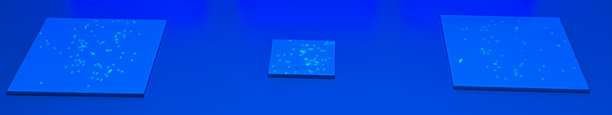
Small Hairlight White Paint over Al Q-Panel
Standard panels used
DISTRIBUTION A. Approved for public release; distribution unlimited.

Slide 14
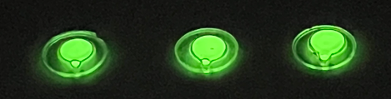
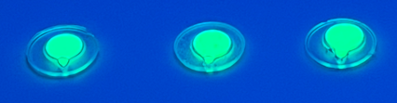
Polymer Encapsulated Disk Lights
Standard panels used
DISTRIBUTION A. Approved for public release; distribution unlimited.

Slide 15
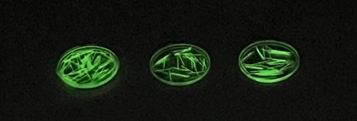
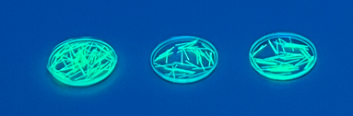
Polymer Encapsulated Large Hairlights
Standard panels used
DISTRIBUTION A. Approved for public release; distribution unlimited.

Slide 16
Underway and Upcoming Tests
Black panel light box comparison
Radiometry measurements
Adhesion strength tape test
Film material development and testing
Thermal vacuum
UV exposure
Materials Exposure Technology Innovation in Space-3 (METIS-3)
Materials International Space Station Experiment-20 (MISSE-20)
DISTRIBUTION A. Approved for public release; distribution unlimited.

Slide 17
Additional Sources
https://www.epa.gov/radiation/radionuclide-basics-tritium
DISTRIBUTION A. Approved for public release; distribution unlimited.

