Slide 1



High Temperature Emissivity Measurement System (HiTEMS)
Meghan Carrico (meghan.carrico@nasa.gov)
Space Environmental Effects, NASA Marshall Space Flight Center (Huntsville, AL)
DISTRIBUTION A. Approved for public release; distribution unlimited.

Slide 2

High Temperature Emissivity Measurement System (HiTEMS)
The High Temperature Emissivity Measurement System (HiTEMS) measures spectral and total near normal emittance
Capable of a range of incident angles from 0° to 180°
Record supplemental data of laser power, blackbody and sample temperature, tolerance, and signal
Wavelength range:
600°C to 1,500°C: approximately 2 µm to 24.9 µm (Experiment-1)
KBr beam splitter
1,600°C+: approximately 0.67 µm to 1.04 µm (Experiment-3)
Quartz beam splitter
Temperature range: approximately 600°C – 2,600°C
Depends on sample size and treatment
Vacuum levels: as low as approximately 10⁻⁷ Torr
DISTRIBUTION A. Approved for public release; distribution unlimited.

Slide 3
High Temperature Emissivity Measurement System (HiTEMS)
Utilizes a Mikron M390 Blackbody Calibration Source
FAR 12257-1 Pyrometer
FTIR: Nicolet 6700
Laser: 400 W 1,070 nm Ytterbium fiber laser
IPG Photonics
Laser uses a beam expander to provide uniform heating
with beam expander: beam diameter of 5 mm
without beam expander: beam diameter of 3 mm
DISTRIBUTION A. Approved for public release; distribution unlimited.

Slide 4
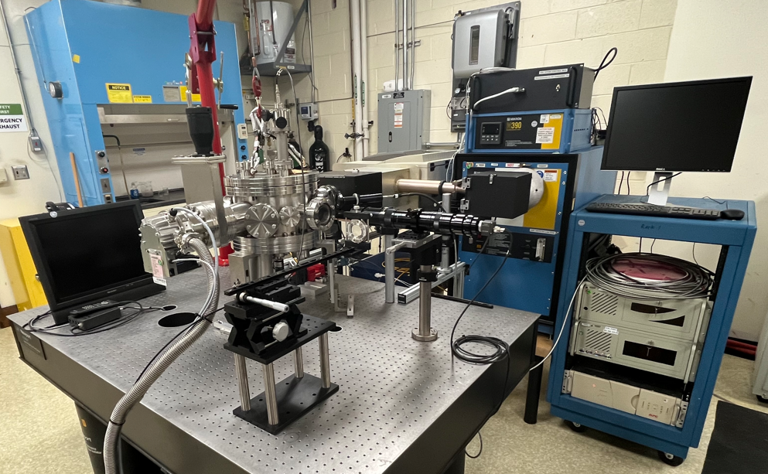
HiTEMS
FTIR
Laser
Blackbody
Pyrometer
Chamber
Camera
DISTRIBUTION A. Approved for public release; distribution unlimited.

Slide 5
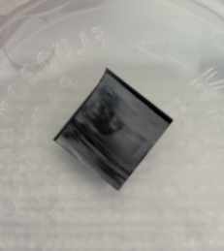
High Temperature Emissivity Measurement System (HiTEMS)
Typical sample size: 3/8’’ x 3/8’’
Circular samples preferred for uniform heating
Flexible on sample dimensions, can provide in-house machining
Utilize a path factor to correct for differences between blackbody and sample path
Hexoloy SA used for calibration
DISTRIBUTION A. Approved for public release; distribution unlimited.

Slide 6
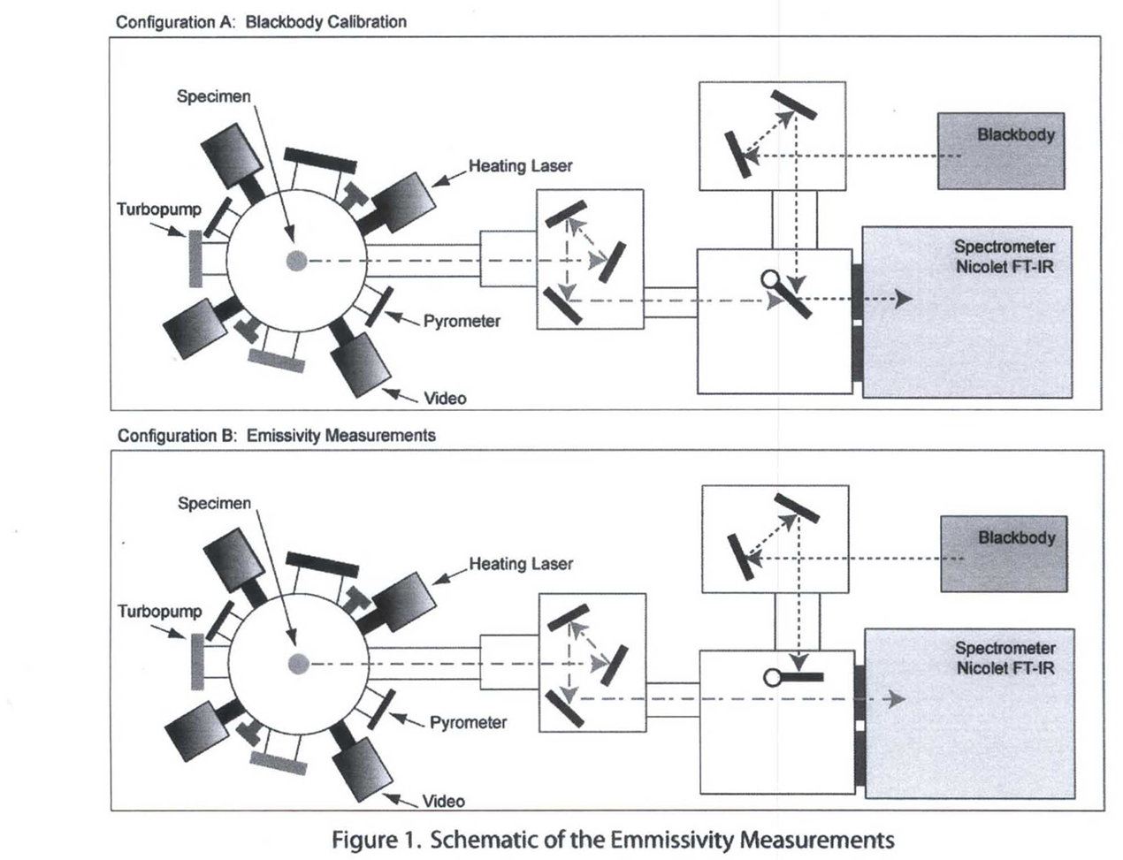
HiTEMS
DISTRIBUTION A. Approved for public release; distribution unlimited.

Slide 7
HiTEMS Tungsten Emittance Tests
HiTEMS tungsten emittance measurements were completed as a follow-up to high temperature molybdenum emittance measurements
Tests were conducted for MSFC ER64 Propulsion Research and Tech Branch
Molybdenum measurements were completed to support the development of new heat transfer correlations to aid in thermal analysis of nuclear rocket fuel elements
During Mo tests:
Tested bead blasted and shiny Mo samples
Discovered change in emittance from HiTEMS test #1 to HiTEMS test #2 for bead blasted Mo
Subsequent HiTEMS tests of tungsten explored this observation with a bead blasted and smooth/shiny sample
DISTRIBUTION A. Approved for public release; distribution unlimited.

Slide 8
Specifications/Outline for Tungsten HiTEMS Tests
ER64-001: Shiny tungsten sample
ER64-002: Bead blasted tungsten sample
ER64-001 test conditions
Test #1: 851 °C to 1,700 °C
ER64-002 test conditions
Test #1: 851 °C to 2,601 °C
Test #2: 849 °C to 2,499 °C
Test #3: 850 °C to 2,503 °C
ER64-001 sample area: 31.77 mm²
ER64-002 sample area: 30.97 mm²
DISTRIBUTION A. Approved for public release; distribution unlimited.

Slide 9
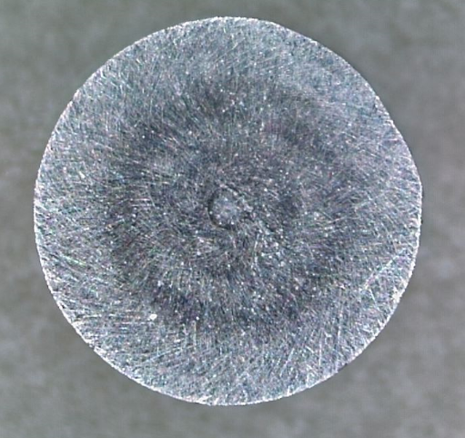
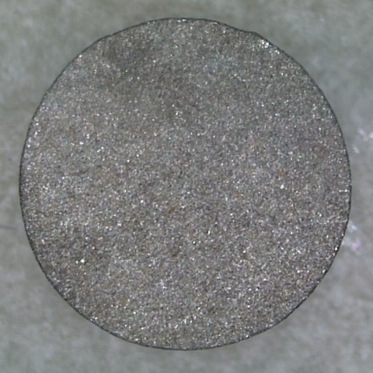
Pre-Test Photos
ER64-001
ER64-002
DISTRIBUTION A. Approved for public release; distribution unlimited.

Slide 10
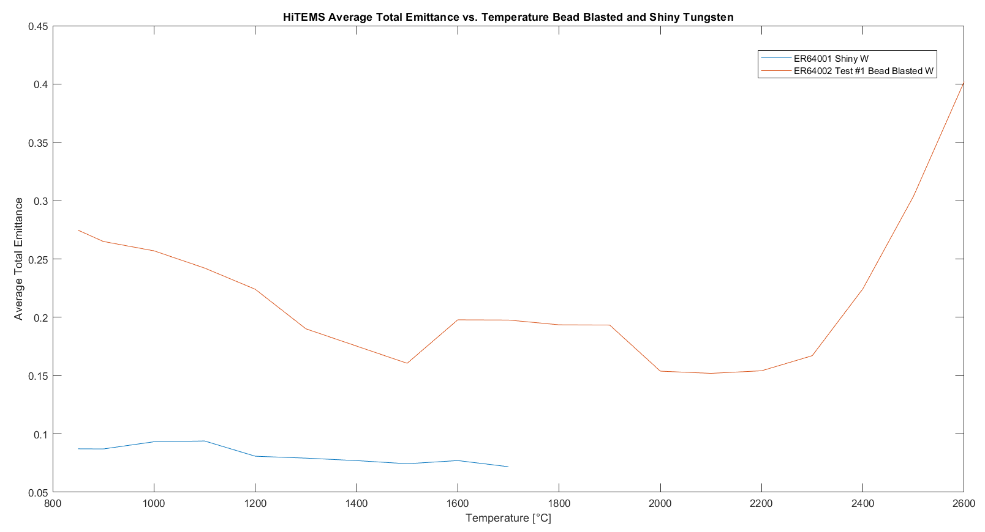
DISTRIBUTION A. Approved for public release; distribution unlimited.

Slide 11
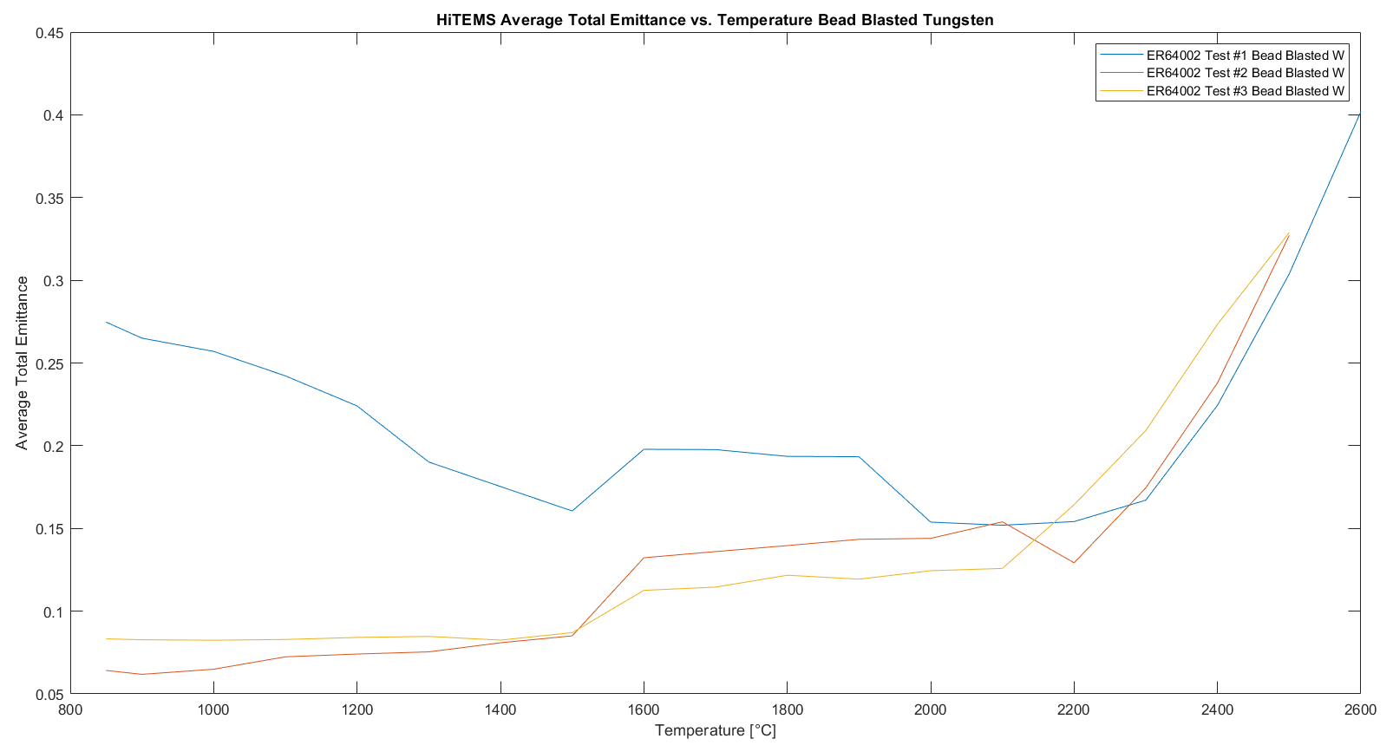
DISTRIBUTION A. Approved for public release; distribution unlimited.

Slide 12
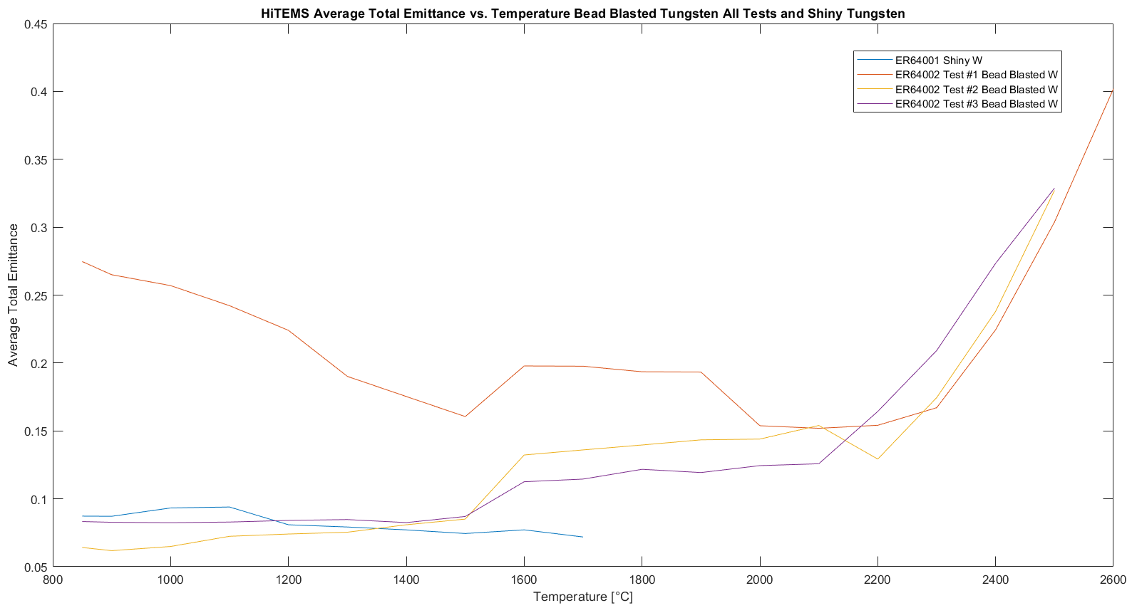
DISTRIBUTION A. Approved for public release; distribution unlimited.

Slide 13
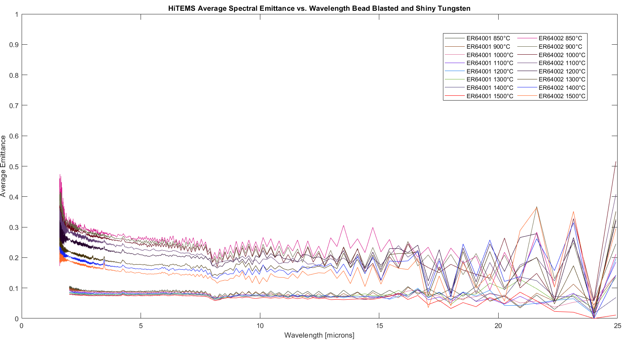
ER64001 & ER64002 Run 1
850°C to 1,500°C
DISTRIBUTION A. Approved for public release; distribution unlimited.

Slide 14
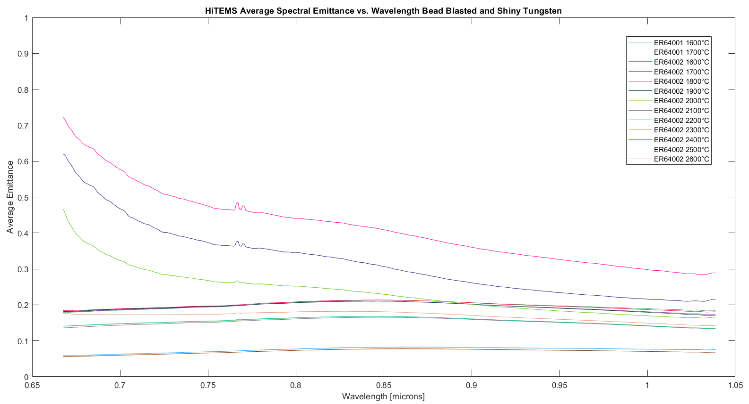
ER64001 & ER64002 Run 1
1600°C to 2,600°C
DISTRIBUTION A. Approved for public release; distribution unlimited.

Slide 15
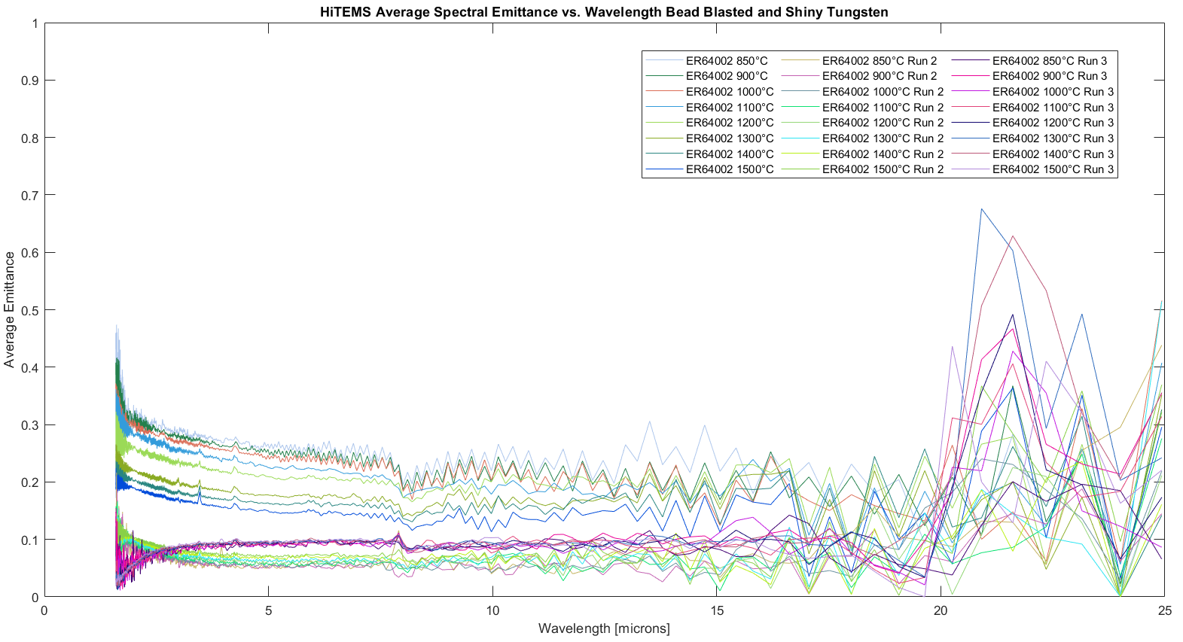
ER64002 All Runs
850°C to 1,500°C
DISTRIBUTION A. Approved for public release; distribution unlimited.

Slide 16
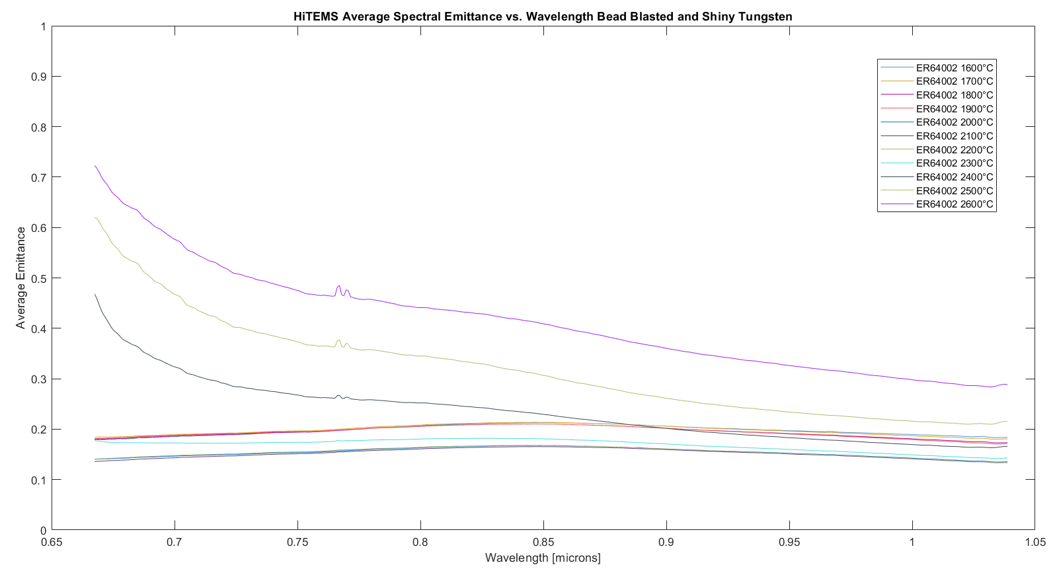
ER64002 Run 1
1600°C to 2,600°C
DISTRIBUTION A. Approved for public release; distribution unlimited.

Slide 17
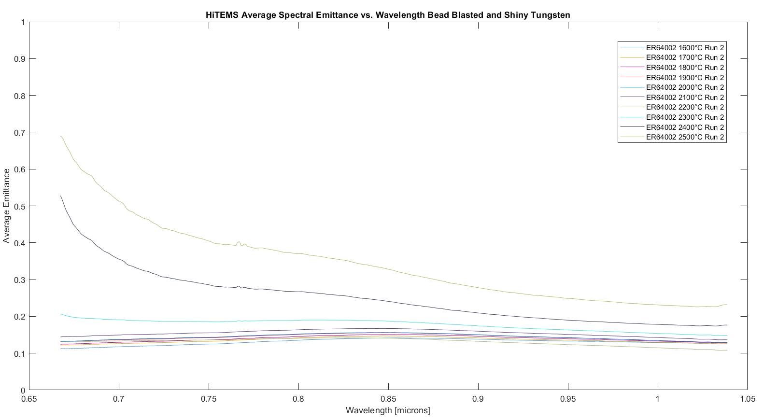
ER64002 Run 2
1600°C to 2,500°C
DISTRIBUTION A. Approved for public release; distribution unlimited.

Slide 18
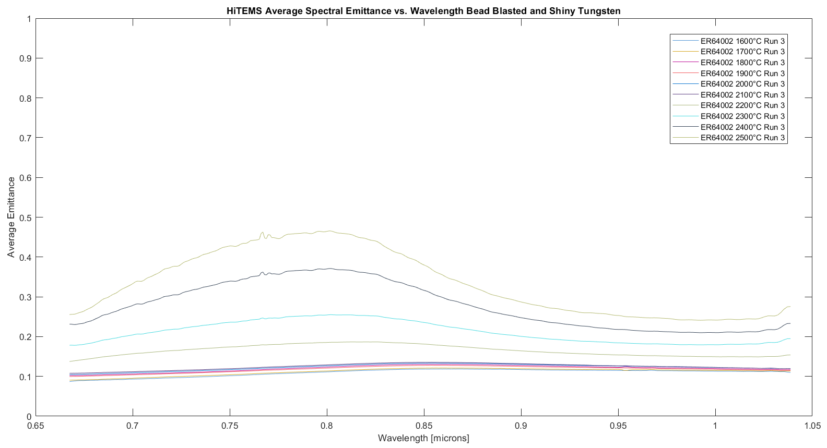
ER64002 Run 3
1600°C to 2,500°C
DISTRIBUTION A. Approved for public release; distribution unlimited.

Slide 19
Observations
As expected, the average total emittance for the first run of the bead blasted tungsten is more than double the shiny tungsten average total emittance
The shiny tungsten average total emittance is similar to the second and third run of the bead blasted tungsten average total emittance
The bead blasted tungsten initial average total emittance drops by more than half from the first run to later runs
The average total emittance for all runs slowly realigns at higher temps
The shiny tungsten spectral emittance is much lower than the spectral emittance from the first run of the bead blasted tungsten
For the lower temperature range, the first run of the bead blasted tungsten spectral emittance is much higher than the following runs
Except for in regions of noise towards the end of the lower temperature range
Not as much variation in the spectral emittance is seen for the bead blasted tungsten through all runs in the high temperature range although the spectral emittance does tend to decrease with each subsequent run
DISTRIBUTION A. Approved for public release; distribution unlimited.

Slide 20
Laser Power
Sample Temperature [°C] | ER64-001 Laser Power Test 1 [W] | ER64-002 Laser Power Test 1 [W] | ER64-002 Laser Power Test 2 [W] | ER64-002 Laser Power Test 3 [W]
850 | 29.7 | 23.6 | 9.38 | 26.9
900 | 33 | 26.3 | 10.3 | 30
1,000 | 40.9 | 33 | 13.3 | 36.3
1,100 | 49.6 | 41.7 | 17.9 | 45.4
1,200 | 59.6 | 51.4 | 24.2 | 55.1
1,300 | 70.8 | 57.2 | 32.7 | 66.2
1,400 | 83.2 | 70.5 | 42.4 | 79.3
1,500 | 97.8 | 83.8 | 55.1 | 94.1
1,600 | 114 | 99.6 | 72.6 | 112
1,700 | 130 | 120 | 99.5 | 132
1,800 | - | 140 | 121 | 158
1,900 | - | 164 | 151 | 185
2,000 | - | 183 | 182 | 215
2,100 | - | 208 | 220 | 249
2,200 | - | 232 | 263 | 286
DISTRIBUTION A. Approved for public release; distribution unlimited.

Slide 21
Laser Power
Sample Temperature [°C] | ER64-001 Laser Power Test 1 [W] | ER64-002 Laser Power Test 1 [W] | ER64-002 Laser Power Test 2 [W] | ER64-002 Laser Power Test 3 [W]
2,300 | - | 263 | 279 | 329
2,400 | - | 297 | 332 | 374
2,500 | - | 340 | 392 | 415
2,600 | - | 387 | - | -
DISTRIBUTION A. Approved for public release; distribution unlimited.

Slide 22
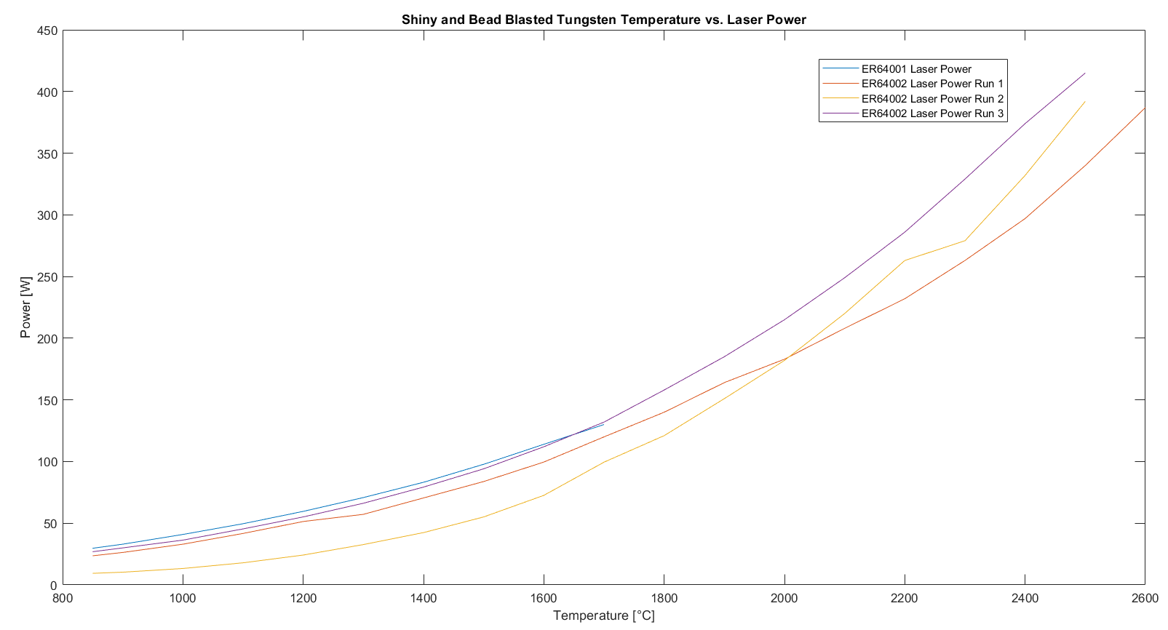
DISTRIBUTION A. Approved for public release; distribution unlimited.

Slide 23
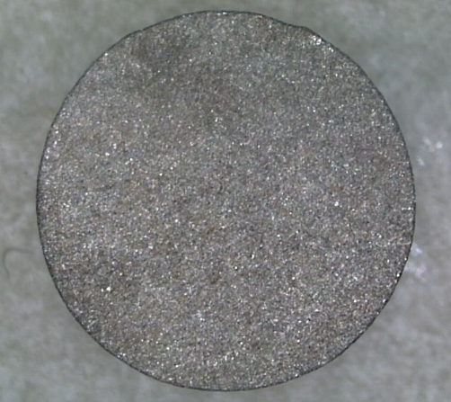
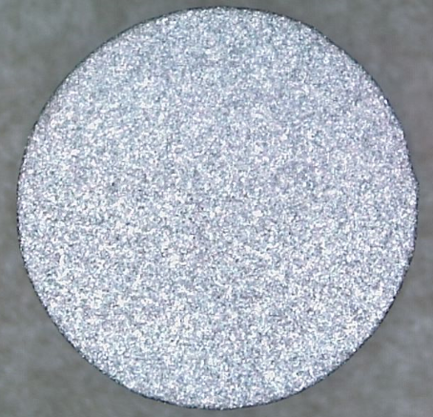
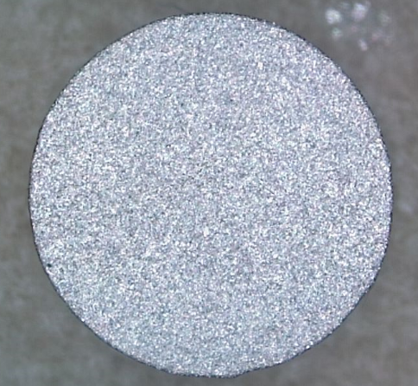
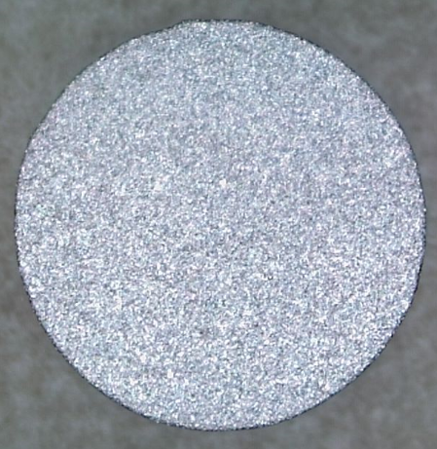
ER64-002 Photo Comparison
ER64002 pre-test
ER64002 post-test #2
ER64002 is visibly more reflective following HiTEMS tests
DISTRIBUTION A. Approved for public release; distribution unlimited.
ER64002 post-test #1
ER64002 post-test #3

Slide 24
Future HiTEMS Enhancements
Starting Summer 2023:
Begin upgrade to a hemispherical emittance capability through remote operation/rotation of the sample mount in-vacuum
Also provides ability to rotate to specific incident angles without re-pressurizing
Near normal still available
Following hemispherical emittance upgrade:
Combine the HiTEMS and Low Temperature Emissivity Measurement System (LoTEMS) systems
Enables the full temperature range from ambient to 2,600°C without interrupting testing
DISTRIBUTION A. Approved for public release; distribution unlimited.

Slide 25
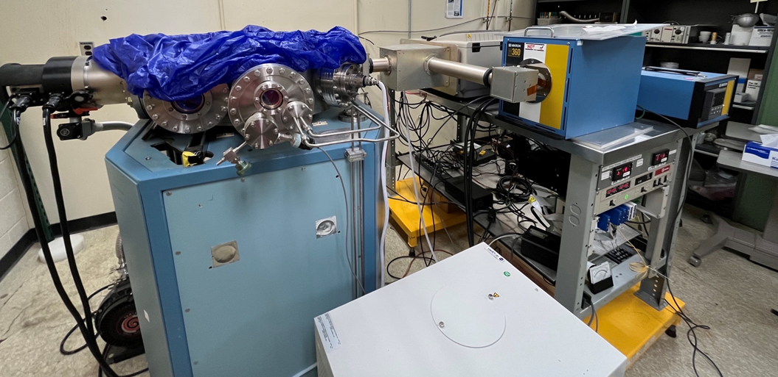
Low Temperature Emissivity Measurement System (LoTEMS)
Not yet operational
Temperature range: ambient to approximately 1,300°C
Utilizes internal contact heating
Measures total and spectral near-normal emittance
Needs mirror upgrade to resemble HiTEMS
Needs Labview and hardware upgrade
DISTRIBUTION A. Approved for public release; distribution unlimited.

