Slide 1
Artemis 1 Ascent Loads Reconstruction Summary
6/27/2023
Lauren Griggs, EV31/ESSCA/DCI
Jake Moseley, EV31/ESSCA/DCI
Jayme Allgood, EV31/ESSCA/DCI
Scott Swatzell, EV31/ESSCA/DCI
Natalie Oliver, EV31/ESSCA/DCI
Austin Decker, EV31

Slide 2
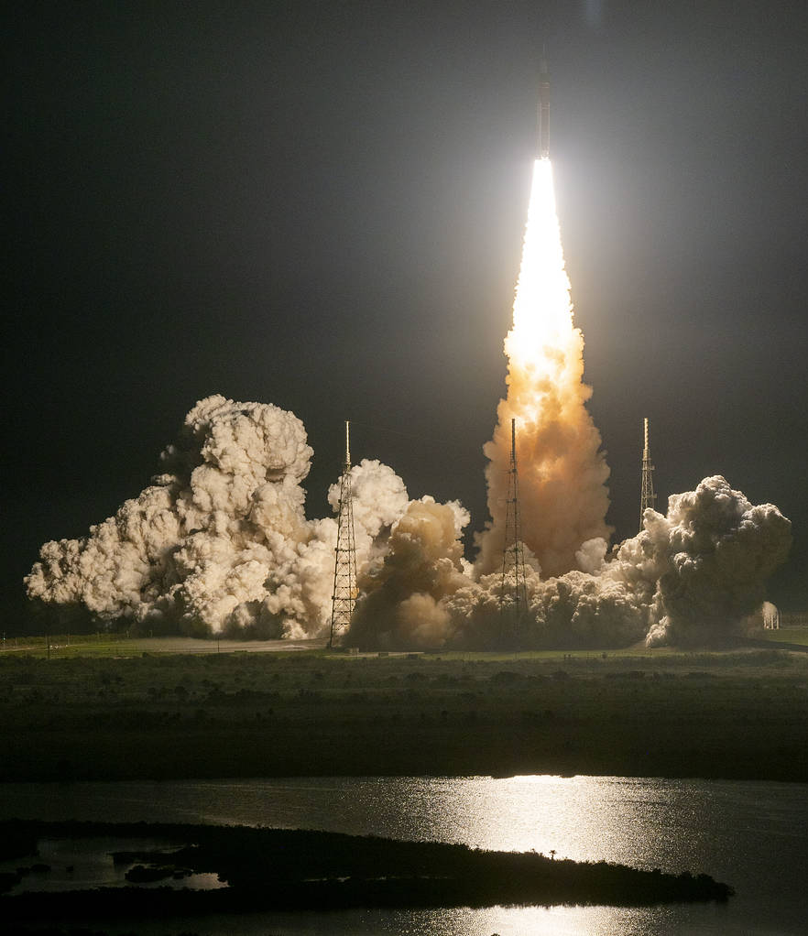
Introduction
On November 16, 2022, NASA successfully launched the Space Launch System (SLS) rocket and Orion spacecraft for the first SLS mission, Artemis 1.
The first flight was instrumented with Developmental Flight Instrumentation (DFI) such as accelerometers, pressure sensors, and strain gauges.
The DFI supported many post-flight activities, one of which is the ascent loads reconstruction effort.
Ascent loads spans both boost and Core phase flight (~ the first 8 minutes of flight). Often, boost phase ascent produces the largest loads experienced by the vehicle during flight.
  Most of today’s presentation will focus on boost phase.
A primary goal of the ascent loads reconstruction effort was to evaluate Coupled Loads Analysis (CLA) design math models, assumptions, and analysis methodologies.
  Today’s presentation will highlight the following:
    Reconstruction inputs: What kind of a day did we fly on?
    Subevent reconstruction: Where possible, all significant ascent subevents have been reconstructed by using flight data, reconstructed inputs, and existing CLA simulations. Comparisons made to DFI where appropriate.
    Combined load reconstruction: Reconstructed combined loads are compared to appropriate DFI and pre-flight predictions.
    Underpredicted flight accelerations: A large amount of work has been dedicated to understanding some measured accelerations that were not predicted pre-flight. This work is on-going, but the current findings will be summarized.

Slide 3
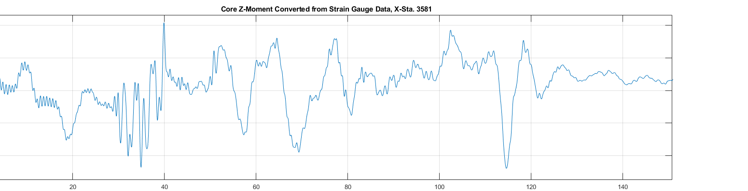
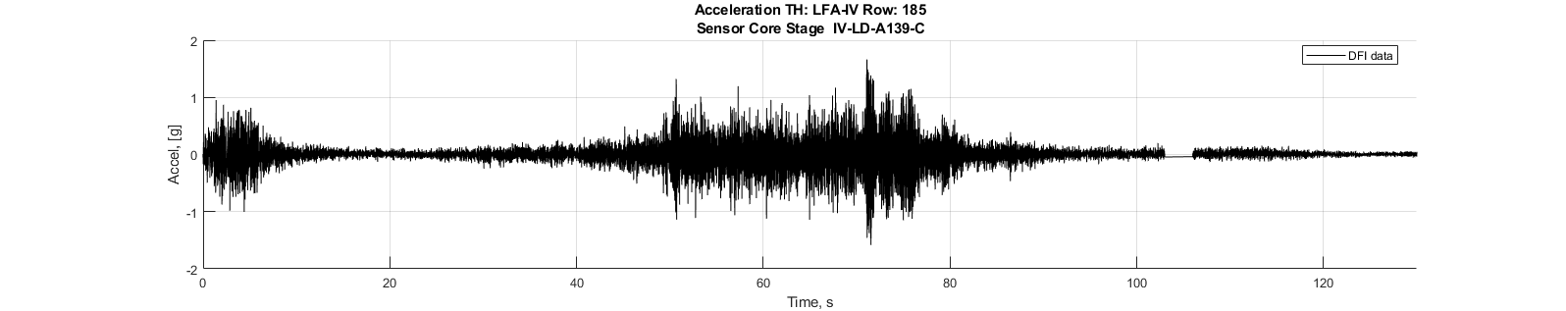
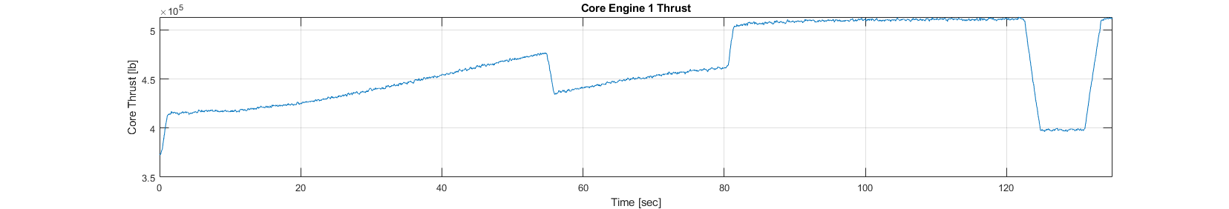
Artemis 1 Boost Phase at a Glance
Two DFI samples are shown below
  Top plot is a Core Z-moment section load (converted from strain data) at a station on the LH2 tank
  Bottom plot is an accelerometer response also in the LH2 tank.
PTI = Programmed Test Input
PTI 25 – 40 sec.
Typical buffet regime: ~40 – 70 sec.
Max Qα_{tot} at 64 sec.
Max Q at 71 sec.
Booster sep at ~131 sec.
There are some DFI responses in the ~70 – 80 sec. timeframe that were not covered by pre-flight predictions that have gotten a lot of attention.
Pre-sep throttle
Max Q throttle bucket

Slide 4
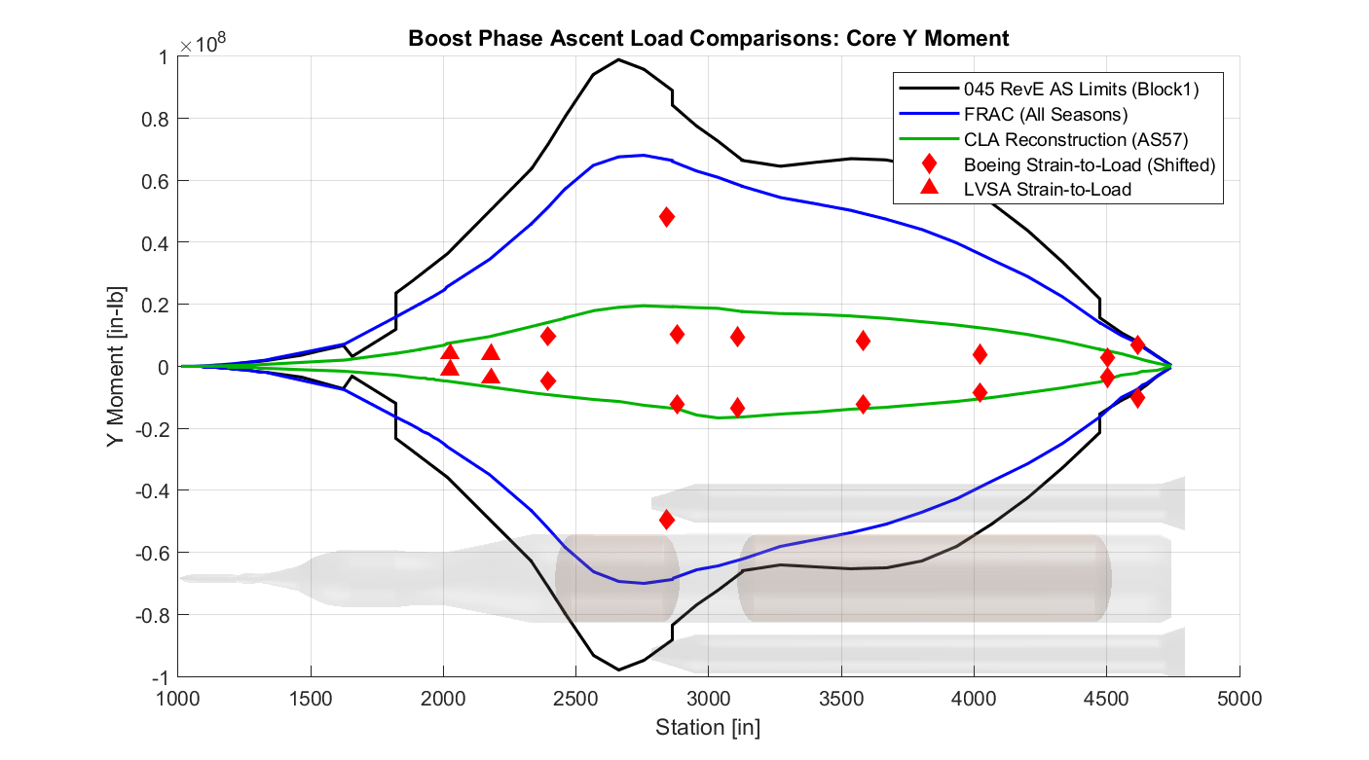
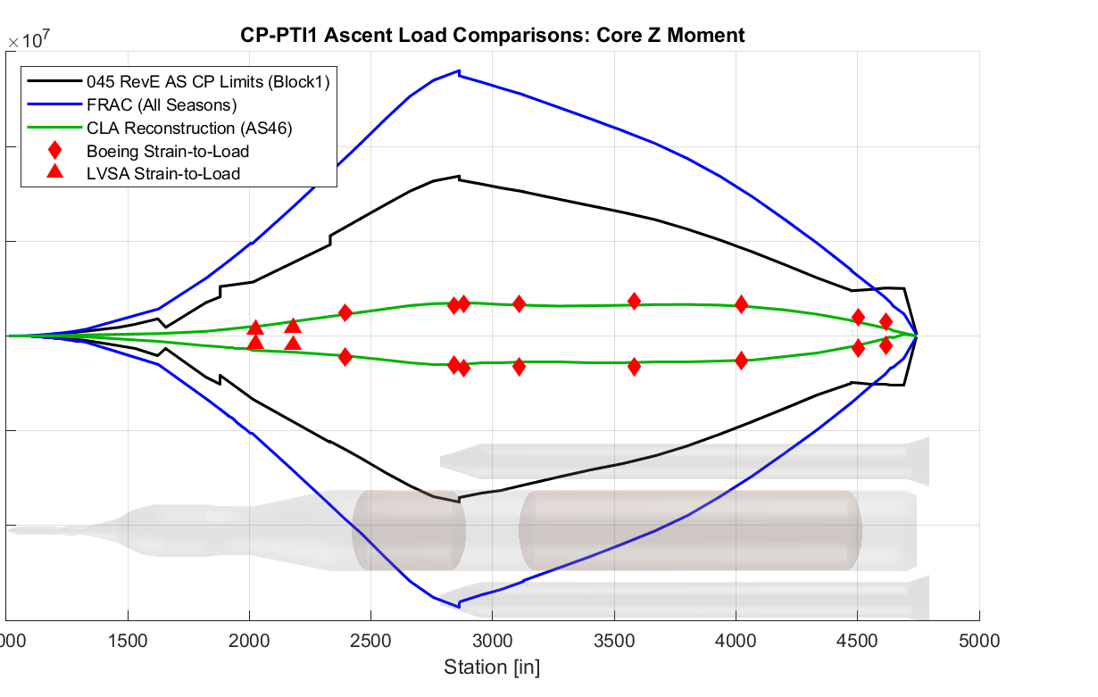
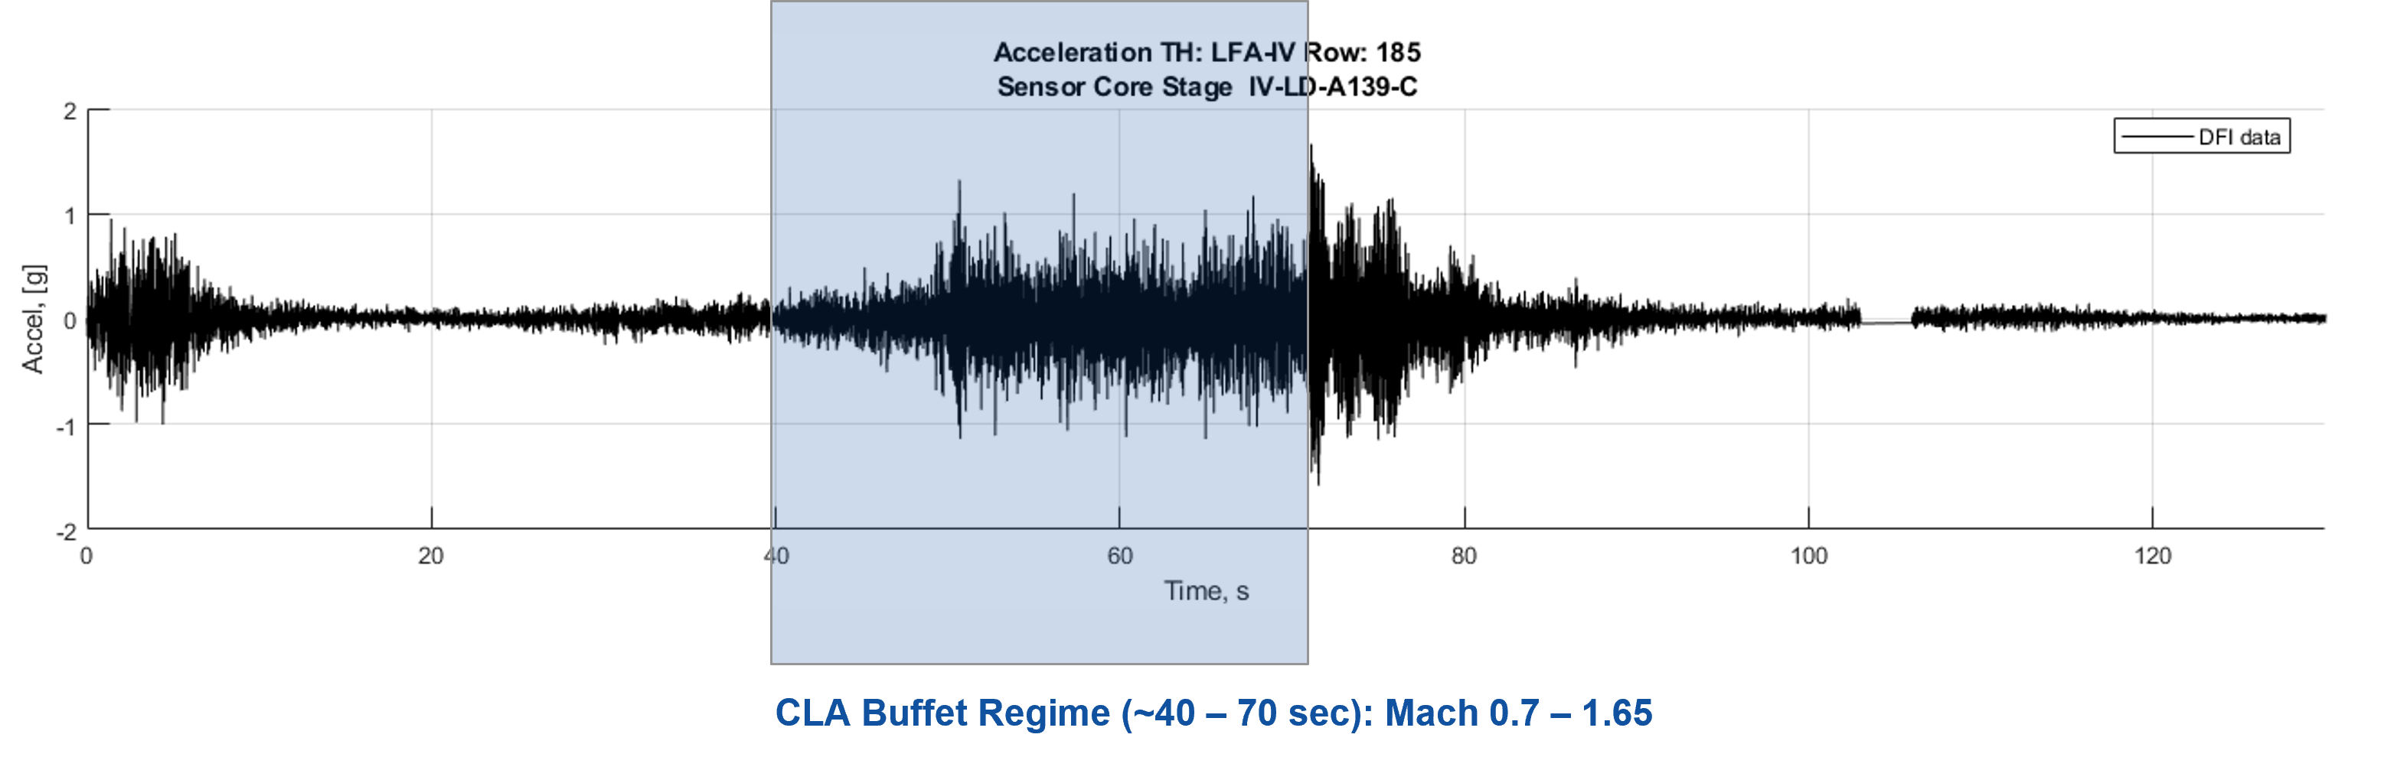
Up Front Summary
The reconstruction of the Artemis 1 ascent section loads was very successful.
  Matched DFI very well
  Showed that Artemis 1 flew well within design loads
The biggest challenge of the reconstruction has been identifying the source of > 20 Hz accelerations that were outside of pre-flight predictions.
  Loss of buffet sensors further complicates the reconstruction effort.
  Work is ongoing.
Boost phase section load example:
Core phase section load example:
Post FRAC, the core phase PTIs were reduced, this reduction is not shown in the FRAC curves.
Suspicious DFI.

Slide 5
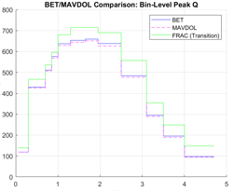
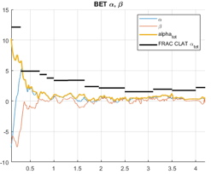
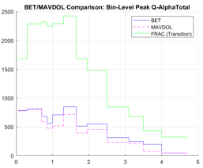
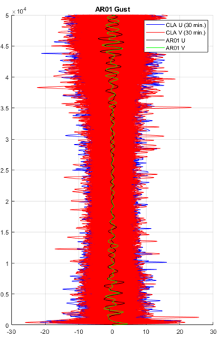
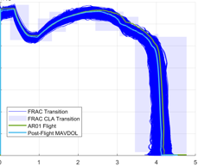
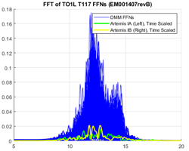
Inputs
Overall, Artemis 1 flew in relatively benign conditions relative to design input levels.
  Dynamic pressure (Q) and angles of attack (α) and sideslip (β) were well with design levels.
  Wind gusts also fell well within the pre-flight database.
  Booster thrust was on the high side of the pre-flight population for the appropriate season.
    Expected because L-1 day PMBT was close to the top of the November range.
  Reconstructed Booster thrust oscillation forcing functions fell well within the pre-flight population.
Flight Max Qα_{total} = 0.35x FRAC at 64 sec.
Flight Max Q = 0.92x FRAC at 71 sec.
AR01 Gust (Alt. vs. Wind Speed)
Booster Thrust vs. Mach No.

Slide 6
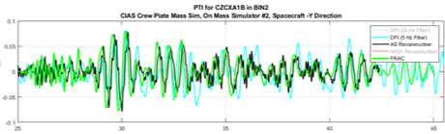
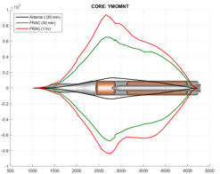
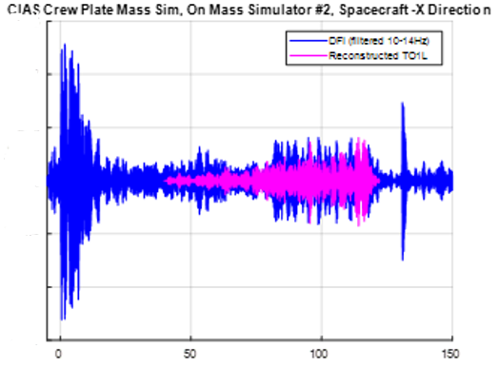
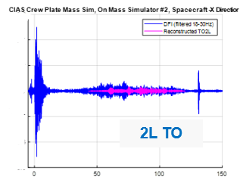
Reconstructed Subevent Loads
The Ascent CLA typically runs subevents (e.g. buffet, gust) separately that are later combined with a Loads Combination Equation (LCE).
Reconstruction/actual flight is never quite as simple because subevents often can not be separated out.
However, most of the significant subevents were successfully reconstructed and compared to DFI. Resulted in no significant changes needed to future CLA subevent analyses.
  Note that buffet is still in work.
PTI:
Not a dispersed analysis; pre-flight should match flight.
Although DFI and reconstruction curves can include some effects of flight-mechanics and/or gust loading, all three curves match well, particularly the max/min values.
Gust: As expected, the reconstructed gust loads fall well-within pre-flight design levels.
Booster Thrust Oscillation (TO): Outside of the buffet regime, 1L and 2L compared to DFI axial accelerations favorably. 2L TO was much lower than the DFI lateral accelerations; this is related to underpredicted accelerations that will be discussed in coming slides.
Core Y-Moment
1L TO
2L TO

Slide 7
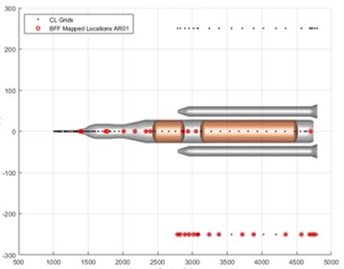
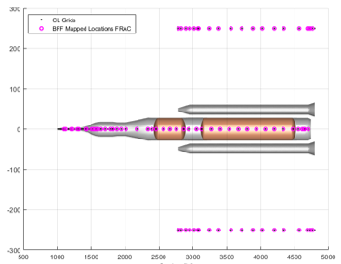
Background of Reconstructed Buffet Forcing Functions (BFFs)
Many of the Artemis 1 buffet sensors were iced over during flight.
  Most icing issues were on the Core LOX and LH2 tanks.
  BFFs were provided for the loads reconstruction effort only where data was available.
Provided Artemis 1 BFFs were mapped to the FEM:
  0 stations on the RSRB
  12 stations on Core
  16 stations on the LRSB
Contrast above to what is available with the wind tunnel based pre-flight BFFs used in the CLA:
  19 stations on the RSRB
  48 locations on Core
  19 stations on the LSRB
BFFs mapped to RSRB (0)
BFFs mapped to Core (12)
BFFs mapped to LSRB (16)
BFFs mapped to RSRB (19)
Because the available reconstructed BFFs were so sparse, they were not included directly in the reconstructed loads. They were, however, used to study trends and evaluate the buffet analysis methodology where possible.
BFFs mapped to Core (48)
BFFs mapped to LSRB (19)

Slide 8
Reconstructed Boost Phase Ascent Loads
Reconstructed loads:
  Straight-add LCE
  “MNVR” sim results (really just means flight-mechanics with dynamics)
    Main input is the Best Estimated Trajectory (BET)
    BET alpha/beta includes response to wind gusts >~1500’ (460m)
    Reconstructed gimbal angles and Core thrust provided by Vehicle Management (VM)
      Gimbal angles include PTI
    Reconstructed booster thrust
    Reconstructed mass properties
    Reconstructed base drag
    No new aero line loads
    Reconstructed Booster TO for 1L & 2L
  All other components are based on pre-flight data and are at a mean level in the LCE:
    Pre-flight turbulent gust filtered to only have content <1500’ (subset of cases)
    Tuned gust
    3L Booster TO
    CSE TO
    Buffet
      This is the most significant missing piece of the reconstruction. Because the measured buffet data was incomplete, the reconstruction curves include the following for buffet: Pre-flight buffet Q and V-scaled to the BET and included at a mean level in the LCE. Includes all α/β conditions up to 4 deg.
    No Thrust Vector Misalignment (TVM) or Thrust Vector Offset (TVO); some TVM might be included in reconstructed gimbal angle

Slide 9
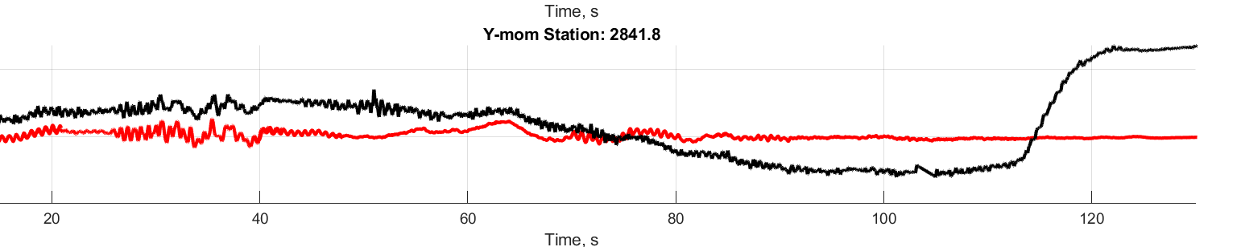
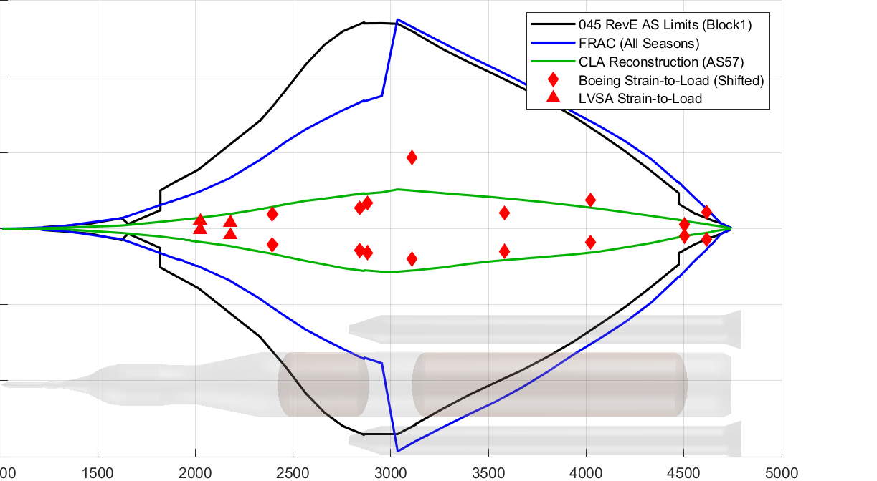
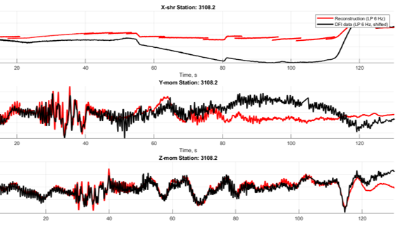
Combined Boost Phase Reconstructed Loads
Axial and bending moments from the DFI strain data compared well to the reconstructed loads.
  Axial in backup.
  Some deviate; worse later in flight where loads are much lower.
  Reconstructed loads are well within pre-flight design.
Boost Phase Core Y-Moment
Load from strain data looks odd
Boost Phase Core Z-Moment
Compares nicely until end

Slide 10
Underpredicted Flight Accelerations
Some Artemis 1 measured accelerations exceeded pre-flight predictions.
  Higher than expected accelerations are present all along the vehicle.
    Intertank and aft of the forward attach areas have the highest measured accelerations.
  ~70 – 80 sec. in flight (~Mach 1.6 – 2)
  Measured accelerations are generally dominated by a ~25 Hz response.
  Often, the large accelerations are occurring at the tail end of the buffet CLA regime (Mach 1.65) and continuing for ~10 sec.
Although these accelerations exceed design levels, the exceedances are at frequencies > 20 Hz; it does not appear that primary structure loads are affected.
Among other things, buffet frequency content aft of the Booster-Core forward attach is being inspected as a possible source.
  2L TO was also considered as a source but was ruled out by the reconstruction analysis.
CLA Buffet Regime (~40 – 70 sec): Mach 0.7 – 1.65

Slide 11
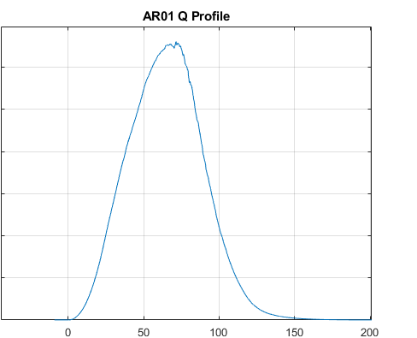
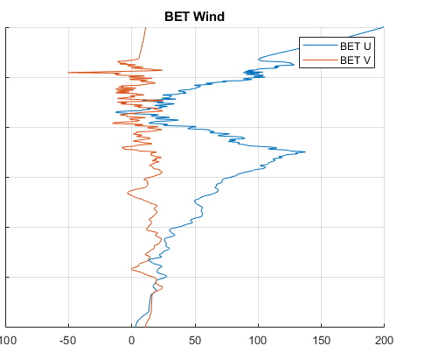
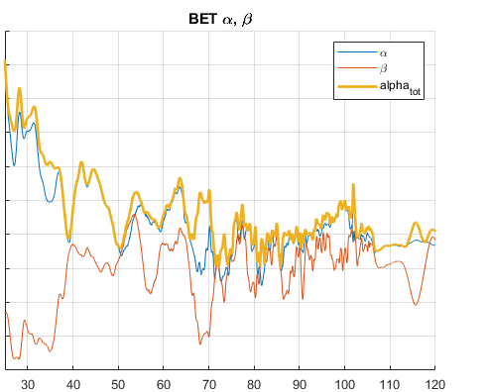
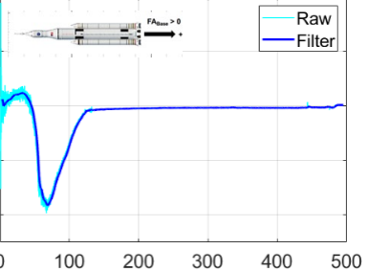
Things that happened at ~70 sec.
Some reconstructed buffet shows there is still content at 70 sec.
Max Q occurred around 70 sec.
DFI responses at ~70 sec. have prompted a lot of investigative work across multiple disciplines.
It does appear that there might have been some higher frequency buffeting going on in this timeframe; however, there are several other things that also happened at this time in flight.
Sample Flight Buffet Forcing Function
Investigations regarding buffet are still in work (joint environments/loads effort).
Included in flight-mechanics portion of reconstructed loads.
Core base force peaked at ~70 sec and is opposite in sign from pre-flight predictions at this time.
Peak winds experienced around 70 sec.
Relatively large dip in β angle at ~70 sec
Reconstructed Core Base Force
Included in flight-mechanics portion of reconstructed loads.
Included in flight-mechanics portion of reconstructed loads.
Raw has since been analyzed and resulted in no significant increase in response.

Slide 12
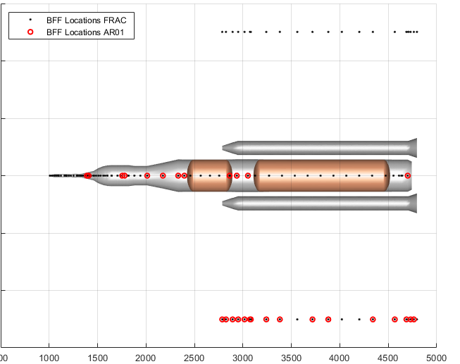
Buffet Frequency Content
Buffet is generally a broadband forcing function that drives CLA responses from 0 – 50 Hz.
  However, aft of the forward attach, both DFI and pre-flight BFFs show that the nature of the forcing functions changes to be more narrowband with content in the 25 Hz range.
  Aft of the attach, on the boosters, is also an area that drove large Intertank responses with the model FRFs.
  Additionally, the pre-flight forcing function did not always accurately predict the frequency of the peak.
    Note that a 0 deg Mach 1.18 pre-flight BFF is being compared to a post-flight reconstructed BFF; therefore, angle of attack and Mach no. (two important factors) are not identical.
      Mach no. is particularly off at this time. Reconstructed BFF PSD is for Mach 1.3 – 1.65. Pre-flight BFF is Mach 1.18.
      V-scaling methodology also shifts frequencies of the BFFs.
Reconstructed BFF
Pre-Flight BFF
Y forces
Z forces
Z forces
Y forces

Slide 13
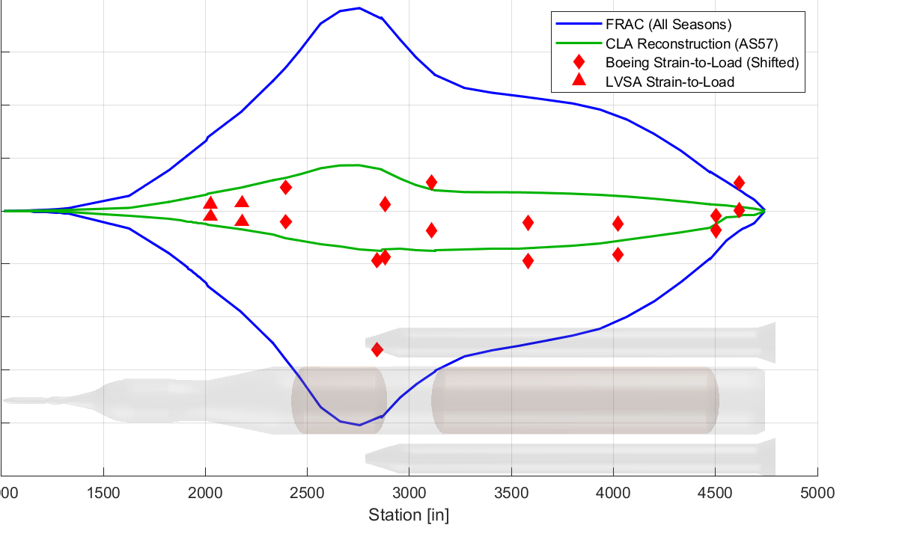
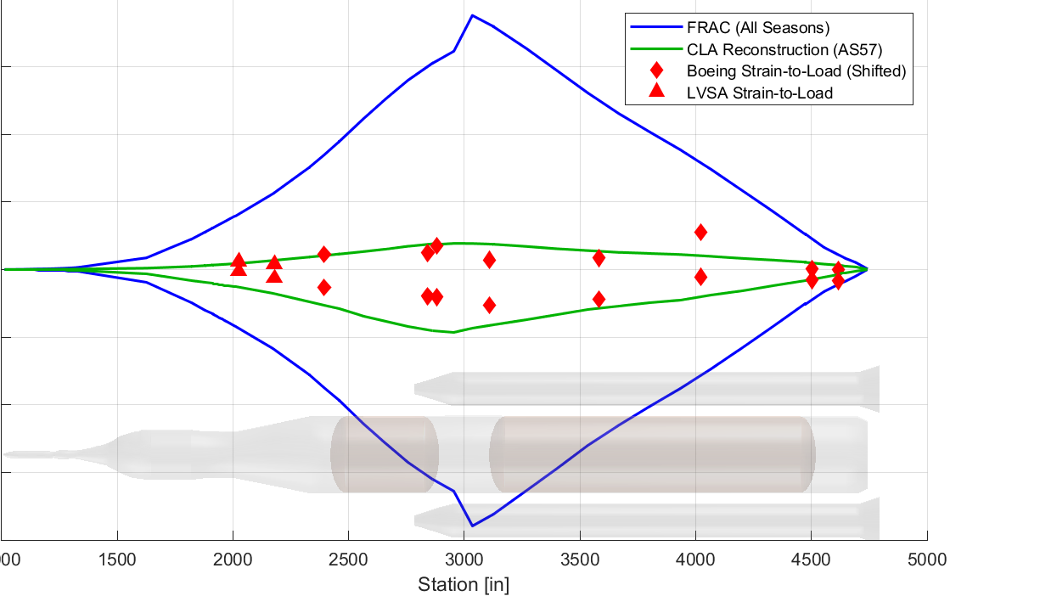
Mach Bin 7 Section Load Comparisons
Although it appears that the vehicle experienced higher than predicted accelerations in the 70 – 80 sec. timeframe, the reconstructed section loads in this timeframe (Mach bin 7) matched the DFI well.
  Indicates that primary structure is not affected.
  Recall that the reconstructed loads include a version of the pre-flight buffet at a mean level.
Boost Phase Mach Bin 7 Core Y-Moment
Boost Phase Mach Bin 7 Core Z-Moment

Slide 14
Summary
Today’s presentation outlined the ascent loads reconstruction effort for the Artemis 1 flight.
  A primary goal of the reconstruction effort was to assess analysis inputs and methodologies.
The Artemis 1 flight day conditions were very benign
The ascent loads reconstruction compared favorably to both DFI and pre-flight design loads.
  No significant deficiencies noted in analysis inputs or methodologies for primary structure loads.
Some measured flight accelerations > 20 Hz did exceed design.
  Does not appear to affect primary structure loads.
  This issue is still being worked from different angles by several different disciplines.
  Among other things, buffet frequency content aft of the Booster-Core forward attach and related analysis methodologies are being inspected as possible sources.

Slide 15
BACKUP

Slide 16
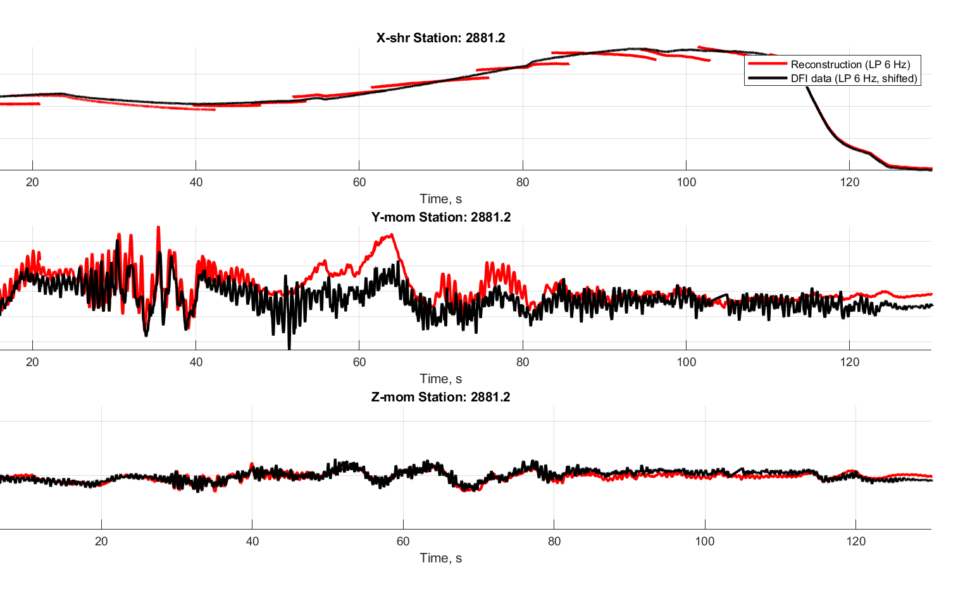
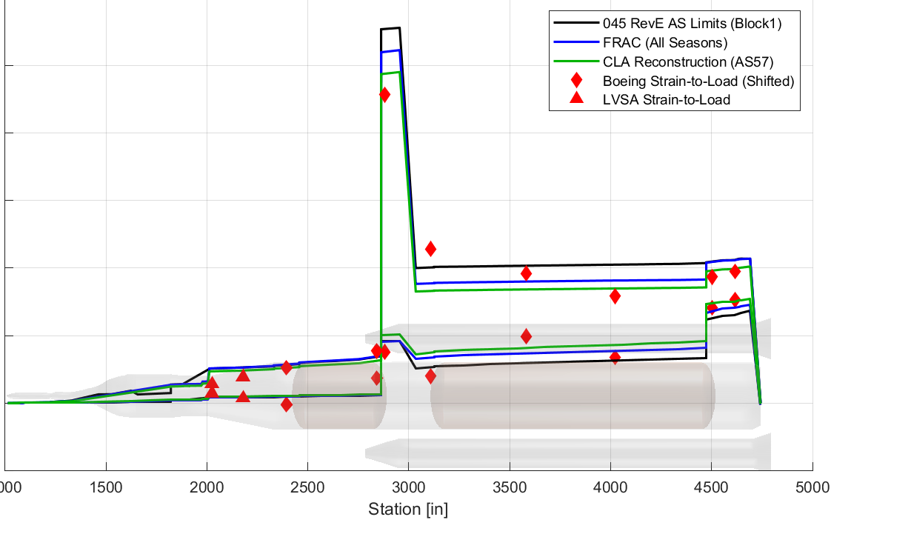
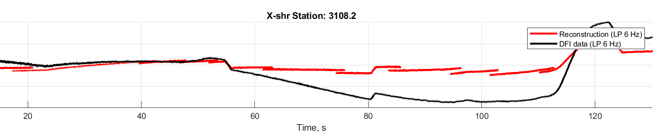
Boost Phase Envelope – Core Axial Load
In general, reconstructed Core axial loads matched the DFI well.
  Reconstructed Core axial loads were enveloped by both FRAC and -045.
Matches reconstruction (steady-state)
Boost Phase Axial Load
Reconstructed time history curve does not include buffet
Deviates from reconstruction during throttle down

