Slide 1
Artemis Vehicle Battery Requirements and Processes
JSC/EP5 Battery Group
May 16, 2023

Slide 2
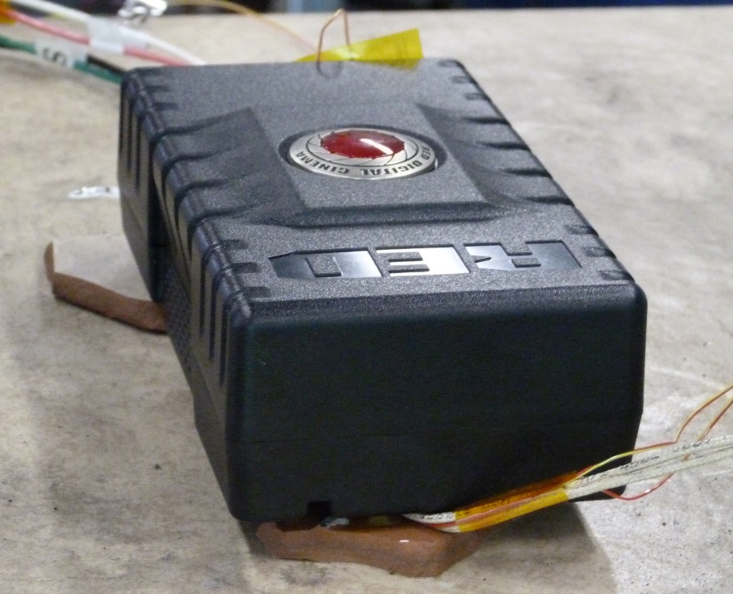
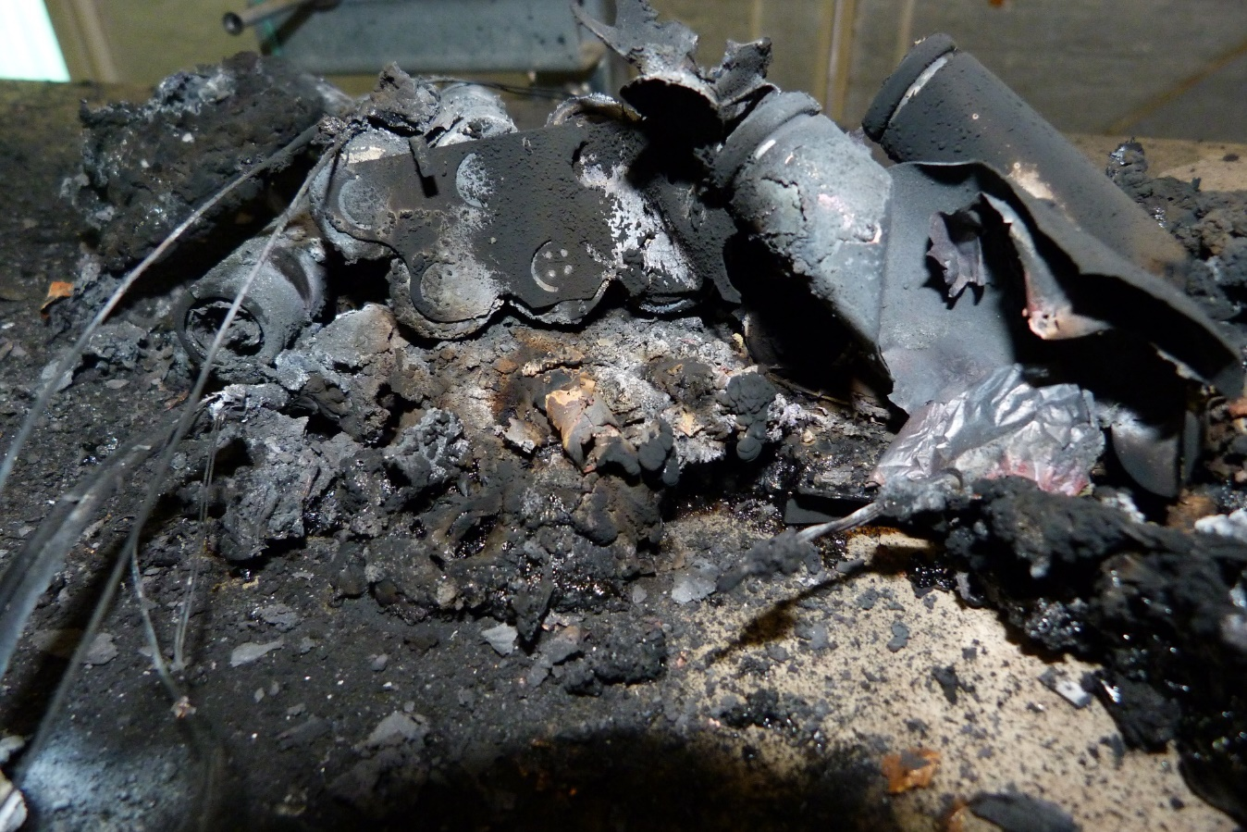
Purpose
Give an overview of cells, batteries and design features for safety
Show what the hazards are for flying batteries in crewed space vehicles
Show how to control the hazards of batteries and verify that they are functioning as expected
Contact Information
Success of batteries being approved for flight is improved by talking with JSC Battery Safety Group early in the development of hardware
Battery Development Flow (from JWI 8705.3)
Battery Design
Battery design based on application
Battery Evaluation
Determine assigned EP Battery Reviewer
Battery requirements and hazard controls per JSC 20793 guidelines
Cell screening or battery pack screening plan per JSC 20793 guidelines
Pre-flight, on-orbit, and post-flight processing plans
Battery Description Form Attachment Review
Battery Testing
Engineering level tests
Flight cell and battery qualification/certification testing
Flight cell and battery lot testing
Flight cell and battery pack acceptance testing
We don’t want batteries like
this
to end up like
this!
Battery Approval
GFE and payload hardware via ISRP/SRP/EP using Unique Hazard Report (UHR)/SDP
Ground use or test hardware information documented via Battery Description Form

Slide 3
Definitions and Requirements
Commercial Off-the-Shelf (COTS) Cells and Batteries
  The manufacturing process of industrial COTS batteries is not suitable for manned space application
  Therefore, attention must be payed to identify cell manufacturing defects that could create safety hazards or create performance issues
  Testing must be performed at the cell level and battery level
Battery Definition
  One cell or a packaged or unpackaged assembly of two or more cells that provide stored electrical energy. Specific design and verification requirements for a battery are dependent upon:
  Chemistry, capacity, complexity, charging, environment, and application
  Variety of battery chemistries available, combined with the variety of battery-powered applications, results in each battery application having specific, unique requirements pertinent to the specific battery application.
Requirements
  JSC 20793, Crewed Space Vehicle Battery Safety Requirements contains the detailed design information for all batteries on crewed spacecraft, including vehicle, payload, and crew equipment batteries
  Separate sections include:
    Section 4, General Battery Requirements: Basic requirements for all battery designs and applications
    Section 5, General Battery Hazards and Controls: Description of hazards and controls and also includes requirements
    Section 6, Safety Relevant to Specific Battery Chemistries: Chemistry-specific information. No requirements appear in this section, only best practices.

Slide 4

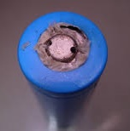
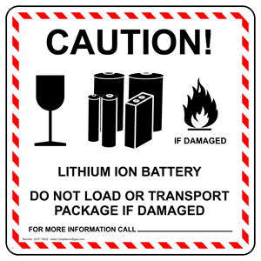
General Battery Hazards
All batteries are inherently hazardous
  Some have greater hazard potential/consequences than others
  If untested, the likelihood of having a hazardous battery increases
  Industry is not infallible in their battery designs and generally not directly suitable for space flight
Battery hazards
  Leaking or venting of flammable gases and electrolyte
  Corrosive or toxic gasses and reaction products
  Fire
Hazard causes
  Over-temperature, internal and external shorts, reverse current, cell reversal, leakage, and overpressure
Electrical, mechanical or environmental abuse could cause internal cell pressure build-up that leads to rupture of battery, leakage of electrolyte, venting, fire or explosion with potential injury to the crew, or damage to equipment, vehicle or other crewed space environment.
Validation of hazard controls are necessary
Determine if battery/cells are healthy to fly

Slide 5
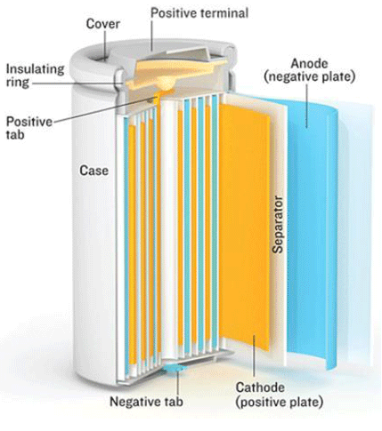
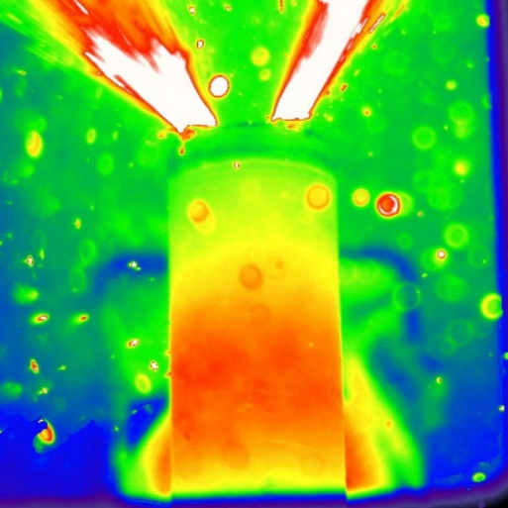
Battery Design Considerations
Batteries aren’t certified!
Applications or systems that use batteries are certified!
Chapter 6 of JSC 20793 discusses hazard and best practices for all chemistries
Two failure tolerance is required for all catastrophic hazards and vary based on cell chemistry
Battery hazards that must be controlled
  Overcharge (or charging of a primary battery)
  Overdischarge (or recharge of an overdischarged battery)
  External Short (reversal)
  Internal Short
  Temperature extremes
Controls must be verified via test when applicable
100% Acceptance Testing is required at the cell and/or battery level
Qualification Testing is required design meets minimum safety requirements
  Safety (Abuse) Tests – Verifying hazard controls for the above as well as Thermal
  Runaway Propagation tests for batteries larger than 80 W-hr
  Vacuum, Vibration and Thermal Tests
  CT Scan and Destructive Physical Analysis (DPA)
Verification of the requirements can be adjusted by NASA, based on battery and application design as needed to meet the intent of JSC 20793
Typical 18650
18650 TR Test

Slide 6
Battery Classifications
Important: Battery classification should be correctly identified as soon as possible to determine necessary testing!
JSC 20793 | SSP 51721 & JWI 8705.3 | Definition
Non-Critical | Low BRC | Lowest level of hazard control that is reserved for low energy cells and battery designs for which standard emergency procedures are written and practiced
Critical | Medium BRC | Typically manufactured in high volumes for the consumer Have commonly available means to help determine the reliability and safety of the products. Due the consequence of a failure, these End Items will follow a comprehensive test and validation plan
Catastrophic | High BRC | Typically custom, high energy, or high power designs Due to the extreme consequence of a failure, these End Items will follow a comprehensive test and validation plan that includes testing to determine the result of single cell thermal runaway Analysis of the thermal runaway can lead to a redesign of the battery to mitigate the consequence.
BRC – “Battery Risk Classification” is defined in the JWI 8705.3 along with JSC 20793 Revision E (draft) and any future updates to battery procedures and guidelines The terms “non-critical”, “critical” and “catastrophic” described above differs in context and are not to be confused with the ISRP hazard severity definitions as defined within SSP 30599, SSP 50021, and SSP 51700.

Slide 7
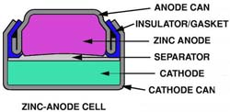
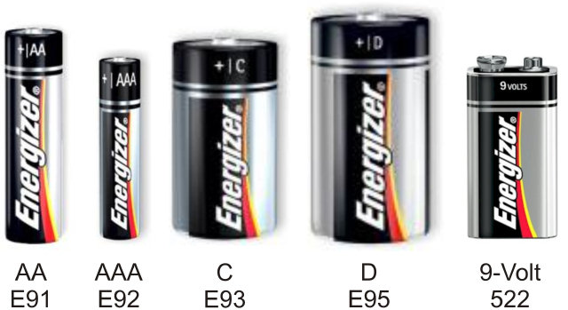

Low BRC Batteries
Lowest level of hazard control that is reserved for low energy cells and battery designs for which standard emergency procedures are written and practiced
Batteries within this ‘Low BRC’ or “Non-critical” classification shall be:
  Low energy < 4 Watt-Hours (Wh) per battery pack where each battery is thermally and electrically isolated (or < 60Wh for Alkaline Primary Batteries) where Wh = Cell Capacity (Ah) × Cell Voltage (V), and
  Rated with a Toxicity Hazard Level (THL) of 1 or 2, and
  Contained within a not intentionally sealed compartment, and
  Meet one of the following criteria based on battery chemistry:
    Alkaline Primary Batteries (meets all five):
      Non-rechargeable cells in sizes D or smaller and,
      Maximum of 12 V and/or 60 Wh and,
      Cells either all in series or all in parallel and,
      No potential charging source and,
      Cells located in a vented compartment
      Note: Silver oxide cells are also considered alkaline chemistry.
    Lithium-ion Secondary Batteries – COTS (rechargeable) lithium-ion button, cylindrical, or pouch batteries of up to 1000 mAh capacity.
    Lithium Primary Batteries – COTS (non-rechargeable) lithium button cells (i.e., Li-MnO2, Li-CFX and LiFeS2) of up to 1000 mAh capacity. (Energizer only AA and AAA Lithium (LiFeS2) cells are now considered low BRC)
    Nickel Cadmium Batteries – Nickel-cadmium (rechargeable) batteries and cells of up to 1000 mAh capacity.
    Nickel-Metal Hydride Batteries – Nickel-metal hydride (rechargeable) batteries and cells of up to 1000 mAh capacity.
    Silver-Zinc Batteries – Silver-zinc (rechargeable) batteries and cells of up to 1000 mAh capacity.
    Zinc-Air Primary Batteries – Zinc-air (non-rechargeable) batteries and cells of up to 1000 mAh capacity.
    Note: For primary cells, rated cell capacity is defined as the maximum stated capacity per cell product data sheet

Slide 8
Low BRC Battery Hazard Reports
Requirement: Low BRC Batteries shall meet manufacturer’s specifications
Use Low BRC Template HR (CP Hazard # 10409)
  This template is intended to be used for cells/batteries that are considered "non-critical"* per JSC 20793, Rev. D. The Battery Risk Classification (BRC) per JWI 8705.3 is "low."
Cause: Battery Leakage/Rupture Due to Improper Workmanship
  Cause Description: Poor quality control of the cell manufacturing process that can result in electrolyte leakage, fire, and thermal runaway.
  Cause Remarks:
    Controls/verification methods noted within "Ctl-1" or "Ctl-2" (either approach is sufficient; only one control approach required) are to be used for cells/batteries procured/provided by the provider directly.
    Control/verification method noted in "Ctl-3" is to be used for cells/batteries provided by the Program provided as Contractor Furnished Equipment (CFE) by the CMC-2 contract.
  Controls:
    Ctl-1: Provider Supplied/Procured Cells/Batteries: UL Certification using Battery Regulations
    Ctl-2: Provider Supplied/Procured Cells/Batteries: Flight Acceptance Testing
    Ctl-3: Program Provided Cells/Batteries: Use of Contractor Furnished Equipment (CFE) Within Certified Limits/Application
HR Battery Description Form
  Will be attached to the unique HR and is available as an attachment to the template

Slide 9
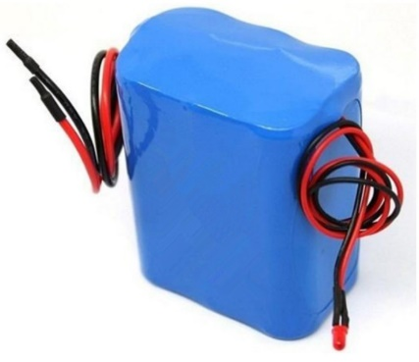
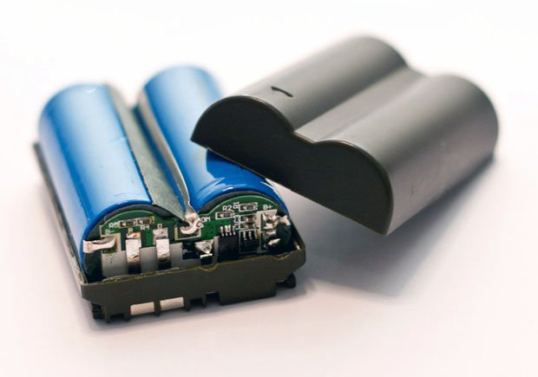
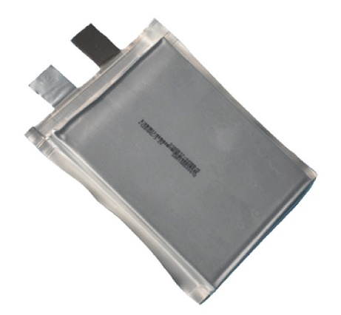

Medium BRC Batteries
Intermediate level of risk classification requiring single fault tolerance typical of commercial devices manufactured in high volumes for the global consumer
Batteries within this “Medium BRC” or “Critical” classification do not meet the ‘Non-Critical’ classification and shall be:
  Energy levels < 80 Wh per battery pack where each battery is thermally and electrically isolated (or > 60Wh for Alkaline Primary Batteries) where Wh = Cell Capacity × Cell Voltage, and
  Rated with a THL of 1 or 2, and
  Contained within a not intentionally sealed compartment, and
  Meet one of the following criteria based on battery chemistry:
    Alkaline Primary Batteries (meets all five):
      Non-rechargeable cells in sizes D or smaller and,
      Greater than 12 V and/or 60 Wh and,
      Cells either all in series or all in parallel and,
      No potential charging source and,
      Cells located in a vented compartment
      Note: Silver oxide cells are considered alkaline chemistry.
    Lithium-ion Secondary Batteries – COTS (rechargeable) lithium-ion button, cylindrical, or pouch batteries > 1000 mAh capacity and ≤ 20 V.
    Lithium Primary Batteries – COTS (non-rechargeable) lithium button cells (i.e., Li-MnO2, Li-CFX and LiFeS2) > 1000 mAh capacity and ≤ 20 V.
    Nickel Cadmium Batteries – Nickel-cadmium (rechargeable) batteries and cells > 1000 mAh capacity.
    Nickel-Metal Hydride Batteries – Nickel-metal hydride (rechargeable) batteries and cells > 1000 mAh capacity.
    Silver-Zinc Batteries – Silver-zinc (rechargeable) batteries and cells > 1000 mAh capacity.
    Zinc-Air Primary Batteries – Zinc-air (non-rechargeable) batteries and cells > 1000 mAh capacity.

Slide 10
Medium BRC Battery Hazard Reports
Requirement: Medium and High BRC Batteries shall be designed to prevent internal cell pressures that result in cell/battery failure in the worst-case flight environments with margin
Use Medium and High BRC Template HR (CP Hazard # 10408)
Causes:
  Battery Leakage/Rupture Due to External Short Circuit
    Improper battery design or operations error/mishandling allows for an external short circuit and subsequent leakage or battery rupture causing a loss of life and/or vehicle.
    Controls include cell seal integrity, energized component separation, and external short tolerance
  Battery Leakage/Rupture Due to Cell Internal Shorts (includes Workmanship)
    Catastrophic internal shorts are generally rare events but can be very violent and damaging
    Demonstrating tolerance to all external shorts does not imply achieving tolerance to all internal shorts
    There are no tests that fully screen for the possibility or the severity of outcome for an internal short circuit of an individual cell
    Controls include cell acceptance test, cell lot qualification test, battery qualification test, battery acceptance test, and single cell failure propagation mitigation
  Battery Leakage/Rupture Due to Inadvertent Charging of Primary Cells/Batteries
    Devices, controls and procedures to prevent inadvertent charging
  Battery Leakage/Rupture Due to Improper Charging (includes Overcharge) of Secondary Cells/Batteries
    Improper or overcharging of battery assembly can cause internal cell pressure build-up that leads to electrolyte leakage, venting, fire, or thermal runaway with potential injury to the crew or damage to surrounding equipment, or vehicle
    Controls include designated charger compatibility, charger protocols, overcharge tolerance and battery overcharge controls

Slide 11
Medium BRC Battery Hazard Reports
Medium and High BRC Template HR (CP Hazard # 10408) continued
Causes (con’t):
  Battery Leakage/Rupture Due to Overdischarge (includes Reversal)
    Overdischarge can lead to electrolyte leakage, venting, fire, or thermal runaway with potential injury to the crew or damage to surrounding equipment, or vehicle
    Controls include tolerance to 100% reversal, low voltage cut-off, low voltage limit for charge by charger, and overdischarge protocol by charger
  Battery Leakage/Rupture Due to Thermal Extremes
    Exposure to thermal extremes leads to electrolyte leakage, venting, fire, or thermal runaway with potential injury to the crew or damage to surrounding equipment, or vehicle
    Controls include operational temperature range
Verifications:
  There are one to many verifications to choose from for each control and other controls may be added to the HR depending on the design of the battery and/or charger hardware
  Verifications stating to "Verify Once" should be performed each lot of cells and/or batteries.
  Verifications stating to "Verify Each Flight" will be performed on each flight battery and/or cell.
HR Battery Description Form will be attached to the unique HR and is available as an attachment to the template

Slide 12
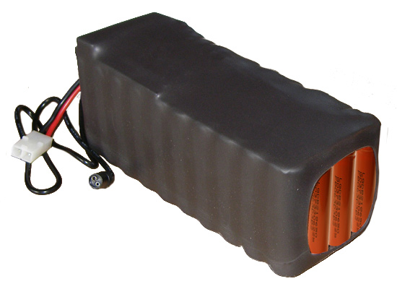
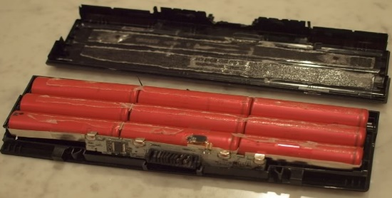
High BRC Batteries
Batteries within this classification do not meet the Low and Medium BRC classification and are typically custom, high energy, or high power designs
Use Medium and High BRC Template HR (CP Hazard # 28907)
Requirement addition to Medium BRC Batteries
  5.1.5.1 – Thermal Runaway Propagation
    For battery designs greater than a 80-Wh energy employing high specific
    energy cells (greater than 80 watt-hours/kg, for example, lithium-ion
    chemistries) with catastrophic failure modes, the battery shall be evaluated
    to ascertain the severity of a worst-case single-cell thermal runaway event and the propensity of the design to demonstrate cell-to-cell propagation in the intended application and environment.
    The evaluation shall include all necessary analysis and test to quantify the severity (consequence) of the event in the intended application and environment as well as to identify design modifications to the battery or the system that could appreciably reduce that severity.
EP-19-001 Interpretation Memo for the Battery TR Propagation Requirements in JSC 20793 Rev D
Verification - High BRC End Item Thermal Runaway
  Verification is considered successful when a Thermal Runaway Assessment with no propagation can be substantiated via testing
  The EP-19-001 memo provides pass/fail criteria and testing requirements to meet the intent of the requirements
HR Battery Description Form will be attached to the unique HR and is available as an attachment to the template

Slide 13
Battery Safety Process
Phase I Safety Data Package
  Preliminary list of type and number of cells and batteries, details of application and usage loads and environments, cell size (capacity), battery configuration (series/parallel), cell/battery chemistry, cell/battery manufacturer, model number(s), voltage, capacity, details of pre-flight test plan and on-orbit operations.
  Preliminary design approach to fault tolerance or design for minimum risk strategy to meet battery safety requirements of JSC 20793, Crewed Space Vehicle Battery Safety Requirements.
  State whether on-orbit cell/battery charging is intended.
  Provide unique phase I hazard report with battery description form attached for each cell/battery model and unique application or hardware.

Slide 14
Battery Safety Process
Phase II Safety Data Package
  Confirmed list of type and number of cells and batteries, cell/battery size (capacity),cell/battery voltage, battery configuration, cell/battery chemistry, cell/battery manufacturer, and model number(s) and charging circuit (if applicable), usage load and environment (including launch and return/landing vehicles).
  Electrical power diagram detailing cell/battery safety circuit diagram including charging circuit showing compliance with applicable technical requirements. Diagram of charging devices, characteristics, and implementation procedures. Confirmed design approach to fault tolerance or design for minimum risk strategy to meet battery safety requirements of JSC 20793, “Crewed Space Vehicle Battery Safety Requirements.” See requirements in JSC 20793, “Crewed Space Vehicle Battery Safety Requirements” and JWI 8705.3, “Battery Processing”.
  Charging characteristics and procedures, e.g., pulse charging, charge rate, trickle charge rate, and method of charge termination.
  Describe on-orbit operations including charging, discharging, conditioning, battery replacement, stowage, and disposal procedures. Provide design details and a diagram for battery boxes that indicates materials of construction, absorbent material, venting provisions and other unique safety controls.
  Verification plan, including qualification, flight acceptance and lot sample testing (where applicable).
  Fracture control approach for battery cells where leakage causes a catastrophic hazard and for nickel-hydrogen batteries.
  Updated unique phase II hazard report with battery description form attached for each cell/battery model

Slide 15
Battery Safety Process
Phase III Safety Data Package
  Final list of type and number of cells and batteries, cell size/battery size (capacity), battery configuration (series/parallel), cell/battery chemistry, cell manufacturer, and model number(s), usage loads and environment, details of application and launch and landing vehicles.
  Final circuit diagrams, including safety circuitry, fracture control summary report (where applicable), and charging circuit showing compliance with applicable technical safety requirements. Final design for fault tolerance controls or design for minimum risk strategy to meet battery safety requirements. See requirements in JSC 20793, “Crewed Space Vehicle Battery Safety Requirements” and JWI 8705.3 “Battery Processing.”
  Final on-orbit operations including charging, discharging, conditioning, battery replacement, stowage and disposal procedures.
  Final design details and a diagram for battery boxes that indicates materials of construction, absorbent material, venting provisions and other unique safety controls.
  Results of verification tests for the safety controls and fault tolerance mitigations, results of qualification and flight acceptance tests, results of lot acceptance tests where applicable, as well as final analyses and inspection closures.
  Approved unique phase III hazard report

Slide 16
JSC/EP5 Battery Group
How can we help?
  Requirements interpretation: Interpret the requirements and help determine battery classification so that the hardware provider knows what to expect from the design, to testing, and through flight
  Identify safety concerns: Design of battery and/or charging to eliminate, or at least minimize, potential safety problems
  Battery design features: Historical features in cells and battery designs that may help a hardware provider maintain performance, fault tolerance and/or deal with thermal runaway propagation
  Communications: Maintaining communications with the JSC/EP5 Battery Group throughout the hardware provider’s development cycle will reduce surprises on both teams
Point of Contacts:
  Dr. David Delafuente, Battery Safety Technical Discipline Lead
  Email: david.a.delafuente@nasa.gov, Office: 281-244-8268
  Dr. Eric Darcy, Battery Technology Technical Discipline Lead
  Email: eric.c.darcy@nasa.gov, Office: 281-483-9055
  Steven Kunkel, Battery SM for EVA and Portable Loads
  Email: steven.r.kunkel@nasa.gov, Office: 281-483-4356

