Slide 1
Structural Evaluation and Optimization of Aeroshell Design Properties for Launch and Reentry Load Cases for Future AI-Informed Design Leveraging Large Datasets
John Bell, Ph.D.¹
Sasan Armand, Ph.D. ¹
Jamshid Samareh, Ph.D.²
NASA Langley Research Center (LaRC), D206 ¹, E401²
APPROVED FOR PUBLIC RELEASE

Slide 2
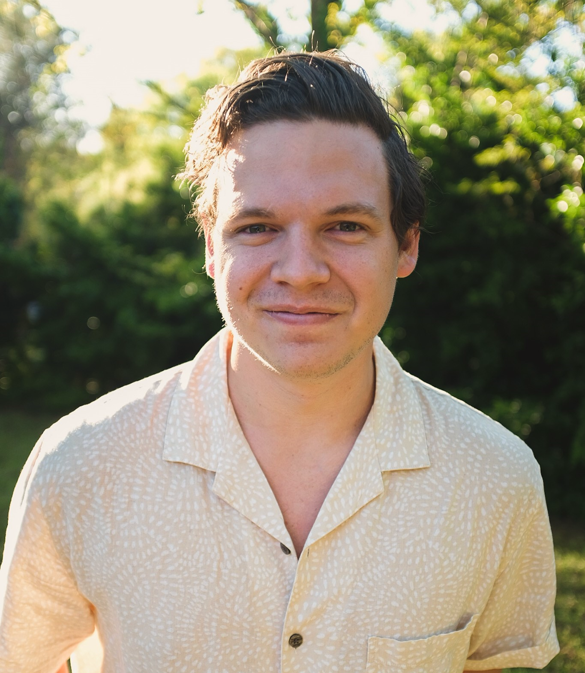
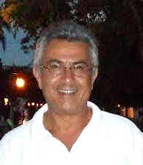
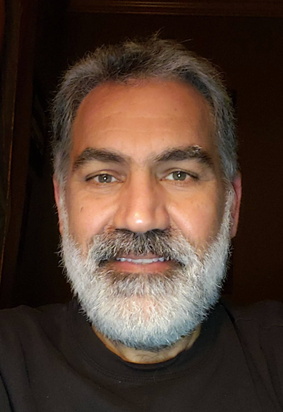
Introduction / Motivation
John Bell, Ph.D.
(LaRC D206) Dr. John Bell is a recent graduate from Clemson University. Holding degrees in mathematics and engineering, he has worked on a variety of interdisciplinary projects. His dissertation research was partnered with NASA JPL and focused on the development of rigid-flex PCB robotic architectures for interplanetary exploration.
Sasan Armand, Ph.D.
(LaRC D206) Dr. Sasan Armand obtained his PhD in engineering in 1990. He has 35 years of civil service at NASA and has worked on multiple high-profile hardware projects and served as the Chief of Mission Analysis Branch and Acting Division Chief at NASA Glenn before coming to LaRC.
Jamshid Samareh, Ph.D.
(LaRC E401) Jamshid holds a B.S., M.E., and a Ph.D. in Mechanical Engineering and Mechanics, and he has authored over 100 technical publications. He is the recipient of the NASA Outstanding Leadership Medal, the NASA Exceptional Public Service Medal, and five group achievement awards. He was a member of the TetrUSS CFD team that won the NASA Software of the Year Award twice. He served as an associate editor for the AIAA journal and on the AIAA MDAO technical committee.

Slide 3
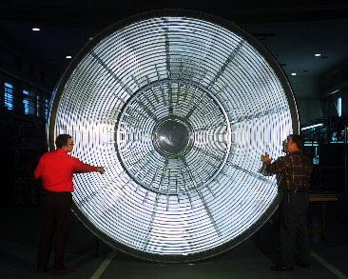
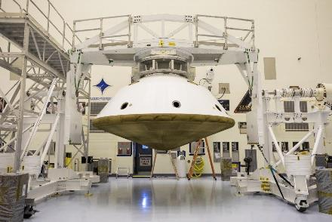
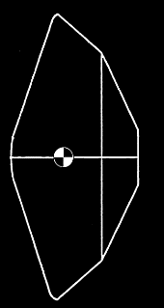
Introduction / Motivation
Aeroshells of reentry vehicles are designed to endure aerodynamic heating and hypersonic entry, descent, and landing (EDL) loads in order to deliver payloads through planetary atmospheres
The main components are the heat shield and the back shell. For this work, when referring to the aeroshell, we specifically are discussing the heat shield.
Current work
[3] Aeroshell side profile showing the heat shield (left of dashed line) and the back shell (right of dashed line)
[1] the Viking Lander I aeroshell that entered the Martian atmosphere in 1976, NASA Langley
[2] The aeroshell used on the Mars 2020 mission, Lockheed Martin
Future work

Slide 4
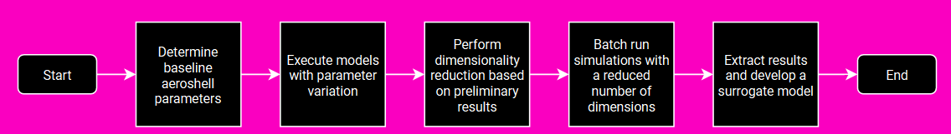
Introduction / Motivation
Aeroshells for reentry vehicles are traditionally designed as mission-specific structures and have a diverse set of geometries.
Some work has been done on aeroshell geometric optimization using multiple objectives. Drawbacks of current state of the art include:
  Manual parameter selection
  Reduction in target objectives
  Implementation of processes that would not produce results as optimized as those obtained with a high-fidelity surrogate model.
Motivation: implement state-of-the-art statistical and artificial intelligence techniques for the design and development of an aeroshell with mass and structural adequacy as the objective functions.

Slide 5
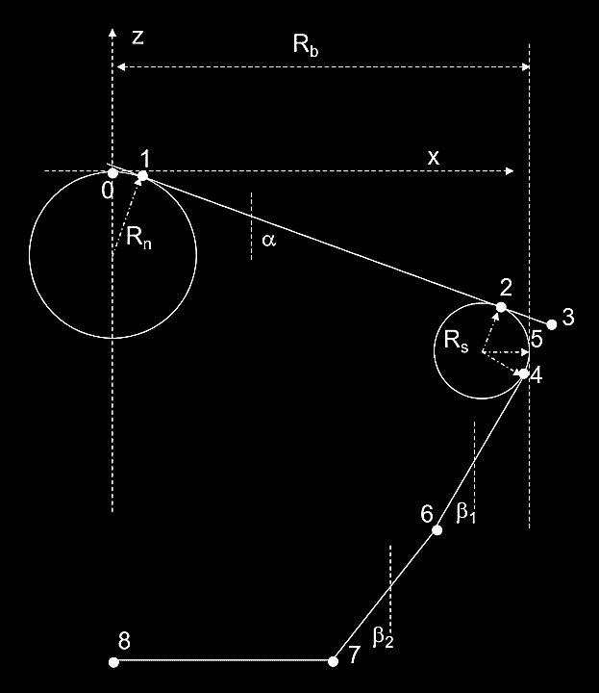



Finite Element Model Construction
Models are generated using a script written in MATLAB with geometric input parameters $[R_{n}, R_{b}, α, R_{s}$]
Generated a 2D mesh with CTRIA3 and CQUAD4 shells on the X-Y plane
Z-values are determined through sets of analytical equations
Radial and circumferential stiffeners are added

Slide 6
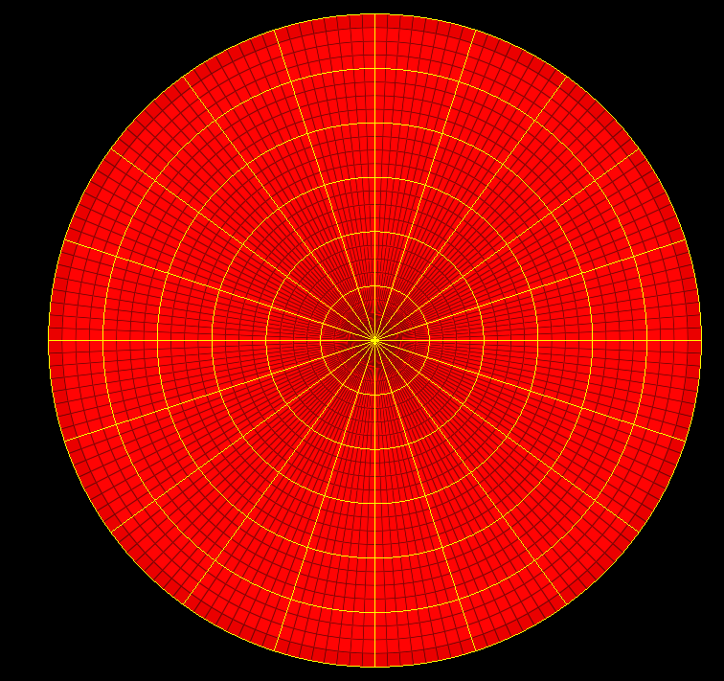
Finite Element Model
Executes with NASTRAN
Three simulations:
  SOL 105 (linear buckling)
  SOL 103 (real eigenvalue analysis)
  SOL 101 (linear statics) with inertia relief
Post-processing written in Python
Adjustable Parameters | Category
Nose radius (Rn) | Aeroshell geometric properties
Total heat shield radius (Rb)
Side curve radius (Rs)
Alpha angle
Beta angles
Thickness
Payload mass
Distance between payload and heat shield
Entry load (Earth g)
Circumferential mesh density | Model mesh properties
Radial mesh density
Material Density | Aeroshell material properties
Material elastic modulus
Material Poisson’s ratio
Radial stiffener spacing | Stiffener geometric properties
Circumferential stiffener spacing
Stiffener cross-section (base, height)
Stiffener elastic modulus | Stiffener material properties
Stiffener Poisson’s ratio | Stiffener material properties
Stiffener density
FEM maximum time | FEM solver options
FEM time step

Slide 7
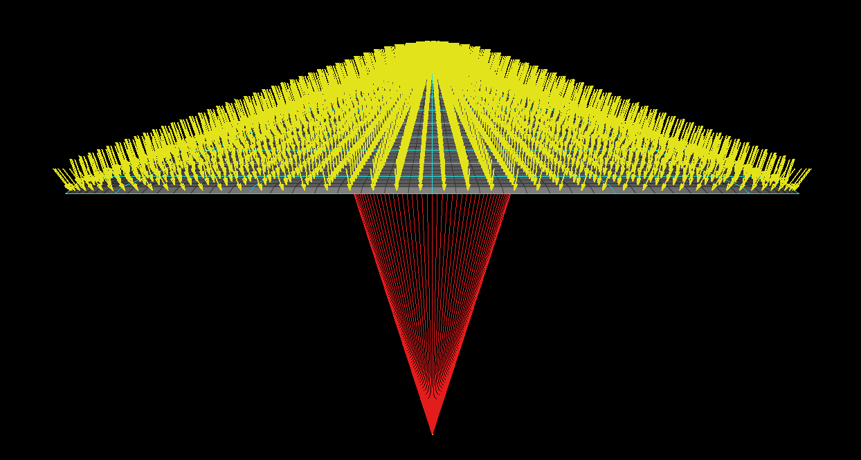
Aeroshell Model Description
PLOAD4 entry pressure loading (modified Newtonian pressure) [backup 1]
Entry static models with inertia relief only: free-free boundary condition
CTRIA3 and CQUAD4 shell elements
Stiffeners (circumferential & tangential)
Buckling model only: fixed boundary condition (123456) at CM
Buckling model only: RBE2 kinematic coupling element
RBE3 distributed coupling elements connected to specified circumferential stiffener ring
Lumped payload mass

Slide 8
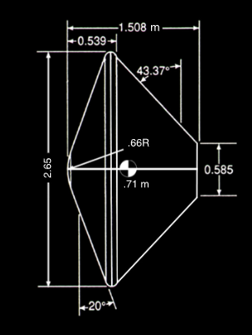
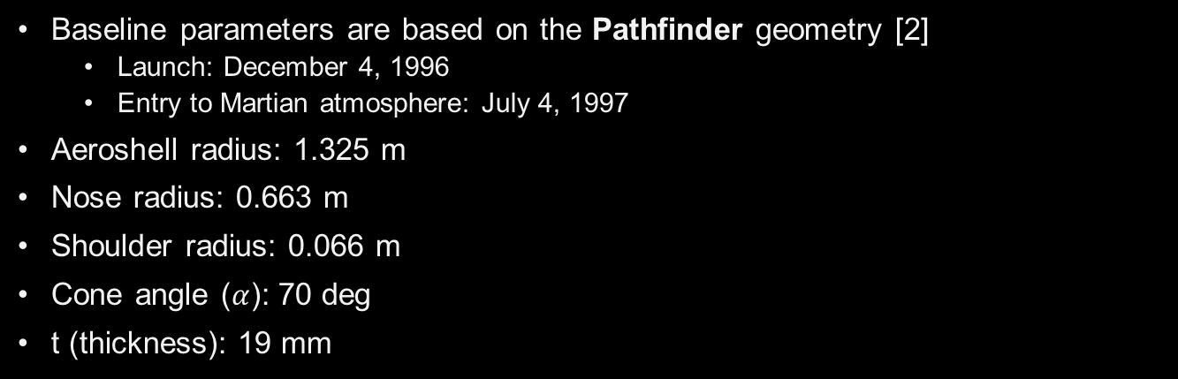
Baseline Parameters
Baseline parameters are based on the Pathfinder geometry [2]
  Launch: December 4, 1996
  Entry to Martian atmosphere: July 4, 1997
Aeroshell radius: 1.325 m
Nose radius: 0.663 m
Shoulder radius: 0.066 m
Cone angle ($α$): 70 deg
t (thickness): 19 mm
$$α$$

Slide 9

Parameter Variation - Applicable Space Filling Techniques
Objective: optimize the parameter variation and dimensionality reduction processes by intelligently sampling sets of parameters
The convergence of a random uniformly-distributed parameter selection is proportional to the variance $O\left(\sqrt{N}\right)$ [backup 2]. To reduce the error of the estimate by half, 4x the samples are needed.
# out = 38
# out = 383
# out = 3790
(0.25, 0.75)
(0.25, 0.75)
(0.25, 0.75)
Notes:
Error is minimized as $n→∞$, but this is computationally expensive. Variation reduction is a method by which the variance of the estimator is reduced such that the method becomes more efficient. Selection methods / generation techniques are often referred to space filling technique (SFT).

Slide 10
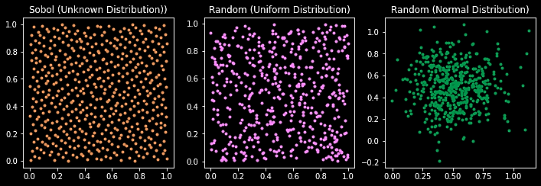
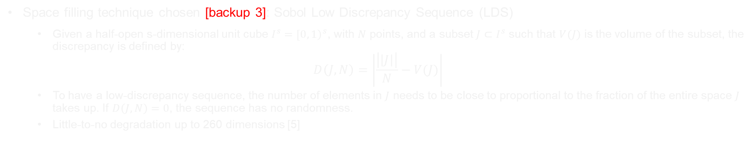
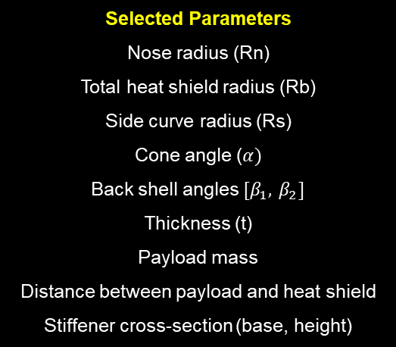
Sobol Space Filling Technique
Space filling technique chosen [backup 3]: Sobol Low Discrepancy Sequence (LDS)
  Given a half-open s-dimensional unit cube $I^{s}={\left[0, 1\right)}^{s}$, with $N$ points, and a subset $J⊂I^{s}$ such that $V(J)$ is the volume of the subset, the discrepancy is defined by:
$$D\left(J, N\right)=\left|\frac{\left|\left|J\right|\right|}{N}−V(J)\right|$$
  To have a low-discrepancy sequence, the number of elements in $J$ needs to be close to proportional to the fraction of the entire space $J$ takes up. If $D\left(J, N\right)=0$, the sequence has no randomness.
  Little-to-no degradation up to 260 dimensions [5]
Selected Parameters
Nose radius (Rn)
Total heat shield radius (Rb)
Side curve radius (Rs)
Cone angle ($α)$
Back shell angles $[β_{1},{ β}_{2}]$
Thickness (t)
Payload mass
Distance between payload and heat shield
Stiffener cross-section (base, height)
Sobol (Uniform Distribution)
Random (Uniform Distribution)
Random (Normal Distribution)
Notes:
Curse of dimensionality: the algorithm becomes less efficient after a specific number. The amount of work that it takes to generate the space. Log(N), log(e^n)….
Latin hypercube, for example, can’t handle 260 dimensions.
To have a low-discrepancy sequence, the number of elements in $J$ needs to be close to proportional to the fraction of the entire space $J$ takes up. If $D\left(J, N\right)=0$, the sequence has no randomness.
The Sobol LDS is constructed using binary operations and is efficient using modern computing power [4]
Little-to-no degradation up to 260 dimensions [5]

Slide 11

Dimensionality Reduction (Algorithms)
Data
Figure: diagram of a decision tree
Implemented regression methods:
Single linear regression
Multiple linear regression
Polynomial regression
Decision tree
Gaussian process regression
Random forest [9] [backup 4]
  Often used for high dimensional data
  Large amount of variable importance metrics [10, 11]
Tree 1
Tree n
Tree 2
. . .
. . .
$$prediction=\frac{1}{n}\sum_{i}{S_{i}}$$
S₁
S₂
S_{n}

Slide 12

Dimensionality Importance Results
Most important variables: t, Rb, cone angle (α), stiffener height, number of circumferential stiffeners, stiffener base
Importance values $∑=1$ and are calculated using the Gini Importance Factor [12]

Slide 13
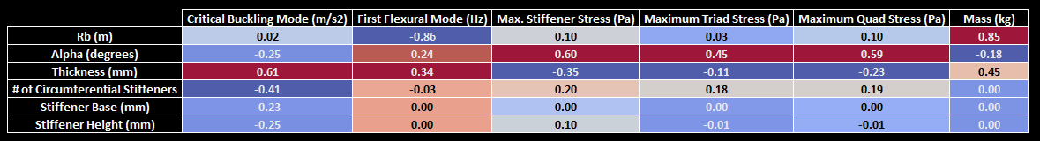

Pearson Product-Moment Correlation Matrix
$$R_{ij}=\frac{C_{ij}}{\sqrt{C_{ii}C_{jj}}}=\frac{\sum_{i=1}^{n}{(x_{i}−\overline{x})(y_{i}−\overline{y})}}{\sqrt{\sum_{i=1}^{n}{{\left(x_{i}−\overline{x}\right)}^{2}}}\sqrt{\sum_{i=1}^{n}{{\left(y_{i}−\overline{y}\right)}^{2}}}}$$
Notes:
Place an emphasis on mass when presenting
Linear correlation
After performing dimensionality importance, we fine-tuned the data and observe these results. Large number implies a linear relationship – low number doesn’t really mean anything

Slide 14
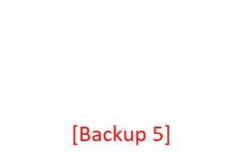
Surrogate Model Formation
Number of runs: 10,000 (x3 – buckling, frequency, inertia relief)
Number of parameters: 6
Sobol space filling
Surrogate Model Selection
Linear, power models
$$y=c_{1}x+c_{2}$$
$$y=c_{1}x^{c_{2}}$$
Multivariate linear fit: [Backup 5]
Neural Network (NN)
Black Box
Outputs
Inputs
Predictability
Clarity
Analytical ability
Accuracy
Robustness
Lack of clarity for higher order models
Notes:
Key term here: explainable
Explainable AI

Slide 15
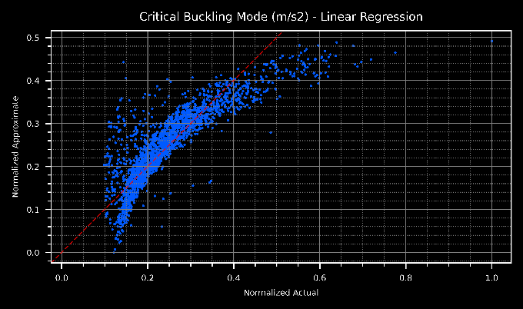
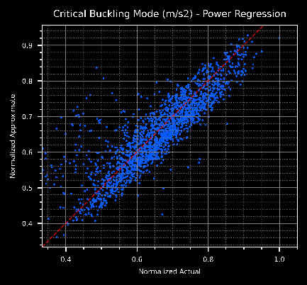
Surrogate Model Results
Other results in [Backup 6]

Slide 16
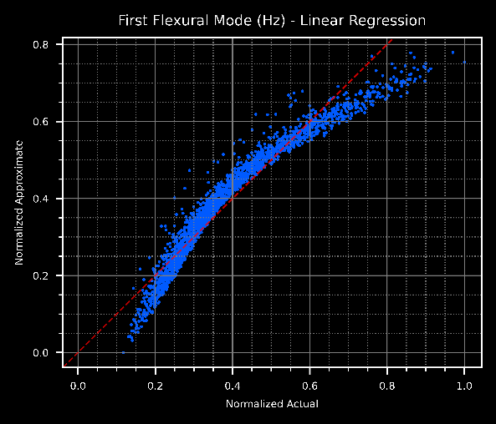
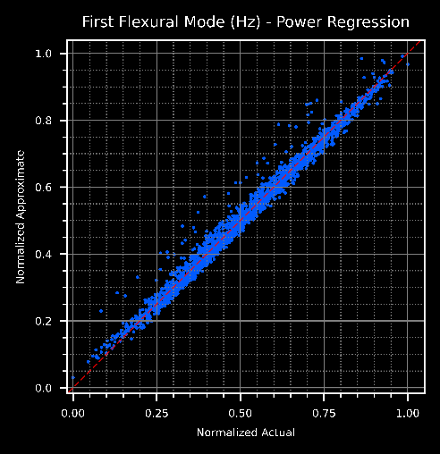
Surrogate Model Results

Slide 17
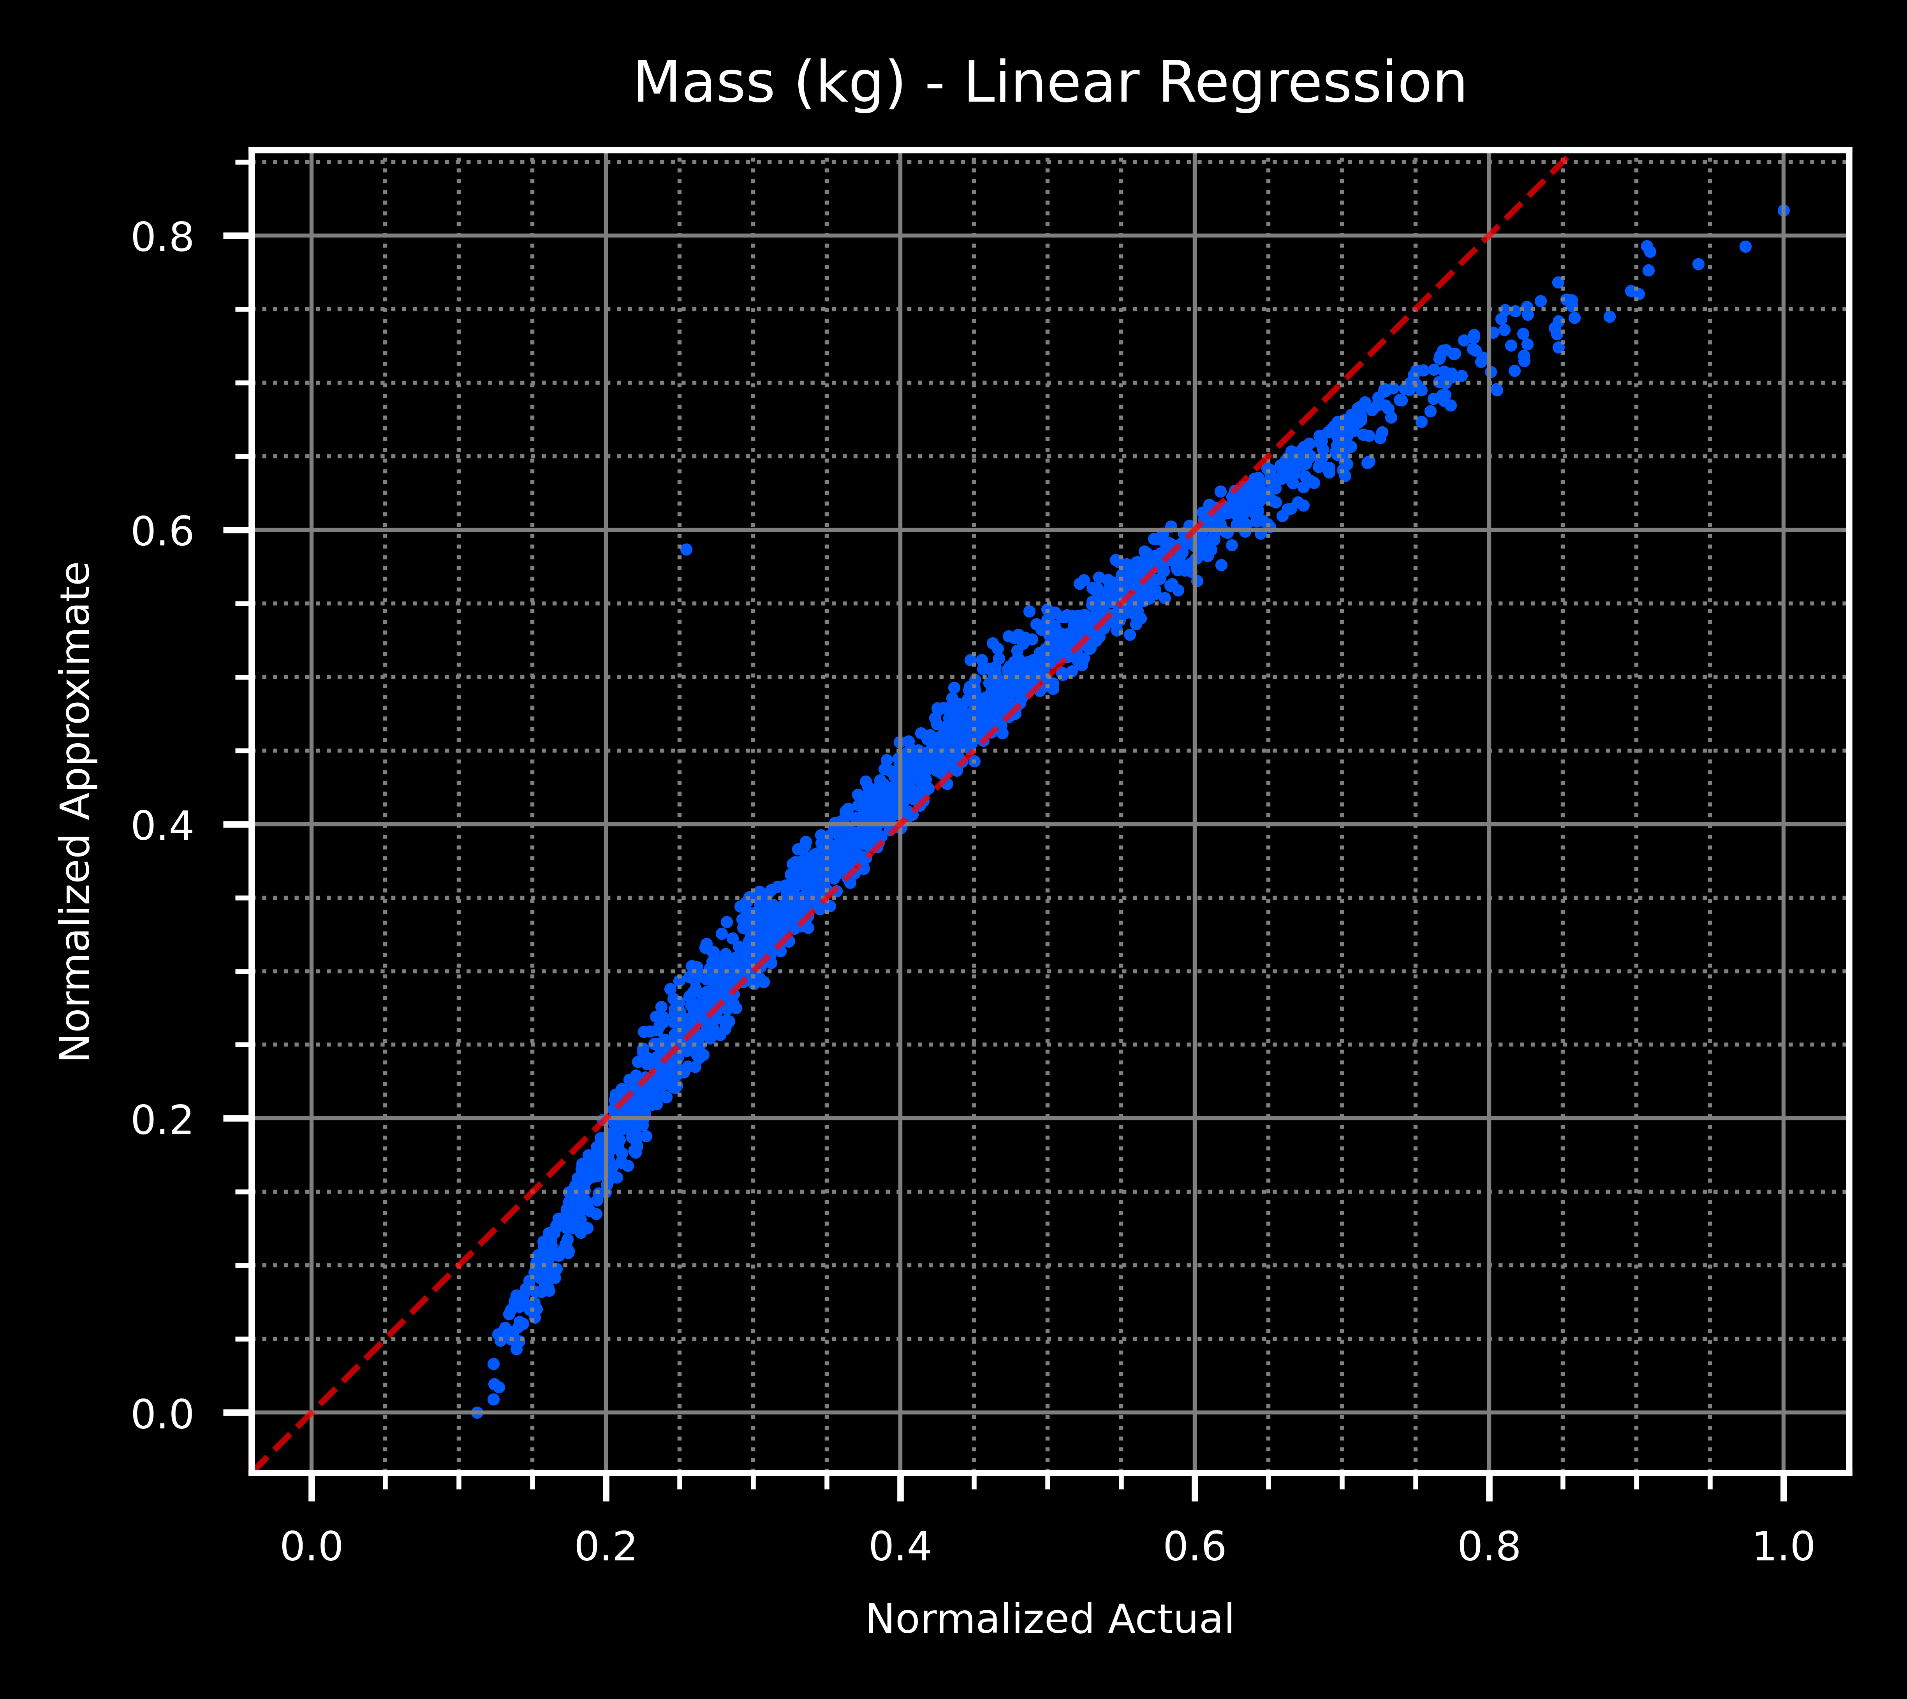
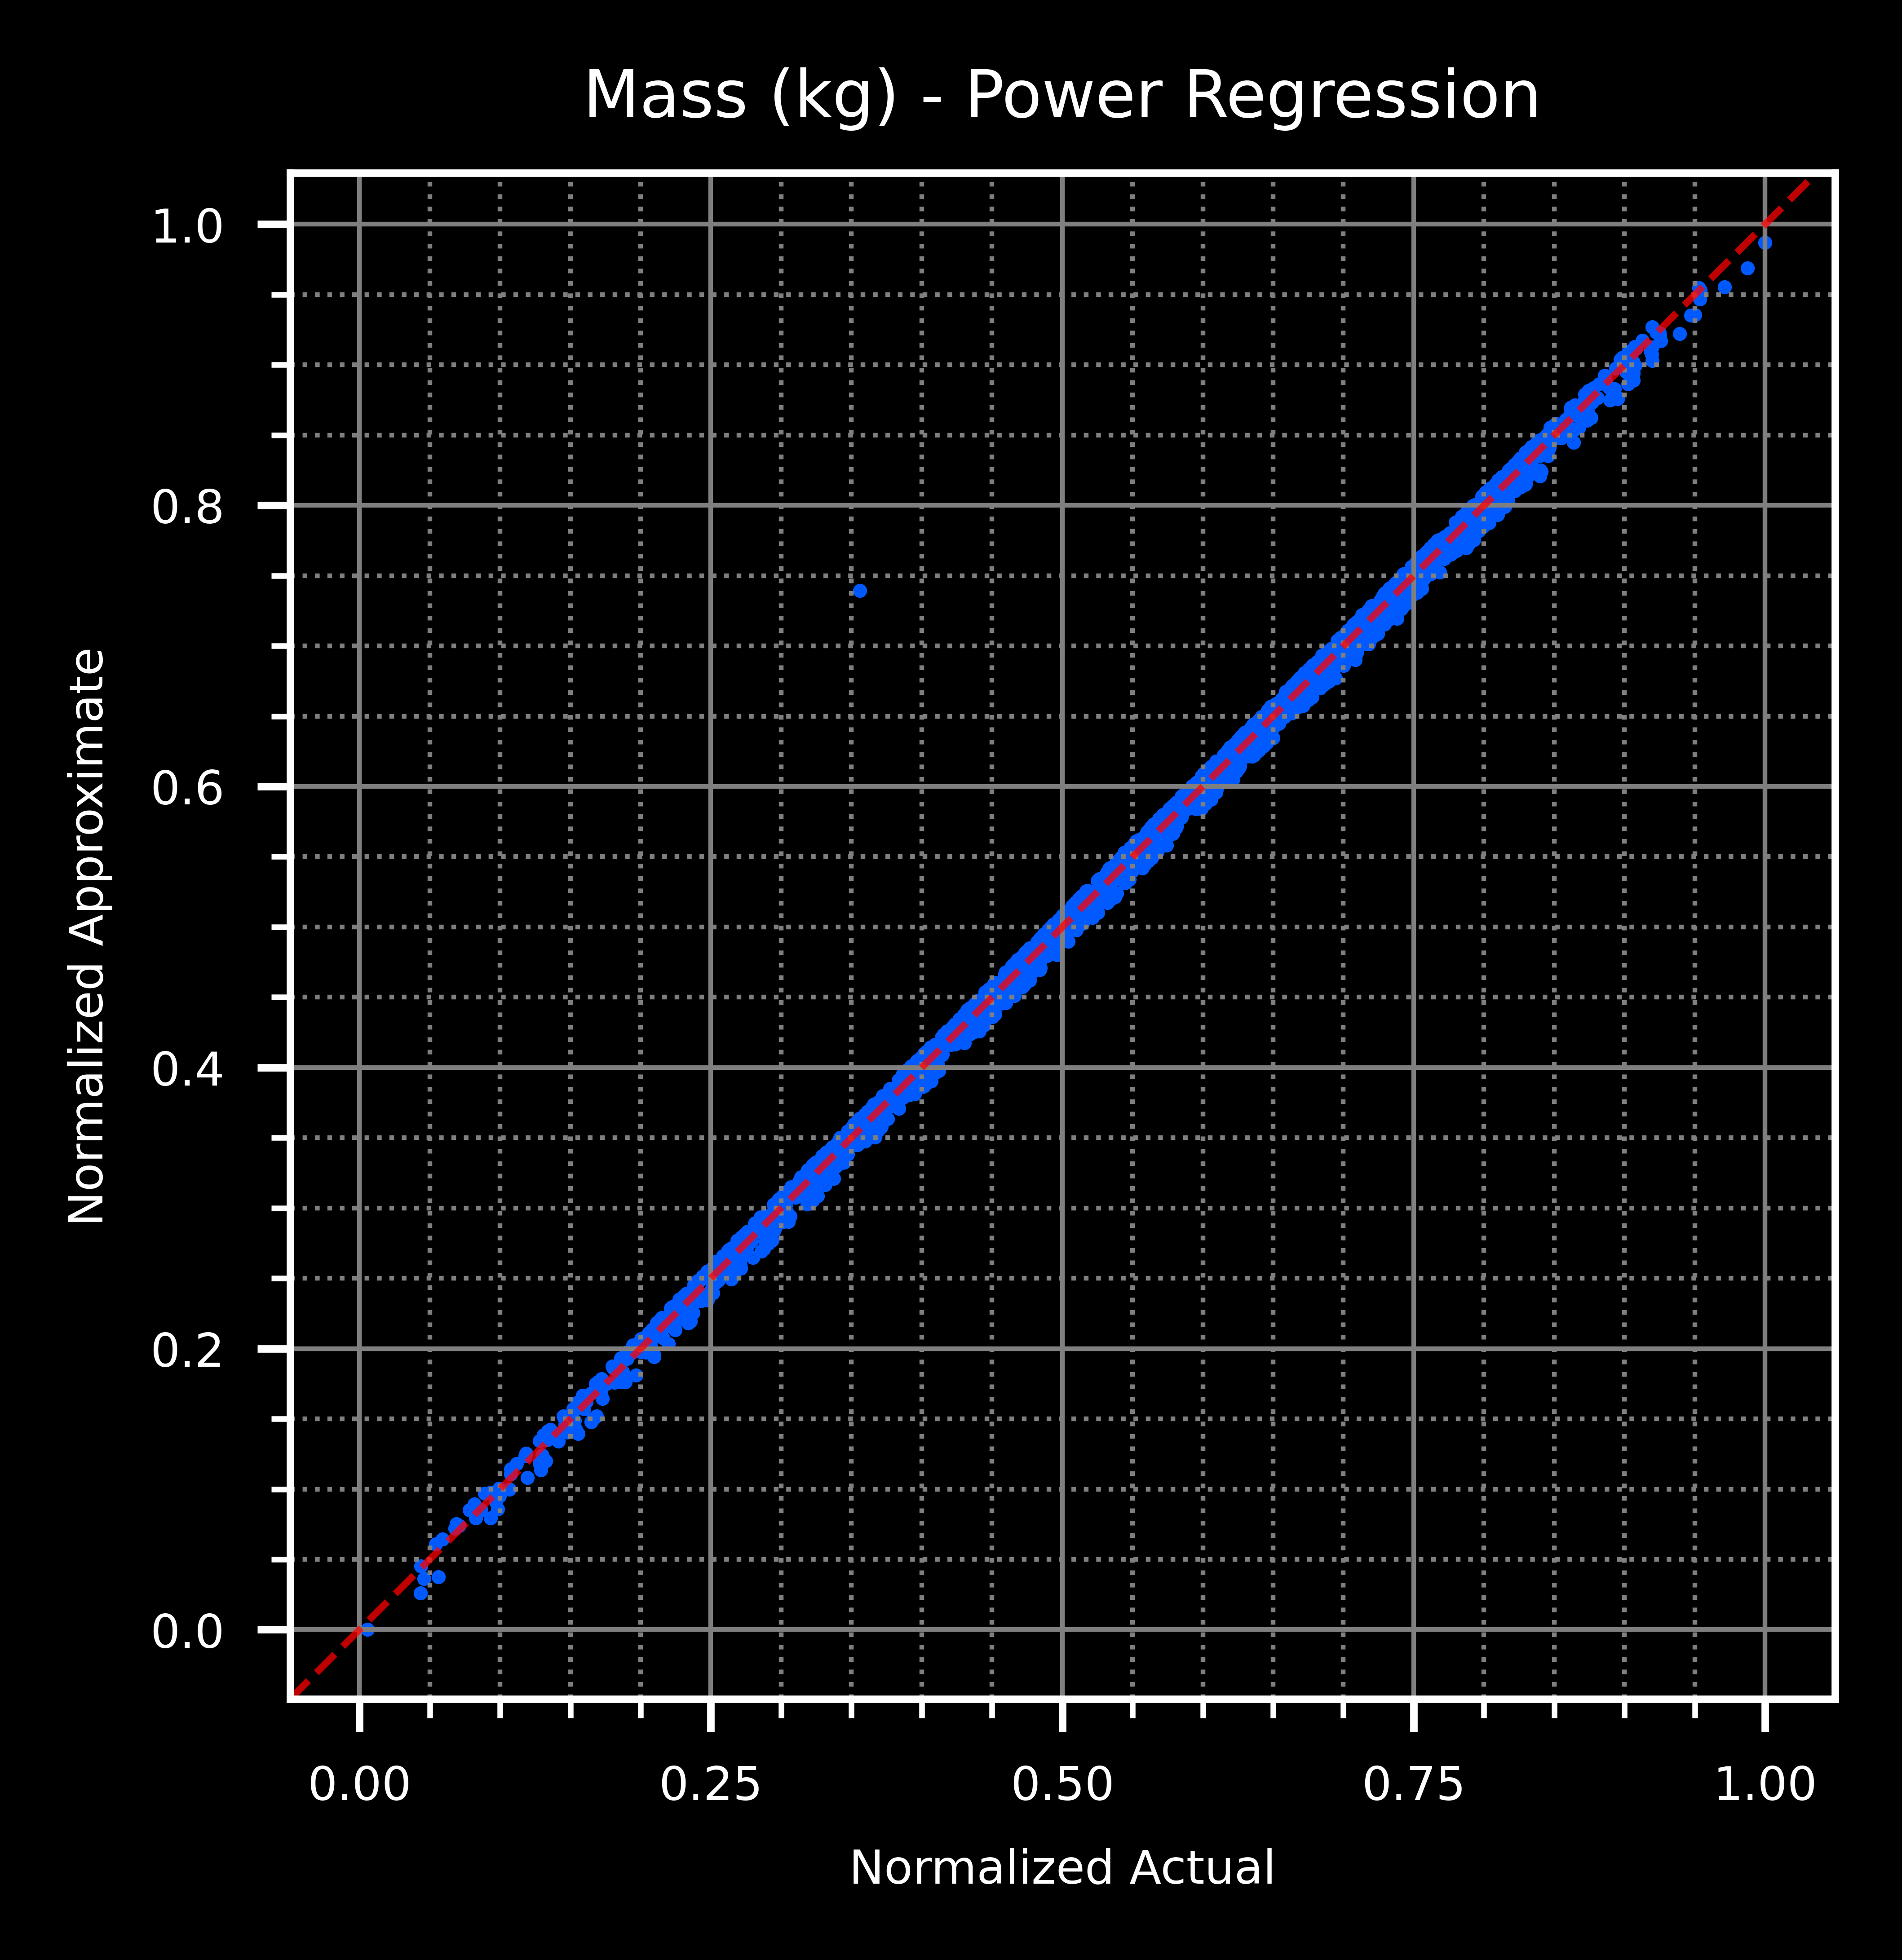
Surrogate Model Results

Slide 18
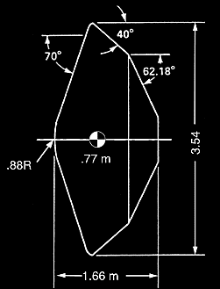
Proof of Concept: Viking Aeroshell
Parameters selected based on the Viking geometry [2]
    Launch: August 20, 1975
    Entry to Martian atmosphere: July 20, 1976
  Aeroshell radius: 1.75 m
  Nose radius: 0.875 m
  Side radius: 0.026 m
  α (cone angle): 70 deg
  t (thickness): 13.8 mm
$$α$$
Output variable: | Critical Buckling Mode (m/s²) | First Flexural Mode (Hz) | Max. Stiffener Stress (Pa) | Maximum Triad Stress (Pa) | Maximum Quad Stress (Pa) | Mass (kg)
LN(Predicted Value): | 6.21 | 2.12 | 21.82 | 19.32 | 21.84 | 6.02
LN(Actual Value): | 5.86 | 2.07 | 21.81 | 18.56 | 21.81 | 5.98
Error: | 6.06% | 2.28% | 0.04% | 4.06% | 0.16% | 0.69%
Notes:
Spend lots of time on this slide

Slide 19
Future Work
Implement the back shell in the FEM
Consider advanced materials for the face sheets
Generate large datasets for the development of a black-box neural network
Implement transient thermal analysis and optimization
Perform analysis of structural-thermal interactions and optimization
Implement controls analysis and optimization
Develop robust design for:
  Performance
  Variability of performance (+/- 𝜎)

Slide 20
References
[1] NASA. (2015, February 27). Viking Aeroshell. NASA. Retrieved May 3, 2023, from https://www.nasa.gov/multimedia/imagegallery/image_feature_542.html
[2] Aeroshells: Keeping spacecraft safe. Lockheed Martin. (n.d.). Retrieved April 3, 2023, from https://www.lockheedmartin.com/en-us/capabilities/space/aeroshell-space.html
[3] Davies, C., & Arcadi, M. (2006). Planetary mission entry vehicles quick reference guide. Version 3.0 (No. NASA/SP-2006-3401).
[4] Dalal, I. L., Stefan, D., & Harwayne-Gidansky, J. (2008). Low discrepancy sequences for Monte Carlo simulations on reconfigurable platforms. 2008 International Conference on Application-Specific Systems, Architectures and Processors. https://doi.org/10.1109/asap.2008.4580163
[5] Galanti, S., & Jung, A. (1997). Low-discrepancy sequences. The Journal of Derivatives, 5(1), 63–83. https://doi.org/10.3905/jod.1997.407985
[6] McGeoch, C. (1992). Analyzing algorithms by Simulation. ACM Computing Surveys, 24(2), 195–212. https://doi.org/10.1145/130844.130853
[7] Kleijnen, J. P., Ridder, A., & Rubinstein, R. (2010). Variance reduction techniques in Monte Carlo Methods. SSRN Electronic Journal. https://doi.org/10.2139/ssrn.1715474
[8] Asmussen, S., & Glynn, P. W. (2011). Stochastic simulation: Algorithms and analysis. Springer.
[9] Breiman, L. Random Forests. Machine Learning 45, 5–32 (2001). https://doi.org/10.1023/A:1010933404324
[10] Breiman, L. (2017). Classification and regression trees. Routledge.
[11] Stefano Nembrini, Inke R König, Marvin N Wright, The revival of the Gini importance?, Bioinformatics, Volume 34, Issue 21, November 2018, Pages 3711–3718, https://doi.org/10.1093/bioinformatics/bty373
[12] Louppe, G., Wehenkel, L., Sutera, A., & Geurts, P. (2013). Understanding variable importances in forests of randomized trees. Advances in neural information processing systems, 26.

Slide 21

Backup 1 - Modified Newtonian Pressure
Hypersonic flow is inherently nonlinear, as it captures the physical behavior of high-temperature chemically reacting flows, viscous interaction, entropy layers, shock, etc. However, it can be expressed in linear terms with accuracy appropriate for early design cycle. In Hypersonic Flow written by Lester Lees, the following form of the Newtonian theory is presented:
$$C_{p}=C_{pmax}\sin^{2}{θ}$$
Where $C_{pmax}$ is the maximum value of the pressure coefficient, evaluated at a stagnation point behind a normal shock wave. In the derivation presented in Hypersonic and High Temperature Gas Dynamics by John Anderson, the following equation for the maximum pressure coefficient is provided.
$$C_{pmax}=\frac{2}{γM_{∞}^{2}}\left\{{\left[\frac{{\left(γ+1\right)}^{2}M_{∞}^{2}}{4γM_{∞}^{2}−2\left(γ−1\right)}\right]}^{\frac{γ}{(γ−1)}}\left[\frac{1−γ+2γM_{∞}^{2}}{γ+1}\right]−1\right\}$$
And the above holds the following characteristics:
$$\lim_{M→M_{∞}}\left\{C_{pmax} \right| γ=1.4\}=1.839$$
$$\lim_{M→M_{∞}}\left\{C_{pmax} \right| γ=1.0\}=2.0$$

Slide 22
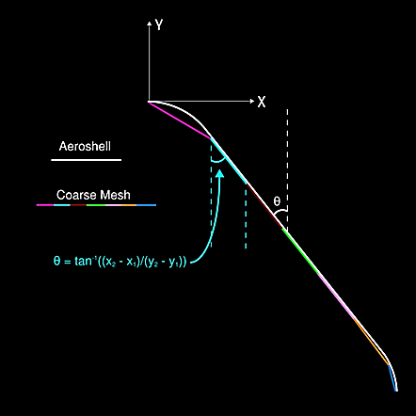

Backup 1 - Modified Newtonian Pressure
Newtonian pressure is applied to the model through the following:
1. Given values for $c_{p}$ and $c_{v}$, calculate:
$$γ=\frac{c_{p}}{c_{v}}$$
2. Providing an input of current air temperature, calculate the speed of sound:
$$ν=331\frac{m}{s}\sqrt{\frac{T_{air}}{273K}}$$
3. Given a Mach number for the aeroshell, M, calculate the corresponding air velocity:
$$V=νM$$
4. Calculate $C_{pmax}$ based on the modified Newtonian pressure equation
5. Using the piecewise equation describing the shape of the aeroshell heat shield and the specified mesh density, calculate the theta angle for each circular “ring” of elements based on the start and end coordinates of the element.
6. Calculate the pressure for each ring (in each ring, all elements have the same theta value) and apply through a PLOAD4 pressure load.

Slide 23

Backup 2 - Parameter Selection Using Space Filling Algorithm
Objective: expedite the dimensionality reduction process by intelligently sampling sets of parameters
Recall the law of the unconscious statistician, which expresses the expected value of a given function $g(X)$ of the random variable (RV) $X$ by using the associated arbitrary probability density function $f(x)$:
$$E\left[g\left(X\right)\right]=μ=\int_{−∞}^{∞}{g\left(x\right)f\left(x\right)dx}$$
Given that the RV $X$ is discrete, the expected value of a sample may be calculated using the following:
$$E\left[g\left(X\right)\right]=μ=\frac{1}{n}\sum_{j=1}^{n}{g(X_{j})}$$
Notes:
https://www.scratchapixel.com/lessons/mathematics-physics-for-computer-graphics/monte-carlo-methods-in-practice/monte-carlo-integration.html
The above formula for expected value comes from the generalization of variance to an arbitrary PDF.

Slide 24

Backup 2 - Applicable Space Filling Techniques
Recall the definition for the variance (error variance):
$$var\left(X\right)=E\left[X^{2}\right]−E{\left[X\right]}^{2}=\frac{σ^{2}}{n}$$
The convergence of a random uniformly-distributed parameter selection is proportional to the variance $O\left(\sqrt{N}\right)$. To reduce the error of the estimate by half, 4x the samples are needed.
(0.25, 0.75)
(0.25, 0.75)
(0.25, 0.75)
Notes:
https://www.scratchapixel.com/lessons/mathematics-physics-for-computer-graphics/monte-carlo-methods-in-practice/monte-carlo-integration.html
The above formula for expected value comes from the generalization of variance to an arbitrary PDF.
Example showing a uniform distribution

Slide 25

Backup 3 - Applicable Space Filling Techniques
Error is minimized as $n→∞$, but this is computationally expensive. Variation reduction is a method by which the variance of the estimator is reduced such that the method becomes more efficient. Selection methods / generation techniques are often referred to space filling technique (SFT).
SFT 1: antithetic sampling is a method to reduce variance in a simulation by introducing negative correlation between pairs of observations.
  Consider the mean of two identically distributed RVs $X$ and $Y$. The variance of the mean of these selected RVs is as follows:
$$var\left(\frac{X_{i}+Y_{i}}{2}\right)=\frac{1}{4}(var\left(X_{i}\right)+var\left(Y_{i}\right)+2cov\left(X_{i}, Y_{i}\right))$$
  Hence, the variance is reduced when a negative correlation is enforced between the random variables.
SFT 2: Latin hypercube sampling typically is more efficient than traditional random sampling. It accomplishes this by representing each variable as its cumulative distribution function and partitioning to then sample from each region. Equivalent to placing rooks on a chess board.
Notes:
https://www.scratchapixel.com/lessons/mathematics-physics-for-computer-graphics/monte-carlo-methods-in-practice/variance-reduction-methods.html
https://www.math.kent.edu/~oana/math60093/10lecture5.pdf

Slide 26

Backup 3 - Applicable Space Filling Techniques
SFT 3: Pseudo-Random Number Generator
  Widely available using MATLAB, Python
  Approximates the properties of sequences of random numbers, but requires a seed
SFT 4: Low Discrepancy Sequences (LDS), also known as pseudo-random sequences, provide a more equidistibuted set of data over a volume than pseudo-random numbers.
  Given a half-open s-dimensional unit cube $I^{s}={\left[0, 1\right)}^{s}$, with $N$ points, and a subset $J⊂I^{s}$ such that $V(J)$ is the volume of the subset, the discrepancy is defined by:
$$D\left(J, N\right)=\left|\frac{\left|\left|J\right|\right|}{N}−V(J)\right|$$
  To have a low-discrepancy sequence, the number of elements in $J$ needs to be close to proportional to the fraction of the entire space $J$ takes up. If $D\left(J, N\right)=0$, the sequence has no randomness.
  The Sobol LDS is constructed using binary operations and is efficient using modern computing power [4]
  Little-to-no degradation up to 260 dimensions [5]
Others: stratified sampling, poststratification, importance sampling, control variates [6 - 8]
Notes:
https://www.scratchapixel.com/lessons/mathematics-physics-for-computer-graphics/monte-carlo-methods-in-practice/variance-reduction-methods.html
https://www.webpages.uidaho.edu/~stevel/565/lectures/2_Monte_Carlo_Integration.pdf
https://www.ynufe.edu.cn/pub/tsxy/jhzhao/teach/CS/notes/lec5.pdf
https://artowen.su.domains/mc/Ch-var-basic.pdf

Slide 27











Backup 4 – Dimensionality Reduction (Algorithms)
Figure: diagram of a decision tree
Information Gain (IG):
$$IG\left(D_{p},a\right)=I\left(D_{p}\right)−\sum_{j=1}^{m}{\frac{N_{j}}{N_{p}}I(D_{j})}$$
$N_{p}$- number of instances on the parent node
$N_{j}$- number of instances on the jth child node
$D_{p}$- data amount of the parent node
$D_{j}$- data amount of the jth child node
$I$– measure of impurity (mean-squared-error, MSE)
$$I\left(t\right)=\frac{1}{N_{t}}\sum_{i∈D_{t}}{{\left(y^{\left(i\right)}−{\hat{y}}_{t}\right)}^{2} }$$
Data
Tree 1
$$IG_{1}^{1}$$
Tree n
$$IG_{3}^{1}$$
Tree 2
$$IG_{1}^{3}$$
$$IG_{2}^{1}$$
. . .
$$IG_{2}^{3}$$
$$IG_{1}^{2}$$
$$IG_{3}^{3}$$
$$IG_{3}^{2}$$
$$IG_{2}^{2}$$
. . .
S₁
S₂
S_{n}
$N_{t}$- number of training objects of the node
$D_{t}$- training subset of the node
$y^{\left(i\right)}$ - actual target value
${\hat{y}}_{t}$ - predicted target value

Slide 28

Backup 5 – Multivariate Linear Fit
Multivariate linear fit:
$$y_{1}=x_{1}c_{11}+x_{2}c_{12}+x_{3}c_{13}+…+x_{m}c_{1m}$$
$$y_{2}=x_{1}c_{21}+x_{2}c_{22}+x_{3}c_{23}+…+x_{m}c_{2m}$$
…
$$y_{n}=x_{1}c_{n1}+x_{2}c_{n2}+x_{3}c_{n3}+…+x_{m}c_{nm}$$
$$\{y\}=\left[C\right]\{x\}$$
Fit through the method of ordinary least squares, assuming response variable $y$, observed variables $x$, scalar error term $ε$, and fitting parameters $β$:
$$y_{i}=β_{1}x_{i}1+β_{2}x_{i2}+…+β_{m}x_{im}+ε_{i}$$
$$\left\{y_{i}\right\}={\left[x_{i}\right]}^{T }\left[β\right]+\left\{ε\right\}$$
The difference between the fit curve and the observed is taken and minimized, resulting in the coefficient vector of the least-squares hyperplane, $\hat{β}$:
$$\hat{\left[β\right]} =\left[β\right]+{\left({\left[x\right]}^{T}\left[x\right]\right)}^{−1}{\left[x\right]}^{T}\left[ε\right]$$

Slide 29
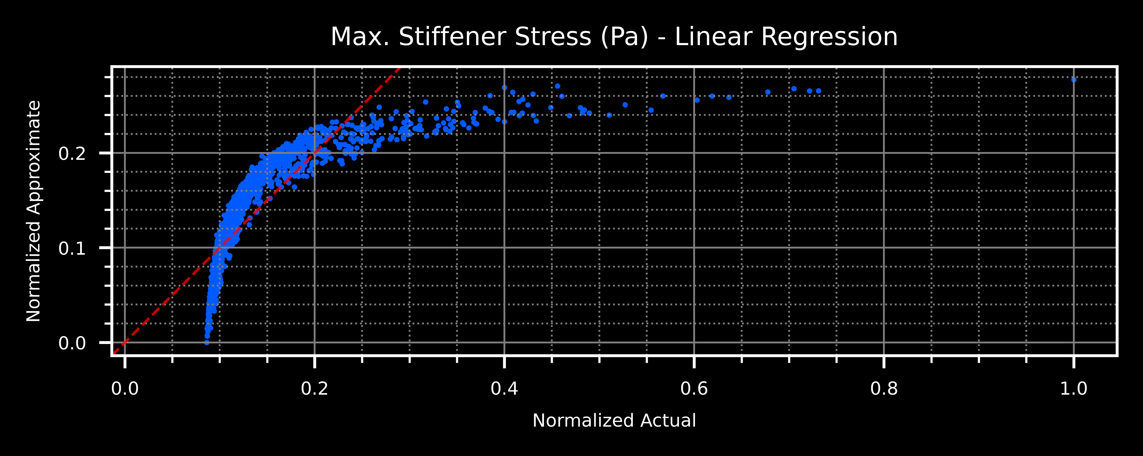
Backup 6 – Surrogate Model Results

Slide 30
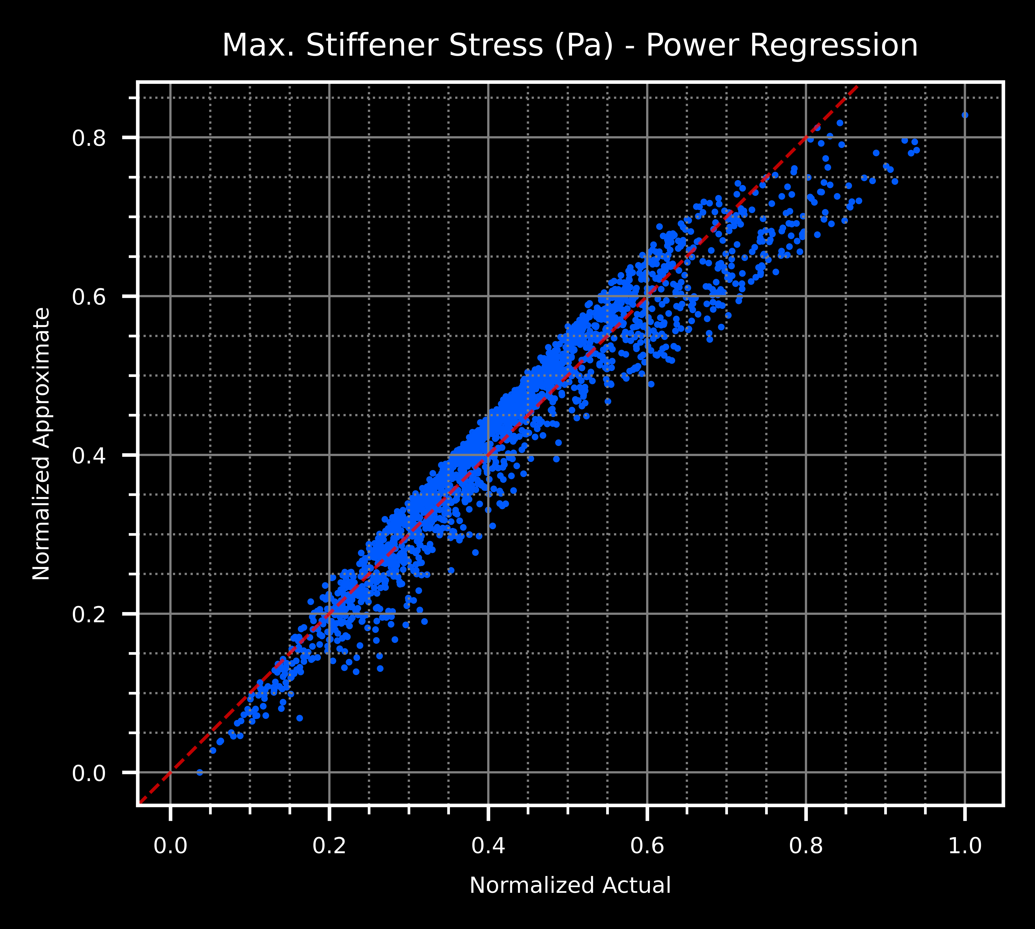
Backup 6 – Surrogate Model Results

Slide 31
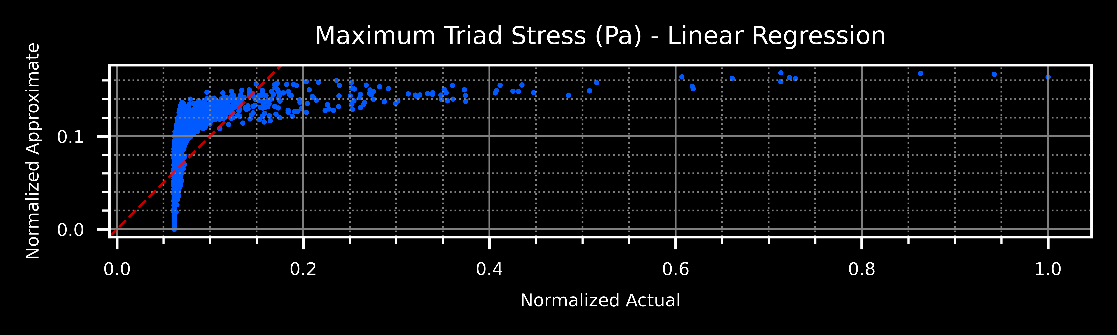
Backup 6 – Surrogate Model Results

Slide 32
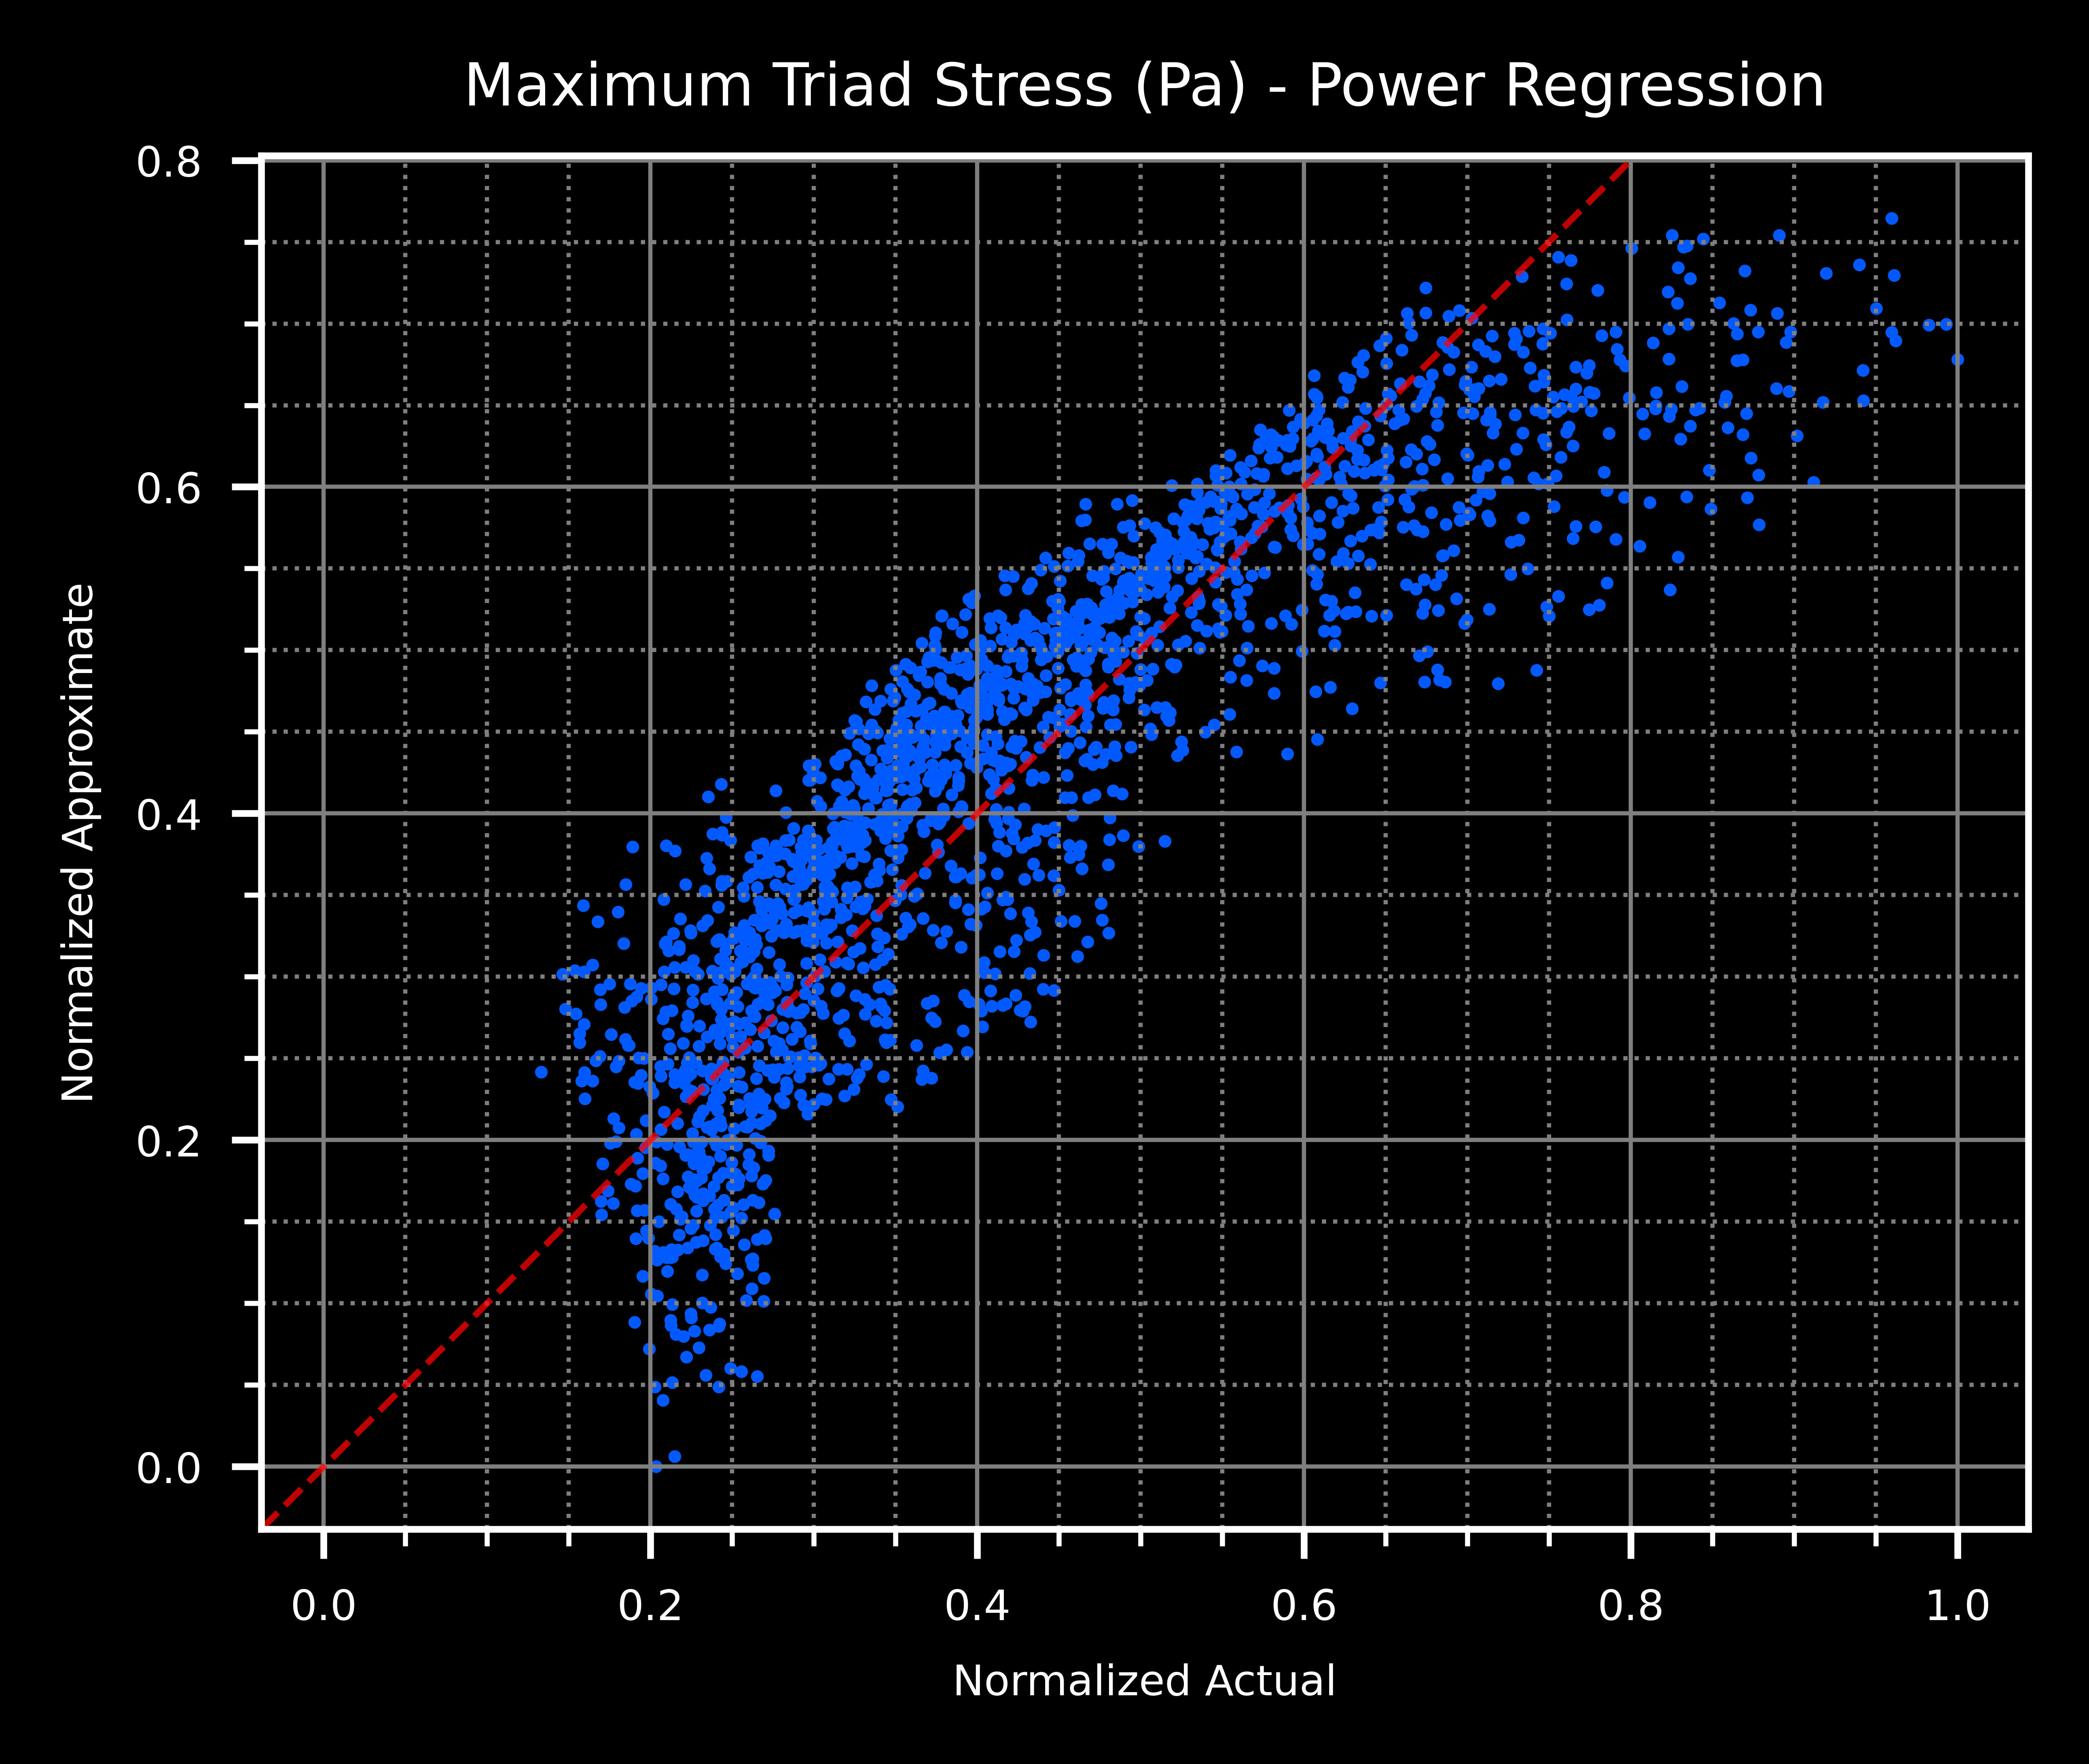
Backup 6 – Surrogate Model Results

Slide 33
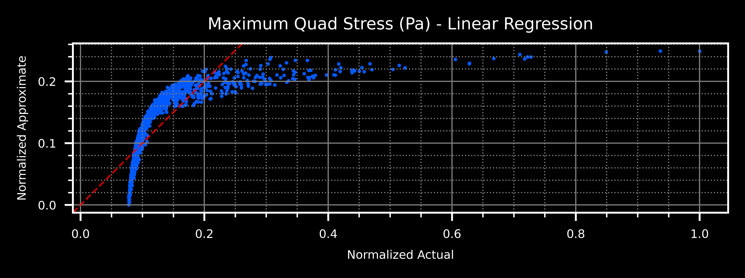
Backup 6 – Surrogate Model Results

Slide 34
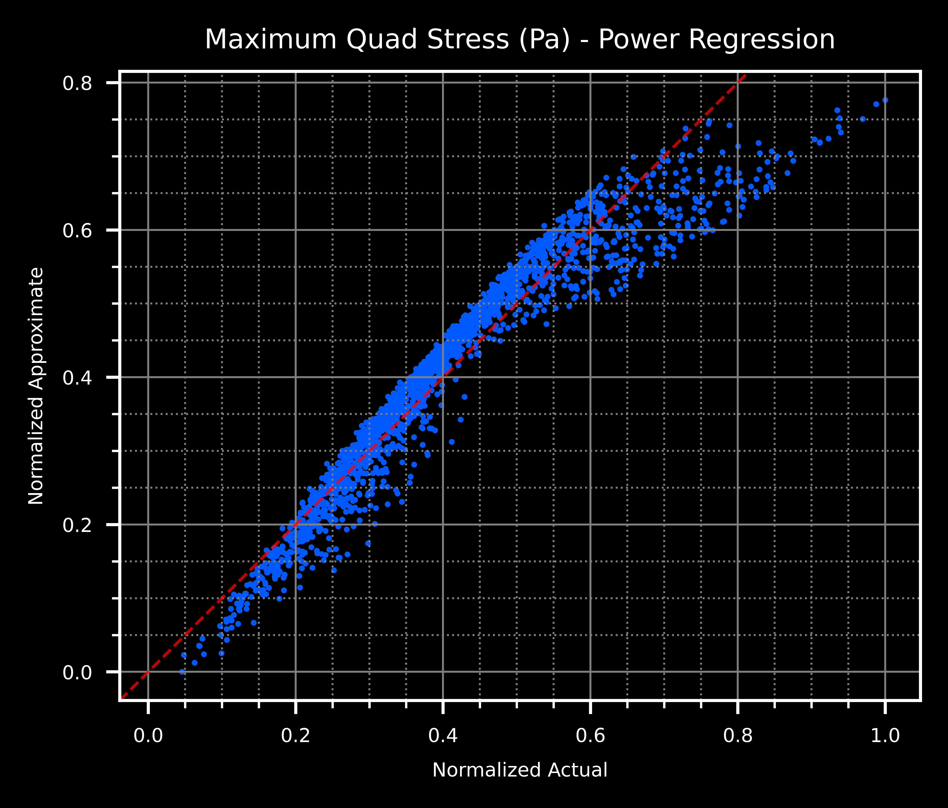
Backup 6 – Surrogate Model Results

