Slide 1
Simulation and Regression Modeling of NASA's X-59 Low-Boom Carpets Across America
Will Doebler, Sara Wilson, and Alexandra Loubeau
NASA Langley Research Center
AIAA HRS Young Professional Lecture
5/24/2023

Slide 2


Presentation Overview
Sonic Boom Background Info
Quesst Mission and X-59 aircraft
Outline of the Sonic Boom Simulation Goals
DoE Approach
for X-59 Sonic Boom Simulation
Simulation Results and Visualizations

Slide 3
Presentation Overview
Sonic Boom Background Info
Quesst Mission and X-59 aircraft
Outline of the Sonic Boom Simulation Goals
DoE Approach
for X-59 Sonic Boom Simulation
Simulation Results and Visualizations

Slide 4
Brief and abbreviated history of civilian supersonic flight
1947 Yaeger breaks the sound barrier in the X-1
1960s Sonic Boom Community Noise Surveys
1973 FAA Prohibits Civilian Supersonic Flight Over Land
1976 Concorde Supersonic Over Water Routes
2003 Concorde Retires
2005 Shaped Sonic Boom Demonstrator
2020 FAA Notice of Proposed Rulemaking Regarding Supersonic Flight
2025 X-59 Low-boom Community Noise Surveys

Slide 5
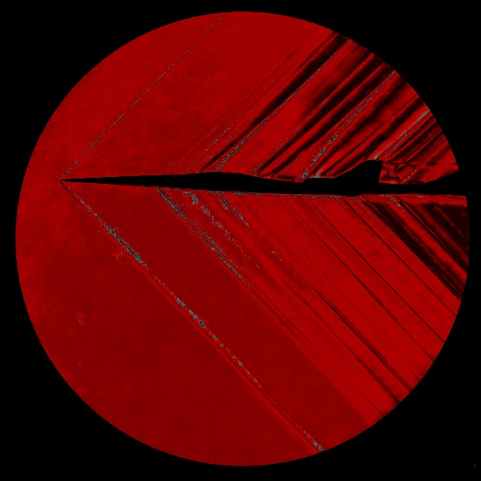
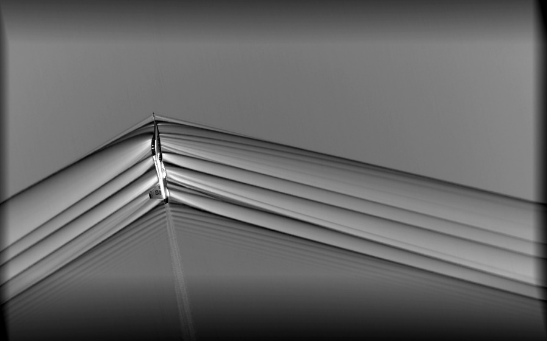
Traditional N-wave Sonic Booms and Shaped Low-Booms
Traditional
Low-boom
Shocks near the aircraft merge together to form an “N-wave” with strong bow and tail shocks
Clever aircraft shaping prevents shocks from merging, which significantly reduces the loudness
Sound arrives at the ground
Bang!
Thump
Bang!
Thump
Pressure
Pressure
Time
Time

Slide 6
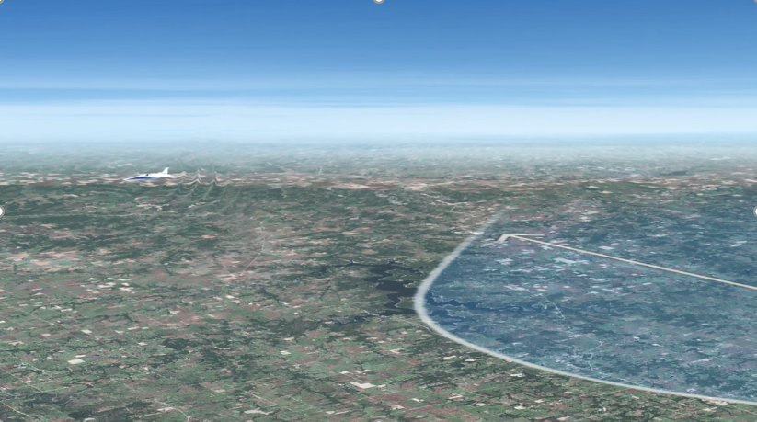
Sonic Boom Exposure Region Size

Slide 7
Presentation Overview
Sonic Boom Background Info
Quesst Mission and X-59 aircraft
Outline of the Sonic Boom Simulation Goals
DoE Approach
for X-59 Sonic Boom Simulation
Simulation Results and Visualizations

Slide 8

Quesst Mission Introduction
Community Noise Surveys to start in 2025
  Four to six community tests are being planned
    X-59 will fly supersonic over a community creating a low-boom of a prescribed loudness chosen by experimental design
    Noise monitors will record the low-booms
    Survey participants will report their annoyance
  Boom level vs. annoyance data (dose-response curves) will be provided to
    International Civil Aviation Organization (ICAO)
    US Federal Aviation Administration (FAA)
    for consideration in noise certification standards
How will the X-59 noise exposure region size and loudness change across the US due to prevailing atmospheric conditions?
  Simulation study was conducted to aid in planning community tests
X-59
Mach 1.4 at 53,200 ft
Low-boom Perceived Level (PL): 75 dB

Slide 9
Presentation Overview
Sonic Boom Background Info
Quesst Mission and X-59 aircraft
Outline of the Sonic Boom Simulation Goals
DoE Approach
for X-59 Sonic Boom Simulation
Simulation Results and Visualizations

Slide 10
Goals of Sonic Boom Propagation Simulation
Assess nationwide X-59 low-boom
  Loudness and variability
  Exposure region size and variability
due to:
  Climate
  Season
  Flight direction
  Time of day
  Geographical location
  Ground elevation
balancing:
  Computational constraints
  Project schedule
Aircraft Trajectory Information
Computational Fluid Dynamics Acoustic Data
Atmospheric Model Data
PCBoom
Acoustic Propagation Model
Size of the region exposed to noise
Low-boom Loudness

Slide 11
Presentation Overview
Sonic Boom Background Info
Quesst Mission and X-59 aircraft
Outline of the Sonic Boom Simulation Goals
DoE Approach
for X-59 Sonic Boom Simulation
Simulation Results and Visualizations

Slide 12
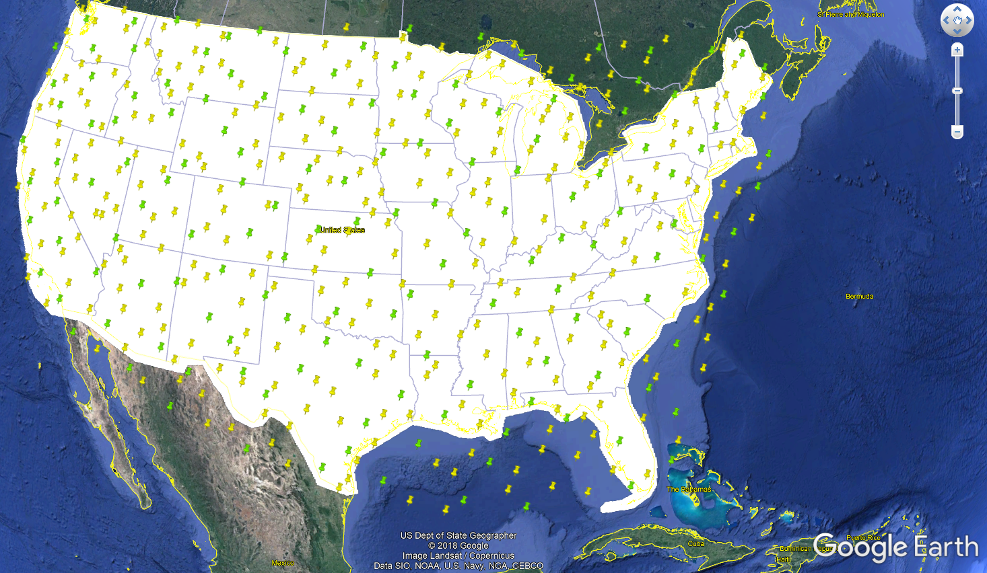
Design of Experiments Approach
Need to determine appropriate locations and times of atmospheric profiles
through which to propagate
Locations across USA chosen using Fast Flexible Filling Design
  Provides good space filling properties and can accommodate irregular shapes like the contiguous USA
Two spatial resolutions:
  150 and 450 locations across USA
Lekivetz, R. and Jones, B., (2015) “Fast Flexible Space-Filling Designs for Nonrectangular Regions,” Qual. Reliab. Engng. Int., 31(5), 829-837

Slide 13
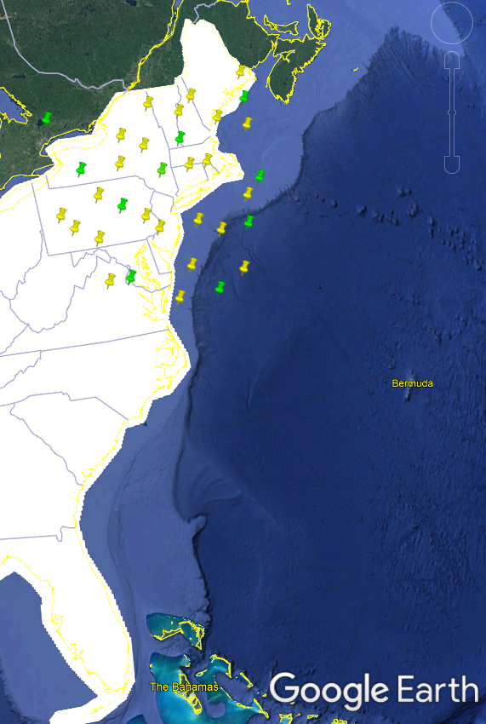
Subset analysis to determine simulation resolution
Completed propagation simulation for subset of locations in the Northeast
Compared results of designs with higher and lower spatial and temporal resolutions
  34 vs. 10 locations in Northeast
  4 vs. 1 atmospheric profiles per day
5 years of atmospheric profiles, 4 aircraft headings
Subset storage size
  About 1.5 TB total for nearly 1 million carpets

Slide 14
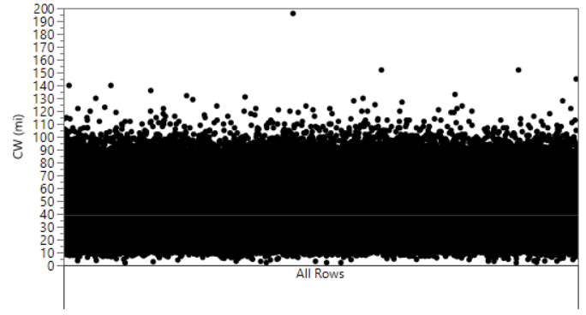
To determine importance of input factors, used decision tree and bootstrap forest analysis
Input factors (predictors)
  Heading
  Latitude/longitude
  Season
  Datetime
  Ground elevation
Carpet quantifiers
  Exposure Region Size
    “Carpet width”
  Undertrack Perceived Level (PL)
  Range of PL
All Data
Example decision tree data for CW
  Carpet Width (km)
All Data

Slide 15
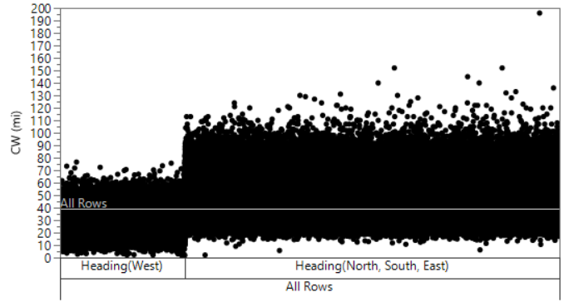
To determine importance of input factors, used decision tree and bootstrap forest analysis
Input factors (predictors)
  Heading
  Latitude/longitude
  Season
  Datetime
  Ground elevation
Carpet quantifiers
  Exposure Region Size
    “Carpet width”
  Undertrack Perceived Level (PL)
  Range of PL
All Data
Example decision tree data for CW
  Carpet width (km)
All Data

Slide 16
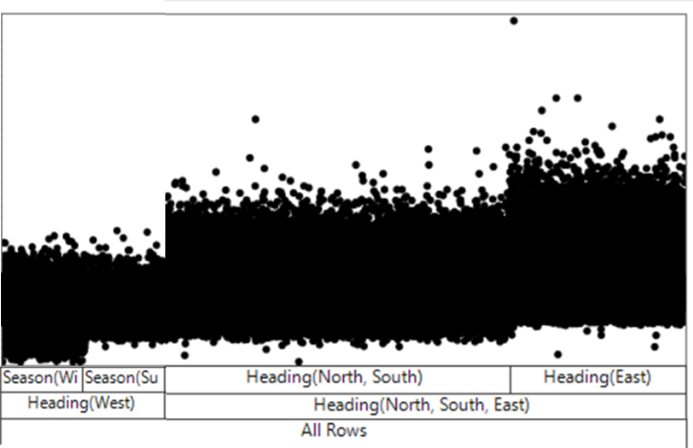
To determine importance of input factors, used decision tree and bootstrap forest analysis
Input factors (predictors)
  Heading
  Latitude/longitude
  Season
  Datetime
  Ground elevation
Carpet quantifiers
  Exposure Region Size
    “Carpet width”
  Undertrack Perceived Level (PL)
  Range of PL
All Data
Example decision tree data for CW
  Carpet width (km)
All Data

Slide 17
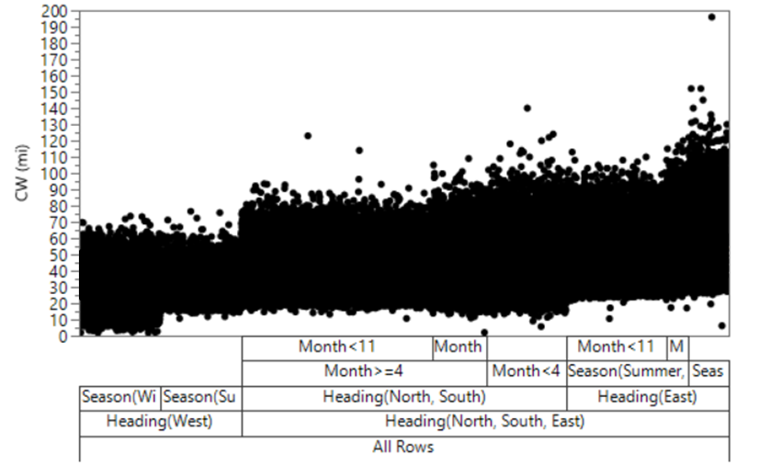
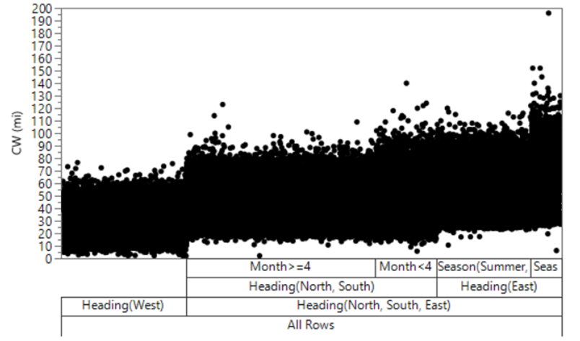
To determine importance of input factors, used decision tree and bootstrap forest analysis
Input factors (predictors)
  Heading
  Latitude/longitude
  Season
  Datetime
  Ground elevation
Carpet quantifiers
  Exposure Region Size
    “Carpet width”
  Undertrack Perceived Level (PL)
  Range of PL
All Data
Example decision tree data for CW
  Carpet width (km)
All Data

Slide 18
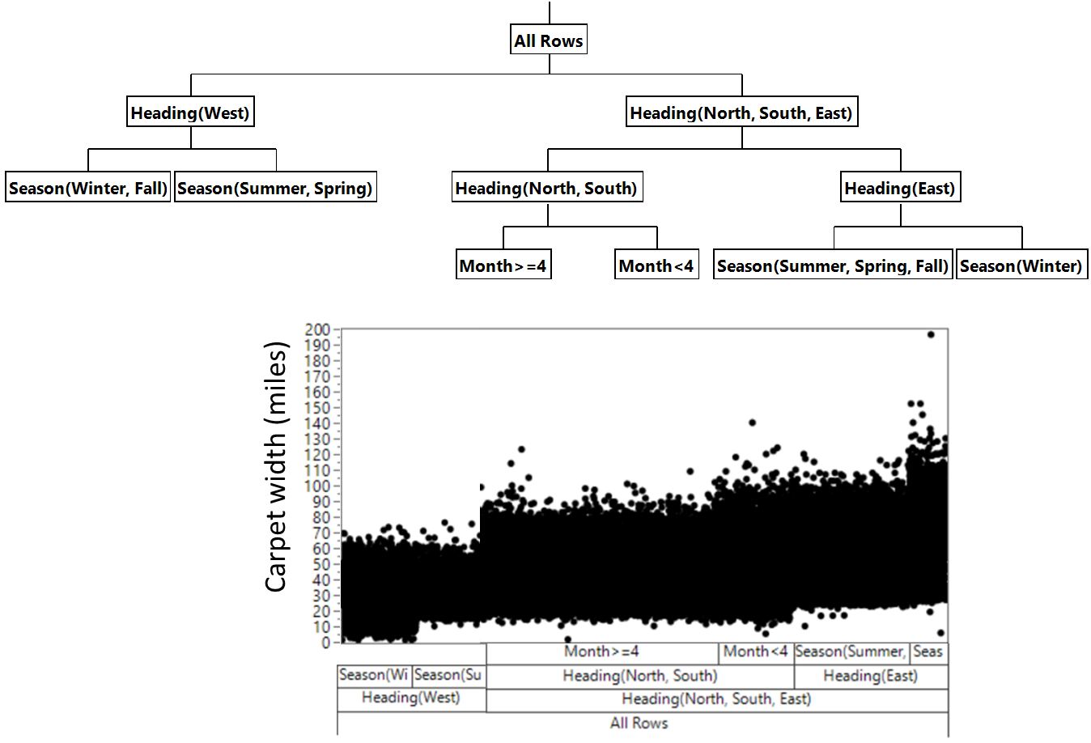
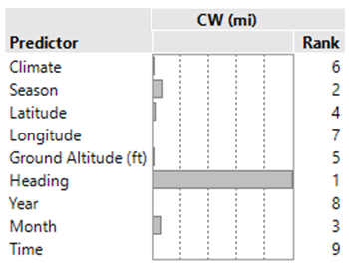
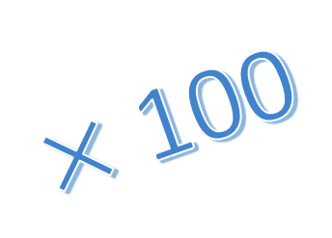
Bootstrap forest analysis description
Bootstrap forest analysis was conducted to evaluate spatial and temporal resolution
  Randomly sampled from the dataset to build 100 decisions trees
  Statistical decision tree recursively partitioned data according to the relationship between predictors and response variables
  Contribution of each predictor was then ranked
All Data
$×$ 100
All Data

Slide 19
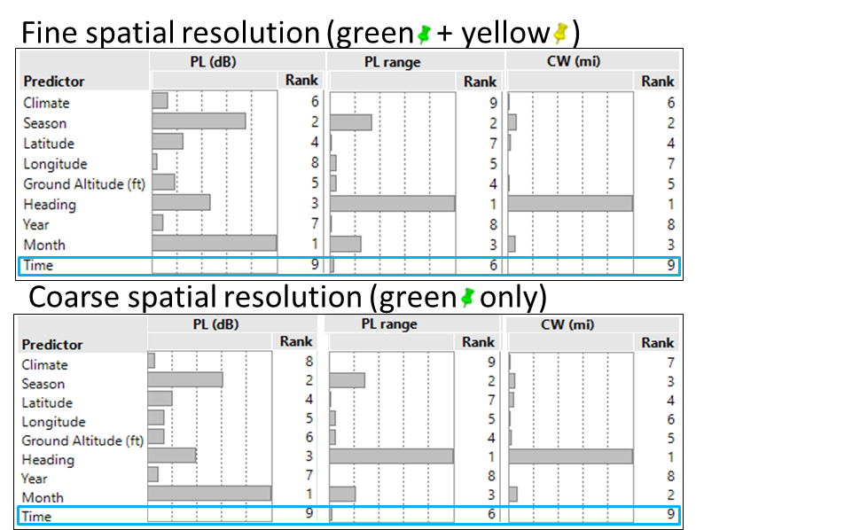
Bootstrap forest results
Time of day was not important
Equivalent predictor importance for both spatial resolutions

Slide 20
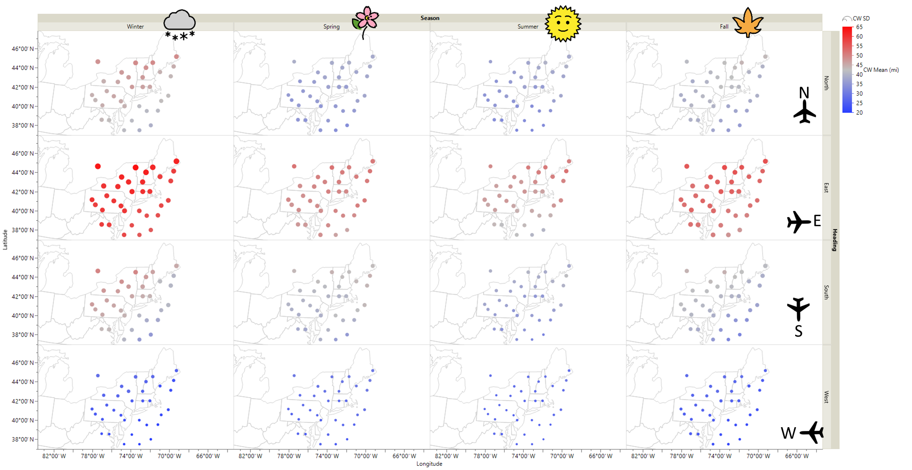
Carpet width (CW) mean and standard deviation (SD) results
  Dot color indicates mean
  Dot size indicates standard deviation (SD)
Range of CW SD:
3.8 to 14.8 mi
(6.1 to 23.8 km)
(105 km)
Mean CW (miles)
Values vary smoothly between nearby points
(32 km)

Slide 21
Final Design
Inputs
  138 locations separated by about 200 km
  5 years of atmospheric data at each location
  One time per day, 1800 UTC, 11 AM to 2 PM local
  4 cardinal aircraft headings
Results
  Over 1 million X-59 sonic boom exposure region sizes
  Over 18 million X-59 sonic boom waveforms
Follow-on analysis
  Multiple linear regression models to estimate quantities in intermediate locations

Slide 22
Presentation Overview
Sonic Boom Background Info
Quesst Mission and X-59 aircraft
Outline of the Sonic Boom Simulation Goals
DoE Approach
for X-59 Sonic Boom Simulation
Simulation Results and Visualizations

Slide 23
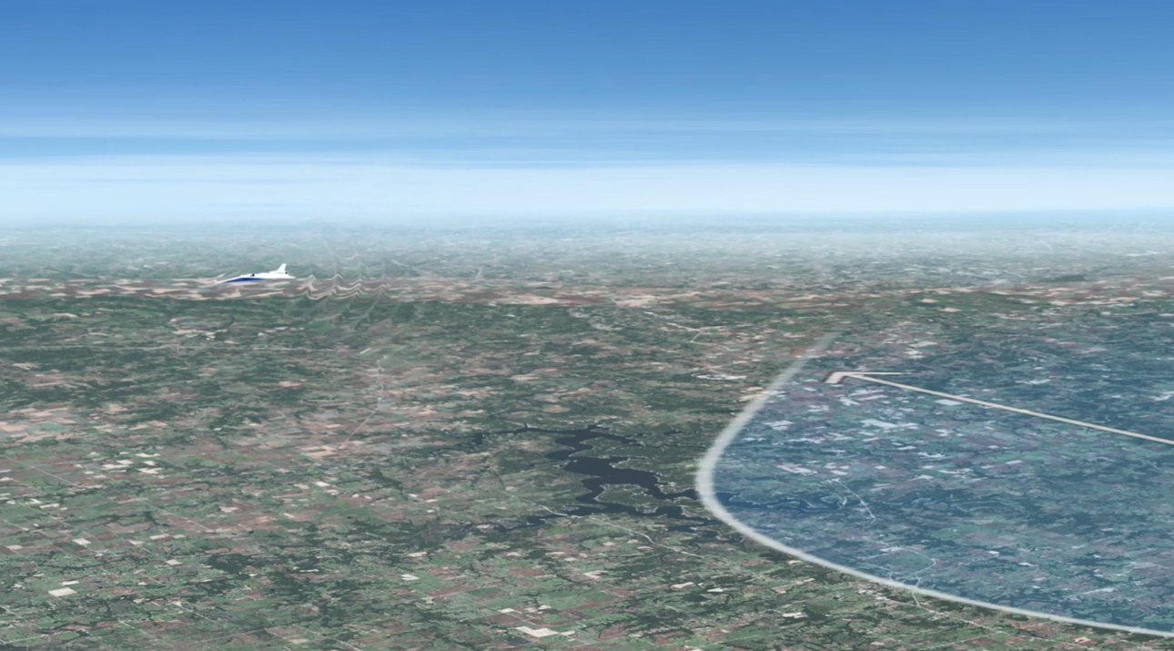
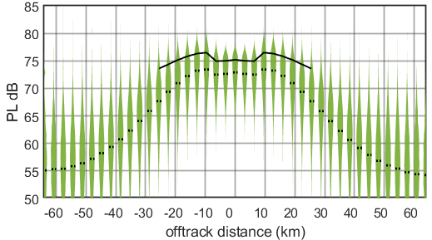
Visualization Techniques: Violin Plots for Loudness

Slide 24
Visualization Techniques: Violin Plots for Climate Results
Season

Slide 25
Visualization Techniques: Map plots for Loudness and Variability

Slide 26
Visualization Techniques: Map plots for Season and Heading

Slide 27
Visualization Techniques: Map plots for multiple linear regression

Slide 28
Key simulation results
X-59 shaped booms expected to be louder at higher latitudes in colder climates
  In general, low-booms produced during winter tend to be louder than summer
Mean PL across the USA varied by 7 dB for this aircraft configuration
Carpet widths are widest with an east heading and most variable at higher latitudes
Mean CW across the USA varied from 42 to 62 km
Propagation through realistic atmospheres results in lower PL than the standard atmosphere in which X-59 was designed to achieve a 75 dB target
Results aid in X-59 community noise survey planning

Slide 29
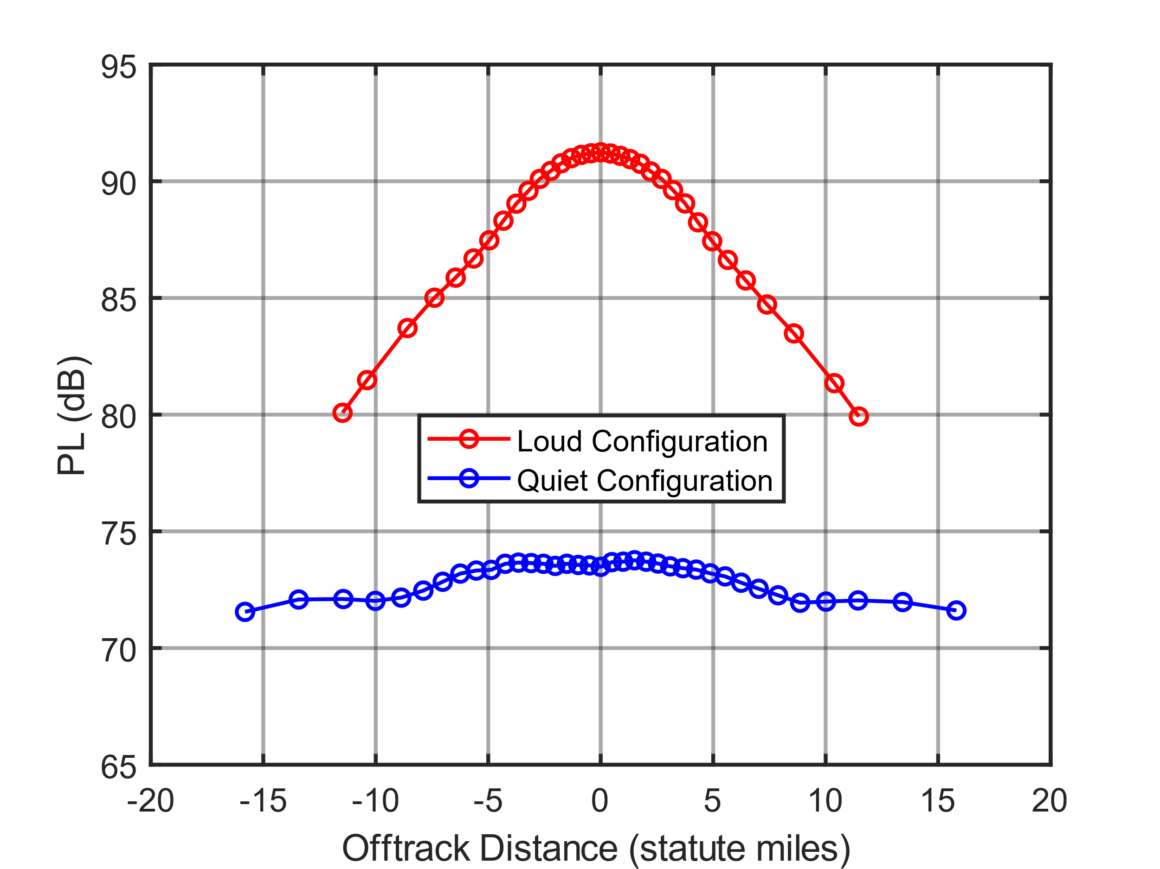
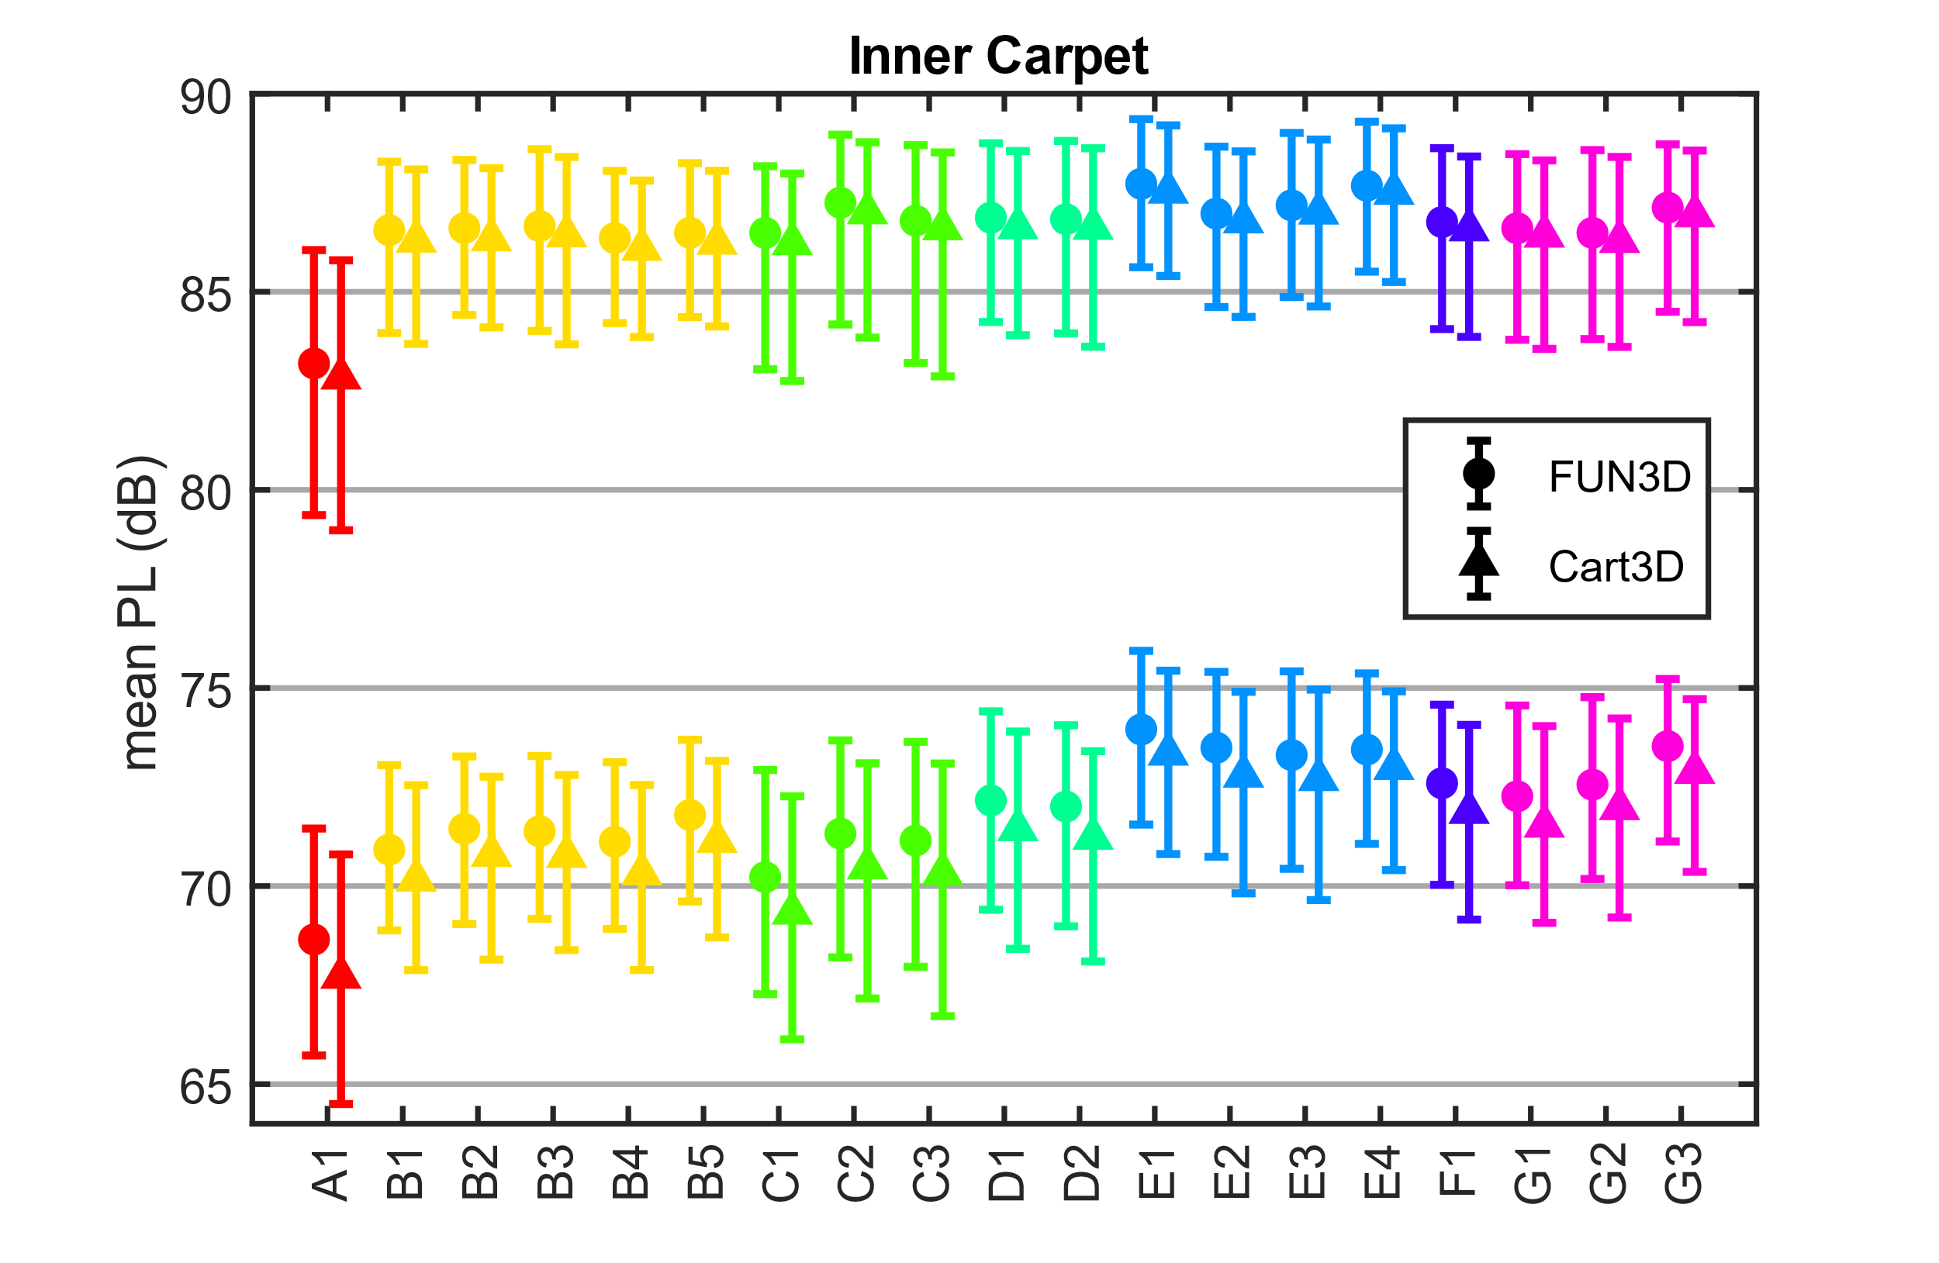
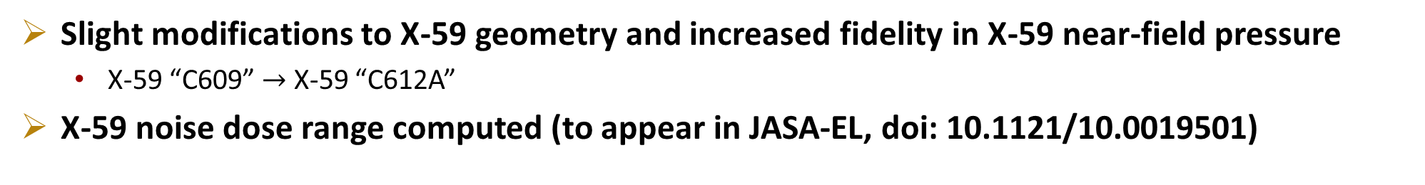
Additional activity since completing this simulation study
Slight modifications to X-59 geometry and increased fidelity in X-59 near-field pressure
  X-59 “C609” $→$ X-59 “C612A”
X-59 noise dose range computed (to appear in JASA-EL, doi: 10.1121/10.0019501)
Location Index

Slide 30
Summary
X-59 will be flying over US communities starting in 2025
to collect community noise data on low-booms
A simulation study was conducted to assess the impact of climate, heading, season, time of day, and geographical location on low-boom loudness, variability, and exposure region size
  Fast-flexible filling design was used to decide the locations
  A bootstrap forest of decision trees was used to decide the final temporal and spatial resolution
  Results included millions of sonic boom waveforms and exposure region sizes
Multiple linear regression was used to estimate loudness, variability, and exposure region size at intermediate locations
  Results were visualized using violin plots and on maps to show trends induced by climate, heading, season, and location
The simulated data will be used to aid X-59 community test plans
Additional work has been conducted to estimate the loudness capabilities of the X-59

Slide 31
Thank you
Season

