Slide 1
ACS3 Flight Dynamics
Andres dono, Ted Hendriks, Keats Wilkie
NASA Ames Research Center
NASA Langley research center
6th International Symposium on Space Sailing

Slide 2
Outline
ACS3 Mission Overview
Flight Dynamics Architecture
Solar Sail Simulation
Orbit Determination
Conclusions

Slide 3
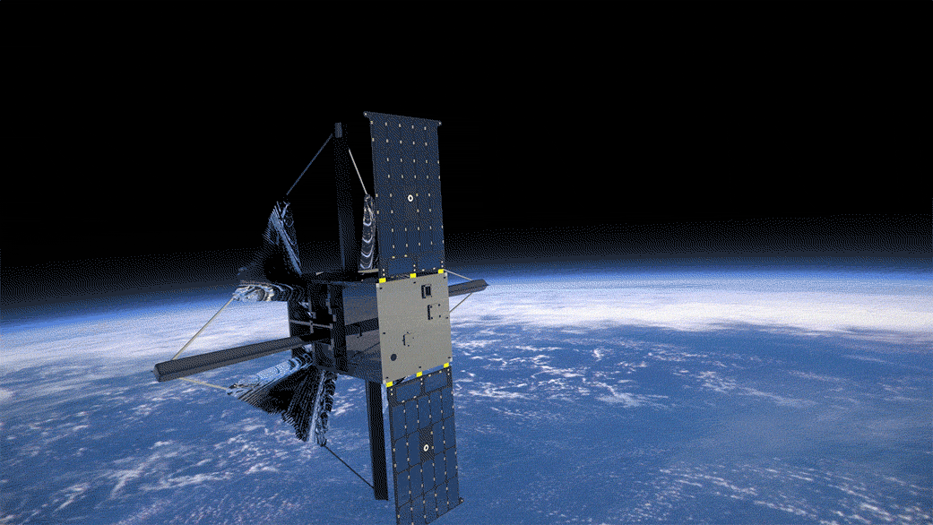
ACS3 Overview
ACS3 is a 12U spacecraft that will deploy an 81 m² solar sail in low Earth orbit.
Launch: October-December 2023 (TBD)​
Orbit: 715 km - 1000 km (TBD)
Midnight-Noon Sun Synchronous​
Objectives:​
  Primary: On-orbit deployment and characterization of a smallsat-class composite solar sail. ​
  Secondary: Demonstrate controlled solar sailing flight (e.g., SMA-raising/lowering) in LEO. Characterize deployed structural dynamics.​
Video Credit: NASA Ames

Slide 4
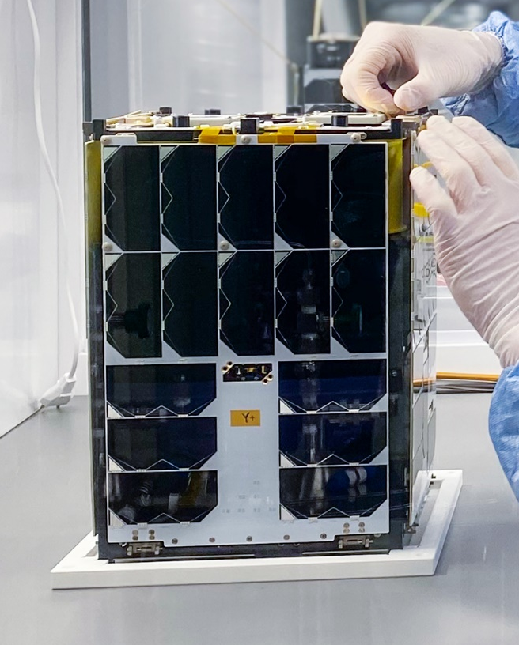
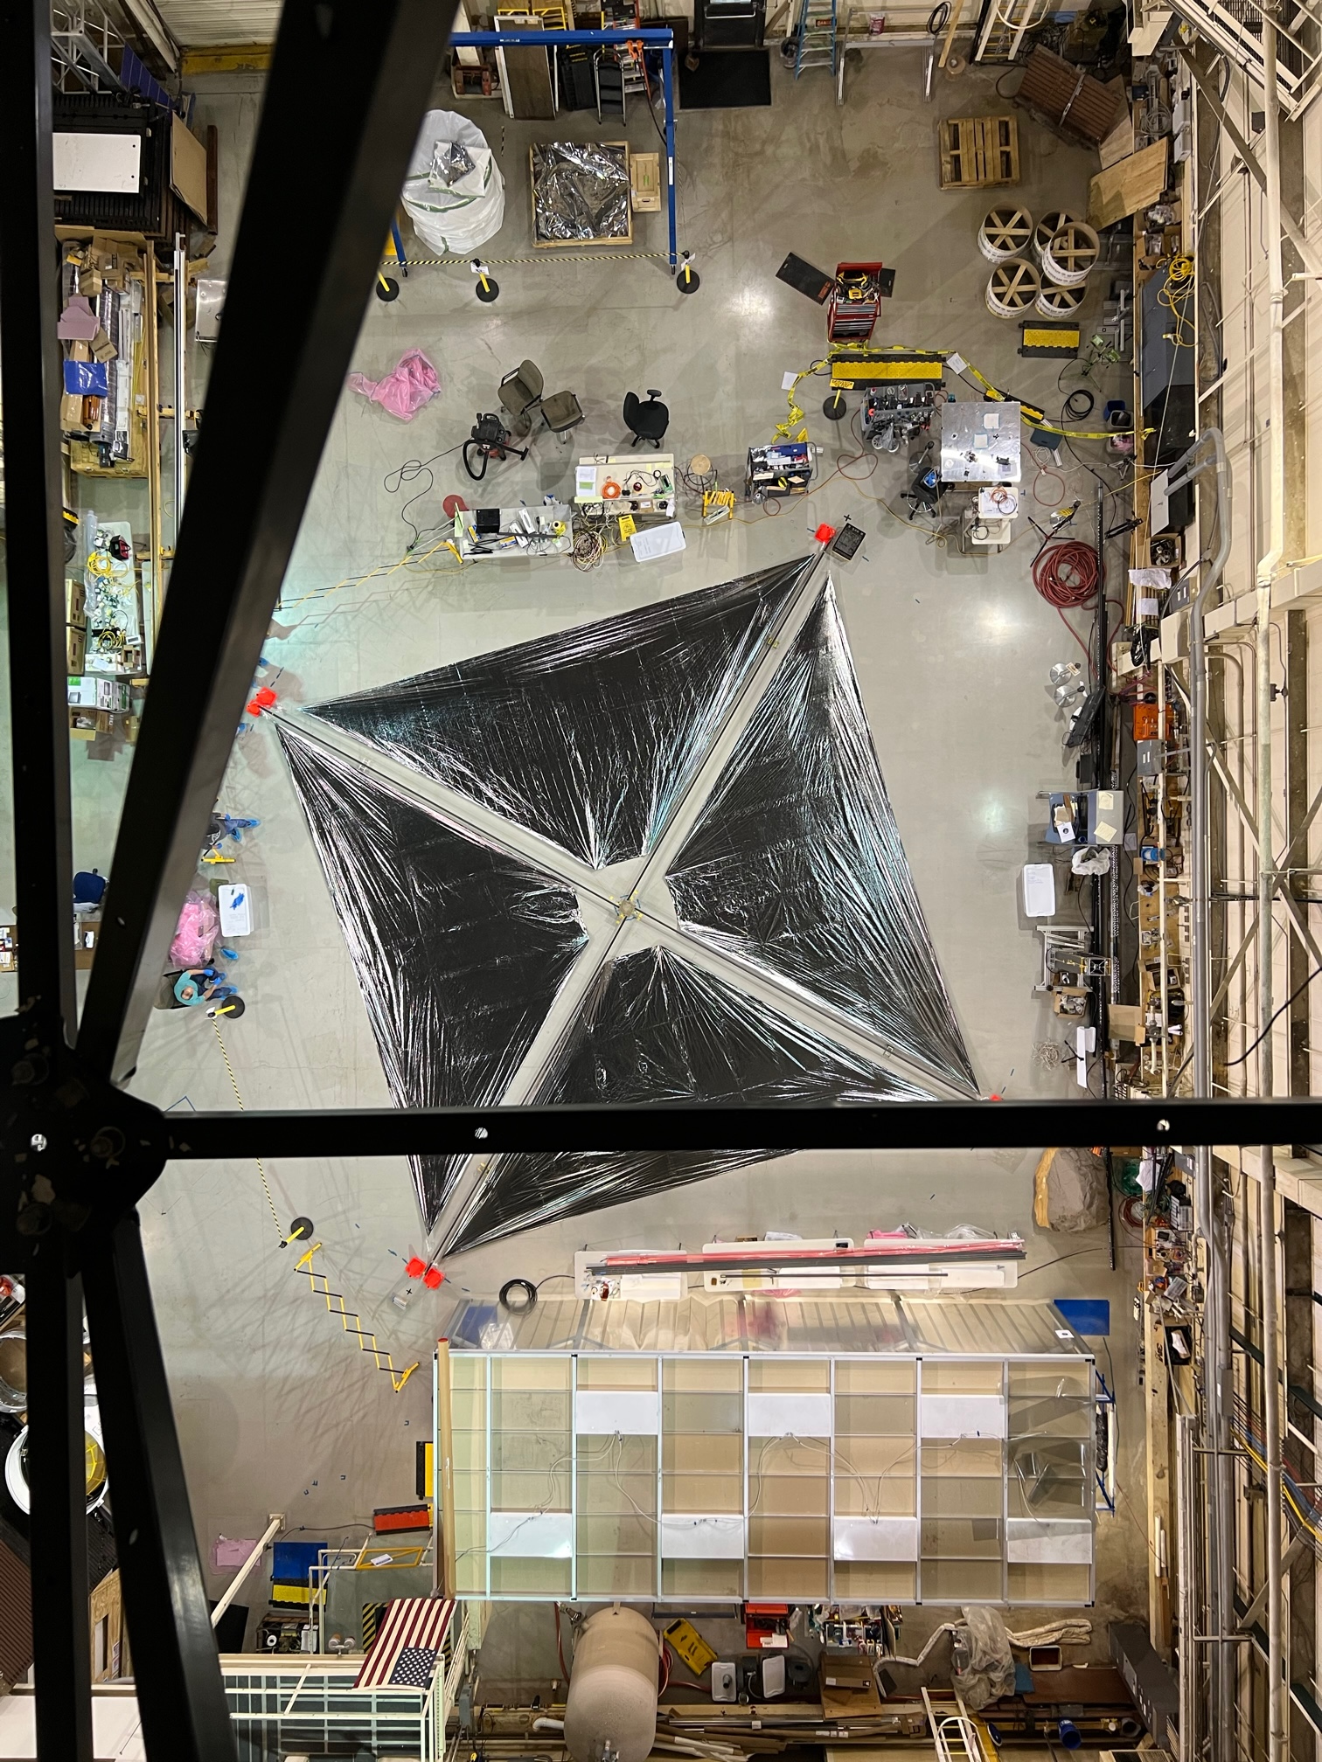
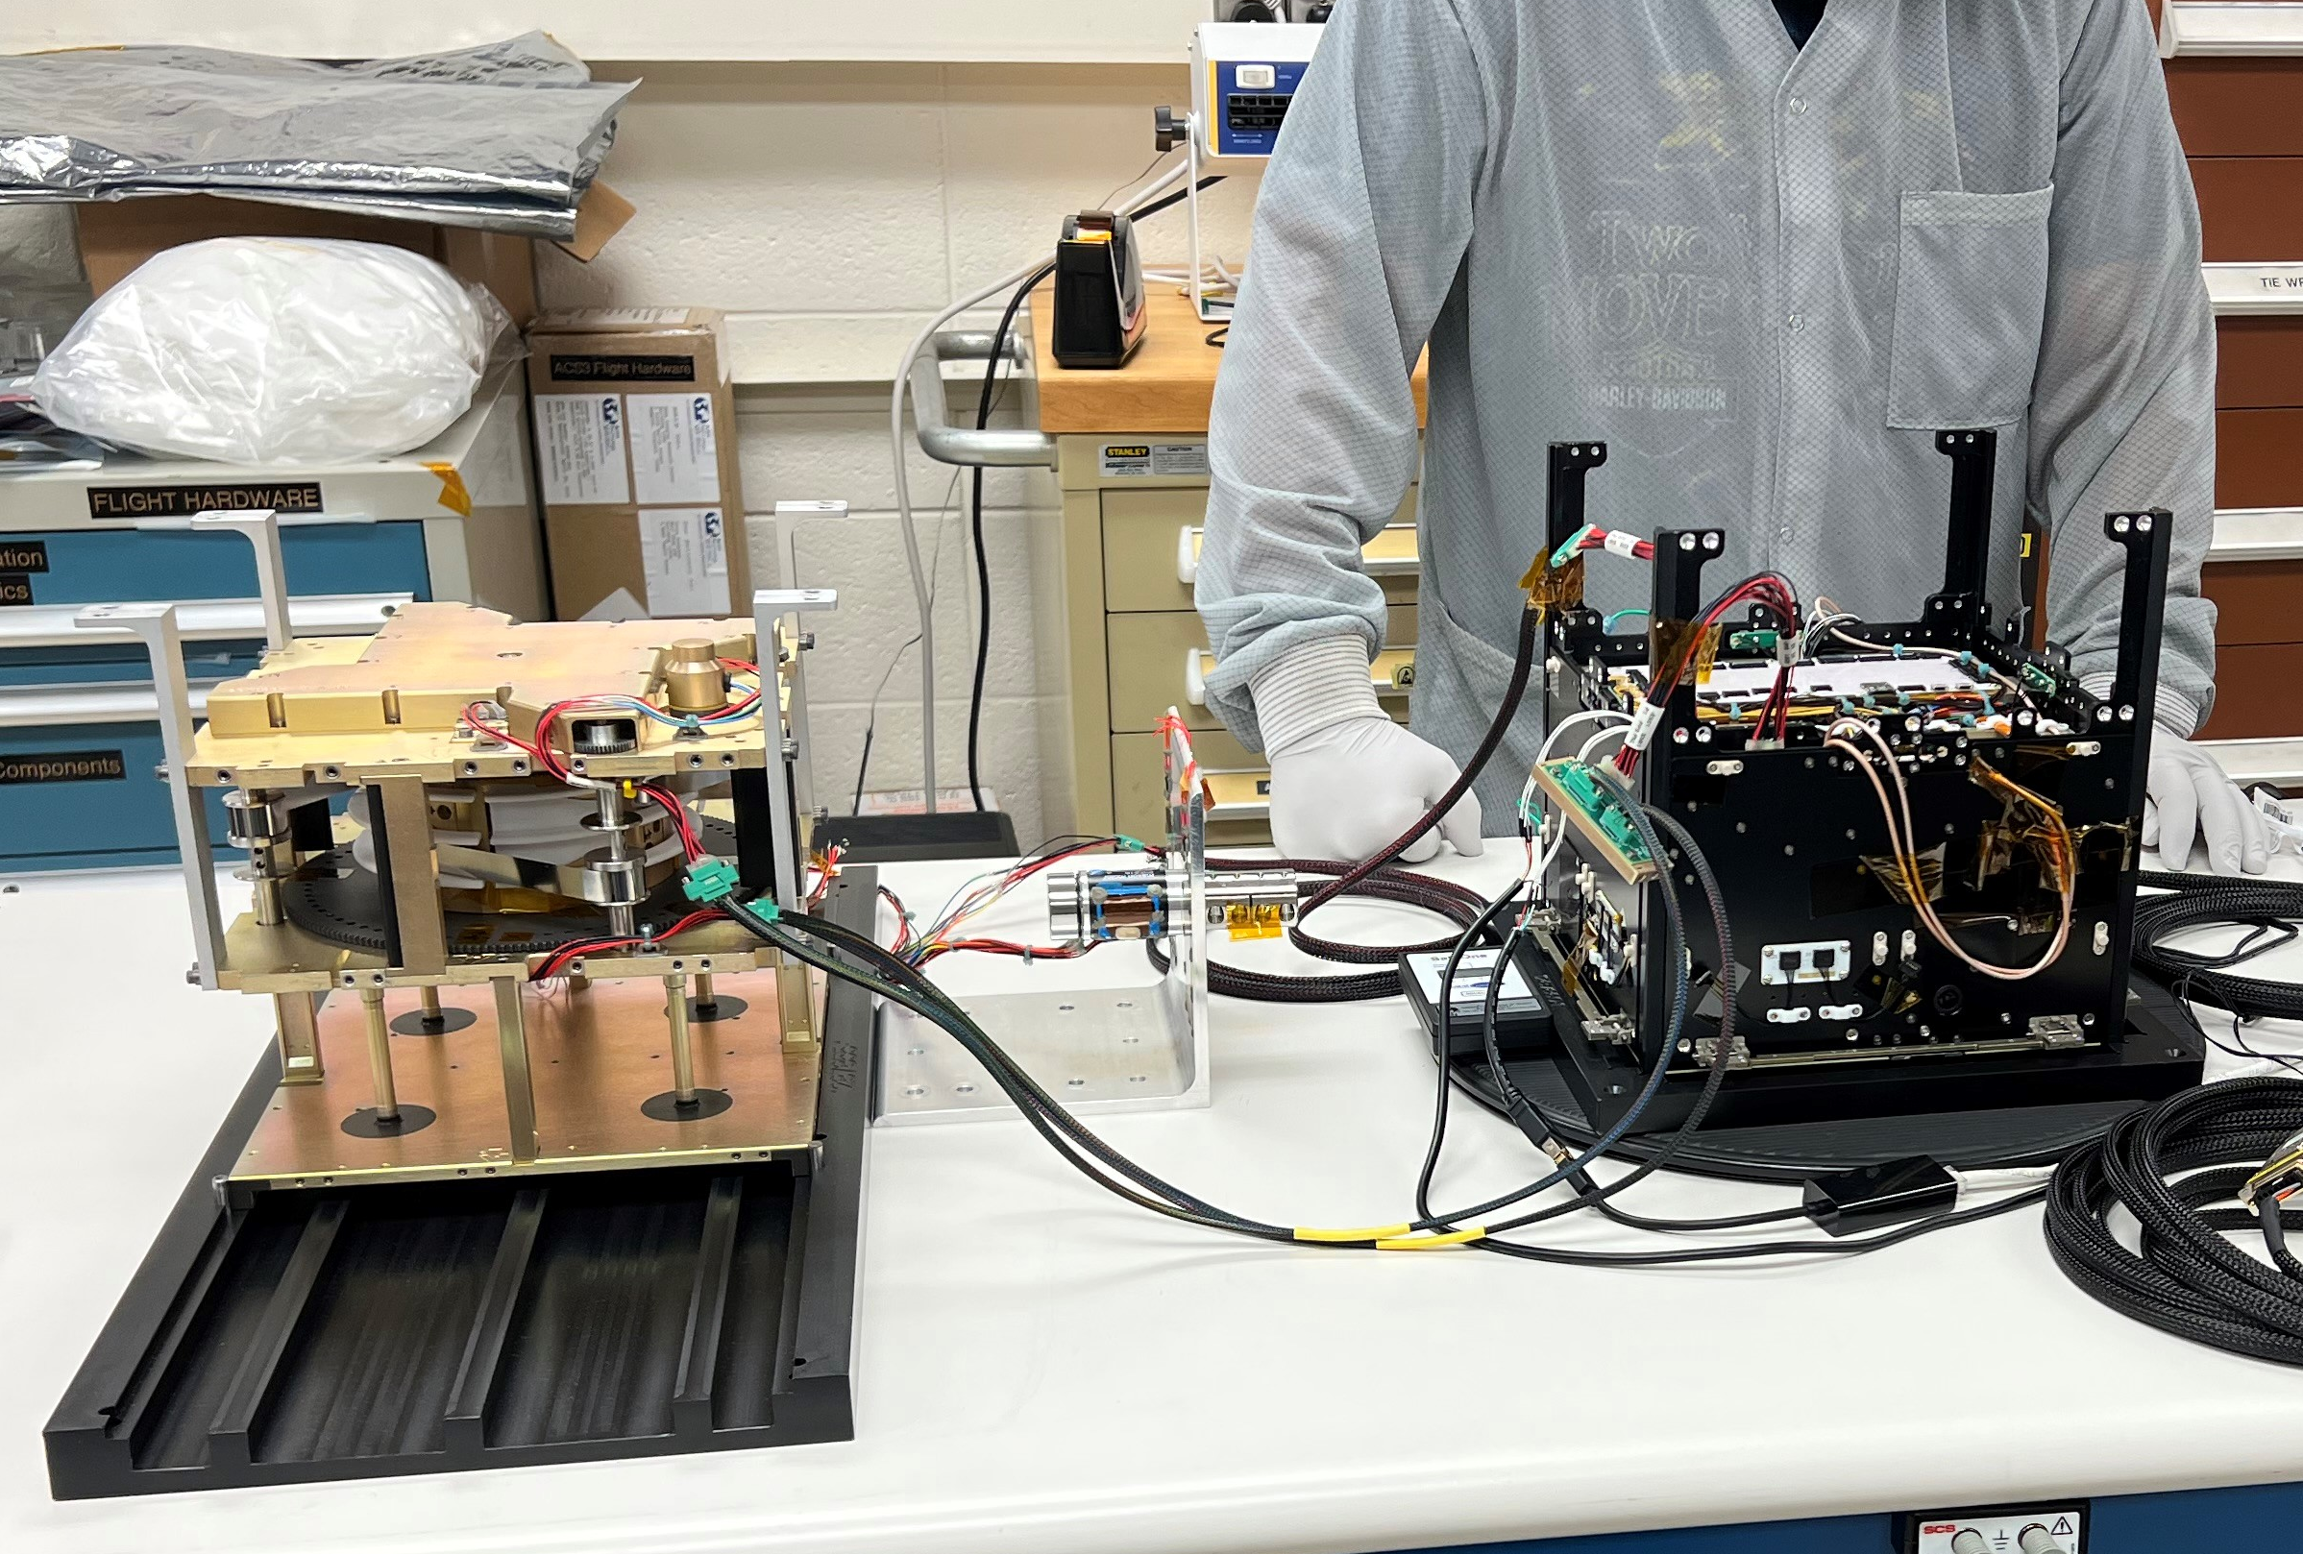
ACS3 Flight Subsystems
12U Spacecraft Bus (NanoAvionics)
80 m² Solar Sail (LaRC)
STMD Deployable Composite Booms (DCB I)
Low-cost Al/PEN/Cr sail quadrants
Image credit: NASA Langley
Sail-Boom Deployer (LaRC)
Deployer Avionics and Camera System (ARC)
Image credit: NASA Langley
Image credit: NASA Langley
Notes:
Major ACS3 flight hardware subsystems. Total ACS3 spacecraft mass: 16 kg. Solar Sail deployed dimensions: 9 m x 9 m (10 m x 10 m with boom tips). Not shown: 12U ExoLaunch dispenser.

Slide 5
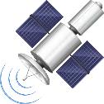
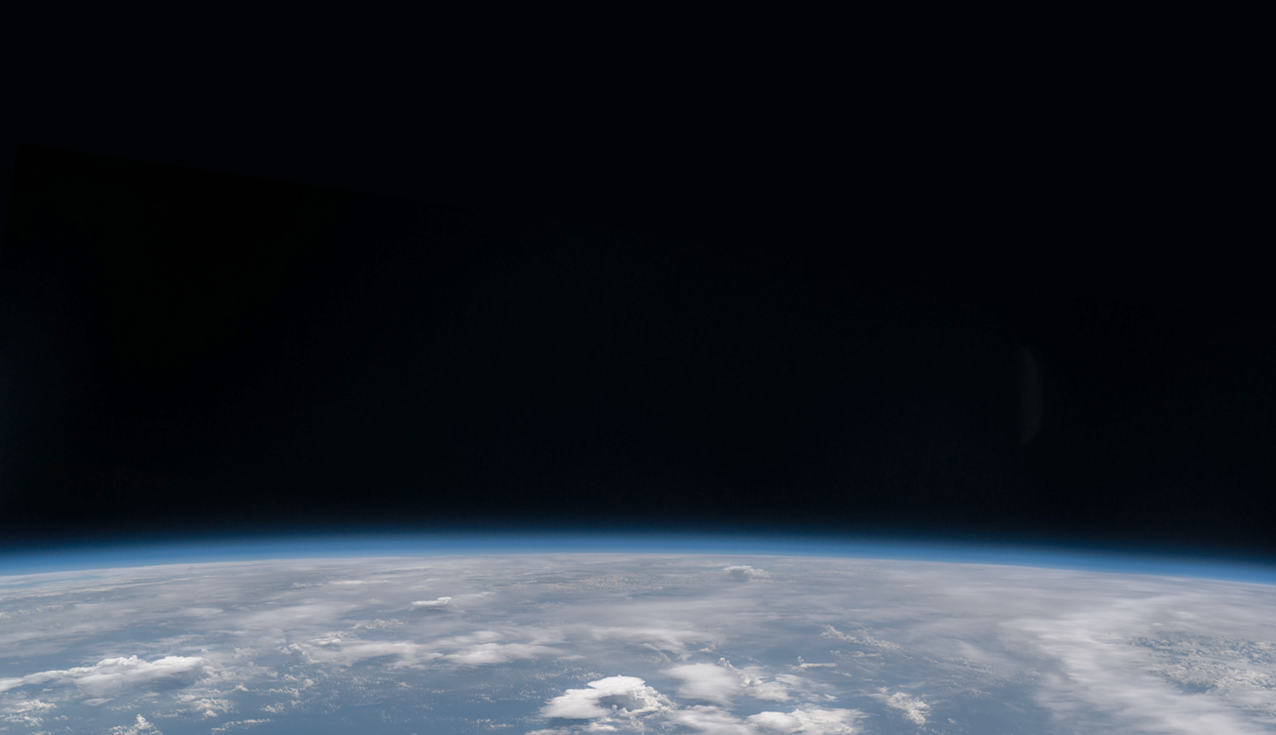

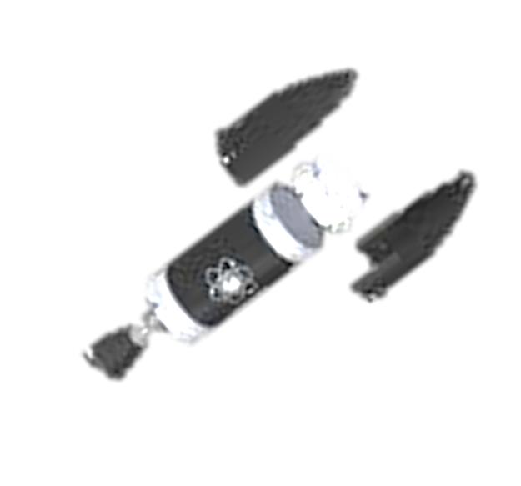

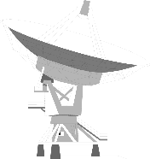


ACS3 CONOPS
GPS for precise orbit determination
Level I requirements
30 days
(optional)
Level I goals
Up to +0.5 km/day
7 days
30 days
Orbit raising demonstration
30 to 60 days
1000 km SSO
Spacecraft commissioning
Solar sail deployment
Solar sail characterization; imagery downlink
Orbit lowering demonstration
Extended sailing operations
Rocket Lab
LC-1 Mahia, NZ
Launch and spacecraft deployment
Up to -3 km/day
UL/DL
30 days (optional)
TBD days
(optional)
NASA ARC
UL/DL
NASA LaRC
Decommissioning and disposal
SCU
MOC and ground station
SLU
<180 days
backup ground station

Slide 6
Flight Dynamics Architecture
FD Internal
Ground Station
(SCU)
Ames
FD
ACS3 Mission
Raw
GPS Data
Telemetry
CARA
Formatted GPS Data
OD Reports
Analysis Reports
Predicted Ephemeris
Orbit Determination
Ephemeris Propagation
OD Results

Slide 7
Orbit Determination

Slide 8
Orbit Determination Process
Ground Station
Spacecraft records one GPS measurement per minute
Data is downlinked at each ground pass (~12 hours between passes)
GPS telemetry data is processed by Ames Flight Dynamics team
  Sequential filter is used to obtain ephemeris solution based on GPS tracking data
Orbit determination results are then used to generate predictive ephemeris with solar sail dynamics model
Raw
GPS
Data
Ames
FD
Formatted
GPS Data
Orbit Determination
OD Results

Slide 9
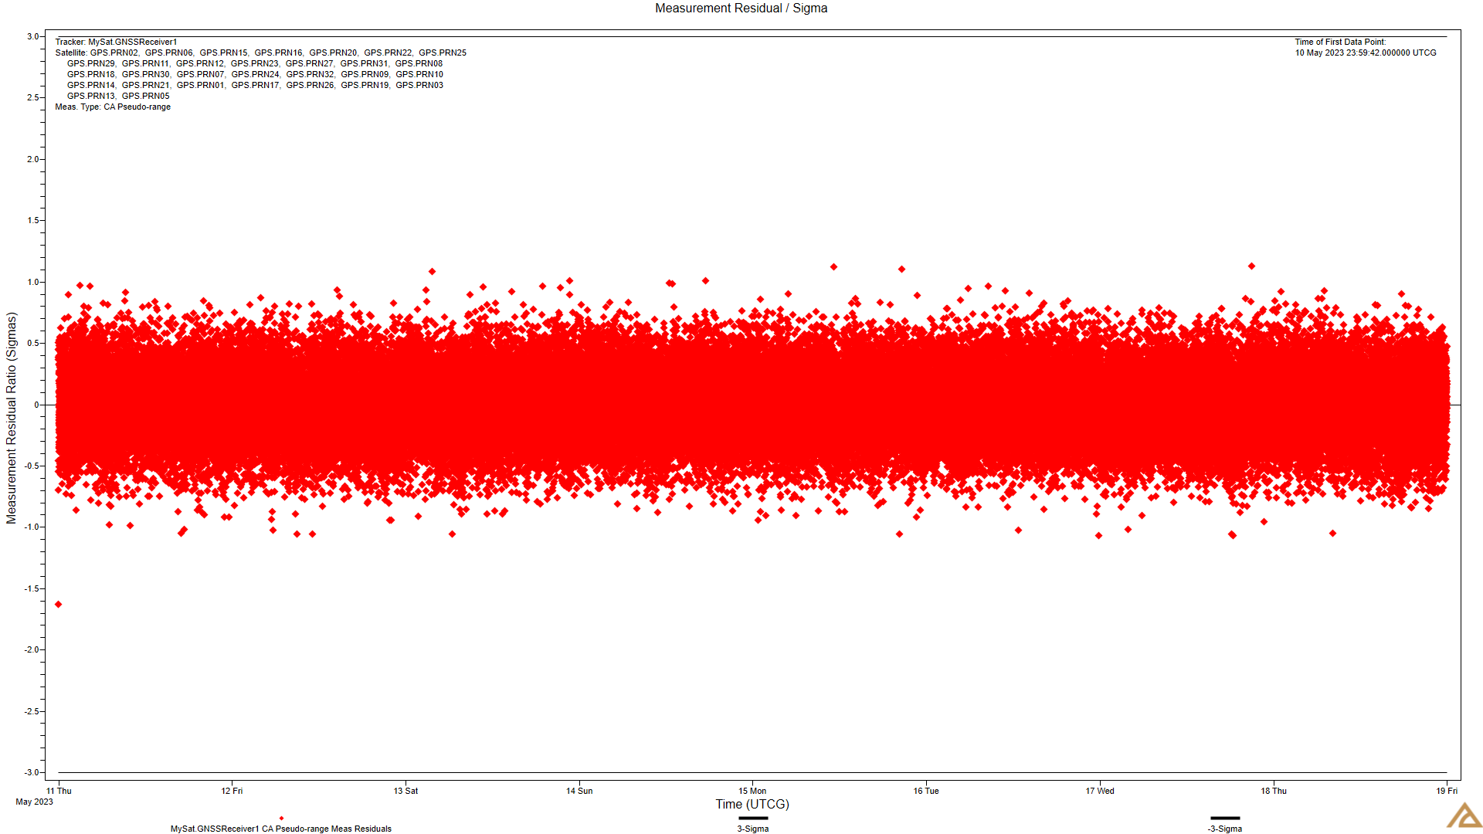
Simulated Tracking Data: Residual Ratios
To prepare for the mission we are running operation readiness tests (ORT)
Test simulates one week of GPS tracking data
Initial position uncertainty (3-σ) of 3 km
Initial velocity uncertainty (3-σ) of 0.3 m/s
Sequential filter and smoother were used to produce an OD solution
Measurement (pseudo-range) residual ratios are portrayed on the left

Slide 10
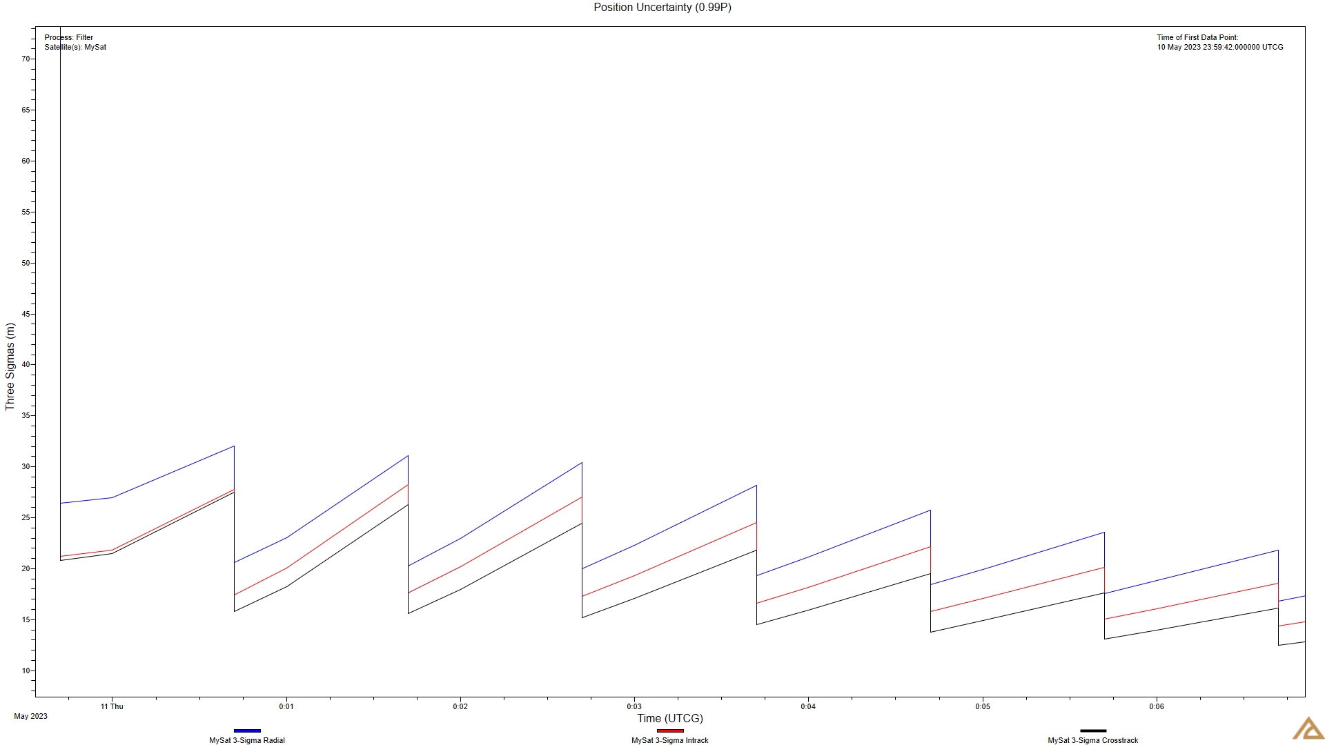
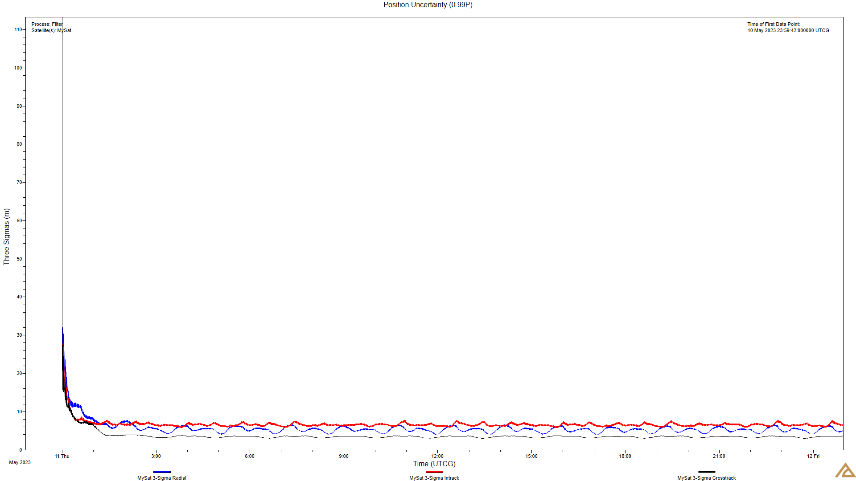
Simulated Tracking Data: Position Uncertainty
After first measurement position uncertainty drops rapidly
Uncertainty grows between measurement points
Long term uncertainty is controlled at this measurement cadence

Slide 11
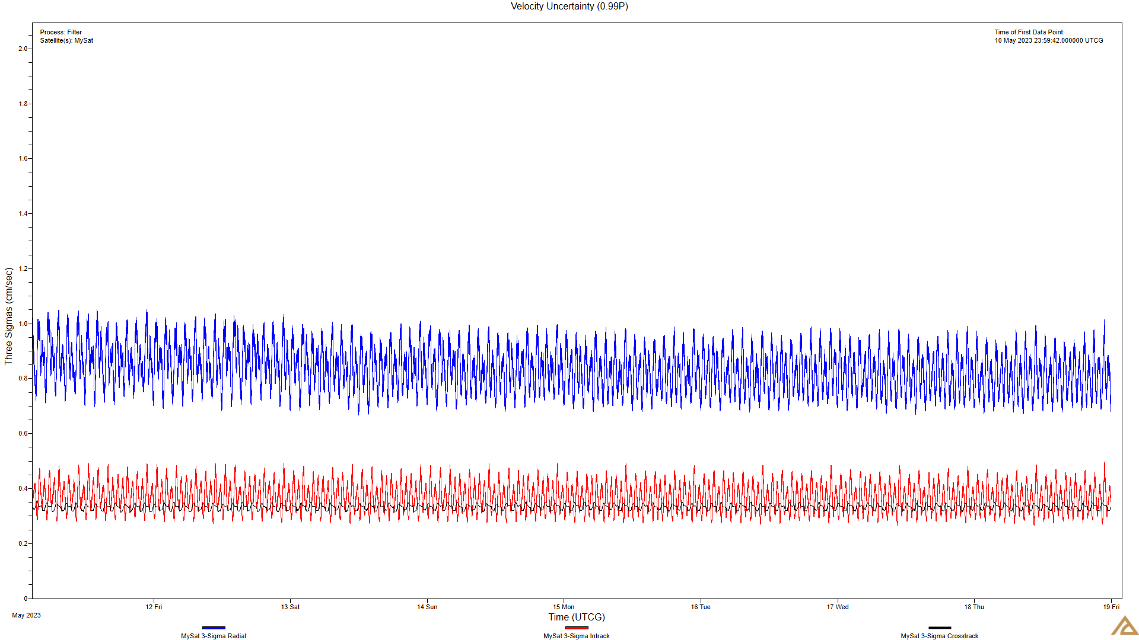
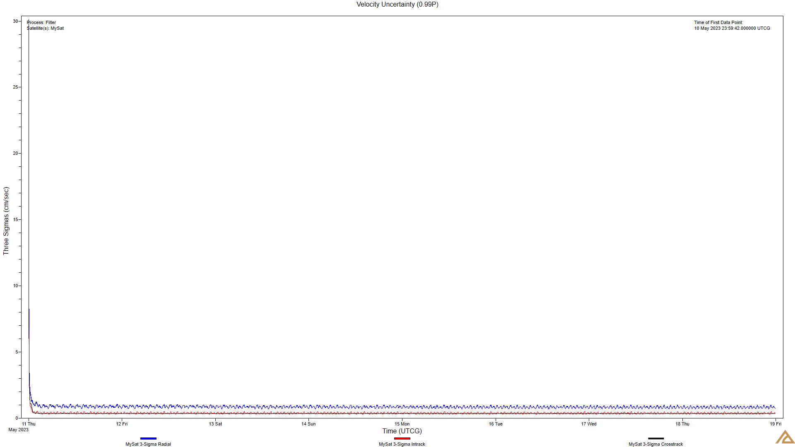
Simulated Tracking Data: Velocity Uncertainty
As with position, after the first measurement velocity uncertainty drops rapidly
Uncertainty grows between measurement points
Long term uncertainty is controlled at this measurement cadence

Slide 12
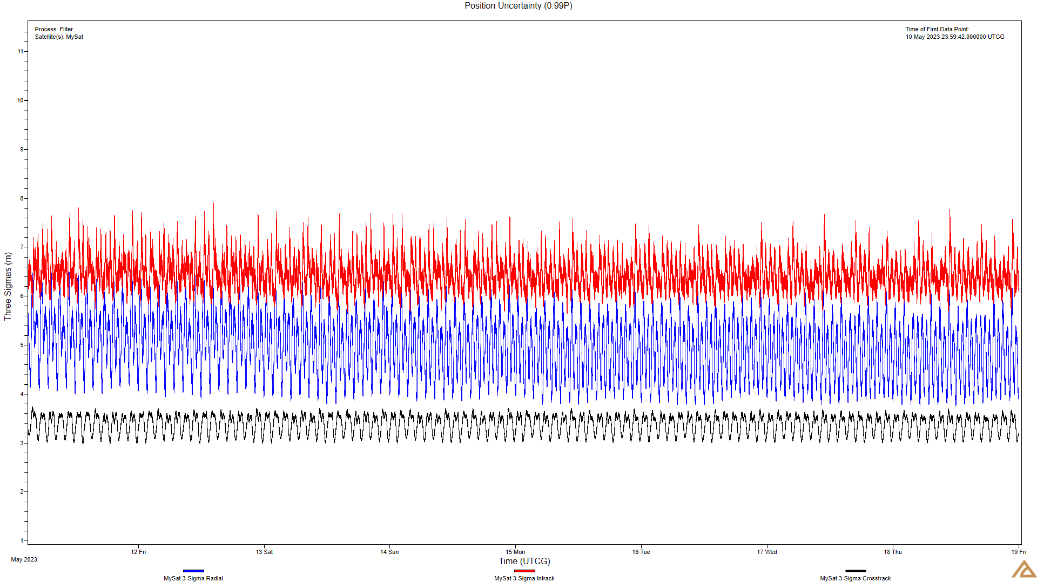
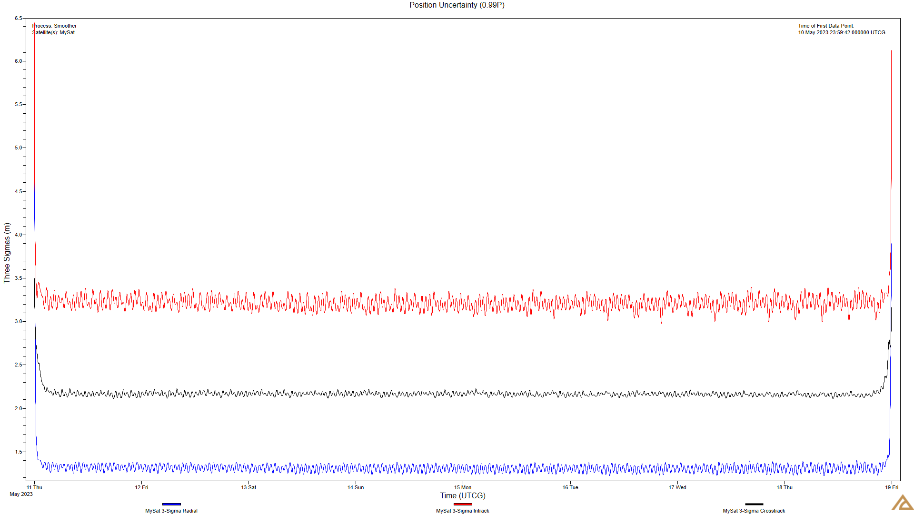
Simulated Tracking Data: Filter vs. Smoother

Slide 13
Solar Sail Simulation
Vehicle Modeling and Propagation

Slide 14
Propagation
Need one week of predictive ephemeris for collision avoidance screenings
Predicted ephemeris, including covariance matrix, is provided to the NASA Conjunction Assessment Risk Analysis (CARA) team to comply with requirements
Ephemeris is produced utilizing a high-fidelity propagator with a full atmospheric density model, and updated solar radiation pressure
OD Solution
Propagator Components
Integrator | RKF7(8)
Gravity Model | EGM08 24x24
Atmosphere Model | NRLMSISE-00
Third Bodies | Sun, Moon
Solar Radiation Pressure | N-Plate Model
Solar Weather | Daily F10.7
Ephemeris Propagation
Predictive
Ephemeris
CARA

Slide 15
Vehicle Modeling
Spherical Solar Radiation pressure (SRP)
N-Plate
Vehicle is a sphere with a constant cross-sectional area.
Attitude of vehicle does not affect apparent cross-sectional area
Vehicle is a collection of flat plates with orientations defined in the body fixed axes
Drag and SRP area are dependent pendent on the attitude, position, and velocity of the spacecraft

Slide 16
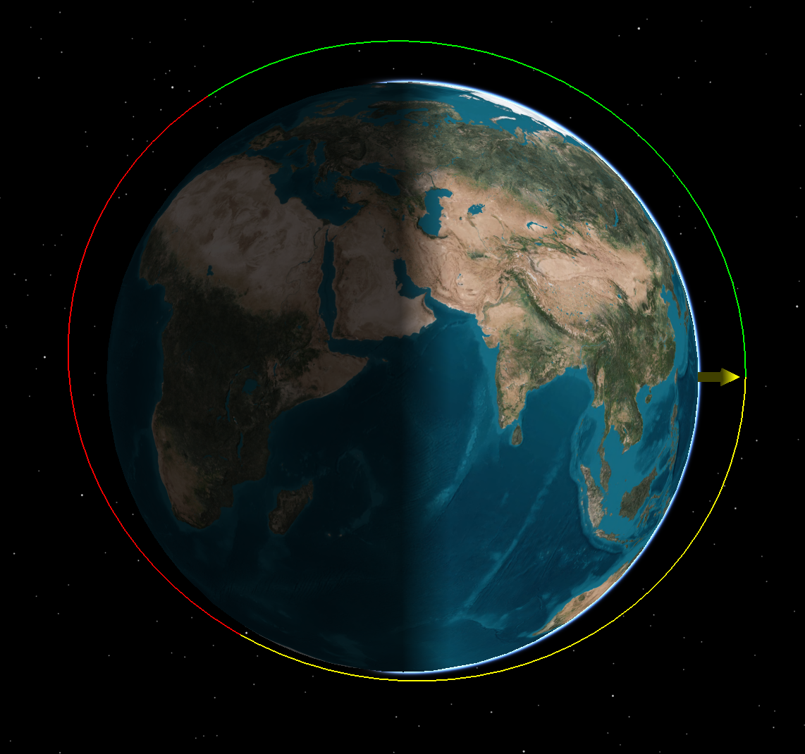
Orbit Raising with Spherical Model
Drag area and SRP area are linked
Update drag and SRP area at certain points in the orbit to maximize SMA change
During eclipse, drag area is minimized
When sun would reduce SMA, minimize SRP area
SRP area is maximized when crossing the ecliptic
Minimum Drag Area
Maximum SRP Area
Minimum SRP Area

Slide 17
Spherical SRP Simulation
Two cases based on potential operational altitudes
Goal was to raise the semi-major axis of each orbit
Simulated each case for 180 days and tracked the mean semi-major axis
 | 715 km | 900 km
Initial Epoch | 21 Jul 2023 00:00:00.000
Propagation Time | 180 Days
Semi Major Axis | 7093.137 km | 7278.137 km
Eccentricity | 0.00
Local Time of Asc. Node | 00:00 (Midnight)
Inclination | 99.370° | 99.154°
Max Drag/SRP Area | 81 m²
Min Drag/SRP Area | 0.06 m²
Mass | 16 kg

Slide 18
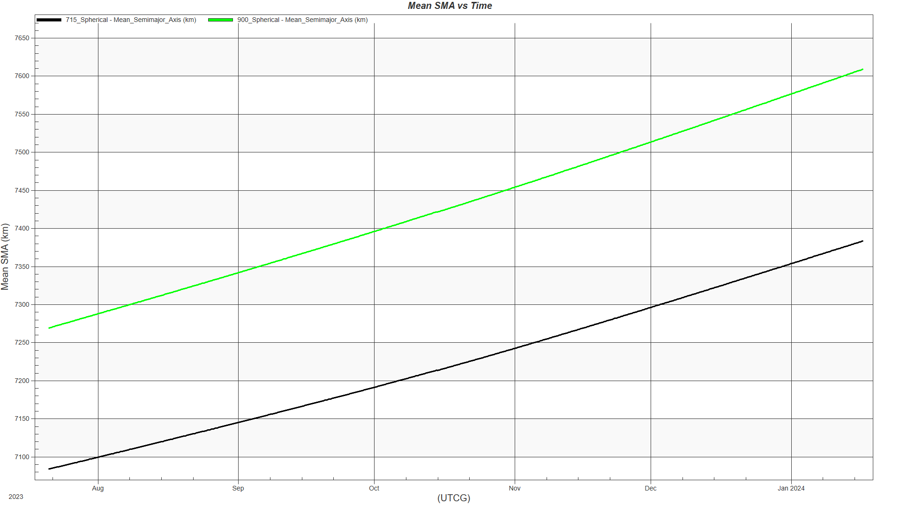
Results: Spherical SRP
Both cases saw an increase in semi major axis
900 km
  Initial – 7269 km
  Final – 7609 km
  Difference – 340 km
715 km
  Initial – 7084 km
  Final – 7383 km
  Difference – 301 km

Slide 19
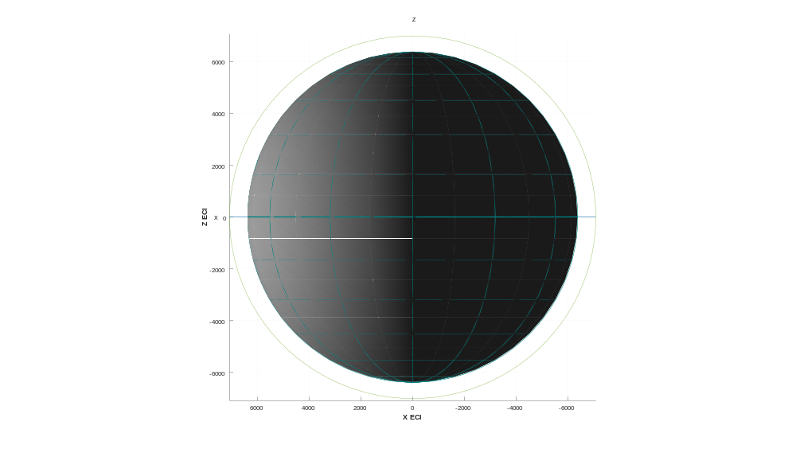
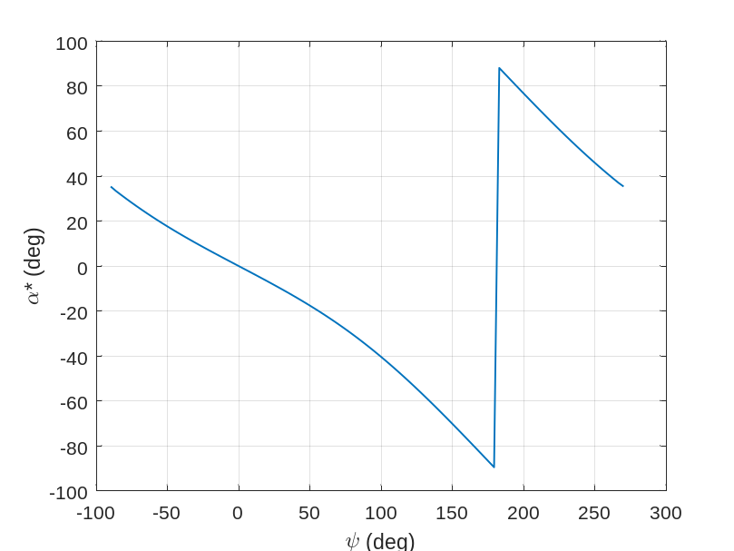

SMA Raising/Lowering Steering Profile [ref: McInnes, 1999]
Locally optimal steering law for maximum energy gain/loss each orbit.
  Sail oriented to maximize solar radiation thrust component in direction of flight.
  For lowering, thrust component opposite direction of flight is maximized.
$$α^{∗}=\frac{1}{2}\left[ψ−\sin^{−1}\left(\frac{\sin{ψ}}{3}\right)\right]$$
Locally optimal sail pitch angle.
Angle of velocity vector with respect to sun line.
ψ
α∗
Velocity vector
ψ = 315°
ψ = 0°
Sun line
α∗ = 15.7°
α∗ = 0°
Sail normal
Profile can be reversed during eclipse to slew 90° and reset for next orbit.
ψ = 270°
α∗ = 35°
ψ = 225°
α∗ = 60.7°
ψ = 180°
α∗ = 90°
- Noon-midnight SSO example shown. -

Slide 20
Propagation of N-Plate Model
N-Plate model requires an accurate model for spacecraft attitude
Current approach is to propagate the spacecraft for 180 days, record needed values, compute attitude for all time points, and then re-run simulation with new attitude values
More accurate model can be achieved by updating vehicle attitude at each time step
Initial State
Update Orientation
Take Step
At Final Time?
End Sim

Slide 21
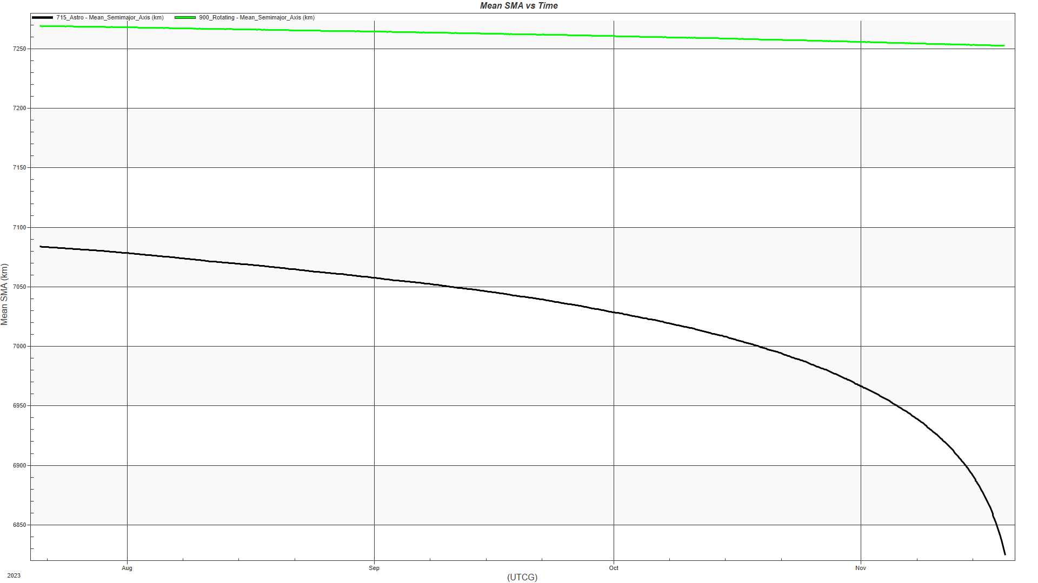
Results: N-Plate
Both cases saw a decrease in semi major axis
900 km
  Initial – 7269 km
  Final – 7241 km
  Difference – -58 km
715 km
  Initial – 7084 km
  Deorbits in ~4 months

Slide 22
Conclusions
Our simulations show that the mission can achieve the mission goals in DURATION DAYS
The ACS3 solar sail dynamics model can be utilized to complete the navigation process and can be used to produce predictive ephemeris for the spacecraft orbit transfer
We have built a custom flight dynamics system to support the ACS3 mission according to NASA CARA and project management requirements
Initial ORT has shown that the spacecraft can be tracked, and position and velocity uncertainty can be contained within expectations
NASA Ames Flight Dynamic team will collaborate with NASA Langley and SCU to track spacecraft and meet requirements.

