Slide 1

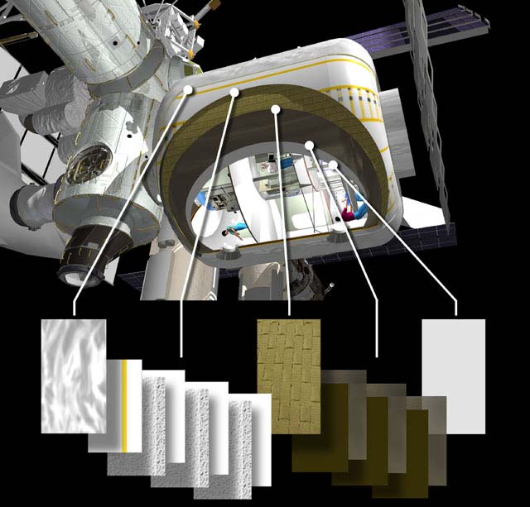

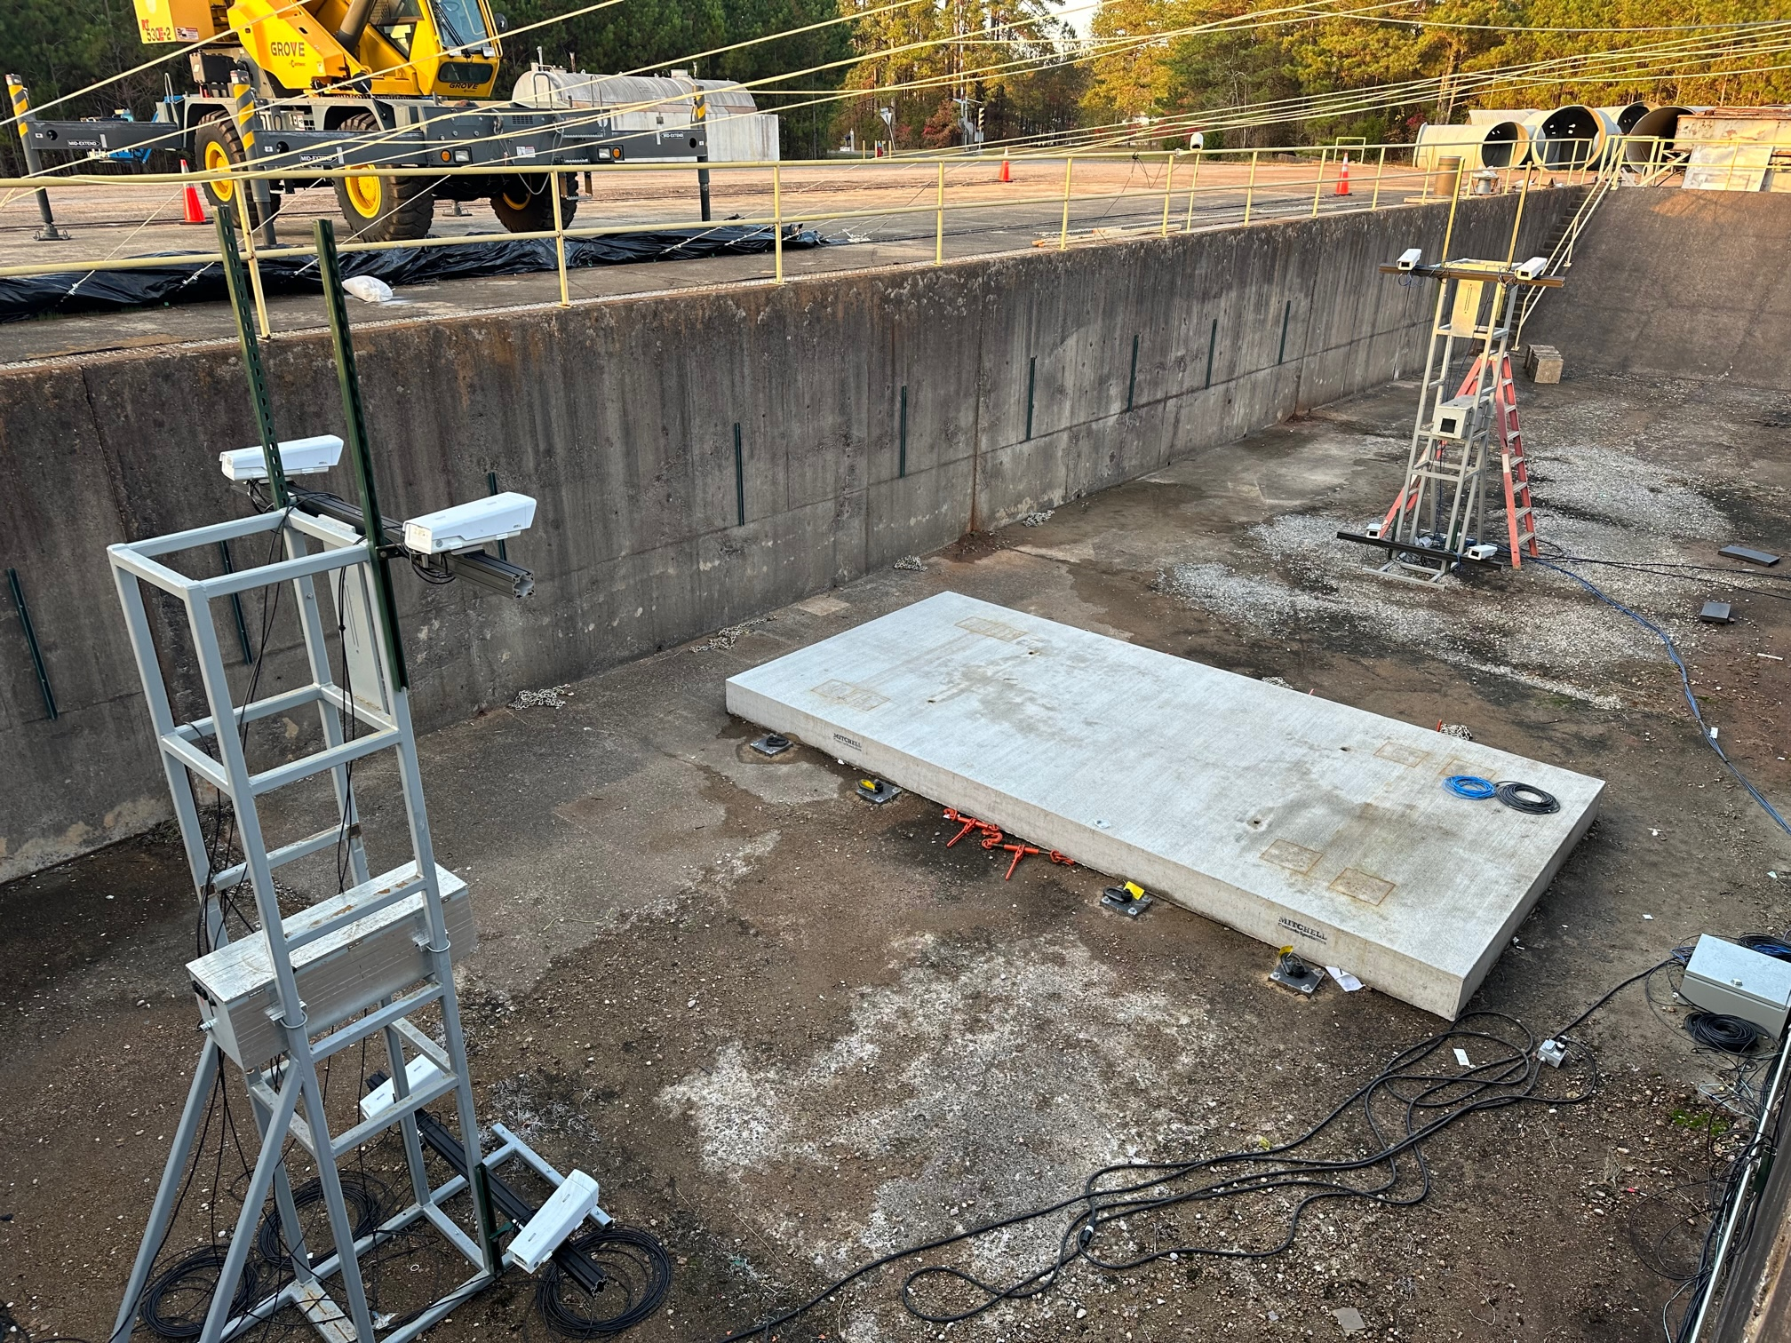
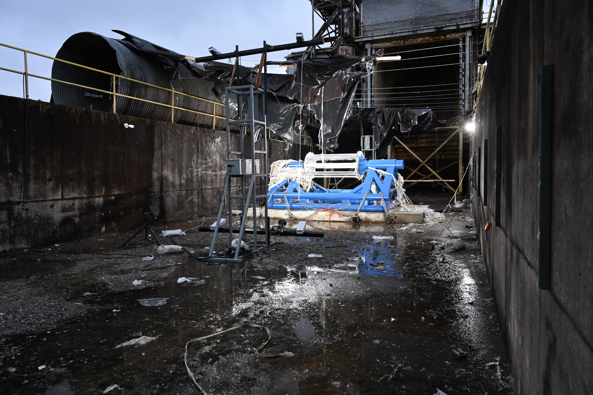
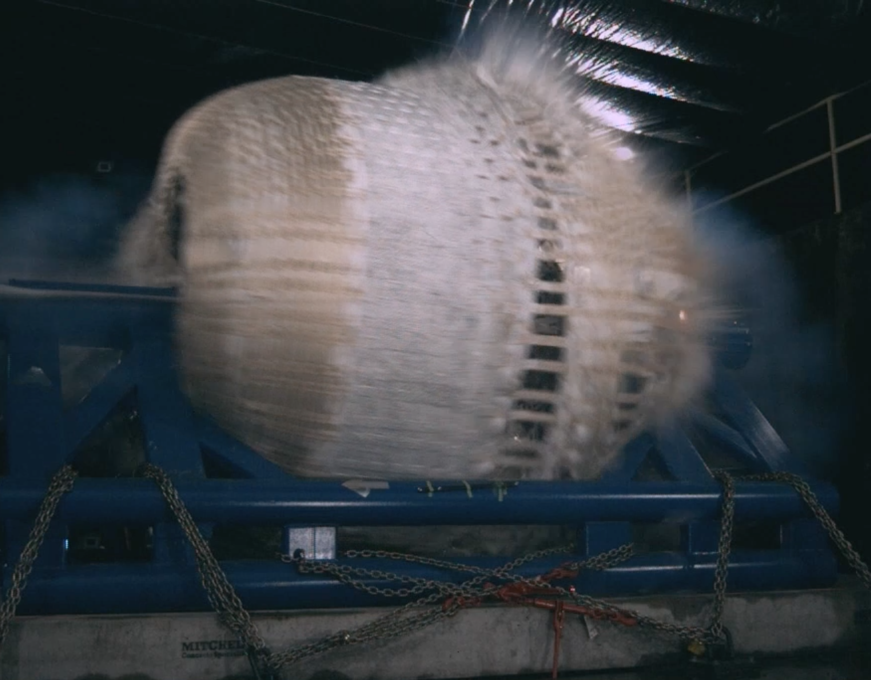
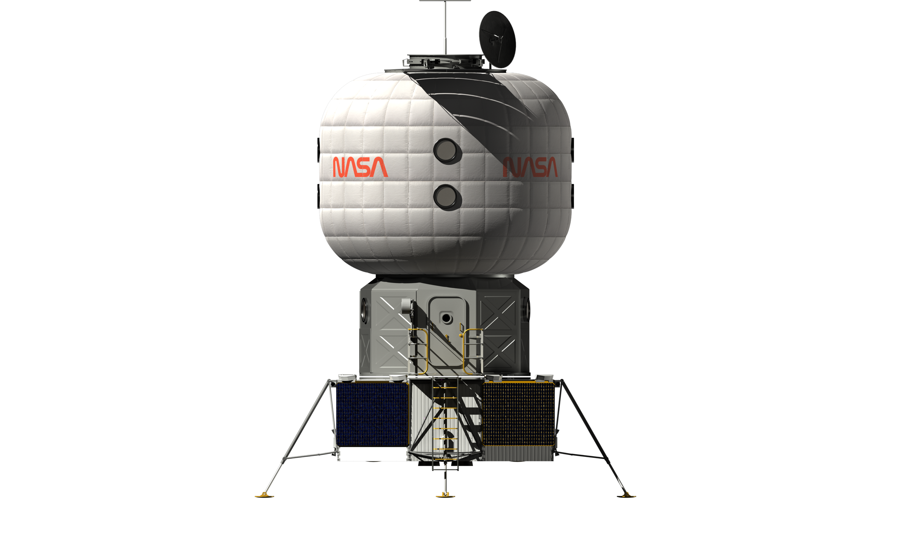
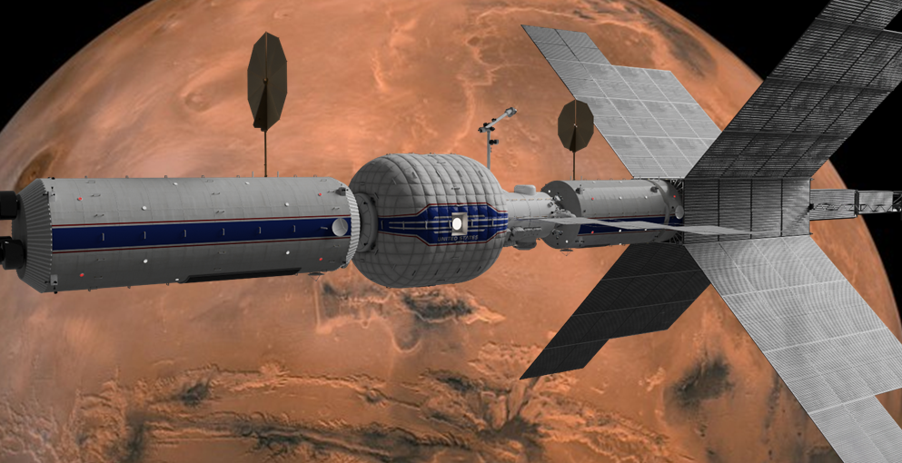
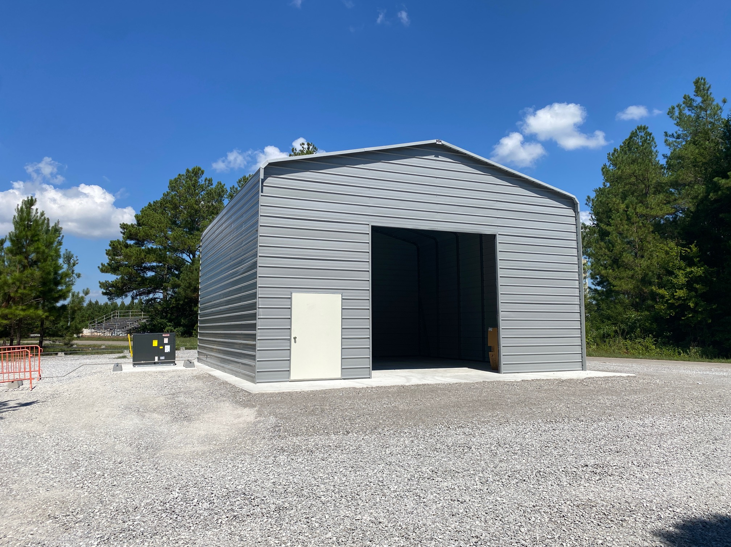
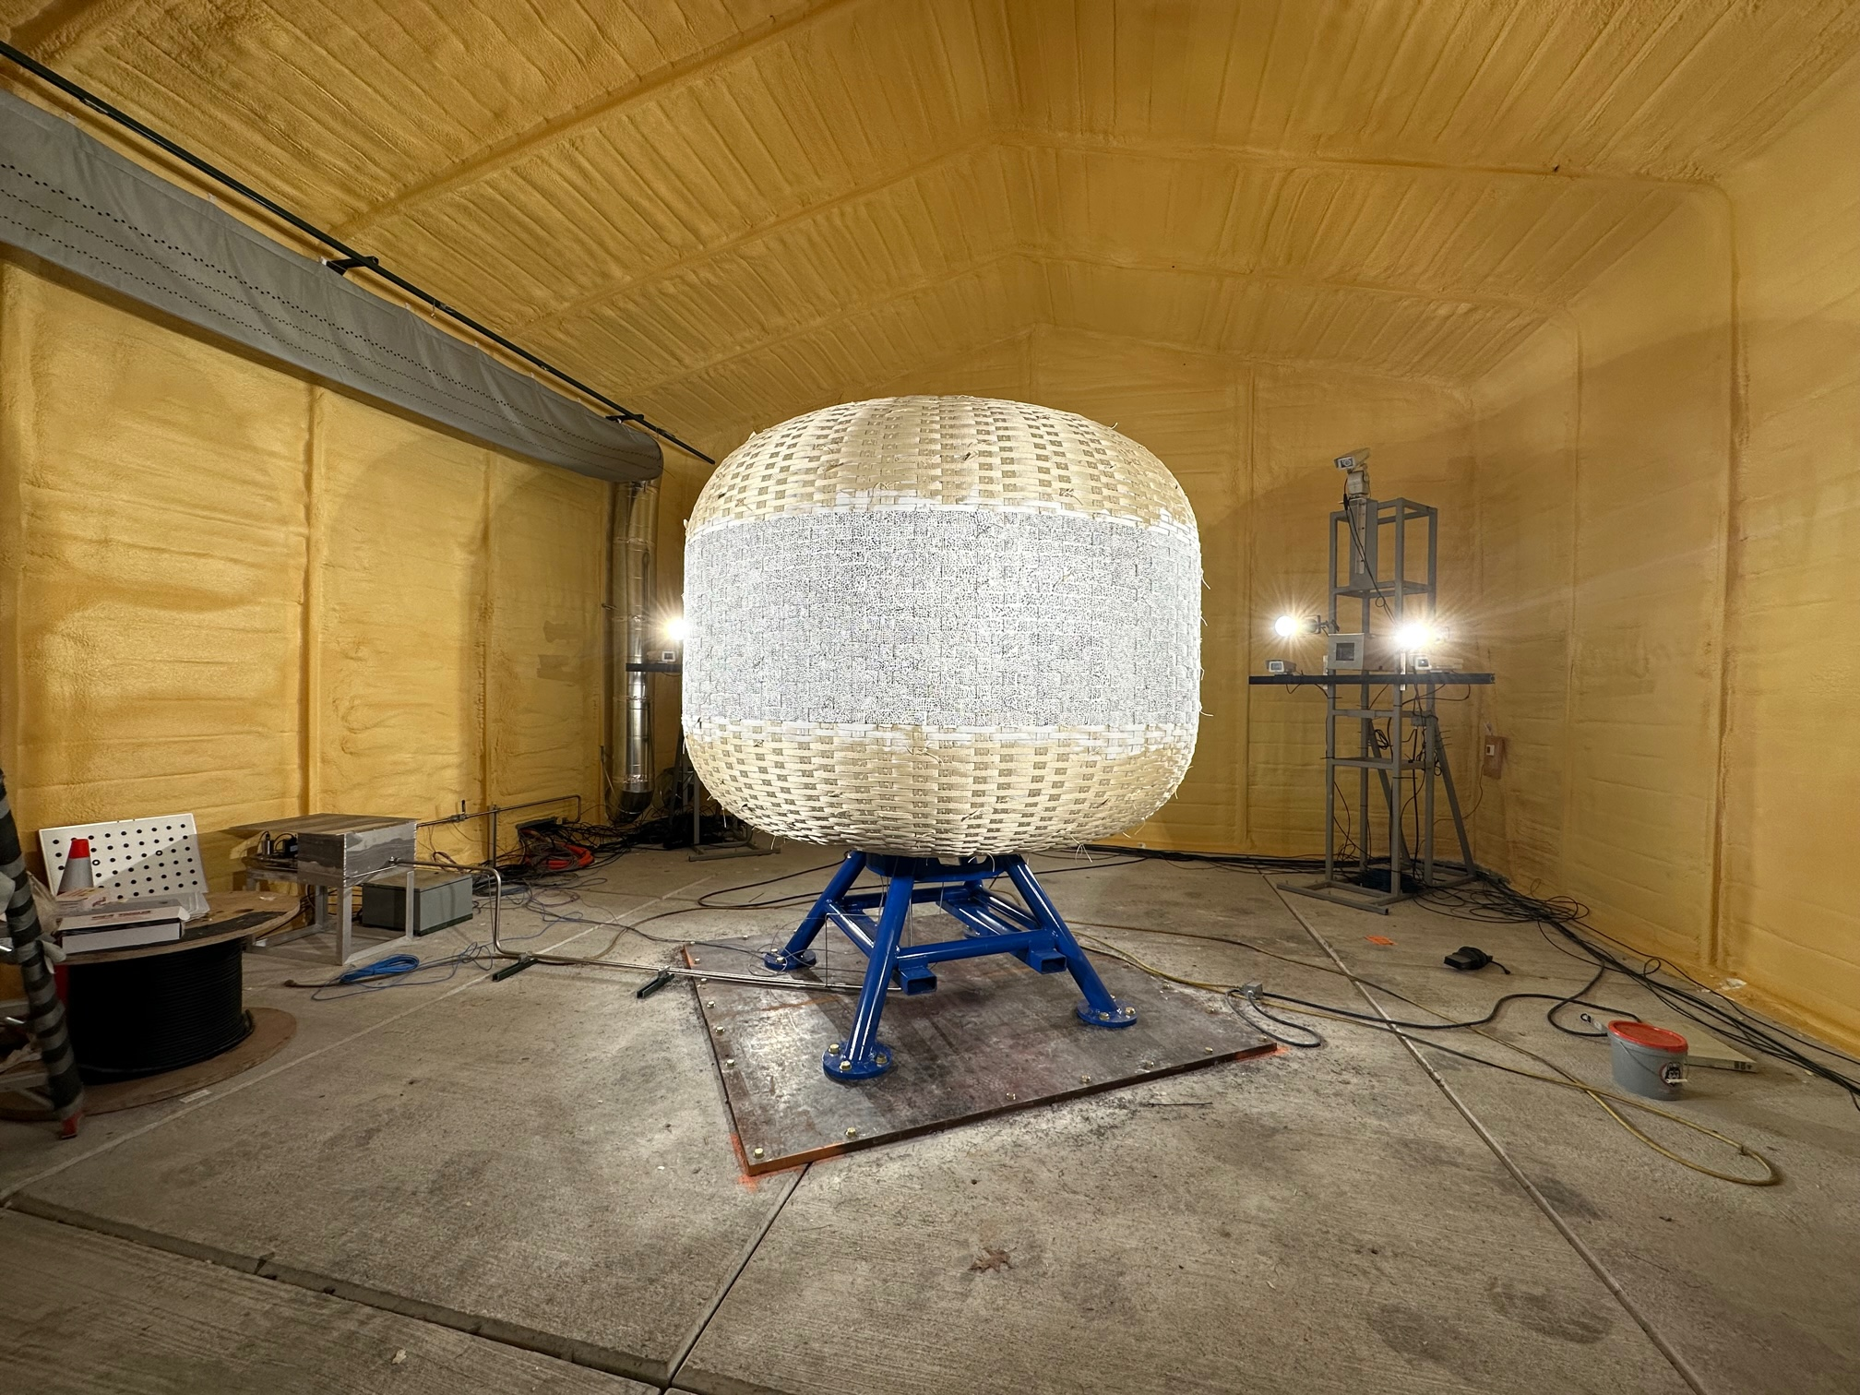
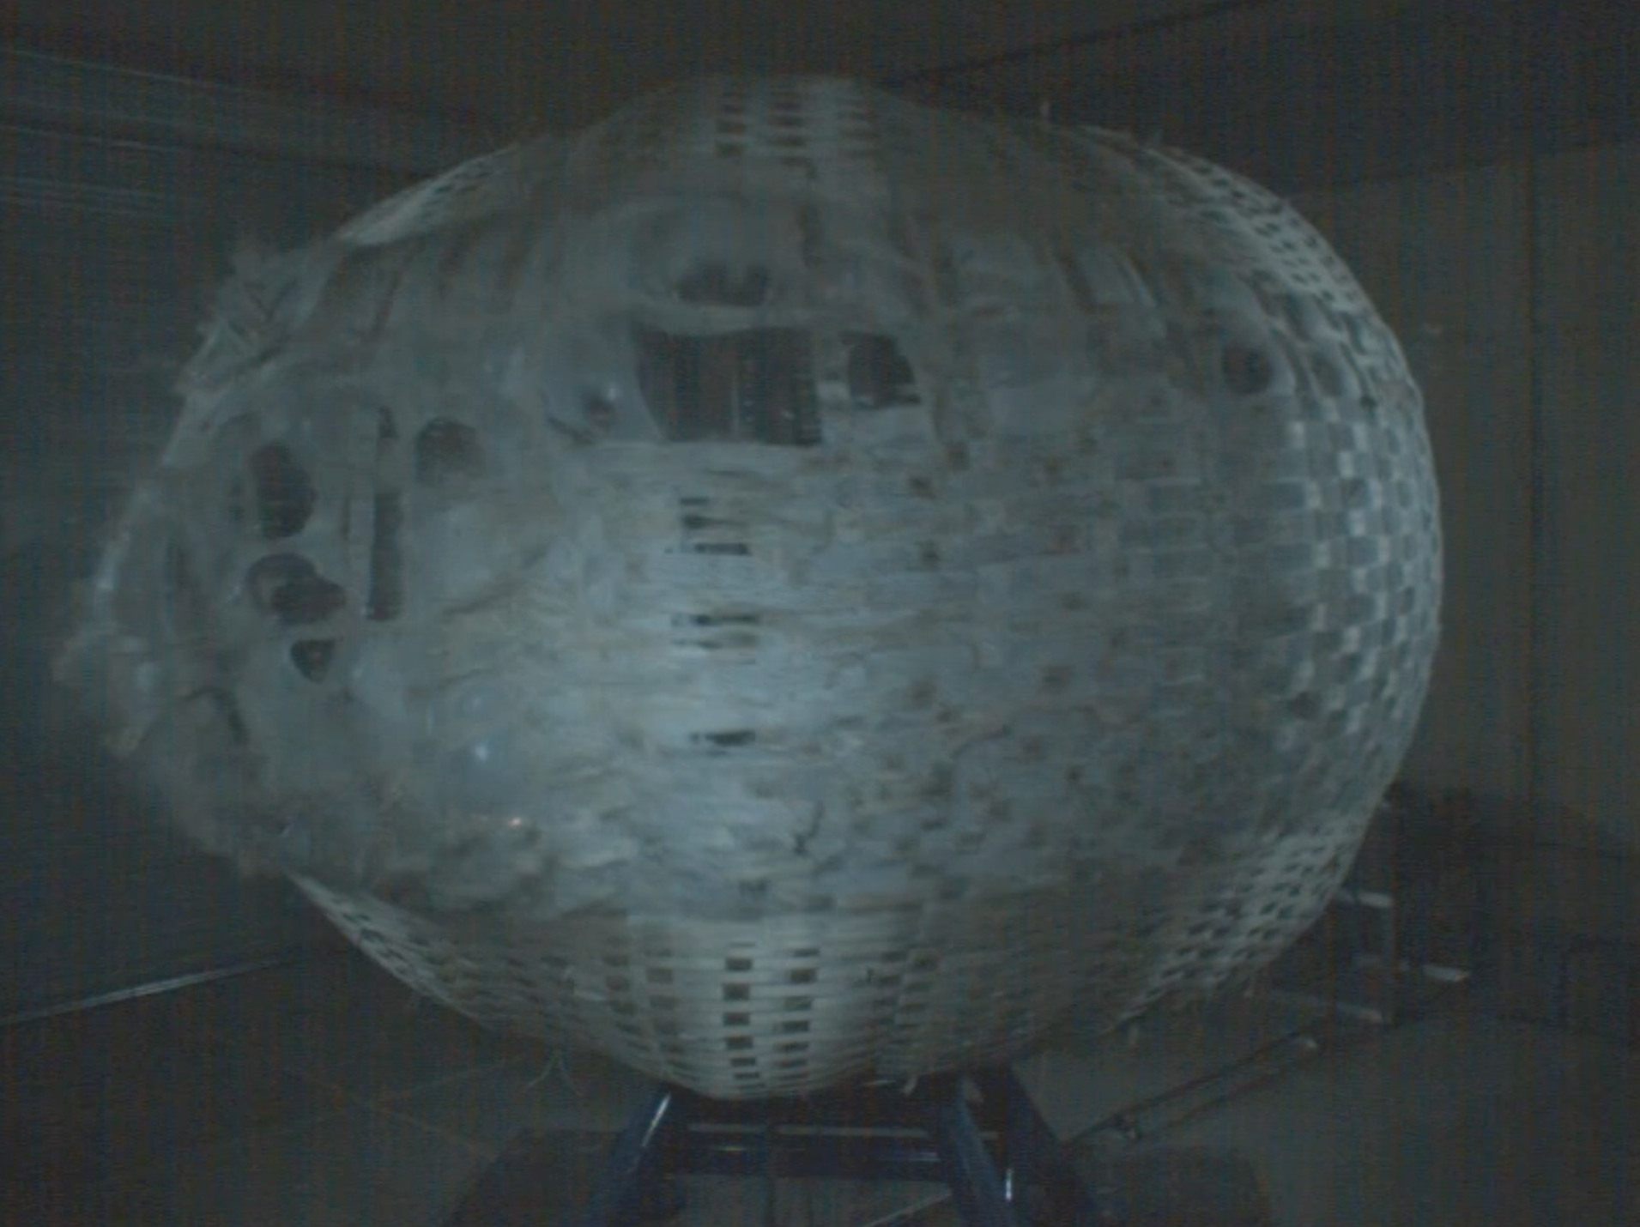
Inflatable Softgoods Testing Capability Development for Habitation
Tracie Prater (HP40), Jonah Burgin (ET10), Kendall Feist (ET10)
Inflatable Softgoods Overview
Path to Flight Certification
NASA recommends a stepwise progression of testing to characterize material performance of softgoods and to mature inflatable habitats for use in crewed systems (per JSC-67721 Guidelines)
Recommended testing includes:
Burst Testing of sub and full-scale articles to determine Ultimate Burst Pressure
Creep testing of Component and sub-scale articles to generate a Time-To-Failure (TTF) Curve
      Module tests with target durations of 100 Hours, 1000 Hours, and 10,000 Hours
Inflatable Softgoods are a complex, multi-material system
Each Layer Performs a
Specific Function:
1. Internal Scuff Layer: Protects against punctures and fires
2. Bladder: Keeps air inside the habitat from escaping
3. Restraint Layer: Structural layer, usually Kevlar or Vectran
MSFC Test Capabilities
4. Micro-meteoroid/ Orbital Debris Shield: Multiple layers protect the structure from impacts
ET10 is developing inflatable softgoods testing capabilities for NASA Marshall to support commercial partners
5. Thermal Blanket: Protects the crew from extreme temperatures
Ultimate Burst Pressure Testing
6. External Shield: Protects the habitat from erosion by atomic Oxygen or regolith
Inflatable Softgoods Applications
Inflatable softgoods are assumed as the primary structural material for habitation in the current government reference design for Lunar Surface Habitat and Mars Transit Habitat.
Historic Saturn I Flame Trench Now Used for Burst Testing
NextSTEP App. A (Habitation) burst test with Sierra Space
High-Speed Camera View of test for Sierra Space
Subscale Ultimate Burst Pressure testing capability augmented from existing facility
Future full-scale Ultimate Burst Pressure test capability will be first of its kind
    Under development and construction with center funding
Long Duration Creep Testing
Lunar surface habitat:
2-4 crew*
30-60 day mission duration
EVA airlock
15 year operational life
*4 crew is surge capability when another habitable asset is on the surface
Mars Transit Habitat:
4 crew
Up to 1,200 day mission duration
Docks with Gateway as visiting vehicle for precursor shakedown and analog missions
Inflatable Habitat Test Position 1 (IHTP1) for Long-Duration Creep Testing
Reimbursable Space Act Agreement (RSAA) with Sierra Space
High-speed camera view of test for Sierra Space
Creep testing capabilities developed for operations lasting up to 2 years
Two test positions allow for parallel operations/running multiple tests at once

