Slide 1


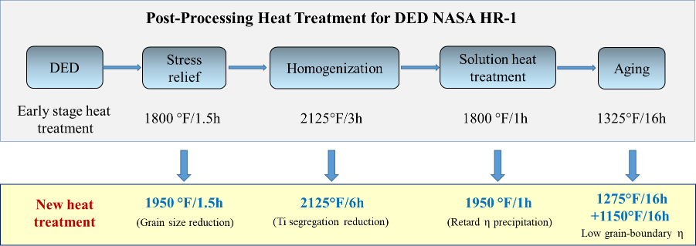
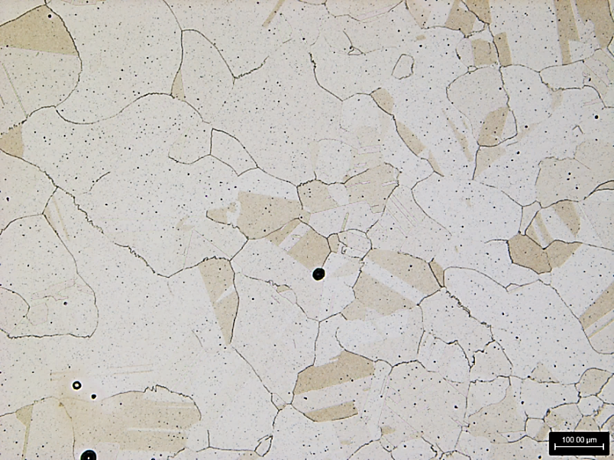

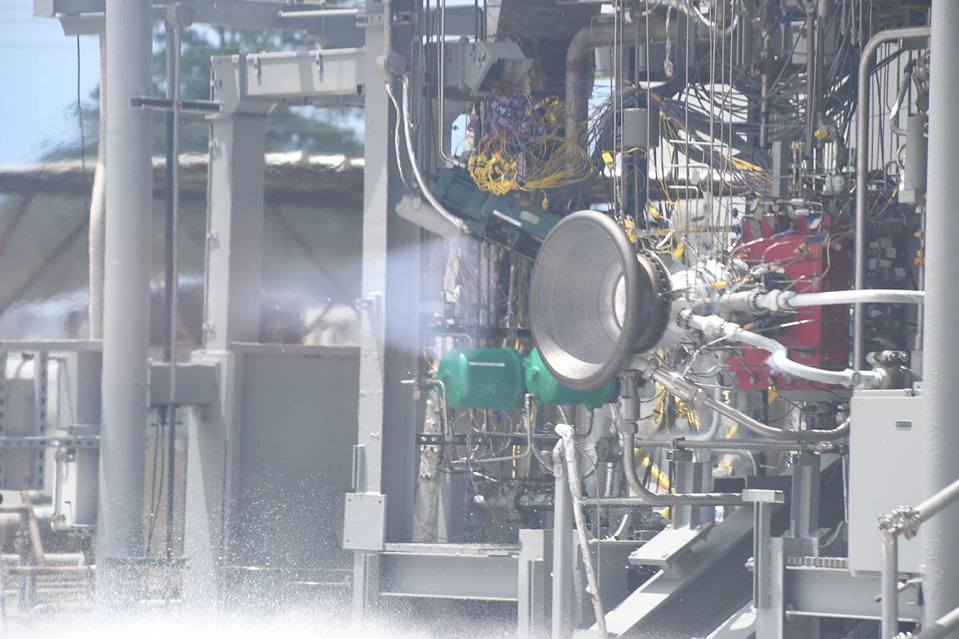
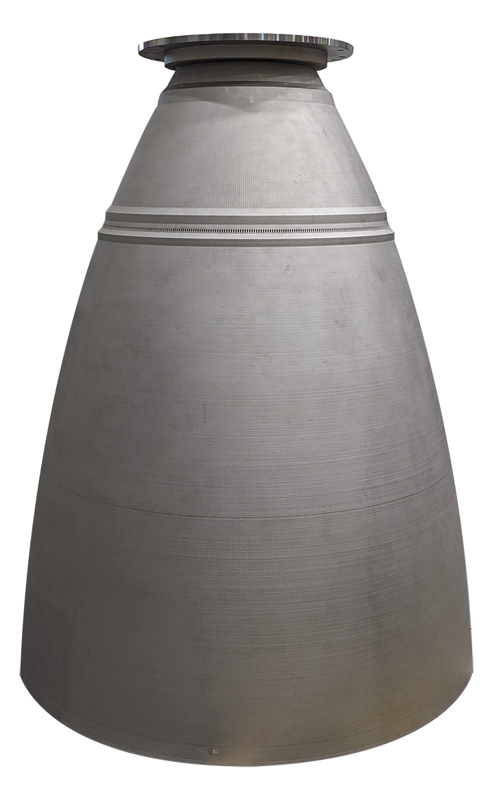
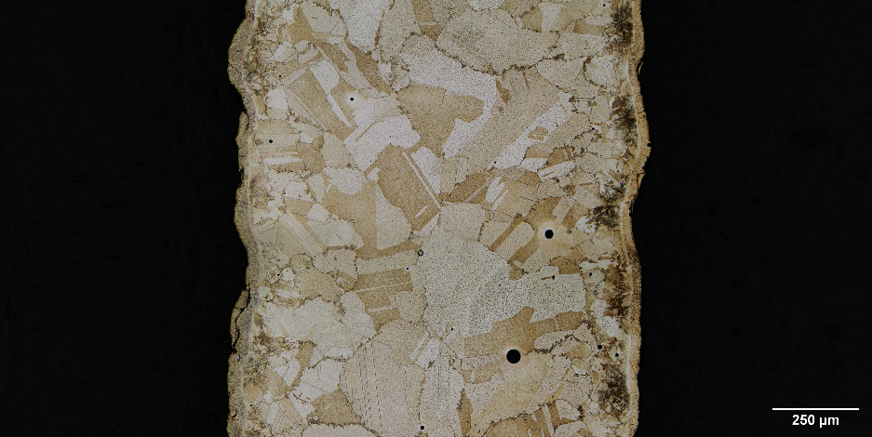
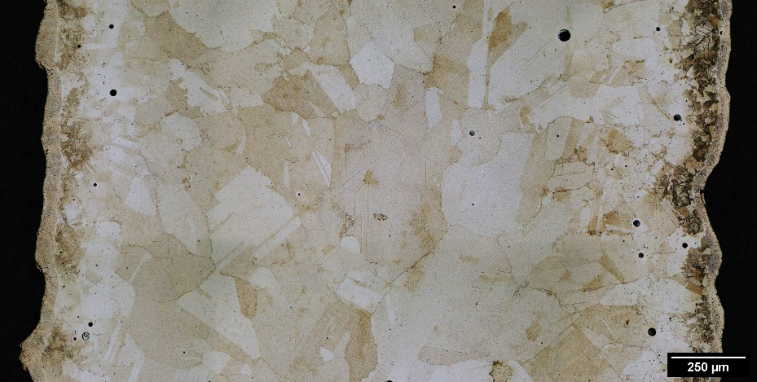
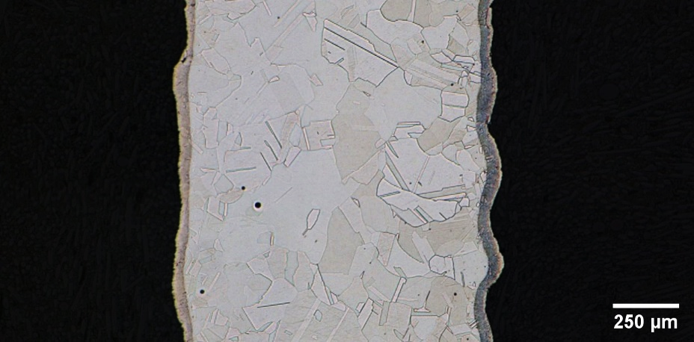
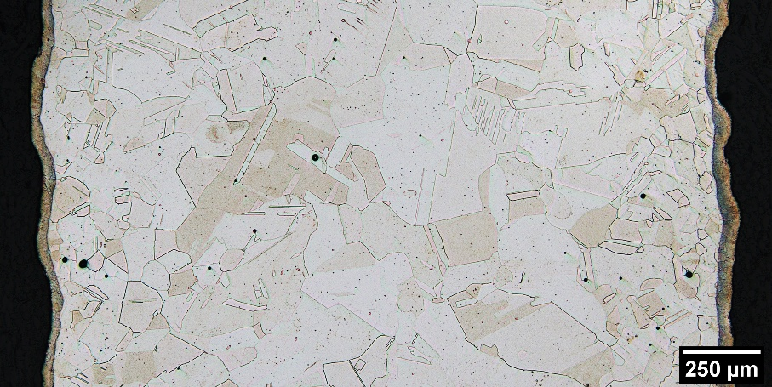
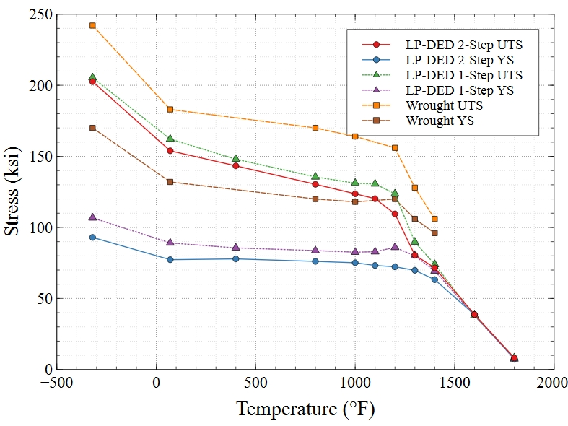
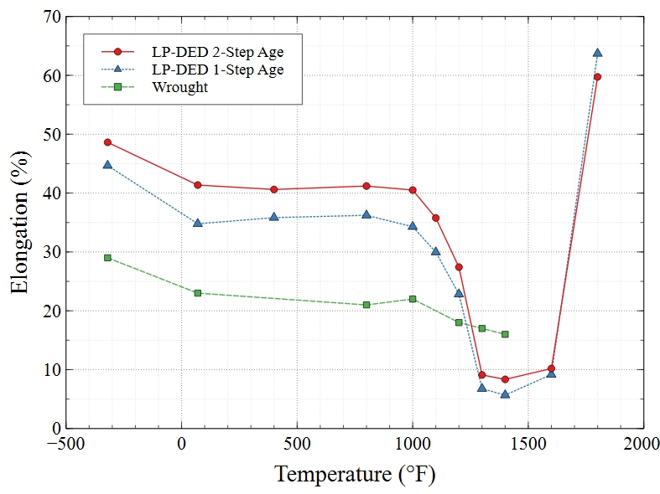
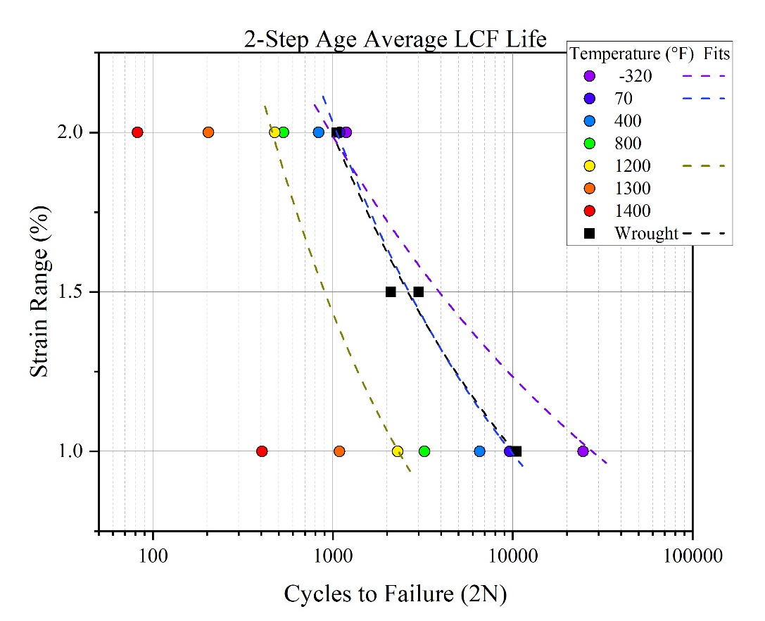
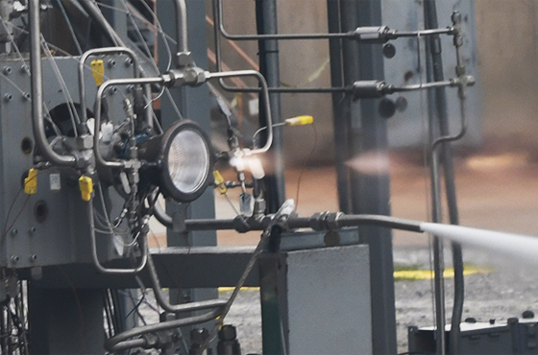
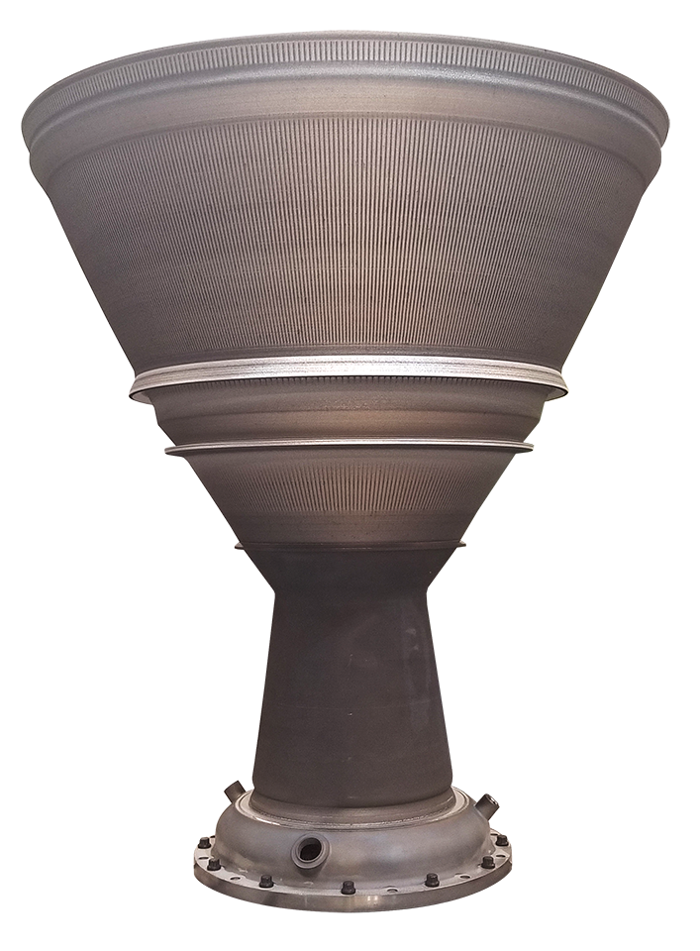
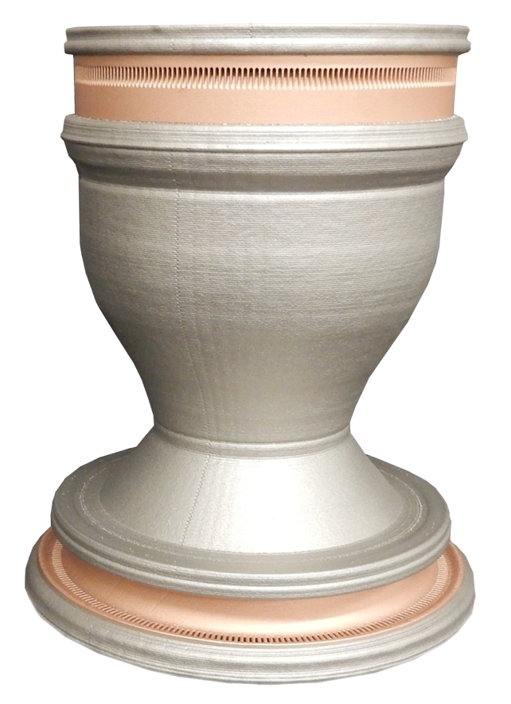
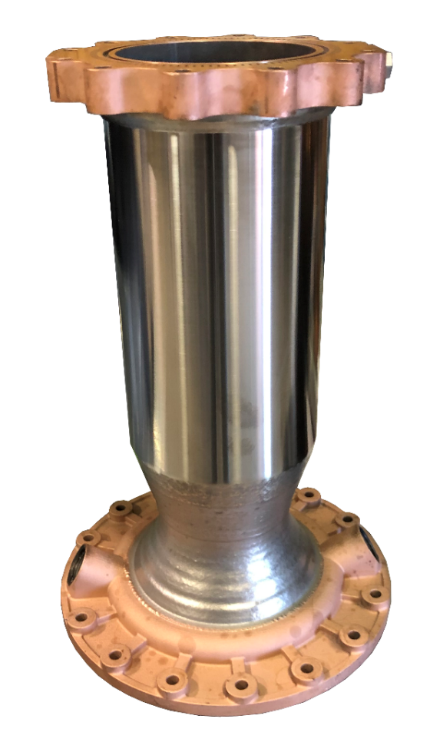
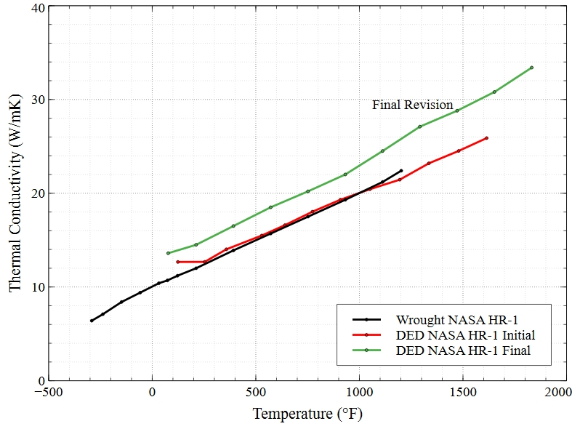
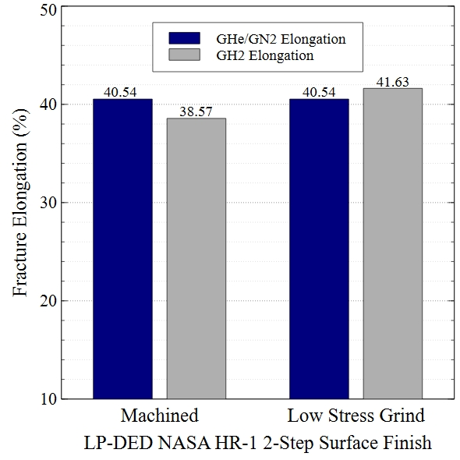
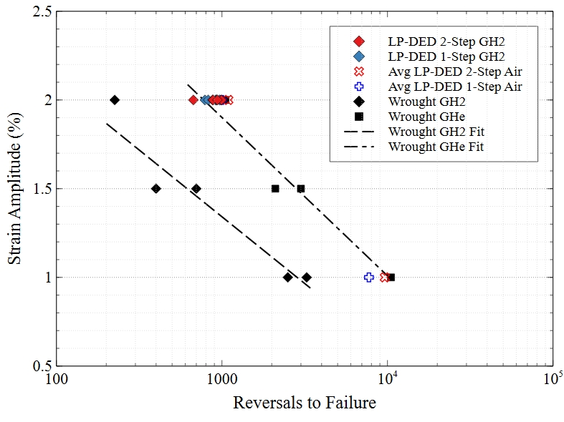
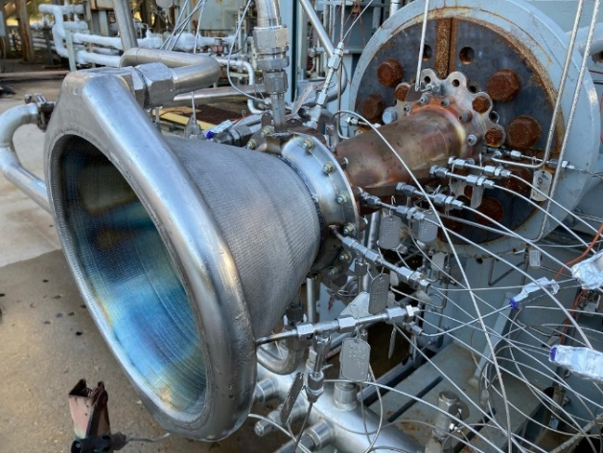
Development of Directed Energy Deposited NASA HR-1 to Optimize Properties
for Liquid Rocket Engine Applications
Colton Katsarelis, Po-Shou Chen, W. Matt Medders, Paul Gradl, Ching-Hua Su – NASA Marshall Space Flight Center
AM Adaptation of NASA HR-1
NASA HR-1 is a high-strength Fe-Ni based superalloy designed to resist hydrogen environment embrittlement (HEE), oxidation, and corrosion
Derived from JBK-75 and A286, NASA HR-1 was designed to have higher strengths to meet the needs of liquid rocket engine applications
Mechanical Strength
Key Design Properties
↓ Mechanical Strength (10 – 15% reduction)
Material Characterization Through Heat Treatment
Post-processing heat treatments are key to obtaining optimal properties for AM alloys and characterization of the microstructure informs on how alloys will perform
Stress relief, homogenization, solution, and aging cycles were developed to optimize the microstructure and properties of LP-DED NASA HR-1
Temperatures and times were adjusted to obtain desirable microstructure, mitigate Ti segregation observed, and prevent the formation of η-phase that is detrimental to the performance of NASA HR-1 in hydrogen environments
Two aging cycles were developed to adjust performance of NASA HR-1:
  2-Step age for improved HEE resistance and LCF life
  1-Step age for higher strength
During characterization, various laser powers were examined to understand the impact of the LP-DED process parameters on the microstructure and properties to inform material application designs
LCF
HEE Resistance
↑ LCF
↑ HEE Resistance
Initial to Final Formulation
Thermal Conductivity
Ductility
↑ Thermal Conductivity
↑ Ductility
Wrought NASA HR-1 was too expensive to produce traditionally, however additive manufacturing (AM) processes such as laser powder directed energy deposition (LP-DED) have enabled the material to be a feasible option for liquid rocket engine applications
The composition of NASA HR-1 was modified to adapt the alloy well to AM using PHACOMP analysis
Early in development of LP-DED NASA HR-1 it was observed that η-phase formed after aging, so the initial formulation was modified to the final formulation shown below to stabilize the matrix to help minimize η-phase formation and optimize properties
Modifications made in the final formulation were expected to improve fatigue life, thermal conductivity, ductility, and HEE resistance at the expense of strength
η-phase
η-phase
Stress Relief:
1950°F 1.5h
350W
1070W
Alloy | Fe | Ni | Cr | Mo | V | W | Co | Ti | Al | Mn | Md
Wrought NASA HR-1 | 38.90 | 34.10 | 15.50 | 2.40 | 0.30 | 2.20 | 3.50 | 2.80 | 0.30 | - | 0.928
LP-DED NASA HR-1 *Initial Formulation | 39.80 | 34.00 | 15.50 | 2.20 | 0.32 | 2.10 | 3.30 | 2.50 | 0.25 | - | 0.922
LP-DED NASA HR-1 *Final Formulation | 41.20 | 34.00 | 14.60 | 1.80 | 0.30 | 1.60 | 3.80 | 2.40 | 0.25 | - | 0.913
Wrought A-286 | 55.20 | 25.00 | 15.00 | 1.30 | 0.30 | - | - | 2.00 | - | 1.50 | 0.912
Wrought JBK-75 | 51.13 | 30.20 | 14.75 | 1.25 | 0.30 | - | - | 2.10 | 0.25 | - | 0.910
SR+Homogenization 2125F/6h
LP-DED NASA HR-1 in Application and Hot Fire Testing
Several manufacturing demonstration parts have been built using LP-DED NASA HR-1 to show versatility of the AM process and alloy
LP-DED NASA HR-1 nozzle extensions have been successfully hot fire tested from 2k lbf thrust class up to 35k under the RAMPT project and other test programs
Commercial space partners are actively building LP-DED NASA HR-1 nozzles for future engine applications
NASA HR-1 has also been used as a cladded jacket on combustion chambers and bimetallic joints between GRCop42 and LP-DED NASA HR-1 have been developed to expand the design space for combustion devices
Material Testing Results
In tensile testing at cryogenic and elevated temperatures up to 1400°F LP-DED NASA HR-1 exhibited good strengths and high ductility in both aging conditions
Yield and ultimate strengths were lower than wrought NASA HR-1, while fracture elongation was significantly higher than wrought. These trends were expected based on the composition changes made for LP-DED and the resulting microstructure. The low cycle fatigue life across temperatures was also in a range good for targeted applications
Tensile and low cycle fatigue tests in high pressure hydrogen exhibited no significant strength or ductility loss occurred in tensile testing and no loss of fatigue life was observed at 2% total strain for either aging cycle. In low cycle fatigue, LP-DED NASA HR-1 outperformed wrought in a high-pressure hydrogen environment
Thermal conductivity results showed that the initial formulation of DED NASA HR-1 aligned well with wrought, and the final formulation improved the thermal conductivity of the material by approximately 15-20%
References
- Chen, P. S., Katsarelis, C. C., Medders, W. M., Gradl, P. R., and Su, C. H. Development of Directed Energy Deposited NASA HR-1 to Optimize Properties for Liquid Rocket Engine Applications. NASA TM 2023.
- Chen, P. S., Fullen, M. D., Watwood, M. C., Rupp, B. L., Medders, W. M., Katsarelis, C. C., Gradl, P. R., Effects of Strain Rate and Surface Finish on Tensile Properties in High Pressure Hydrogen – A Case Study for LP-DED NASA HR-1. NASA TM 2023
- Gradl, P. R., Teasley, T., Protz, C., Katsarelis, C., and Chen, P. Process Development and Hot-Fire Testing of Additively Manufactured NASA HR-1 for Liquid Rocket Engine Applications. 2021.

