Slide 1
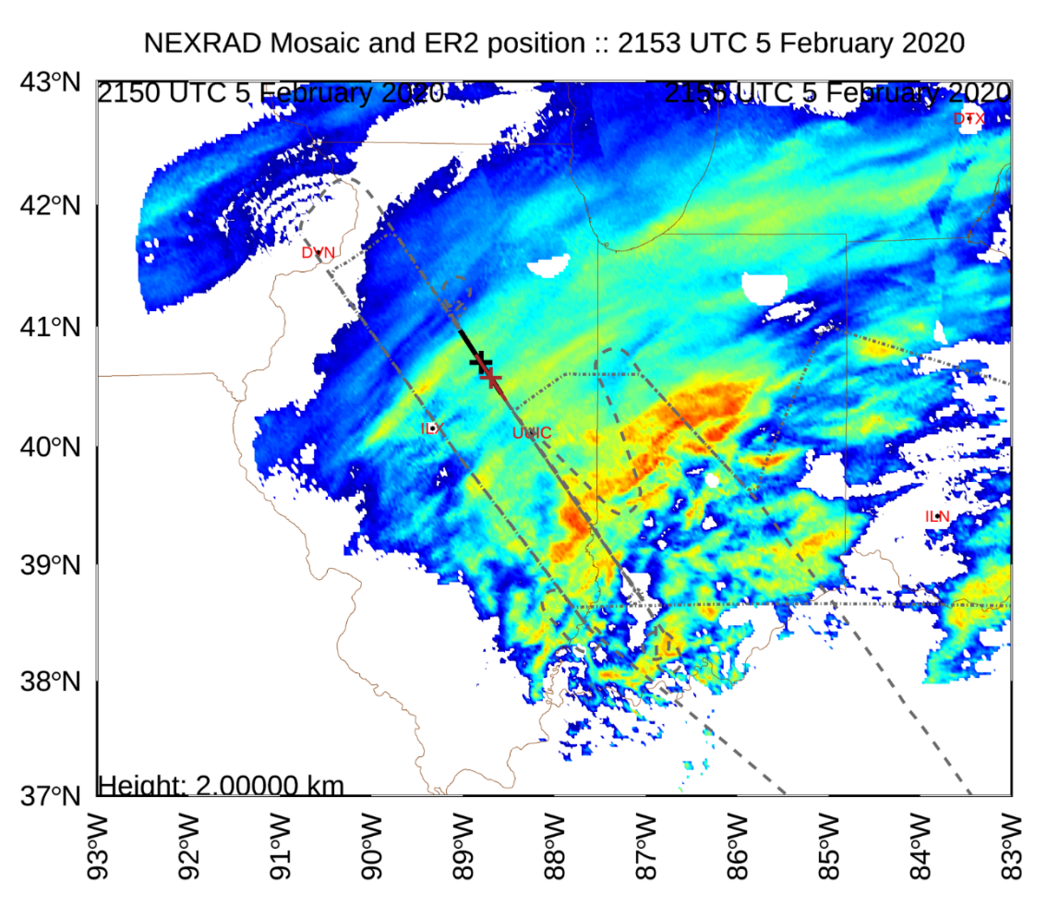

Understanding the Vertical Slope of Mesoscale Snow Band Reflectivity Signatures
Charles Helms, Gerald Heymsfield,
and Stephen Nicholls
American Geophysical Union Fall Meeting
14 December 2022

Slide 2
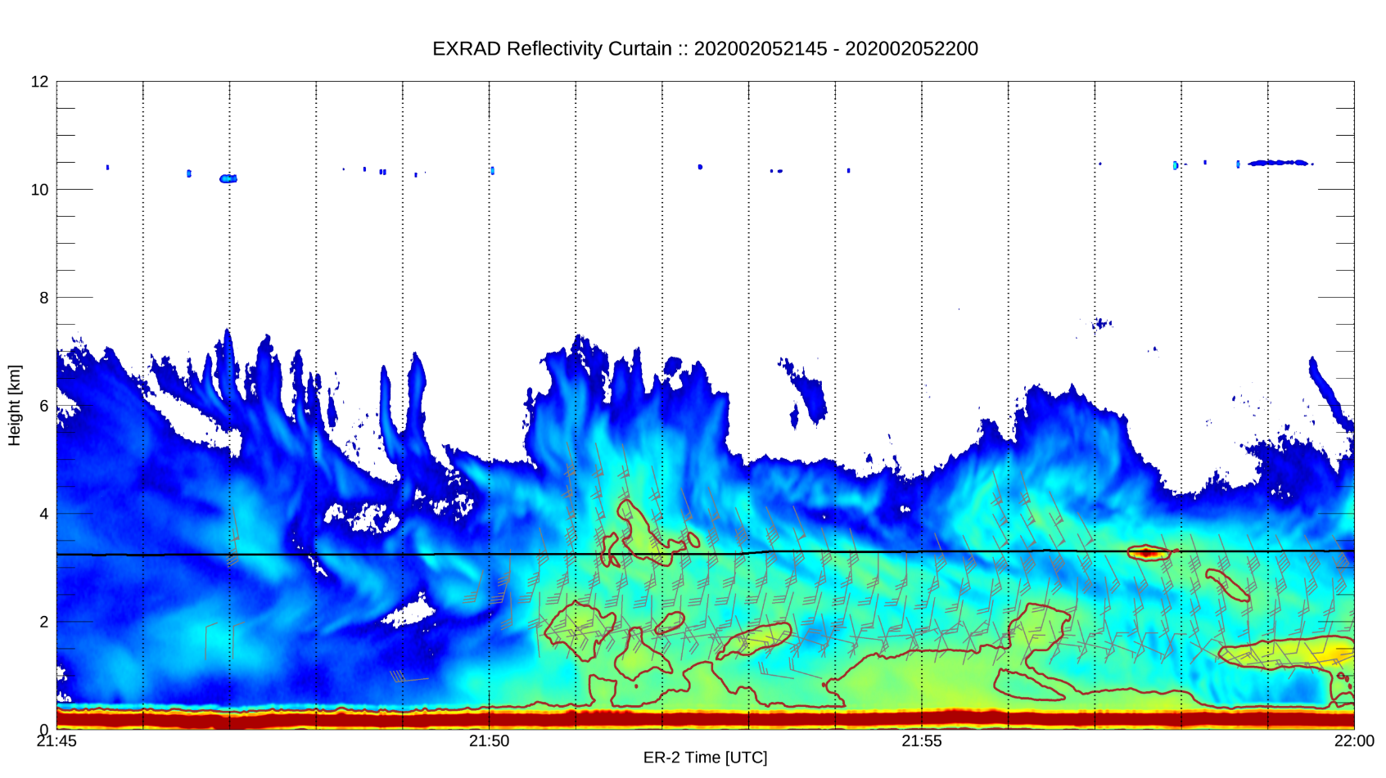

5 February 2020 Case
EXRAD – Nadir Beam Reflectivity
NW
SE

Slide 3
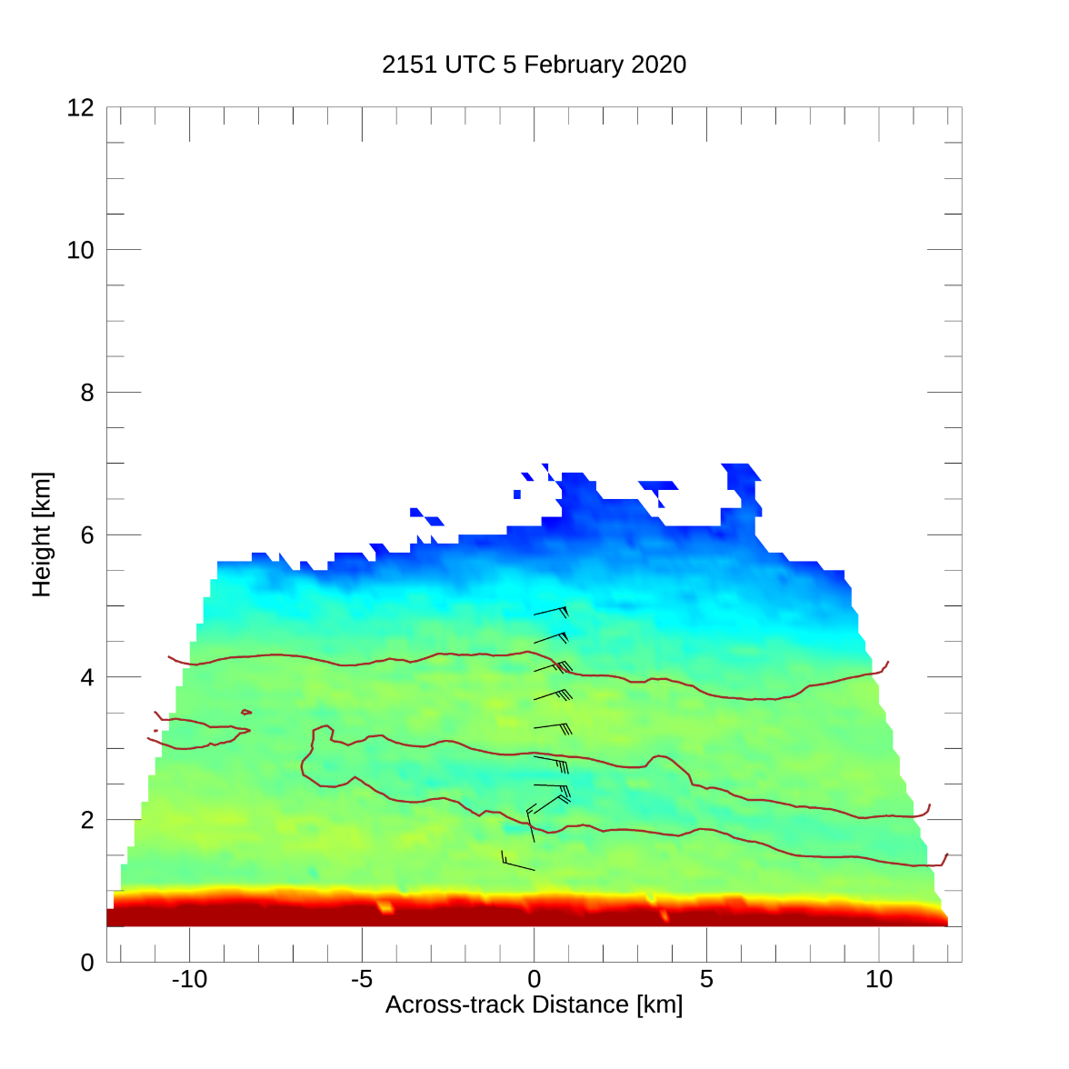
5 February 2020 Case
EXRAD – Scanning-beam Reflectivity
Cross-track Slice
EXRAD – Nadir Beam Reflectivity
What processes are responsible for the slope of this reflectivity feature?
What can this tell us about the formation and maintenance mechanisms of these banding features?
NW
SE
NE
SW

Slide 4
5 February 2020 Case
EXRAD – Scanning-beam Reflectivity
Cross-track Slice
Possible causes of a sloped reflectivity signature:
Isentropic flow
Fall streak (snowflake size sorting)
Slantwise convection (symmetric instability)
Sloped dynamic features (e.g., a sloped deformation zone)
Sloped aggregation layer (due to a sloped temperature field)
NE
SW

Slide 5
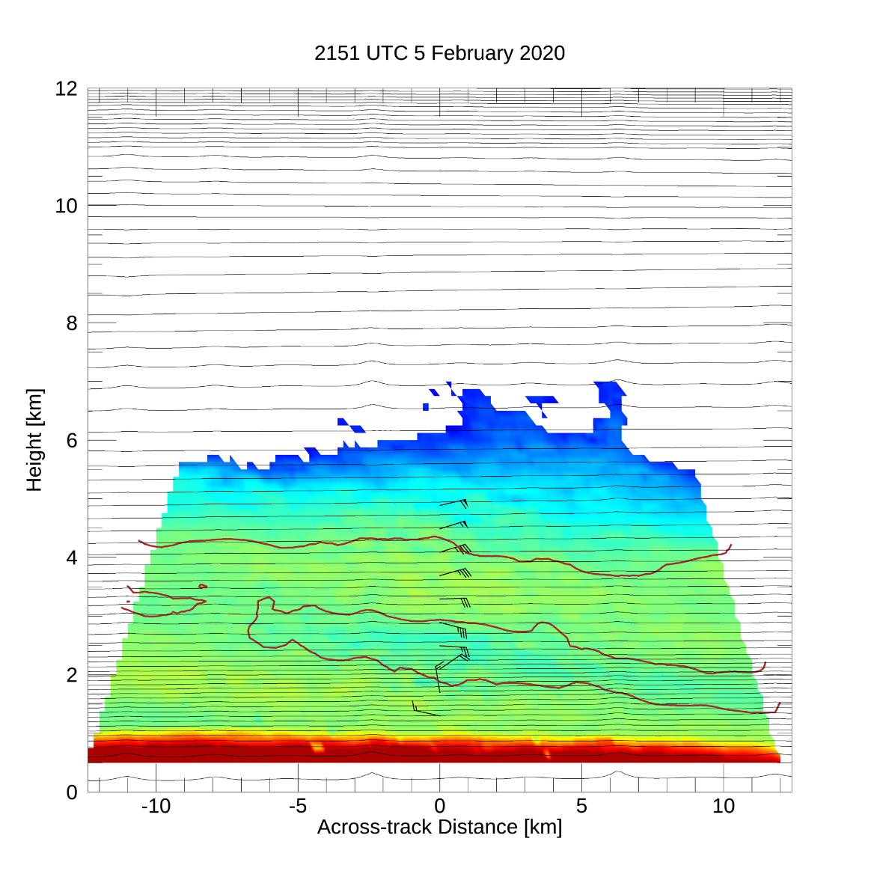
5 February 2020 Case
EXRAD – Scanning-beam Reflectivity
Cross-track Slice
Possible causes of a sloped reflectivity signature:
Isentropic flow
Fall streak (snowflake size sorting)
Slantwise convection (symmetric instability)
Sloped dynamic features (e.g., a sloped deformation zone)
Sloped aggregation layer (due to a sloped temperature field)
Isentropes from the HRRR analysis
Isentropes are mostly flat
Slight upward slope towards the southwest between 5 and 8 km
NE
SW

Slide 6
5 February 2020 Case
EXRAD – Scanning-beam Reflectivity
Cross-track Slice
Possible causes of a sloped reflectivity signature:
Isentropic flow
Fall streak (snowflake size sorting)
Slantwise convection (symmetric instability)
Sloped dynamic features (e.g., a sloped deformation zone)
Sloped aggregation layer (due to a sloped temperature field)
Isentropes from the HRRR analysis
What snow fall speed would be needed for this feature to exist?
Slope = FS / ΔD
FS = Fall speed
ΔD = horizontal displacement rate by shear
ΔD = (vertical shear) * (thickness over which shear acts)
-> FS = (slope) * (vertical shear) * (thickness)
NE
SW

Slide 7
5 February 2020 Case
EXRAD – Scanning-beam Reflectivity
Cross-track Slice
Possible causes of a sloped reflectivity signature:
Isentropic flow
Fall streak (snowflake size sorting)
Slantwise convection (symmetric instability)
Sloped dynamic features (e.g., a sloped deformation zone)
Sloped aggregation layer (due to a sloped temperature field)
Isentropes from the HRRR analysis
2–4-km along-band vertical shear (from EXRAD VAD)
7.8 m/s/km
Slope: 24 m/km
Thickness over which shear acts (height difference along slope)
Top: 0.6 km, Bottom: 1.5 km
Slope: 60 m/km
Required fall speeds
Top: 0.06 m/s
Bottom: 1.62 m/s
------------ Very slow for falling snowflake
---- Reasonable snowflake fall speed
NE
SW

Slide 8
5 February 2020 Case
Geostrophic momentum
Virtual Potential Temperature
Unstable displacements
Possible causes of a sloped reflectivity signature:
Isentropic flow
Fall streak (snowflake size sorting) – plausible
Slantwise convection (symmetric instability)
Sloped dynamic features (e.g., a sloped deformation zone)
Sloped aggregation layer (due to a sloped temperature field)
θ_{v}
θ_{v} + Δθ_{v}
M_{g} + ΔM_{g}
Symmetric instability
Slantwise displacement will result in forces that push parcel farther from initial position
Environment can be stable to pure vertical or horizontal motion
Vertical forces produced by buoyancy differences
Horizontal forces produced by momentum differences
M_{g}
Adapted from House (2014) – Cloud Dynamics
Useful references:
Shultz and Schumacher (1999; MWR)
Emanuel (1983; JAS)

Slide 9
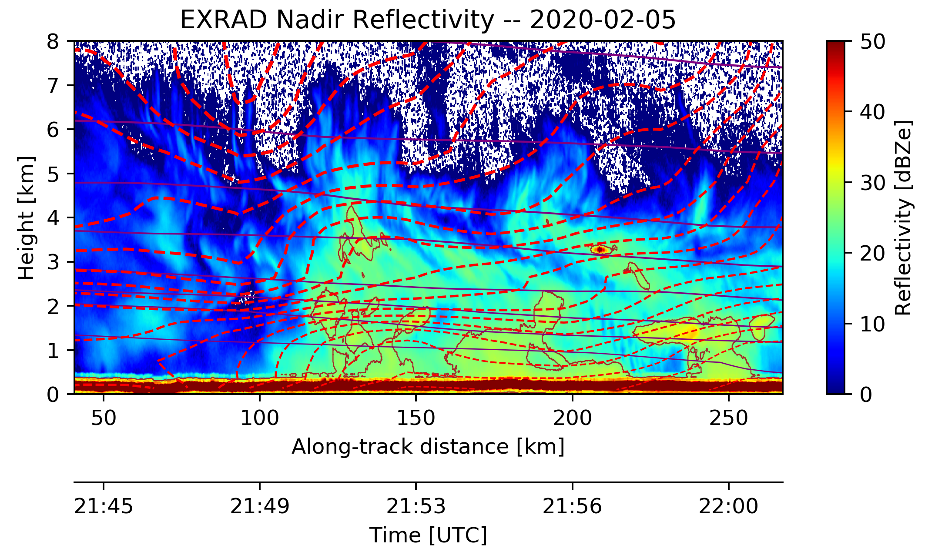
5 February 2020 Case
HRRR Virtual Potential Temperature and Geostrophic Momentum
Geostrophic Momentum
Stable
Virtual Potential Temperature
Stable
Unstable
Stable
Stable
Doesn’t explain along-band slope, but provides formation mechanism
Unstable
Is the analysis just off by 50 km?
NE
SW

Slide 10

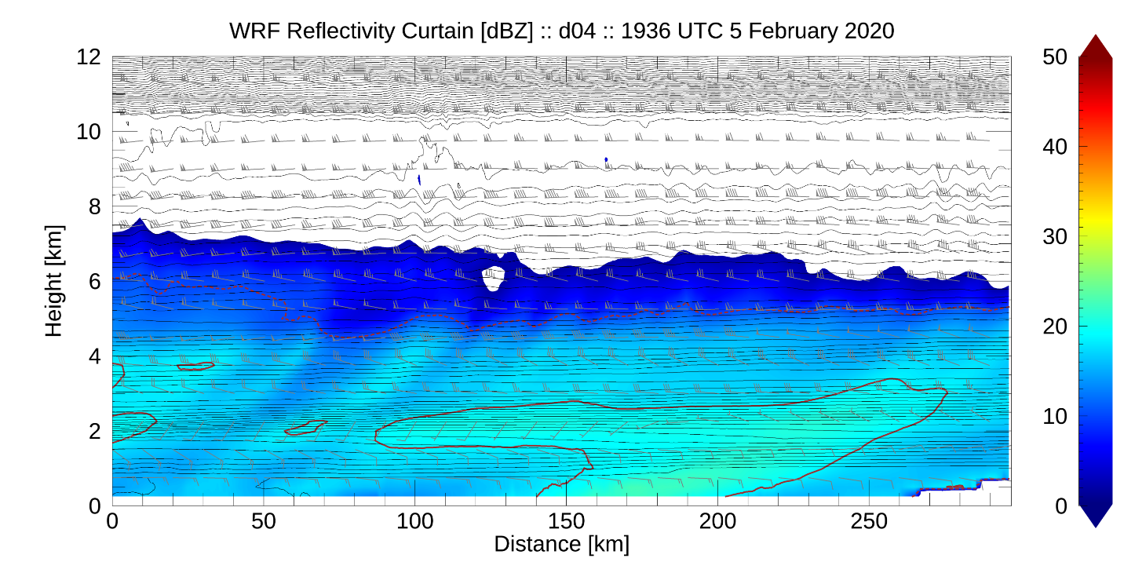
5 February 2020 Case
Possible causes of a sloped reflectivity signature:
Isentropic flow
Fall streak (snowflake size sorting) – plausible
Slantwise convection (symmetric instability) – possibly related
Sloped dynamic features (e.g., a sloped deformation zone)
Sloped aggregation layer (due to a sloped temperature field)
Current working hypothesis:
Bands are formed by slantwise convection and the along-band slope is produced as a fall streak

