Slide 1
EGS Reliability, Maintainability, and Availability Overview
Angelo Conner
Tyler Starr

Slide 2
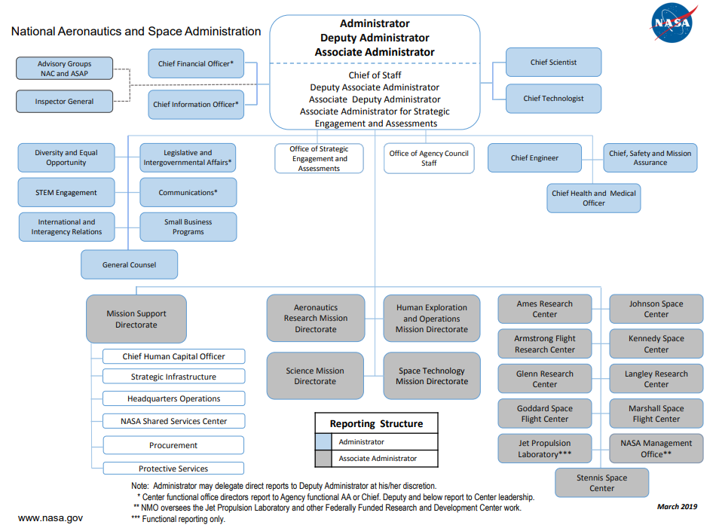
Where We Fit Into the Agency
Launch Services Office
International Space Station Division
Orion
Commercial Spaceflight Development Division
Space Launch System (SLS)
Advanced Exploration Systems Division
Exploration Ground Systems (EGS)
Exploration Systems Development Division
We are here

Slide 3
Where We Fit Into the Program
EGS Analytics Org Chart
EGS Analytics Group
Reliability, Maintainability, and Availability (RMA)
Discrete Event Simulation (DES)
Data Analysis
Ad hoc analyses
KSC Center Director Office (AA)
Launch Services Program (VA)
Program Planning & Control Division (LX-B)
Viz Works
Commercial Crew Program (FA)
Command, Control & Comm. Office (LX-C)
GSE Integration
EGS (LX)
Project Management Division (LX-D)
Operations Planning Branch (LX-O1)
Program Logistics Office (LX-L)
Range Systems
Exploration R&T Programs (UB)
Operations Implementation Branch (LX-O2)
Operations & Test Management Div. (LX-O)
Cross-Cutting
Information Technology (IT)
Operations Integration Branch (LX-O3)
Center Planning (AD)
Systems Engineering & Integ. Div. (LX-S)
Operations Processes Planning
Test Planning & Mangmt. Branch (LX-O4)
Safety & Mission Assurance (SA)
Future Mission / Advanced Planning
Spaceport Integration & Services (SI)
EGS Analytics
Engineering (NE)
Reliability, Maintainability, Availability (RMA)
Software
Modeling & Simulation Analysis (DES)
Chief Financial Officer (GG)
We are here
Communications & Public Engagement (PX)
Procurement (OP)
Human Resources (BA)
Diversity (AJ)
Chief Counsel (CC)

Slide 4
EGS Program Requirements
EGS Artemis 1 RMA Requirements
Inherent Launch Availability
98% for each launch attempt
Analyzed at 24 hours
Operational Availability (Nominal Scrub Turnaround)
80% for initial launch attempt through prior to next launch attempt
Analyzed at 360 hours
Inherent Launch Availability
Operational Availability
LH2 Inherent Launch Availability Allocation
CAA Inherent Launch Availability Allocation
Various Inherent Launch Availability Allocation
HYPER Operational Availability Allocation
CT Operational Availability Allocation
Various Operational Availability Allocation
Reliability Lower Bound
MTTR Upper Bound
Reliability Lower Bound
MTTR Upper Bound

Slide 5
The Availability Curve
Availability is a function of Reliability and Maintainability
Many different Reliability and Mean Times to Repair can yield the required availability.
Reliability Lower-Bound
MTTR Upper Bound
Reliability
Acceptable Area
Availability
Reliability Lower-Bound
MTTR
Upper-Bound
MTTR

Slide 6
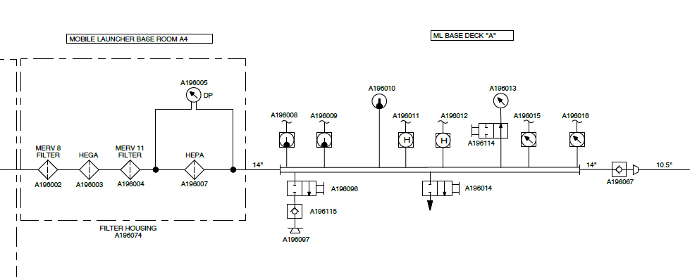
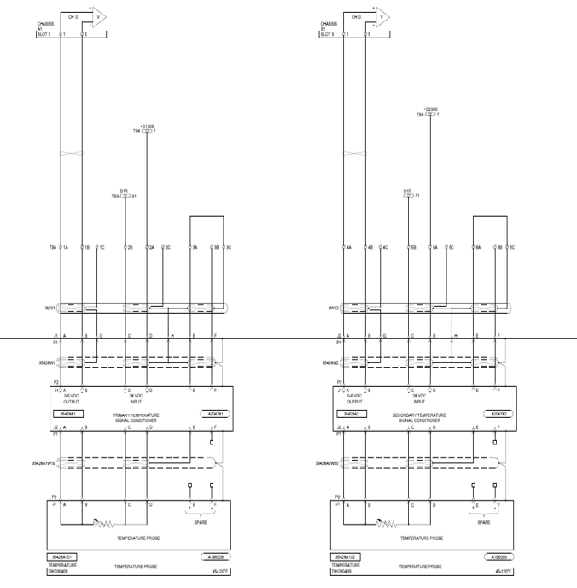
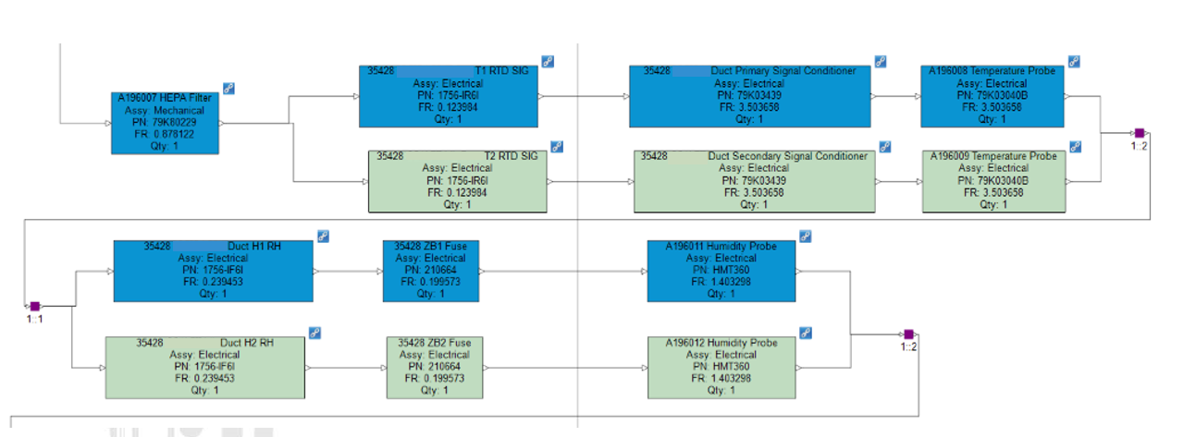
Analysis Process
Procedure
Gather schematics and support documents
Build parts list and assign a failure rate and MTTR to each component
Build Reliability Block Diagram (RBD) via Windchill Risk and Reliability (WRR) and run Monte Carlo simulation

Slide 7
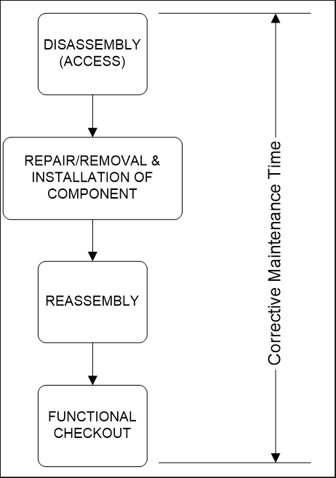
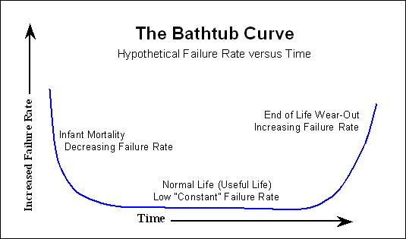
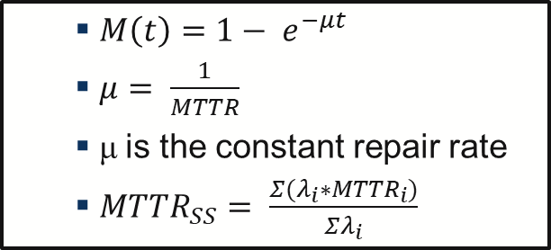
Analysis Assumptions
Assumptions
Failure/Repair rates are predicted
Military Handbook Data
Manufacturer Data
Subject Matter Experts
Failure rates are constant over the analysis timeframe
Use Exponential Distribution – Bottom of the “Bathtub”
Component failure on a redundant path assume a 100% switch over success rate
Repair rates (MTTR) account for corrective maintenance actions only
Preventive/Schedule maintenance, Logistics delays, and Administrative delays are excluded

Slide 8
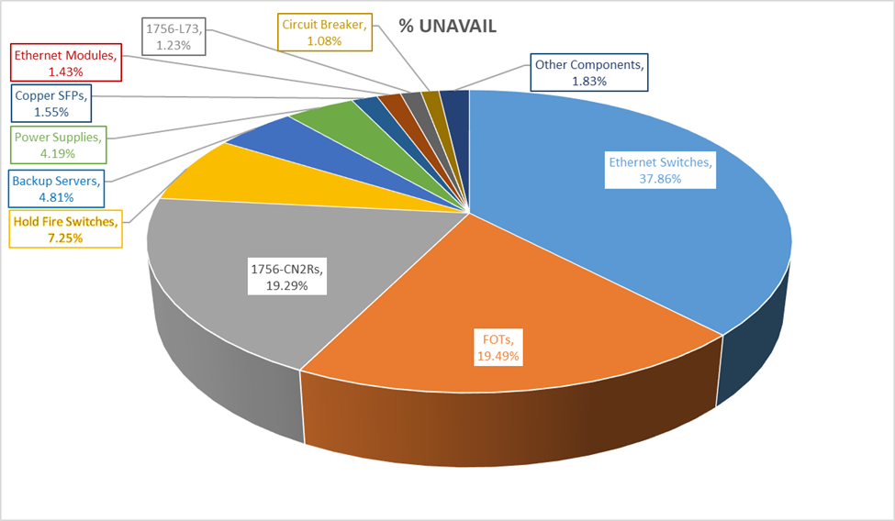
2713 RMA Analysis Report
Results
Inherent/Operational Report
Results table
Cut-set analysis
Configuration | Reliability Lower-Bound (@ 24 hrs) | MTTR Upper-Bound (hrs) | Availability Allocation (A_{inh} @ 24 hrs)
REQUIREMENT | 0.998157 | 15.00 | 0.999402
30% Analysis | 0.999825 | TBD | 0.999825
60% Analysis | 0.999305 | 7.37 | 0.999786
90% Delta Analysis | 0.999045 | 6.01 | 0.999760
CDG Analysis | 0.999088 | 10.87 | 0.999659
100% Design Analysis | 0.999179 | 10.43 | 0.999706

Slide 9
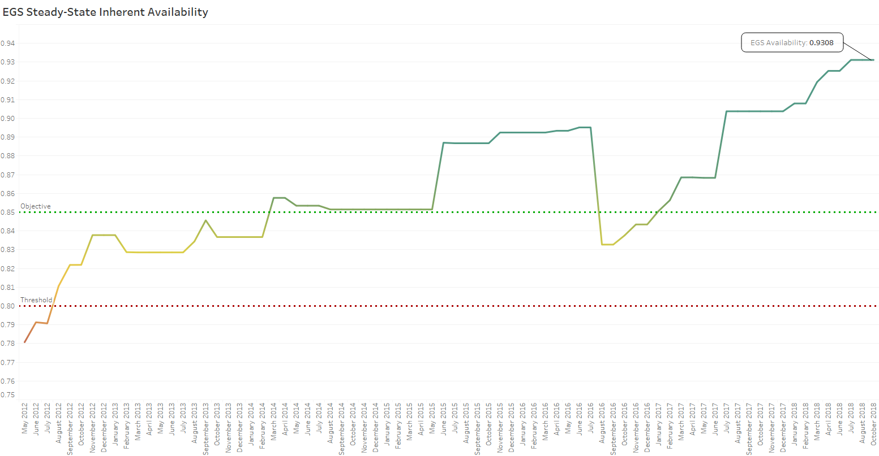
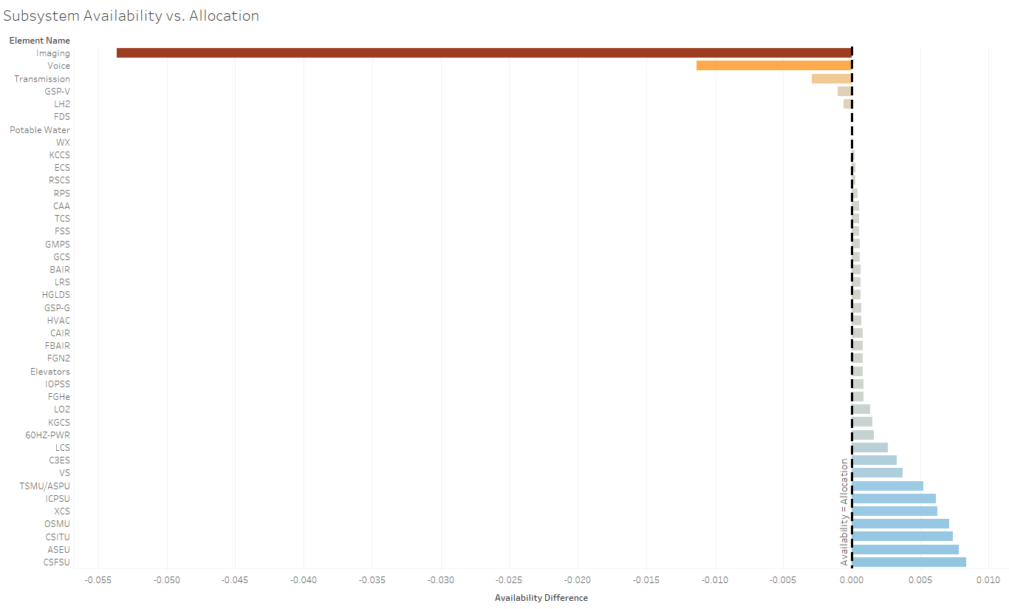
Program Level Reporting
Results Reporting
Technical Performance Measures
NOTIONAL
NOTIONAL

Slide 11
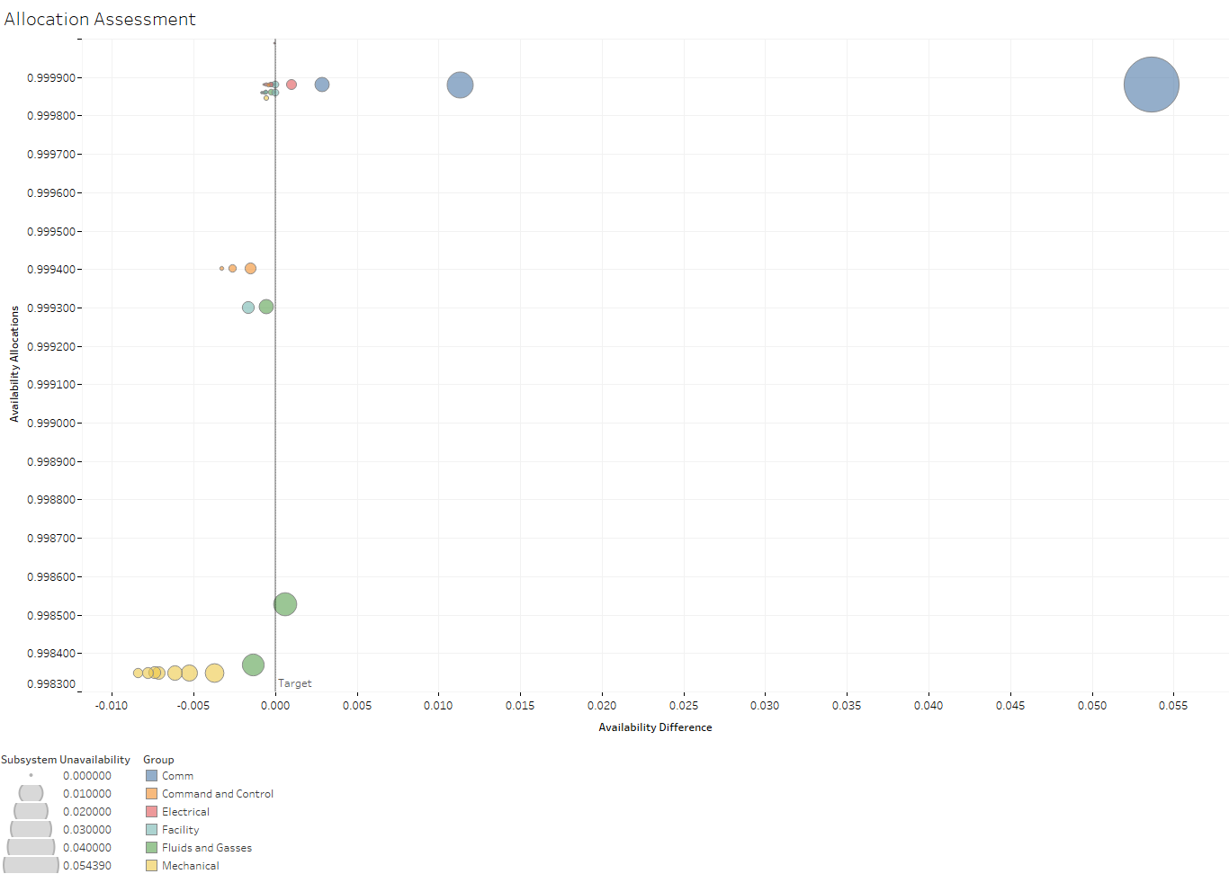
Allocation Difficulties

