Slide 1

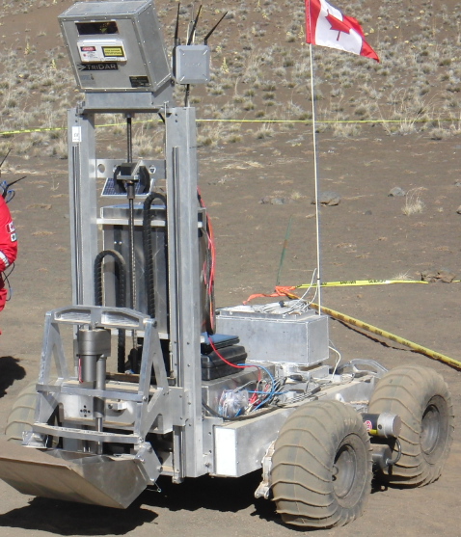
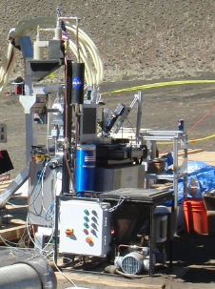
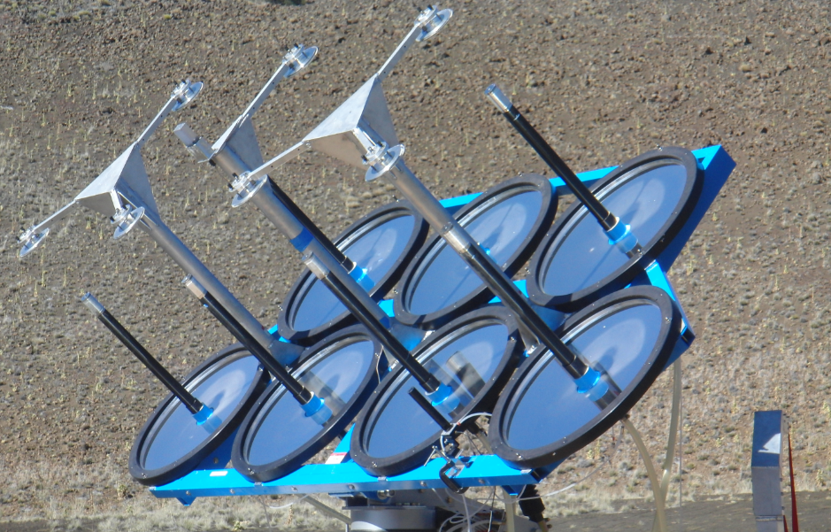
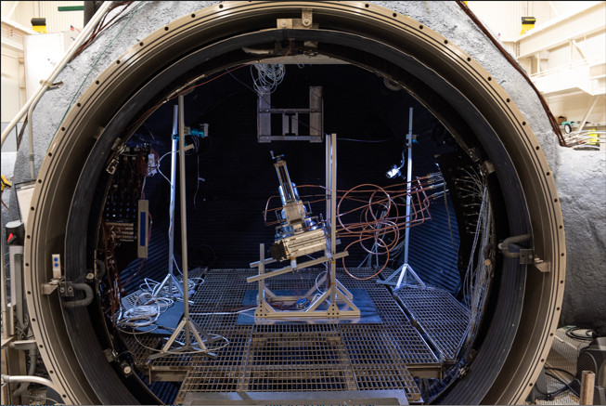
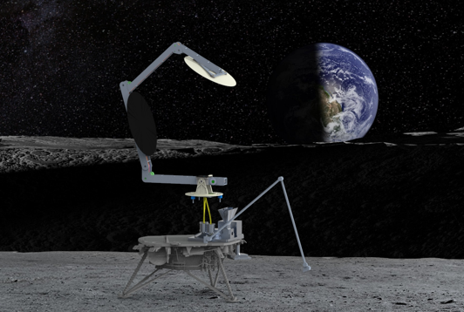
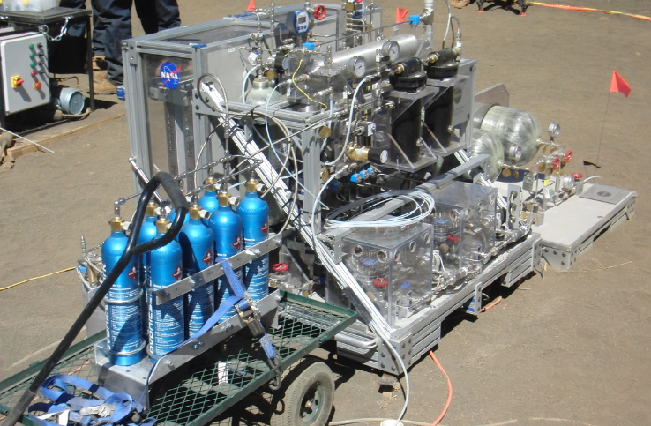
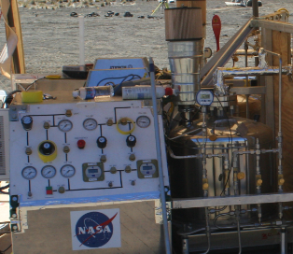
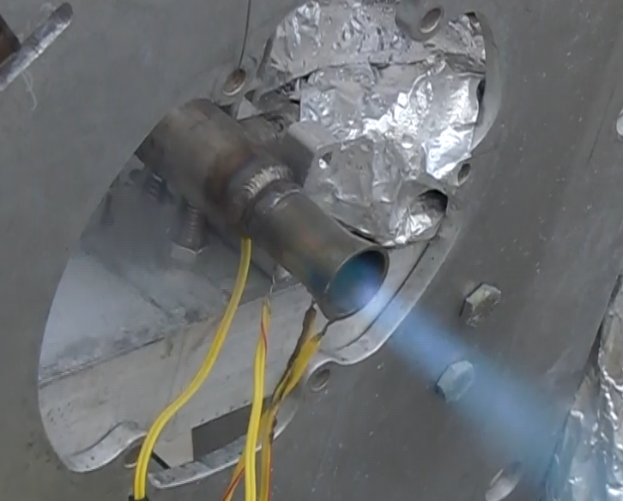
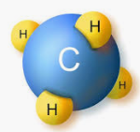
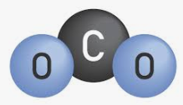

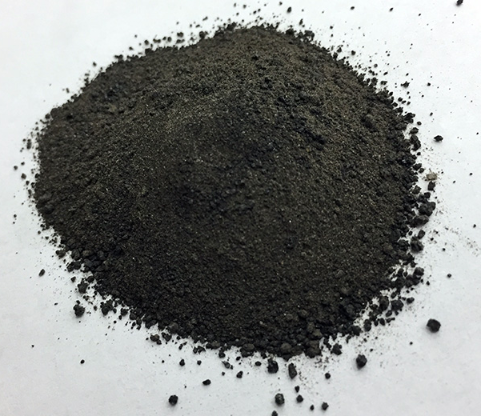
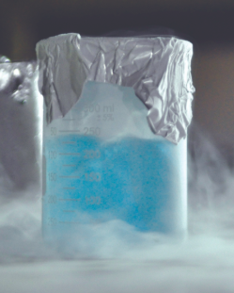
Carbothermal Reduction Demonstration (CaRD)
Project Status 2023
CaRD project scope includes all of the subsystems necessary to determine the performance of the carbothermal reduction process (SiO₂ + 2C → Si + 2CO) on the lunar surface.
Downstream components that convert CO into oxygen gas can be implemented at a larger scale once the yield is known.
Past
Present
Future
Soil
Heat
Excavator
Canadian Space Agency
Carbothermal Reactor
Orbitec
Solar Concentrator Physical Sciences Inc.
H₂O
O₂
LOX
Water Electrolysis Johnson Space Center
Liquefaction Johnson Space Center
Propulsion
Johnson Space Center
“Dust to Thrust” Demonstration 2010
Carbothermal Reactor Developed by Sierra Space Inside 15ft Dirty Thermal Vacuum Chamber at JSC
CaRD Prototype Test in FY24.
Targeting Payload on the Lunar Surface in 2027
Concentrated Solar Energy
End-to-end Lunar Carbothermal Oxygen From Regolith Process
Included in CaRD Project
CH₄
Included in Digital Engineering Design Center Project
Carbothermal Reactor
CH_{4,} CO, H_{2,} CO₂
Methanation Reactor
CH₄
Common to Mars ISRU, Carbothermal and ECLSS
Soil Excavation
Inlet Hopper
Condenser
H₂O
Common to Mars ISRU and Carbothermal
Spent Soil Disposal
H₂
Outlet Hopper
Water Electrolysis
O2 Dryer
O2 Liquefaction & Maintenance
O₂
The current cost to land 1kg on the lunar surface is $1.2M. At that rate, landing 10 tonnes of LOX would cost $12B

Slide 2

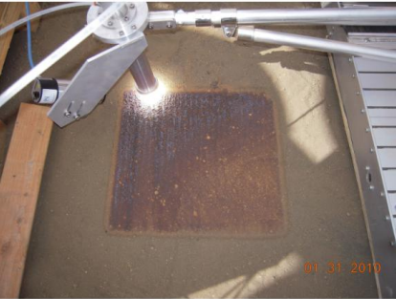
“Dust to Thrust” 2010
Tephra
Heat
Excavator
Canadian Space Agency
Carbothermal Reactor
Orbitec (Now Sierra Space)
Solar Concentrator
Physical Sciences Inc.
H₂O
Heat
O₂
LOX
Plume
Water Electrolysis
Johnson Space Center
Liquefaction
Johnson Space Center
Propulsion
Johnson Space Center
Sintered Pad
Physical Sciences Inc.
NORCAT

Slide 3
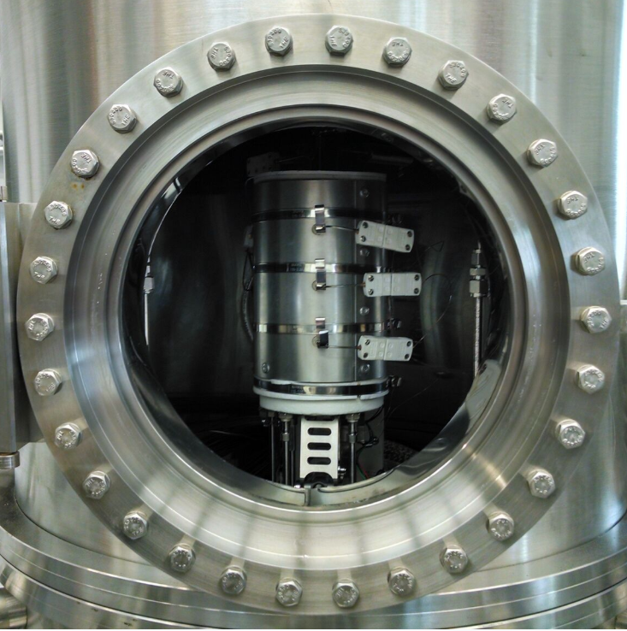
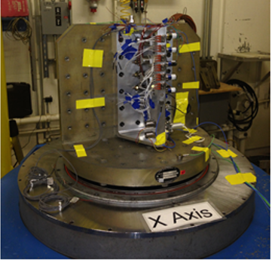
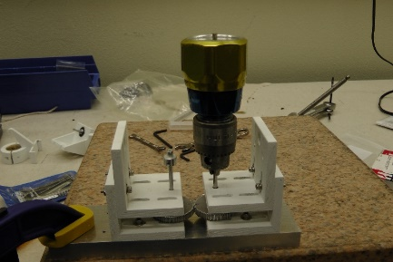
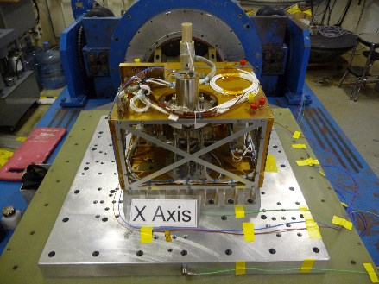
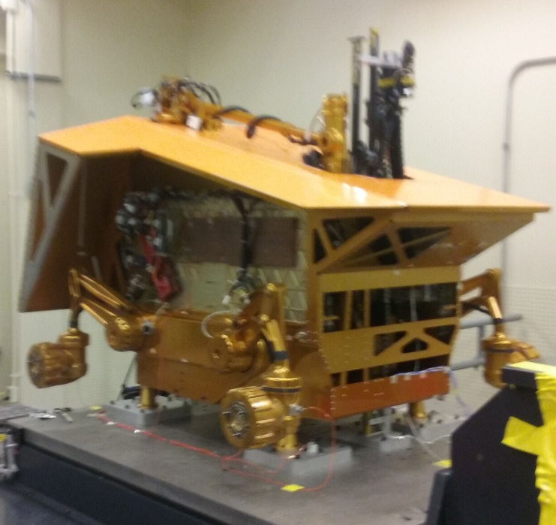
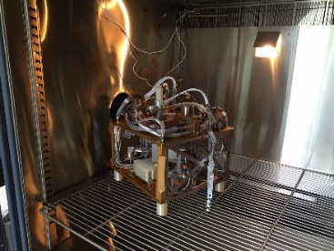
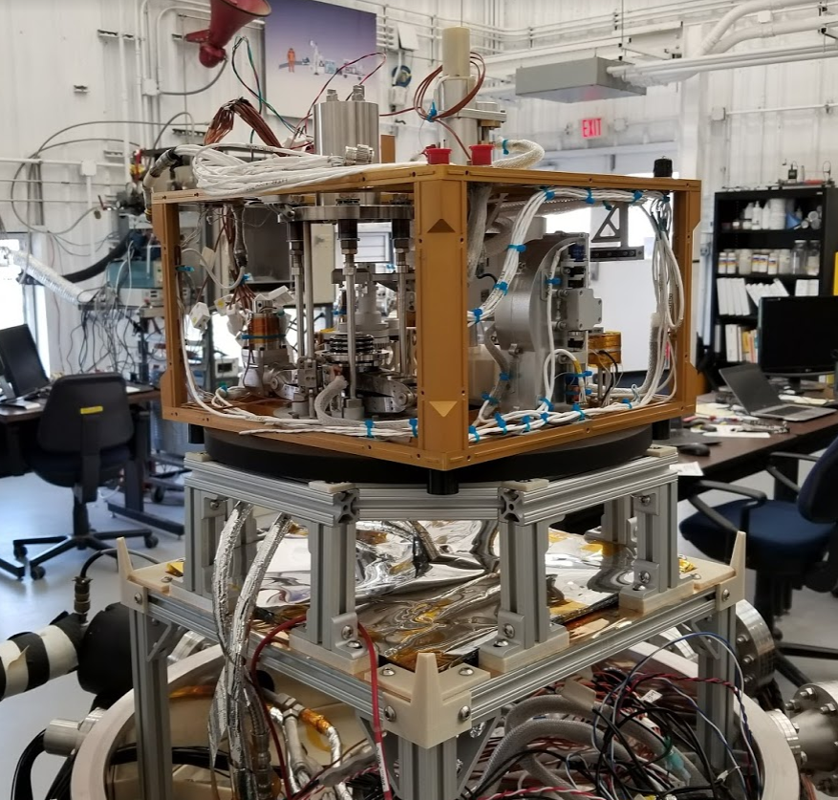
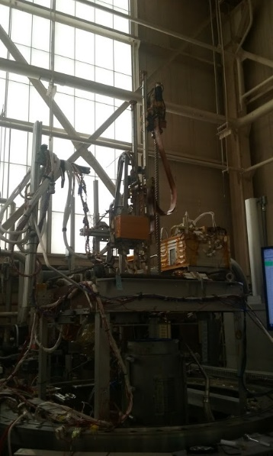
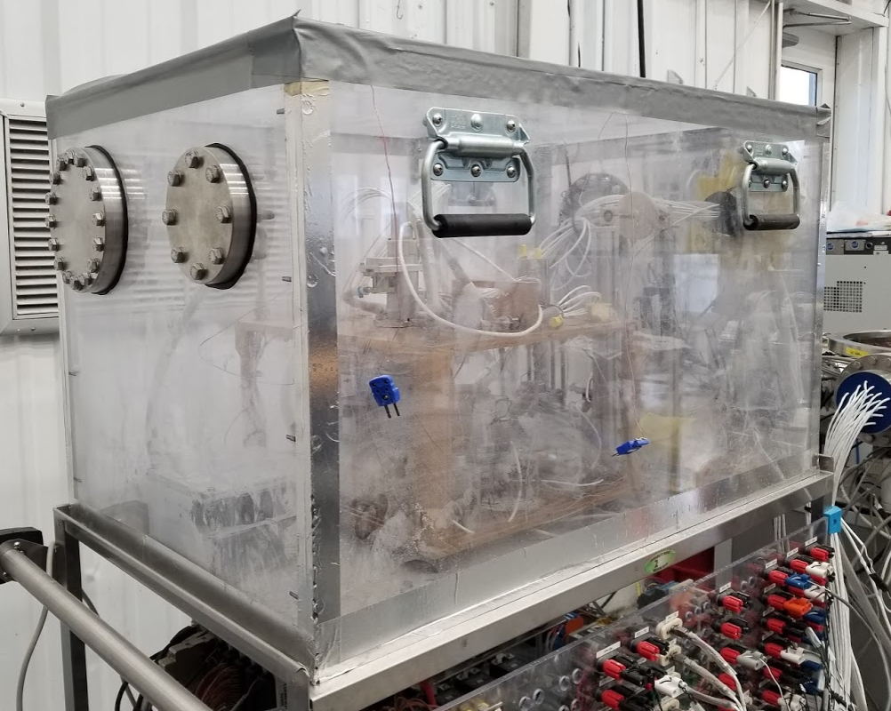
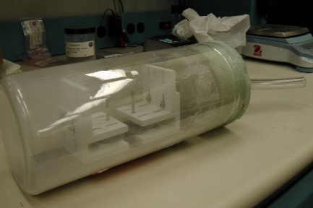
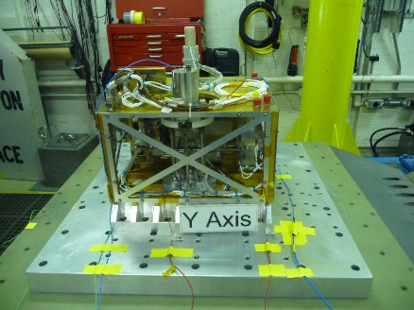
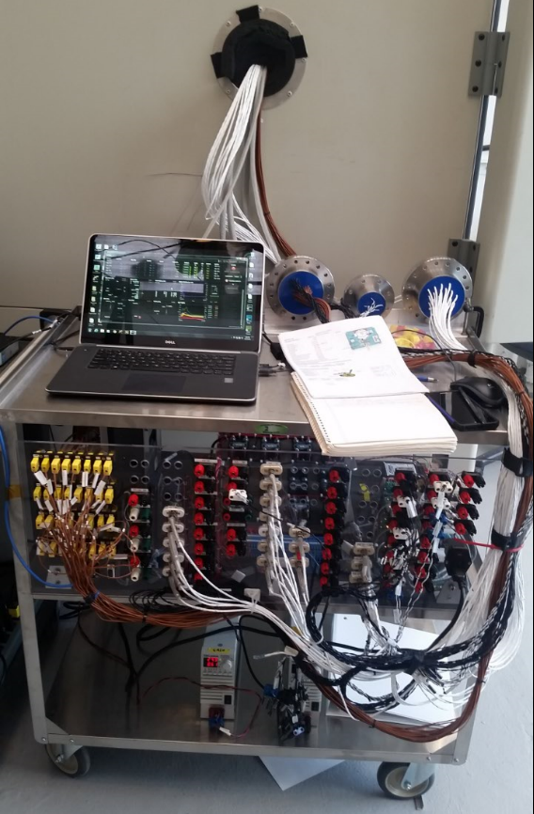
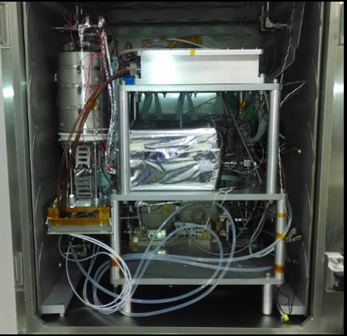
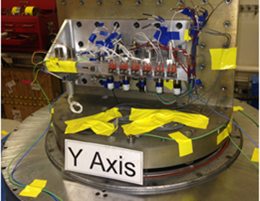
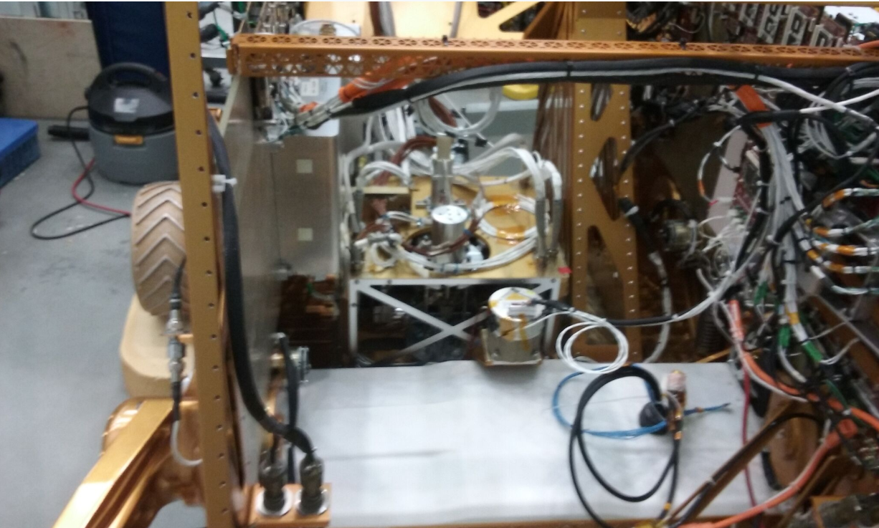
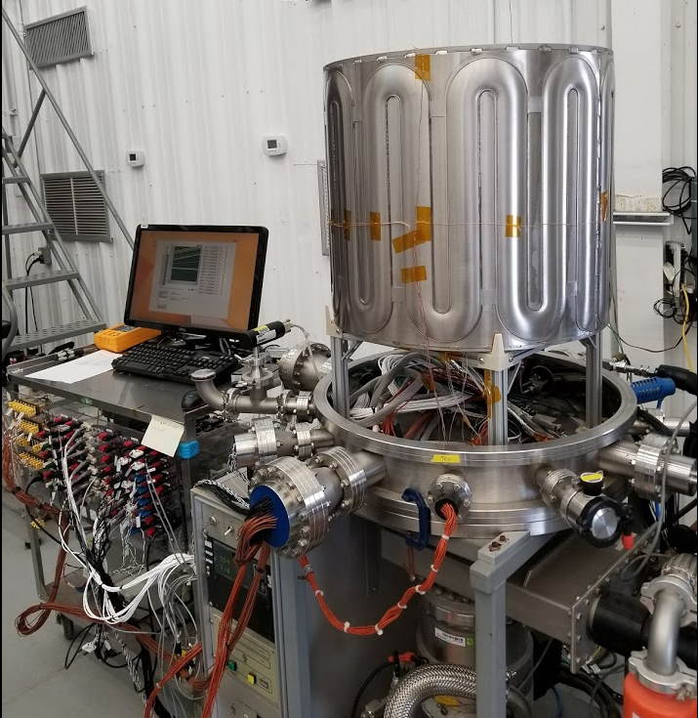
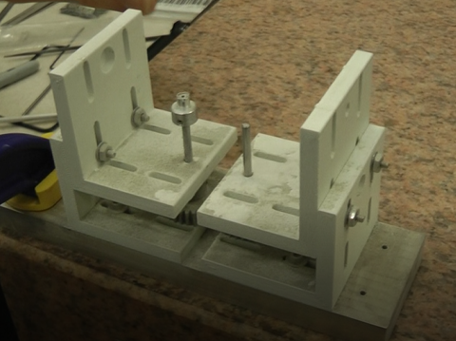
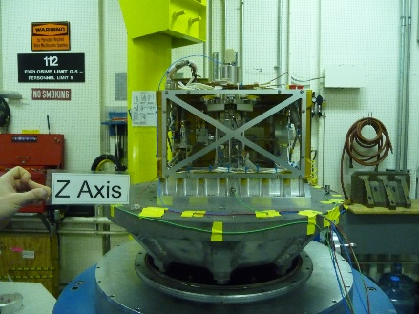
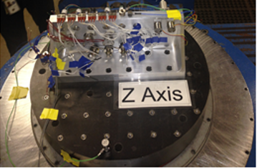
Example of TRL 4 to 6 for the Moon
Component Vibration
Component Dust
Subsystem Vibration
Integrated Vibration
Component TVAC
Thermal Cycles
Component Thermal Vacuum
Integrated Thermal Vacuum
Torque Margin/Dust
Environmental Testing of the OVEN

Slide 4
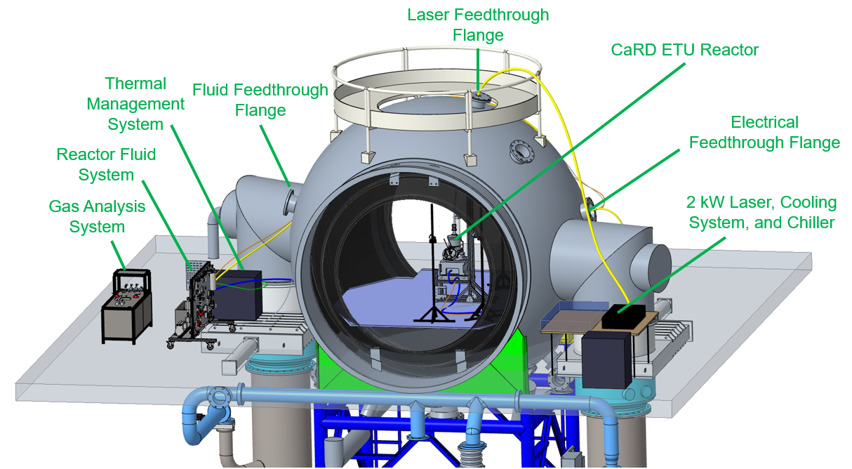


CaRD Environmental Test Unit (Brassboard)

Slide 5
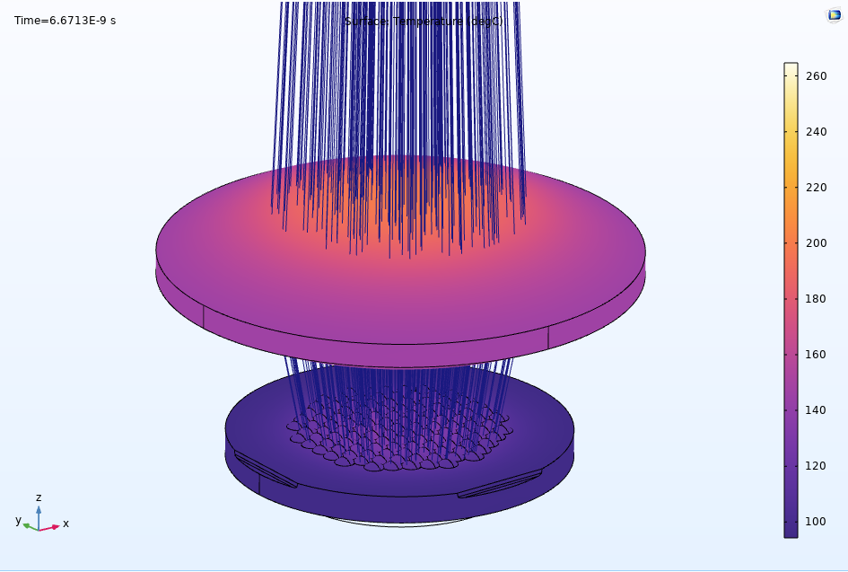
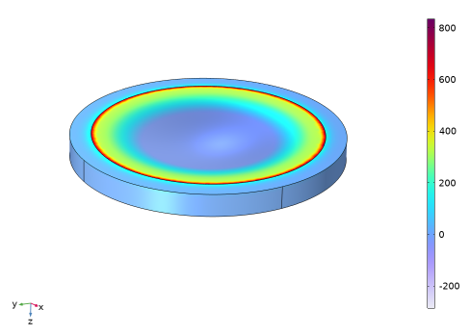
COMSOL Multiphysics Analysis
Lens Heating Analysis
Lens Stress Analysis

Slide 6


CaRD Brassboard Test Results
Test Number | grams oxygen extracted/ kWh thermal
CaRD Ambient | 13.42
CaRD Vacuum 1 | 11.53
CaRD Vacuum 2 | 15.79
CaRD Vacuum 3 | 10.77
This test will be repeated in 2024 with an automated reactor being developed by Sierra Space through the Carbothermal Oxygen Production Reactor (COPR) Tipping Point project

Slide 7
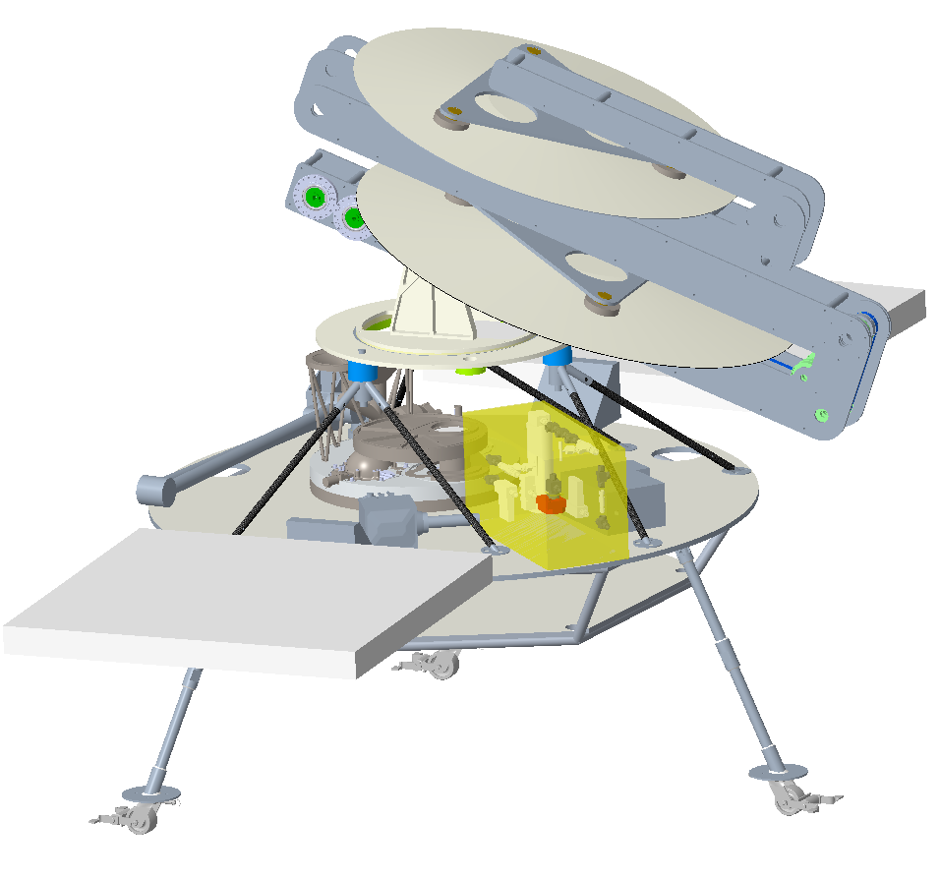
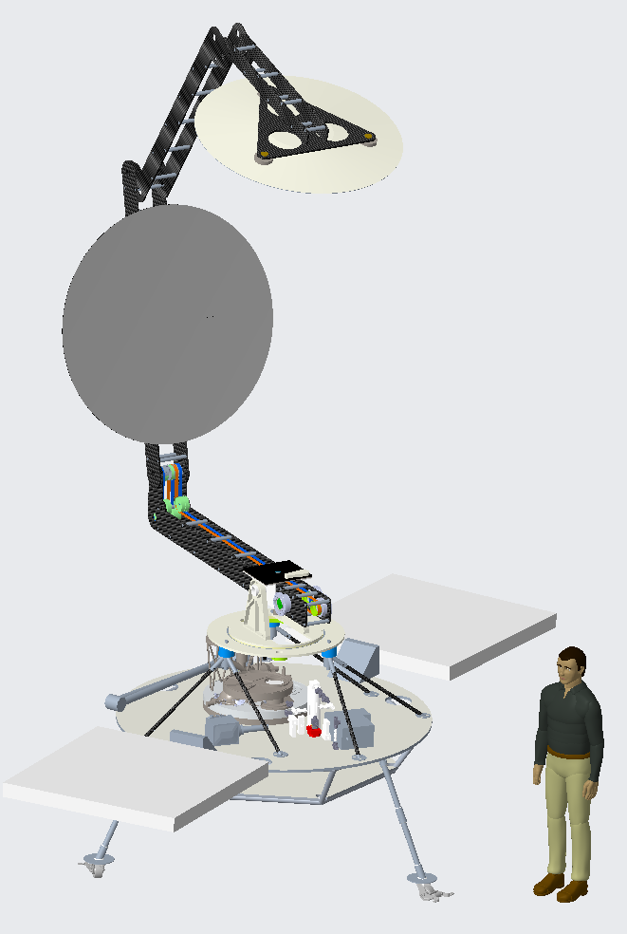
CaRD Prototype
Solar Concentrator
Reactor
Arm Mockup
Avionics/Software
Gas Analysis
Lander Mockup
Thermal Management
Reactor Fluid System

Slide 8

Long Term Overview
Full Scale
10MT/yr
(2 kg/hr)
SBIR Phase 3 (CTOP) (GRC-Sierra Space)
Full Scale Plant
Compass Study
3.5 MT/yr per module
Pilot Plant
1MT/yr
(0.2 kg/hr)
Studies/Development
Pilot Plant
Completed
Active
Needed
Flight Demo
(single melt)
Flight Demo
Demonstrations
Requirements
Studies/Development
Ground Demo
(single melt)
Ground Demo
CaRD
Brassboard Reactor SBIR Phase 3 (Sierra Space)
Brassboard Waveguide, SBIR Phase 2 (Physical Sciences Inc.)
Prototype Reactor, COPR Tipping Point (Sierra Space)
Prototype Waveguide, SBIR Phase 3 ( Physical Sciences Inc.)

Slide 9
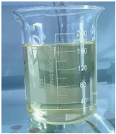
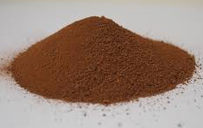
Mars and ECLSS Commonality
End-to-end
Lunar Carbothermal O2FR Process
Methane Gas
Common to Mars ISRU, Carbothermal and ECLSS
CH₄
Common to Mars ISRU and Carbothermal
Carbothermal Reactor
CH_{4,} CO, H_{2,} CO₂
Sabatier Reactor
CH₄
Soil Excavation
Inlet Hopper
H₂O
Condenser
H₂O
H₂
Spent Soil Disposal
Outlet Hopper
Water Electrolysis
O2 Liquefaction & Maintenance
Water Cleanup
O₂
O2 Dryer
End-to-end
Mars Propellant Production Process
Dust Filtration
CO₂ Collection
CO2
Sabatier Reactor
CH₄
Condenser
CH₄ Liquefaction & Maintenance
H₂O
CH₄
CH₄ Dryer
H₂O
H₂
Soil Excavation
Inlet Hopper
Regolith Dryer
Water Cleanup
Water Electrolysis
O2 Dryer
O2 Liquefaction & Maintenance
H₂O
O₂
Spent Soil Disposal
Outlet Hopper

Slide 10
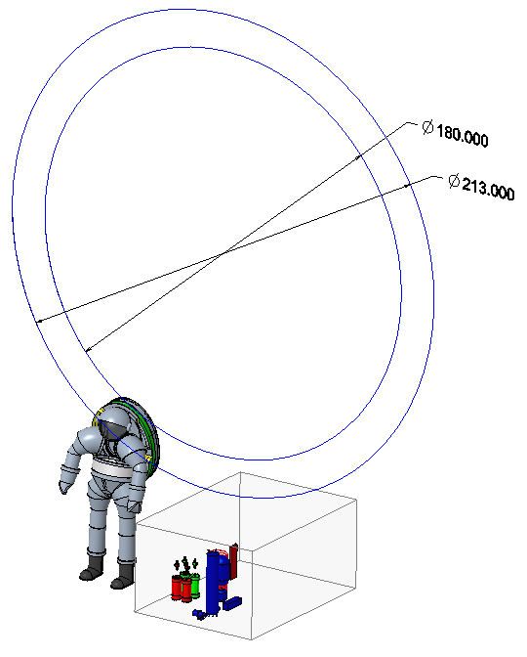
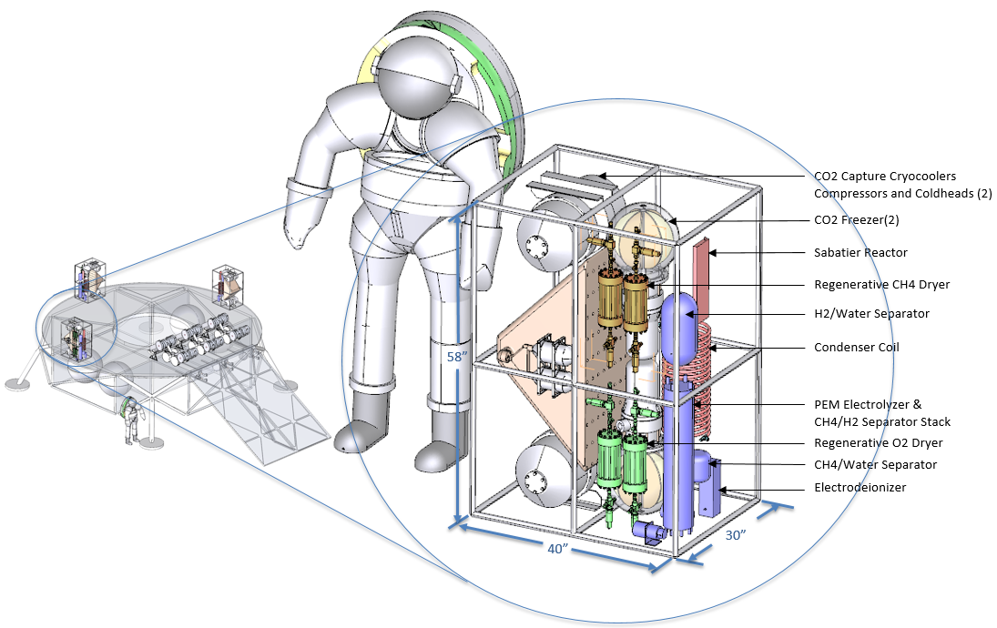
Scalability & Modularity
 | Tonnes of O₂ | days | kg/day | kg/hr
O2FR pilot plant | 1.000 | 182 | 5.49 | 0.23
O2FR full scale O2FR | 10.000 | 182 | 54.95 | 2.29
Mars ISRU LOX Methane | 27.912 | 480 | 58.15 | 2.42
180” DIA = Falcon 9 payload fairing diameter
213” DIA = Minimum mirror diameter required for 1 tonne per year based on current results
Notional packaging of Mars ISRU module sized for 40% of Mars LOX/Methane. 3 modules x 40% = 120% of full scale
Reference: Kleinhenz, J. E., & Paz, A. (2017). An ISRU propellant production system for a fully fueled Mars Ascent Vehicle. In 10th Symposium on Space Resource Utilization (p. 0423).
Components common to Mars ISRU module would easily fit inside of a flex rover cargo box
Flex Rover cargo box volume

Slide 11
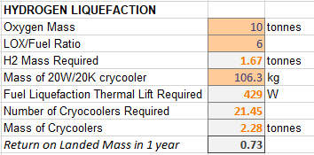
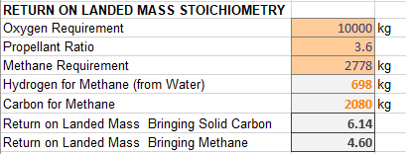
Mars Commonality – Expanded to Lunar LOX/Methane
Modified Lunar Carbothermal Concept
Solid Carbon
Methane Pyrolysis
Common to Mars ISRU, Carbothermal and ECLSS
CH₄
Common to Mars ISRU and Carbothermal
Carbothermal Reactor
CH_{4,} CO, H_{2,} CO₂
Sabatier Reactor
CH₄
CH₄ Liquefaction & Maintenance
Soil Excavation
Inlet Hopper
H₂O
Condenser
CH₄
CH₄ Dryer
H₂O
H₂
Spent Soil Disposal
Outlet Hopper
Water Electrolysis
O2 Liquefaction & Maintenance
Water Cleanup
O₂
O2 Dryer
Water from Icy Regolith
Producing both LOX and LCH4 on the moon would be the best “Moon to Mars” architecture for propellant production and can be accomplished if solid carbon is combined with hydrogen sourced from lunar water
Current hydrogen liquefaction crycooler technology will have to operate for over a year in order to see a return on landed mass (assuming 183 days of sunlight per year)¹
The use of solid carbon to drive a carbothermal reduction reaction has been demonstrated for terrestrial silicon production²
Methane pyrolysis technology is being developed for terrestrial hydrogen and carbon production³
References:
Nugent, B. T., Grotenrath, R. J., & Johnson, W. L. (2022). 20 Watt 20 Kelvin Reverse Turbo-Brayton Cycle Cryocooler Testing and Applications.
Maeng, S. H., Lee, H., Park, M. S., Park, S., Jeong, J., & Kim, S. (2020). Ultrafast carbothermal reduction of silica to silicon using a CO2 laser beam. Scientific reports, 10(1), 21730.
Methane Pyrolysis for Hydrogen-Opportunities and Challenges

