Slide 1


OSSEs – Lessons Learned in the Troposphere
Nikki Privé
1 June 2023

Slide 2
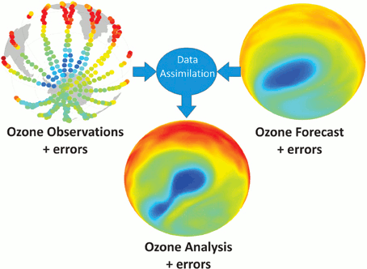
How NWP Uses Observations
Data assimilation combines observations and a prior forecast to generate a new initial condition (“analysis”)
The estimated errors of the observations and forecast are used as weighting by the data assimilation system
Image: Lahoz, W. and P. Schneider, Front. Environ. Sci., 2014, with permission from the author

Slide 3
OSSEs vs the Real World
Real world forecasts
verification
observation
DAS
Forecast model
Reality
Data
Analysis
Forecasts
background
OSSE forecasts
Nature Run
interpolation
Synthetic
data
DAS
Forecast model
Analysis
Forecasts
background
verification

Slide 4
Why Do an OSSE?
You want to find out if a new observing system will add value to NWP analyses and forecasts
  Most common goal
You want to make design decisions for a new observing system
    Can compare many different configurations; determine instrument requirements
    Early involvement in instrument design process
You want to investigate the behavior of data assimilation systems in an environment where the truth is known. The availability of a complete true state of the atmosphere allows the explicit calculation of some quantities not possible in the real world:
    Analysis error
    Short-term forecast error
    Efficacy of the data assimilation system

Slide 5
When Not to Run an OSSE
When you can't model the phenomena you are interested in
When you can't simulate your new observations
When you can't assimilate your new observations

Slide 6
Challenges with Nature Runs
Identical or fraternal twins
  Same model (identical) or similar model (fraternal) used for the Nature Run as for experiments
  Lack of model error complicates every aspect of the OSSE process
  Mitigation: use different model bases and resolutions for the NR and experiment model; use alternative options for parameterizations; Nature Runs as community resources
Gigantic output files and huge computational resource requirements
  Need both high spatial and high temporal resolution
  I/O is the heaviest burden
  Mitigation: integrate observation simulators into the Nature Run model to reduce I/O and space requirements

Slide 7
General OSSE Challenges
  Results only apply within the OSSE system – no concrete connection to the real world
    Mitigation: validation of the OSSE behavior and performance compared to the real world – both overall and specific to the particular experiments at hand
  Observation simulation – achieving realism including observation errors
    Mitigation:
      Make sure the Nature Run produces realistic fields needed to simulate the observations
      Use different “operators” to simulate observations than for assimilation
      Build capability for simulating realistic observation errors
      New instruments – test a range of simulated observation errors and/or observation operators
  By the time the new instrument is deployed, both the global observing network and the forecast models/DAS will be different

