Slide 1


In Situ Monitoring for Defect Detection and Certification of AM
Delphine Duquette
Erin Lanigan
James Mavo
NASA Marshall Space Flight Center
Damage Tolerance and Non-Destructive Evaluation Team

Slide 2
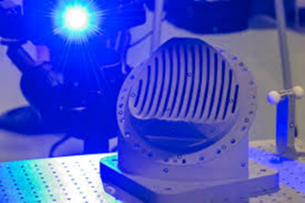
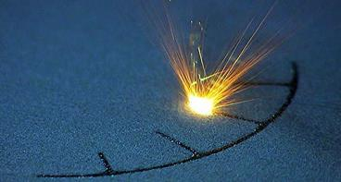
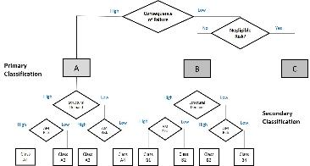
Qualification of In Situ Process Monitoring for Certification of AM Space Hardware
We will discuss NASA’s interest in qualifying NDE and in situ monitoring methods for certification of AM space hardware.
NASA’s involvement and approach
Qualification of NDE and in situ monitoring
Certification framework

Slide 3
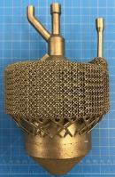
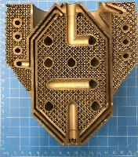
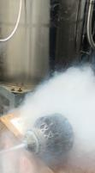
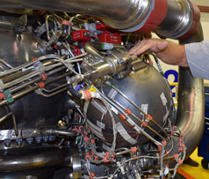
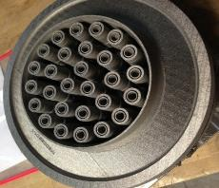
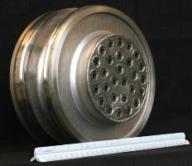
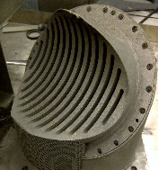
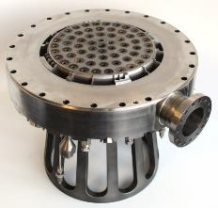
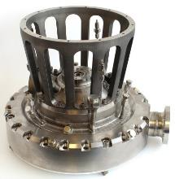
Qualification of In Situ Process Monitoring for Certification of AM Space Hardware
NASA is interested in qualifying in situ monitoring for complex, critical parts that are difficult to inspect using traditional NDE.
Cryogenic Heat Exchanger-Injector-Condenser Demo
28-Element Inconel® 625 Fuel Injector
Reduced 163 parts to 2
Schedule reduced from 1 year to 4 months
70% cost reduction
RS-25 Pogo Accumulator Z-Baffle
Over 100 Welds Eliminated
Nearly 35% Cost Reduction
Injector Assembly
MSFC Project with Army Air and Missile Defense (AMD)

Slide 4
In Situ Process Monitoring Functions
There are two main functions of in situ process monitoring:
Process Control Function
Part Quality Function
Real-time warning of build problems
Use to check for process drift
Monitor effects of parameter changes, spatter, etc.
Not counting on it for quantitative part quality metrics or defect detection
  May help tell you where to look for a problem, but would require verification with NDE
Quantitative analysis of part quality
Requires a known correlation between indications, physics of the process, and actual defects in the finished part
Need to know probability of detection
  Extra step – verify actual size, location of created defects
Need to treat it like NDE – believe and investigate every indication
  Can’t dismiss anything as a false positive unless proven
vs.

Slide 5
Challenge Current Paradigm
When considering the use of in situ process monitoring for part qualification, there are a few aspects that challenge the current paradigm.
In-process vs. post-process NDE
Often, defect observations are indirect
  Directly observing process variation, inferring final defect
  Must understand physical basis for measured phenomena
  Need to prove a causal correlation from measured indications to defect state
Probability of detection (POD) study must include secondary verification of created defects
Closed-loop process control
Current NASA qualification logic based on a locked process
For real-time parameter changes, a new approach is needed
no longer nondestructive

Slide 6
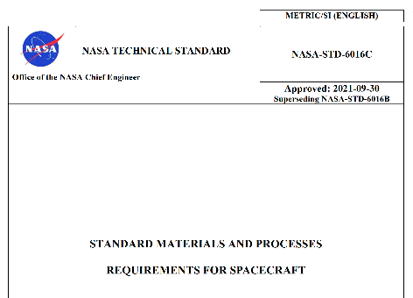
NASA AM Certification Approach
The current logic of additive manufactured part certification is outlined in NASA-STD-6016C, NASA-STD-6030, and NASA-STD-6033.
MSFC-STD-3716
MSFC-SPEC-3717
Standard for Additively Manufactured Spaceflight Hardware by Laser Powder Bed Fusion in Metals
Specification for Control and Qualification of Laser Powder Bed Fusion Metallurgical Processes
NASA-STD-6030
NASA-STD-6033
NASA Technical Standard
NASA Technical Standard
NASA-STD-6016C
Additive Manufacturing Requirements for Spaceflight Systems
Additive Manufacturing Requirements for Equipment and Facility Control
General M&P requirements
Handbook coming soon with more specifics on implementation.

Slide 7
Qualified In Situ Process Monitoring
Passive in situ process monitoring may be used as a quantitative indicator of part quality, if qualified.
Language:
“Prior to use as a quantitative indicator of part quality for part acceptance, passive in-situ process monitoring technologies shall be qualified by the CEO to the satisfaction of NASA in a manner analogous to other NDE techniques.”
Rationale:
“All processes that are used to establish quantifiable quality assurance metrics are qualified against established criteria to verify detection reliability, calibration, and implementation. If in-situ monitoring techniques are employed for such purposes, the need for such qualification is unchanged.”
(emphasis added)

Slide 8
Qualified In Situ Process Monitoring
Passive in situ process monitoring may NOT replace NDE.
Rationale (cont.):
“Certification of a passive in-situ monitoring technology relies upon a thorough understanding of the physical basis for the measured phenomena, a proven causal correlation of the measured phenomena to a well-defined defective process state, and a proven level of reliability for detection of the defective process state.”
“If qualified in the manner stated above, an in-situ process monitoring technique can be used to complement NDE in the Integrated Structural Integrity Rationale of the PPP. At this time, even a qualified in-situ process monitoring method cannot be considered a complete replacement for NDE.”
“Even if qualification is not desired, the use of in-situ process monitoring is encouraged as a source of process control data. This data can also be used to help guide targeted inspection.”
(emphasis added)

Slide 9
Overview of the In Situ Process Monitoring Qualification Study Efforts
What: The In-Situ Project
  Correlating In-situ monitoring data and Non-Destructive Evaluation (NDE) methods to characterize defect populations in Laser Powder Bed Fusion (L-PBF) material
How: Analyze defect detection capabilities of in-situ monitoring by comparison to traditional NDE using flaws created with controlled off-nominal build parameters and verified by metallography
  Create samples with known defects on EOS M290
  Record layer to layer AM process quality with EOState Optical Tomography Monitoring system
  Compare results using North Star Imaging X5000 Mini-/Micro-Focus CT and UES RoboMet serial sectioning system
Why:
  Supports developing roadmap for qualifying in-situ monitoring technologies to support NASA-STD-6030 certification approach
    Proven causal correlation between indications in in-situ monitoring data and final state of the part
  Supports Agency Lunar Infrastructure objectives

Slide 10

Context
Certification of Additively Manufactured (AM) parts
  Advancement on Process Qualification
    V&V of in-situ monitoring
      The in-situ project
        Inadequate traditional NDE methods
        AM parameters & quality
          Many, variable results
        In-Situ monitoring + Machine learning
          Defect prediction
https://www.nasa.gov/sites/default/files/atoms/files/m2m-objectives-exec-summary.pdf

Slide 11
Introduction
Current L-PBF process, like any process, can generate material that contains defects:
  gas porosity trapped in the powder feedstock
  random fluctuations in laser power output
  error in the build process: skipped layer or short feed
Defects have detrimental effect on the properties of the material produced:
  crack initiation sites
  reduce safe-life of the component
Traditional NDE methods are not fully adapted to AM:
  Limitations in reliably detecting defects in large or complex part geometries
Development of new approach is necessary:
  Pairing data from in-situ monitoring with NDE

Slide 12
Objectives
Develop L-PBF material defect detection and characterization methodologies
Understand the influences of build parameter variations on the resulting material defect populations.
Correlate detected defect populations with tensile and fatigue properties.
Characterize the effect of heat treatment on the defect populations and their detectability with mini-CT.
Evaluate part-to-part and build-to-build defect population repeatability.
Establish a preliminary probability of detection for the available in-situ monitoring tools and for mini-CT.
Evaluate seeded defect methodologies for realistic defect creation.
Baseline defect populations for an established AM process as defined in NASA-STD-6030 Qualified Material Process (QMP).

Slide 13
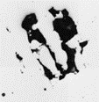
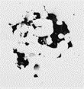

Simulated Flaws
0%
75%
125%
nominal
nominal
nominal
Unfused powder
Lack of fusion
Keyhole voids
Different laser powers in seeded flaws simulate different flaw conditions
Material: NASA HR-1

Slide 14
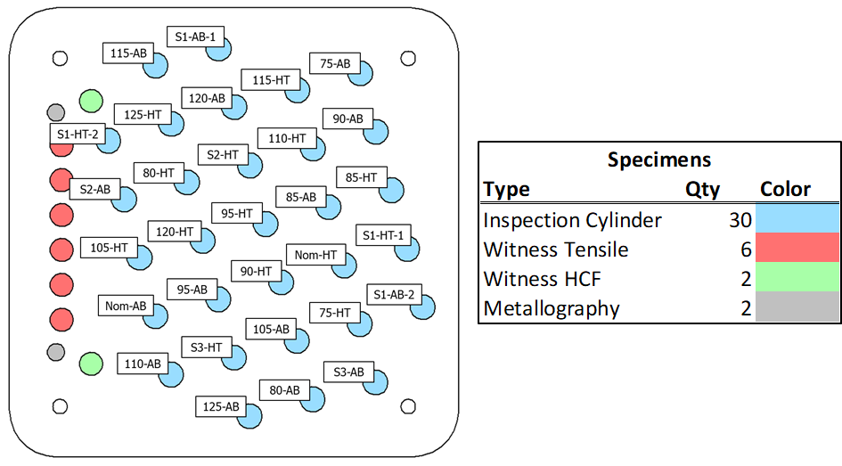
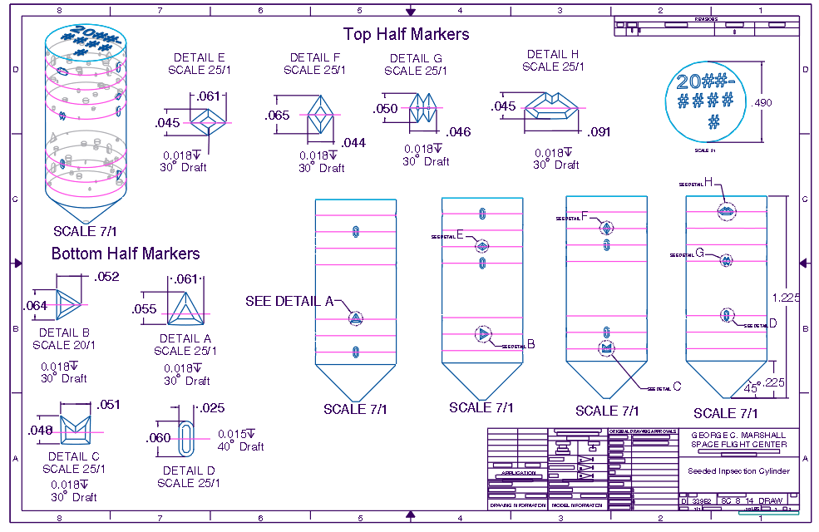
Test Plan
S1 samples: Skipped Layer (Unfused Powder) Defects
= 0% Laser Power
S2 samples: Low Power (Lack of Fusion) Defects
= 75% Laser Power
S3 samples: High Power (Keyhole) Defects
= 125% Laser Power
Laser Power Variation samples
75% to 125%

Slide 15
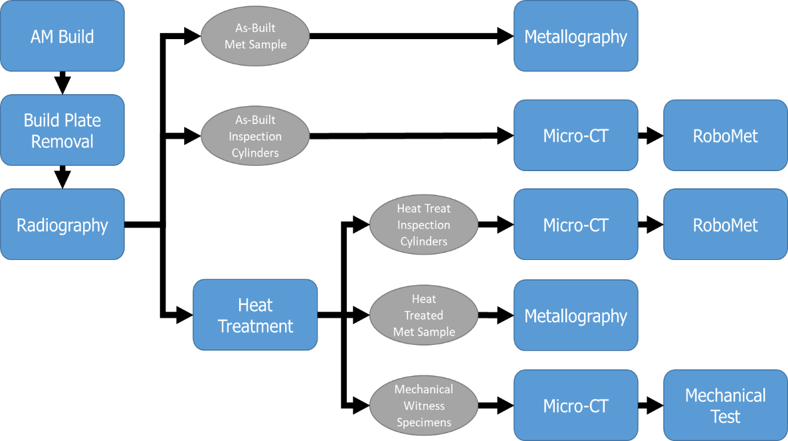
Test Plan
HR-1 Sample population
2 kinds of inspection cylinders
  Seeded defects (3 types)
    7 planes, 7 defects
    Different thicknesses and diameters
  Laser power variation
    75% to 125%
Data Collection on samples
  In-situ monitoring:
    Optical Tomography
  NDE
    Computed Tomography (CT)
  Metallography
    RoboMet Serial Sectioning
Mini-CT
Mini-CT
Mini-CT

Slide 16
History
2 Builds so far
  First build built with In718 parameters
    6 flaws per plane, 6 planes of flaws
    Seeded flaws 2 to 7 build layers thick
  Second build built with HR-1 parameters
    7 flaws per plane, 7 planes of flaws
    Seeded flaws 8 to 14 build layers thick

Slide 17
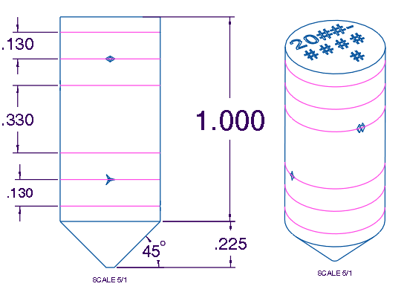
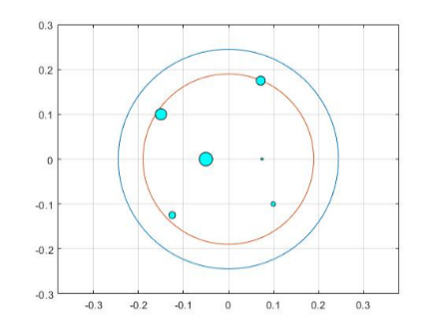
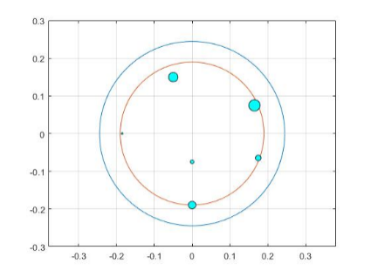
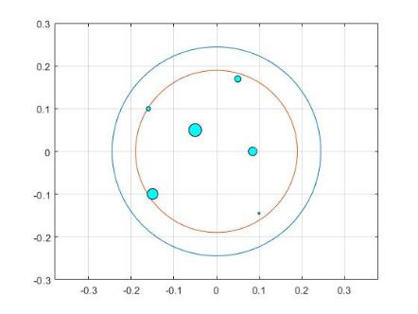
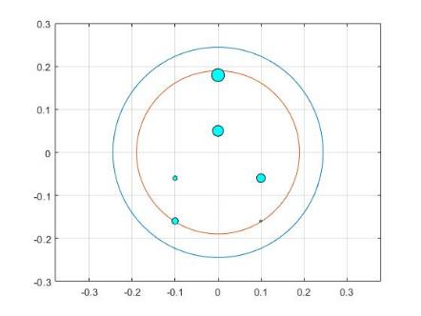
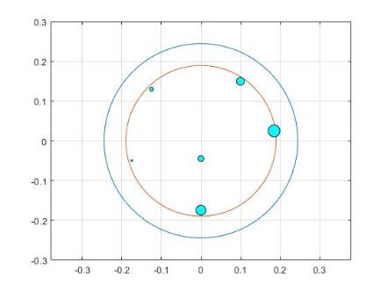
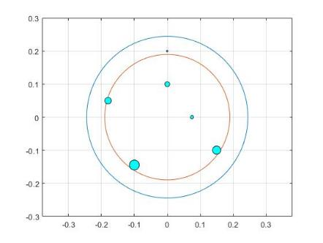
Build 1 Defect Samples Design
Defect Layer Cross Sections (Top View)
Ø0.490 x 1.0 inch Inspection Cylinder
Ø0.38 where defects can be found
Plane 1
Plane 2
Plane 3
All possible Defect Diameters | All possible Thicknesses (in) | Corresponding Thicknesses (µm) | # Layers
0.005" | 0.00472” | 80 | 2
0.01" | 0.00315” | 120 | 3
0.015" | 0.00630” | 160 | 4
0.02" | 0.00787” | 200 | 5
0.025" | 0.00945” | 240 | 6
0.03" | 0.0110” | 280 | 7
Plane 4
Plane 5
Plane 6

Slide 18
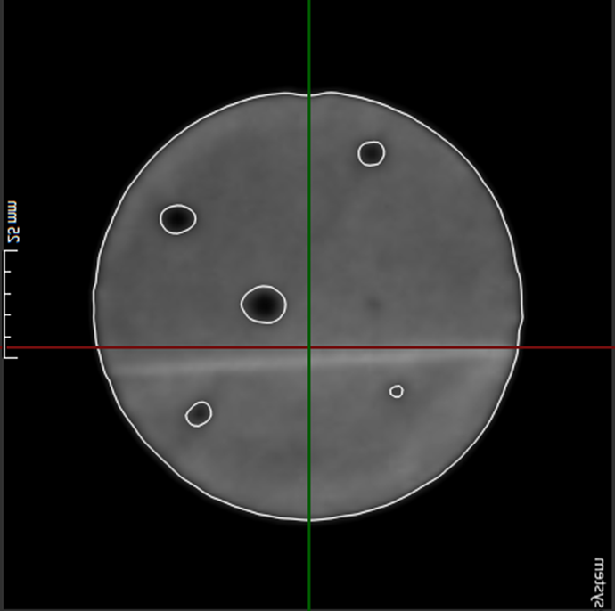
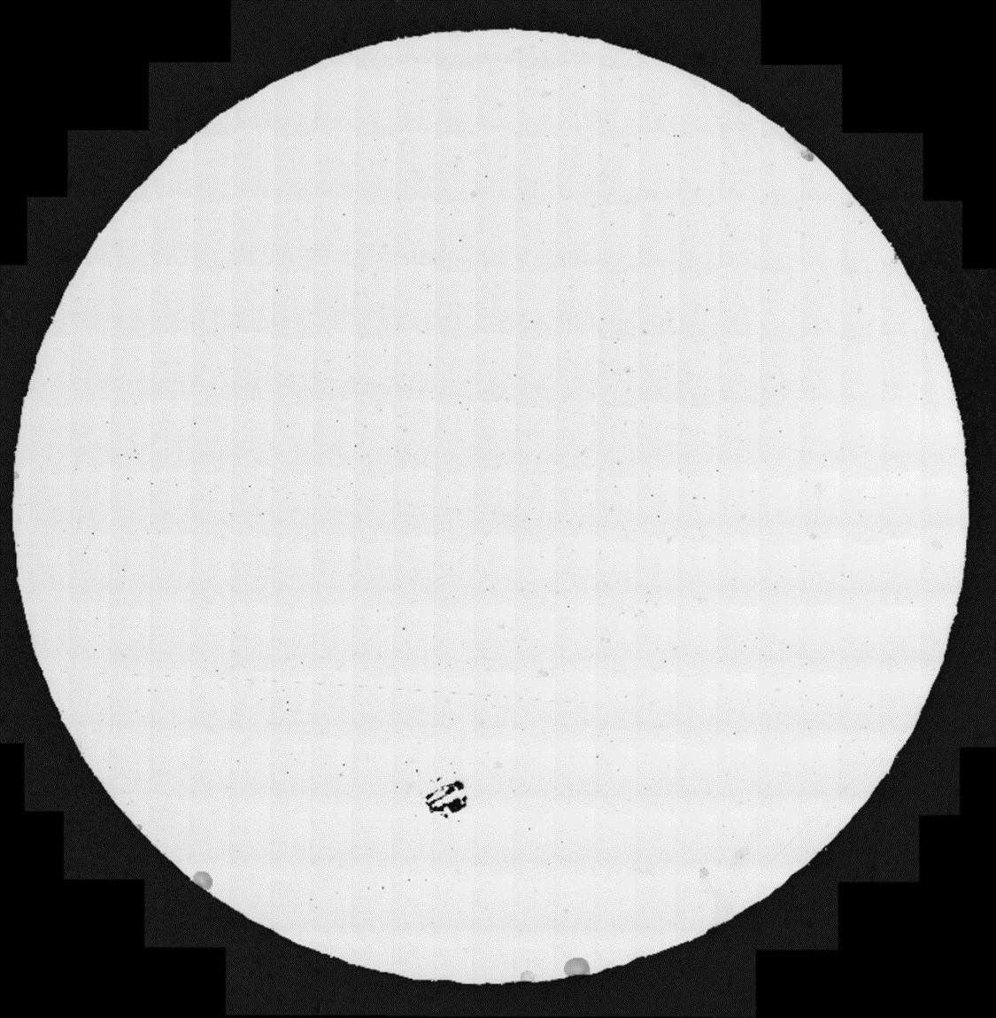
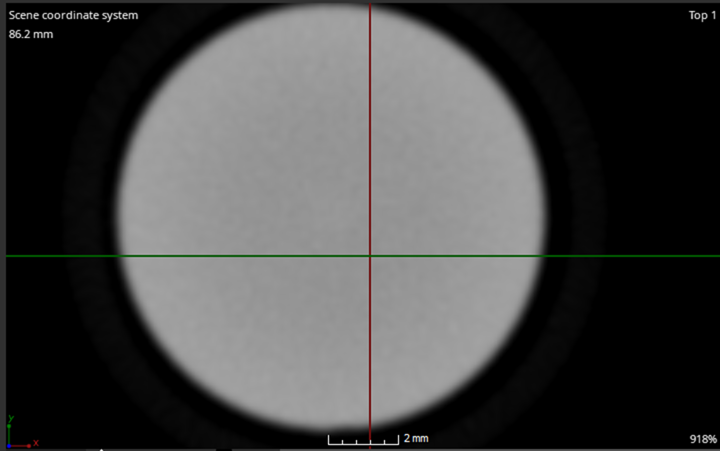
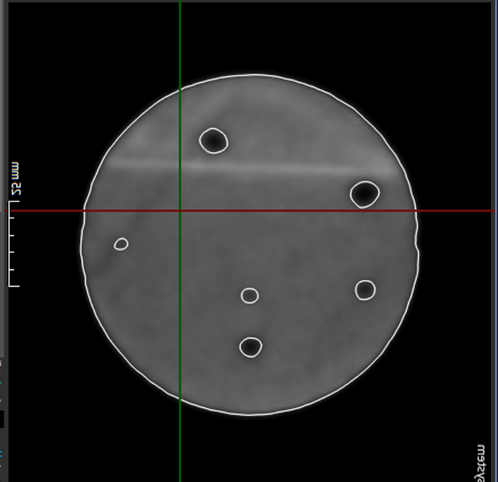
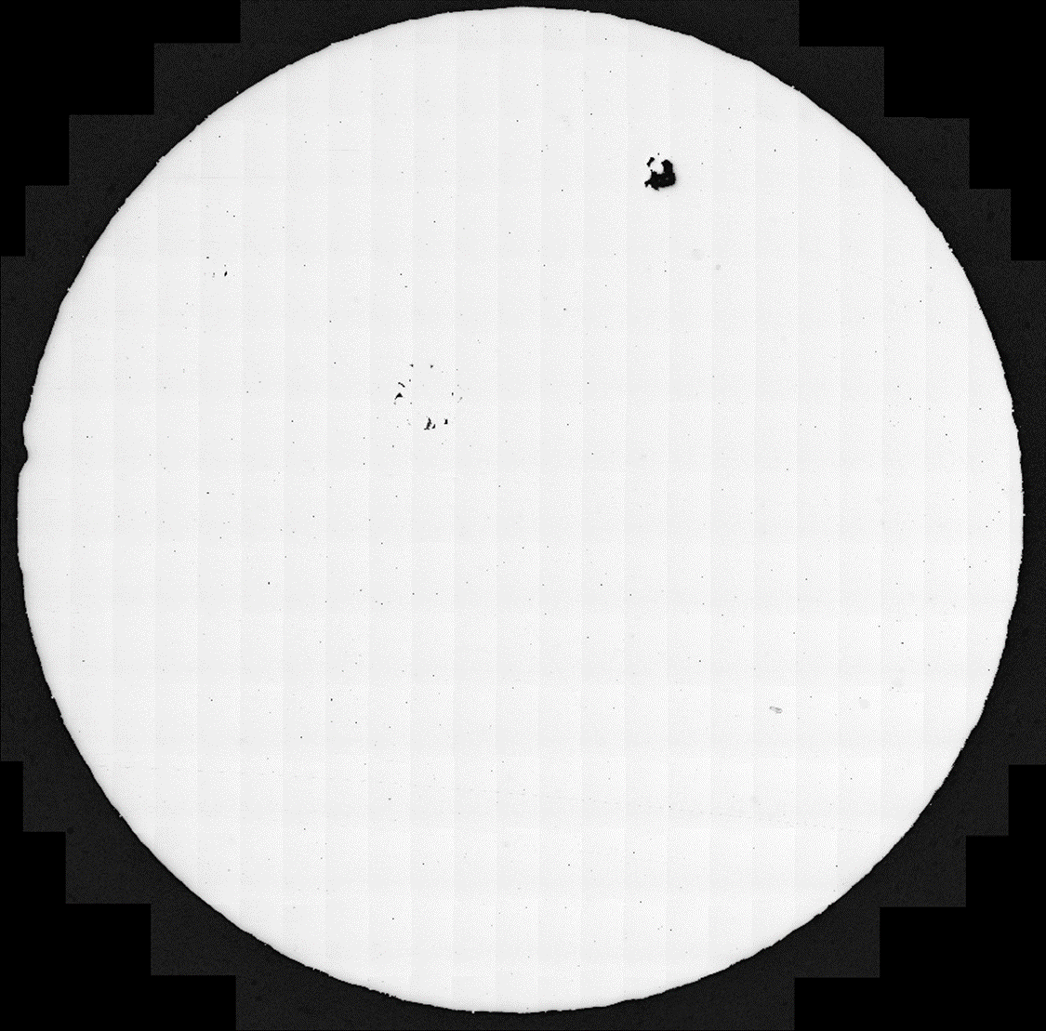
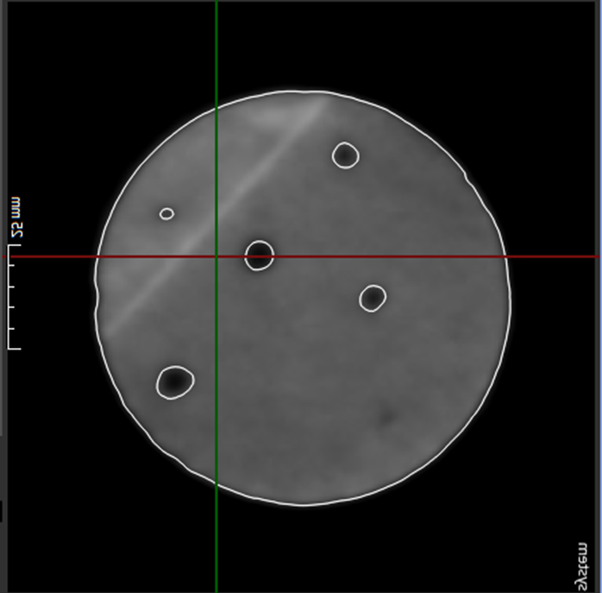
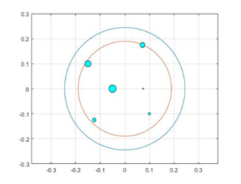
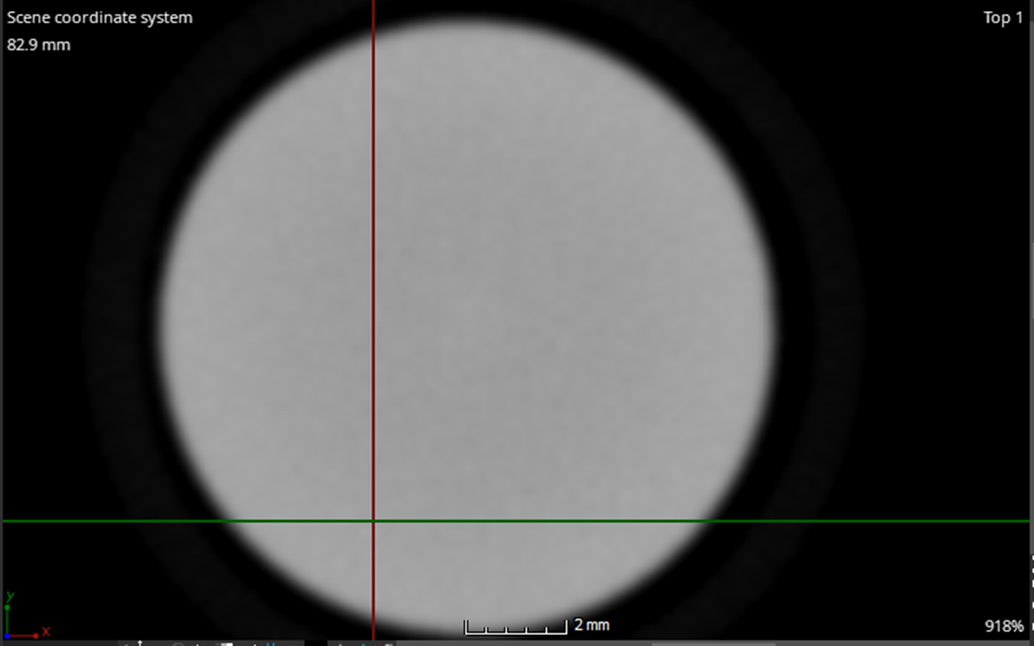
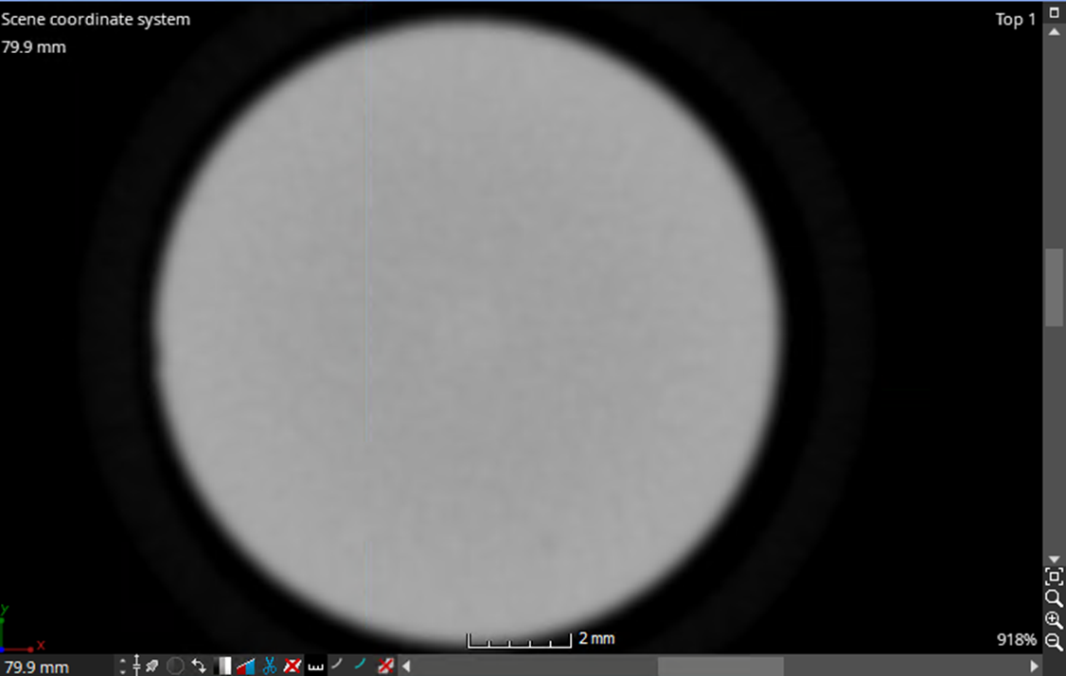
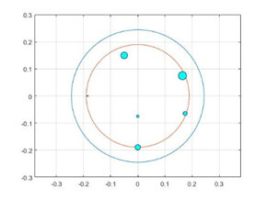
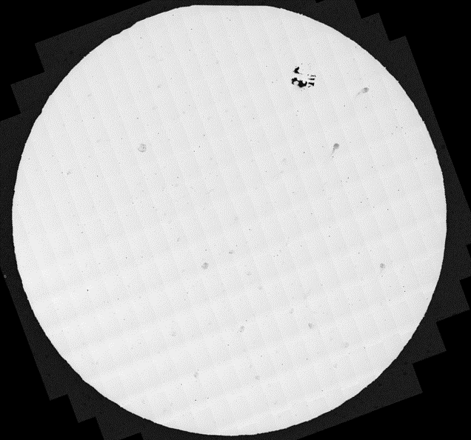
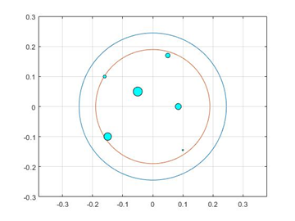
Summary Of Results Build 1 [Pre HT]
Comparison of Detection Methods for S1-AB-1 (Skipped Layer)
CT showed only one seeded defect
In-situ monitoring captured an image for every layer showing insertion of seeded defects as designed
RoboMet slices seeded defect sample at planes 1, 2 & 3
  1 or 2 defect remnants per plane: only the higher thicknesses remain
 | MATLAB | Mini CT | In-situ | RoboMet
Plane 1
Plane 2
Plane 3
S1 samples: Skipped Layer (Unfused Powder) Defects = no power
S2 samples: Low Power (Lack of Fusion) Defects = 75% Laser Power
S3 samples: High Power (Keyhole) Defects = 125% Laser Power
HT: Heat Treated
AB: As Built

Slide 19
Summary of Build 1 Findings
Seeded defects were not thick enough to be picked up by NDE methods
  Mini-CT does not offer high enough resolution to pick up that size defect (~0.00315”-0.00945” = 80-240 microns thickness)
  To be verified with next build with thicker (more layers) seeded defects: 8 to 14 layers
Defects “heal” during AM build process
  Meltpool was deep enough that remaining unfused powder within thinner defects melted with the rest of the part, “healing” the sample
All possible Thicknesses (in) | Corresponding Thickness (µm) | # Layers | Total defects identified by Robomet | Total defects identified by CT | Out of
0.00315” | 80 | 2 | 0 | 0 | 9
0.00472” | 120 | 3 | 2 | 0 | 9
0.00630” | 160 | 4 | 2 | 0 | 9
0.00787” | 200 | 5 | 7 | 0 | 9
0.00945” | 240 | 6 | 7 | 0 | 9
0.0110” | 280 | 7 | 9 | 1 | 9/216

Slide 20
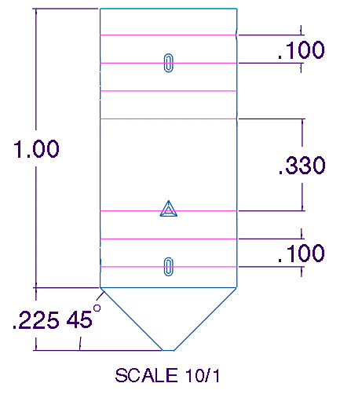
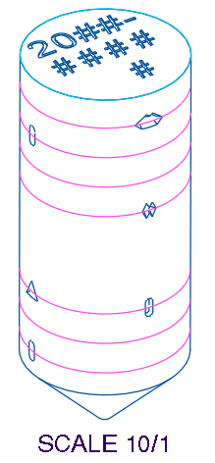
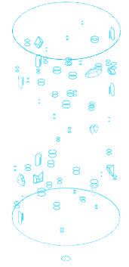
Modifications For Build # 2
    Previous designed defects’ thickness ranging from 2 to 7 layers (~40 microns/layer), new build with thickness ranging from 8 to 14 layers (320 – 560 microns) will be created
All possible Defect Diameters | All possible Thicknesses (in) | Corresponding Thicknesses (µm) | # Layers
0.005" | 0.00472” | 80 | 2
0.01" | 0.00315” | 120 | 3
0.015" | 0.00630” | 160 | 4
0.02" | 0.00787” | 200 | 5
0.025" | 0.00945” | 240 | 6
0.03" | 0.0110” | 280 | 7
Build 1
Ø0.490” x 1.0” Inspection Cylinder
Plane 7
All possible Defect Diameters | All possible Thicknesses (in) | Corresponding Thicknesses (µm) | # Layers
0.005" | 0.0126 | 320 | 8
0.01" | 0.01417 | 360 | 9
0.015" | 0.01575 | 400 | 10
0.02" | 0.01732 | 440 | 11
0.025" | 0.0189 | 480 | 12
0.03" | 0.02047 | 520 | 13
0.035" | 0.02205 | 560 | 14
Plane 1
Build 2

Slide 21
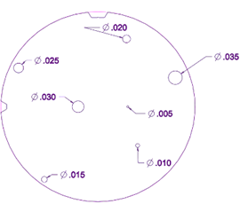
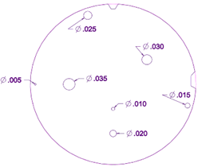
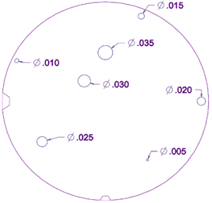
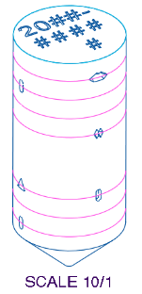
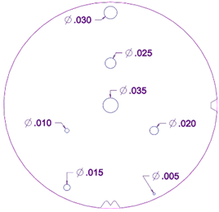
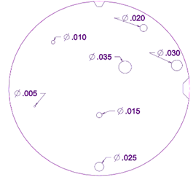
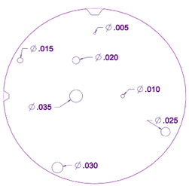
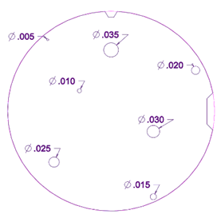
Build 2 Defect Samples Design
Defect Layer Cross Sections (Top View)
Ø0.490” x 1.0” Inspection Cylinder
Plane 1
Plane 2
Plane 3
Plane 7
Plane 1
Plane 4
Plane 5
Plane 6
Plane 7

Slide 22
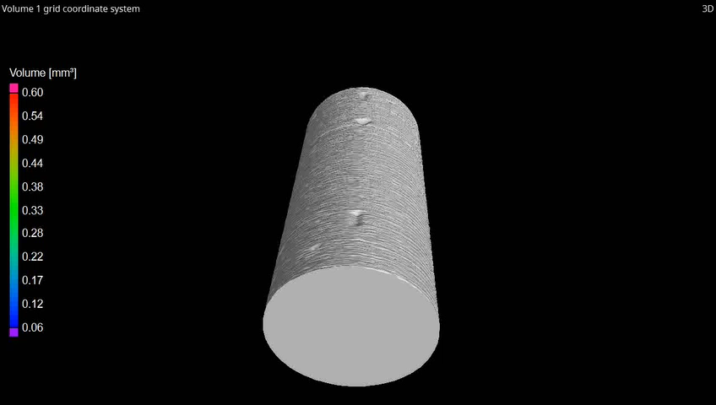
S1-AB-1 In Situ Reconstruction [Pre HT]

Slide 23
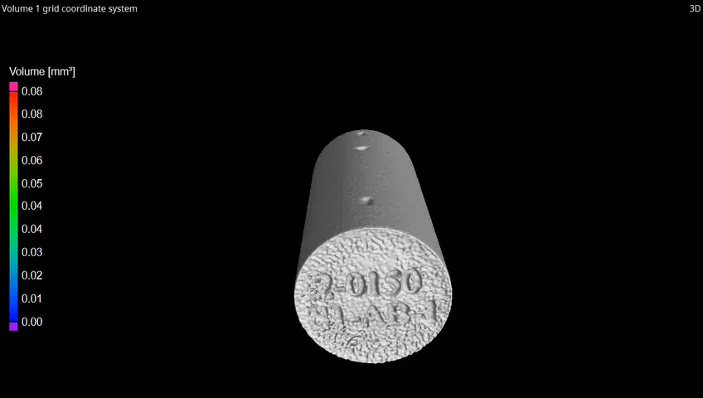
S1-AB-1 CT Data Reconstruction [Pre HT]

Slide 24

CT data
S1-AB-1 [Pre] and S1-HT-1 [Post] HT
Post HT sample
Pre HT sample

Slide 25




S1-AB-1 Robomet Data [Pre HT] - Planes 1, 2 & 3
Plane 1
Plane 2
Plane 3
3
S1 samples: Skipped Layer (Unfused Powder) Defects = no power
S2 samples: Low Power (Lack of Fusion) Defects = 75% Laser Power
S3 samples: High Power (Keyhole) Defects = 125% Laser Power
HT: Heat Treated
AB: As Built
2
1

Slide 26



S1-HT-1 Robomet Data [Post HT] - Planes 1, 2 & 3
Plane 1
Plane 2
Plane 3
S1 samples: Skipped Layer (Unfused Powder) Defects = no power
S2 samples: Low Power (Lack of Fusion) Defects = 75% Laser Power
S3 samples: High Power (Keyhole) Defects = 125% Laser Power
HT: Heat Treated
AB: As Built
3
2
1

Slide 27


S1-HT-1 [Post HT] (Top View)
Zeiss Axio Observer Z1m Microscope 10x
Leica DMi8 Optical Microscope 10x

Slide 28


S2-AB [Pre HT] & S2-HT [Post HT]
Leica DMi8 Optical Microscope 10x Post HT (Z axis view)
RoboMet Pre HT
S1 samples: Skipped Layer (Unfused Powder) Defects = no power
S2 samples: Low Power (Lack of Fusion) Defects = 75% Laser Power
S3 samples: High Power (Keyhole) Defects = 125% Laser Power
HT: Heat Treated
AB: As Built

Slide 29


S3-AB [Pre HT] & S3-HT [Post HT]
Leica DMi8 Optical Microscope 10x Post HT (Z axis view)
RoboMet Pre HT
S1 samples: Skipped Layer (Unfused Powder) Defects = no power
S2 samples: Low Power (Lack of Fusion) Defects = 75% Laser Power
S3 samples: High Power (Keyhole) Defects = 125% Laser Power
HT: Heat Treated
AB: As Built

Slide 30


75% Laser Power Sample
75% Pre HT
75% Post HT

Slide 31


125% Laser Power Sample
125% Pre HT
125% Post HT

Slide 32



MSFC Machine Learning (ML) Tools for Defect Detection and Prediction
Current ML tools at MSFC:
  Autoencoder-based algorithm for defect detection
  Autoencoder is an unsupervised machine learning method that can be trained to process thermal and optical tomography images and produce a generalized reconstruction for defect detection
Video(left) shows defect defection of induced skipped layer flaws in a part. Video(right) showing CAE isolating spatter marks and short feed indications from in-situ images
Developing ML Tools:
  Development of Convolutional Neural Network (CNN) for defect detection
  Development of ML platform for detection and labeling in-situ images

Slide 33
What’s Next?
  In Situ Process Monitoring Probability Of Detection
    Uncharted territory -> first step: CT POD to understand the process using collected data
  Multi sensor data post processing using machine learning
    Evaluate the range of flaw detection
    Expand machine learning software for classification and labeling
    Investigate processing of different data types using machine learning
  Include thermal modeling to better target regions of heat concentration
  Study flaw distribution on coupons and its effect on material properties determined by performing mechanical tests
    The data collected can be used to calculate transfer function to help relate coupons to real components of similar geometry. This will inform future NDE standards
Notes:
Design AM build with complex features
Incorporate realistic propulsion components
Use thermal modeling tools to guide design and predict flaw formation (Langley’s support)
Print challenge build, collect heightmaps and optical tomography in-situ data
Inspect with computed tomography
Application of CT POD (FY23) analysis parameters
Serial sectioning at relevant locations using RoboMet
Implement machine learning software for classification and labeling
Study flaw distribution on coupons and its effect on material properties determined by performing mechanical tests
The data collected can be used to calculate transfer function to help relate coupons to real components of similar geometry. This will inform future NDE standards

Slide 34
Acknowledgements
Erin Lanigan
Ron Beshears
Ashley Taets
Colton Katsarelis
James Mavo
Isabelle Sadowski
Chris Palmer
Bobby Brown
Sam Cordner
Scott Ragasa
Will Tilson
James Walker

Slide 35
Back-Up Slides

Slide 36
Scope Of Results
S1-AB-1; S1-HT-1
S2-AB; S2-HT
S3-AB; S3-HT
75-AB; 75-HT
125-AB; 125-HT
S1 samples: Skipped Layer (Unfused Powder) Defects = no power
S2 samples: Low Power (Lack of Fusion) Defects = 75% Laser Power
S3 samples: High Power (Keyhole) Defects = 125% Laser Power
HT: Heat Treated
AB: As Built

Slide 37



NASA HR-1
B7

Slide 38
List of all samples with AM process variation
Table 1. Machine Parameter Settings for Phase I Build
Specimen ID | Laser Power (% of nominal) | Laser Power (W) | Heat Treatment | Notes
75-AB | 75 | 213.75 | As-Built | ---
75-HT | 75 | 213.75 | Full HT | ---
80-AB | 80 | 228 | As-Built | ---
80-HT | 80 | 228 | Full HT | ---
85-AB | 85 | 242.25 | As-Built | ---
85-HT | 85 | 242.25 | Full HT | ---
90-AB | 90 | 256.5 | As-Built | ---
90-HT | 90 | 256.5 | Full HT | ---
95-AB | 95 | 270.75 | As-Built | ---
95-HT | 95 | 270.75 | Full HT | ---
Nom-AB | 100 | 285 | As-Built | Nominal
Nom-HT | 100 | 285 | Full HT | Nominal
105-AB | 105 | 299.25 | As-Built | ---
105-HT | 105 | 299.25 | Full HT | ---
110-AB | 110 | 313.5 | As-Built | ---
110-HT | 110 | 313.5 | Full HT | ---
115-AB | 115 | 327.75 | As-Built | ---
115-HT | 115 | 327.75 | Full HT | ---
120-AB | 120 | 342 | As-Built | ---
120-HT | 120 | 342 | Full HT | ---
125-AB | 125 | 356.25 | As-Built | ---
125-HT | 125 | 356.25 | Full HT | ---
S1-AB-1 | 100 | 285 | As-Built | Seeded 1
S1-HT-1 | 100 | 285 | Full HT | Seeded 1
S1-AB-2 | 100 | 285 | As-Built | Seeded 1
S1-HT-2 | 100 | 285 | Full HT | Seeded 1
S2-AB | 100 | 285 | As-Built | Seeded 2
S2-HT | 100 | 285 | Full HT | Seeded 2
S3-AB | 100 | 285 | As-Built | Seeded 3
S3-HT | 100 | 285 | Full HT | Seeded 3
S1 samples: Skipped Layer (Unfused Powder) Defects = no power
S2 samples: Low Power (Lack of Fusion) Defects = 75% Laser Power
S3 samples: High Power (Keyhole) Defects = 125% Laser Power
HT: Heat Treated
AB: As Built

Slide 39
Build 2 Defect Samples Per Plane
Plane 1 | Defect Diameter | Thickness
Circle 1 | 0.005" | 0.01260
Circle 5 | 0.01" | 0.01417
Circle 4 | 0.015" | 0.01575
Circle 2 | 0.02" | 0.01732
Circle 3 | 0.025" | 0.01890
Circle 6 | 0.03" | 0.02047
Circle 7 | 0.035" | 0.02205
Plane 2 | Defect Diameter | Thickness
Circle 3 | 0.005 | 0.02205
Circle 2 | 0.01 | 0.01260
Circle 5 | 0.015 | 0.01417
Circle 4 | 0.02 | 0.01575
Circle 1 | 0.025 | 0.01732
Circle 6 | 0.03" | 0.01890
Circle 7 | 0.035" | 0.02047
Plane 3 | Defect Diameter | Thickness
Circle 3 | 0.005 | 0.02047
Circle 1 | 0.01 | 0.02205
Circle 4 | 0.015 | 0.01260
Circle 5 | 0.02 | 0.01417
Circle 2 | 0.025 | 0.01575
Circle 6 | 0.03" | 0.01732
Circle 7 | 0.035" | 0.01890
Plane 4 | Defect Diameter | Thickness
Circle 5 | 0.005 | 0.01890
Circle 1 | 0.01 | 0.02047
Circle 2 | 0.015 | 0.02205
Circle 4 | 0.02 | 0.01260
Circle 3 | 0.025 | 0.01417
Circle 6 | 0.03" | 0.01575
Circle 7 | 0.035" | 0.01732
Plane 5 | Defect Diameter | Thickness
Circle 4 | 0.005" | 0.01732
Circle 1 | 0.01" | 0.01890
Circle 3 | 0.015" | 0.02047
Circle 5 | 0.02" | 0.02205
Circle 2 | 0.025" | 0.01260
Circle 6 | 0.03" | 0.01417
Circle 7 | 0.035" | 0.01575
Plane 6 | Defect Diameter | Thickness
Circle 4 | 0.005" | 0.01575
Circle 2 | 0.01" | 0.01732
Circle 1 | 0.015" | 0.01890
Circle 3 | 0.02" | 0.02047
Circle 5 | 0.025" | 0.02205
Circle 6 | 0.03" | 0.01260
Circle 7 | 0.035" | 0.01417
Plane 7 | Defect Diameter | Thickness
Circle 4 | 0.005" | 0.01417
Circle 2 | 0.01" | 0.01575
Circle 1 | 0.015" | 0.01732
Circle 3 | 0.02" | 0.01890
Circle 5 | 0.025" | 0.02047
Circle 6 | 0.03" | 0.02205
Circle 7 | 0.035" | 0.01260

Slide 40

EOS M290 In-Situ Monitoring System

Slide 41

Serial Sectioning w/ Robomet

Slide 42
What’s Next?
How big can we expect a defect to close off after HT?
  Can we predict based on in-situ data which will close off, which will not?
Mechanical testing of all those samples and comparing mechanical test w/ nominal parameters
  Understanding what flaw size will affect the material properties
Crossing data w/ melt pool monitoring data
Confirming limitations of NDE tools
    Minimum flaw size detected
Calculating probability of detection
    Based on CT data
L-PBF HR-1 Defect Characterization is just a piece of the bigger in situ project
  Next step is to practice the methodology on AM complex parts/ propulsion components
  Study natural flaws in complex geometries (e.g. heat concentration)
  Machine learning (defect prediction)

Slide 43








Computed tomography (CT) is the most capable NDE method for AM but still has limitations due to mass and complexity.
Ultrasonic
Laser notches in as-built LPBF In 718 panels
Method A
Method D
Computed Tomography (CT)
Radiography
Penetrant

Slide 44


MSFC has investigated in situ process monitoring through various mechanisms.
ASTM Working Group WK73289
Small Business Innovation Research
“Standard Guide for In-Situ Monitoring of Metal Additive Manufactured Parts”
Monitoring Systems
ASTM AM Center of Excellence
EOS | Optical Tomography
& Meltpool Monitoring
ARCTOS | Thermal Tomography & High-Speed Spatter Imaging
Completed a landscape survey and workshop with road mapping session

Slide 45
There are many different in situ process monitoring technologies which observe different physical phenomena.
Electromagnetic Frequency Spectrum
Ultrasonic Frequency Spectrum
Monitor During Build Process
Inspection Between Build Layers
Passive
Infrared/near-IR
melt pool monitoring
Visual
Laser profilometry
(No external excitation)
Active
-
Laser ultrasonic
X-ray
(Added excitation)

Slide 46
There are also different additive manufacturing technologies that can be monitored.
Powder Bed Systems
Freeform Fabrication
Process:
Laser Powder Bed Fusion (L-PBF)
Electron Beam Melting (EBM)
Selective Laser Sintering (SLS)
Laser Directed Energy Deposition (DED)
Electron Beam Free Form Fabrication (EBF³)
Rapid Plasma Deposition
Additive Friction Stir Weld
Fused Filament Fabrication (FFF)
Feedstock:
Metals: Nickel alloys, copper alloys, titanium alloys, etc.
Polymers: nylon, polyamide
Metal powder/wire/chips
Filament: polymer, carbon fiber, biological, etc.

Slide 47

Classifications for AM parts consider the risk of AM manufacturability and inspectability.
Catastrophic Failure?
Heavily Loaded?
Does the build have challenging aspects or areas that cannot be inspected?

Slide 48
The NASA standard requires quantitative NDE with full coverage of the surface and volume for Class A Parts.
Language:
“All Class A parts shall receive quantitative NDE with full coverage of the surface and volume of the part, including verifiable detection of critical initial flaw size in critical damage tolerant parts, with any coverage limitations due to NDE techniques(s) and/or part geometry documented in the PPP”
Rationale:
“NDE provides a necessary degree of quality assurance for AM parts in addition to the process controls of this NASA Technical Standard.”
“No methodology currently exists to preclude all AM process failure modes through the available manufacturing process controls.”
(emphasis added)

Slide 49
For Class A parts, the NDE approach must comply with the Special NDE requirements in NASA-STD-5009.
Language:
“The NDE approach for Class A parts shall meet the Special NDE requirements of NASA-STD-5009, Nondestructive Evaluation Requirements for Fracture Critical Metallic Components, and be documented in the PPP.”
Rationale:
“The defects of interest in AM are of a different nature than those listed in Tables 1 and 2 of NASA-STD-5009, and AM microstructures can impact the effectiveness of NDE methods. Therefore, all inspection of fracture critical AM hardware should be treated as Special NDE.”
“Alternative flaw screening methods for Class A parts (e.g., proof testing) may be feasible with full justification provided in the PPP.”

Slide 50
The NASA standard requires NDE for process control with full coverage of the surface and volume for Class B Parts.
Language:
“All Class B parts shall receive NDE for process control with full coverage of the surface and volume of the part, including verifiable detection of critical initial flaw size in critical damage tolerant parts, with any coverage limitations due to NDE techniques(s) and/or part geometry documented in the PPP”
Rationale:
“NDE for process control requires the use of physical reference standards for calibration and acceptance criteria based on the capability of the NDE technique but does not require quantitative validation of flaw detection.
“Targeted approaches for NDE can be proposed and approved per the PPP.”
(emphasis added)

Slide 51
For Class B parts, the NDE approach must meet the requirements in NASA-STD-5009.
Language:
“The NDE approach for Class B parts shall meet the Special NDE requirements of NASA-STD-5009 and be documented in the PPP.”
Rationale:
“The requirements in NASA-STD-5009 establish important controls, including the definition, validation, documentation, and approval of all NDE procedures, standards, methods, and acceptance criteria […]”
“Alternative post-build quality assurance methods for Class B parts (e.g., proof testing), as well as a reduction in NDE scope for Class B parts, may be feasible with full justification provided in the PPP."

Slide 52

In situ monitoring can be used in several aspects of certification:
Qualification of Material Process (QMP)
Use with process development
Part Classification
Improve inspectability for better AM risk posture
Inspection process must be qualified by cognizant engineering org. (CEO)
Part Production Plan
Integrated Structural Integrity Rationale (ISIR):
  Can be specified as a defect screening action
  Must be qualified by CEO
Production Controls
Could develop certain metrics to track over time

Slide 53
The current certification approach does not accommodate the use of adaptive systems.
“Closed-loop process control based on adaptive in-situ monitoring technologies that alter the defined AM process in response to monitored phenomena are not currently applicable technology per this NASA Technical Standard and cannot be used without prior approved tailoring.”
Adaptive (Closed-Loop) Systems
Monitor the process using sensors (e.g. meltpool thermal signature) and change a machine/process parameter (e.g. laser power) to optimize the response
Currently available in many directed energy deposition (DED) systems
Two issues for verification:
(control system)
Verify the sensor performance, algorithm and machine response
Verify the physics – does controlling this parameter result in a good part?
(materials)

Slide 54
For certifying closed-loop control systems, NASA can leverage the expertise of the spacecraft control systems community.
Verification of a control system:
Verify the accuracy of the sensor data
Verify the software/algorithm processing and response
Verify that the changed parameter responds correctly
Black box issue:
For commercial systems, machine parameters may not be known, algorithms may not be accessible
Ideal approach: collaborate with machine manufacturers
Can also develop transfer function by studying inputs/outputs

Slide 55
Verifying that the adaptive system results in good material is a challenge that will require further study.
What is being monitored, and to what end?
Assume you’re monitoring the meltpool thermal emissions
Are you looking to keep it constant, or vary it based on part geometry?
What does it really tell you about the process and the material?
Is this a good indicator of material quality?
Is the resulting microstructure/morphology consistent and repeatable?
What parameter will you change?
More complex if monitoring multiple signals and/or changing multiple parameters
Qualify process for each different system, alloy, part?

Slide 56

In summary, NDE and in situ monitoring both have a role in certification of AM space hardware.
To use for quantitative part quality function, monitoring system must be qualified.
→ Main challenge: developing correlation of indication to verified defect
Qualifying closed-loop, adaptive systems will require a new approach to the QMP.
NDE is still vital for verification of post-build quality.
Thank you for your time!
Questions?

Slide 57
Title

Slide 58
Title

Slide 59
Title

Slide 60
Title

