Slide 1
Zarr stores in NASA’s EOSDIS
ESIP Summer Meeting, July 2023
Owen Littlejohns
EED-3 Transformation Train Architect
owen.m.littlejohns@nasa.gov
This work was supported by NASA/GSFC under Raytheon Technologies contract number 80GSFC21CA001.
This document does not contain technology or Technical Data controlled under either the U.S. International Traffic in Arms Regulations or the U.S. Export Administration Regulations.

Slide 2
Earthdata cloud status and opportunities
Primarily migrating data sets (collections) to the cloud in their native formats:
  >1000 Network Common Data Form version 4 (NetCDF-4) collections
  150 Geographic Tagged Image File Format (GeoTIFF) collections
Cloud-optimized formats offer potential performance benefits:
  Zarr
  Cloud-Optimized GeoTIFF (COG)

Slide 3
What is Zarr?
Zarr is a storage format
Can be hosted in the cloud or on disk
Expresses files of N-dimensional arrays via an open-source specification
Designed for efficient I/O and parallel computing
Compatible with tools such as xarray via Python package

Slide 4
What is a Zarr store?
Array chunks written to separate files
Metadata stored as JavaScript Object Notation (JSON)
Zarr store can contain multiple variables, e.g., a whole NetCDF-4 file (or collection)
Group hierarchy from a NetCDF-4 file can be preserved
Files only created for initialized chunks

Slide 5
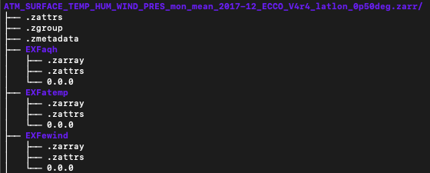
What is a Zarr store?
Image source: NASA / Earth Observing System Data and Information System (EOSDIS) (https://harmony.earthdata.nasa.gov – see image for full request used to generate output)

Slide 6
When to generate a Zarr store?
On-demand:
  ✅ Only generate Zarr stores an end-user needs
  ✅ Potential for custom chunk sizes
  ❌ Duplicative
Persistent:
  ✅ Can generate the Zarr store once only.
  ✅ More appropriate for whole collections
  ❌ Chunk size may not be appropriate for all analyses.

Slide 7
On-demand Zarr stores
NetCDF-to-Zarr service developed as a backend service to Harmony (https://harmony.earthdata.nasa.gov)
Harmony is an Application Programming Interface (API) and orchestration engine for transformation services
Service converts NetCDF-4 files into a single Zarr store
Preserves file hierarchy and metadata

Slide 8
On-demand Zarr stores
Example Harmony request:
Produces a Zarr store representation of a single NetCDF-4 file
Results can be accessed via an Amazon Web Services (AWS) Simple Storage Service (S3) link within the Harmony SpatioTemporal Asset Catalog (STAC) output, from within the AWS us-west-2 region
https://harmony.earthdata.nasa.gov/C1990404814-POCLOUD/ogc-api-coverages/1.0.0/collections/all/coverage/rangeset?forceAsync=true&granuleId=G1991243142-POCLOUD&format=application%2Fx-zarr&skipPreview=true

Slide 9
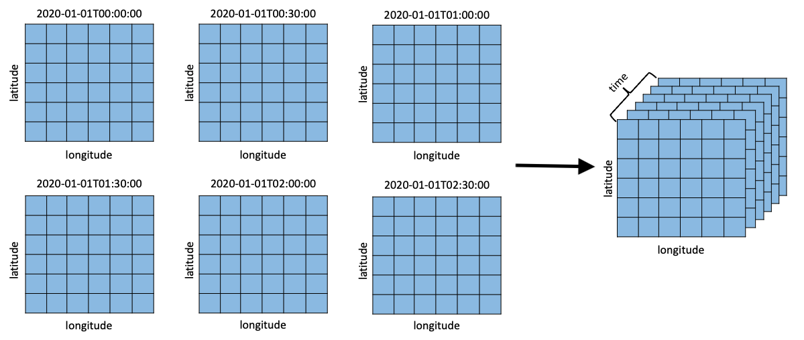
Aggregating with Zarr
https://harmony.earthdata.nasa.gov/C1990404814-POCLOUD/ogc-api-coverages/1.0.0/collections/all/coverage/rangeset?forceAsync=true&format=application%2Fx-zarr&skipPreview=true&concatenate=true
Image source: NASA / EOSDIS (https://github.com/nasa/harmony-netcdf-to-zarr – see image link for full Uniform Resource Locator (URL))

Slide 10
Aggregating with Zarr
Downloads input granules to determine output temporal dimension values
Creates an empty Zarr store with required dimensions
Writes each NetCDF-4 input to Zarr store, chunk size determined by input granules
Rechunks the output Zarr store using the Rechunker Python package

Slide 11
Aggregating with Zarr
Uses process-based parallelism
Chunk sizes balanced for all dimensions
Service challenged by large data volumes
  Obtaining all temporal values
  Rechunking output for reading
Spatial aggregation not yet implemented
Overlap with pangeo-forge recipes

Slide 12
Persistent Zarr stores
Actively pursuing the best path forward for supporting Zarr store copies of EOSDIS data in the cloud
Collection-level Zarr stores can enable highly performant analyses
The Goddard Earth Science Data and Information Services Center (GES DISC) Distributed Active Archive Center’s visualization tool and analysis tool, Giovanni, leverages such Zarr stores for performant data processing
Presents several questions:
  Data duplication (cost)
  Updating stores for active collections
  Metadata representation
  Chunking strategies

Slide 13
Looking ahead
Earth Science Data and Information System (ESDIS) considering strategy to host and best utilize and support cloud-optimized formats.
Is there a place for on-demand Zarr generation?
Comparison study between NetCDF-to-Zarr service and Pangeo Forge

Slide 14
This work was supported by NASA/GSFC under Raytheon Technologies contract number 80GSFC21CA001.

