Slide 1
STAC: an EOSDIS Standard
ESIP Summer meeting, July 18th, 2023
Doug Newman
NASA ESDIS Project, Goddard Space Flight Center

Slide 2
Agenda
Motivation
Catalog
API
Evidence of implementation
Interoperability

Slide 3
Motivation
STAC as an essential component of a ‘cloud-ready’ repository

Slide 4
What is STAC?
‘The SpatioTemporal Asset Catalogs (STAC) specification is a common language to describe geospatial information, so spatiotemporal assets can more easily be leveraged, indexed, and discovered.’*
Tailored specifically to the spatial and temporal domain
Asset-oriented
Cloud-friendly
A lean standard
Popular
*https://stacspec.org
Notes:
STAC: SpatioTemporal Asset Catalogs

Slide 5
Why it is a standard?
Wide adoption
Wide support
A key element of EOSDIS’ cloud strategy
Notes:
EOSDIS: Earth Observing System Data and Information System

Slide 6
STAC catalogs
A representation of the whole or a subset of a spatiotemporally defined inventory

Slide 7
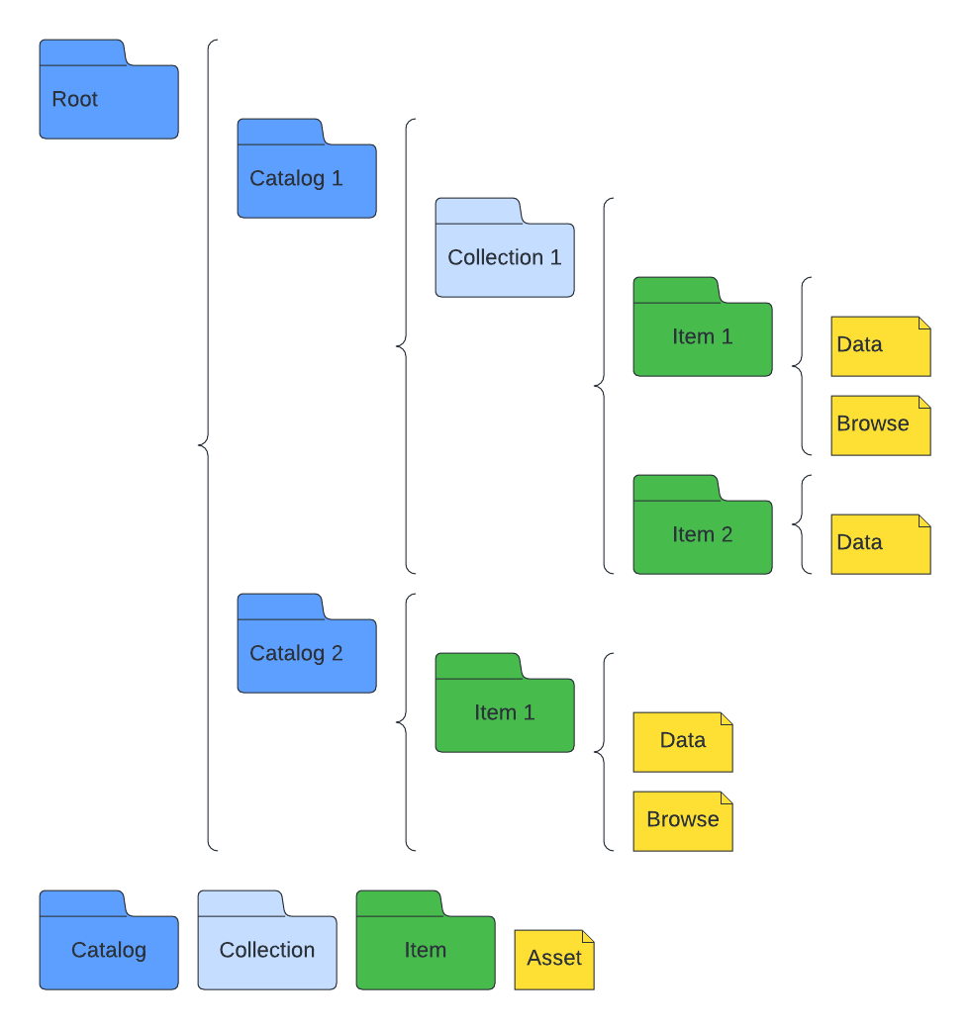
Concept
A simple, flexible JSON file of links that provides a structure to organize and browse STAC Items.
A structure composed of Catalogs, Collections and Items.
Hierarchical
Self-navigable
Asset-oriented
Notes:
JSON: JavaScript Object Notation

Slide 8
Catalogs
{
"stac_version": "1.0.0",
"type": "Catalog",
"id": "20201211_223832_CS2",
"description": "A simple catalog example",
"links": []
….
}
Can contain catalogs and/or collections and/or STAC items.
CMR uses this concept to describe a data provider.
Notes:
CMR: Common Metadata Repository

Slide 9
Collections
{
"stac_version": "1.0.0",
"type": "Collection",
"license": "ISC",
"id": "20201211_223832_CS2",
"description": "A simple collection example",
"links": [],
"extent": {},
"summaries": {}
}
An extension of a catalog, containing additional information.
CMR maps this concept to a collection.

Slide 10
Items
{
"stac_version": "1.0.0",
"type": "Feature",
"id": "20201211_223832_CS2",
"bbox": [],
"geometry": {},
"properties": {
"datetime": "",
"start_datetime": "",
"end_datetime": "”
},
"collection": "simple-collection",
"links": [],
"assets": {}
}
The core atomic unit of STAC, a GeoJSON feature with temporal extent.
CMR maps this concept to a granule.

Slide 11
Links
The supplemental information about an item. The locations of:
Documentation
Canonical metadata

Slide 12
Assets
The tangible artefacts of an item. The locations of:
Science data
Browse imagery

Slide 13
STAC API
A dynamic version of a SpatioTemporal Asset Catalog
Notes:
API: Application Programming Interface

Slide 14
Concept
A queryable API endpoint that returns a Collection.
For example: https://cmr.earthdata.nasa.gov/stac

Slide 15
Request
POST /stac/PODAAC/search HTTP/1.1
Host: cmr.earthdata.nasa.gov
Accept: application/json
Content-Type: application/json
Content-Length: 89
{
"bbox": [5.5, 46, 8, 47.4],
"time": "2018-02-12T00:00:00Z/2018-03-18T12:31:12Z"
}

Slide 16
Response
{
"type": "FeatureCollection",
"stac_version": "1.0.0",
"numberMatched": 1,
"numberReturned": 1,
"features": [
{
{
"type": "Feature",
"id": "sg178_Oct2019_data_L2",
"stac_version": "1.0.0",
"stac_extensions": [],
"collection": "SEAGLIDER_GUAM_2019.vV1",
"geometry": {
"type": "Polygon",
"coordinates": [[ [-180,-85.5],[180,-85.5], [180,89.5],[-180,89.5],[-180,-85.5]]]
},
"bbox": [-180, -85.5,180,89.5],
"links": [
...,
{
"rel": "via",
"href": "https://cmr.earthdata.nasa.gov/search/concepts/G2188230253-POCLOUD.json"
},
{
"rel": "via",
"href": "https://cmr.earthdata.nasa.gov/search/concepts/G2188230253-POCLOUD.umm_json"
}
],
"properties": {
"datetime": "1900-01- 01T00:00:00.000Z",
"start_datetime": "1900-01-01T00:00:00.000Z",
"end_datetime": "2018-12-31T00:00:00.000Z”
},
"assets": {
"data": {
"title": "Download sg178_Oct2019_data_L2.nc",
"href": "https://archive.podaac.earthdata.nasa.gov/podaac-ops-cumulus-protected/SEAGLIDER_GUAM_2019/sg178_Oct2019_data_L2.nc"
},
"metadata": {
"href": "https://cmr.earthdata.nasa.gov/search/concepts/G2188230253-POCLOUD.xml",
"type": "application/xml"
}
}
}
}
{
"type": "FeatureCollection",
"stac_version": "1.0.0",
"numberMatched": 1,
"numberReturned": 1,
"features": [
…
]
}
Notes:
HATEOS - self-navigable

Slide 17
Response
{
"type": "FeatureCollection",
"stac_version": "1.0.0",
"numberMatched": 1,
"numberReturned": 1,
"features": [
{
{
"type": "Feature",
"id": "sg178_Oct2019_data_L2",
"stac_version": "1.0.0",
"stac_extensions": [],
"collection": "SEAGLIDER_GUAM_2019.vV1",
"geometry": {
"type": "Polygon",
"coordinates": [[ [-180,-85.5],[180,-85.5], [180,89.5],[-180,89.5],[-180,-85.5]]]
},
"bbox": [-180, -85.5,180,89.5],
"links": [
...,
{
"rel": "via",
"href": "https://cmr.earthdata.nasa.gov/search/concepts/G2188230253-POCLOUD.json"
},
{
"rel": "via",
"href": "https://cmr.earthdata.nasa.gov/search/concepts/G2188230253-POCLOUD.umm_json"
}
],
"properties": {
"datetime": "1900-01- 01T00:00:00.000Z",
"start_datetime": "1900-01-01T00:00:00.000Z",
"end_datetime": "2018-12-31T00:00:00.000Z”
},
"assets": {
"data": {
"title": "Download sg178_Oct2019_data_L2.nc",
"href": "https://archive.podaac.earthdata.nasa.gov/podaac-ops-cumulus-protected/SEAGLIDER_GUAM_2019/sg178_Oct2019_data_L2.nc"
},
"metadata": {
"href": "https://cmr.earthdata.nasa.gov/search/concepts/G2188230253-POCLOUD.xml",
"type": "application/xml"
}
}
}
}
{
"type": "Feature",
"id": "sg178_Oct2019_data_L2",
"stac_version": "1.0.0",
"stac_extensions": [],
"collection": "SEAGLIDER_GUAM_2019.vV1",
"geometry": {
"type": "Polygon",
"coordinates": [...]
},
“bbox": [-180, -85.5,180,89.5]
},
"properties": {
"datetime": "1900-01- 01T00:00:00.000Z",
"start_datetime": "1900-01-01T00:00:00.000Z",
"end_datetime": "2018-12-31T00:00:00.000Z”
}
"links": [...],
"assets": {...}
}

Slide 18
Response
{
"type": "FeatureCollection",
"stac_version": "1.0.0",
"numberMatched": 1,
"numberReturned": 1,
"features": [
{
{
"type": "Feature",
"id": "sg178_Oct2019_data_L2",
"stac_version": "1.0.0",
"stac_extensions": [],
"collection": "SEAGLIDER_GUAM_2019.vV1",
"geometry": {
"type": "Polygon",
"coordinates": [[ [-180,-85.5],[180,-85.5], [180,89.5],[-180,89.5],[-180,-85.5]]]
},
"bbox": [-180, -85.5,180,89.5],
"links": [
...,
{
"rel": "via",
"href": "https://cmr.earthdata.nasa.gov/search/concepts/G2188230253-POCLOUD.json"
},
{
"rel": "via",
"href": "https://cmr.earthdata.nasa.gov/search/concepts/G2188230253-POCLOUD.umm_json"
}
],
"properties": {
"datetime": "1900-01- 01T00:00:00.000Z",
"start_datetime": "1900-01-01T00:00:00.000Z",
"end_datetime": "2018-12-31T00:00:00.000Z”
},
"assets": {
"data": {
"title": "Download sg178_Oct2019_data_L2.nc",
"href": "https://archive.podaac.earthdata.nasa.gov/podaac-ops-cumulus-protected/SEAGLIDER_GUAM_2019/sg178_Oct2019_data_L2.nc"
},
"metadata": {
"href": "https://cmr.earthdata.nasa.gov/search/concepts/G2188230253-POCLOUD.xml",
"type": "application/xml"
}
}
}
}
{
"type": "FeatureCollection",
"stac_version": "1.0.0",
"numberMatched": 1,
"numberReturned": 1,
"features": [
…
]
}
{
"type": "Feature",
"id": "sg178_Oct2019_data_L2",
"stac_version": "1.0.0",
"stac_extensions": [],
"collection": "SEAGLIDER_GUAM_2019.vV1",
"geometry": {
"type": "Polygon",
"coordinates": [...]
},
“bbox": [-180, -85.5,180,89.5]
},
"properties": {
"datetime": "1900-01- 01T00:00:00.000Z",
"start_datetime": "1900-01-01T00:00:00.000Z",
"end_datetime": "2018-12-31T00:00:00.000Z”
}
"links": [...],
"assets": {...}
}
"links": [
...,
{
"rel": "via",
"href": "https://cmr.earthdata.nasa.gov/search/concepts/G2188230253-POCLOUD.json"
},
{
"rel": "collection",
"href": "https://cmr.earthdata.nasa.gov/stac/POCLOUD/collections/REYNOLDS_NCDC_L4_MONTHLY_V5.v5"
}
]

Slide 19
Response
{
"type": "FeatureCollection",
"stac_version": "1.0.0",
"numberMatched": 1,
"numberReturned": 1,
"features": [
{
{
"type": "Feature",
"id": "sg178_Oct2019_data_L2",
"stac_version": "1.0.0",
"stac_extensions": [],
"collection": "SEAGLIDER_GUAM_2019.vV1",
"geometry": {
"type": "Polygon",
"coordinates": [[ [-180,-85.5],[180,-85.5], [180,89.5],[-180,89.5],[-180,-85.5]]]
},
"bbox": [-180, -85.5,180,89.5],
"links": [
...,
{
"rel": "via",
"href": "https://cmr.earthdata.nasa.gov/search/concepts/G2188230253-POCLOUD.json"
},
{
"rel": "via",
"href": "https://cmr.earthdata.nasa.gov/search/concepts/G2188230253-POCLOUD.umm_json"
}
],
"properties": {
"datetime": "1900-01- 01T00:00:00.000Z",
"start_datetime": "1900-01-01T00:00:00.000Z",
"end_datetime": "2018-12-31T00:00:00.000Z”
},
"assets": {
"data": {
"title": "Download sg178_Oct2019_data_L2.nc",
"href": "https://archive.podaac.earthdata.nasa.gov/podaac-ops-cumulus-protected/SEAGLIDER_GUAM_2019/sg178_Oct2019_data_L2.nc"
},
"metadata": {
"href": "https://cmr.earthdata.nasa.gov/search/concepts/G2188230253-POCLOUD.xml",
"type": "application/xml"
}
}
}
}
{
"type": "FeatureCollection",
"stac_version": "1.0.0",
"numberMatched": 1,
"numberReturned": 1,
"features": [
…
]
}
{
"type": "Feature",
"id": "sg178_Oct2019_data_L2",
"stac_version": "1.0.0",
"stac_extensions": [],
"collection": "SEAGLIDER_GUAM_2019.vV1",
"geometry": {
"type": "Polygon",
"coordinates": [...]
},
“bbox": [-180, -85.5,180,89.5]
},
"properties": {
"datetime": "1900-01- 01T00:00:00.000Z",
"start_datetime": "1900-01-01T00:00:00.000Z",
"end_datetime": "2018-12-31T00:00:00.000Z”
}
"links": [...],
"assets": {...}
}
"links": [
...,
{
"rel": "via",
"href": "https://cmr.earthdata.nasa.gov/search/concepts/G2188230253-POCLOUD.json"
},
{
"rel": "collection",
"href": "https://cmr.earthdata.nasa.gov/stac/POCLOUD/collections/REYNOLDS_NCDC_L4_MONTHLY_V5.v5"
}
]
"assets": {
"data": {"href": "https://archive.podaac.earthdata.nasa.gov/podaac-ops-cumulus-protected/REYNOLDS_NCDC_L4_MONTHLY_V5/ersst.v5.185401.nc",
"title": "Download ersst.v5.185401.nc"
},
"opendap": {"href": "https://opendap.earthdata.nasa.gov/collections/C2036878116-POCLOUD/granules/ersst.v5.185401",
"title": "OPeNDAP request URL"
},
"metadata": {"href": "https://cmr.earthdata.nasa.gov/search/concepts/G2119923120-POCLOUD.xml",
"type": "application/xml"
}
}

Slide 20
Evidence of implementation
Catalogs, APIs and software

Slide 21
Catalogs
https://stacindex.org/catalogs?type=static
36 static catalogs including
  FedEO
  Google Earth Engine
  Pangeo
Notes:
FedEO: Federated Earth Observation missions access

Slide 22
APIs
https://stacindex.org/catalogs?type=api
24 dynamic catalogs including
  CMR
  Google Earth Engine
  Planetary Computer
  USGS Landsat
  Sentinel Hub
Notes:
USGS: United States Geological Survey

Slide 23
Software
STACBrowser
IntakeSTAC
stac-server
QGIS
Notes:
QGIS: Quantum Geographic Information System

Slide 24
STAC extensions
An extensible specification with a minimal core specification

Slide 25
Useful extensions
Raster
Grid
Label
Scientific
Storage
Collection search
Federated

Slide 26
Interoperability
How well does it fit into our ecosystem

Slide 27
In general, all EOSDIS data can be described in a STAC catalog.
The specification is aligned with OGC OpenAPI and WFS standards.
Potential for federated, dynamic catalogs across agencies.
Notes:
OGC – Open Geospatial Consortium
WFS – Web Feature Service

Slide 28



Standards are your best friend!
Questions?
Email Address:
douglas.j.newman@nasa.gov
Website:
earthdata.nasa.gov
Social Media:
@NASAEarthData

