Slide 1
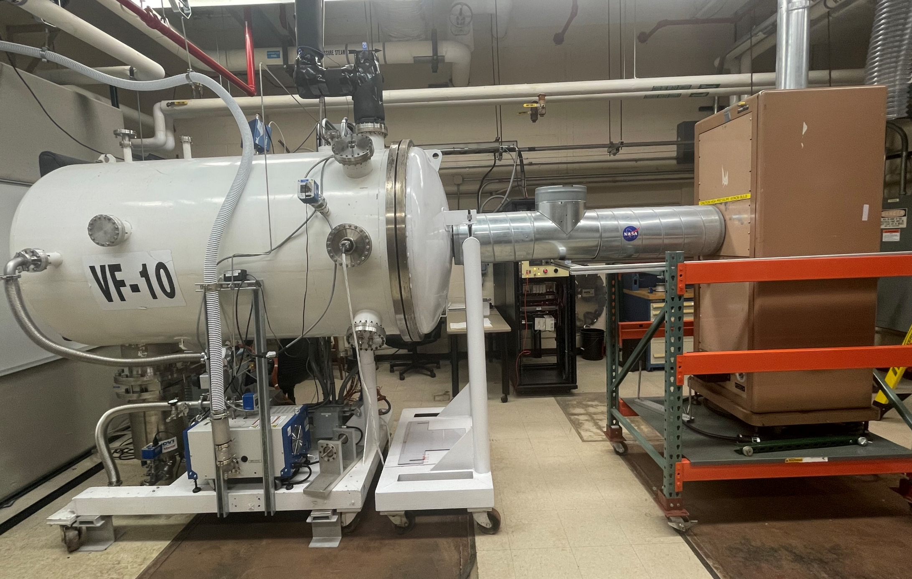
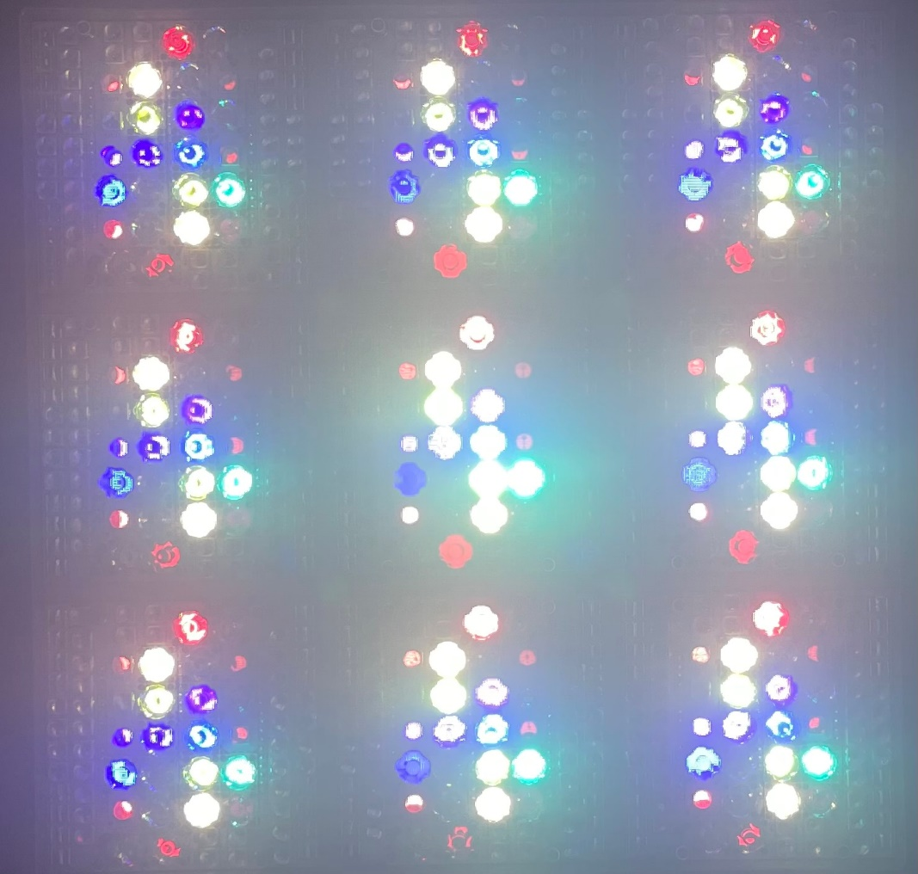
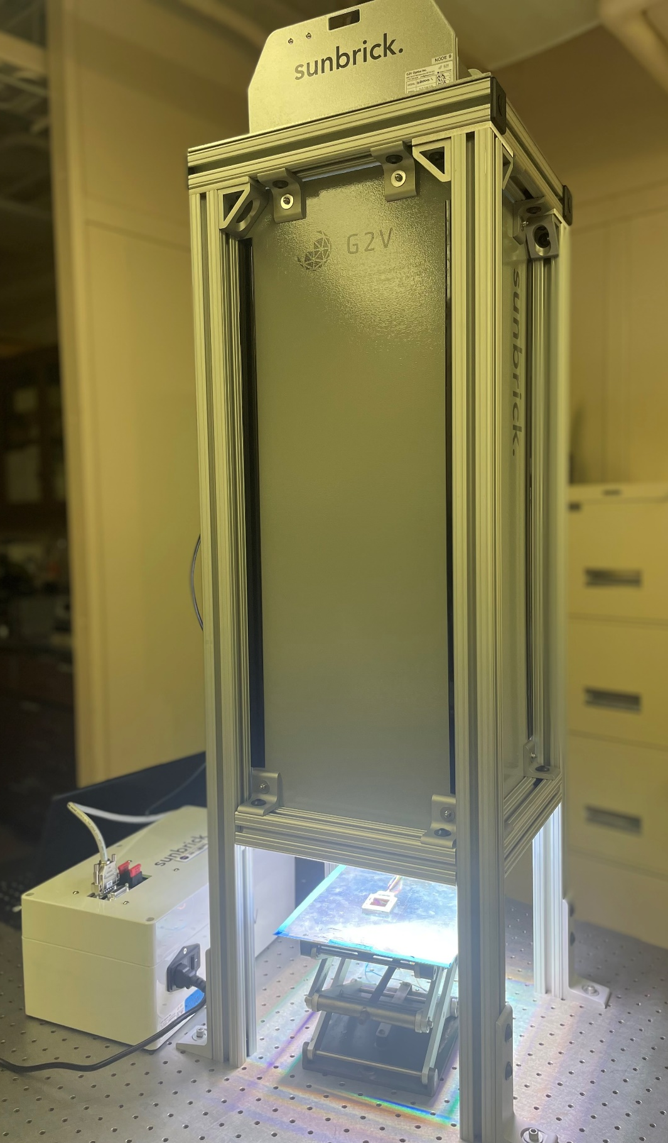
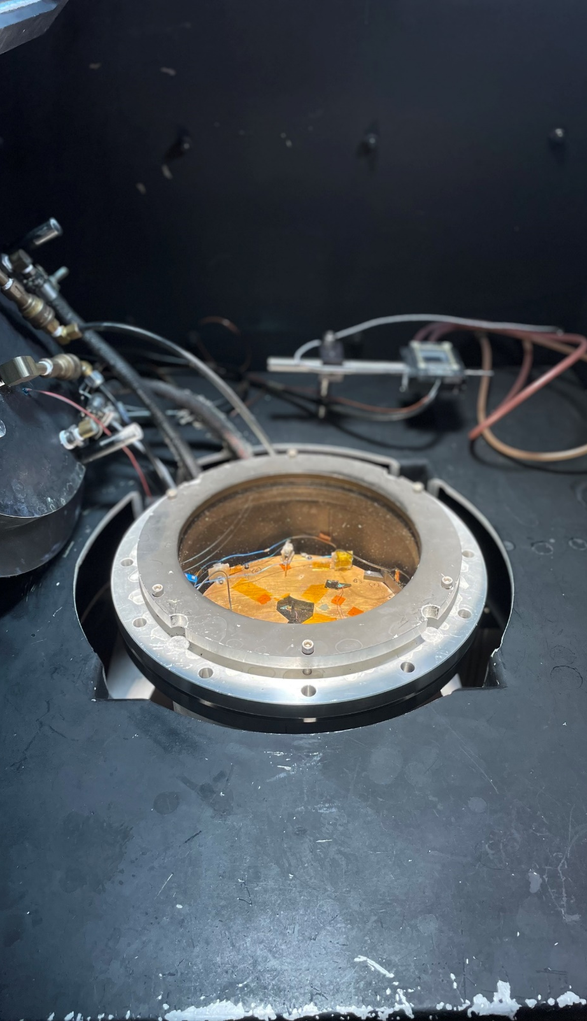
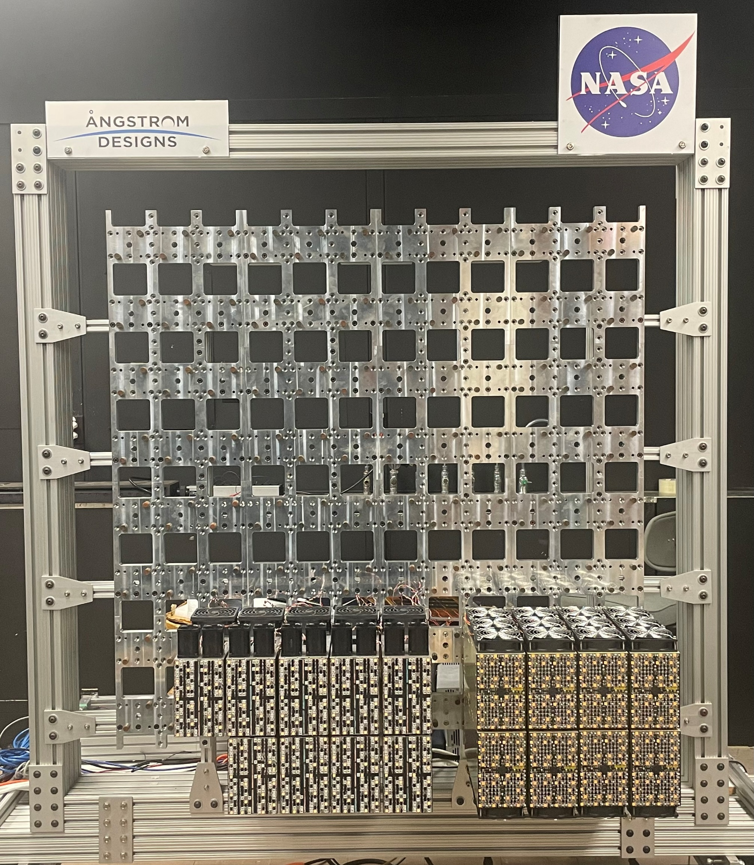
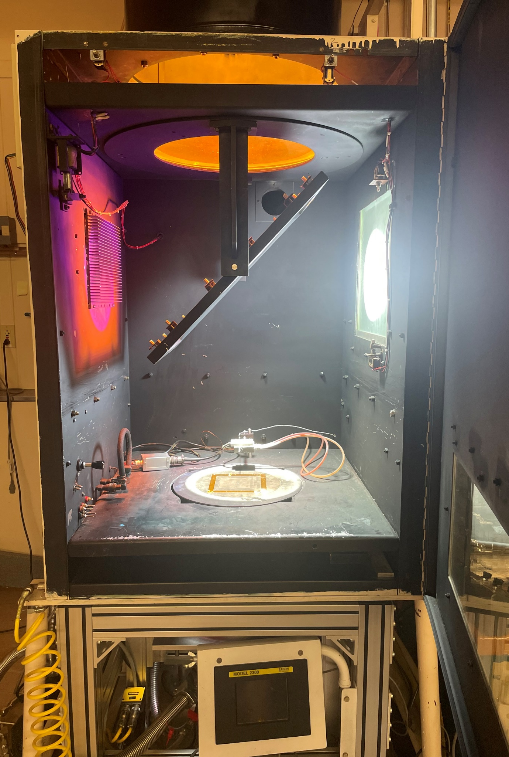
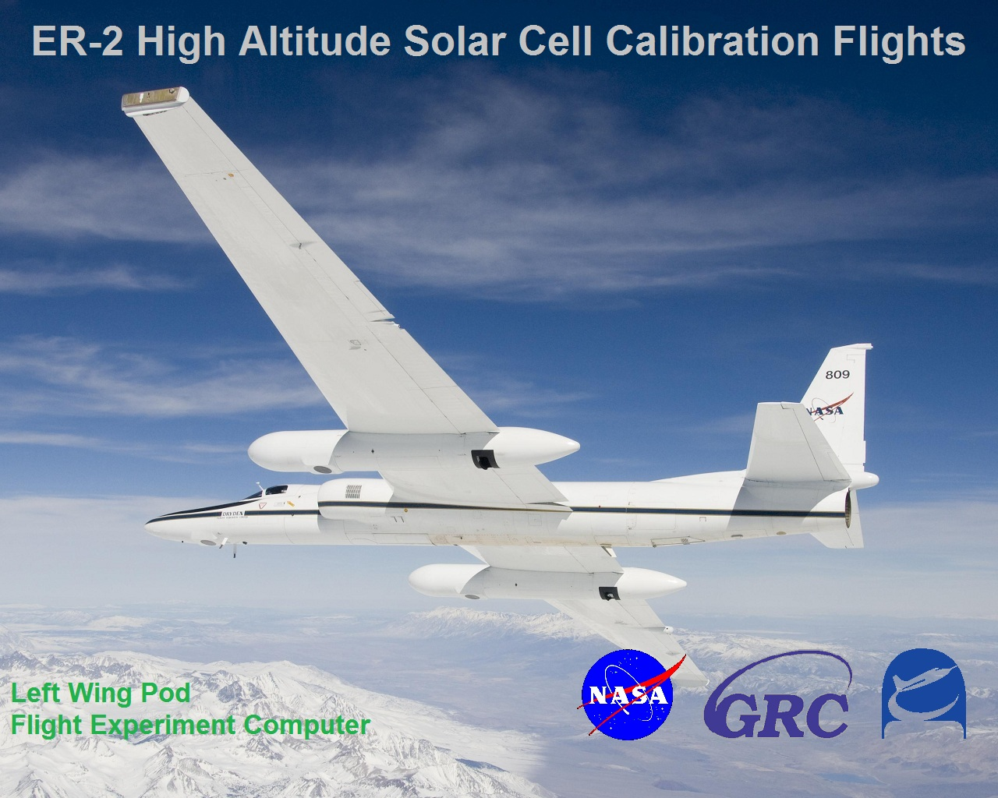
NASA GRC Solar Cell characterization Facilities
Jeremiah Sims
Photovoltaics and Electrochemical Systems Branch, NASA Glenn Research Center, Cleveland, Ohio, USA, 44106
Abstract
NASA GRC maintains various equipment to calibrate and characterize photovoltaic cells at Air Mass Zero (AM0) standards and in simulated space environments. These characterization facilities are critical to developing and advancing solar cell technologies, allowing advancements in a wide variety of NASA projects (Artemis, Lunar Gateway, Human Landing System, etc.).
Right: NASA GRC’s Sunbrick Solar Simulator, courtesy of G2V
Above: Active LEDs
NASA GRC’s second X-25 retrofitted to a medium size vacuum chamber to perform thermal balance testing down to -180°C.
Xenon-based Solar Simulators
Solar simulators are ground systems that utilize a combination of various light sources to replicate the irradiance of the sun. NASA GRC houses two X-25 (Xenon-based) solar simulators used for small-area AM0 testing. One X-25 utilizes two additional Tungsten light sources that improve the fidelity of the spectral output. Lastly, each X-25 is retrofitted with to a vacuum chamber to allow for AM0 temperature coefficient and thermal balance testing.
High altitude platform
LED-Based Solar Simulators
NASA GRC also houses two LED-based solar simulators, Angstrom Designs’ pLEDss and G2V’s Sunbrick. LED-based solar simulators are innovative tools for solar simulation due to a high degree of control in spectral flexibility and illumination sizing. pLEDss allows for large area solar simulation. G2V utilizes 36 channels of LEDs to allow tunable spectra over a small area.
NASA GRC collaborates with NASA AFRC to utilize the ER-2, a high altitude research plane that flies at 70,000 ft, to characterize solar cells in a near-space environment. These cells can then be used as primary standards. Primary standards are essential tools for performing calibration on ground system solar simulators. Availability to perform high altitude flights will be October 2023.
Left: Triple Source X-25 solar simulator. Right: Vacuum chamber designed for temp. coef. testing ranging from -150°C to 150°C.
NASA’s ER-2 plane, a high altitude research platform
NASA GRC’s Programmable LED Solar Simulator, courtesy of Angstrom Designs.

