Slide 1


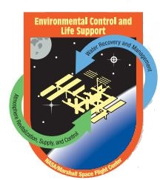
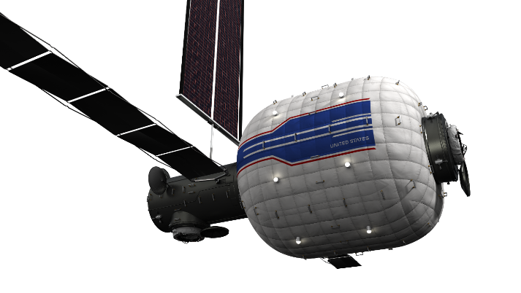
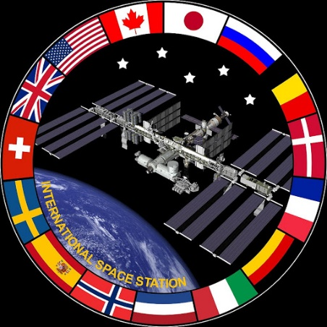


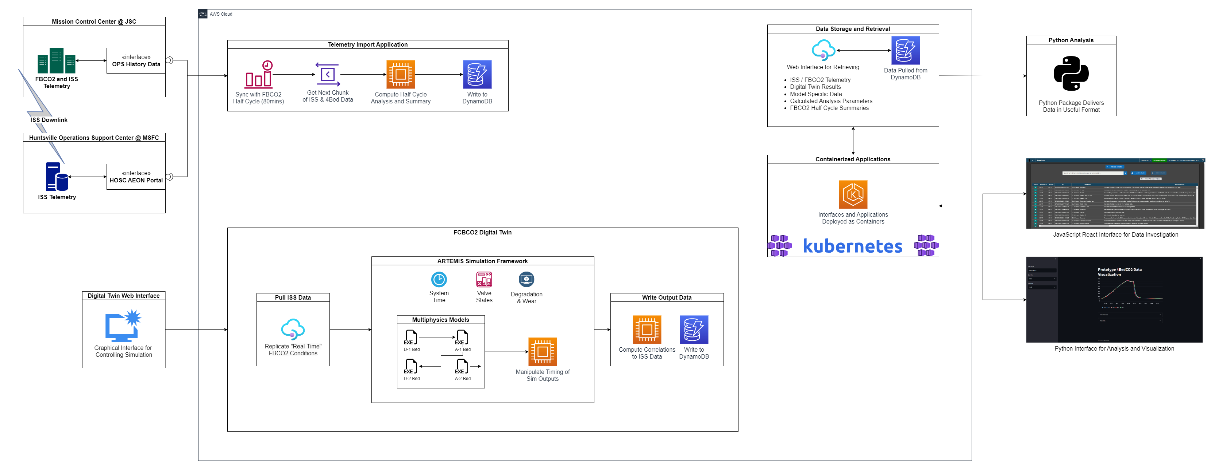
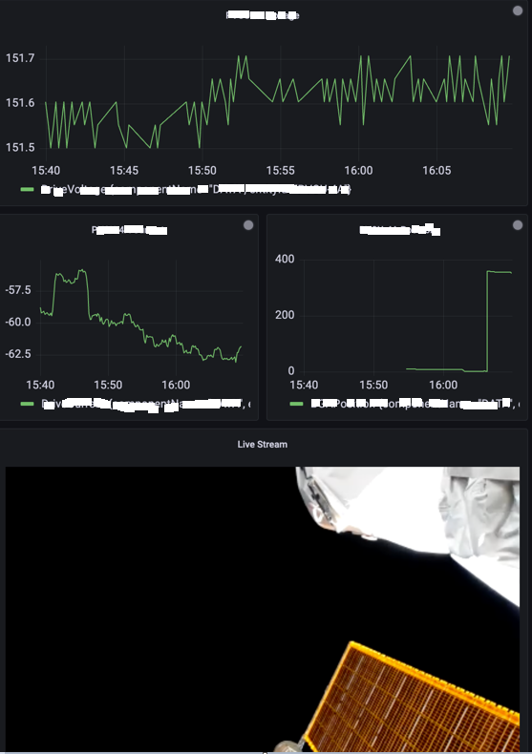
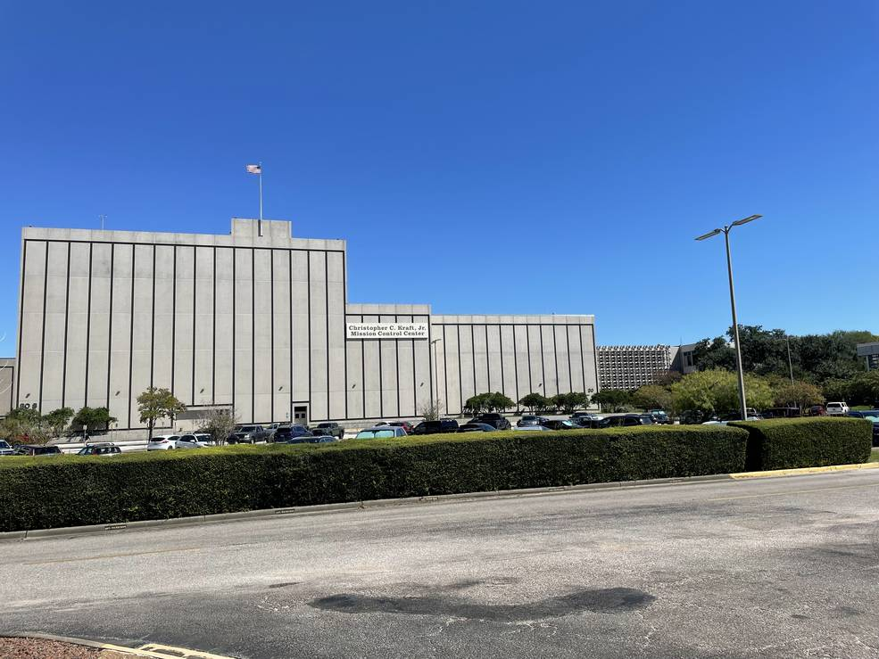
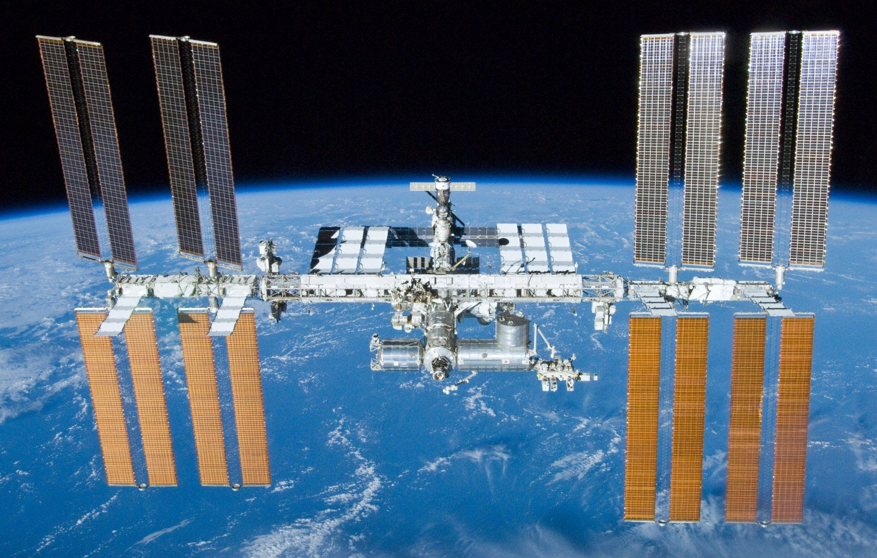
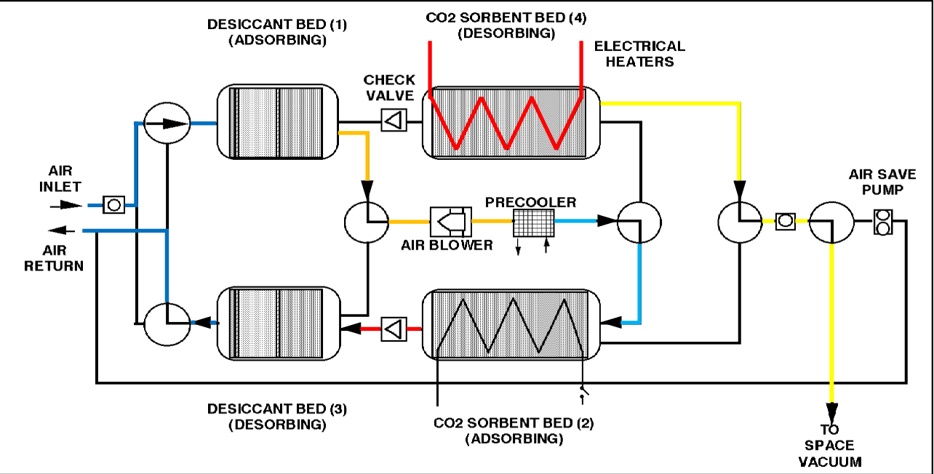
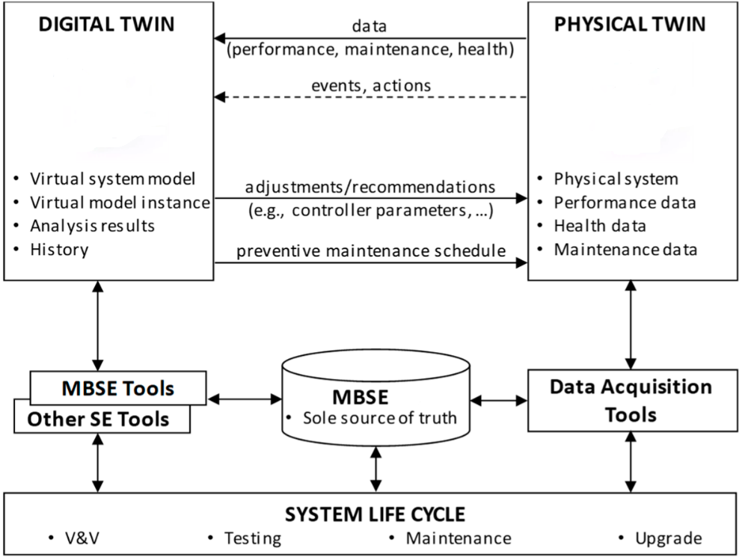
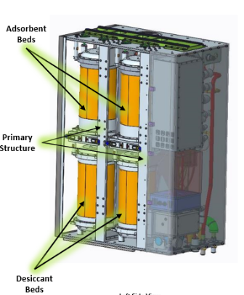
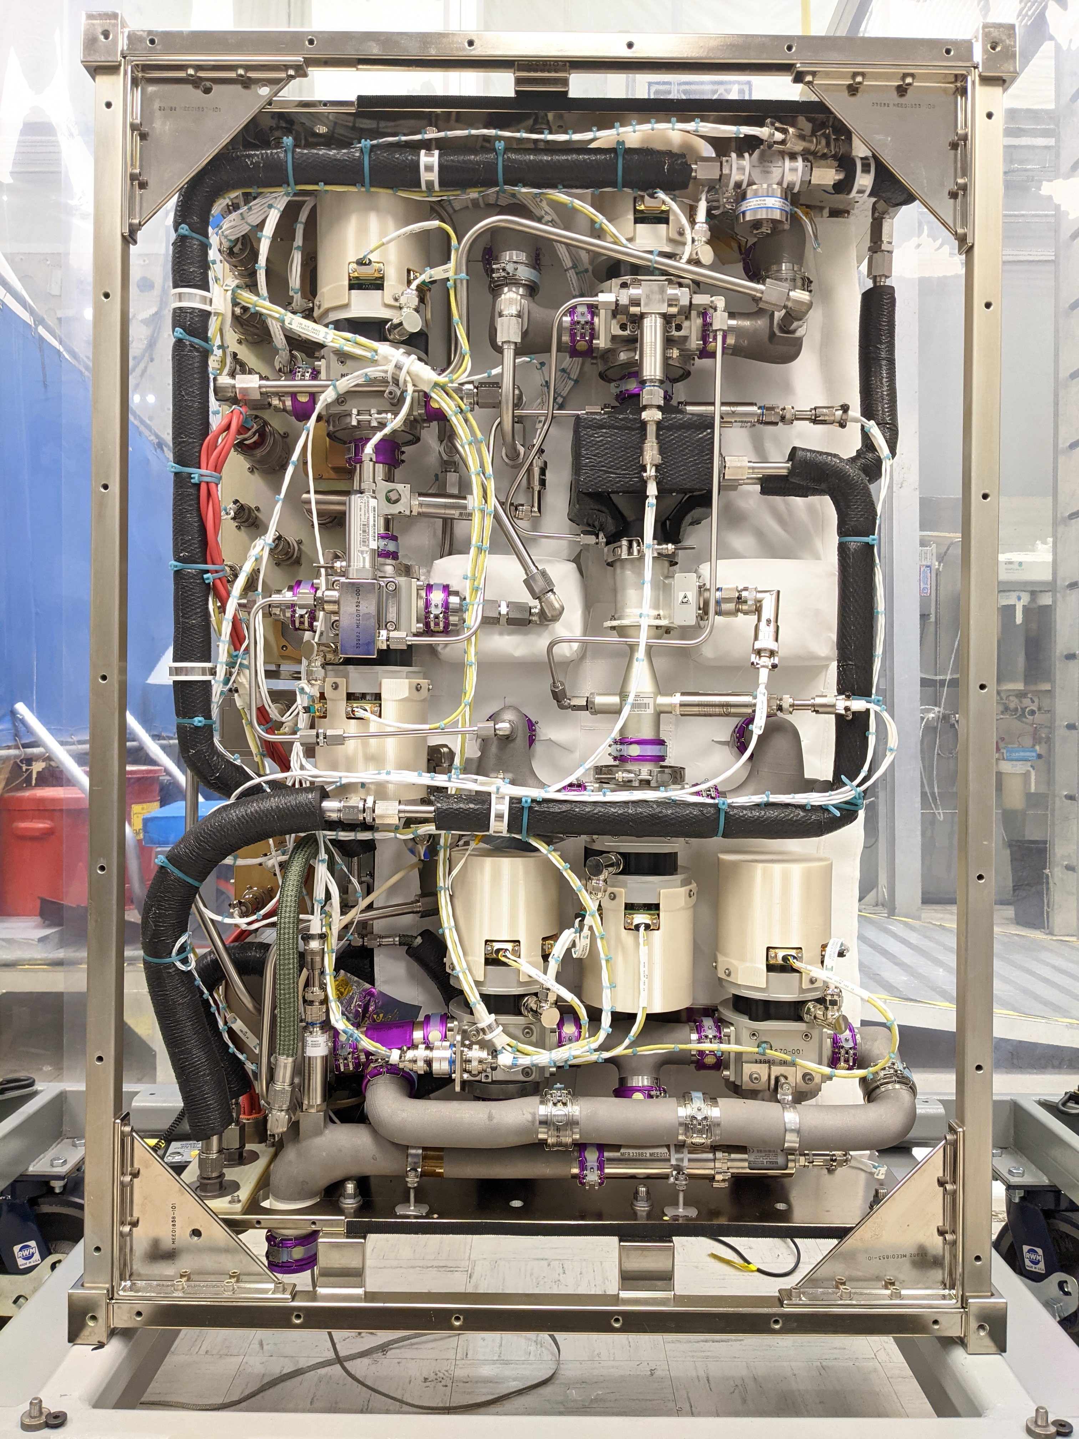
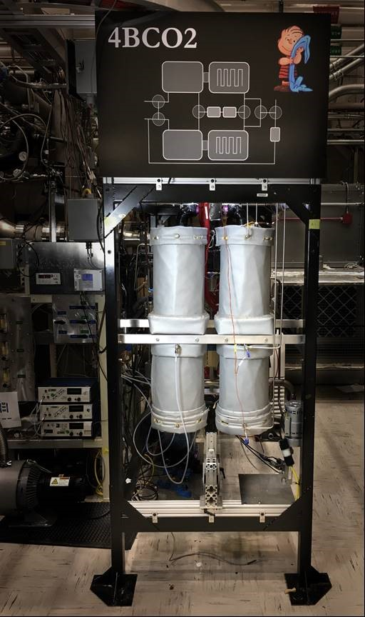
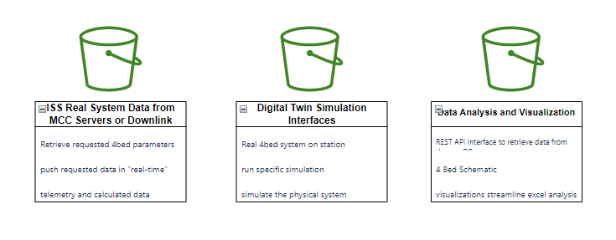
ECLSS Four-Bed CO2 Scrubber Digital Twin
Jared Wilson and Anthony Maenza
Engineering Directorate | Space Systems Department - MSFC
Abstract
  Workflow | Architecture
Collaboration
The ECLSS Digital Twin is a cloud-based simulation of the Four-Bed CO2 Scrubber, currently one of the primary means of removing carbon dioxide onboard the International Space Station, that operationalizes SME-developed multi-physics models and replicates conditions of the actual hardware in near real-time. In addition to providing insight into the system’s performance, it will enable prognostics, diagnostics, predictive maintenance, and simulated off-nominal scenarios. By leveraging digital representations, projects can save resources and gain a better understanding of their physical systems with the goal of building robust and reliable hardware for future deep space exploration. The use of data infrastructure in the cloud allows for streamlined analysis and visualization on a much larger scale than is possible with current tools.
(IS01) Chief Information Office
(ED01) Digital Transformation
(ES01) Space Systems Department
(ES62) ECLSS Subject Matter Experts
(ES50) Software Development
(ED04) Advanced Concepts
(JSC) APPDAT / AWS GovCloud
(GSFC) Mission Cloud Platform
Future DT Capabilities
Integrate with MBSE tools and products
Increase simulation fidelity
Implement off-nominal and failure scenarios
Incorporate CAD Modeling
Digital Systems Modeling (DSM)
What is a Digital Twin?
Digital Twin Key Points | Epics
A Digital Twin is a dynamic, virtual representation of a physical asset, product, process, or system. It digitally models the properties, conditions, and attributes of the real-world counterpart.
Data
Diagnostics
Prognostics
Forecasting
Optimization
Simulate Properties
Vary Parameters
Gather Data
Transfer Data
Sensor Readings
Optimize
Physical Asset
Physics Based +
Statistical Model

