Slide 1




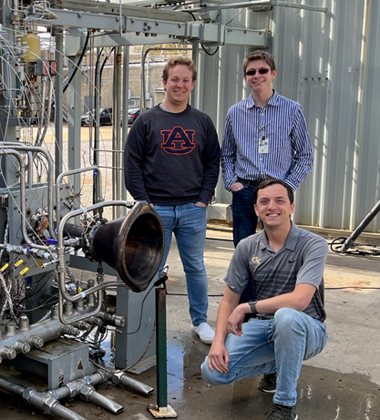
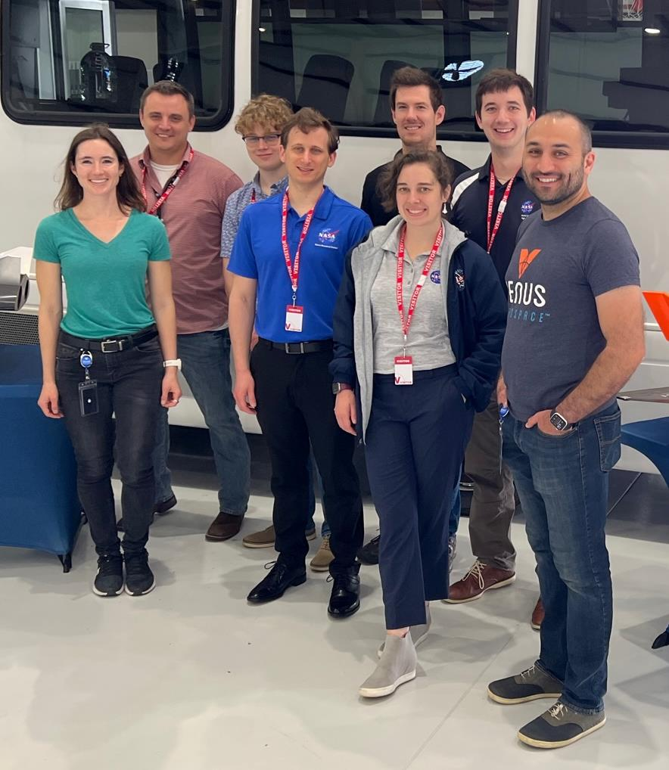
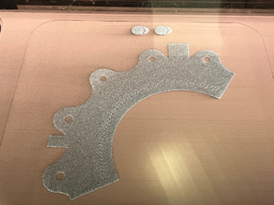
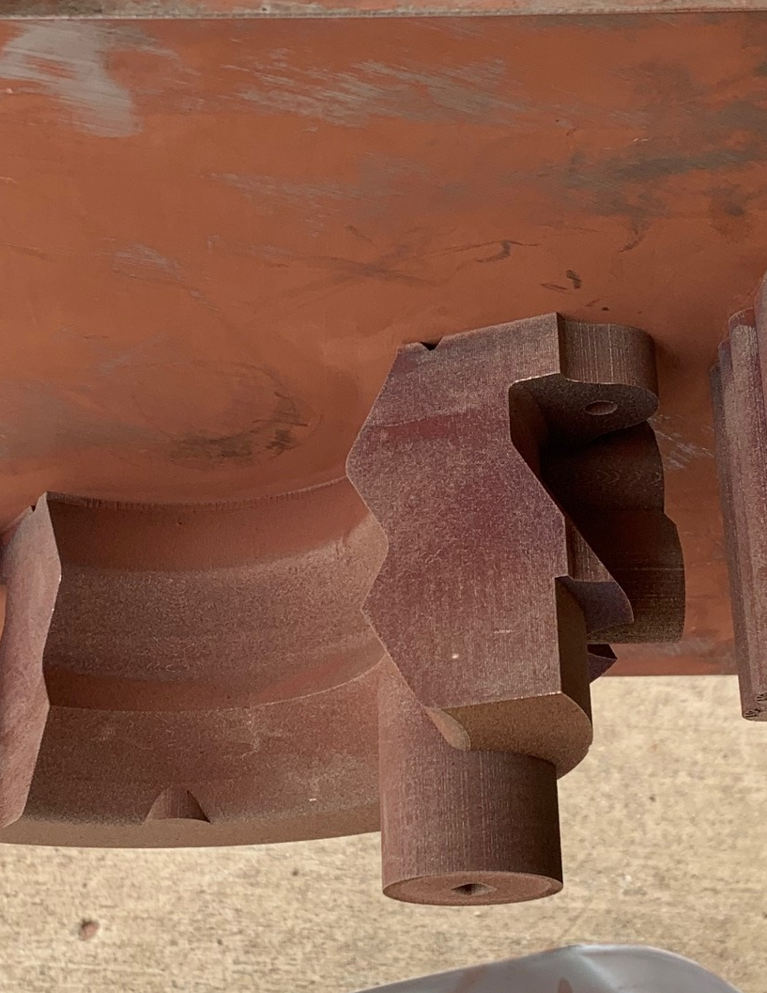
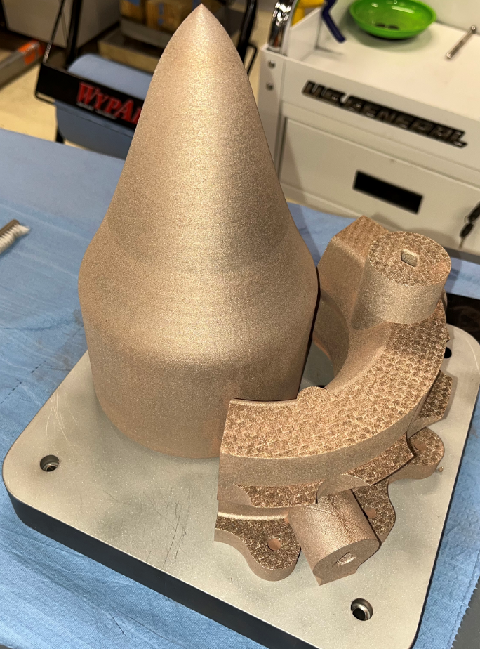
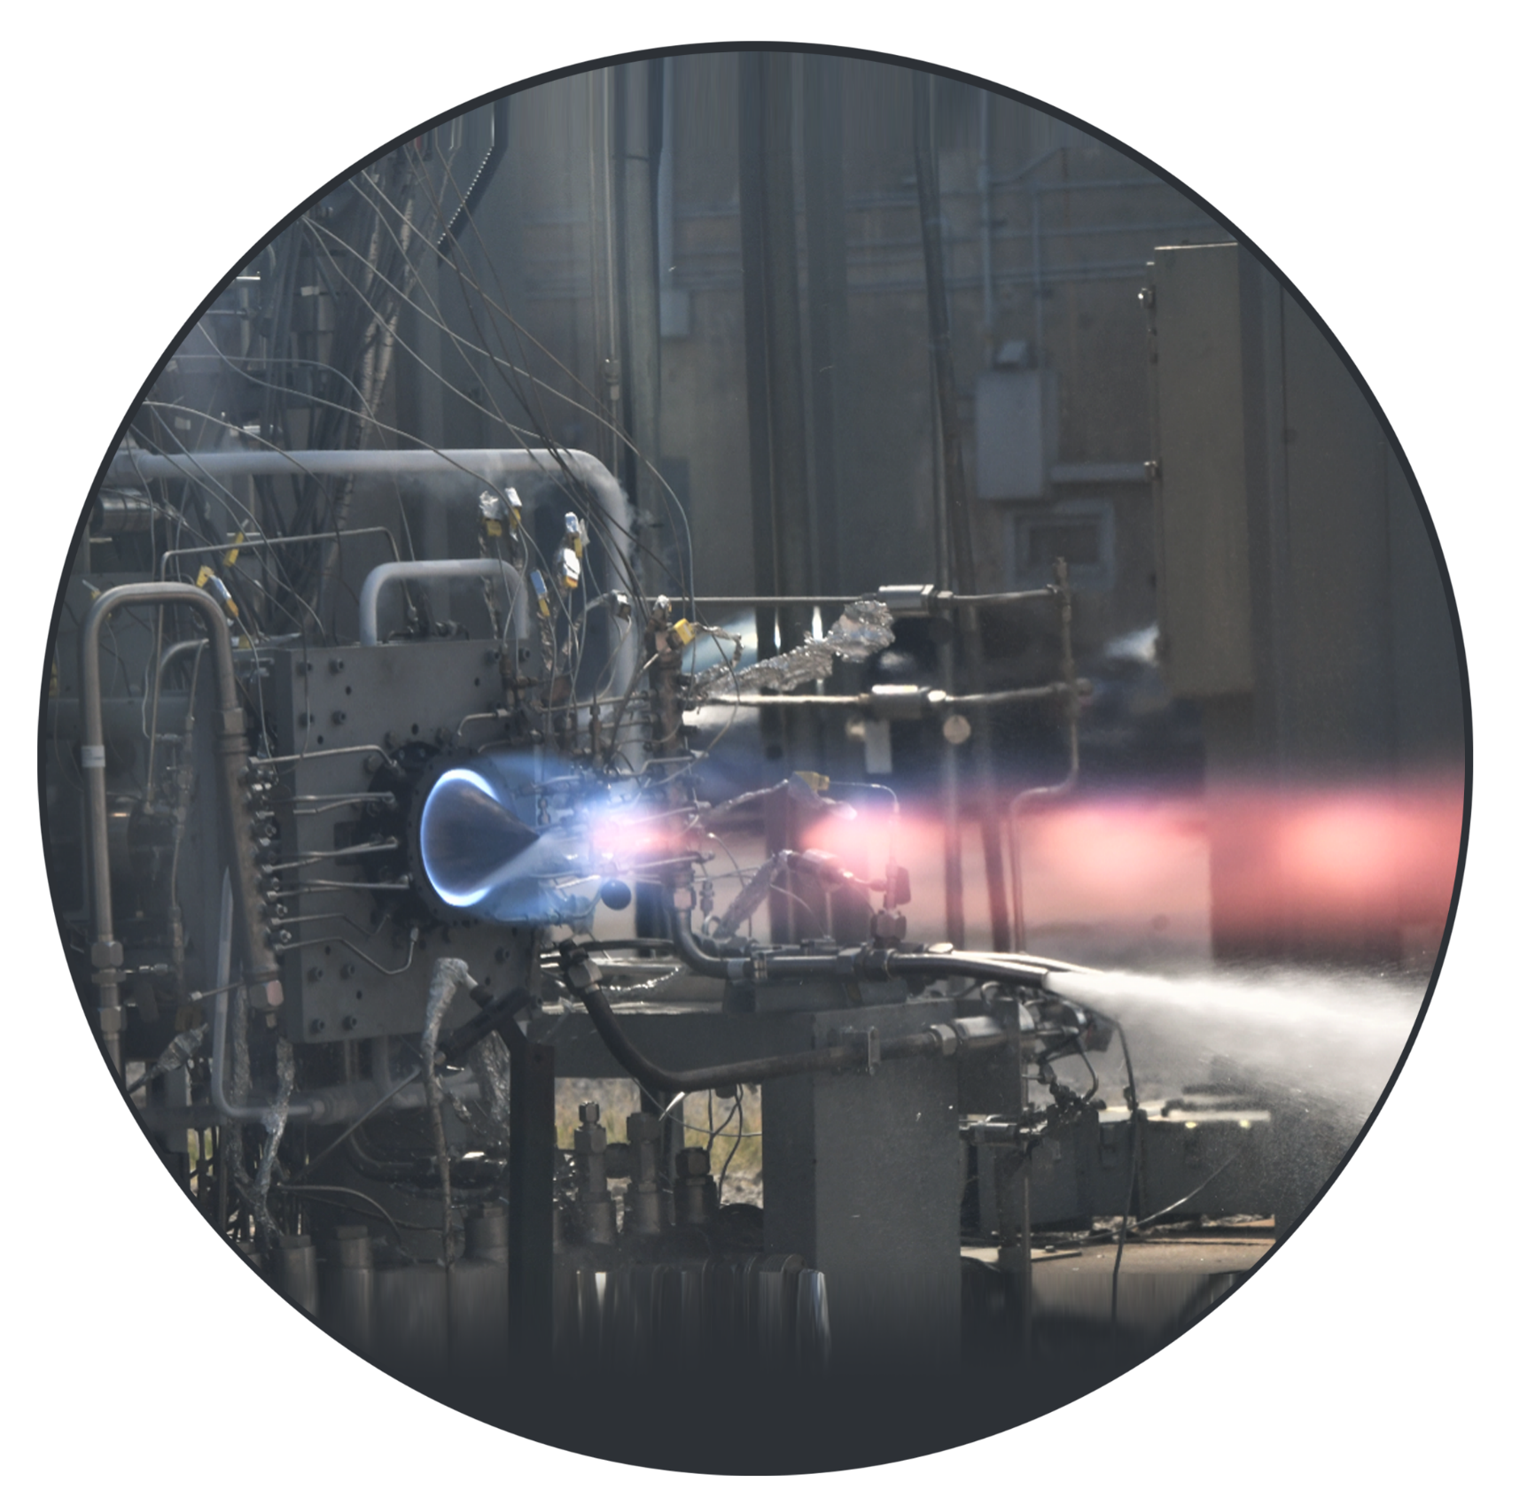
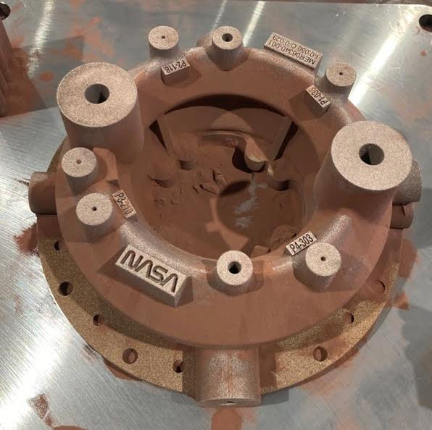
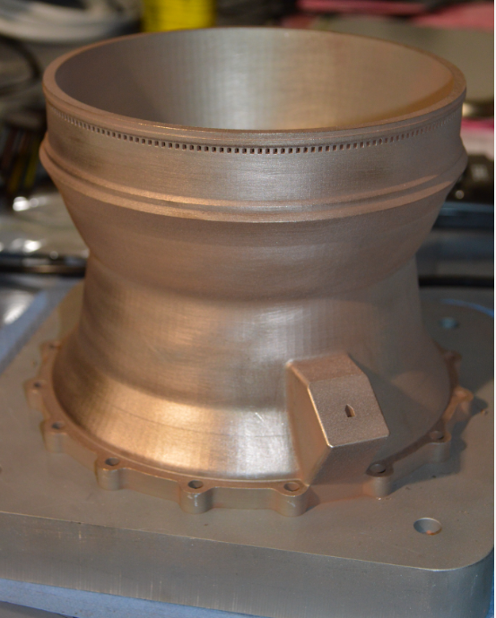
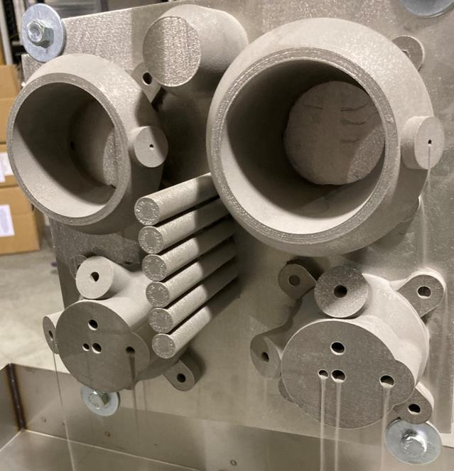
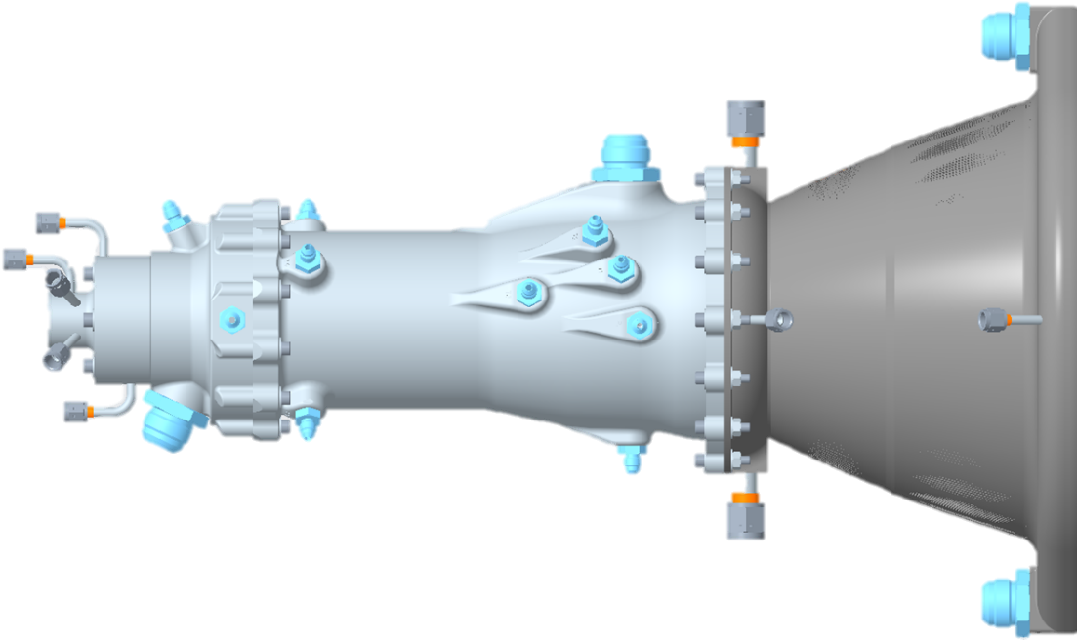
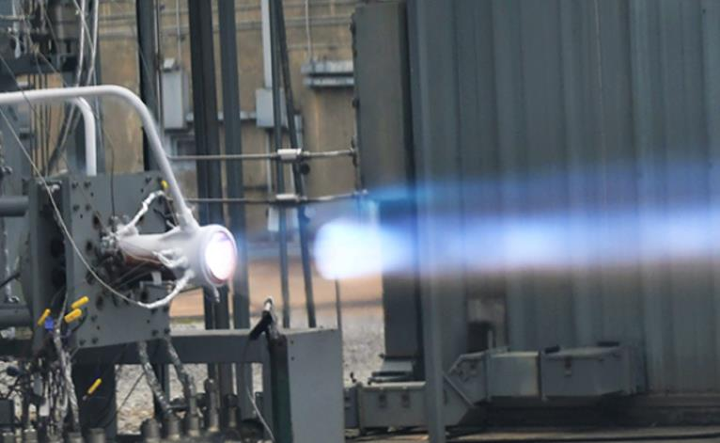

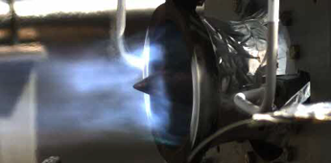
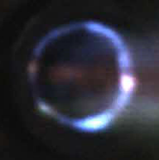
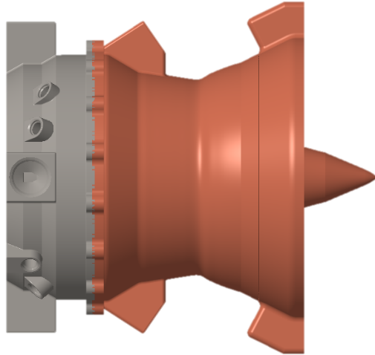


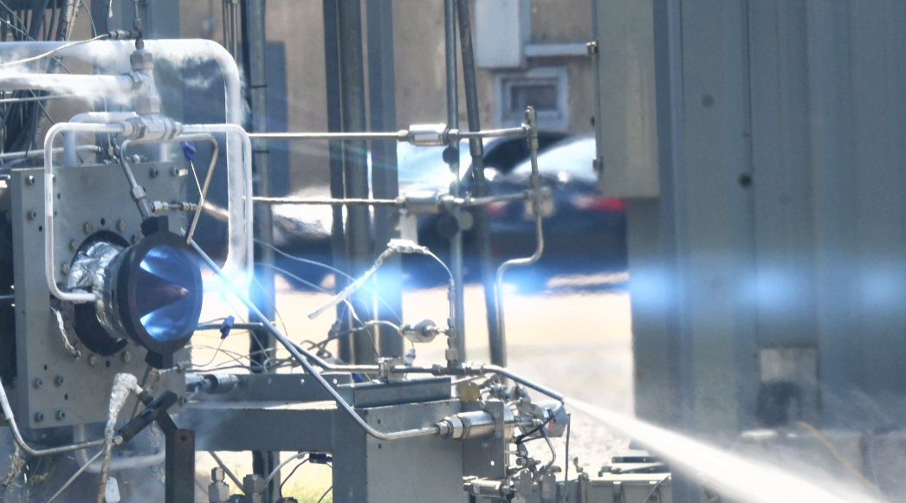
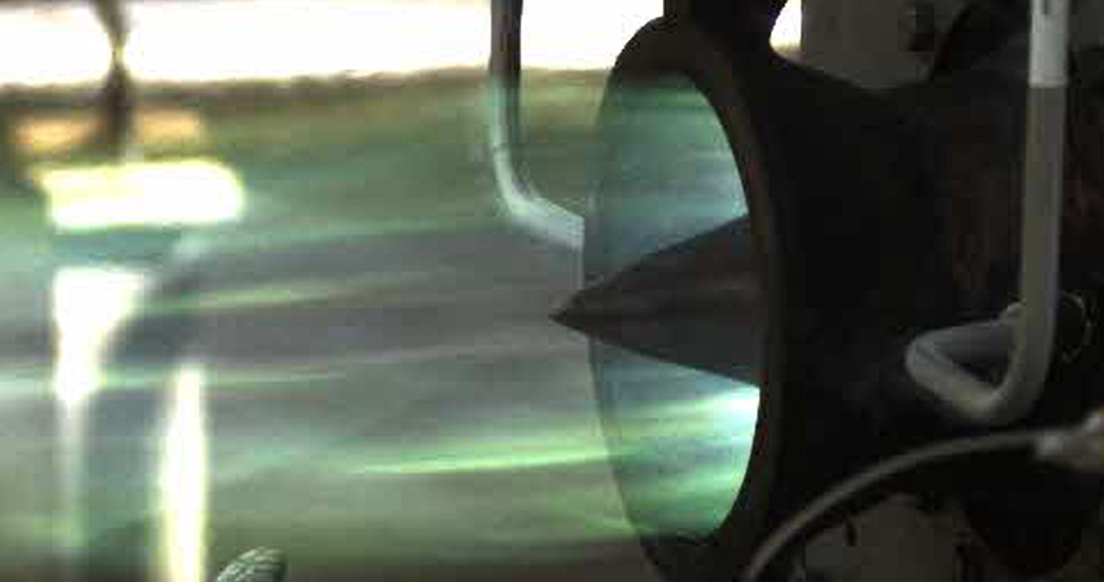

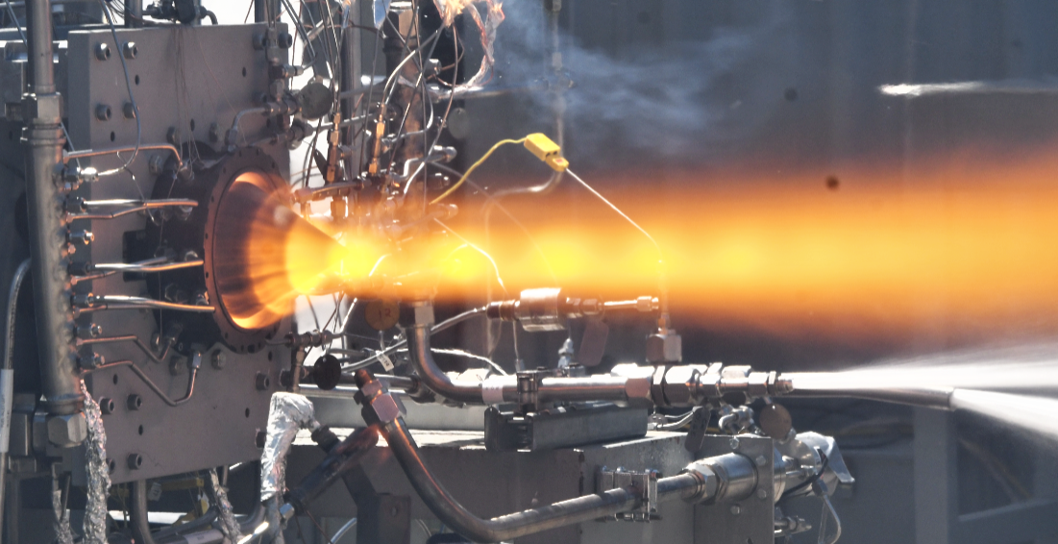
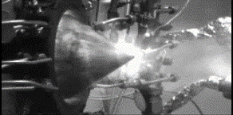
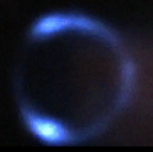
High Performance Rotating Detonation Rocket Engine for Mars Interplanetary Transport
PI: Thomas Teasley
Team: Shawn Skinner, Tessa Fedotowsky, Jonah Burgin, Robert Thacker, Ben Williams, Doug Perkins, Michael Allison, Dalton Luedke
Novel Use of Additive Manufacturing Alloys
GRCop-42/84, GRX-810, NASA HR-1
RDRE TEST
NASA/Venus RDRE Team
High Pressure 622 psia GCH4/LOX
Advancement of Additive Manufacturing
Demonstrated GRCop-alloys in extreme detonative environments > 100 seconds in duration.
Utilizing novel alloys such as GRX-810, NASA HR-1.
Traditional Rocket
Deep Throttle
8:1 CH4/LOX
Multi - Propellant Demonstration
RDRE
40% Length Reduction
GCH4/LOX
High Pressure
622 psia CH4/LOX
Performance Benefits
Radical increase in heat output and completion of combustion.
Substantial length and mass reduction and potential increase in Isp.
Substantial reduction in cost and schedule for AM components.
Annular geometry enables far higher nozzle area ratios and thus higher in-space Isp.
Liquid/Liquid
133 s LCH4/LOX
GH2/LOX

