Slide 1
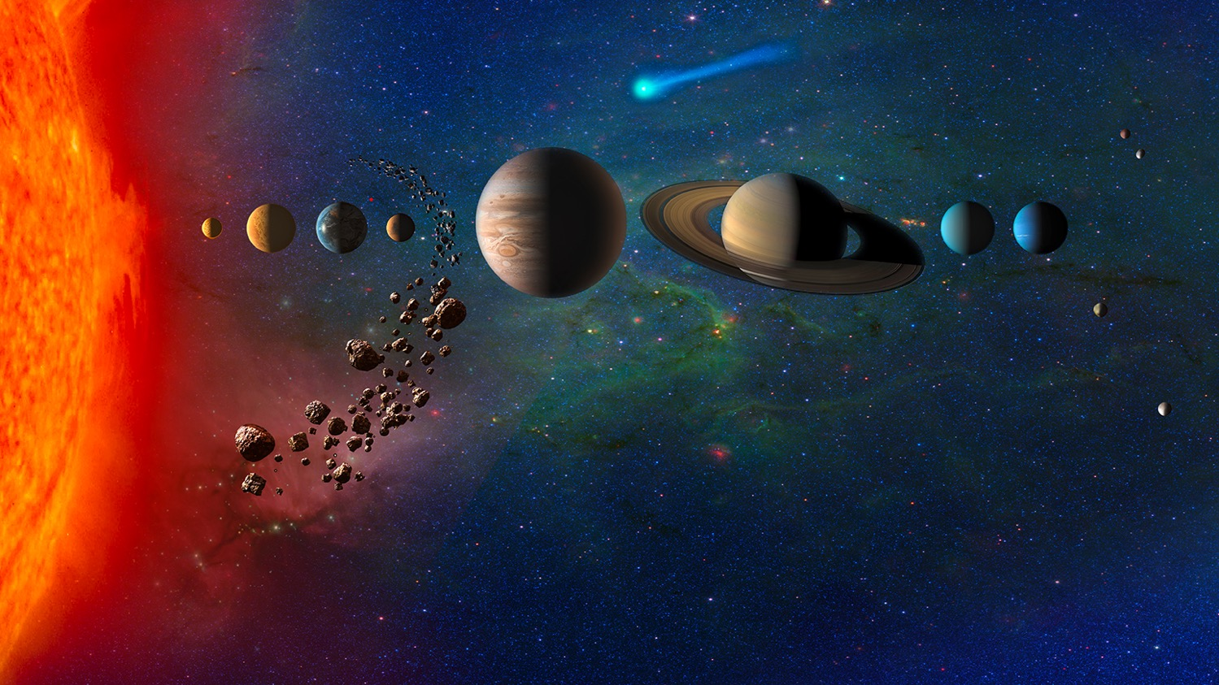
Solar System Infrastructure
Presentation to the Off-Earth Atlas Workshop • 9 June 2023 •
Lynn D. Harper • Space Portal • NASA Ames Research Center
Why Before How
Based on collaborations with Space Portal leadership: Dr. Daniel Rasky, Mr. Bruce Pittman, and Mr. Mark Newfield. Inspired by discussions with Dr. Victor Buchli
Notes:
https://solarsystem.nasa.gov/resources/678/our-solar-system-artists-concept/

Slide 2
Disclaimer
This presentation represents the opinion of the author and is offered for the purposes of brainstorming solar system infrastructure possibilities with colleagues of the global village.
This presentation cannot and does not represent official NASA or United States programs or plans except where specifically cited; and it does not imply any commitment to implement the ideas discussed.
All of the great ideas herein belong to many others.
The mistakes are entirely mine.
Off-Earth Atlas Workshop
Lynn D. Harper
Lynn.d.harper@nasa.gov
Lead for Integrative Studies
Space Portal
NASA Ames Research Center

Slide 3

Why Build Infrastructure in Space?
Notes:
Art is from Microsoft PowerPoint Creative Commons

Slide 4
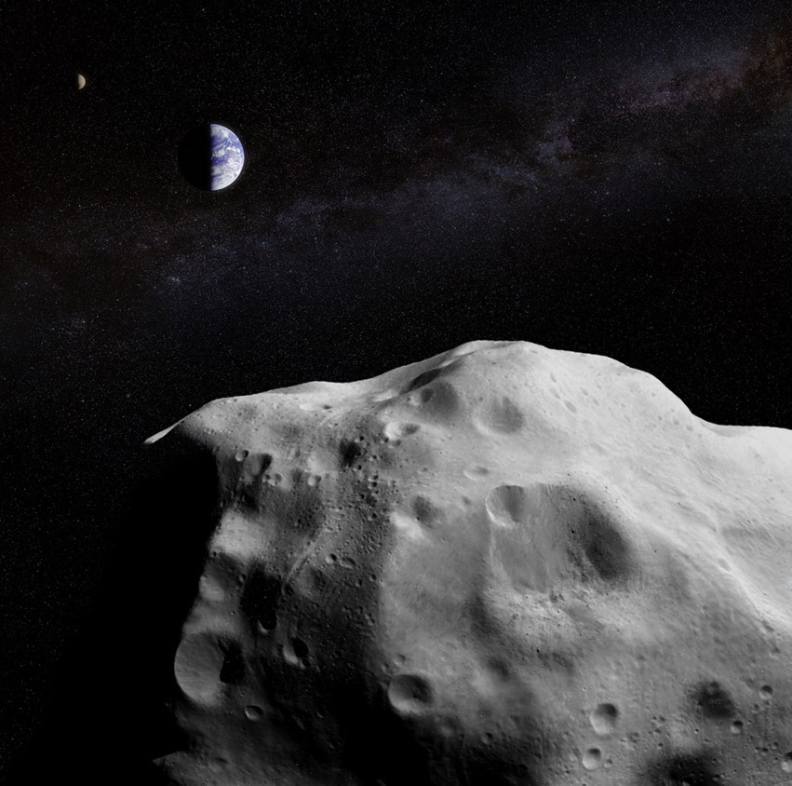
Why Before How
Hazards
As of this writing, we cannot see asteroids of any size coming directly at Earth from any direction until they are too close to respond safely and effectively.
Asteroids coming directly at us do not appear to be moving in the sky.
We are at the wrong angle to see these dark cold objects against a dark cold sky because almost all of our killer Near Earth Object (NEO) detection assets are here on Earth.
In order to see the asteroids coming at Earth, we need to monitor the sky from different angles.
This requires NEO detection systems infrastructure deployed throughout the solar system.
This Photo by Unknown Author is licensed under CC BY
Notes:
https://www.nasa.gov/specials/pdco/index.html . For further information on killer NEOs and what can be done about them, see https://docs.google.com/document/d/1hAZNNzpKcblcxUBhywnu2Im1ADcneCD-omSR_PY34LQ/edit

Slide 5
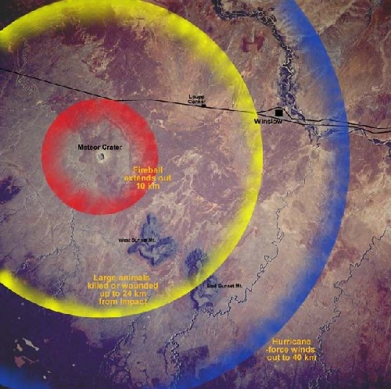
Why Before How
Impact Hazards
Barringer Impact Crater, Arizona, USA
Crater Hole = 1.2 km diameter x 180 meters deep
Impact of a 50-meter asteroid would cause local damage equivalent to the largest nuclear weapon on Earth. Currently we have detected ~ 5% of an estimated 230,000 of these near-Earth objects.
150-meter asteroid would cause destruction on a regional to national scale. Energy released: ~50 nuclear bombs. Currently we have detected ~45% of an estimated 24,000 of these near-Earth objects.
300-500-meter asteroid would cause destruction on a continental scale. Energy released: ~1000 nuclear bombs. Currently we have detected ~68% of an estimated 3500-7200 of these near-Earth objects. (note the size of the error bar).
1000-meter asteroid would cause global effects with many millions dead. Energy released: ~8000 nuclear bombs. Currently we have detected ~95% of an estimated 940 of these near-Earth objects, leaving ~50 undetected.
Notes:
Superimposed on this Space Shuttle image of Berringer crater area are the effects of the asteroid impact with its accompanying fireball on the local environment (from NASA/Univ. AZ Space Imagery Center). Any animal within 25 km of the impact probably would not have survived the blast. Data from from Finding Hazardous Asteroids Using Infrared and Visible Wavelength Telescopes. Page 8. National Academies of Sciences, Engineering, and Medicine 2019. Washington, DC: The National Academies Press.

Slide 6
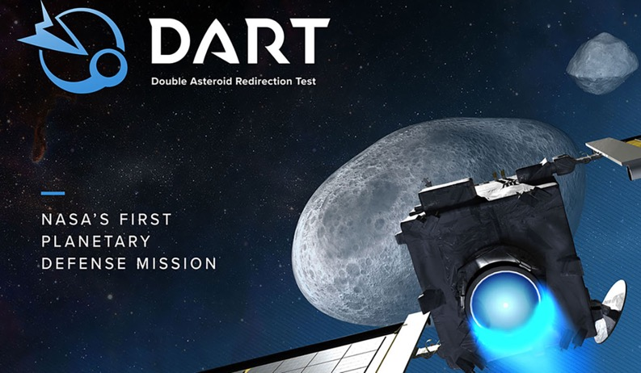
Killer Asteroids –Status Today
Analysis of data obtained by NASA’s DART investigation team shows the spacecraft's kinetic impact with its target asteroid, Dimorphos, successfully altered the asteroid’s orbit.
We can redirect asteroids away from Earth …
IF we can find them early enough.
That’s where solar system infrastructure comes into play.
Notes:
https://solarsystem.nasa.gov/missions/dart/in-depth/#:~:text=What%20is%20DART%3F,in%20space%20through%20kinetic%20impact.&text=On%20Sept.%2026%2C%202022%2C,(160%20meters)%20in%20diameter.

Slide 7
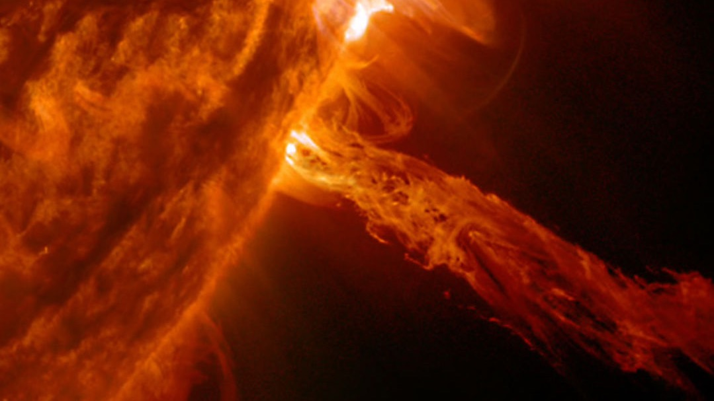
Why Before How
Hazards: Solar Storms
Strong solar flares and storms can disrupt and damage modern electric power grids, contribute to the corrosion of oil and gas pipelines, interfere with radio communications and navigation signals from Global Positioning System (GPS) satellites, black out communications along aviation routes.
Exposure of spacecraft to energetic particles during solar energetic particle events and radiation belt enhancements can cause temporary operational anomalies, damage critical electronics, degrade solar arrays, blind optical systems, and pose a significant hazard to space travelers.
A severe solar storm could cause trillions of dollars in damage
This Photo by Unknown Author is licensed under CC BY-ND
Notes:
https://www.nasa.gov/subject/3165/space-weather/

Slide 8
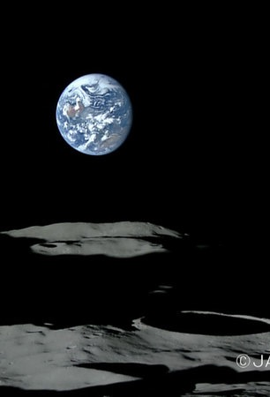
Why Before How
Resources
There is vast wealth in knowledge, raw materials, uniquely processed materials, location, and supply of infrastructure, instruments, equipment, and services in extraterrestrial environments.
Regardless of where we go beyond Earth with people, we need:
Habitat, life support, communication, data storage and transfer, transportation, navigation, power, protection from the environment.
2022 Global Space Industry ~ $ 386 Billion expected to grow to $1 trillion by 2040
Notes:
2017 Image from Jaxa Kaguya Mission https://global.jaxa.jp/projects/sas/selene/topics.html

Slide 9
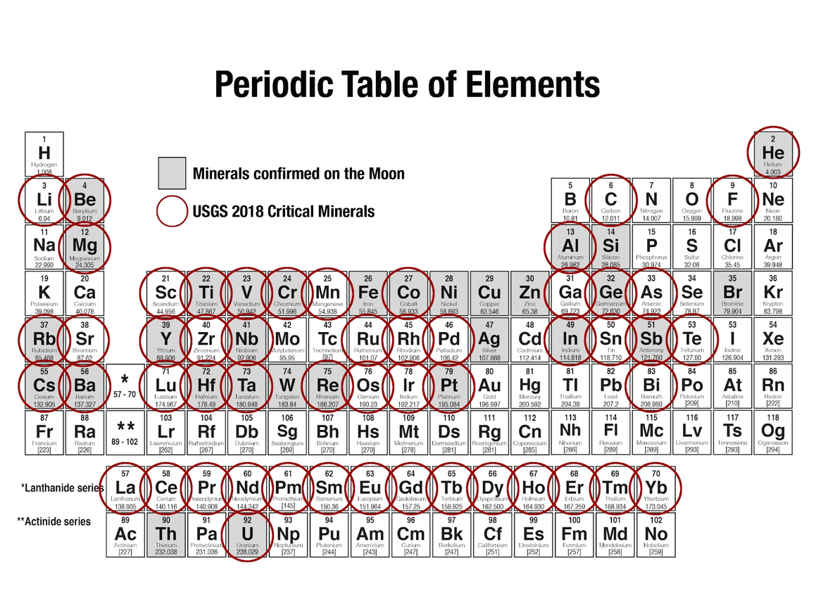
With the right space infrastructure, none of Earth’s children will need to go to war over rocks.
Notes:
Source: Harper and Satana https://docs.google.com/document/d/1B4N4IhpJqfTGOEF218wNDOx60wL7Du7ZRdKNDCHuzkY/edit

Slide 10
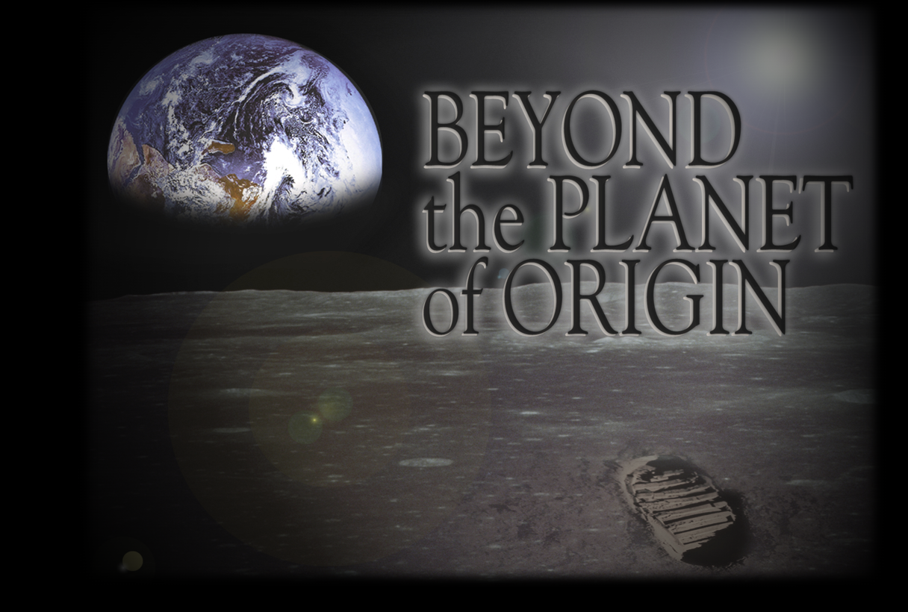
Notes:
2003 Artwork by Cheryse Triano and Joseph Minafra, NASA Ames Research Center

Slide 11
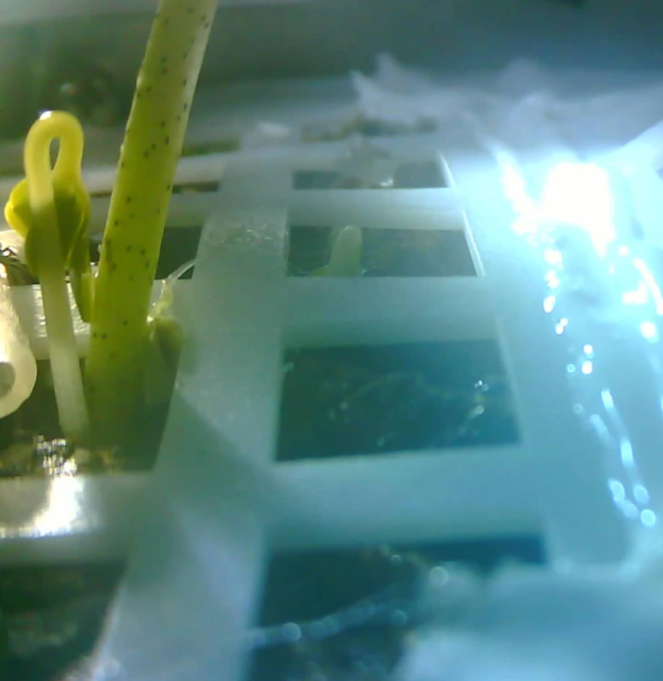
Why Before How
Life on Other Worlds
When we send living organisms to other worlds, one of two profound things will occur.
Either life from Earth will encounter life from another world, and first contact will be made with an alien species.
or
We will be the origin of life on that world, with all of the evolutionary potential that implies.
Notes:
Image of the first seedling (cotton) to germinate on the Moon. “A cotton seedling is shown inside an experimental farm tank on the Chang‘e 4 lunar lander on the moon. Chongqing University”. https://globalnews.ca/news/4848295/china-moon-seed-plant-cotton/

Slide 12
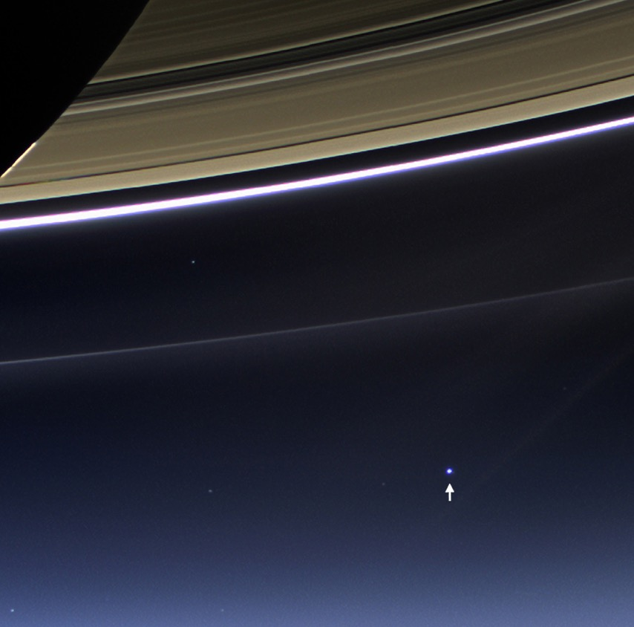
Why Before How - Prudence
“Look again at that dot. That's here. That's home. That's us.
On it, everyone you love, everyone you know, everyone you ever heard of, every human being who ever was, lived out their lives.
The aggregate of our joy and suffering, thousands of confident religions, ideologies, and economic doctrines, every hunter and forager, every hero and coward, every creator and destroyer of civilization, every king and peasant, every young couple in love, every mother and father, hopeful child, inventor and explorer, every teacher of morals, every corrupt politician, every "superstar," every "supreme leader," every saint and sinner in the history of our species lived there -- on a mote of dust suspended in a sunbeam.” Carl Sagan
But will Earth be the only place for humans in the future?
In large part, that question will be answered by infrastructure.
Notes:
2013 View of Earth from Saturn’s rings b NASA’s Cassini spacecraft. https://www.nasa.gov/image-feature/cassini-earth-and-saturn-the-day-earth-smiled

Slide 13
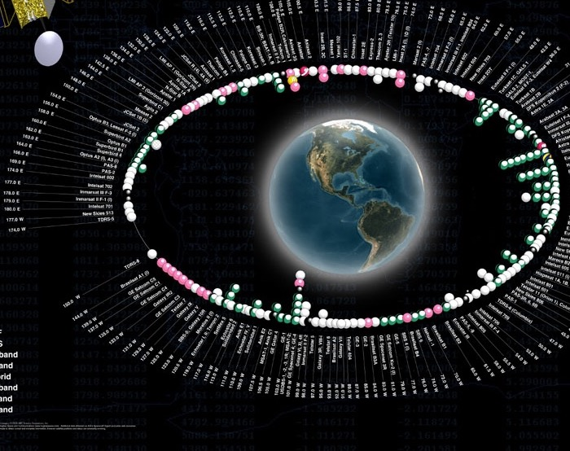
Space infrastructure saves lives, generates wealth, increases standards of living worldwide, promotes global connectivity, improves navigation, supports global resource management, encourages enterprises, delivers wonder, enables planetary defense, and provides tools for crafting better futures.
2022 Global Space Industry ~ $ 386 Billion
expected to grow to $1 trillion by 2040
Notes:
Art from Microsoft PowerPoint Online Images Creative Commons. This Photo by Unknown Author is licensed under CC BY-SA

Slide 14
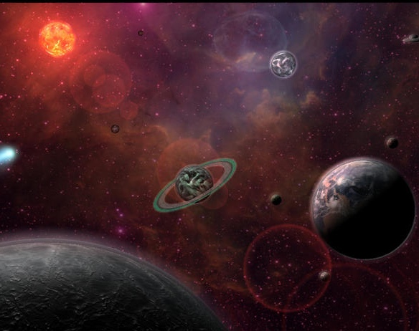
How
Notes:
Art from Microsoft PowerPoint Online Images Creative Commons. This Photo by Unknown Author is licensed under CC BY-SA

Slide 15
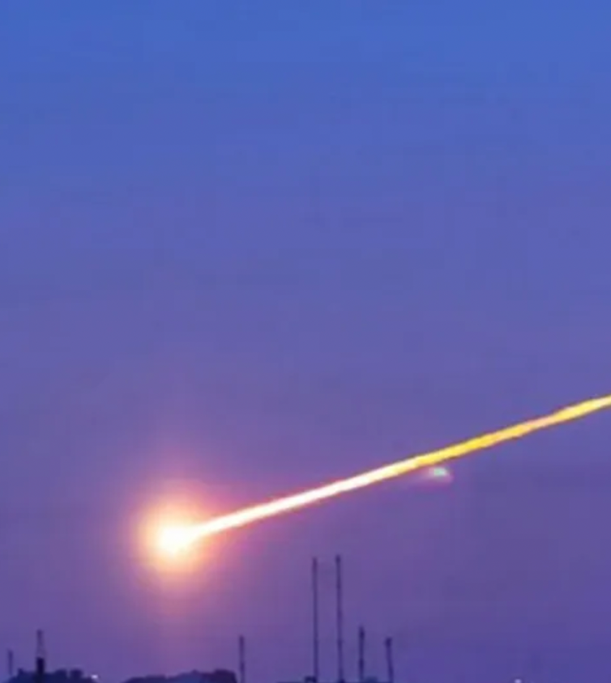
How –
Killer Asteroids Detection and Management
For the global village, one of the important space infrastructure questions of the century should include:
What do we need to do to detect and manage killer asteroids one year before they reach Earth’s vicinity?
And given today’s technology, how soon can and should we make this happen?
What happens to the cost, time, and opportunities if we mass produce spaceships and space instruments?
Benchmark: SpaceX manufactures more than 1000 Starlink spacecraft per year.
Notes:
Image of meteorite impact in Chelybinsk in 2013. https://en.wikipedia.org/wiki/Chelyabinsk_meteor Image from Wikipedia

Slide 16
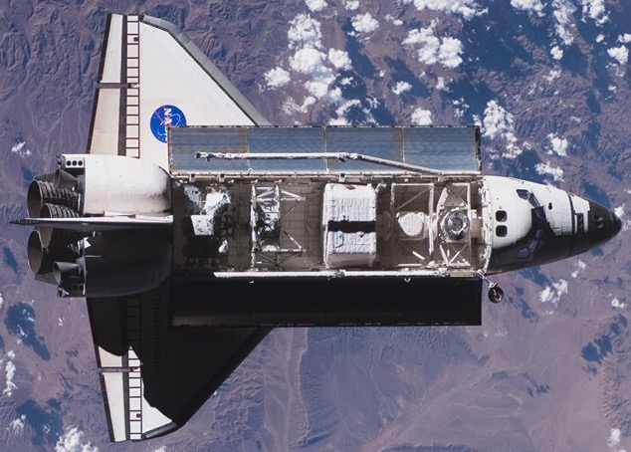
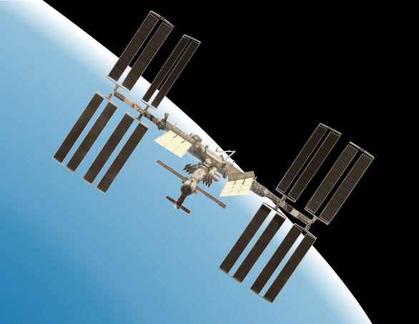
How: Sortie vs Settlement
Sortie: Space Shuttle 1982-2010
Time in Space: 3.6 years
Settlement: International Space Station 2000 to now
Time in Space: 24/7/365 for 23+ years
Notes:
Art from Microsoft PowerPoint Online Images Creative Commons. This Photo by Unknown Author is licensed under CC BY-SA

Slide 17
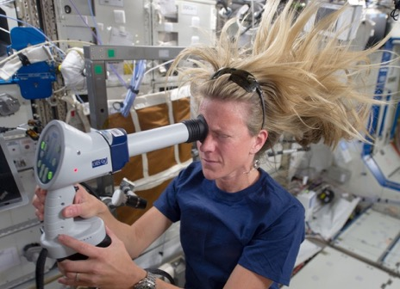
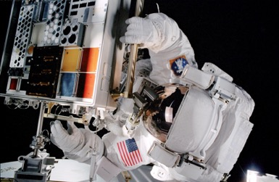
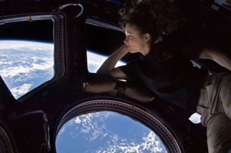
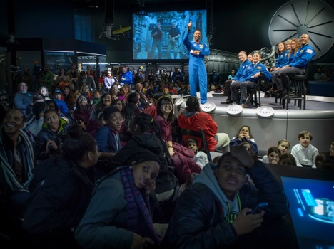
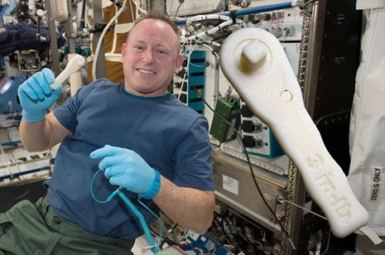
• Assembly of Large Structures in Space via Multiple Flights and Multiple Spacecraft • Versatile Evolving Human Supported Space Laboratory • Observatories • Technology Testbeds • STEM • 16 Nations Collaborating for Decades • Commercial R&D
First National Lab Beyond Earth
First Long Term Space Resource Depot
• 22 Years and Counting of Continuous Human Habitation Beyond Earth • Catalyst, Inspiration, and Accelerator of Commercial Space Enterprises • Existence Proof that Permanent Human Occupation of Other Worlds is Feasible
Notes:
Images from NASA. Upper left = MISSE. Upper middle astronaut at ISS cupola. Upper right astronaut using onboard eye testing equipment. Bottom left Astronauts talking with students about STEM. Bottom right first tool manufactured entirely in space

Slide 18

How: Off-World Infrastructure for Learning:
Lunar University – the first institution of higher education on another world
Notes:
2003 Art by Joseph Minafra, NASA Ames Research Center

Slide 19

How: Together
It will take a global village to save the Earth
Notes:
Art from Microsoft PowerPoint Online Images Creative Commons. This Photo by Unknown Author is licensed under CC BY-SA

Slide 20
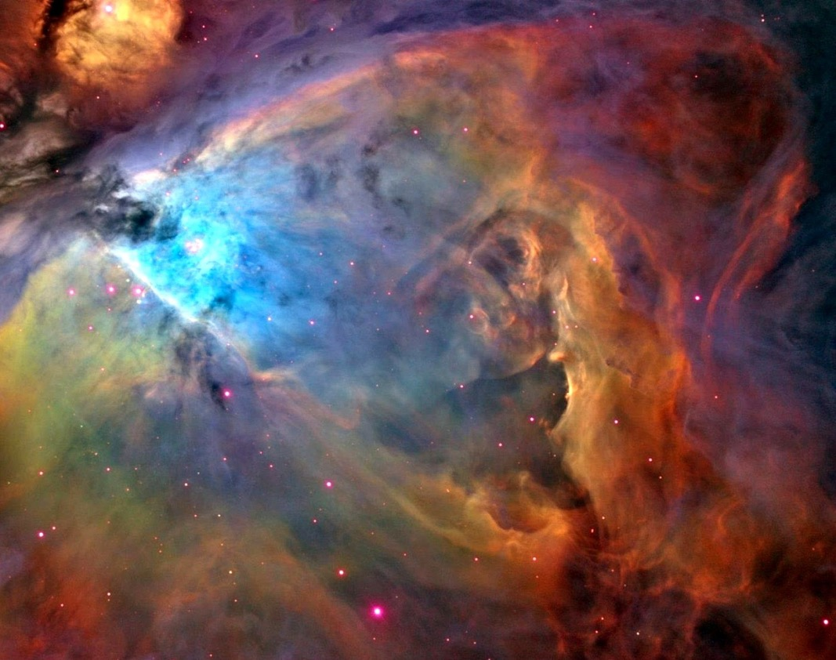
Unless something more catastrophic than COVID occurs, humanity will explore and develop space forever.
The right infrastructure will make that possible.
Notes:
Hubble Space Telescope Image of Great Orion Nebula in the constellation Orion.

Slide 21
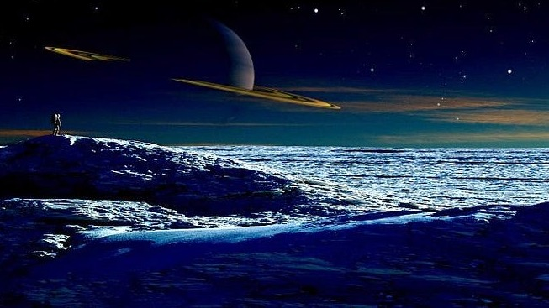
Very different futures are available to those who can thrive beyond their planet of origin versus those whose destinies are constrained to a single world.
Notes:
Art from Microsoft PowerPoint Online Images Creative Commons. This Photo by Unknown Author is licensed under CC BY-SA

Slide 22
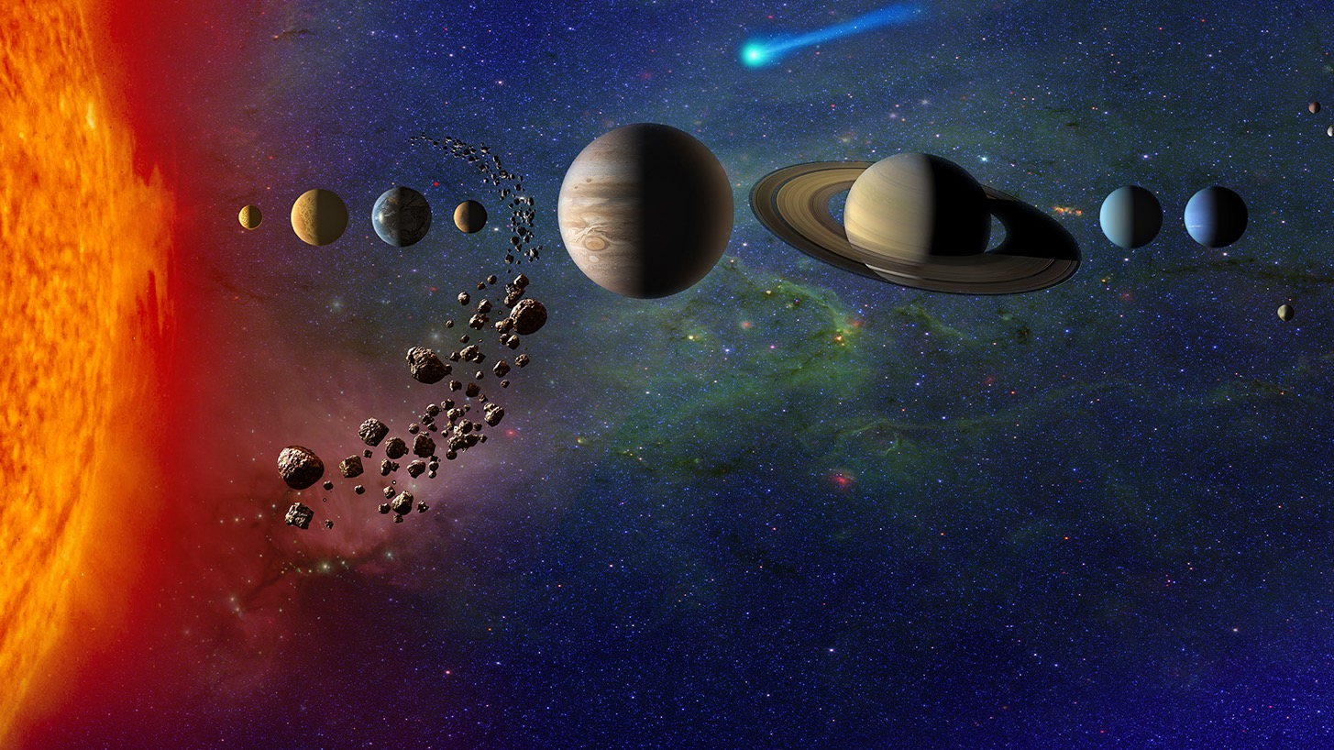
Should we add hazards and resources assessments of the Solar System as part of the Off Earth Atlas?

Slide 23
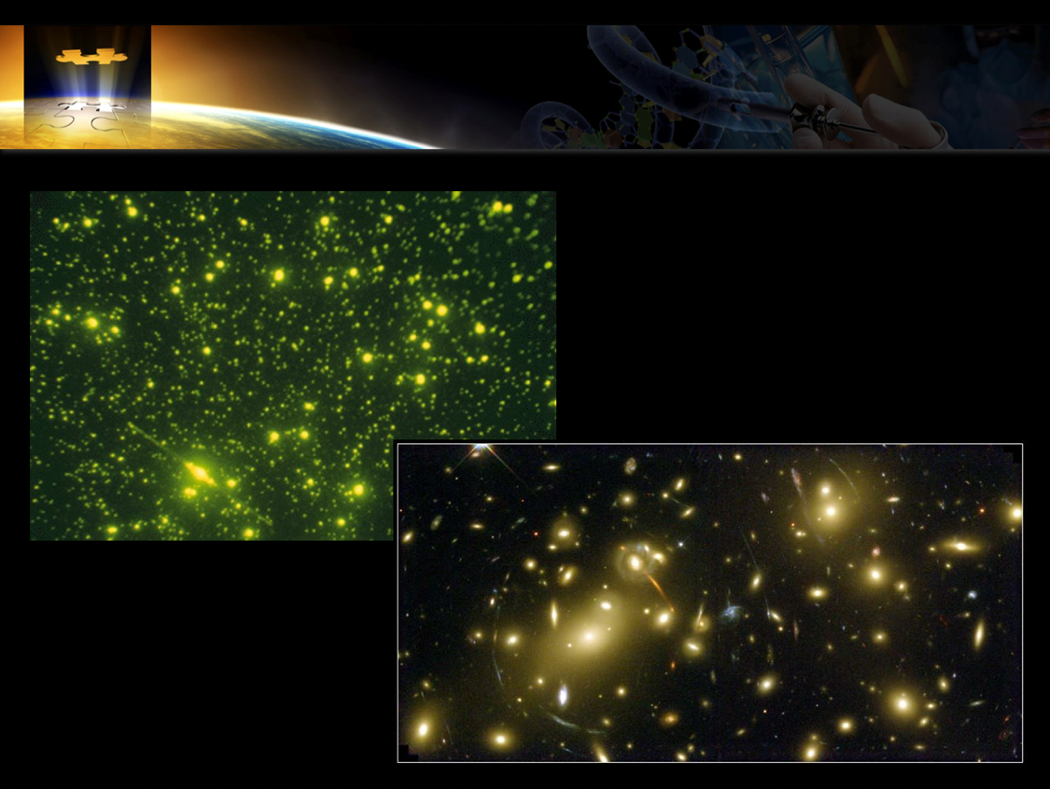
Whether on Earth or Beyond … What does it mean to be human?
Notes:
Upper image is a drop of seawater with the DNA illuminated. Lower image is a Hubble Space Telescope image of the earliest galaxies using the gravitational lens of a galaxy.

