Slide 1
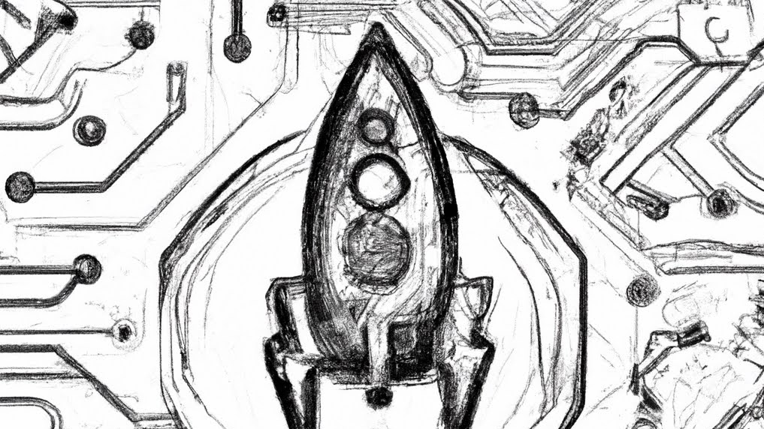
Printed Hybrid Electronics (PHE) in a Flight Environment: 3D Printed Electronics on Suborbital Technology Experiment Carrier 9 (SubTEC-9)
Beth Paquette/ NASA GSFC
Jason Fleischer/Laboratory for Physical Sciences
To be presented by Beth Paquette and Jason Fleischer at the Electronic Parts and Packaging (NEPP) Program’s Electronics Technology Workshop (ETW), Greenbelt, MD, June 12-15, 2023
1

Slide 2
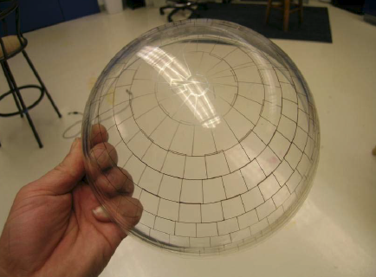
Printed Hybrid Electronics (PHE)
Printed Hybrid Electronics (PHE) – additive manufacturing technique where electronic circuits are fabricated by depositing materials onto an existing substrate without the use of masking or etching, and using existing electrical components
Advantages:
Fine feature sizes down to 20-30 microns
Variety of substrates – flexible, rigid, 3-dimensional non-planar
Demand for increased sensitivity and performance
Reduced size weight and power (SWaP)
Subsystem miniaturization can increase the SWaP available for instruments, thereby increasing the science return for a mission
Applications:
Hard Energy X-Ray Photoelectric Polarimeter (HXPP) detector strips
Next Generation Microshutter Arrays (NGMSA) interconnects
Microcontroller Circuitry providing telemetry data
EMI shield [Optomec]

Slide 3
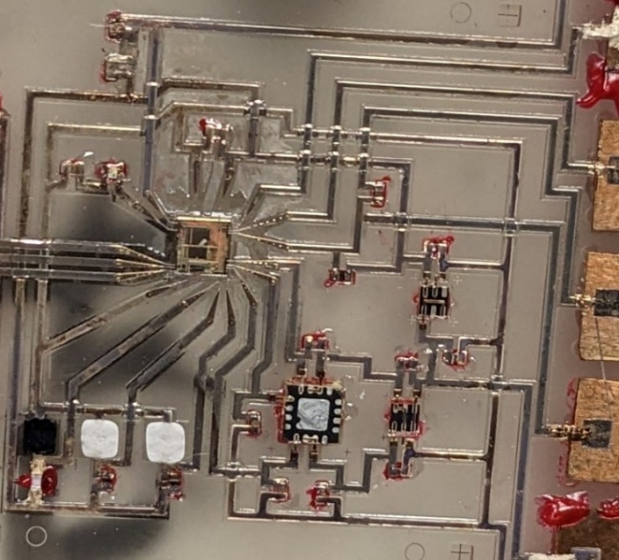
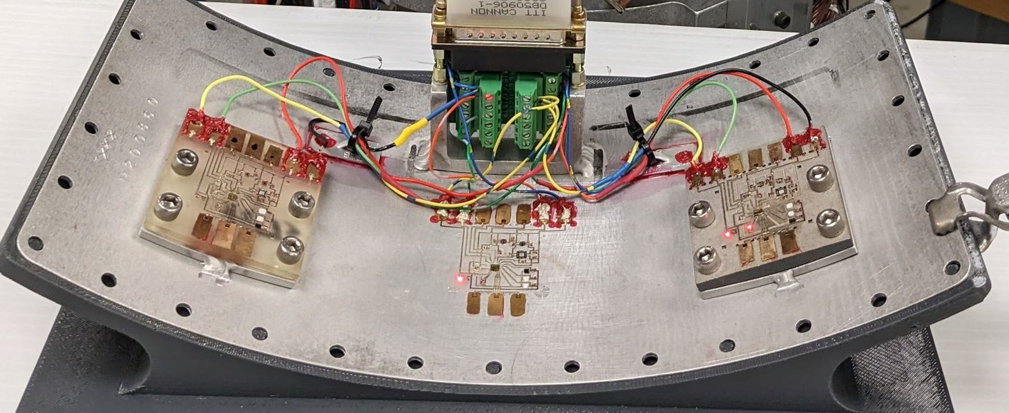
PHE Experiment Objective
Additively Manufacture Arduino-type microcontroller Circuits, including temperature and Humidity sensors on the inside of a sounding rocket payload door in a waterproof section
Collect data and recover circuits from experiment to evaluate performance over flight and robustness of the circuits
This experiment provides environmental data on the technology that we did not have before!
Thermally insulated, swappable
Thermally connected, swappable
Thermally connected, directly on door
12 inch x 6 inch curved aluminum door panel
To be presented by Beth Paquette and Jason Fleischer at the Electronic Parts and Packaging (NEPP) Program’s Electronics Technology Workshop (ETW), Greenbelt, MD, June 12-15, 2023
3
Notes:
list of document section numbers, topics and presenters
3

Slide 4
PHE Circuit Details
Cavities were milled out of or printed with the substrate
Components were placed upside down in the cavities
Insulating “moats” were added around the components
Traces were printed to the pads on the components to complete the circuit – multiple layers
Voltage Regulators
Accelerometer
Passive Components (circled)
Syringe Printed Temperature and Humidity Sensors
Microcontroller bare die, unencapsulated
To be presented by Beth Paquette and Jason Fleischer at the Electronic Parts and Packaging (NEPP) Program’s Electronics Technology Workshop (ETW), Greenbelt, MD, June 12-15, 2023
4

Slide 5
Rocket and Flight Details
Suborbital Technology Experiment Carrier 9 (SubTEC-9)
14 Experiments on board
20 ft long payload, Terrier-Improved Malemute Vehicle
181.5km altitude
Launched from Wallops Island, VA April 25, 2023
12 minute flight
Sub-TEC 9 Launch [Youtube]
To be presented by Beth Paquette and Jason Fleischer at the Electronic Parts and Packaging (NEPP) Program’s Electronics Technology Workshop (ETW), Greenbelt, MD, June 12-15, 2023

Slide 6
Post-Flight Analysis:
Flight Data
Monitored PHE circuit health during flight in real-time
Received telemetry data recorded from flight
Analyzing data from events leading up to flight, including vibration tests, payload buildup, and dress rehearsal
Thermally insulated, swappable
Survived until T+47s
Thermally connected, swappable
Did not work since integration
Thermally connected, directly on door
Survived the entire flight
To be presented by Beth Paquette and Jason Fleischer at the Electronic Parts and Packaging (NEPP) Program’s Electronics Technology Workshop (ETW), Greenbelt, MD, June 12-15, 2023
6
Notes:
list of document section numbers, topics and presenters
6

Slide 7
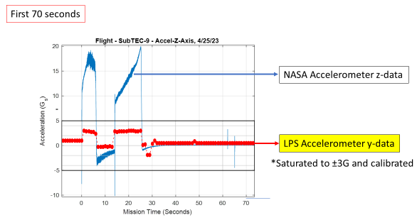
Post-Flight Analysis:
Flight Data
Preliminary findings from flight:
Thermally insulated, swappable circuit
T+37 seconds: on the sensor data channels show a spike up prior to not functioning
T+47 seconds: The Main Payload PHE current increases
Thermally Connected Circuit printed directly on door:
Rebooted at T+47 seconds
Continued to function properly the rest of the flight
Acceleration and sensor data follows main payload data
To be presented by Beth Paquette and Jason Fleischer at the Electronic Parts and Packaging (NEPP) Program’s Electronics Technology Workshop (ETW), Greenbelt, MD, June 12-15, 2023
7
Notes:
Good accelerometer response

Slide 8
Post-Flight Analysis:
Next Steps
Additional inspection and analysis in Goddard’s Parts Analysis Lab to have a complete picture of the flight
Independent functional testing
Visual External Inspection
X-Ray Inspection
Visual inspection of Connector and wiring
Report out any areas where further analysis may be required
To be presented by Beth Paquette and Jason Fleischer at the Electronic Parts and Packaging (NEPP) Program’s Electronics Technology Workshop (ETW), Greenbelt, MD, June 12-15, 2023
8

Slide 9
Special Thanks
Goddard Space Flight Center
Parts, Packaging and Assembly Branch
Brian Banks
Sean Donohue
Ahmed Ghalib
Cathy Hesh
Scott Hesh
Peter Hughes
Michael Johnson
Matthew Morrow
Tristan Epp-Schmidt
Chris Green
Wes Powell
Margaret Samuels
Joshua Yacobucci
Laboratory for Physical Sciences
Donghun Park
Dan Hines
Edwin Quinn
Marshall Space Flight Center
Curtis Hill
Ian Small
Jennifer Jones
Army Research Lab
Harvey Tsang
Sami Hawasli

Slide 10
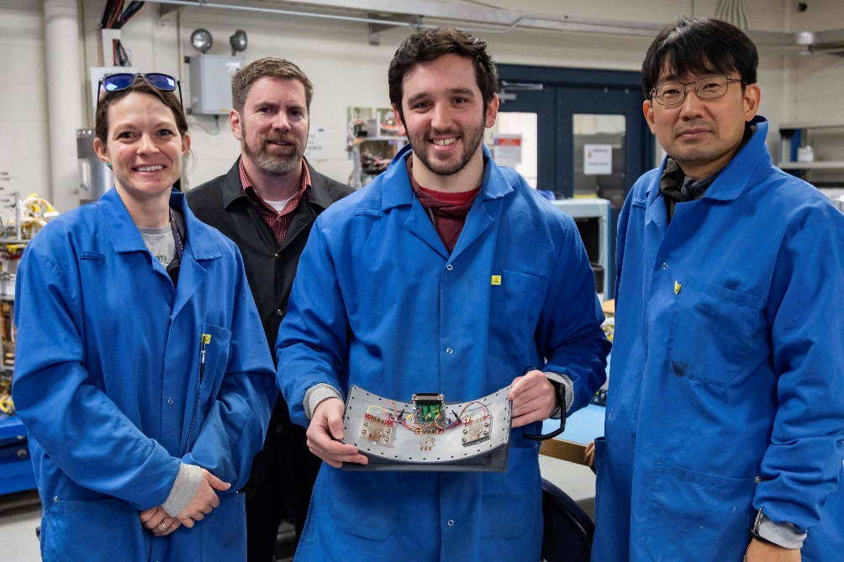
Thank you!
Printed Hybrid Electronics Team: From left to right: Beth Paquette/GSFC, Brian Banks/GSFC, Jason Fleischer/Laboratory for Physical Sciences (LPS), Donghun Park/LPS. Photo by Berit Bland
Questions?
Contact:
beth.m.paquette@nasa.gov

Slide 11
Acronyms
Acronym | Definition
PHE | Printed Hybrid Electronics
PCB | Printed Circuit Board
SWaP | Size Weight and Power
SubTEC | Suborbital Technology Experiment Carrier

