Slide 1
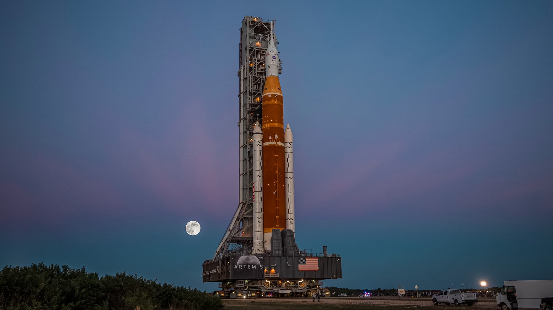


Applied Spaceflight and Artemis I
Tim Atkins
Tim Atkins | Senior Engineer
SLS Avionics & Electrical Integration
TriVector Services, Inc.
Visiting Lecturer, Erskine Fellow
University of Canterbury
August 2023

Slide 2
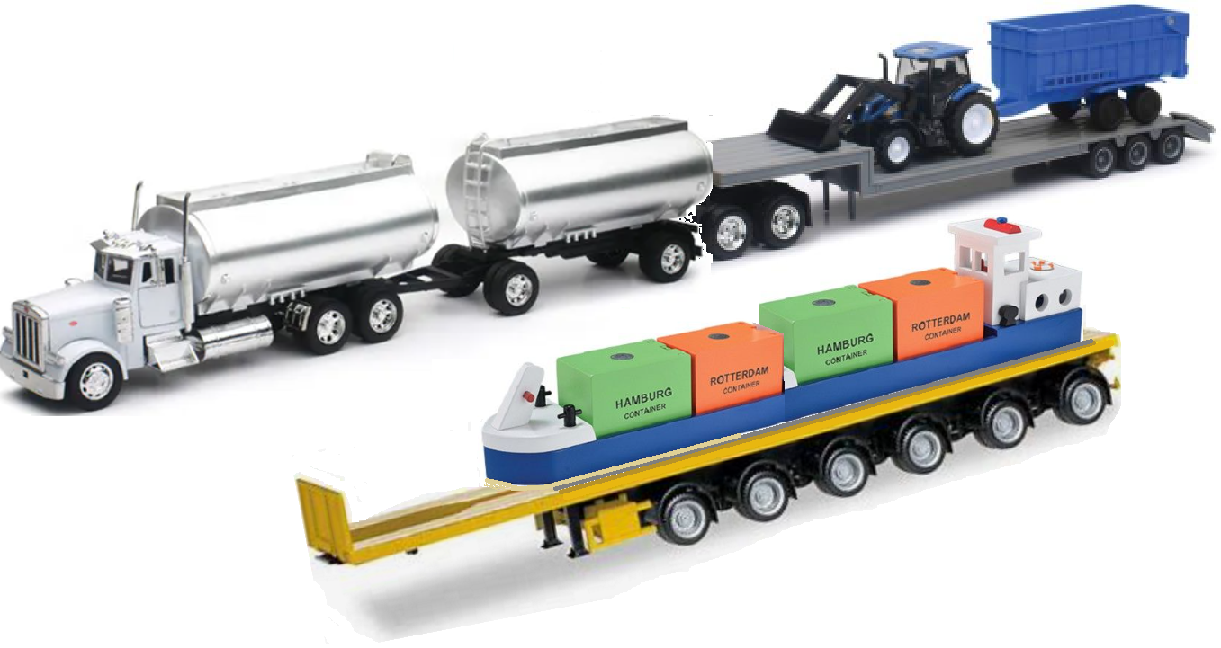


Rocket Staging
Imagine a mission…
Build a small cabin atop Mount Ruapehu
Explore the area for a month with 2 other Ruapehunauts
However…
The only available vehicles and fuel are here in town
Surface
Boosters separate at a desired ΔV…
Space
1. Boosters (with Core Engines) provide high thrust through atmosphere
Then Core separates at desired ΔV
2. Core Engines continue, then the stage releases ICPS into its orbit
This LAS is gone early
{
3. ICPS conducts small burns in its orbit,
then separates at desired ΔV for Orion’s TLI
Notes:
Imagine a mission… In this case, we won’t worry about returning. But you could plan for fuel to get your tractor to a nice downhill trajectory…
Prior to launch, Core Stage Engines ramp up, then Boosters (solid , aka 1st stage) ignite to kick-start SLS and Orion through the atmosphere – as in “low gear”. Boosters (in conjunction with Core Engines) phase provide the highest thrust during initial minutes of flight. REVIEW FUEL TYPES.
Core Engines (LH+LOX) continue several minutes into a trajectory that inserts Upper Stage (ICPS) into a very specific orbit.
Then Upper Stage (ICPS) conducts a few burns – one very long one at the end – to point Orion to the Moon and be disposed into space.
Orion has some fuel to make minor in-space maneuvers. (Note the Launch Abort System is jettisoned soon after launch.)
Mention LAS = Launch Abort System is jettisoned soon after launch…

Slide 3
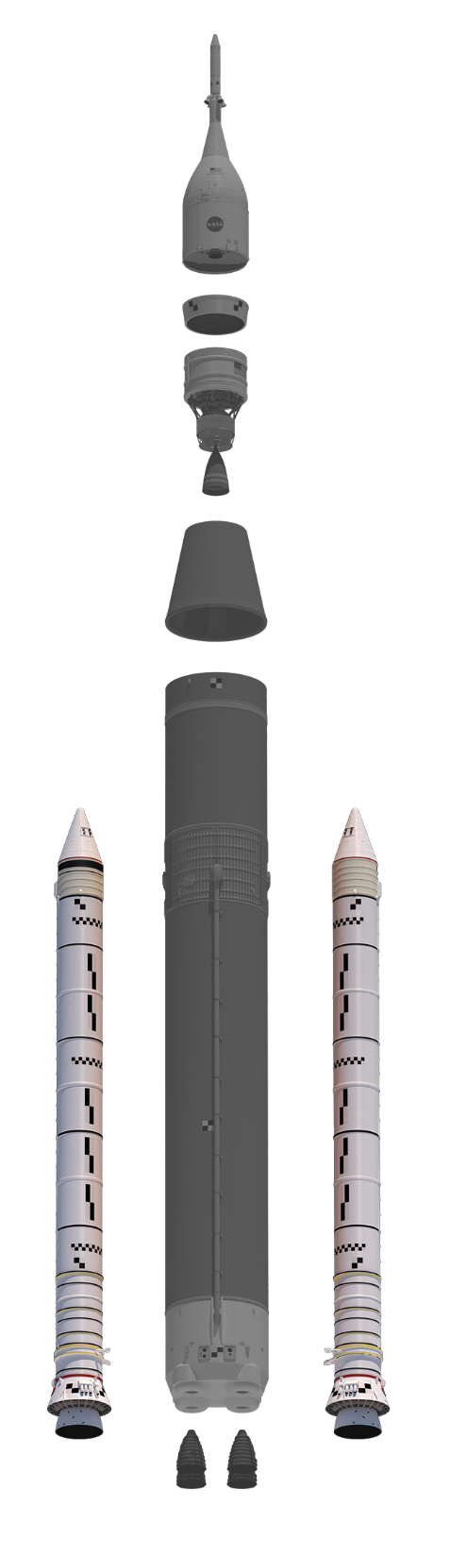
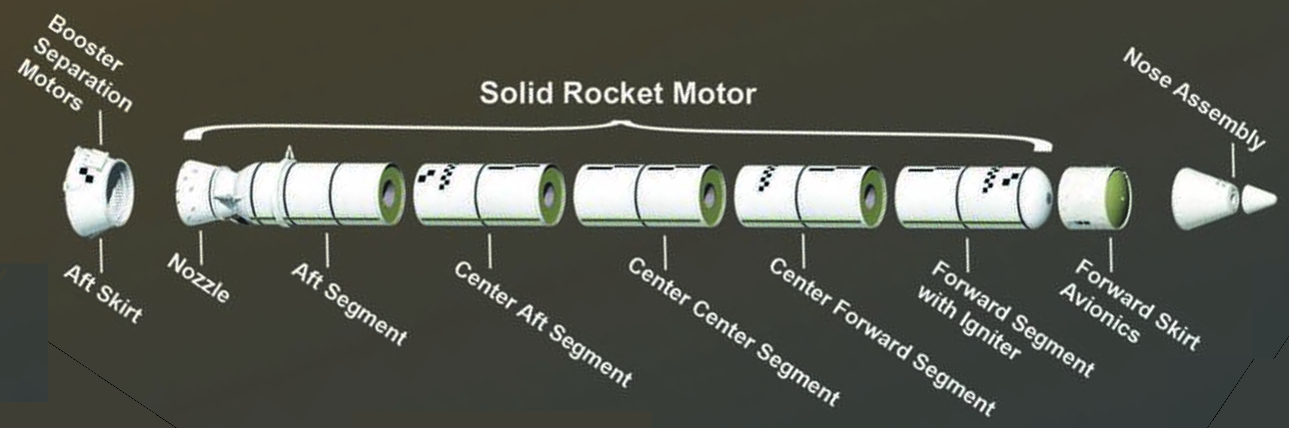
SLS: Booster Stage
Ignition at T-0
with RS-25 engines already ramped up
The combined thrust powers the stack through the stratosphere.
Boosters separate using explosive bolts.
Then drop into the ocean
RS-25 engines continue on
Each Booster:
has 5 segments (Shuttle Boosters had 4)
burns 693 tons of propellant for 126 sec
produces 16 million N (3.6 m lb) thrust
motor chamber gases reach > 2800°C
3.7m (12’) diameter, 54m (177’) tall
Notes:
5.5 tons of propellant / second. polybutadiene acrylonitrile (PBAN), for 126 s (so 693 t prop, 5.5 t / se c).
Temp of the motor chamber gases reach > 2800°C (5000°F) – hot enough to boil steel
16 million N (3.6 million lbs) of thrust is > 14 Boeing 747s at full power
For Artemis I, Boosters performed flawlessly.

Slide 4
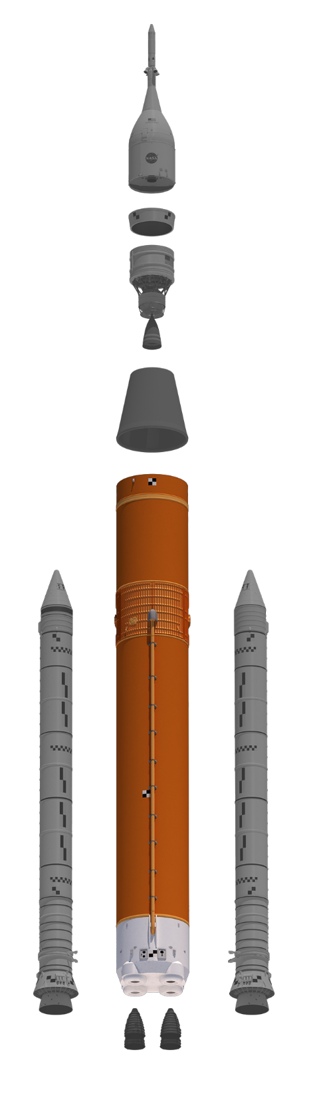
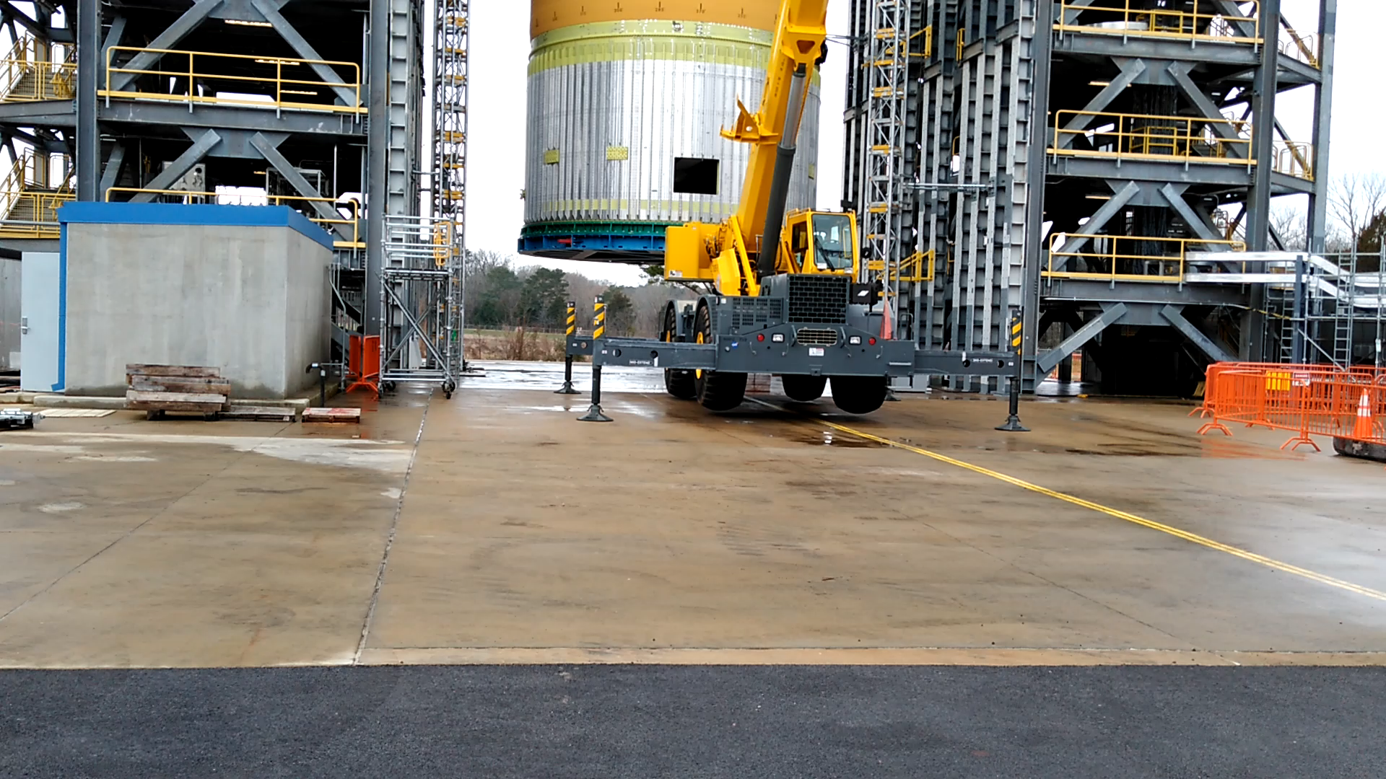
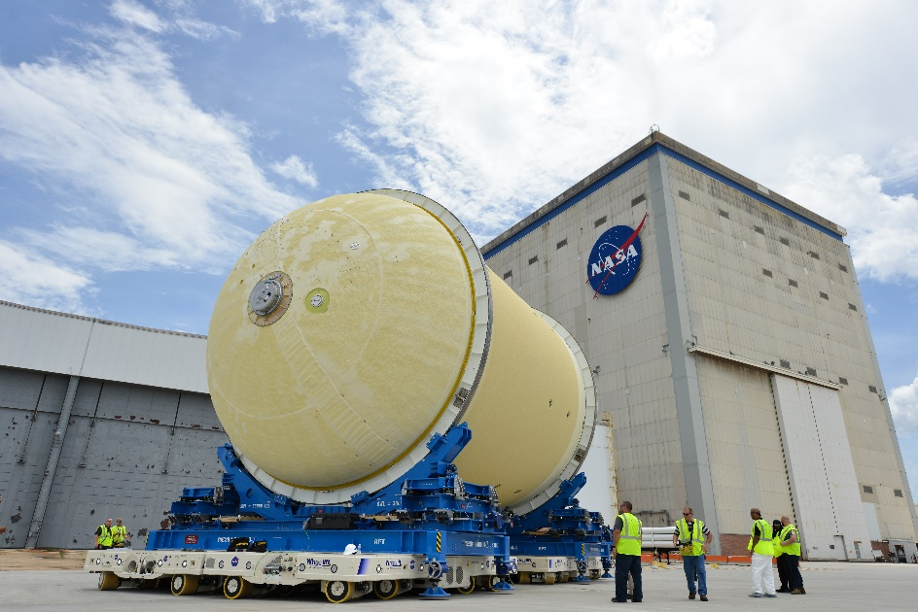
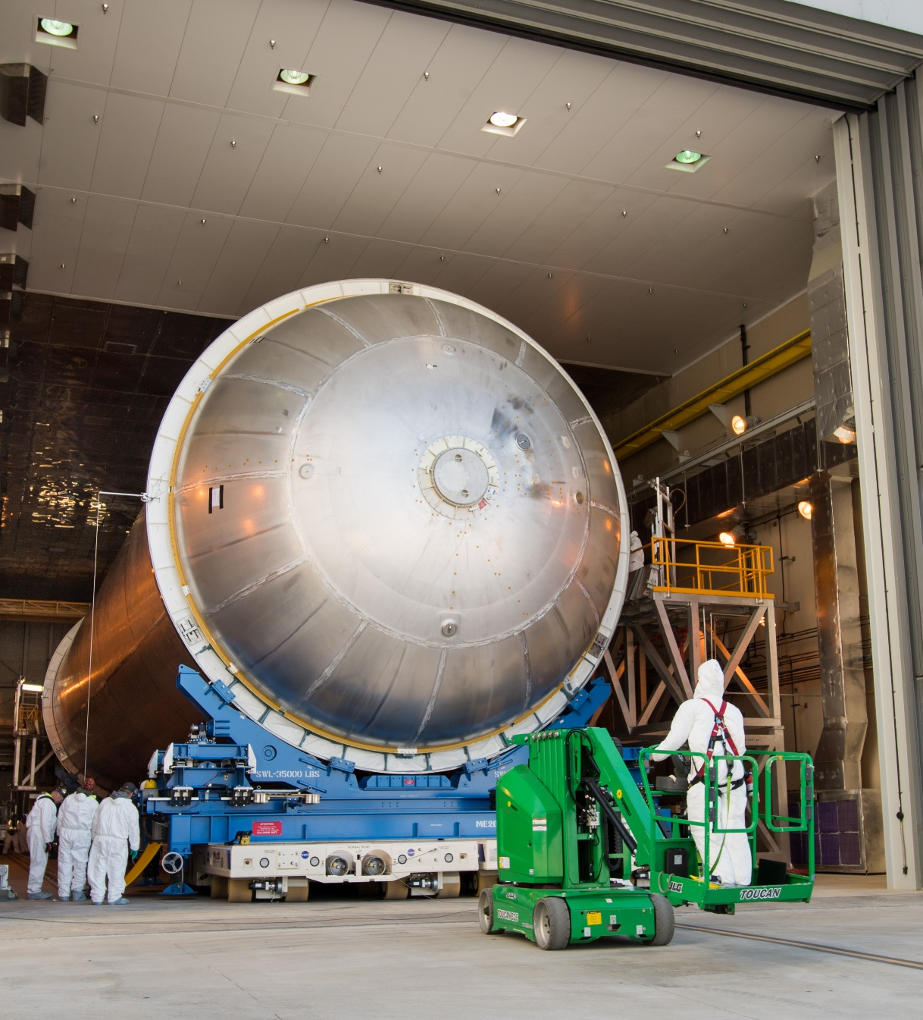
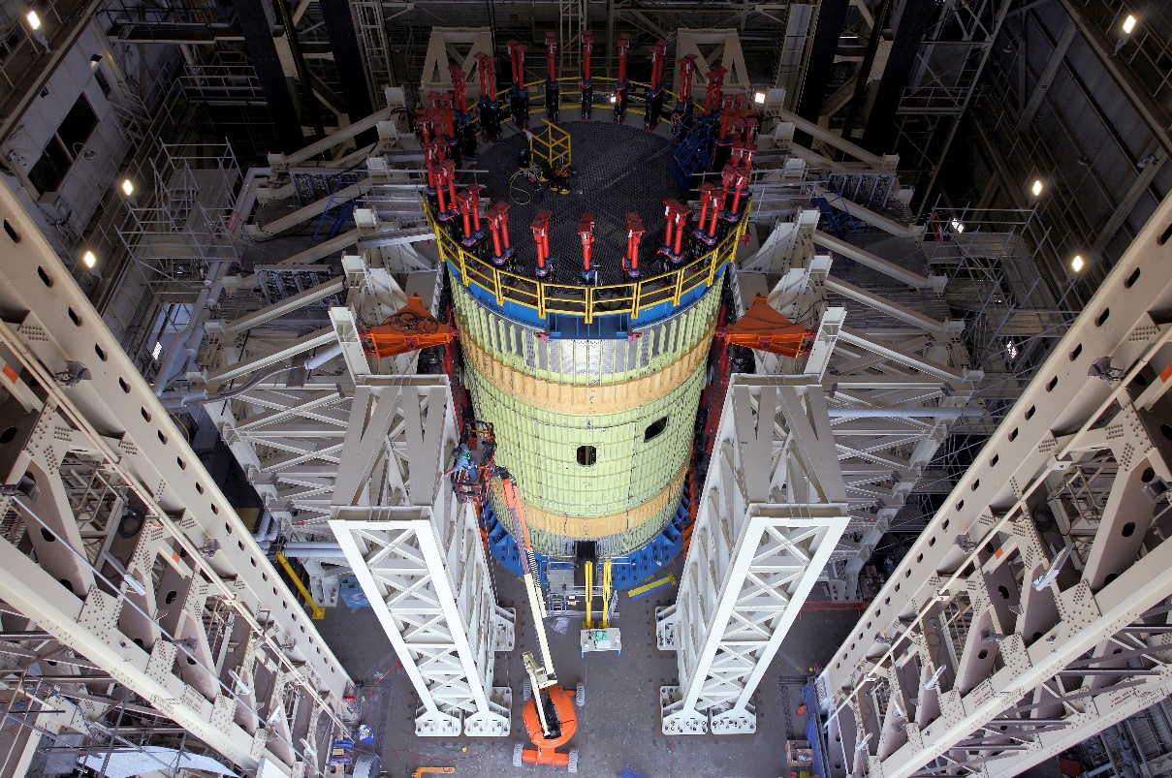
SLS: CORE STAGE
Core Stage uses four RS-25 engines which have been continuously matured for decades
  Space Shuttle was powered by three
Each engine
  Has a thrust of >2200 kN (>500k lb)
The most reliable, efficient rocket engine built.
  If your 200HP car engine was as efficient as an RS-25 it would fit in the palm of your hand.
Notes:
Top Left: Rocket tanks experience extreme temperatures from cold propellants to friction-heat as they soar through Earth’s atmosphere into space. An innovative robotic system sprayed thermal protection foam on the tank, shown here, that holds the cryogenic liquid oxygen propellant. Engineers vertically stacked the tank with the intertank and forward skirt, which form half of the 212ft (~65m)-tall rocket core stage.
Bottom left: Intertank structural test hardware in a test stand. The test version of these sections were pushed, pulled and bent with millions of pounds of force to ensure they could withstand the forces of launch and ascent. The test hardware is structurally identical to the flight version of the intertank that connected the 2 fuel tanks, serve as a connection point for the two boosters and house avionics.
Right: LH tank preparing to be primed before thermal protection system application (foam insulation.)
212 feet tall (64.6 m) and 27.6 ft. (8.4 m) in diameter~1000 MT (2.3 m pounds) when fueled.
It has > 4m parts. 562 cables totaling > 45 mi (70 km).
LH tank is > 130’ (40 m) tall (almost 2/3 CS height); holds 537k gal (>2m L) of LH2 at (-253°C/-423°F).
Built using state-of-the-art manufacturing tools, including the world’s largest friction-stir welding tool, the Vertical Assembly Center.
A tremendous number of engineering problems. E.g., LH2 and LOX are very cold: LH2 has to be stored at ~20° above absolute 0 (-253°C/-423°F). The hydrogen tank shrinks ~6” (15 cm) in length and ~an “ (couple cm) in diameter when filled with propellant. The liquid oxygen tank shrinks proportionally. To compensate for those changes, everything that attaches to them – ducts, vent lines, systems tunnel, brackets, etc. are connected by accordion-like bellows sections, slotted joints, telescoping sections, or ball joint hinges.
VIDEO: LH2 tank test article in test stand at Marshall in 2019
Space shuttle was powered by RS-25 engines which have been continuously matured for decades.
Shuttle had 3 engines; SLS has 4, which have been further upgraded with current technology.
Most reliable efficient rocket engine ever built; if a 200HP car engine was as efficient as an RS-25 it would fit in your hand.
Each burns roughly 1500 L fuel / sec; >500k lbs (>2.2 megaNewton) thrust each.
For Artemis I, Core Stage performed flawlessly.

Slide 5
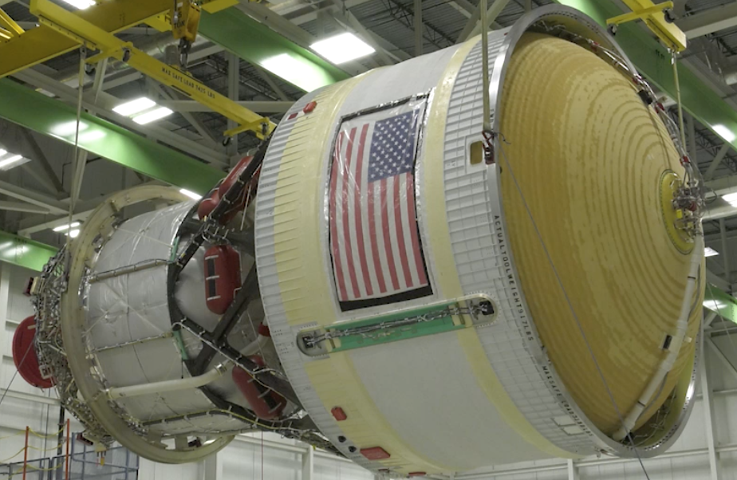
SLS: INITIAL UPPER STAGE
“Interim” Cryogenic Propulsion Stage (ICPS)
13 m (43’) tall, 5 m (17’) diameter
LH / LOX propellant
One RL10 Engine
110 kN (24,750 lb) max thrust during translunar injection (TLI)
Notes:
ICPS is a single-engine LH/LOX system that provides in-space propulsion after Core Stage is jettisoned.
ICPS gave Orion the push needed to fly beyond the moon; it’s a modified Delta Cryogenic 2nd Stage, a proven upper stage used on ULA’s Delta IV
ICPS is powered by one RL10 engine which generates 25k lbs. of max thrust.
The RL10 is a liquid-fuel rocket engine built in US by Aerojet Rocketdyne that burns cryogenic LH and LOX. Its specific application has been for in-space propulsion of upper stages. The initial RL10 was the first LH engine in the US, with development by NASA beginning in the 1950s and continuously upgraded since. Three recent versions are in production for the Atlas V and Delta IV. Three more versions are in development for the SLS EUS and the Vulcan upper stage.

Slide 6
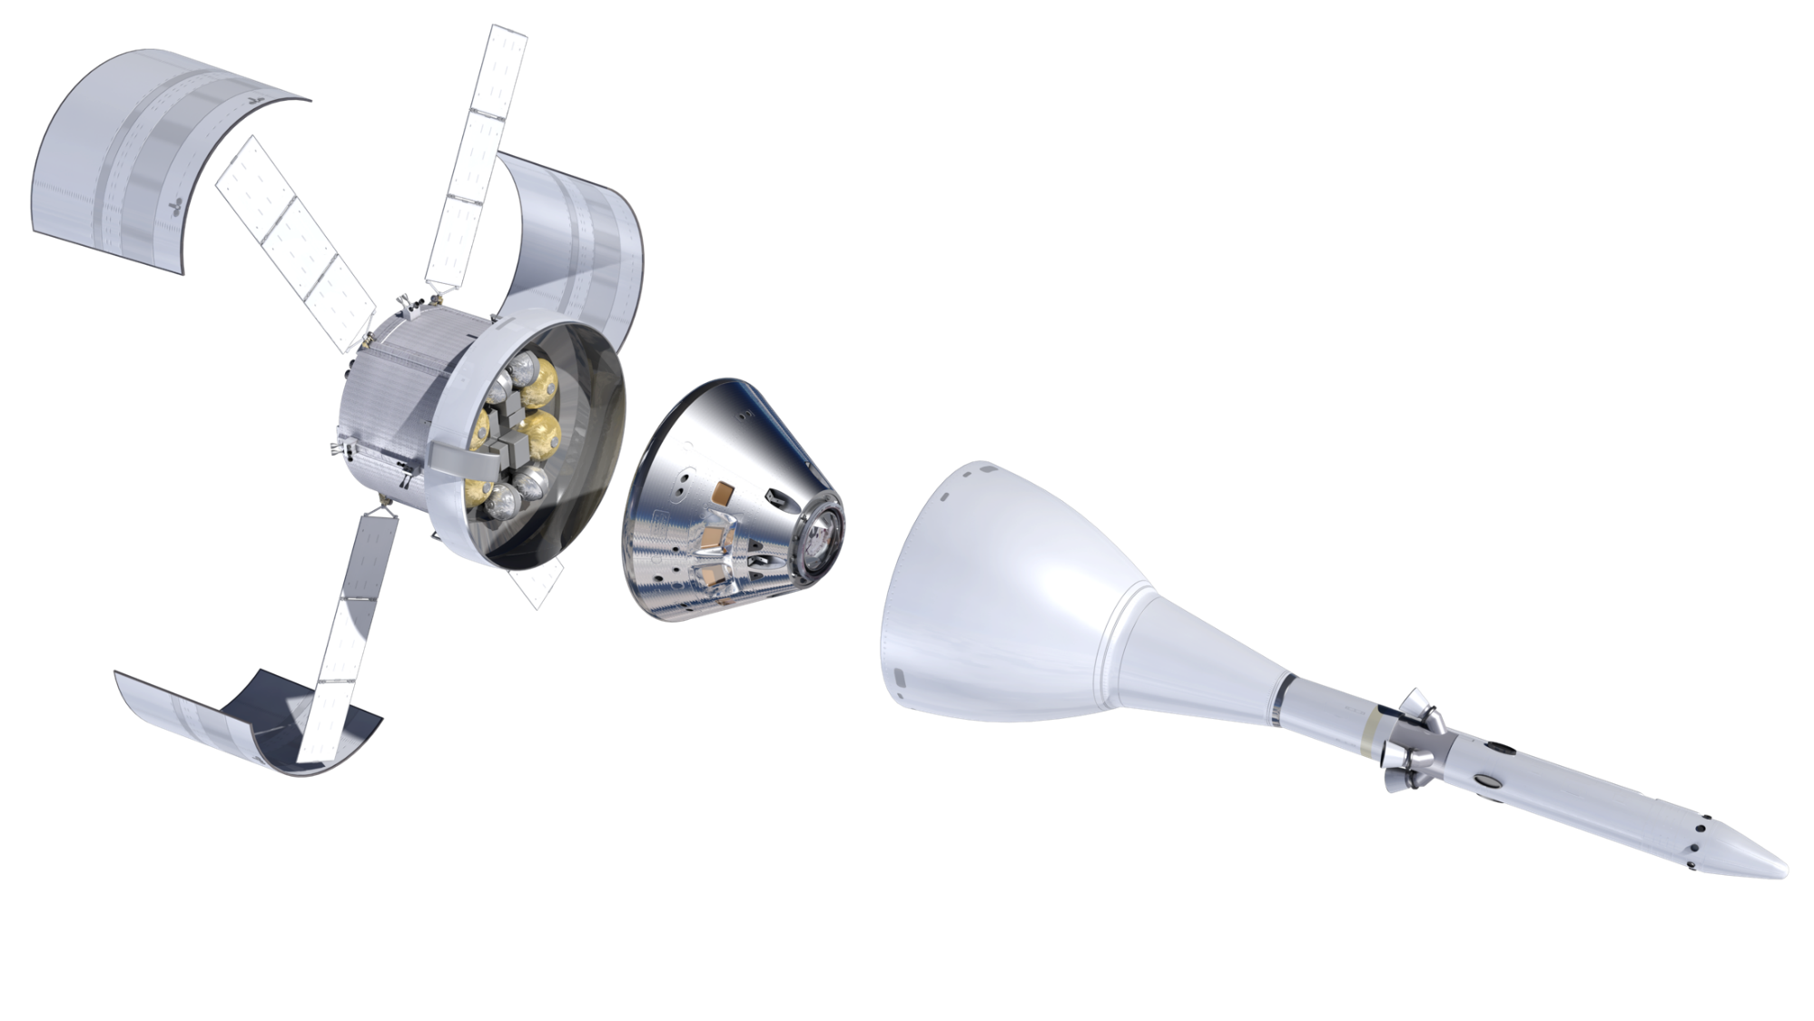
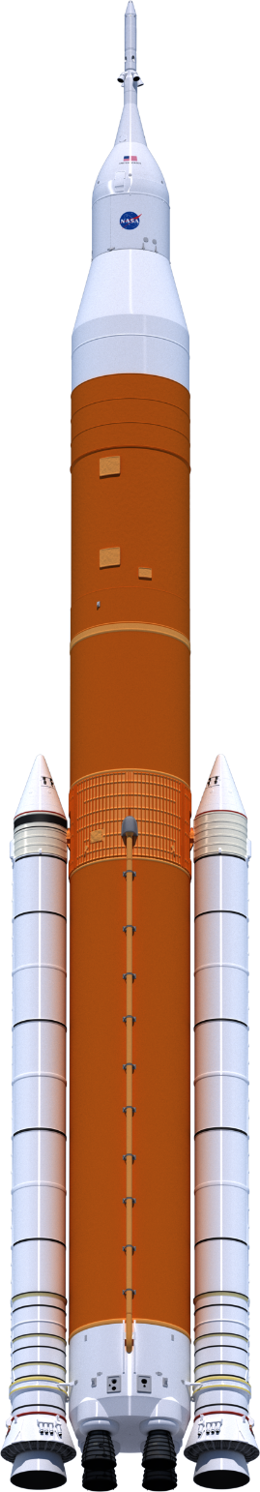
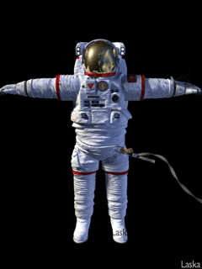



THE PAYLOADS
> 3,300 ºC
Crew Module
Launch
Abort
System
43,000 kph
Orion
European Service
Module
Shuttle
Commercial Jet
Notes:
Orion can carry up to 4 astronauts; can be unattended for 6 months in orbit when docked to Gateway (designed for upgrades to support future missions up to 1,000 days). (https://www.lockheedmartin.com/en-us/news/features/2022/orion-eleven-things.html)
Heatshield can withstand temperatures up to 5400 °F (3300 °C) (~ ½ temp of Sun’s surface) & protect humans.
Small rocket: Launch Abort – available during initial ascent, disposed after ~3 mins.
Orion returned to Earth at a speed of up to 27k mph (43k kph) – periodically skipping on atmosphere to reduce net drag.
Svc Module was developed by the Euro Space Agency (Artemis is an international effort)

Slide 7
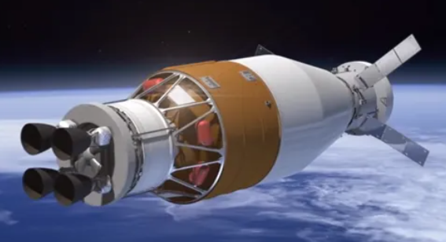
SLS: IMPROVED UPPER STAGE
Exploration Upper Stage
Larger propellant tanks than ICPS, with four RL10 engines, so…
  430 kN (97k lb) thrust during TLI
  40% more payload to the Moon (and beyond): 38,000 kg (83,000 lb) of cargo - such as a small lunar habitat - in one crewed mission
EUS is much heavier than ICPS, resulting in different staging:
When ICPS separated from Core Stage, the spent stage continued across continents and dropped into the Pacific Ocean.
When EUS separates from Core (earlier), the spent stage briefly continues ascent, then falls into the middle of the Atlantic Ocean.
Notes:
ICPS disposal for A01 was helio; A02 will use Earth disposal
https://www.nasa.gov/exploration/systems/sls/multimedia/rocket-to-the-moon-what-is-the-exploration-upper-stage.html
Starting with Artemis IV, the EUS will be used on the rocket’s advanced Block IB configuration. The EUS will replace the ICPS. Compared to the single-engine ICPS, the EUS has larger propellant tanks and four RL10 engines. EUS provides 97k lb of thrust during TLI versus nearly 25 klb of thrust from ICPS.
You can also see how rockets and stages are optimized for certain missions: a system designed for LEO is much different than for deep space.

Slide 8
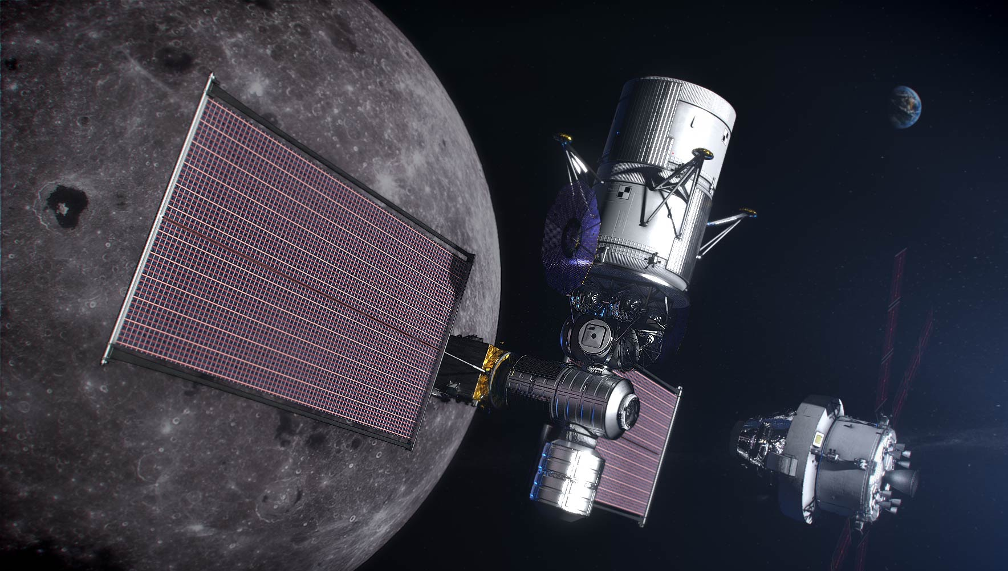
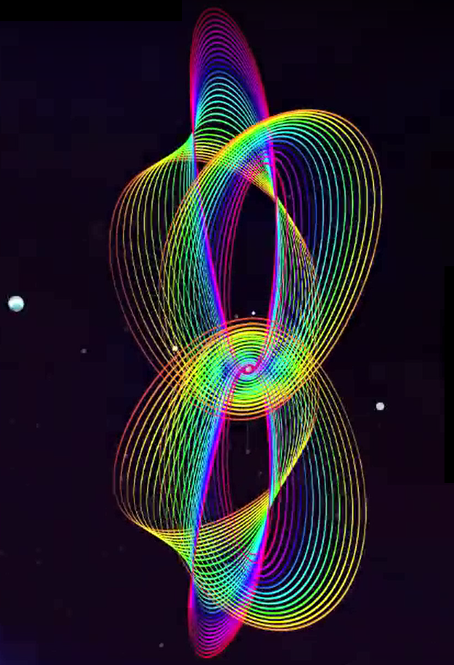
GATEWAY FOR LUNAR MISSIONS AND BEYOND
Lunar Landing System (Ascent, Descent, Transfer)
Earth
Orion with European
Service Module
Near Rectilinear Halo Orbits
L1
L2
Gateway
Lagrange Points
Davis, D. et. al (2017): Orbit maintenance and navigation of human spacecraft at cislunar NRHOs
Notes:
The next mission is about sustainability – a continuous presence on the Moon. One key is the Lunar Gateway.
Gateway will be a permanent station around the Moon.
It interfaces with the ESM, which supplies Orion with electricity, propulsion, thermal control, air and water.
Initial Gateway focuses on the systems required to support a human landing - and also sets the stage (literally) for next phases.
Provides command center and aggregation point for human landing
Building block for the future, expanded capabilities on and around the Moon
Modules will be built by NASA with Euro, Japanese Space Agencies; others support (Canadian space agency, for example, is providing the robotic arm)
It will be in a near-rectilinear halo orbit (NRHO) around the moon balanced between the Earth’s and Moon’s gravity. Solar electric propulsion (very light thrust) to maneuver and support docking access.
From Davis, D. et. al (2017): Orbit maintenance and navigation of human spacecraft at cislunar NRHOs - Sample NHROs. A large, elongated orbit and enables the gateway to:
Use minimal propellant for orbital corrections (very stable orbit)
Offers inexpensive (in term of energy) transfers from Earth, to the Moon’s surface, and trajectories beyond the Moon
Minimize blocking of sunlight by Earth or Moon (support the gateway’s solar panels)
Keep the spacecraft within LOS of Earth, for ground controllers
The NRHO selected for the gateway is a 7-day path around the Moon.
As close as 3,000 km (1,865 mi) and up to 70,000 km (43,500 mi).

Slide 9
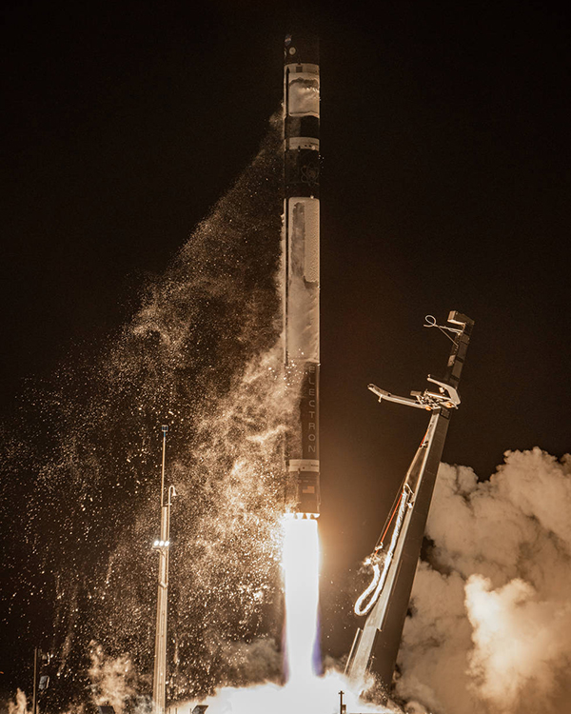
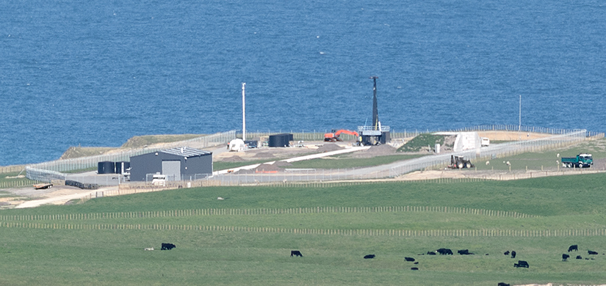
CAPSTONE
Cislunar Autonomous Positioning System Technology Operations and Navigation Experiment
Verifying a specific orbit to be used by the Lunar Gateway space station
Launched June 2022 on a Rocket Lab Electron from Launch Complex 1 on the tip of the Māhia Peninsula
Notes:
More charts from public source
www.space.com article "NASA's tiny CAPSTONE probe snaps 1st photo of the moon, begins extended mission."

Slide 10
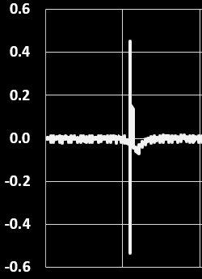
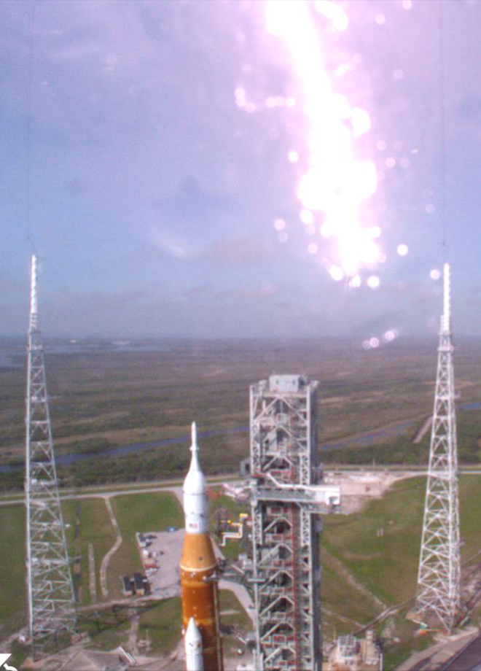
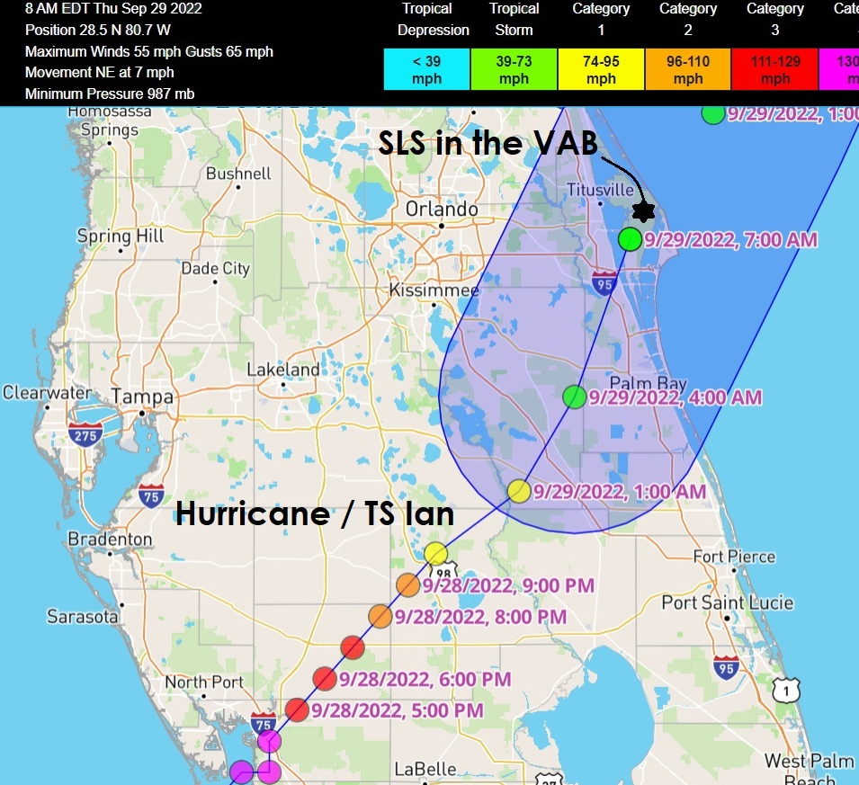
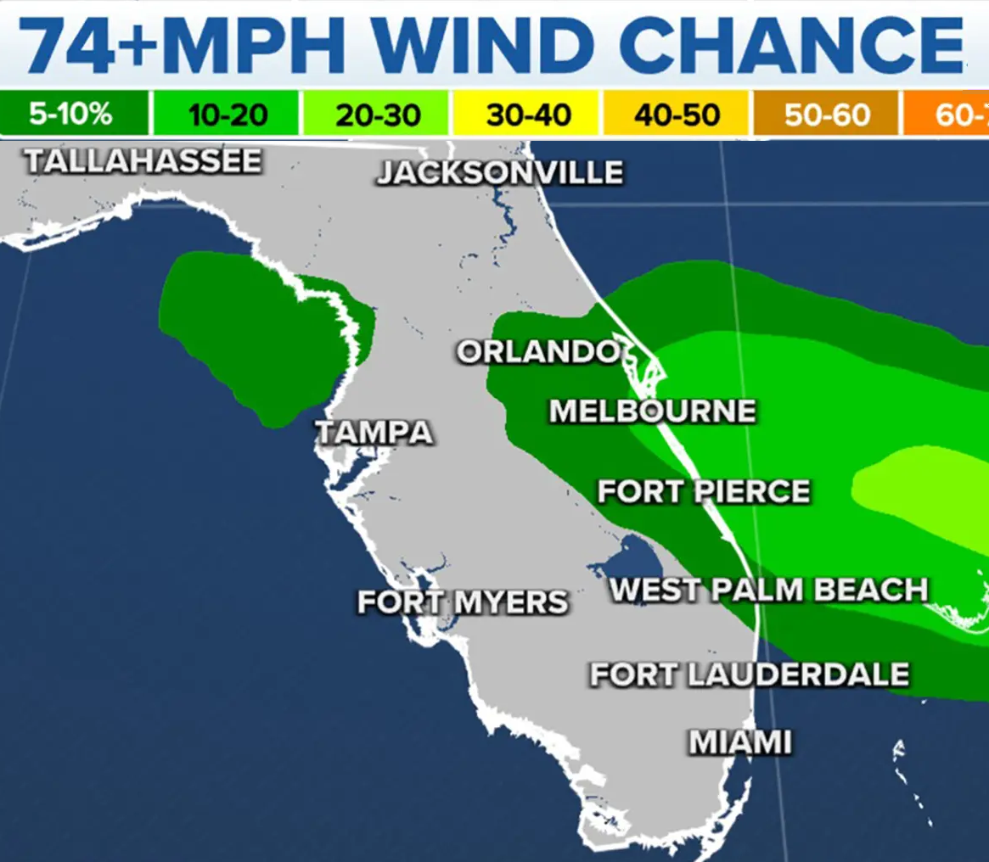
SLS SurvivED the Storms of 2022
Lightning Strike
(April)
SLS is → designed for winds up to 136 kph (85 mph) on the launch pad.
During a trip to the VAB, it could only tolerate winds of ~half that.
Hurricane Ian
SLS Safely in the VAB
← The lightning protection system worked flawlessly against the most powerful strike ever at KSC – with avionics powered on!
Hurricane Nicole (SLS Rode Her Out)
Notes:
The lightning protection system at the launch pad includes three 200m / 600’ towers and catenary wires positioned to protect SLS, Orion, and mobile launcher. The wires run to the ground diagonally, and steered the lightning current away from the stack.
This was the most powerful lightning strike ever recorded at NASA’s Kennedy Space Center and occurred during a rehearsal on 2 April 2022 with all avionics powered on. In fact, many SLS instruments recorded the strike, so we went ahead and validated SLS clocks using this event!
Hurricane Ian (27-29 Sep); Hurricane Nicole (8-9 Nov); Lightning Strike (2 April)
However, during a 12-hr trip back to the VAB, it can only tolerate winds of ~half that without risk of toppling over.

Slide 11
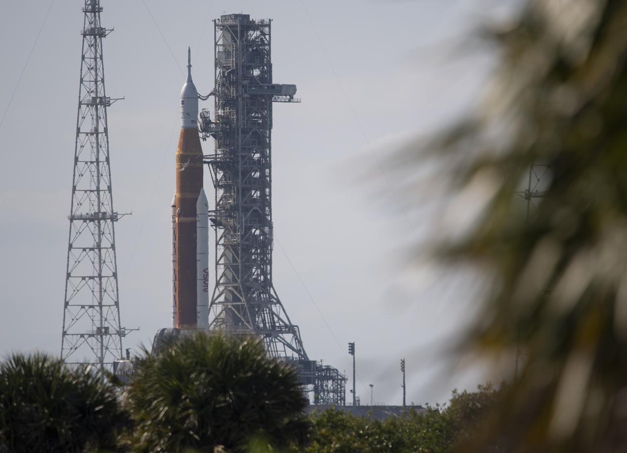
the Power of a Wrench
NASA article https://www.nasa.gov/feature/artemis-red-crew-team-helps-enable-successful-launch

Slide 12
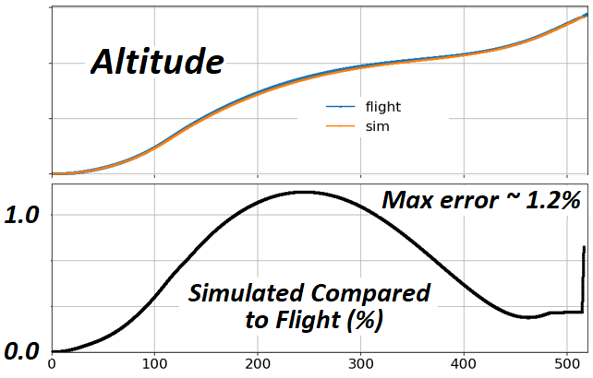
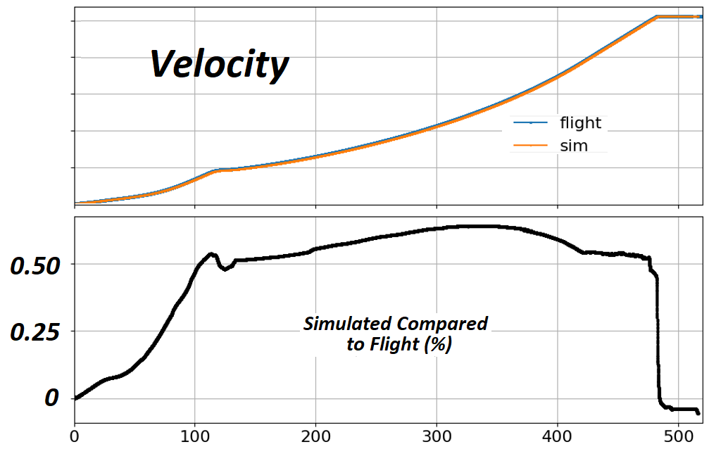
SLS Flight Models
Models predicted SLS flight
Validated against actual flight parms:
  Time of separation events
  Acceleration, Altitude, Velocity
  Body Rates: Pitch, Roll, Yaw
  Propulsion system pressures, thrust vector parameters, electrical power and loads
  Orbital Parameters Near Insertion:
  Periapsis, Apoapsis, RAAN, Inclination Angle, Eccentricity, Period, Semi-Major Axis
  Each separation event was < 1 s off
  Target orbital insertion was < 6 km off
  Insertion velocity was 99.64% accurate … symmetry in motio” - John Blevins, SLS Chief Engineer
example results
Notes:
Why model? Models predicted SLS flight AND SLS flight Validated the MODELS
Models were based on requirements. Simulations predicted flight, as validated by comparing Rocket Flight Parameters for SLS Boosters + Core Stage; SLS Core reached ~180 km altitude @ ~7.6 km/s. Alt and Relative Vel discrepancies shown here – very small.
Orbital parameters describe an elliptical orbit at Core separation. RAAN = Right Ascension of the Ascending Node and describes the longitude orientation of the orbit’s plane in inertial space.

Slide 13
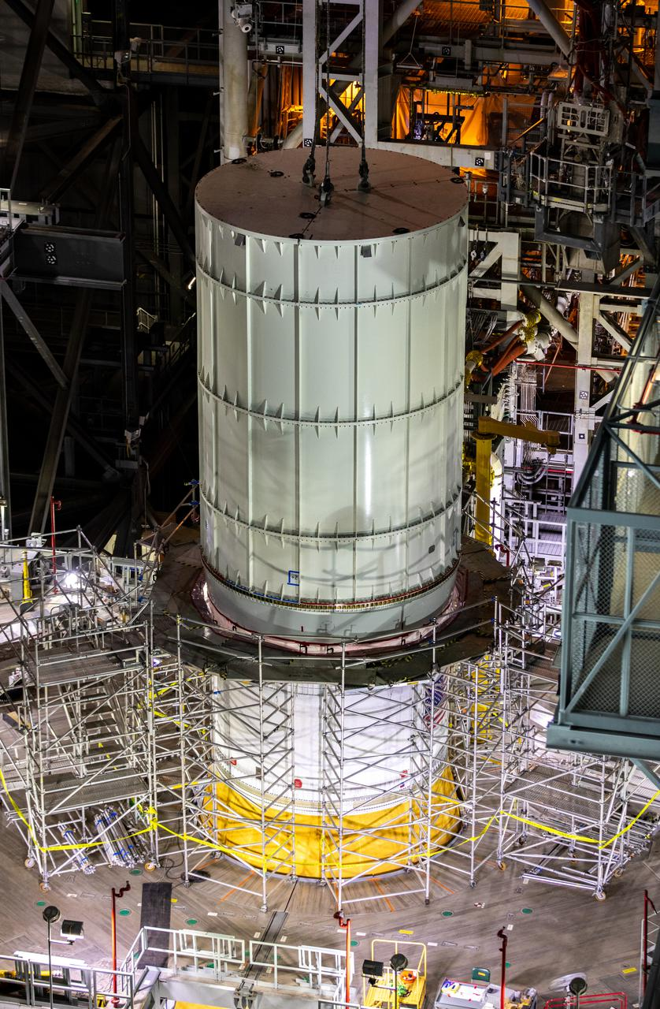
TESTED BEFORE FLIGHT
COMPREHENSIVE TEST PROGRAM
Green Run test series at Stennis Space Center
Avionics Systems Integration Lab
  > 7 years of simulated flyouts with fault management in a HWIL facility
Integrated Test and Check-Out series
  Modal Testing
  Interface Verification
  Communications End-to-end
  Umbilical Release and Retract
Dynamic Roll-out Test
Wet Dress Rehearsal
Cryo-Demo Test
Notes:
SLS was rigorously tested, and its performance is validated from the material level to each individual component, and from structure, to system, to integrated vehicle. The SLS Program completed the largest structural testing campaign since the space shuttle. From Integrated Test and Check-Out series - Modal Testing at https://gcc02.safelinks.protection.outlook.com/ap/p-59584e83/?url=https%3A%2F%2Fnasa-my.sharepoint.com%2F%3Ap%3A%2Fg%2Fpersonal%2Fwdsheppa_ndc_nasa_gov%2FEVEDxVV_MqBIqs2wIvE0DpABmnOsjkUjFvZk7Jm0grzMNg%3Fe%3DkKqZfo&data=05%7C01%7Ctim.atkins%40nasa.gov%7C8ec3031171ed47c8c43a08db8709d8fe%7C7005d45845be48ae8140d43da96dd17b%7C0%7C0%7C638252248939798213%7CUnknown%7CTWFpbGZsb3d8eyJWIjoiMC4wLjAwMDAiLCJQIjoiV2luMzIiLCJBTiI6Ik1haWwiLCJXVCI6Mn0%3D%7C3000%7C%7C%7C&sdata=4NugS%2FUQVmlAEpEbwnkRzbRwlSceKeYbCQAcD2%2BL9cM%3D&reserved=0

