Slide 1
AIOps for Large-Scale
IT Systems
Summer ESIP 2023
Ben Williams
EED-3 Platform Train Product Manager
ben.williams@wit-office.net
This work was supported by NASA/GSFC under Raytheon Technologies contract number 80GSFC21CA001.
This document does not contain technology or Technical Data controlled under either the U.S. International Traffic in Arms Regulations or the U.S. Export Administration Regulations.

Slide 2
What is AIOps ?
AIOps:
  Artificial Intelligence for Information Technology (IT) Operations
The application of artificial intelligence and machine learning (AI/ML) techniques to improve operations outcomes for IT systems

Slide 3
Problem Statement
Earth Science IT systems have increasing:
  Scale
  Complexity
  Diversity
  Inter-Dependence
Operations Teams and System Administrators face an increasing challenge keeping systems online, performant, cost efficient, and secure

Slide 4
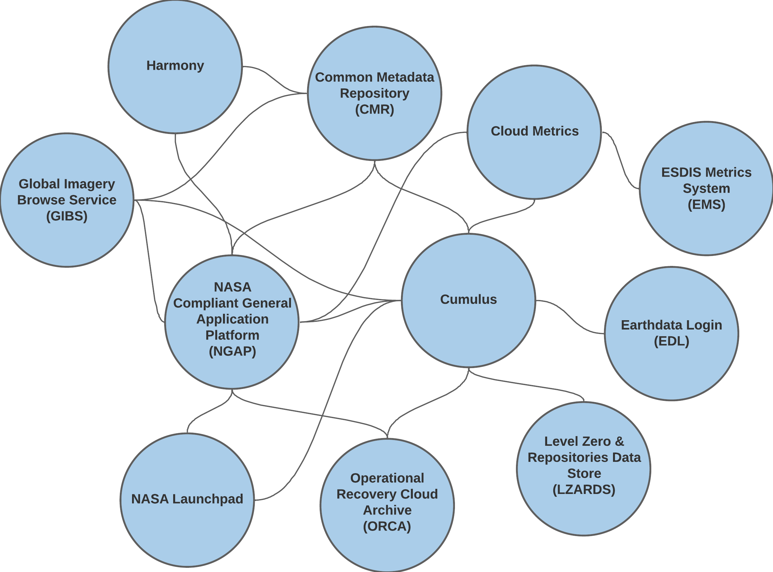
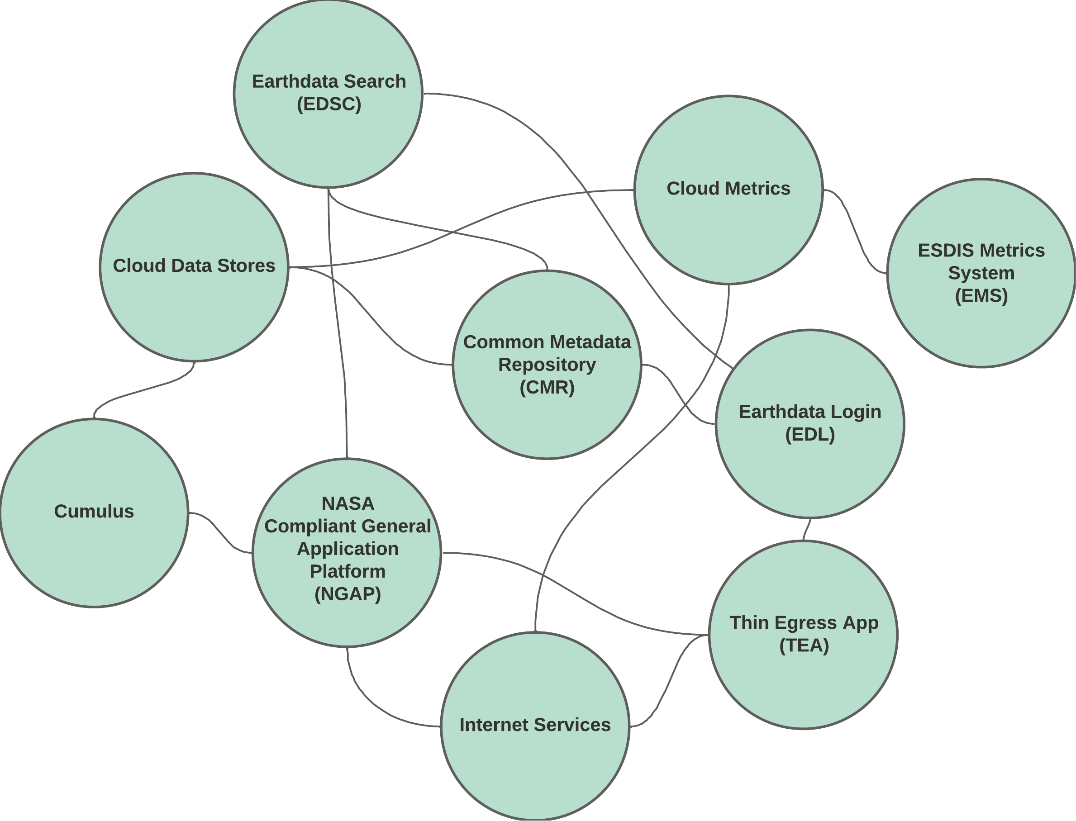

Earthdata Cloud: Key Systems
Mission Data Ingest*
Mission Data Distribution*
* woefully non-comprehensive summary
Image Source: NASA / GSFC Ben Williams
Image Source: NASA / GSFC Ben Williams
“Hey, there’s something up with [ ingest | distribution ] !?”

Slide 5
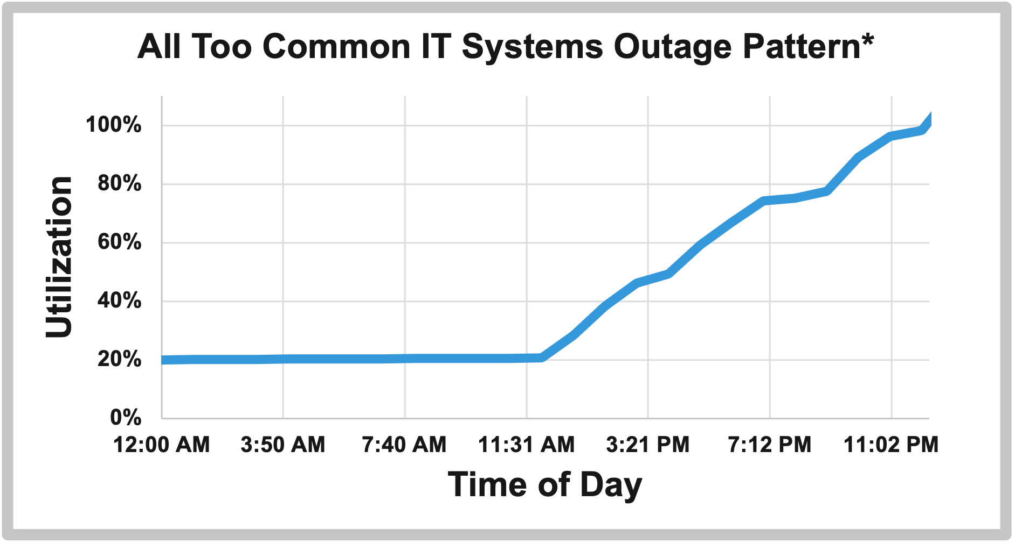
Traditional Approach
Logs and Metrics Collection
Pre-defined Alert Thresholds
Basic Operator Dashboards
*Fabricated example – no admins were harmed in the making of this chart
Image Source: NASA / GSFC Ben Williams

Slide 6
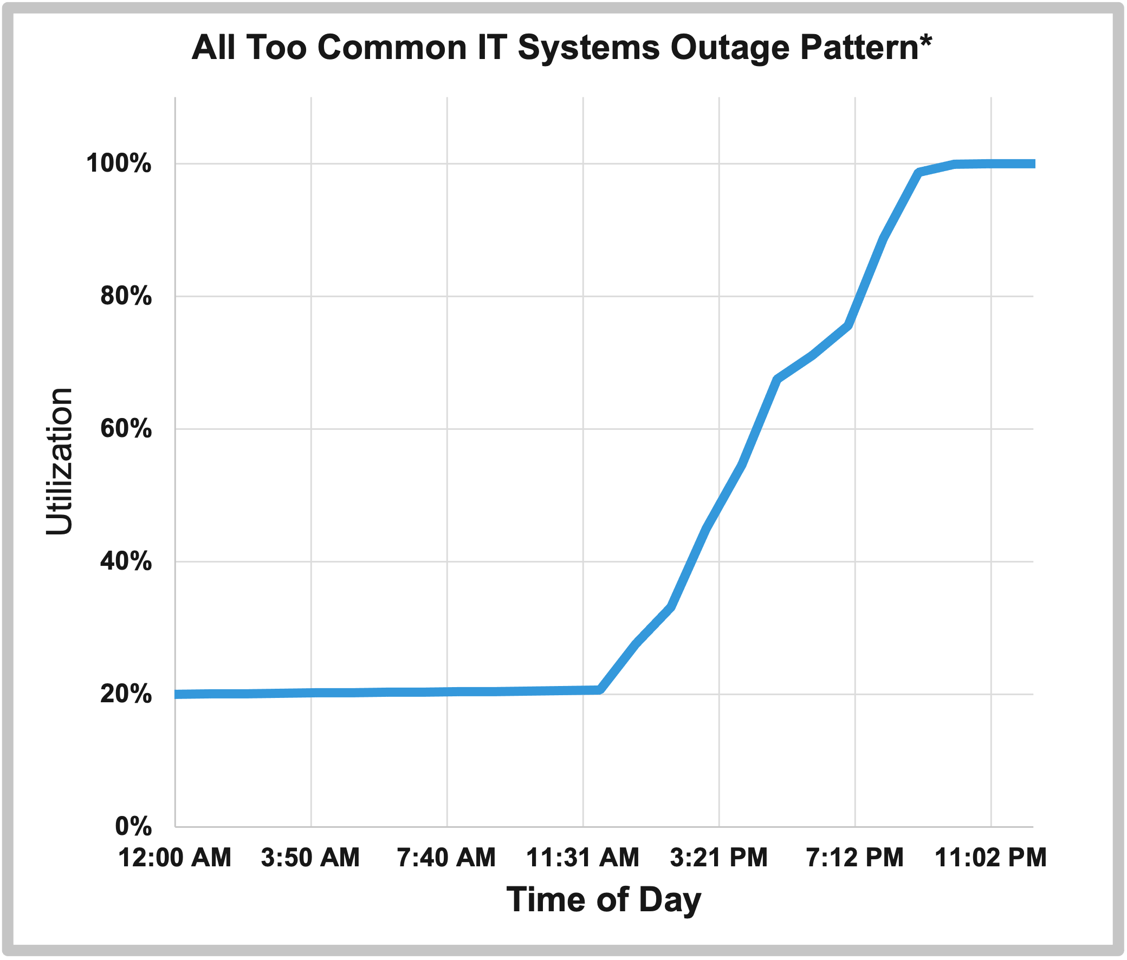
Traditional Approach
Fabricated Outage Timeline
11:30AM:
change deployed to production
3:30PM:
post-deployment system checks all show nominal status
9:00PM:
90% utilization alert triggered.
On-call admin notified
10:00PM:
system froze due to resource exhaustion
10:30PM:
on-call admin begins investigation
1:00AM:
Admin repairs resource overrun.
System resumes normal operation
*Fabricated example – no admins were harmed in the making of this chart
Image Source: NASA / GSFC Ben Williams

Slide 7
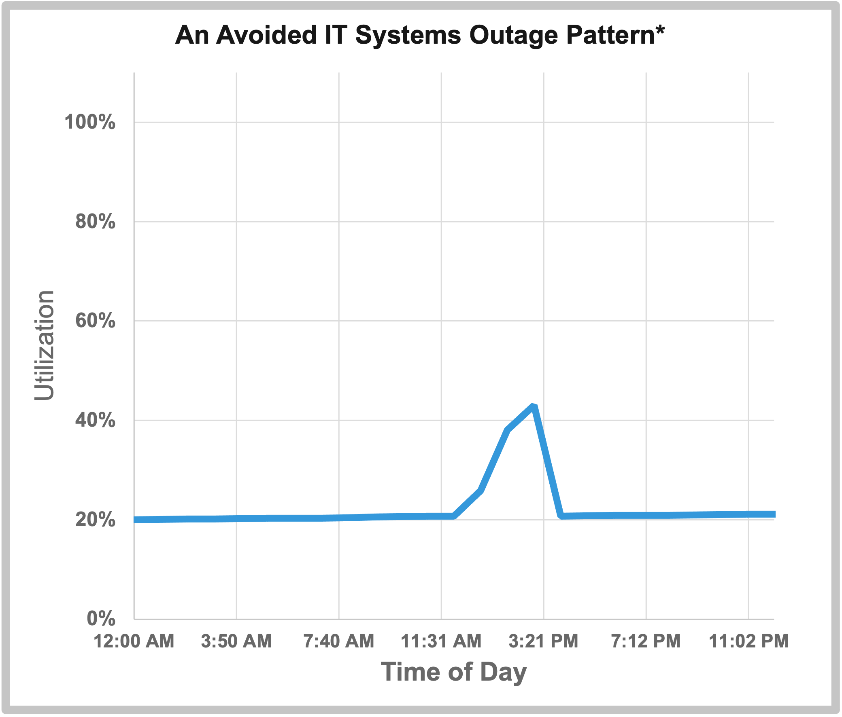
AIOps Enabled Approach
Fabricated Outage Timeline
11:30AM:
change deployed to production
2:30PM:
AIOps system anomaly detection identifies unusual resource utilization spike
3:15PM:
Admin repairs resource overrun
5:00PM
Admin leaves work for the day
10:30PM
Admin goes to sleep
*Fabricated example – no admins were harmed in the making of this chart
Image Source: NASA / GSFC Ben Williams

Slide 8
AIOps Categories
Statistical Analysis
Correlation | Clustering
Classification
Natural Language Processing (NLP) &
Large Language Models (LLM)

Slide 9
AIOps: Statistical Analytics
Anomaly Detection
+
Outlier Detection
Regression Analysis
+
Trends, Forecasts, Predictions
Notes:
Examples:
- Anomaly Detection: cost consumption suddenly increased beyond normal levels
- Outlier Detection: average ingest rates are in normal levels, but [xyz] data product is 5x slower than the average
- Regression Analysis: storage consumption increasing linearly/exponentially – expected to reach capacity by [x] date

Slide 10
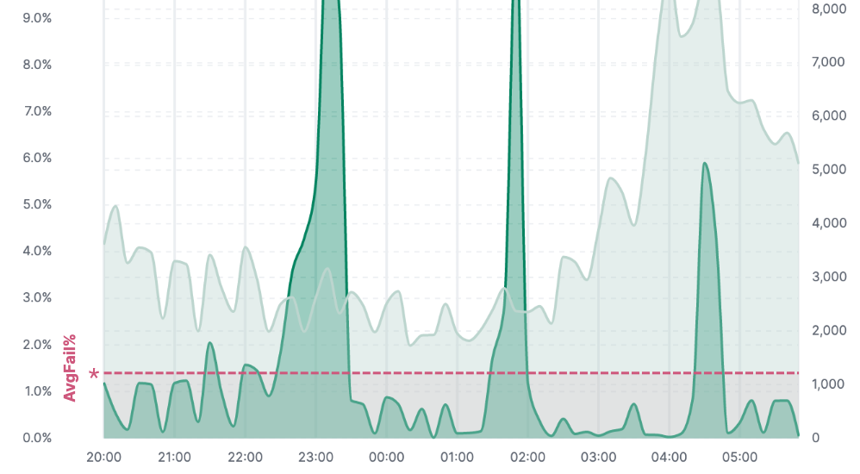
AIOps: Correlation | Clustering
Correlation help teams accelerate
root-cause analysis
  especially for inter-connected systems
Example: Cumulus Ingest Error Rates
Image Source: NASA / GSFC - ESDIS Cloud Metrics link (accessed controlled)

Slide 11
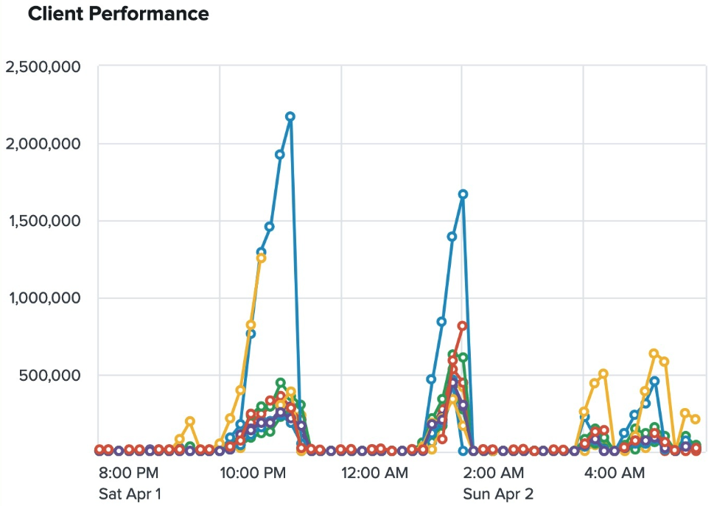

AIOps: Correlation | Clustering
Correlation help teams accelerate
root-cause analysis
  especially for inter-connected systems
Example: Cumulus Ingest Error Rates
Example: CMR Ingest & Search Performance
Image Source: NASA / GSFC - ESDIS Cloud Metrics link (accessed controlled)
Image Source: NASA / GSFC - ESDIS Degraded Service Events link (accessed controlled)

Slide 12
AIOps: Classification
Machine Learning to distinguish normal vs. abnormal behavior
  think credit card fraud detection and alerts
IT Systems Examples:
  Cost / Usage - is a surge in access:
    legitimate demand increase
    user error / infinite-loop
    denial of service attempt
  Cyber Security - are an admin’s actions:
    legitimate maintenance and sustainment
    indicative of an active hacking attempt
Uses supervised machine learning and requires high volumes of well labeled training data
  Several commercial observability and cyber security tools have
  pre-trained models to help identify likely malicious use

Slide 13
AIOps: NLP & LLMs
Service Desk Automation | Chatbots
Knowledge Base Management
Sentiment Analysis
Workforce Education

Slide 14
Where to Start
Robust logging from your applications
  Not just success / failure events
  As much application activity info as practical
Aggregate logs & metrics in analytics systems
  Numerous commercial and open-source options:
    CloudWatch, Grafana, ElasticSearch, Splunk, New Relic, etc.
Reduce reliance of pre-defined alert thresholds by augmenting with anomaly detection

Slide 15
Where to Start
Some words of caution:
  Avoid analysis paralysis of seeking normalized data schemas up-front
    Data normalization is a good thing, but it isn’t required to get started and to start seeing benefits
    Lots of current and emerging observability schemas. Ex:
      Elastic Common Schema (ECS)
      Splunk Common Information Model (CIM)
      OpenTelemetry
      Open Cybersecurity Schema Framework (OCSF)
  Data transformation is a good and normal part of AIOps
    When you start treating raw system logs as ”level-0” data, you open lots of analytic opportunities

Slide 16
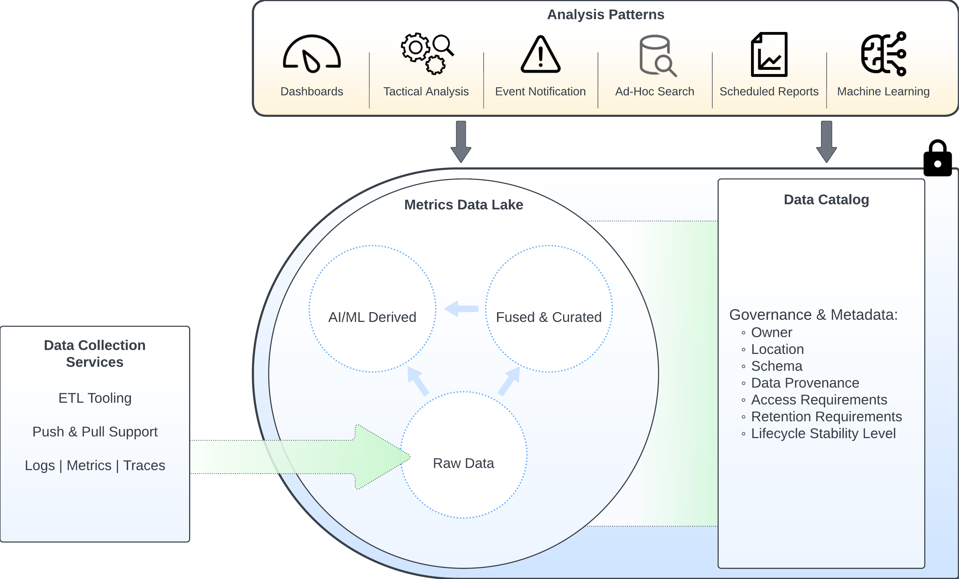
Scaling Up: Data Lake House
ESDIS Data Lake House Architecture - Draft
Image Source: NASA / GSFC Ben Williams

Slide 17
Open Discussion

Slide 18
Discussion Starters
What areas do you think AIOps may help your organization?
Does your organization have AIOps success/horror stories?
What are key risks/challenges in adopting AIOps in your organization?

Slide 19
This work was supported by NASA/GSFC under Raytheon Technologies contract number 80GSFC21CA001.

