Slide 1
Identity Management &
Open Science
Summer ESIP 2023
Ben Williams
EED-3 Platform Product Manager
ben.williams@wit-office.net
Dana Shum
EED-3 Solution Engineer
dshum@rtx.com
Nathan Clark
EED-3 Platform Architect
nathan.i.clark@rtx.com
Srikanth Davu
EED-3 Earthdata Login Product Owner
srikanth.davu@rtx.com
This work was supported by NASA/GSFC under Raytheon Technologies contract number 80GSFC21CA001.
This document does not contain technology or Technical Data controlled under either the U.S. International Traffic in Arms Regulations or the U.S. Export Administration Regulations.

Slide 2
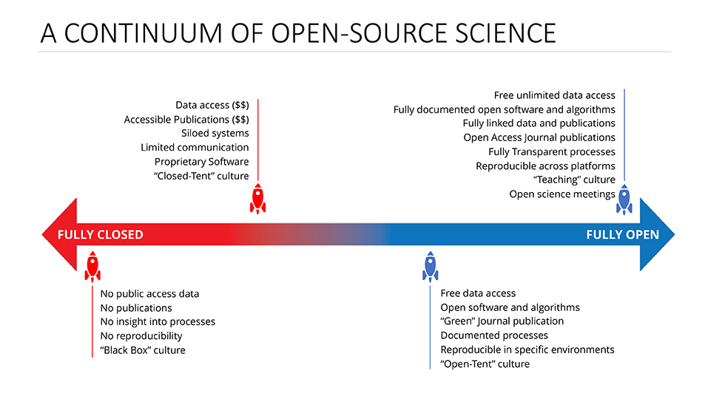
Open-Source Science
FAIR
Findable
Accessible
Interoperable
Reusable
Image Source: NASA ESDS https://www.earthdata.nasa.gov/esds/open-science

Slide 3
Identity Management & Open Science
Advancing Open Science includes ensuring science data is accessible to the scientific community
Identity (and access) Management seeks to ensure users of are identified, authenticated, and authorized for science data use
… at a level appropriate for that use
This is a complex challenge needing community collaboration to find the best solution(s)

Slide 4
A story about scaling Identity Management…

Slide 5


A story about scaling Identity Management…
Image Source: NASA / GSFC Ben Williams

Slide 6

A story about scaling Identity Management…
Image Source: NASA / GSFC Ben Williams

Slide 7
A story about scaling Identity Management…
Image Source: NASA / GSFC Ben Williams

Slide 8


A story about scaling Identity Management…
Image Source: NASA / GSFC Ben Williams

Slide 9







A story about scaling Identity Management…
Image Source: NASA / GSFC Ben Williams

Slide 10
A story about scaling Identity Management…
Image Source: NASA / GSFC Ben Williams

Slide 11
A story about scaling Identity Management…
?
Image Source: NASA / GSFC Ben Williams

Slide 12
there are multiple pieces to solving this puzzle
we think we know some of them
we are sure we do not know all of them

Slide 13
Holistic Identity Management
Active Earth Science Data and Information System (ESDIS) analysis
Goals:
  An identity rosetta stone that scales
  Don’t use a sledgehammer and require every app to support everything
Use Cases:
  40 unique use cases identified (to date) ranging across:
    public access to science data with no end-user license agreement
    data curation by both organizational and non-organizational partners
    science data shared for limited use through commercial and/or international agreements
    privileged access to underlying application infrastructures

Slide 14
Solutions Space Considerations
Human & Machine Access | User Experience
Non-Organizational Users | System Performance
Data Usage Metrics Collection | Cost Efficiency
End-User License Agreements (EULA) | Scalability
Commercial Data | Adaptability
International Partners | Maintainability
Domestic Partners | Auditability
Personal Identifiable Information (PII) | Stability
Vendor Lock-In | Evolution and Migration Paths

Slide 15
Current Analysis Focus Areas
Third-Party Authentication
  Extending Earthdata Login authentication beyond username/password to include:
    Ex: social-media login (Google / Facebook / etc.)
Trusted Friends and Partners
  Non-organizational users with right-sized identity vetting to grant limited permissions beyond read-only
    Ex: metadata curation, data upload
Identity Federation
  Commercial and/or open-source tools to connect:
    multiple identity providers with varying capabilities and identity assurance levels
    with multiple applications/datasets with varied access control requirements
Relaxed Registration
  Feasibility of anonymous read-only access to fully public, non-EULA’d datasets

Slide 16
Community Discussion Starters
What are your current pain points around data access?
What are some solutions that should be considered?
Are there constraints / must-haves that need to be talked about?
Are we asking the right questions?

Slide 17
This work was supported by NASA/GSFC under Raytheon Technologies contract number 80GSFC21CA001.

