Slide 1
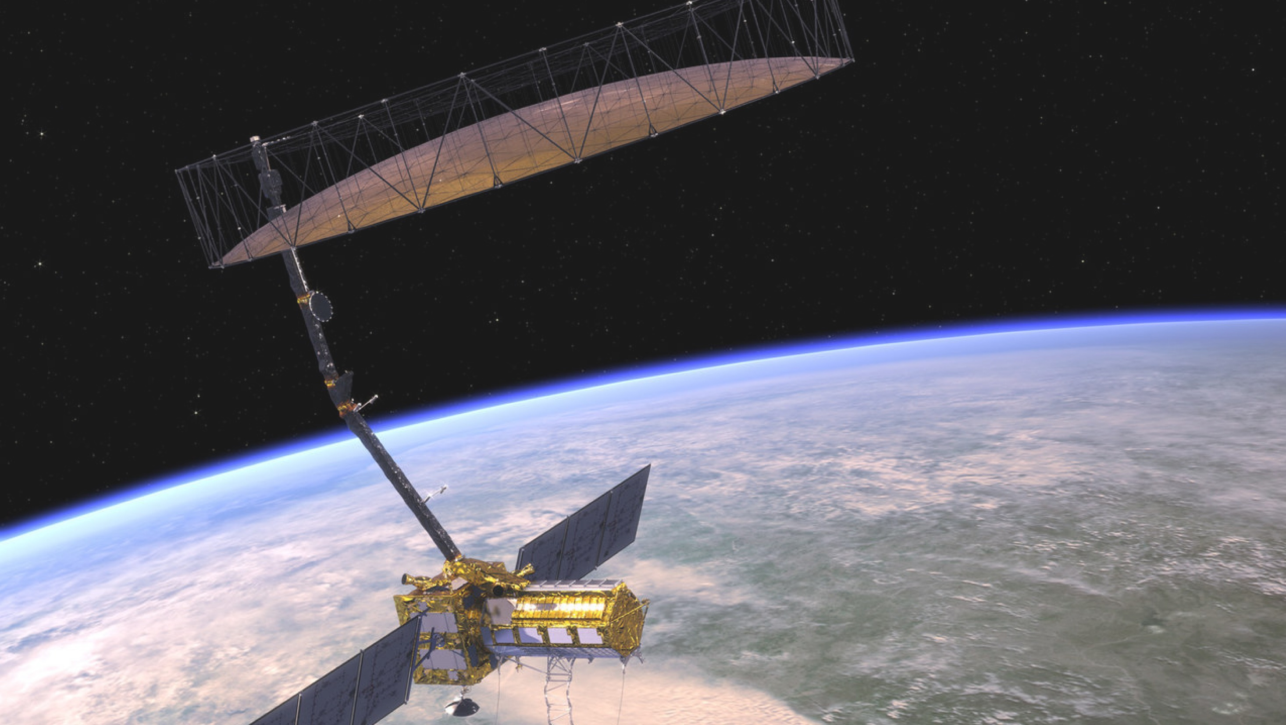

NASA cooperation
with ISRO
Dennis McSweeney
Office of International and Interagency Relations
June 2023
www.nasa.gov

Slide 2

NASA-India Cooperation
ISRO Structure

Slide 3
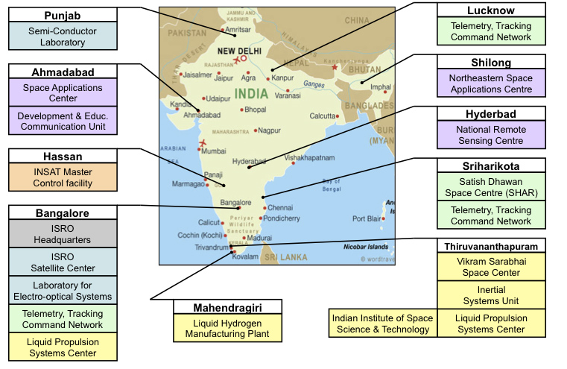
ISRO Installations
U.R. Rao Satellite Centre
Human Space Flight Centre

Slide 4
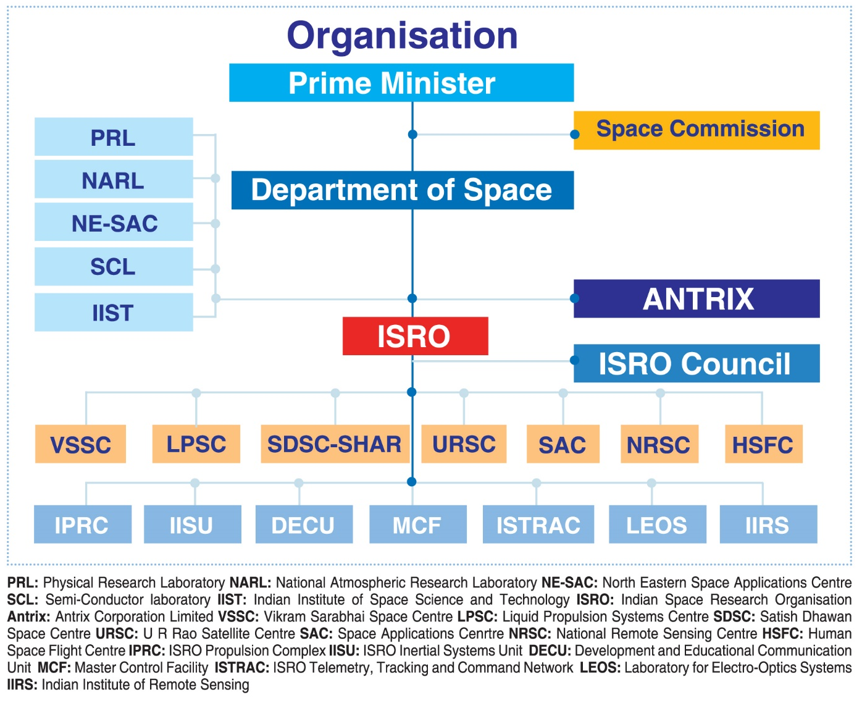
Department of Space and ISRO
NSIL & IN-SPACe

Slide 5
  The 2023 Indian Space Policy establishes regulatory and policy framework to enable Indian space companies to carry out end-to-end activities in the space sector.
  IN-SPACe (Indian National Space Promotion & Authorisation Centre)
    IN-SPACe shall function as an autonomous Government organization, mandated to promote, hand-hold, guide and authorize space activities in the country.
    For this purpose, IN-SPACe shall periodically issue guidelines and procedures, that would among other things promote ease of doing business.
  NSIL (New Space India Limited)
    Responsible for commercializing space technologies and platforms created through public expenditure
2023 India Space Policy
Focus on growing capabilities of Indian space industry

Slide 6
  2008: Chandayaan-1 orbiter mission to Moon
  2013: Mars Orbiter Mission (MOM)
  2015: AstroSat astrophysics mission
  2019: Chandrayaan-2 mission to Moon
  2023 (Jul): Chandrayaan-3 lander/rover mission to Moon
  2023 (Aug): Aditya heliophysics mission to L-1
  NET 2023: Xposat (x-ray observatory to measure cosmic radiation)
  NET 2024: First uncrewed Gaganyaan crew module mission
  NET 2024: Second uncrewed Gaganyaan crew module mission
  NET 2024: NISAR
  NET 2025: Gaganyaan crew mission
  NET 2025: MOM-2
  NET 2025: Lunar Polar Exploration (LUPEX) mission with JAXA
  NET 2025: Shukrayaan-1 Venus mission (TBC)
ISRO Space Science
and Human Space
Flight Missions
Growing space ambitions comes with more opportunity and more risk

Slide 7

NASA-India Cooperation
NASA-ISRO Cooperation

Slide 8

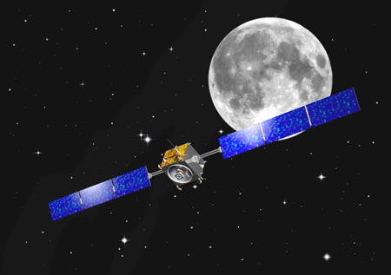
2000s: Reinvigorating Cooperation
2000: India joins Global Learning and Observations to Benefit
the Environment (GLOBE)
    Over 2,200 participating Indian schools
2005: Establishment of U.S.-India Civil Space Joint Working Group
2008: NASA-ISRO Civil Space Framework Agreement
    Individual NASA-ISRO cooperative activities conducted through Implementing Arrangements under the Framework Agreement
2008: ISRO’s Chandrayaan-1 Lunar mission launched
with two NASA payloads
    Moon Mineralogy Mapper
      - Detected water molecules on lunar surface
    Mini-SAR
      - Detected ice deposits near the lunar north pole
  ISRO’s Moon Impact Probe
      - Detected water vapor in atmosphere near
      lunar surface

Slide 9
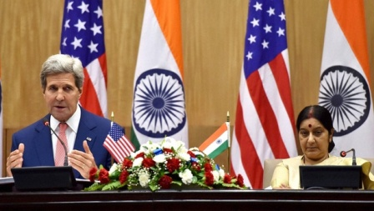
2010s: Space Collaboration part of Government-Level Cooperative Structure
2010–2016:
U.S.-India Strategic Dialogue
2011: U.S.-India Civil Space Joint Working Group reestablished after 4-year hiatus
2011: U.S.-India Earth Science Working Group established
2014: NASA-ISRO Mars Working Group established
  2017: Renamed NASA-ISRO Planetary Science Working Group
2016: NASA-ISRO Heliophysics Working Group established
2019: NASA-ISRO Human Space Flight Program Working Group established
2023: U.S.-India initiative on Critical and Emerging Technology (iCET)
Secretary of State John Kerry and Minister of
External Affairs Sushma Swaraj at the India-U.S.
Strategic Dialogue, Washington, DC, September 22, 2015.

Slide 10

U.S.-India Earth Science Working Group
U.S. Participants
NASA, NOAA, USGS
India Participants
ISRO, Ministry of Earth Science
Activities
NASA-ISRO Synthetic Aperture Radar (NISAR)
NASA Airborne Visible/Infrared Imaging Spectrometer–Next Generation (AVIRIS-NG)
Airborne Synthetic Aperture Radar (ASAR)
Balloon measurements of the Asian Tropopause Aerosol Layer (BATAL)
Global Precipitation Measurement (GPM)/Megha Tropiques
Professional Engineer and Scientist Exchange Program (PESEP)
AErosol RObotic NETwork (AERONET)
Global Learning and Observations to Benefit the Environment (GLOBE)
NASA Administrator Charles Bolden and ISRO Chairman K. Radhakrishnan sign agreement to cooperate on NASA-ISRO Synthetic Aperture Radar (NISAR). Toronto, Canada, September 30, 2014.

Slide 11


NASA-ISRO Synthetic Aperture Radar (NISAR)
12-meter antenna reflector
9-meter boom
Spacecraft bus
L-band SAR structure
S-band SAR

Slide 12
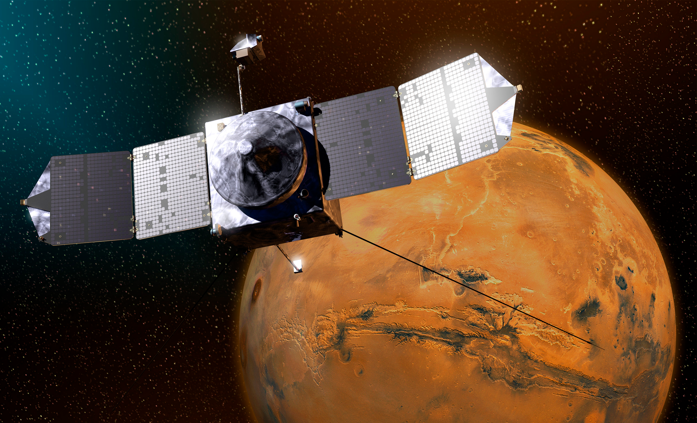

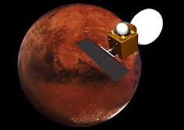
NASA-ISRO Planetary
Science Working Group
@MarsCuriosity, 11:03 PM – 23 Sep 2014
Namaste, @MarsOrbiter! Congratulations to @ISRO and India's first interplanetary mission upon achieving Mars orbit.
@MarsOrbiter, 11:32 PM – 23 Sep 2014
Howdy @MarsCuriosity ? Keep in touch. I'll be around.
New and Potential Cooperation:
Chandrayaan-3: A NASA-provided Laser Retro-Reflector Array (LRA) will fly on ISRO’s Chandrayaan-3 lunar lander, which is scheduled to launch in July 2023.
ISRO-JAXA LUPEX Mission: NASA is in discussions to provide a neutron spectrometer and Deep Space Network (DSN) support for the JAXA rover, through a bilateral agreement with JAXA.

Slide 13

NASA-ISRO Heliophysics Working Group
NASA and ISRO established a Heliophysics Working Group in September 2016.
NASA and ISRO are in discussions to establish a data exchange activity in support of ISRO’s Aditya Heliophysics mission, scheduled to launch in August 2023.

Slide 14
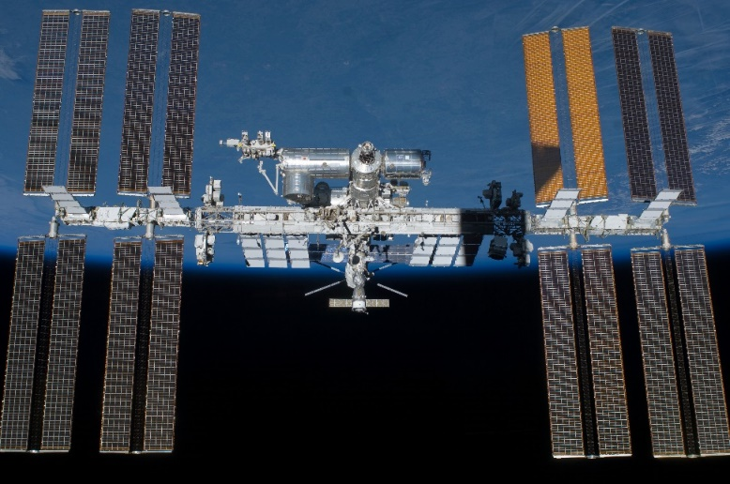

NASA-ISRO Human Space Flight Program Working Group
NASA and ISRO are discussing human space flight cooperation in a number of areas:
  Astronaut Training
  Crew Health and Performance
  Medical Operations
  Human Research and Space Biology
  Data Exchanges
  Education and Outreach

Slide 15
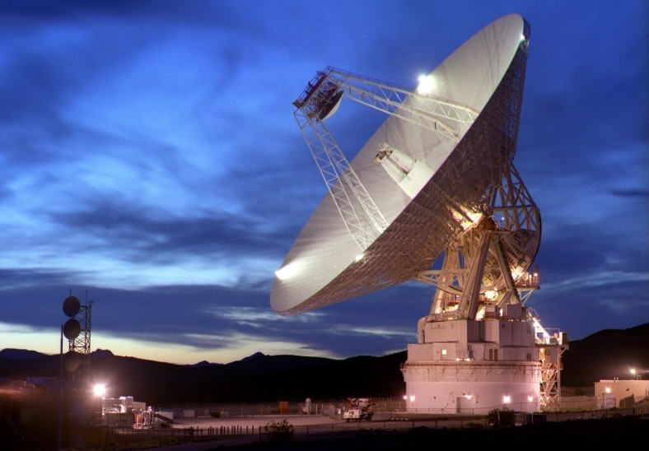
NASA Communications and Navigation Support to ISRO Missions
NASA has provided and/or will provide ISRO with communications and navigation support:
Chandrayaan-1
Chandrayaan-2
Mars Orbiter Mission
Chandrayaan-3

Slide 16
2020s and beyond:
Potential areas of future cooperation:
  Artemis Accords
  Human Space Flight
  NASA to provide a Laser Retro-Reflector Array (LRA) on Chandrayaan-3
  Expansion of Professional Engineering and Scientist Exchange Program to Space Science
  Data exchange to support ISRO’s Aditya-L1 mission
  NASA International Internship (NASA I²) Program

