Slide 1
Plasma Activated Water: A Technology for Acid Generation and Space Crop Production
Dr. Ryan Gott, Dr. Kenneth Engeling, Misle Tessema, Dr. Christina Johnson, Dr. Joel Olson, Bruce Link, Dr. Carolina Franco, Jason Fischer
52nd International Conference on Environmental Systems
Calgary, Canada
July 17th, 2023

Slide 2
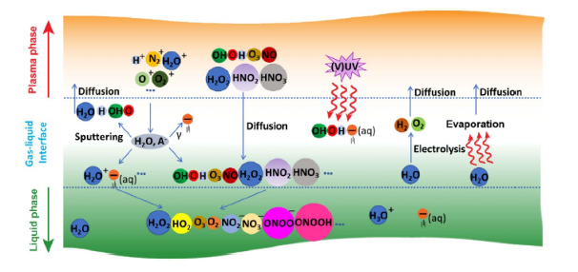
Plasma Activated Water
Introduction of many species
Oxygen species
O₃, O*, O⁻, O₂⁺, O₂*, O
Nitrogen species
N₂⁺, NO, NO₂⁻, NO₃⁻, NH₃, NH_{4,} N₂*, N
Water species
OH, H₂O₂, H3O⁺, H₂O⁺, OH*, e⁻
Use of air as feed gas favors acid production
NO₃⁻ and NO₂⁻ have reactions in water that result in HNO₃
Zhou, et al. 2020

Slide 3
Space Infusion Goals
Moon to Mars architecture requires in-situ resource utilization and reuse of materials
Plant growth is of great interest
Hydroponic pH balancing
Nutrient solutions
Sanitization is essential
Plasma generated acid has the ability to address all of this and more in a unified system
3

Slide 4
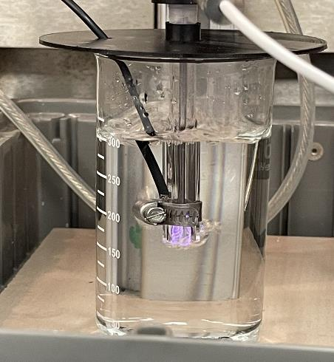
Setup
Electrode
3D Printed Tee
Gas Inlet Tube
Vent
Quartz Tube
3D Printed Beaker Lid
Beaker
Electrode at Tube Exit
Plasma
Air plasma
Spill Bucket

Slide 5
pH Results
pH Range
2.7-6.14 (Platinum electrodes)
Electrode material pH range (2.7-9.7)
DC/pulsed able to achieve lowest pH
AC supply limited 4-6.1 range
Conductivity range
≈ 0-673 µS·cm⁻¹
DC full range
AC/Pulsed ≈ 0-240 µS·cm⁻¹ range

Slide 6
Nitrate Results
DC vs. AC vs. Pulsed
DC supply up to 126 ppm in 15 minutes
AC 5-6 ppm at 15 minutes
400 ns, up to 26 ppm at 15 minutes
Florikan® comparison
Slow-release ceramic
Nitrate production comparable for 60/90 day release formula
DC N₂ also produces NO₂⁻ and NH₄⁺
On-demand production
No resupply needed
Enables microgreen growth on ISS
Tailor to plan needs as needed
Adjustments during growth cycle

Slide 7
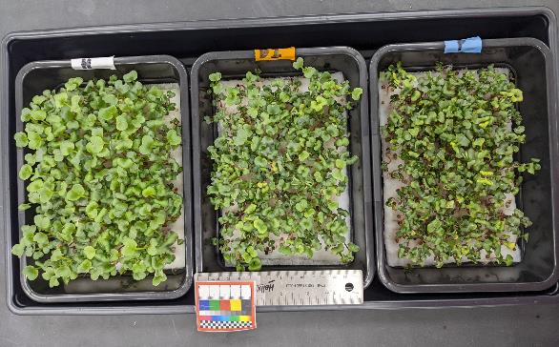
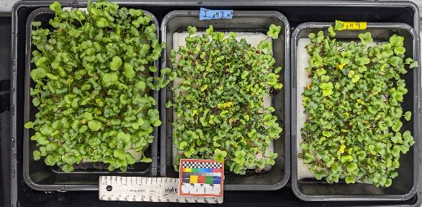
Microgreen Growth Trial
a)
1st PAW Microgreen growth set
1st PAW Microgreen growth set
DC air plasma, DI, 15 min. pH≈3
NO₃ ≈ 120 ppm (high)
Stressed compared to Hoagland's
Comparable to DI
2nd PAW Microgreen growth set
Pulsed, DI, 15 min., pH balanced, pH≈6.8 and 9.5
NO₃≈ 25 ppm (Florikan® levels)
Earlier emergence
Comparable dry mass to Hoagland’s
Hoagland’s
DI
PAW pH ≈3
b)
2nd PAW Microgreen growth set
Hoagland’s
PAW pH ≈7
PAW pH ≈9

Slide 8
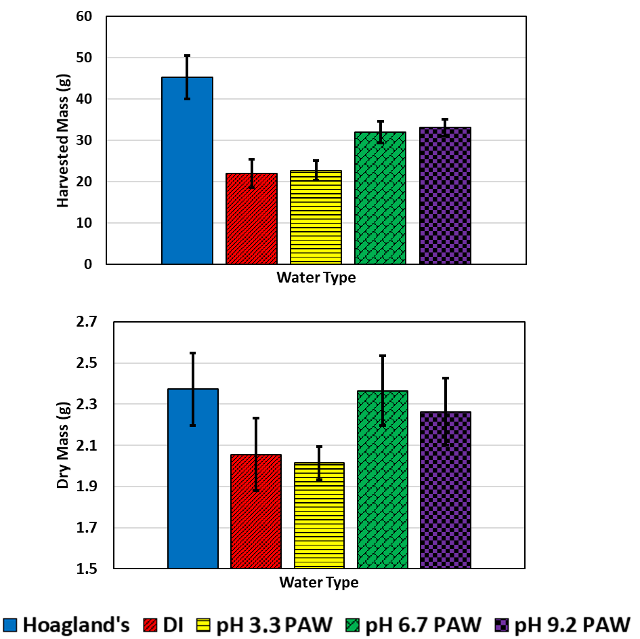
Microgreen Growth Trial

Slide 9
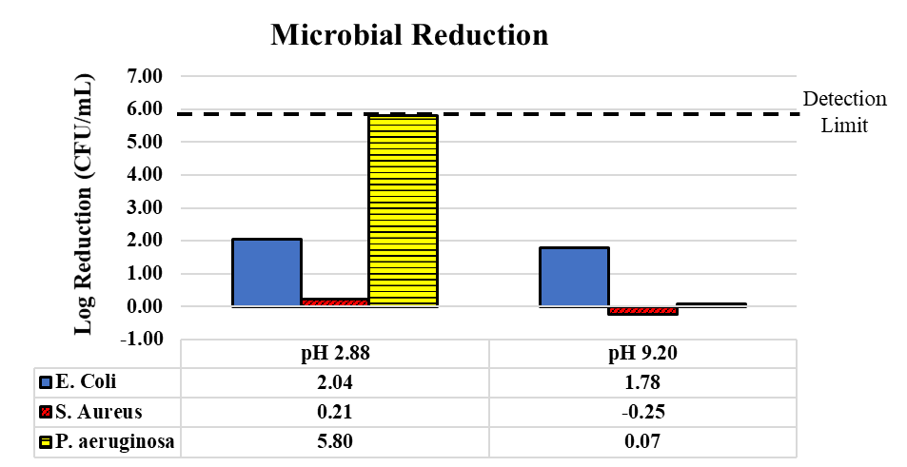
Sanitization Applications
Biofilm mitigation efforts
Difficult to remediate
Common on Space systems
P. aeruginosa
> 5 log reduction
Greater than det. Limit

Slide 10
Martian Applications
Martian atmosphere composition:
95% CO₂, 3% N₂, 2% Argon
Simulated mixture produced 24.8 ppm on nitrates with DC
Run for 15 minutes at 1 atm. pressure
Allows for in-situ acid production
Potential for Martian farming
10

Slide 11
Summary
Plasma generation of acid has numerous ISRU applications
Plant growth and sanitization can both benefit from plasma acid
Why Plasma?
On-demand production
No resupply needed
Power efficiencies will be achieved soon

Slide 12
Thank you!
Any questions are welcome.
Contact: ryan.p.gott@nasa.gov

