Slide 1

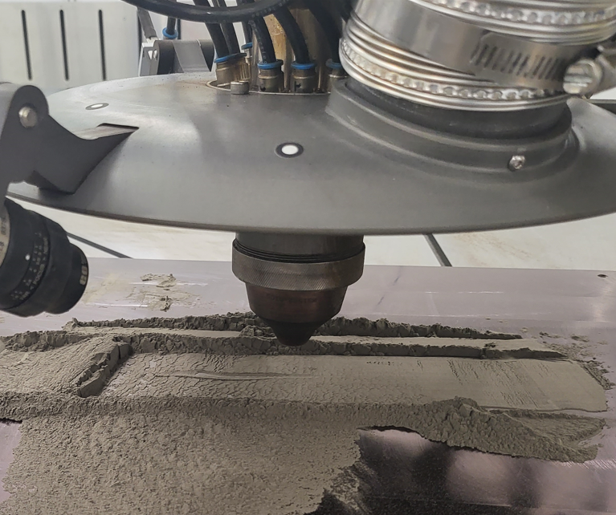
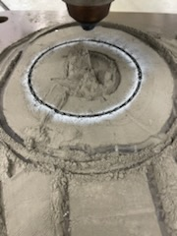
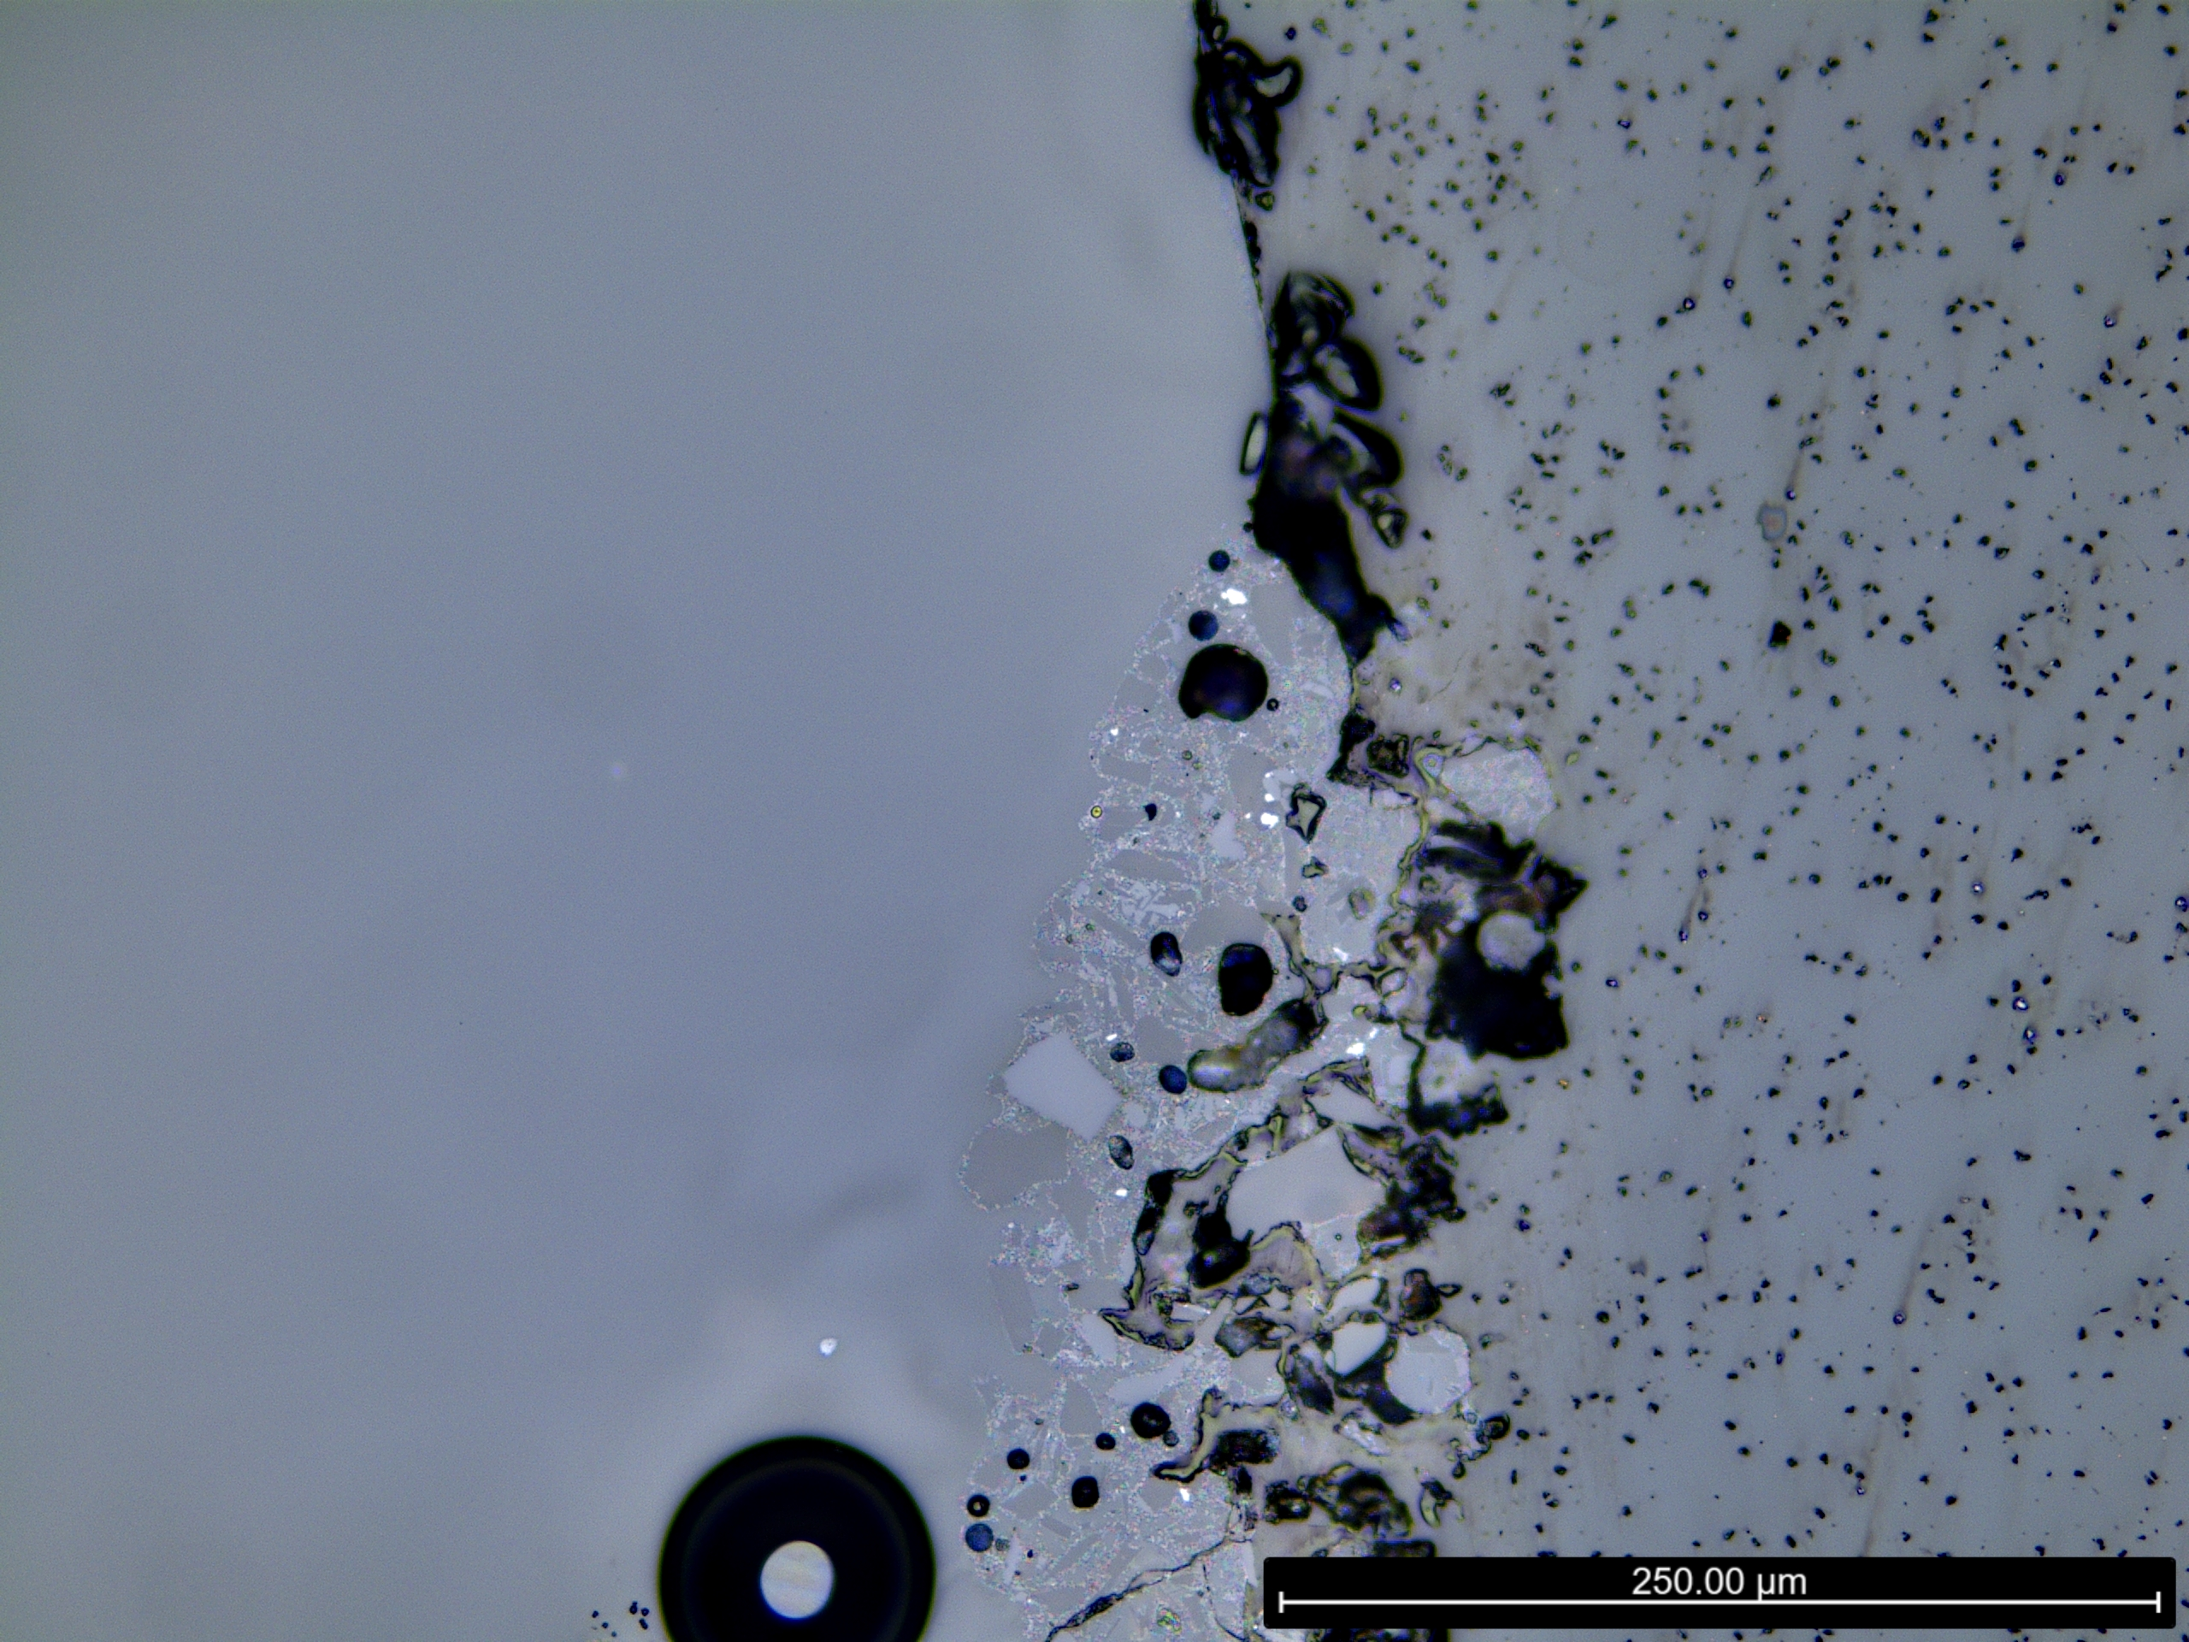
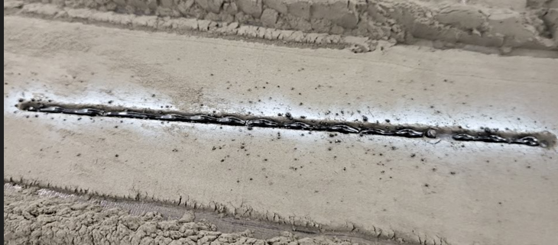
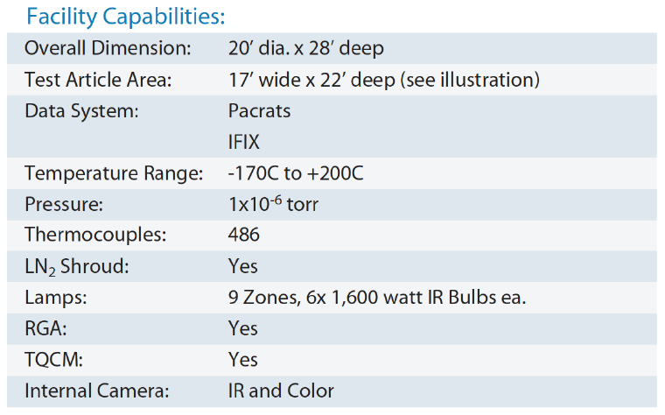
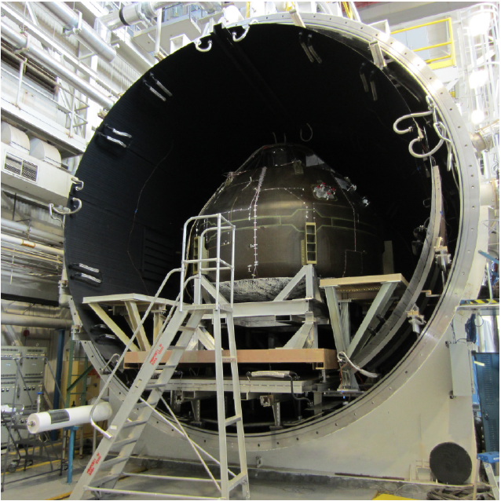
Additive Manufacturing Using Lunar Regolith in a Dirty Vacuum
NASA Marshall Space Flight Center
Engineering Directorate, Materials & Processes Lab
Parker Shake, Advanced Manufacturing Branch – EM42
Overview
Initial Trials
Robotic Arm
Directed Energy Deposition (DED) in its various forms is proposed to be the primary technology for additive manufacturing on the lunar surface
A powder bed fusion and DED hybrid approach has been proven out at a low TRL by NASA MSFC EM42
An injected powder DED system has been designed to operate in the low gravity environments of the lunar surface
A CAT 3 TE was awarded for $1.4M
Melting and stacking single pass beads using the existing Laser Powder Directed Energy Deposition tool in EM42 demonstrated the feasibility of the manufacturing approach
A $1.05M Phase III SBIR with Motiv Space Systems was initiated to procure the robotic arm.
Motiv space systems is under contract to construct the robotic arm on OSAM2 with RedWire
The arm will have a 4 foot reach.
V20 – Dirty Vacuum Chamber
The V20 Dirty Vacuum Chamber at MSFC will be used for testing
The new PLANET vacuum chamber at MSFC is also being considered for future work
Future Work
  The first task will focus on dialing in the robot and laser for operation in the V20. Afterwards a parameter development DOE will be completed to determine the highest performance parameters for additive manufacturing using lunar regolith.
  The end effector is modular any tool that meets the weight and electrical requirements can be used.
  An ECI is being proposed to turn regolith into an aluminum wire feedstock and then will be used in a laser wire DED style set up
Laser
A 1000W diode laser has been selected for the end effector. This enables a steady beam at powers appropriate for melting regolith.
Iteration of Process Cycle

