Slide 1
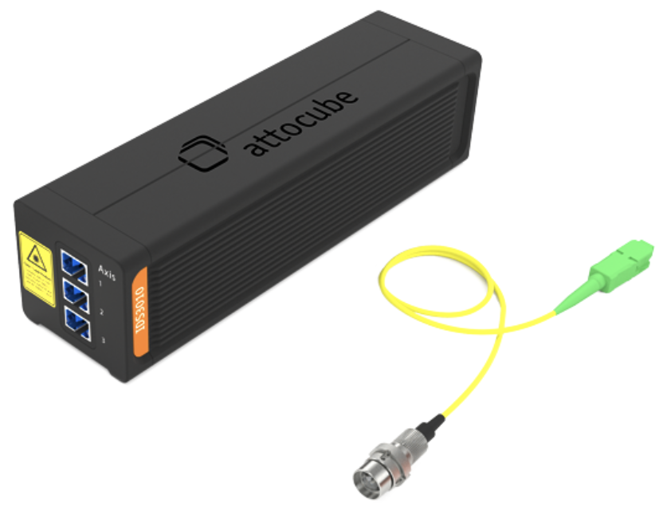
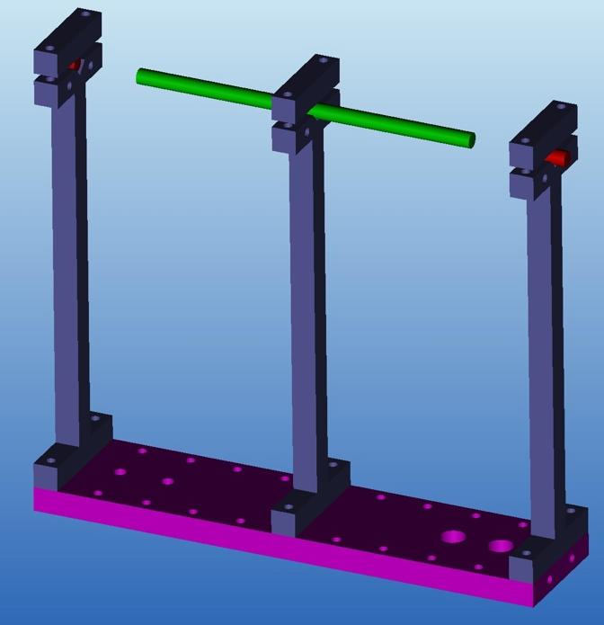
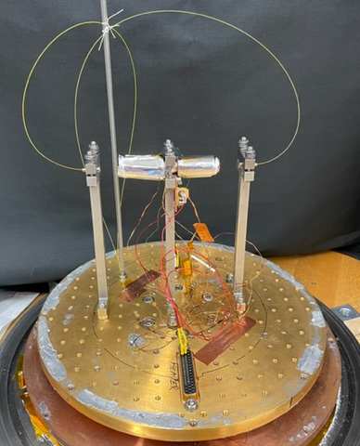
Development of an Apparatus and Process for Precision Measurement of Cryogenic Thermal Expansion of Materials
Jim Tuttle, Amir Jahromi, Ed Canavan, and Jacob Nellis, NASA Goddard Space Flight Center; Justin Scheidler, NASA Glenn Research Center
Measurement Device
Measurement Details
Verifying our Method: copper sample 6 K – 293 K
Alumina Sample
Attocube Model IDS3010 position sensor
  Fiber-optic-based sensors measure distance to nearby reflecting surfaces
  Pico-meter resolution at frequencies up to 500 KHz
  Smallest available sensor heads are compatible with cryogenic environment
Sample rod
  Flat, polished end surfaces
  Most of length is covered by small MLI blanket
  For materials that can’t be polished, thin reflective disks epoxied to ends
  Two thermometers on sample to monitor temperature
After cooling cryostat cold plate to 3.5 K, position sensors are effectively stationary
  Heat required to warm sample to 293 K warms cold plate from 3.5 to 7 K
  Resulting motion of sensors is < 1 x 10⁻⁵ times ΔL in a copper sample
Sample height changes slightly with temperature; ends must be flat and parallel
Instantaneous sensor measurements vary by +/- 5 μm due to cryocooler vibrations
  Up to 150,000 measurements time-averaged over 10 minutes at each temperature
Recently automation software was implemented
  Sends temperature setpoints to a PID controller box
  Collects/averages distance measurements after waiting for steady state
“Thermophysical Properties of Matter,” Vol. 12, 1975 [Y. S. Touloukian, editor]
  Comprehensive (although dated) list of published thermal expansion data for metals and alloys
We chose 99.99% pure copper for our first sample
  All but one published data set in Touloukian matched very closely
  ΔL/L from 293 K to 4 K fell into narrow range: -0.322% to -0.327%
Our measured ΔL/L from 293 K to 6 K: -0.3248%
Candidate for use in structural supports of magnetic actuators
  High thermal conductivity
  Good strength
  Relatively low density
  Electrical insulator to avoid eddy current heating in AC magnetic fields
Our measured ΔL/L from 293 K to 6 K: -0.0647%
Compares well with Touloukian’s Wachtman data; vol. 13, p. 188
https://www.attocube.com/en/products/laser-displacement-sensor
Measurement Approach
Checking Precision, Accuracy; copper from 6 K – 30 K
Sintered SmCo Samples
Sample rod (held above cryostat cold stage on thermally-isolating supports)
  length measured at room temperature with a caliper or micrometer
Stationary position sensors also on supports; measure distances to sample ends
Sample temperature is varied using heater, thermometers; sensors remain at ~ 4K
Sample length change is determined by changes in sensor-sample distances
  Measured at several steady temperatures between ~6 K and 293 K
Final measurement is at 293 K, where length L is known
ΔL/L from room temp. down to ~ 4 K is determined
Sample (with reflective ends; blanket not shown)
Our sample contracted by about 0.2 mm between 393 K and 6 K
Random uncertainty of mean distance was ~ +/- 0.2 nm at each end of sample
  This is 3 x 10⁻⁷ % of length at each end; trivial compared to ΔL in each temperature step
  Resolution is good, but we must look for systematic errors
Touloukian reference has copper thermal expansion data between 4K and 30 K
  Very low thermal expansion in this temperature range
  We decided that measuring in this range would be good test of accuracy
Our data matched published results to within their scatter
  Error bars are smaller than the graphed red circles
Used as permanent magnets in space instrument motors and brakes
  High magnetic strength and radiation tolerance at cryogenic temperatures
CTE measured parallel/perpendicular to easy magnetization direction (c-axis)
  Short sample; parallel to c-axis
  Long sample; perpendicular to c-axis
Our measured ΔL/L from 293 K to 6 K; short sample:, long sample
  Short sample: -0.1916%
  Long sample: -0.2170%
Sensor Head (~ 4K)
Sample
Thermometers
Sensor Head (~ 4K)
Clamp
Thermometer
Clamp
Heater
32 nm
Our data’s
random uncertainty
Is +/- 0.2 nm
Cryostat’s copper cold plate (3.5 K – 7 K)

