Slide 1
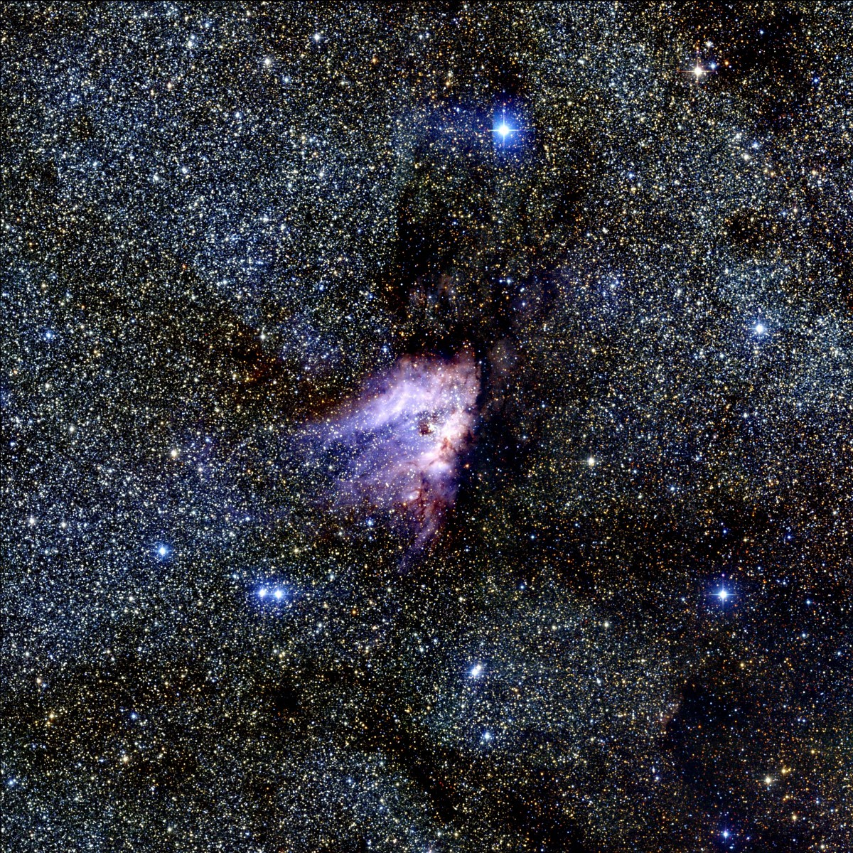


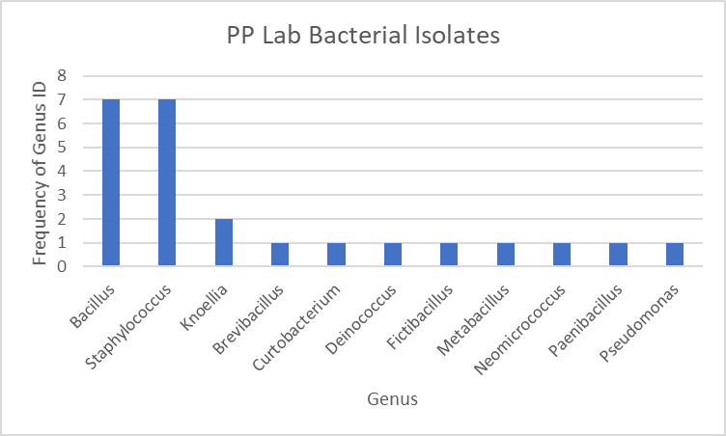
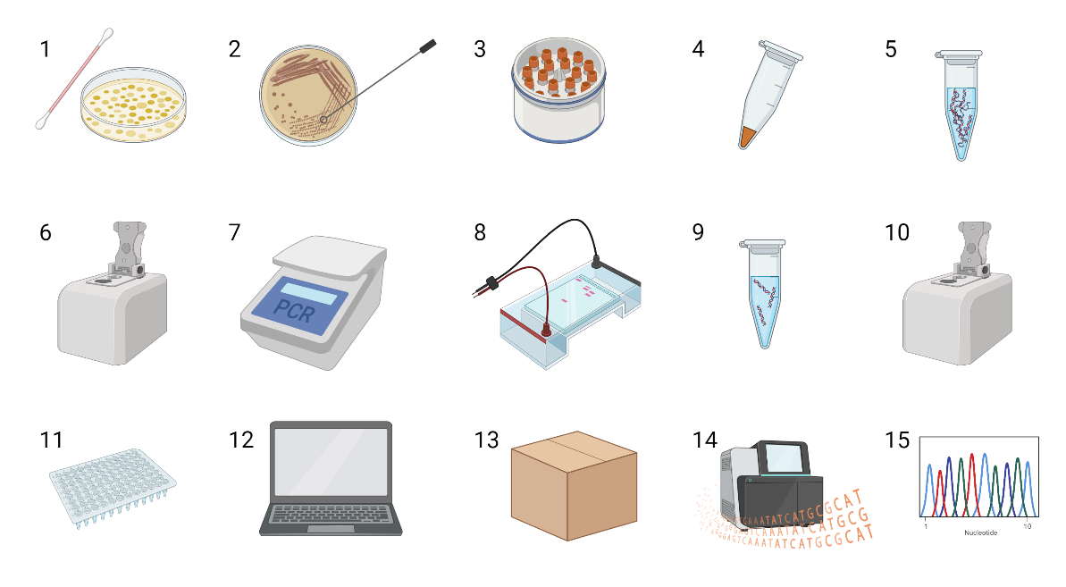
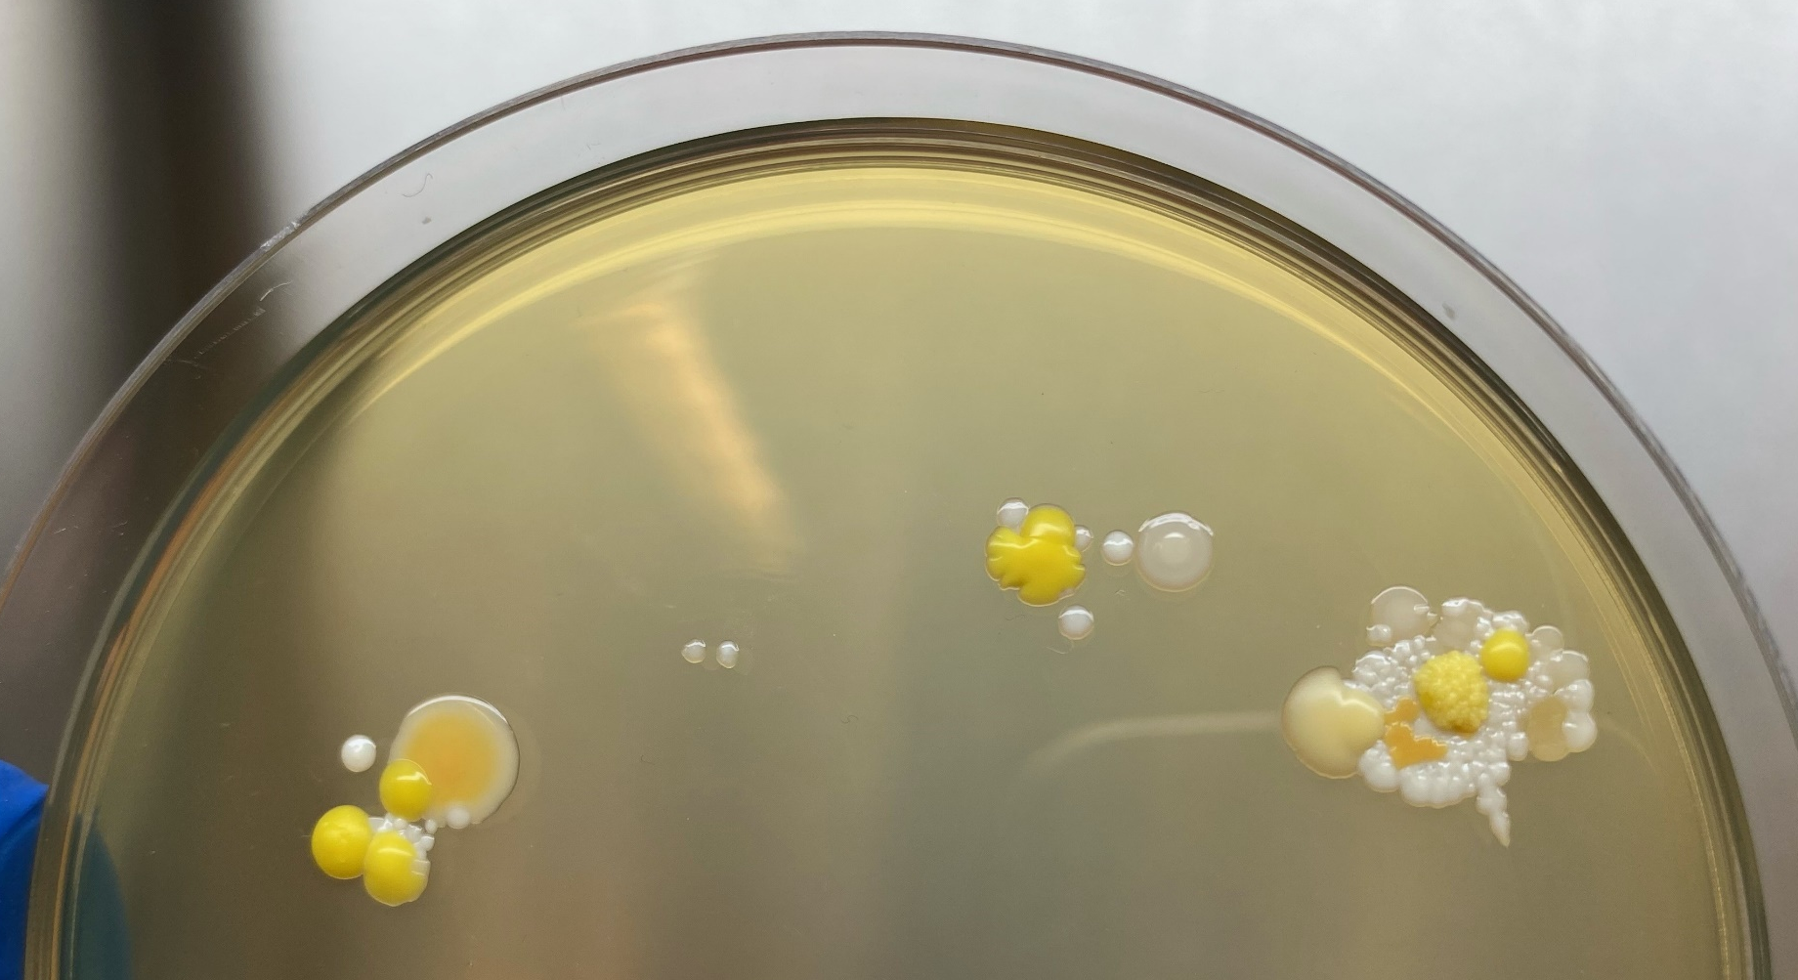
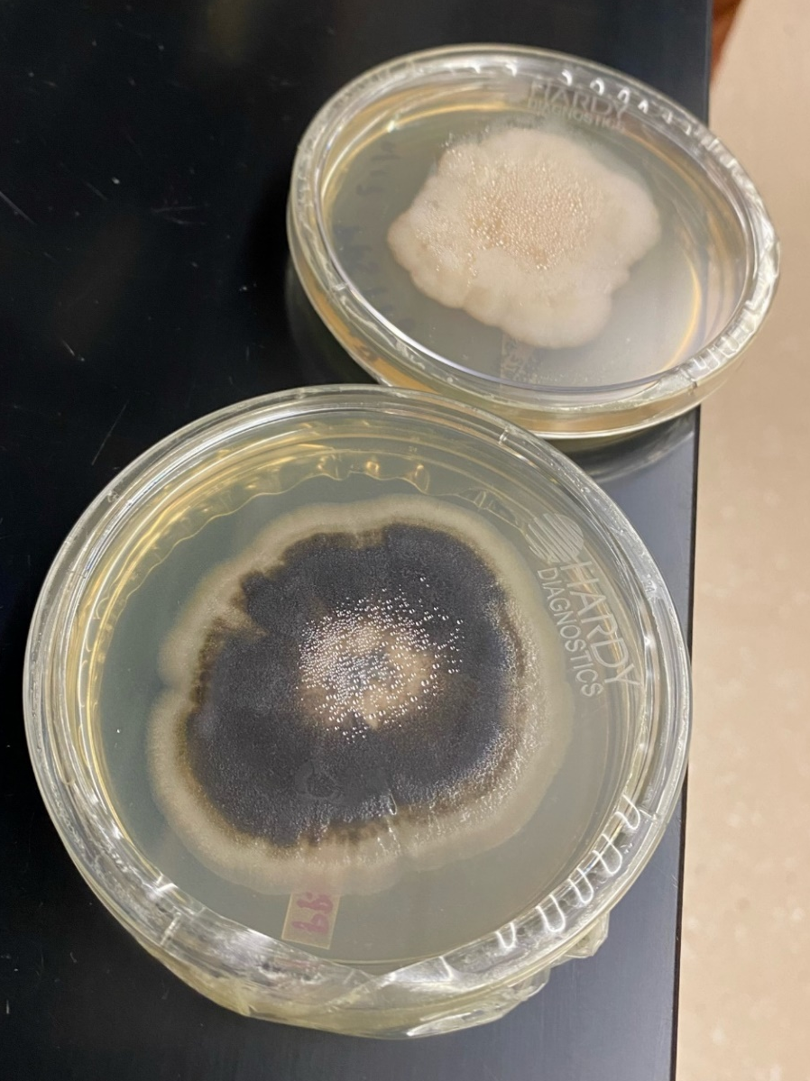
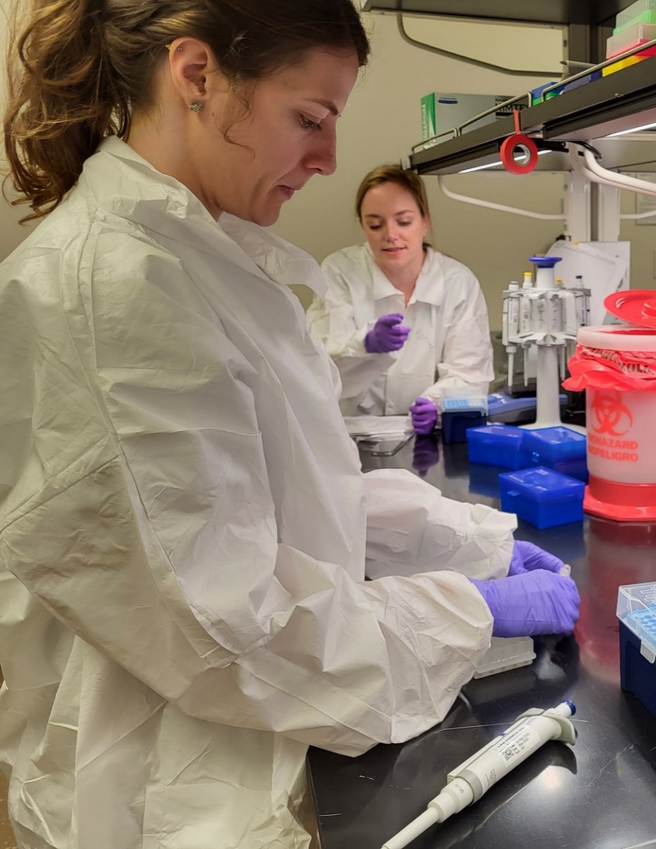
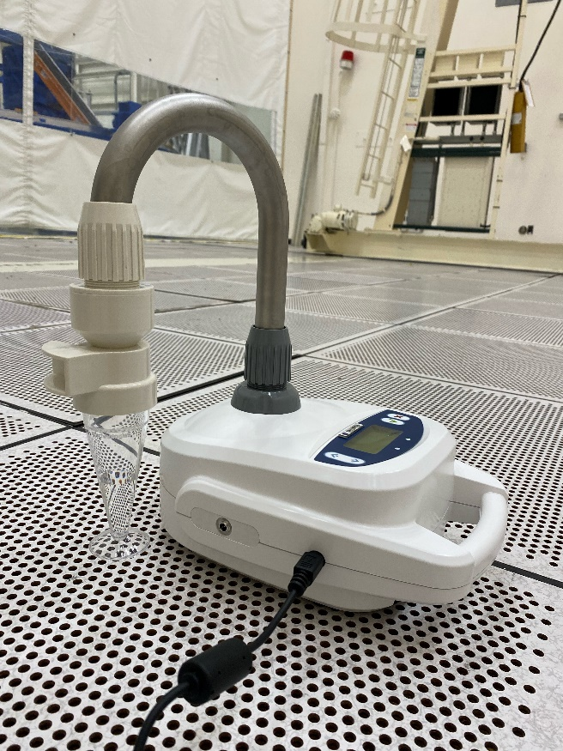
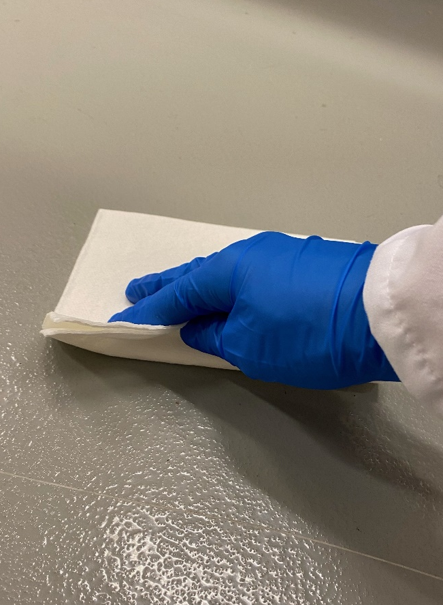
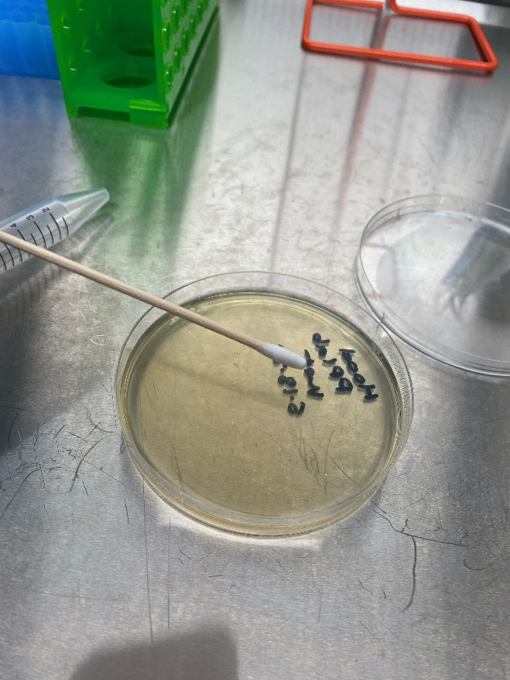
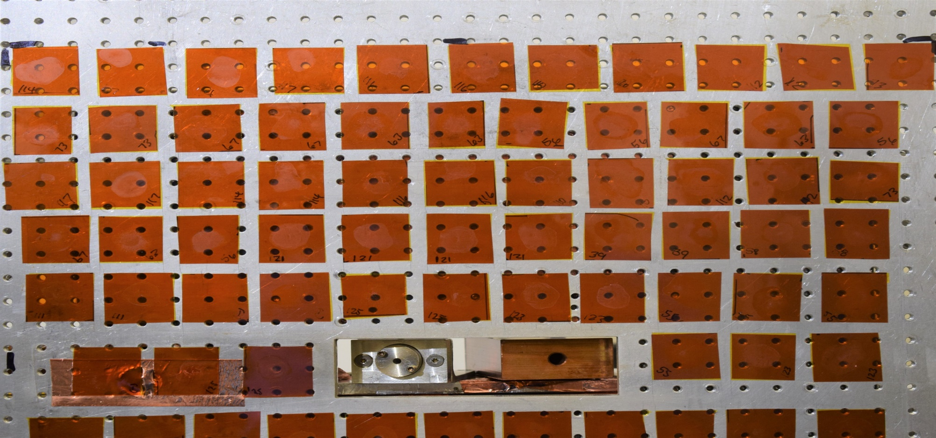
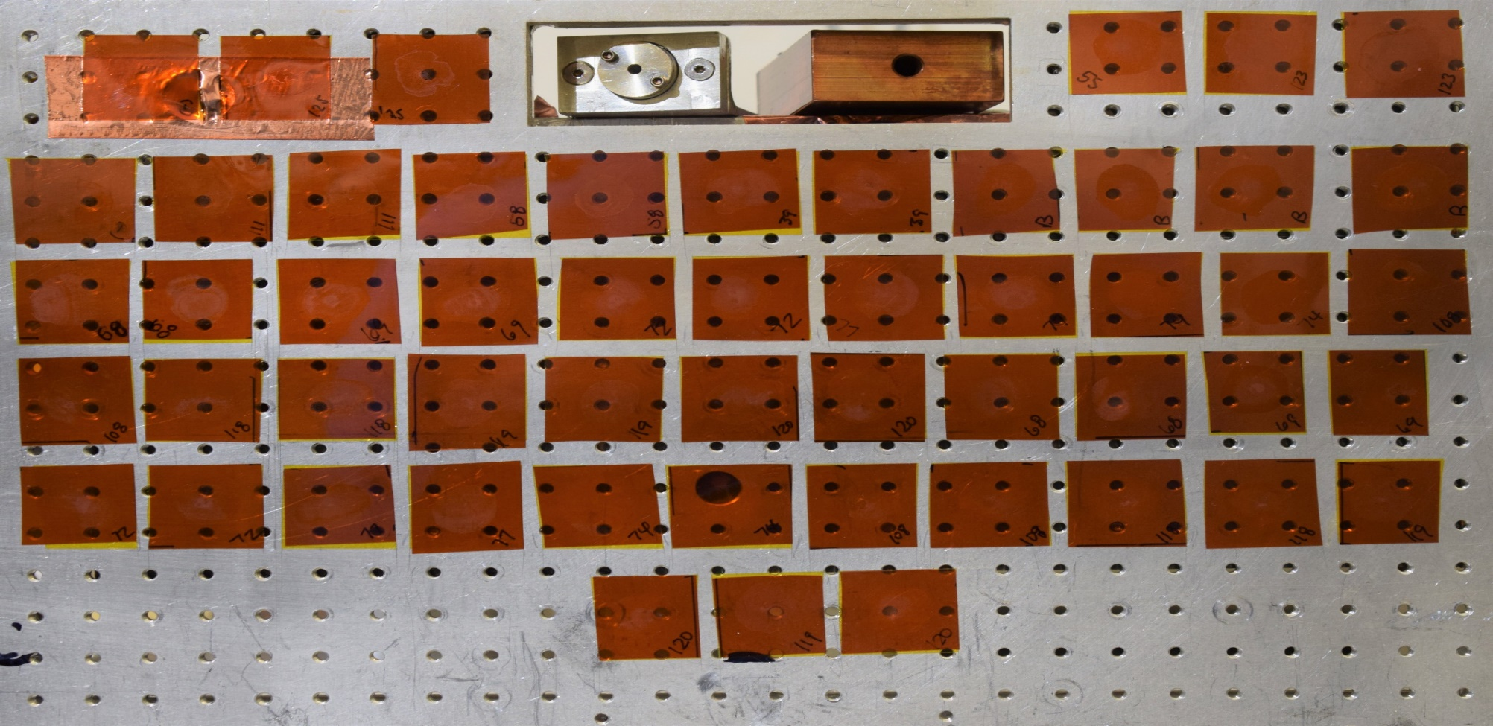
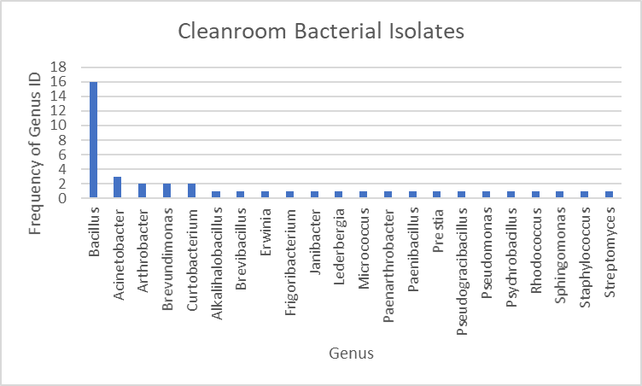
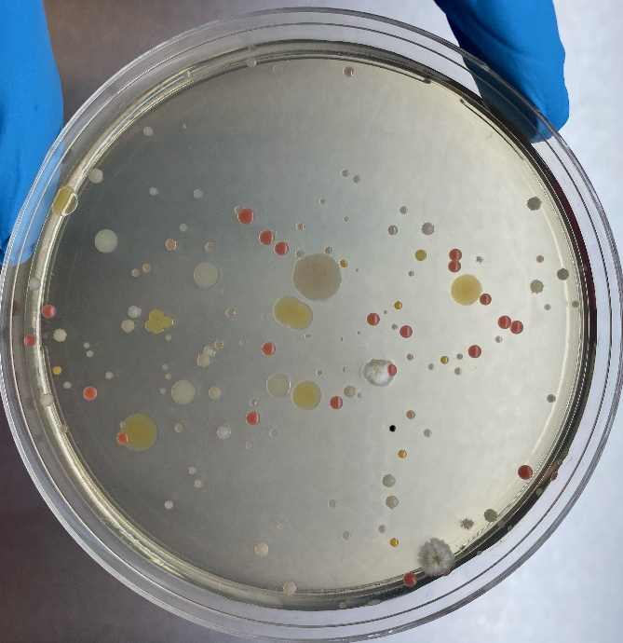
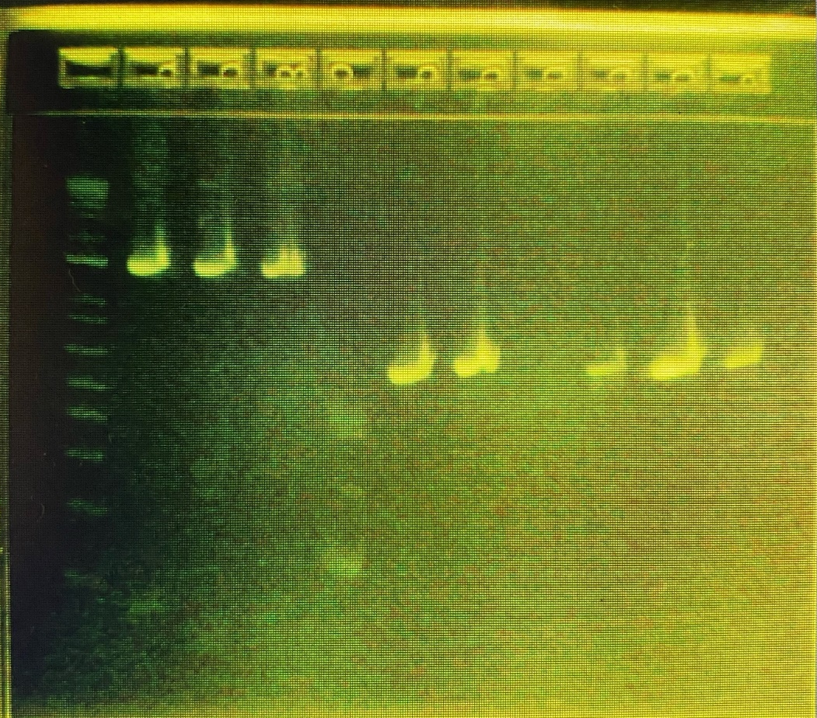
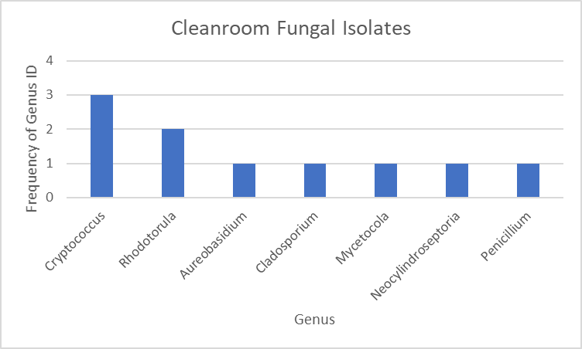

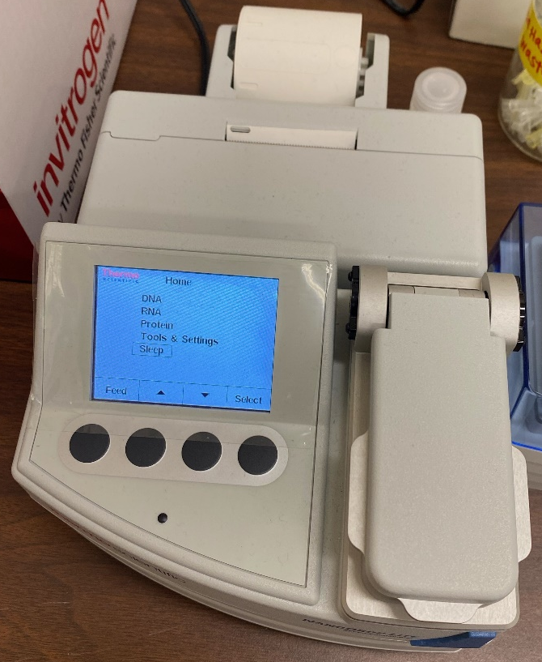
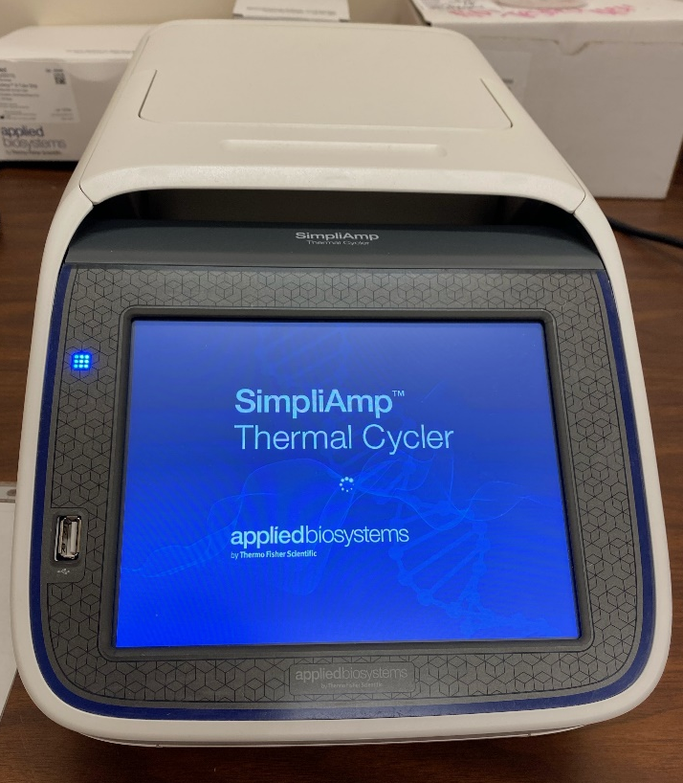
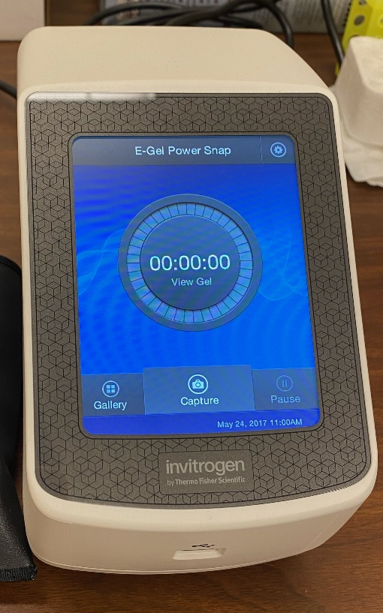
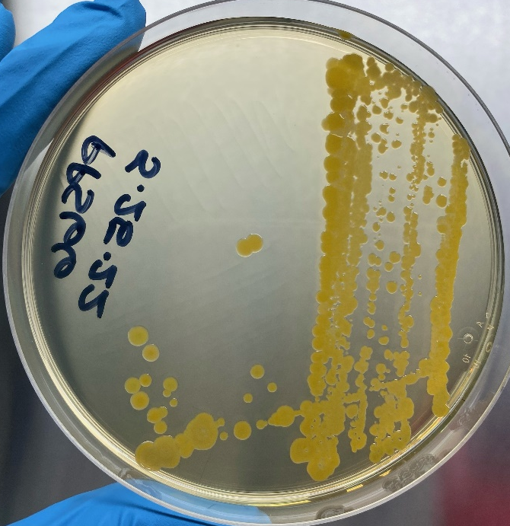
Isolation, Identification, and Characterization of MSFC Cleanroom Microbes
Chelsi D. Cassilly Ph.D.¹, Samantha A. Marcella², Heather C. Morris³, Todd A. Schneider⁴, Peter Bertone Ph.D.⁴, Erin G. Hayward Ph.D.⁴, Jason A. Vaughn⁴, Jarvis A. Caffrey Ph.D.⁵, Mary K. Nehls⁴
¹EM41 Space Environmental Effects Team (ESSCA); ²EM31 Materials Science and Metallurgy Branch (ESSCA); ³ST23 Space Technology (ESSCA), ⁴EM41 Space Environmental Effects Team (NASA); ⁵ER64 Propulsion Technology Branch
Background and Significance
The process of molecular identification can be understood in the flow chart depicted below, starting with isolation of microbes and ending with molecular identification.
Microbial Identification
Microorganisms can have significant impacts on the success of NASA’s missions, including the integrity of materials, the reliability of scientific results, and crew health. Robust cleaning and sterilization protocols are currently in place in NASA facilities, but microbial contamination is unavoidable and its impact on NASA’s missions and science must be minimized. Stringent cleaning and sterilization protocols are currently utilized by NASA, but many projects and materials have constraints on available sterilization procedures. Therefore, it is of utmost importance to be informed of: 1) what specific microorganisms are present, 2) how they may impact mission objectives, and 3) how to mitigate them.
In total, 95 microbial isolates underwent our procedure. Based on plate morphology, 11 were classified as fungi while 84 were considered bacteria. As expected, cleanrooms demonstrated fewer microbes than the uncontrolled areas, with the exception of Location F which is environmentally uncontrolled but geographically isolated and infrequently visited. Air from all cleanrooms tested yielded no microbes.
Of the 95 isolates, we amplified PCR products from 77 strains. The remaining 18 strains were streaked fresh on plates, packaged, and sent to Johnson Space Center (JSC) in Houston, TX. With funding and support from NASA’s Office of Planetary Protection (OPP), we traveled to JSC and aided in the DNA isolation, purification, amplification, and sequencing of these strains which resulted in eventual identification for all 18, at least to a genus level.
The frequency of genus identification for isolates from the environmentally-uncontrolled PP lab at MSFC.
1) Collect samples and plate; 2) Isolate pure cultures; 3) Freeze strains and curate an organism library; 4) Accumulate biomass; 5) Perform DNA extraction; 6) Quantify DNA on Nanodrop; 7) Amplify targeted gene sequence using PCR; 8) Confirm PCR using gel electrophoresis; 9) Purify DNA; 10) Quantify DNA on Nanodrop 11) Array samples in 96 well plate; 12) Set up account and create order with commercial sequencing service; 13) Ship samples to commercial sequencing service; 14) Sanger sequencing; 15) Perform DNA analysis to identify organisms. Figure created with BioRender.com.
Space Environmental Effects on Microbial Survival
NASA’s OPP is interested in understanding the PP threats associated with microbes isolated from cleanroom environments. Specifically, they wish to understand the ability of these microbes to survive in the space environment.
The Space Environmental Effects (SEE) team at MSFC is perfectly poised to address this question. With a second Jacobs Innovation Grant, and in support of a ROSES C.15 Planetary Protection Research proposal to be resubmitted in 2023, the SEE team has begun work on exposing a selection of MSFC cleanroom microbes to simulated space conditions. This has included the application of microbes at onto sterilized Kapton coupons. We then adhered them to the exposure plate and irradiated them with protons.
Microbes collected from human skin, one of the most common sources of microbial contamination within cleanrooms.
Microbial Isolate Collection
Four cleanrooms at MSFC were selected for sampling, in addition to the uncontrolled lab spaces. One cleanroom, Location F in the table below, is not maintained as a cleanroom but still has limited access.
MSFC has an established planetary protection (PP) microbiology lab with multiple capabilities to analyze spacecraft materials and associated microbial contamination. However, many microbes cannot be cultured or identified using the NASA standard microbiological methods. With funding from a Jacobs Innovation Grant, we collected samples from four different cleanrooms onsite at MSFC, isolated nearly 100 microbes, and then identified them using modern methods of molecular identification. We also traveled to Johnson Space Center (JSC) and conducted similar procedures to identify microbes that failed our initial round of identification. Combining all results, we achieved a 93% success rate with highly confident identifications.
Furthermore, NASA’s office of planetary protection (OPP) is interested in understanding how the space environment might impact or mitigate cleanroom-associated microbes. With funding from a second Innovation Grant, we have begun studying the survivability of a selection of cleanroom microbes from our library against space-like stressors. Thus far, we have begun initial characterization of these microbes by subjecting dried samples to ionizing radiation, noting significant drops in viability. Ongoing work includes optimization of test parameters and repeated exposures.
Ultimately, this body of work will improve PP efforts at MSFC (i.e. identifying contaminating microorganisms in cleanrooms or on spacecraft) and will provide an additional service center-wide for the identification of contaminants that arise in other projects. Furthermore, we will help define the role that the space environment may play in mitigating these microbes from spacecraft. Accurate identification and appropriate mitigation will then increase the chances of success for NASA’s missions and objectives.
An isolate misidentified as bacteria at MSFC correctly identified as a yeast at JSC (left). Cassilly working at JSC in the sequencing lab (right).
Of the remaining 77 DNA samples submitted for DNA sequencing, 66 yielded high quality DNA traces while 11 demonstrated sequencing errors. Most of these were due to either high background (indicating potentially contaminating DNA) or poor quality (indicating that the DNA was insufficient to be sequenced). Of the 11, six were identified at least to a genus level using the NCBI database. Finally, the remaining five showed no significant similarity within the NCBI database.
Of the 66 DNA samples that yielded high quality DNA traces, only one sample showed no significant similarity found within the NCBI database while one other sample pulled up no matches above 97% identity. The remaining 64 were identified to at least a genus level specificity.
Combining the results from JSC with our work, we achieved a 93% success rate with highly confident identifications. Summaries of the bacterial and fungal genera identified in MSFC cleanrooms are shown below compared with those identified in the environmentally uncontrolled PP lab.
114
117
114
117
116
116
110
110
112
112
73
73
73
67
67
63
63
56
56
67
63
56
117
117
114
114
116
116
110
110
112
112
73
67
63
56
121
121
121
121
39
39
58
58
From left to right: air sampling of Location F; wipes sampling of a floor in Location A; and swab samples being applied to a petri dish.
111
111
(-)
(-)
125
125
123
123
55
55
55
55
123
123
(-)
55
123
123
(-)
125
125
(-)
111
125
125
39
39
B
B
B
B
Various locations within each cleanroom were selected for sampling described in the table below. Samples were taken, stored at 4°C, then processed within the PP lab.
111
58
58
72
77
77
74
74
68
68
69
69
72
108
108
118
118
119
119
120
120
68
68
69
69
Location | Cleanliness Rating | Collection Date | Collection Method | CFU
A | Uncontrolled | 5/9/2022 | air sample | 6
A | Uncontrolled | 5/12/2022 | dry swab (table) | 27
A | Uncontrolled | 5/12/2022 | wet swab (table) | 12
A | Uncontrolled | 5/12/2022 | wet wipe (table) | TMTC
B | Uncontrolled | 5/12/2022 | wet swab (air) | 0
B | Uncontrolled | 5/12/2022 | dry swab (air) | 0
B | Uncontrolled | 5/12/2022 | wet swab (BSL2 hood) | 0
B | Uncontrolled | 5/12/2022 | dry swab (BSL2 hood) | 0
C | ISO 8 | 5/12/2022 | air sample (air) | 0
C | ISO 8 | 5/12/2022 | wet swab (air) | 0
C | ISO 8 | 5/12/2022 | wet swab (floor) | 7
C | ISO 8 | 5/12/2022 | wet wipe (table) | 463
D | ISO 8 | 5/12/2022 | wet swab (floor) | 26
D | ISO 8 | 5/12/2022 | wet swab (table) | 11
D | ISO 8 | 5/12/2022 | wet wipe (table) | 154
E | ISO 8 | 5/12/2022 | air sample | 0
E | ISO 8 | 5/12/2022 | wet swab (air) | 0
E | ISO 8 | 5/12/2022 | wet swab (floor) | 2
E | ISO 8 | 5/12/2022 | wet wipe (table) | 229
F | Uncontrolled | 9/22/2022 | air sample | 0
F | Uncontrolled | 9/22/2022 | wet swab (floor) | 0
F | Uncontrolled | 9/22/2022 | wet swab (floor) | 4
F | Uncontrolled | 9/22/2022 | wet wipe (floor) | 2
72
72
77
77
74
74
108
108
118
118
119
120
119
120
Microbe-inoculated Kapton coupons attached to the sample plate for irradiation with protons. Microbes are identified by numbers and color coded by survival (green), death (red), or unknown/contamination (yellow).
Several isolates survived irradiation, including some human-associated microbes. To confirm these data, we repeated these experiments and have narrowed our microbe selection for our ROSES submission, strengthening our proposal and increasing our chances of success.
Representative colonies from all plates were selected and streaked for isolation on fresh plates. Cultures were then scraped from the plates and DNA was isolated using a commercial kit. DNA was quantified then amplified using polymerase chain reaction (PCR). Once amplified, DNA was visualized using gel electrophoresis (shown below).
Conclusions
These findings summarize the accomplishments from two Jacobs Innovation Grants. The first has brought a new capability to MSFC. The PP lab can now easily collect and identify microbes using a standard molecular identification procedure. This service can be offered to the center whenever a need to identify microbial contaminants arises either within cleanrooms or on flight hardware. This capability also advances MSFC’s ability to provide reliable microbial identification, an area that PP requirements verification is heading. Finally, this effort has resulted in a library of cleanroom microbes which can be used in future studies or collaborations even outside of NASA MSFC.
The second Innovation Grant has tied together the capability and results of the first with practical research areas of interest to NASA. Characterizing the ability of cleanroom microbes to survive space-like conditions will directly support a funding proposal, helping to advance MSFC’s contribution to NASA’s goals and missions.
The Process of Molecular Identification
L 1 2 3 4 5 6 7 8 9 10
In order to identify microbes using a molecular approach, three primary capabilities must be available: 1) DNA quantification, 2) DNA amplification, and 3) DNA visualization. Each of these capabilities is accomplished using the instruments below, purchased by Jacobs.
Amplified DNA visualized on a gel imager. Lane L = size ladder; 1–3 = bacterial DNA; 4 = failed PCR; 5, 6, 8–10 = fungal DNA; and 7 = negative control.
1
2
3
Selection of a representative colony streaked for isolation or pure colonies on a fresh plate.
The frequency of genus identification for bacterial (top) and fungal (bottom) isolates from cleanrooms at MSFC.

