Slide 1

BioSentinel Avionics Design Approach with COTS Parts
Shang Wu
NASA Ames Research Center
06/14/2023

Slide 2
Outlines
ARC’s Spaceflight Project Niche/Specialty
ARC’s COTS Use Strategy/Methodology
Examples ARC Missions
BioSentinel Mission Performance to Date
Conclusions

Slide 3
ARC’s Niche/Specialty
Small Spacecraft ($100M ~ $250M)
  LADEE, IRIS, LCROSS, Kepler
Nano-Satellites (CubeSats)
  GeneSat, PharmaSat, BioSentinel
Class D Spaceflight Payloads
  Eucropis, UVLED, Astrobee (ISS)
High Risk/High Reward Missions, Tech Demos
  ADEPT, PhoneSat, TechEdSats
Typical Projects
  Quick Turn (< 2-3 Years)
  Low Cost (LCC < $25M)
  Short Duration (<30 Days)

Slide 4
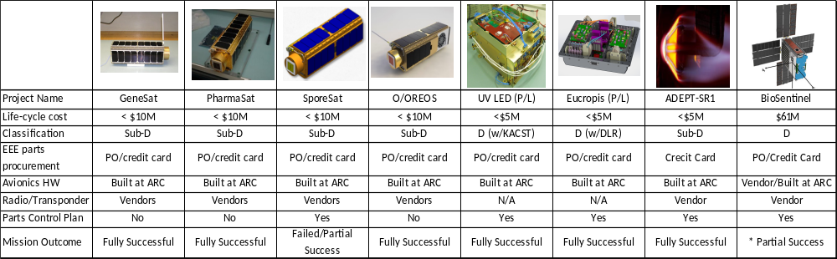
ARC Spaceflight Projects with Almost Entirely COTS Parts
SporeSat: OLED package trimmed in water contributing the payload failure (against datasheet)
Eucropis: Exceeded max success criteria; Comm. chip likely damaged by SEE in the extended mission
BioSentinel: Extensive launch delays caused excessive humidity (desiccant saturation) beyond design spec, contributing to biology payload failure. The bus was fully successful and has been operating in an extended mission

Slide 5
Traditional QML/QPL Challenges for ARC
Cost
  Prohibited MOQ (Unit Cost Not Main Blocker)
Schedule
  Lengthy Procurement Process & Delivery (6~12 months not uncommon)
  Tight Design & Prototype Schedule
Inflexibility
  Design Changes → Cost & Schedule Loop
  No Alternatives/Replacements
Size, Weight & Power
Performance & Functionality

Slide 6
Ames COTS Parts Selection Strategy
Careful COTS
  MIL/Automotive/Industrial/Commercial Grades
  Wide Design Margins (Temperature, Voltage, Power)
  Commonly Used Parts (Huge Production Volume)
  Flight Heritage
  Trusted Manufacturers & Distributors
  Limited screening including GIDEP search, visual inspection, counterfeit controls
Board/System/Mission-Level Testing
  Risk mitigation at board/system level
  Extensive testing with multiple design revisions
  Test on orbits and in low-cost missions

Slide 7
Observations in ARC Missions
Design & Workmanship Issues >> Component Failures
QPL Approach Needs More Resources
  Less upper-level testing (Undetected bugs)
QPL (Less integrated) Often Requires More Supporting Circuits
Up-Screened Components Would Not Have Saved/Improved Most ARC Missions.
COTS Benefits ARC:
  Wider selections, faster development schedule, lower costs
  Few radiation test data, but significantly more use cases
  Solid design/testing has better returns than solid parts

Slide 8
Radiation Risks for COTS Approach
Lack of Radiation Test Data on COTS
Mitigations
  Software (TMR), EDAC
  Over-current detection & protection.
  Redundant Design
  Watchdog Timers (H/W & SW)
  Selective Radiation Tolerant Components
    QPL Engineering Unit, COTS Equivalent RT-Parts (same die)
    COTS with radiation test data
    FRAM, MRAM, GaN, SiC

Slide 9
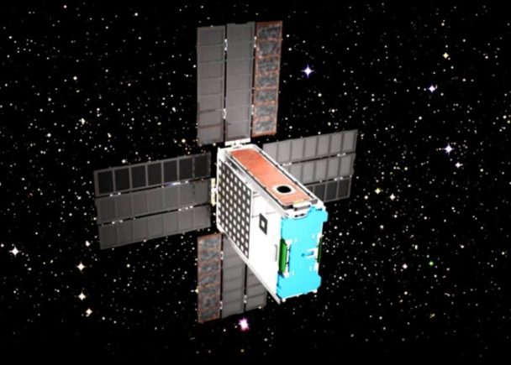
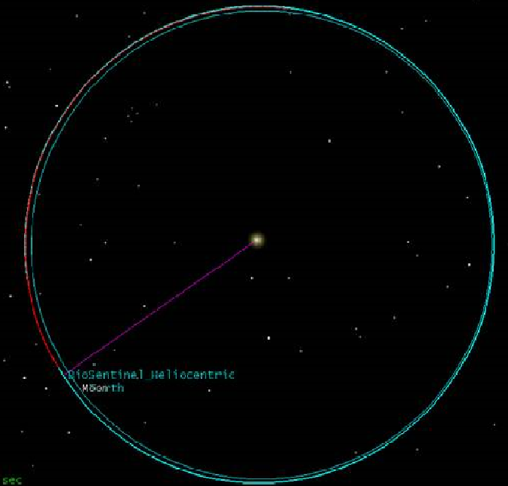
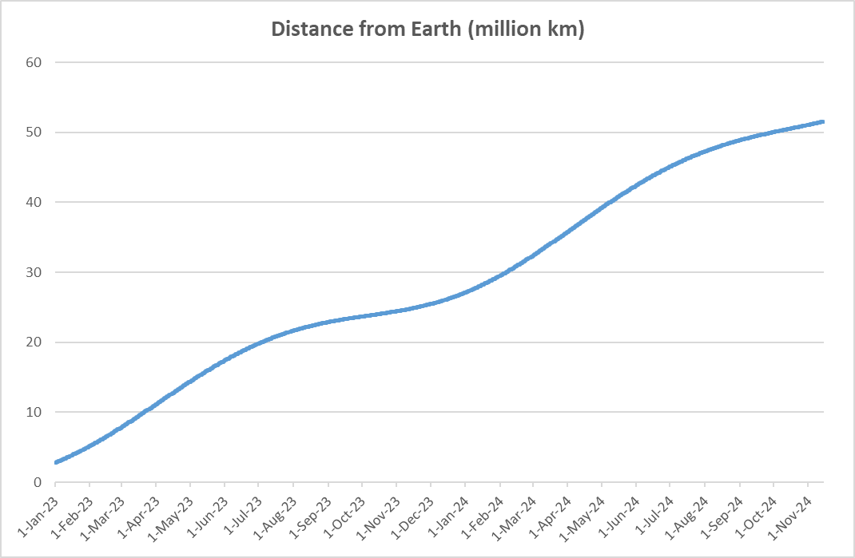
BioSentinel
6U CubeSat Launched with Artemis (Nov 2022)
One of the only Two Still in Operation
Heliocentric Earth-Trailing Orbit
Currently 18-million km from Earth
Extended Mission

Slide 10
BioSentinel Mission Performance
Largely COTS Components
ARC Designed Subsystems – 100% Careful COTS Strategy
7 Months in the Orbit → Extended Mission
Vendor Supplied Subsystems – Quality Varies (Mostly COTS)
Bit Flips & Resets – Likely Software Glitches (TBV)
Main Issue to Date – Biology Payload Failure
Subsystem | Source | Component Level | Anomalies
Transponder | Vendor | QML? | *Resets
C&DH | Vendor | COTS + QML | *Resets, Bit Flips
ADCS | Vendor | COTS | *Resets
Propulsion | Vendor | COTS | Stuck Valve
Sun Sensors | Vendor | COTS | *Reset
Solar Arrays | Vendor | COTS | None
LET Spectrometer | Vendor | COTS | None
Biology Payload | Ames | COTS | **Excessive Humidity
Battery BMS | Ames | COTS | None
EPS | Ames | COTS | None
  * Software glitches may be the source of resets and bit flips (TBV).
  ** Excessive humidity due to extensive launch delays caused circuit failure.

Slide 11
Conclusions
COTS has better SWaP & performance
Component failures are very rare among ARC missions
Higher grade parts would not have saved most missions.
Radiation test data on COTS is typically not available
  Risk Awareness
  Risk Mitigations (Proper S/W & H/W Design, Careful Parts Selection)
  Risk Taking (Stakeholder buy-ins)
Parts availability, performance, cost & schedule remain key drivers for ARC to pursue COTS solutions for high risk & high reward missions
ARC has 30+ successful projects with COTS (past 17 years)
COTS approach (potentially) good for higher classes of missions too

Slide 12
Backup

Slide 13
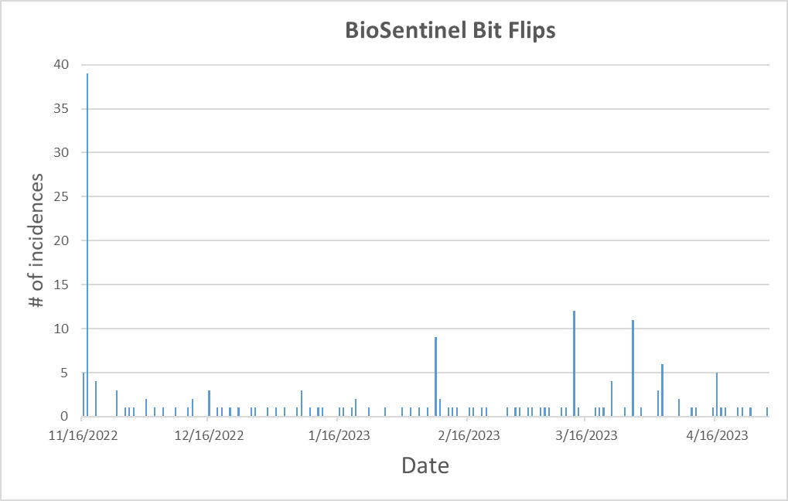
BioSentinel Bit Flips
* Dates are when bit flip incidences were detected, not when they actually occurred.

Slide 14
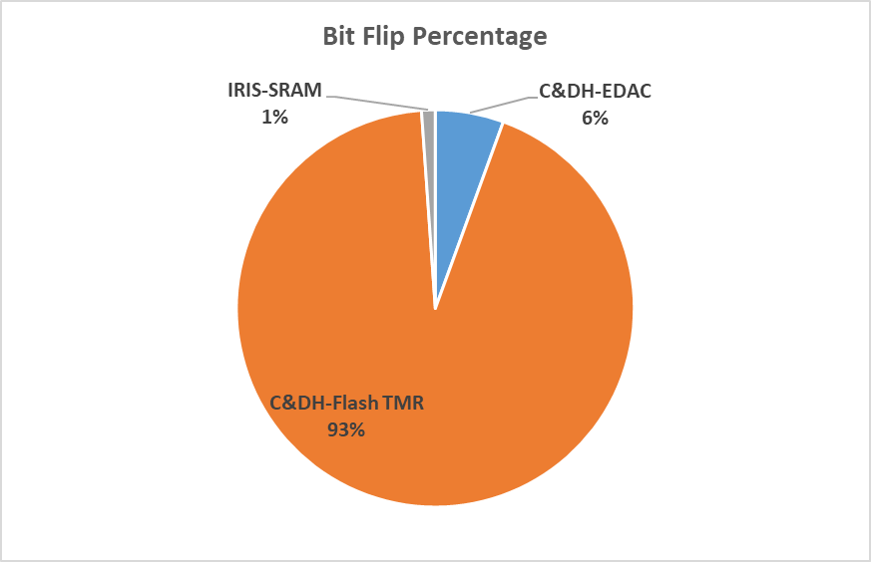
BioSentinel Bit Flips
Total of 180 bit flips detected since launched on 11/16/2022
Some incidences may be software issues (TBV)

Slide 15
BioSentinel Resets & Other Anomalies
Date | Event | Notes
2/8/2023 | Memory Error (Correctable)
2/20/2023 | C&DH Reboot
3/4/2023 | C&DH Reboot | Watchdog Timeout
3/13/2023 | ADCS Reboot
3/19/2023 | C&DH Reboot
4/16/2023 | Memory Error (Correctable)
4/25/2023 | ADCS Reboot
Root causes are still being investigated.

Slide 16
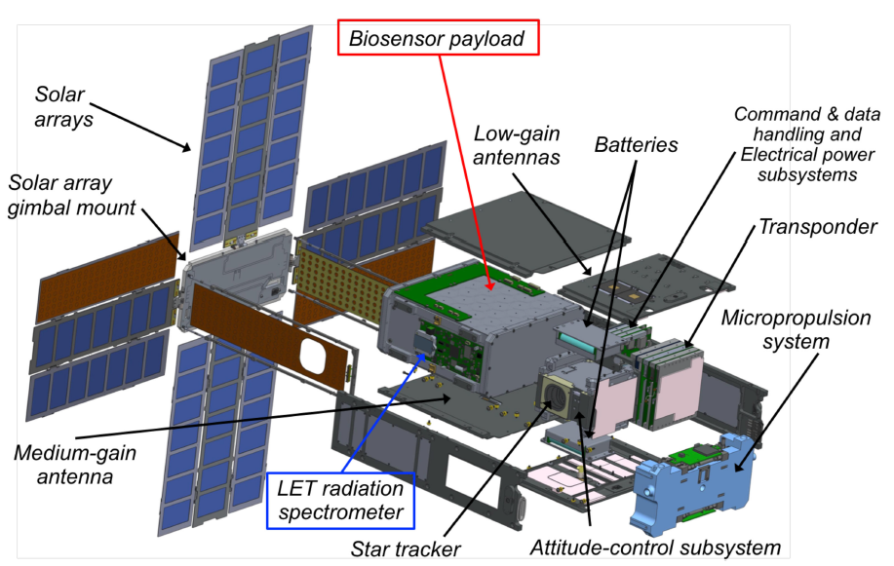
BioSentinel Subsystems

Slide 17
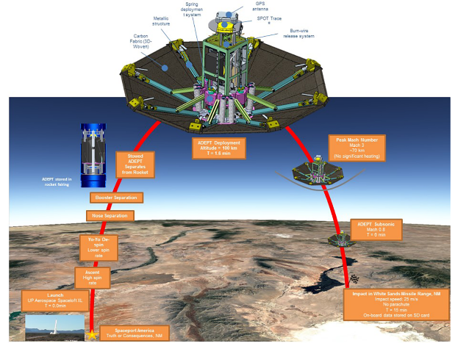
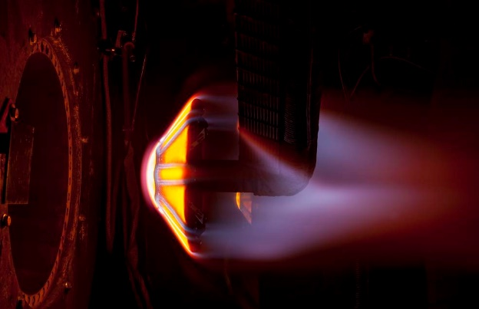
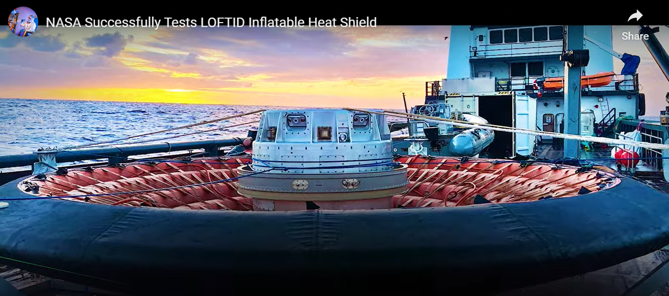
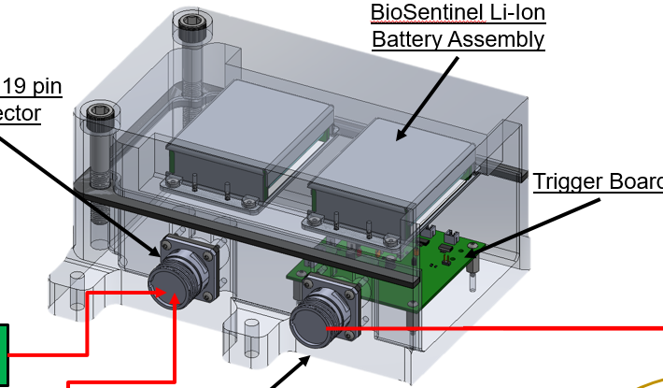
Deployable Entry Systems (ADEPT-SR1, LOFTID Recovery Lights)

Slide 18
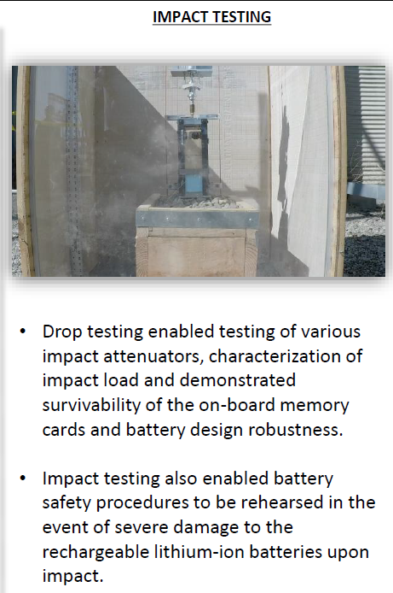
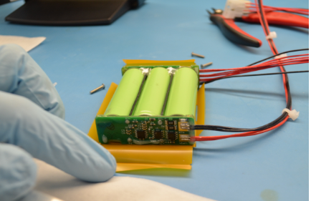
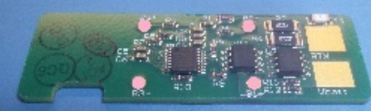
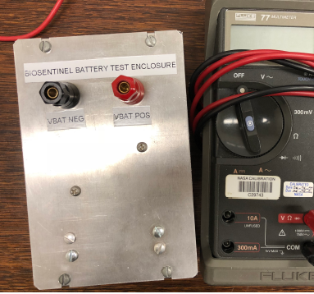
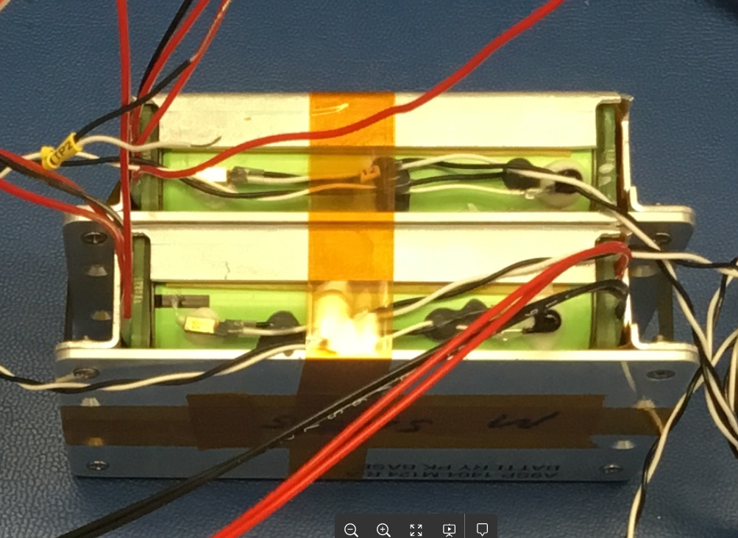
ARC Battery/BMS
ADEPT (2018)
LOFTID (2022)
BioSentinel (2022)
100% COTS
100% Success Rate

Slide 19
Additional COTS Benefits
Benefits
  Wide Part Selections & Design Flexibility
  Size, Weight & Power
  Fewer Components => Improved Reliability
  More time available for thorough testing of designs
  Far Lower Cost & Shorter Schedule to Accomplish Missions
  COTS may not have radiation test data; but has millions of samples over multitude of applications to establish quality & reliability
  Any parts can fail, a solid design beats a solid part
  Proven Successes Over 30+ Spaceflight Missions (17 years)

