Slide 1


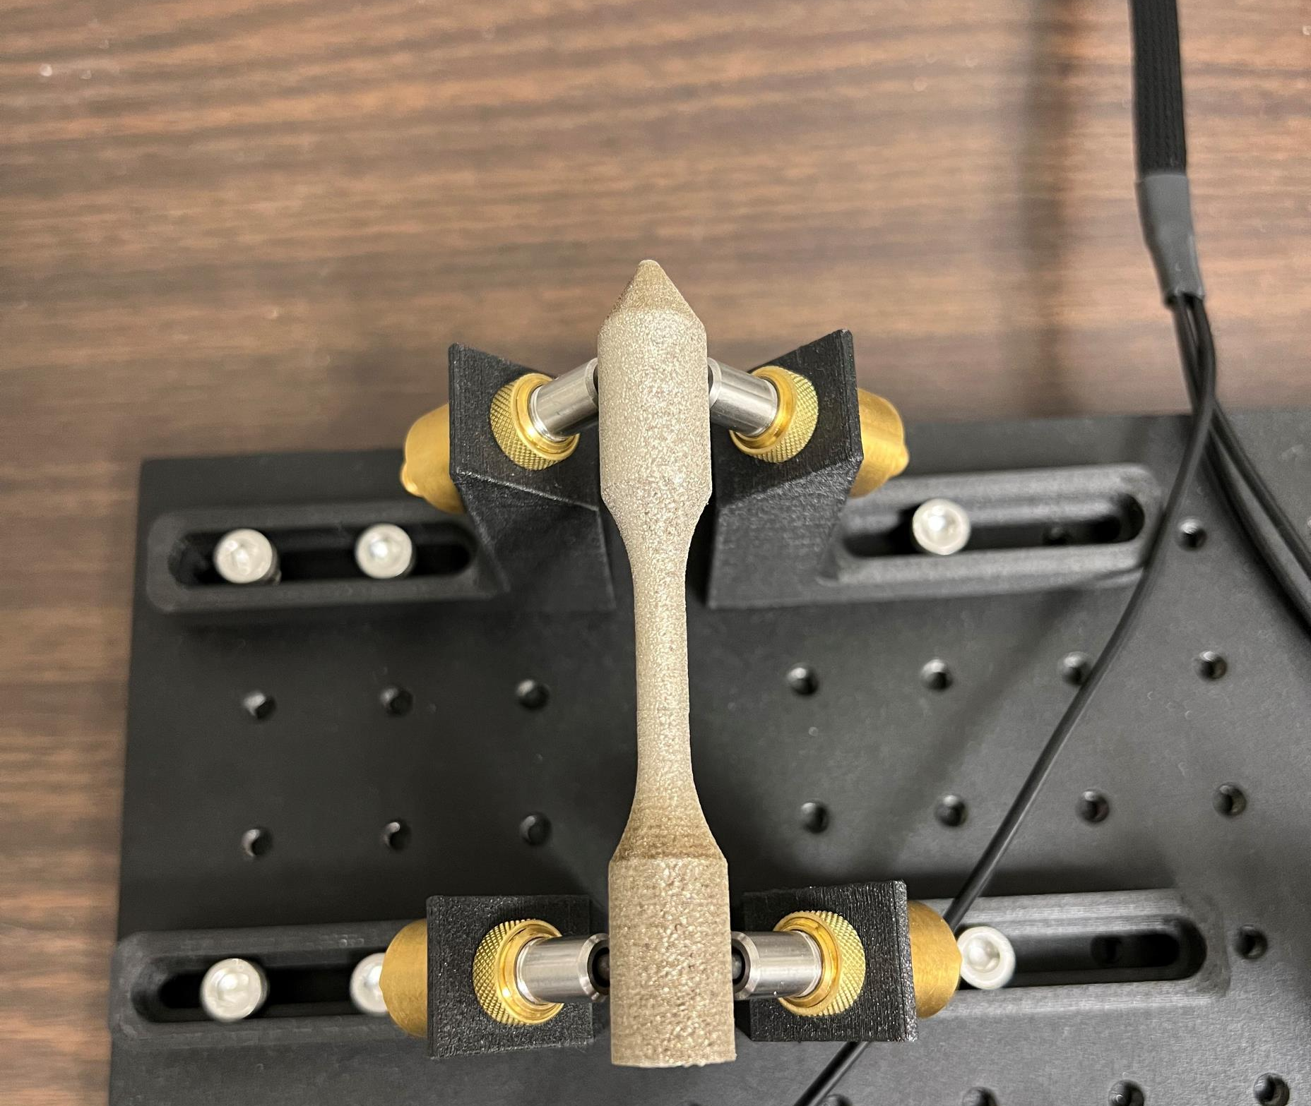
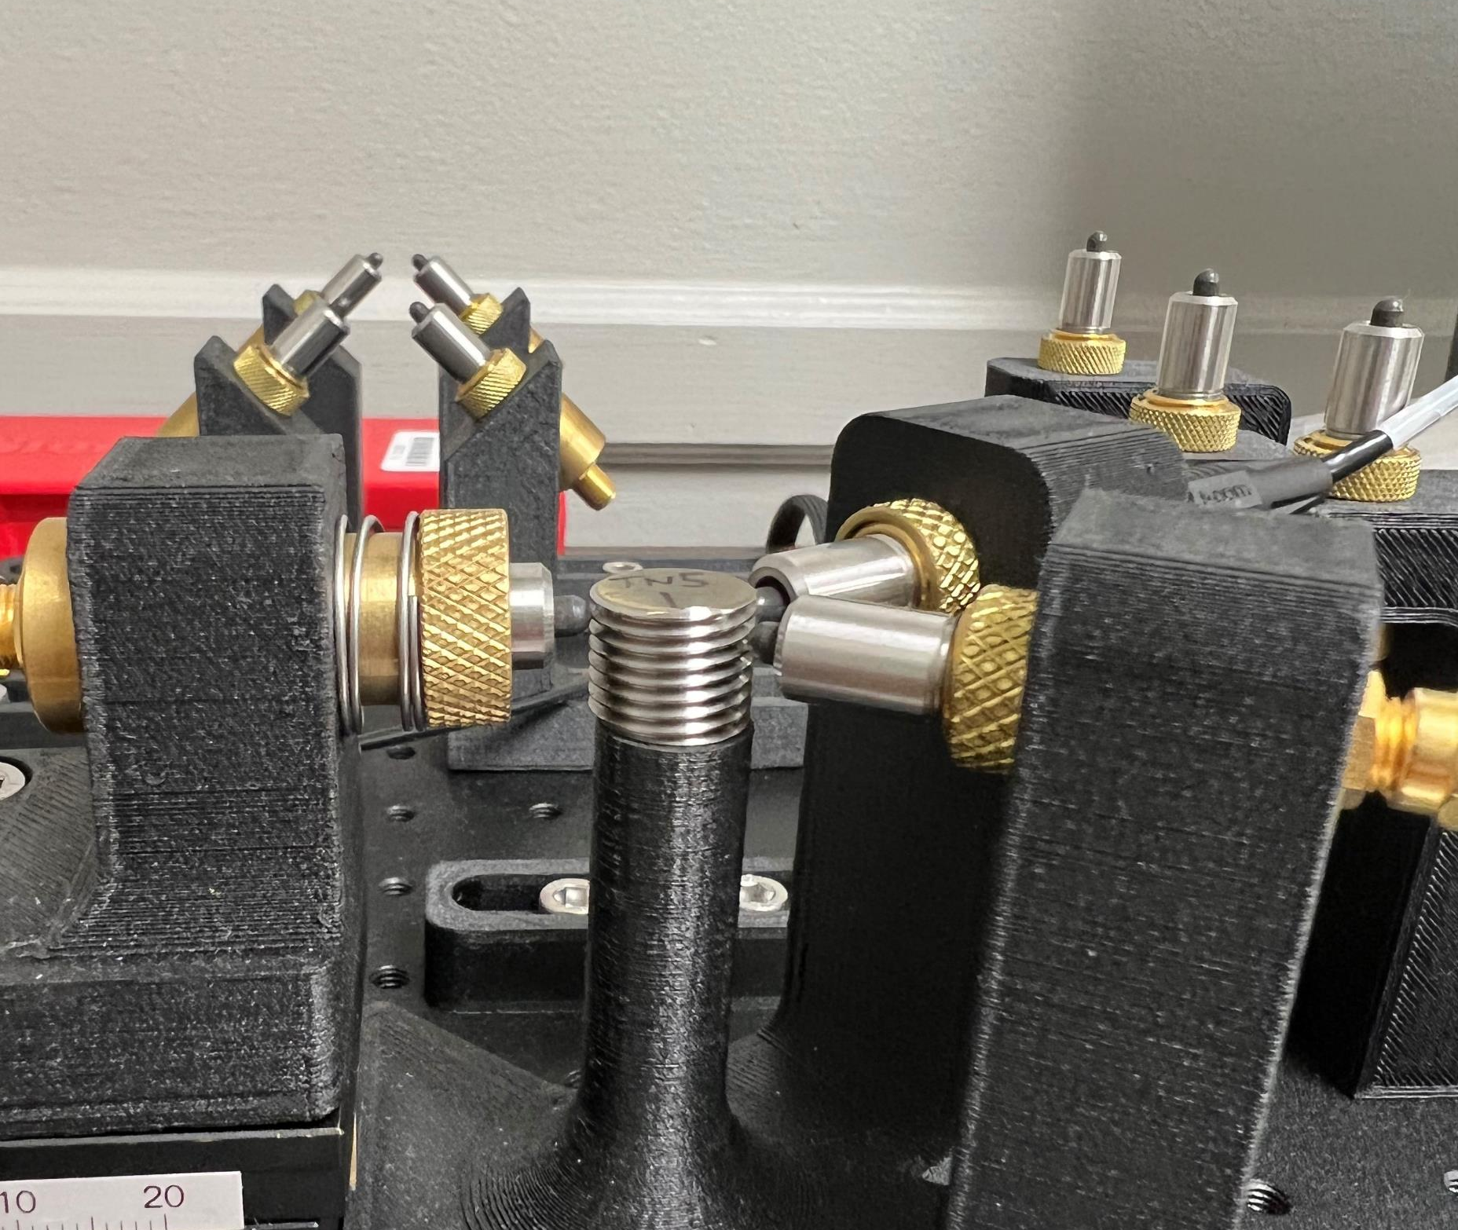
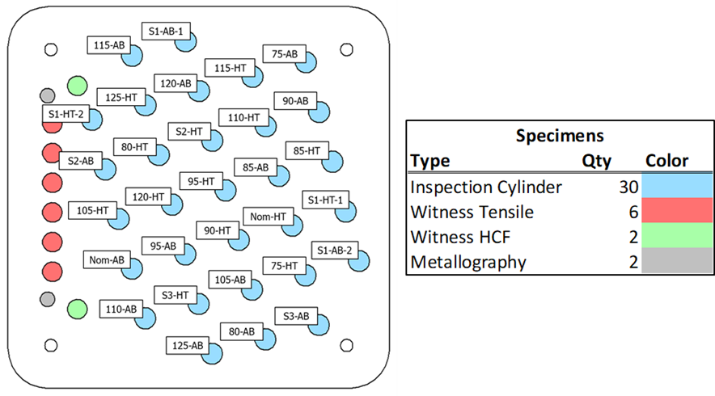
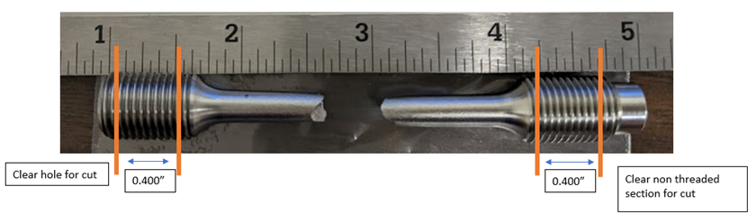
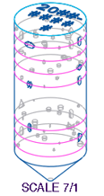
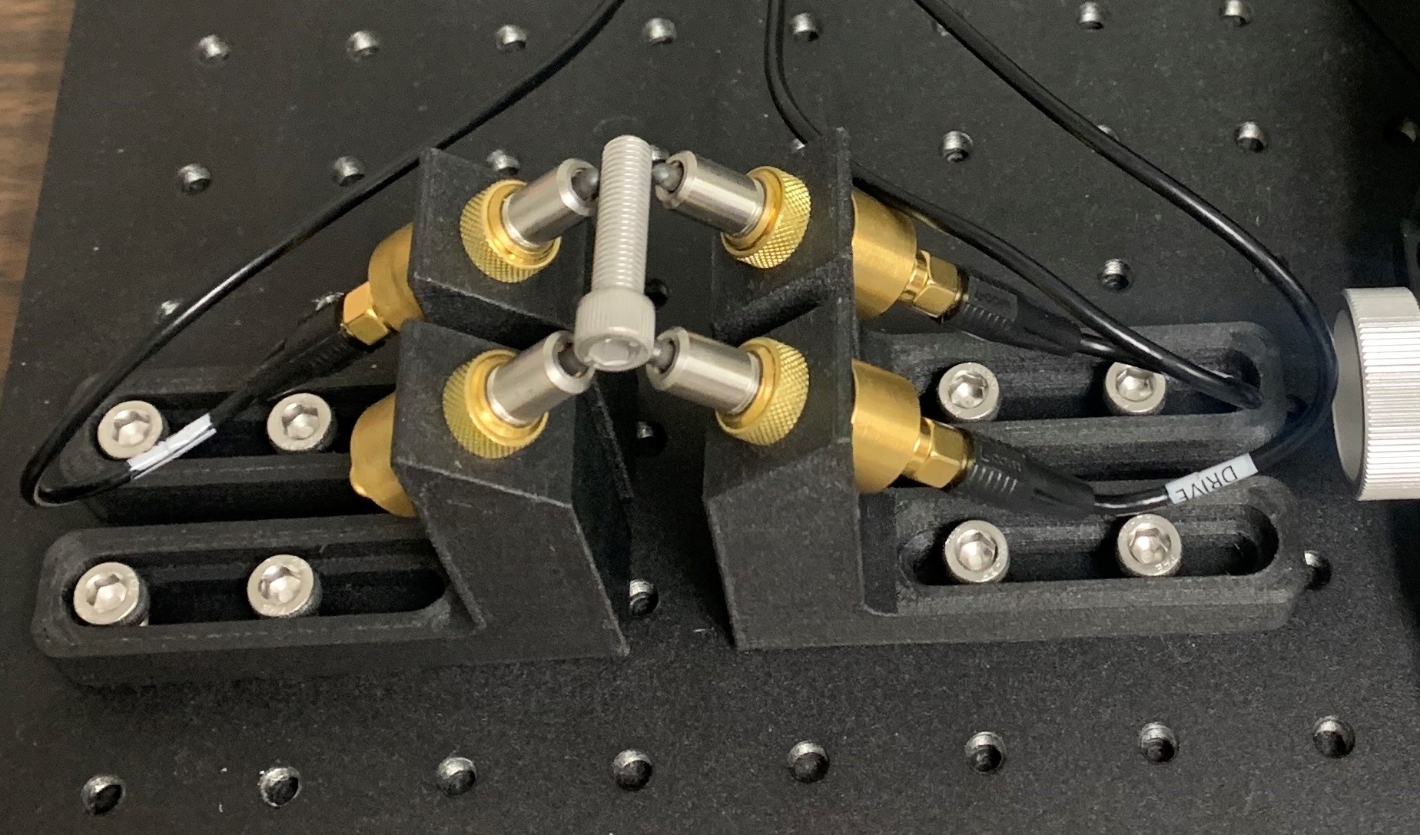
Process Compensated Resonance Testing (PCRT)
NASA Marshall Space Flight Center
Engineering Directorate, Materials & Processes Lab
Erin Lanigan, Delphine Duquette, Daniel Vaughan, Isabelle Sadowski (EM21)
Overview
PCRT uses resonant frequency – the natural frequency where a medium vibrates at the highest amplitude. PCRT measures the resonance frequencies of whole parts and compares the results to parts of the same type that are known to be nominal.
Off-nominal properties or defects in a part will affect its resonant frequency. This technology is an especially important technology as additive manufactured parts become more prevalent.
The nondestructive evaluation (NDE) of additively manufactured parts presents unique challenges and opportunities. Additive manufacturing (AM) technology enables complex part geometries and morphologies, which test the limits of conventional NDE techniques. PCRT can potentially detect common AM defects such as porosity, lack of fusion, inclusions, oxides/corrosion, etc.
Current Projects
Current Projects (continued)
AM Dogbone Samples
Tensile test remnants are machined down for consistent size and shape
Parts are PCRT tested to determine if PCRT analysis aligns with mechanical test notes, which already determined if the build was good or bad.
Initial PCRT analysis (Z-score) shows distinctions between builds with outliers present.
  Analysis showed PCRT capability to compensate for variables such as mass, height, and diameter to find true outliers
HR-1 Defect Study
Defect study includes various types of NDE inspection, PCRT being one of them
Only two nominal parts per build
  In the future, more nominal parts to be created to have better baseline established for PCRT
Z-score analysis found that AB and HT groups for 125% laser power showed large differences in Z magnitude
  Build plate locations show that 125% power samples were on the edge of the build plate
PCRT could show variation across build plates
Demonstrates that PCRT can possibly identify main factors in material property anomalies.
How does PCRT work?
Set Up
Sending/Receiving transducers must be in contact with the part
Transducers sweep over a range of frequencies to identify resonant modes
Fixture & Transducer set-up must remain consistent with each specimen
  Channels must be in the same pattern
  Hardware Verification Test can give a red/green light to indicate if the fixture is correctly set up
Analysis
Vibrant – the company that developed this system – has pattern recognition software to provide pass/fail analysis.
There are three main methods of analysis Vibrant uses:
  Z-score Analysis
    Characterizes part resonances relative to a reference population
    Identifies Gross Outliers
  Vibrational Pattern Recognition (VIPR)
    Uses Mahalanobis-Taguchi System (MTS)
  Part-to-Itself (PTI)
    Metrics describe how a part changes due to processing operations (e.g. heat treated)
Process Sensitivities
Consistent part geometry is critical
  Failed AM builds can result in incorrect height or shape
  Messy build plate removal can result in incorrect shape
  Changing build parameters will invalidate previous population
Fig 1: IN718 High Cycle Fatigue Specimen
Fig 2: IN718 Dogbone Specimen
Fig 5: HR-1 Defect Build Plate
GSFC Fastener Study
Goddard Space Flight Center has an interest in using PCRT for flight fastener quality control
GSFC sent two lots of fasteners – Lot A and B – of two different sizes
Goal is to compare population of ‘good’ fasteners to population of ‘bad’ (defected) fasteners
Fig 3: IN718 Dogbone Specimen Cut Plan
HR-1 Defect Study
Two kinds of defects: seeded defects and laser power variation defects
  Seeded defects of varying diameters
  Laser power variation from 75%-125%
These defects replicate defects commonly found in AM builds such as:
  Gas porosity trapped in powder feedstock
  Fluctuations in laser power output
  Build process errors
Fig 4: HR-1 Defect Study Seeded Defect Specimen Drawing
Fig 5: GSFC Lot A Fastener

