Slide 1
Plasma Abatement of Volatile Organic Compounds
Dr. Ryan Gott, Dr. Kenneth Engeling, Ray Pitts, Shayla Wilhelm, Caiden Campbell, Dr. Joel Olson
52nd International Conference on Environmental Systems
Calgary, Canada
July 17th, 2023

Slide 2
Space Infusion Goals
Volatile Organic Compounds (VOCs) are common byproducts of important systems
  Trash to Gas technology
  Mechanical Lubricants
  Hygiene Products
The state of the art for reduction of VOCs relies on consumable scrubbers
  Plasma reduces logistics and uses only electricity (~50 W)
2

Slide 3
SMAC Limits
Analyte | 1 hr | 24 hr | 7 day | 30 day | 180 day | 1000 day
Acetone | 500 | 200 | 22 | 22 | 22 | Not Set
Pentane | 150 | 80 | 60 | 20 | 3 | Not Set
Benzene | 10 | 3 | 0.5 | 0.1 | 0.07 | 0.013
Ethanol | 5000 | 5000 | 1000 | 1000 | 1000 | 1000
Spacecraft Maximum Allowable Concentration limits are shown in ppm.

Slide 4
Methods
Introduce 100 ppm of a select VOC (Acetone, Ethanol, Pentane, or Benzene) into CO₂ environment
Recirculate for 15 minutes through a plasma
Sample gases at 1, 2, 5, 10, and 15 minutes
Quantify VOC via Gas Chromatography Mass Spectrometry
Quantify principal gases via Gas Chromatography with thermal conductivity detectors

Slide 5
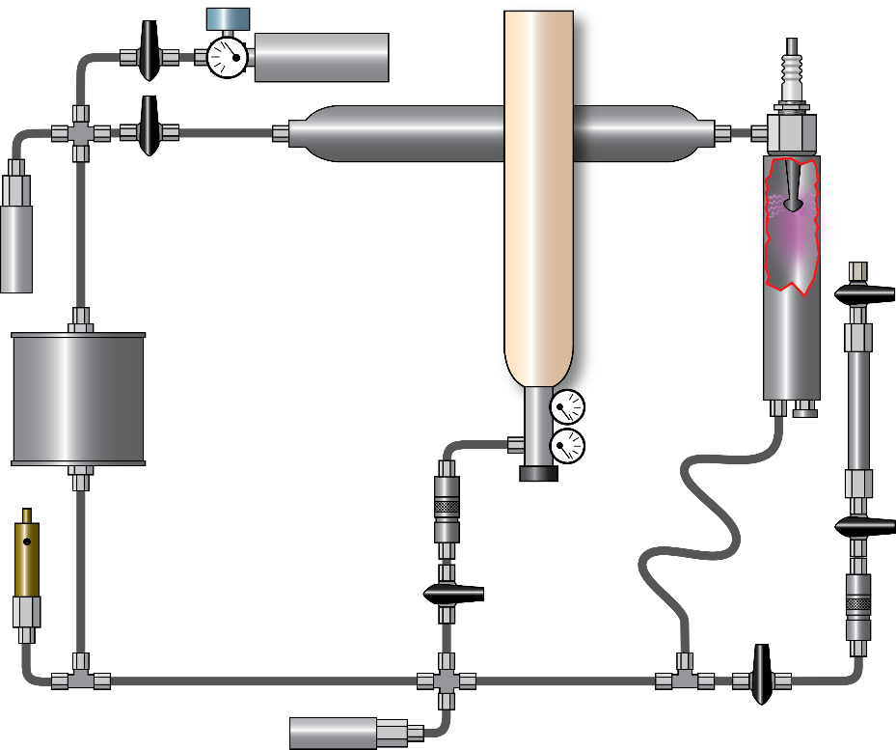
Experimental
Arrangement
Gas Collection
HV4
HV3
Plasma Torch
Gas Input
PT2
HV6
Pump
Flow
Gas Sampling
QD1
HV5
PT = Pressure Transducer
RV = Relief Valve
QD = Quick Disconnect
HV = Hand Valve
RV
HV1
QD2
Air plasma
PT1
HV2

Slide 6
Results
VOC Concentrations (ppm)
Time (min) | Benzene | Pentane | Ethanol | Acetone
0 | 100.0 | 100.0 | 100.0 | 100.0
1 | 47.71 | 61.54 | 8.38 | 36.68
2 | 25.68 | 27.63 | 0.22 | 14.64
5 | 10.13 | 4.24 | n.d. | 0.56
10 | 0.96 | 0.27 | n.d. | n.d.
15 | 0.07 | n.d. | n.d. | n.d.

Slide 7
Results
VOC Concentrations (ppm)
Time (min) | Benzene | Pentane | Ethanol | Acetone
0 | 100.0 | 100.0 | 100.0 | 100.0
1 | 47.71 | 61.54 | 8.38 | 36.68
2 | 25.68 | 27.63 | 0.22 | 14.64
5 | 10.13 | 4.24 | n.d. | 0.56
10 | 0.96 | 0.27 | n.d. | n.d.
15 | 0.07 | n.d. | n.d. | n.d.
All VOCs obeyed first-order rate kinetics.

Slide 8
Results
Analyte | Rate Const. (min⁻¹) | R² | Half-life (s) | Time to C = 1/1000 (min)
Benzene | 0.913 | 0.9904 | 45.6 | 7.6
Pentane | 0.825 | 0.9743 | 50.4 | 8.4
Ethanol | 3.061 | 0.9962 | 13.6 | 2.3
Acetone | 1.010 | 1.000 | 41.2 | 6.9
ethanol >> acetone > benzene > pentane

Slide 9
Results
In order of rate constant (fastest to slowest degradation):
Ethanol >> Acetone > Benzene > Pentane
Analyte | ΔH°(comb.) (kJ/mol) | FP (°C) | IT (°C) | IE (eV)
Ethanol | 1367 | 13 | 363 | 10.43
Acetone | 1790 | -20 | 465 | 9.70
Benzene | 3268 | -11 | 498 | 9.24
Pentane | 3509 | -40 | 260 | 10.28
ΔH°(comb) = enthalpy of combustion
FP = flash point
IT = ignition temperature
IE = ionization energy

Slide 10
Summary
Plasma removed target VOCs by >99% in 10 minutes or less
In CO₂ environment, CO, O₂, and water are byproducts
Why Plasma?
  Compact system
  No resupply needed
Future work
  Improved power efficiencies will be achieved soon
  Evaluate for different background gases
  Improve recirculation system for increased flow rate

Slide 11
Acknowledgements
Funding from NASA Kennedy Space Center’s Center Engineering and Support Operations
NASA funded contract with Oak Ridge Associated Universities
Dr. Tracy Gibson
Eric Parrish

Slide 12
Thank you!
Any questions are welcome.
Contact: ryan.p.gott@nasa.gov

