Slide 1


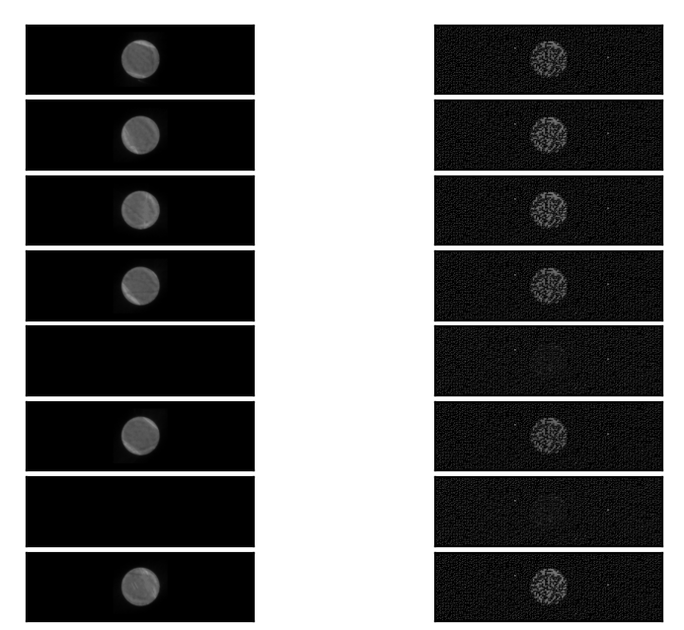
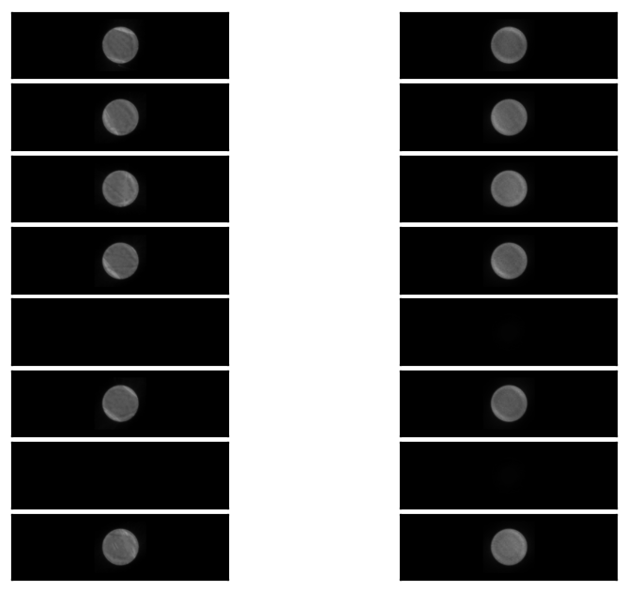
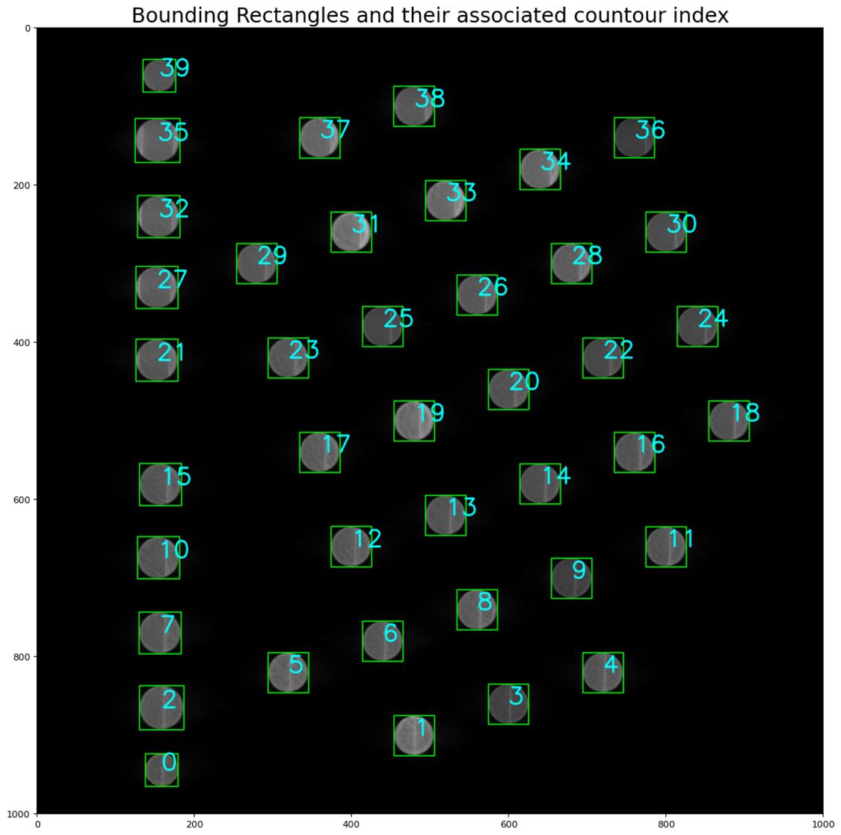
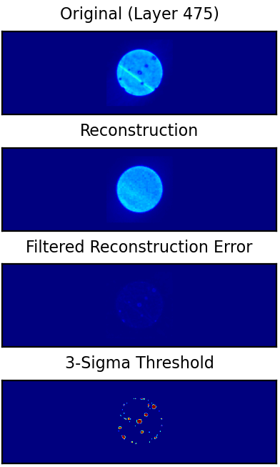
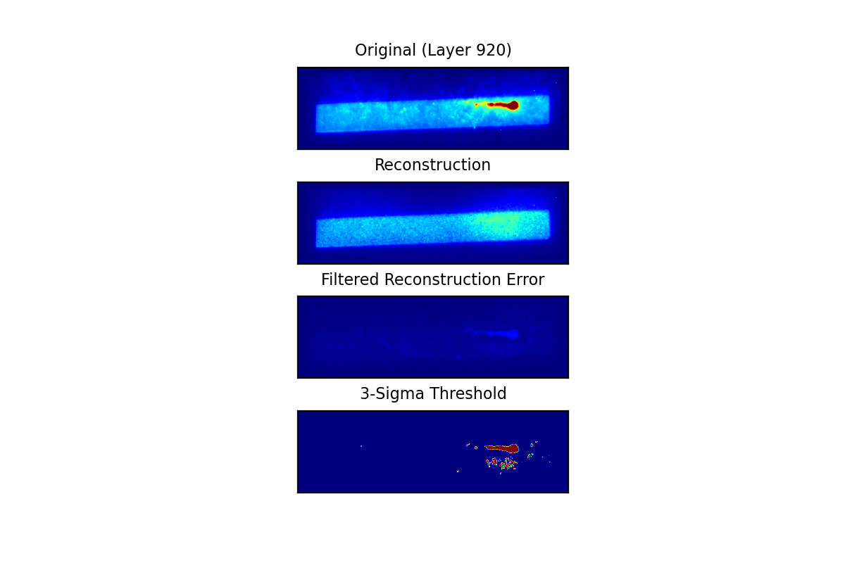
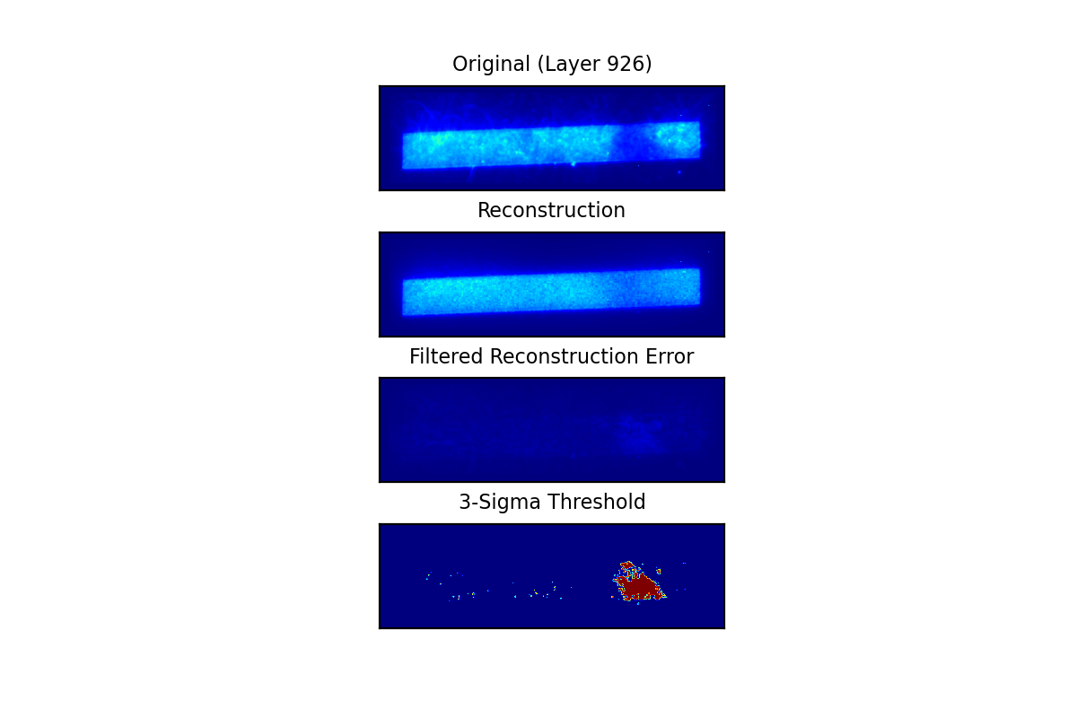
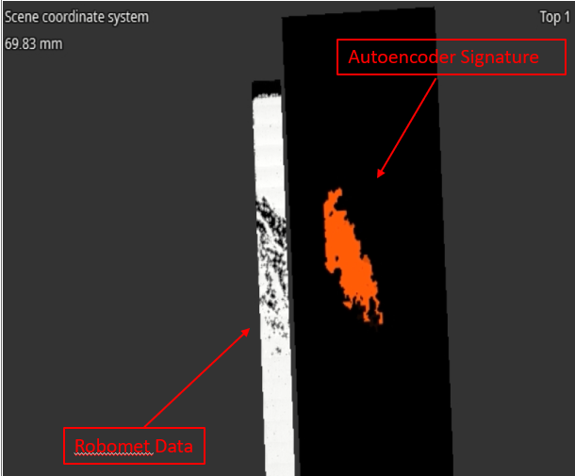
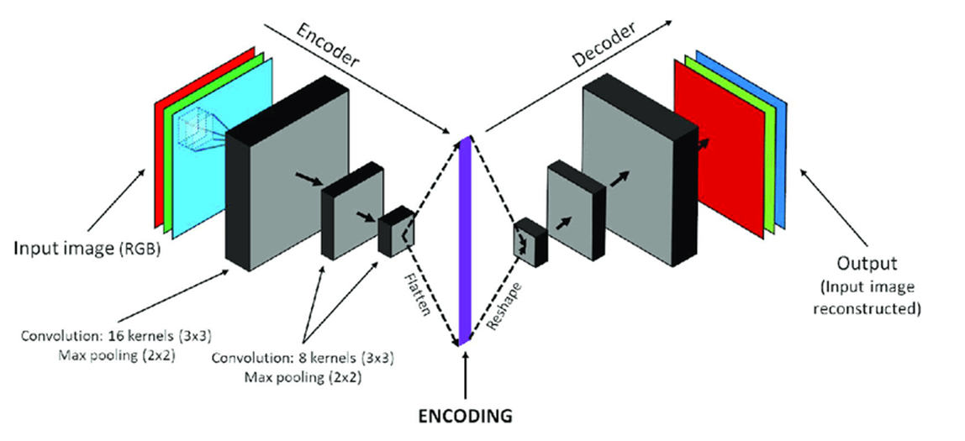
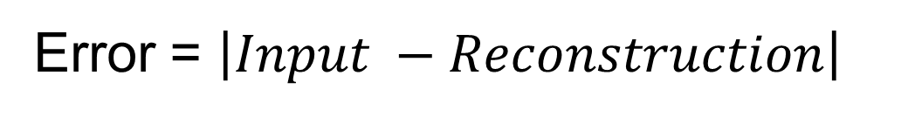
Convolutional Autoencoder for Defect Detection in Additive Manufacturing
NASA Marshall Space Flight Center
Engineering Directorate, Materials & Processes Lab
James Mavo, Aidan Faino, Daniel Vaughan, Raymond Carter, Erin Lanigan, Delphine Duquette, (EM21)
Overview
The core idea behind using machine learning (ML) for defect detection is that it can be used to detect flaws as they are being formed in an AM part. As the part is being made, a near-infrared (NIR) sensor records each layer and creates an image of the entire build layer. These images, usually thousands, can be compiled into a ‘3D’ array of the entire part. ML tools, such as a convolutional autoencoder (CAE) can go through these images and highlight potential anomalous regions of your part.
CAE - Training/Defect Detection
  An initial nominal version of the desired part is created by first removing noise and outlier pixels on the input slices that fall outside of a desired histogram range, before filling them in again with a Navier-Stokes inpainting algorithm.
  This preprocessed version of the original part image is used as input to train the CAE and create a nominal, abstract version, of the original defective image.
Original Image
Reconstructed
Original Image
Reconstructed
Fig 1.Captured Build Image from AM Machine. Bounding Boxes applied to Extract Object of Interest
150 Epochs
What is a Convolutional Autoencoder?
  The new nominal copy is compared to the defective image, and the absolute difference between the two is found.
  This ‘error difference’ dataset is then filtered using a 3-sigma threshold to mark locations whose reconstruction error is greater than 3 standard deviations from the mean of the layer; which ostensibly should be the faults in question.
A CAE is an unsupervised machine learning neural network with encoding and decoding layers.
These are used in convolutional layers which can be trained to ‘learn’ what features correspond to an initial, nominal input.
The Encoder abstracts these input images down and identifies key features.
The Decoder uses these features from the defect regions, in conjunction with the initial training regimen, to reconstruct a new, nominal part image.
Types of Defects Detectable by CAE
Short Feeds
Spatter
LOF (Induced)
Keyholing (Induced)
Skipped layers
Error = $\left|Input −Reconstruction\right|$
Flaw Signature and Final Part State
Fig 2.Diagram Depicting a CAE For 2D Images

