Slide 1
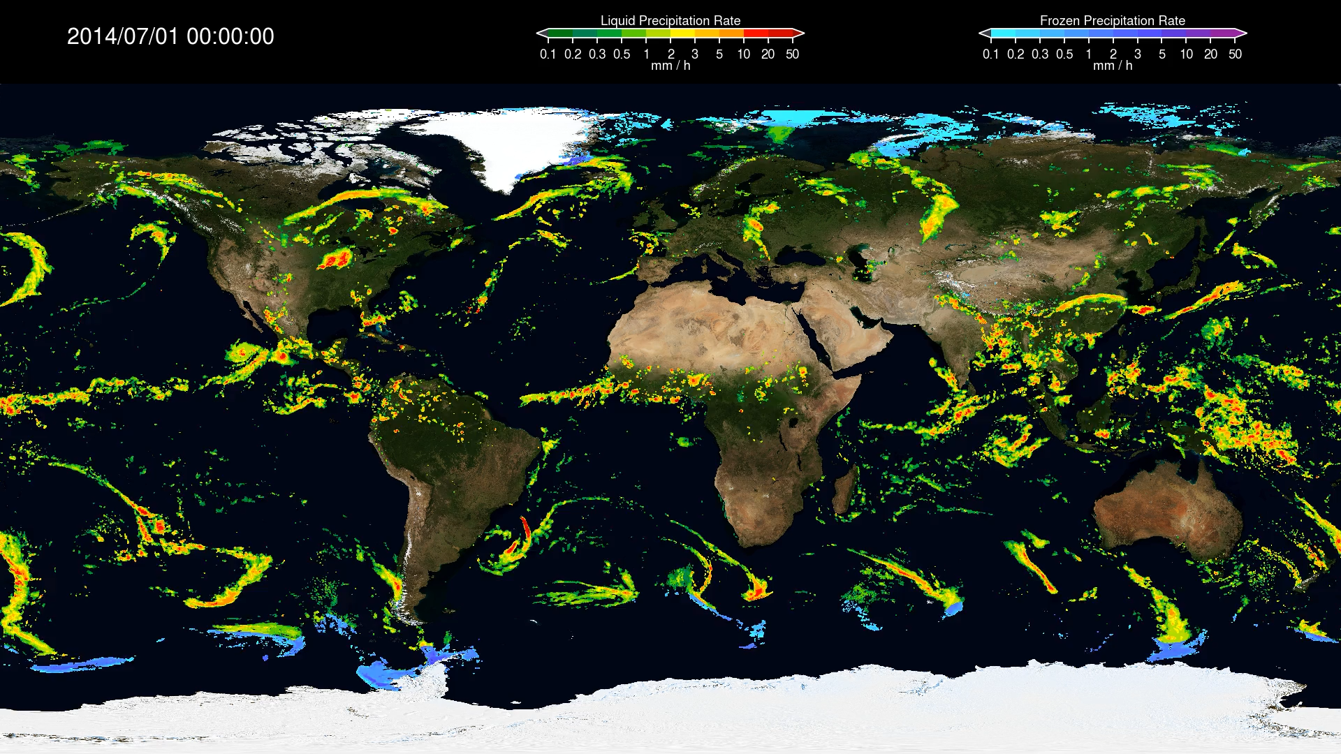
Where IMERG Goes Next: Version 08 and Beyond
George J. Huffman¹, David T. Bolvin^{1,2}, Robert Joyce^{1,2}, Eric J. Nelkin^{1,2}, Jackson Tan^{1,3}
1 NASA Goddard Space Flight Center, Greenbelt, MD, USA
2 Science Systems and Applications, Inc., Lanham, MD, USA
3 University of Maryland Baltimore County, Baltimore, MD, USA

Slide 2
Introduction
• the Version 07 (V07) Integrated Multi-satellitE Retrievals for GPM (IMERG) algorithm is finalized and production initiated
• the focus turns to enhancements for Version 08:
• innovations not included in V07 due to time constraints,
• issues revealed by the initial V07 products.
• post-V08 landscape:
• the final GPM reprocessing will be restricted to fixing known code or algorithmic errors,
• what comes next?
• thoughts on the session questions

Slide 3
Version 08 input data
• accommodate new passive microwave (PMW) sensors, which include the next generation of small-sats
• improve the homogeneity between the TRMM and GPM eras
• characterize differences between the two eras and apply corrections as feasible, perhaps by enforcing spatial scale consistency (an overarching issue)
• adapt to GPROF and the Combined Radar-Radiometer Algorithm (CORRA) converting to Machine Learning schemes in V08
• revisit/revise performance in difficult surfaces
• coast, orographic, snowy/icy-surface, high-latitude performance
• additional automated quality control for artifacts in the IR brightness temperatures and PMW precipitation fields

Slide 4
Version 08 code/processing development
• evaluate and revise the schemes in V07 that rectify temporal artifacts caused by the time interpolation that fills the gaps between the various PMW sensor overpasses (SHARPEN, t=0 KF)
• revisit/revise the specification algorithm for the probability of liquid phase
• refine the intercalibration scheme among CORRA, TMI, and GMI
• refine setting priorities for sensor types and times when they overlap in a half hour
• explore
• performance at high latitudes
• orographic enhancement in the propagation (morphing) scheme
• incorporating sub-monthly gauge data
Funk, C.C. and co-authors, 2022: Introducing and evaluating the Climate Hazards center IMErg with Stations (CHIMES) - Timely Station-Enhanced Integrated Multi-satellitE Retrievals for Global Precipitation Measurement. Bull. Amer. Meteor. Soc., 103(2), E429–E454. doi:10.1175/BAMS-D-20-0245.1
• developing error estimates – consider quantile estimates?
• adding a satellite-gauge-reanalysis/model estimate

Slide 5
Post-Version 08 input data
• plan for post-GPM intercalibration standard
• more small-sat PMW radiometers
• AVHRR-based precipitation estimates (most useful in high latitudes)
• ISCCP-Next Generation and GEO-Ring projects that could provide easy access to multiple GEO-satellite channels and enable significantly improved algorithms compared to GEO-IR alone
Behrangi, A., and co-authors, 2009: PERSIANN-MSA: A Precipitation Estimation Method from Satellite-based Multi-spectral Analysis. J. Hydrometeor., 10(6), 1414-1429. doi:10.1175/2009JHM1139.1

Slide 6
Post-Version 08 code/processing development
• start or continue developing quantile estimates
• shift to equal area grid for internal computations
• shift to Cloud computing
• testbed design for IMERG system

Slide 7
1. Precip characteristics
• better captured
• oceanic rain [finer-resolution, polarimetric low+high-freq. channels]
• less well captured
• coast [finer resolution, algorithms]
• orographic [radar, algorithms]
• snowy/icy-surface [algorithms?]
• high-latitude [synthesis of previous 3]
• short-lived events [more-frequent PMW observations]

Slide 8
2. Challenges/opportunities
• challenges
• almost-good-enough next-generation sensors
• cope with spatial resolution and bias differences
• between sensors
• across swaths
• balance use of model data to aid in retrievals against diluting observations
• RFI trashing channels
• opportunities
• next-generation sensors with “good” resolution, channel selection, calibration
• both active and passive
• use disparate channels from multiple sensors
• flying in formation
• from both LEO and GEO
• design in subchannels for better RFI resilience
• stable, uniformly (re)processed, long-term multi-channel datasets (PMW, GEO, radar, …)

Slide 9
3. Algorithm timeline forecast
now
improve IR Tb and PMW precip QC
coast
consistent
resolution
improve TRMM/GPM homogeneity
submonthly gauge
multi-channel
multi-sensor
error
estimates,
quantiles
snowy/icy surface
5
years
orographic
multi-sat.
testbed
alternate time interpolation
combine in
model precip
particle scattering database/
aggregation
10
labels placed at expected development time or mature state
lines show period of effort

