Slide 1
Statistical Interpretation of Life Test - Comparison between MIL and JEDEC requirements
Yuan Chen, Ph.D.
NASA Langley Research Center

Slide 2
Background
Some contents were prepared (but didn’t go through) for EEE Parts 101 training at MSFC in December 2022.
Some thoughts were triggered during the NESC COTS assessment.
Would not consider as a complete training or tutorial package, but for sharing and discussion purpose.
Focus or use semiconductor parts as an example

Slide 3
Outline
JEP001-1A, 2A and 3A
“Foundry Process Qualification Guidelines” for semiconductor
Life Tests in MIL-STD and JEDEC Standards
45 parts for 1000 hours and 3 lots with 77 parts from each lot for 1000 hours
Assumptions
Constant failure rate
Exponential Distribution
What does life test data mean?
What a life test can demonstrate for λ?
What a life test can demonstrate for lifetime or reliability?
Volume matters
Different philosophy
Different processes

Slide 4
JEP001-1A, 2A and 3A (I)
“Foundry Process Qualification Guidelines”
Wafer Fabrication Manufacturing Sites
Provide methodologies for the minimum set of measurements to qualify a new semiconductor wafer process .. with particular reference to a generic silicon-based CMOS logic technology.
1A – Backend of Line
2A – Front End Transistor Level
3A – Product Level (part-level)
Describe backend-level, transistor-level or package-level test and data methods for the qualification of semiconductor technologies.

Slide 5
JEP001-1A, 2A and 3A (II)
Does not give pass or fail values or recommend specific test equipment, test structures or test algorithms.
Two levels of qualification
Level 1 - pure process qualification intended to find reliability weaknesses. Primarily addresses technology wear-out mechanisms through packages or wafer level reliability tests on specially designed test structures.
Level 1 qualification report – qual plan, description of the test vehicle including test structure features and dimensions, summary of test methods used, pass/fail criteria, and test results, analysis and model parameters.
Level 2 – demonstrates the reliability of the process that corresponding to the reliability demands from projected or known applications. Can be implemented via the testing of a relevant functional technology qualification vehicle (TQV), including life test.
Level 2 qualification report – qual plan, description of TQV, test description and specification, pass/fail criteria, test results & analysis including failure analysis and FA results.

Slide 6
JEP001-1A, 2A and 3A (III)
Provide references for each test
1A – Backend of line testing
Electromigration (EM), Stress Migration (SM) or Stress-Induced Voiding (SIV), Thermal Cycling (TC), Inter/Intra Metal-Dielectric Reliability (IMD), Yield Data & Defect Density Calculation
2A – Transistor-level testing
Time-Dependent Dielectronic Breakdown (TDDB), Voltage Ramp Dielectronic Breakdown (VRDB)/Charge to Breakdown (QBD), Hot Carrier Injection (HCI), Bias Temperature Instability (BTI), Plasma Process Induced Damage (P2ID), Ionic Contamination/Bias Temperature Stress (BTS), Ionic Contamination/Triangular Voltage Sweep (TVS)
3A – Product-level testing
Early Life Test, Long Term Life Test (HTOL), Temperature Cycling (TC), Temperature Humidity Bias (THB) or Highly Accelerated Stress Test (HAST), ESD characterization, Latch-up characterization, Process Control Monitor (PCM), Construction Analysis (CA)

Slide 7
Life Test

Slide 8
Life Tests in MIL-STD Standards
MIL-STD-883K, Method 1005.10 “Steady-State Life”
The steady-state life test is performed for the purpose of demonstrating the quality or reliability of devices subjected to the specified conditions over an extended time period. Life tests conducted within rated operating conditions should be conducted for a sufficiently long test period to assure that results are not characteristic of early failures or "infant mortality,“….
Sampling: MIL-PRF-38535 “General Specification for Integrated Circuits (Microcircuits) Manufacturing”, Appendix D Table D-I
Sample sizes are based upon the Poisson exponential binomial limit.
Minimum size of sample to be tested to assure with a 90 percent confidence that a lot having percent-defective equal to the specified sample size series value will not be accepted (single sample).
45 parts for 90% confidence with < 5% defective allowable testing for 1000 hours at 125C.

Slide 9
Life Tests in JEDEC Standards
JEDEC Standard, JESD47I, “Stress-Test-Driven Qualification of Integrated Circuits”
HTOL (high temperature operating life) - The duration listed here is generally acceptable to qualify for the given application level. However, it does not necessarily imply the demonstrated of the lifetime requirements for a particular use condition. It depends on failure mechanisms and application environments.
Sampling in Table A
3 lots with 77 sample per lot for 1000 hours w/o failure.

Slide 10
Assumptions -- important to remember or verify
Exponential distribution is typically assumed when estimating the failure rate using life test data.
Bottom portion of bathtub curve or constant failure rate.
Upper bound if actual failure rate is decreasing.
The analysis/data on the following slides assume no failure has occurred during life test. The same methodology applies to cases when there are failures during life test.
The failure rate, lifetime and reliability estimates on the following slides are for the testing condition.
An activation energy needs to be used to translate to a use condition.

Slide 11
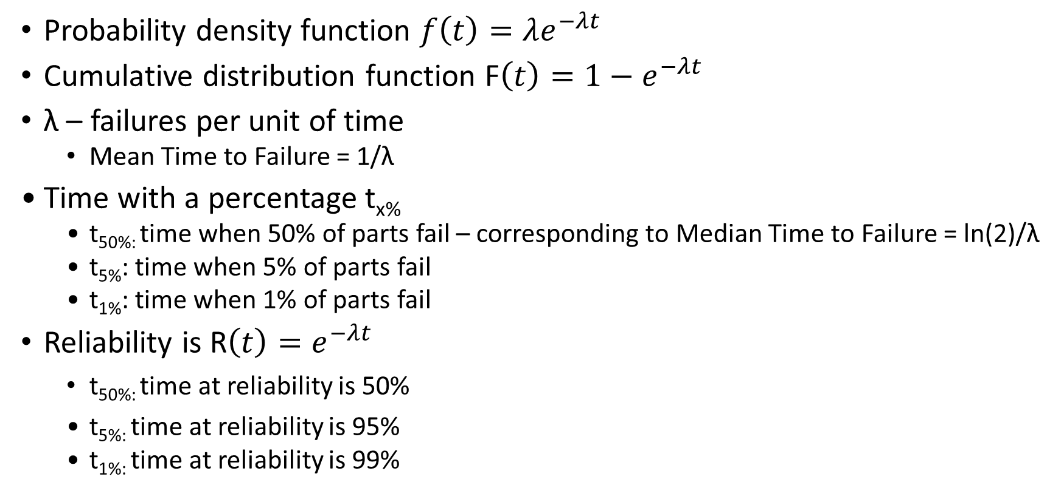
Exponential Distribution
Probability density function $f\left(t\right)=λe^{−λt}$
Cumulative distribution function F$\left(t\right)=1−e^{−λt}$
λ – failures per unit of time
Mean Time to Failure = 1/λ
Time with a percentage t_{x%}
t_{50%:} time when 50% of parts fail – corresponding to Median Time to Failure = ln(2)/λ
t_{5%}: time when 5% of parts fail
t_{1%}: time when 1% of parts fail
Reliability is R$\left(t\right)=e^{−λt}$
t_{50%:} time at reliability is 50%
t_{5%:} time at reliability is 95%
t_{1%:} time at reliability is 99%

Slide 12
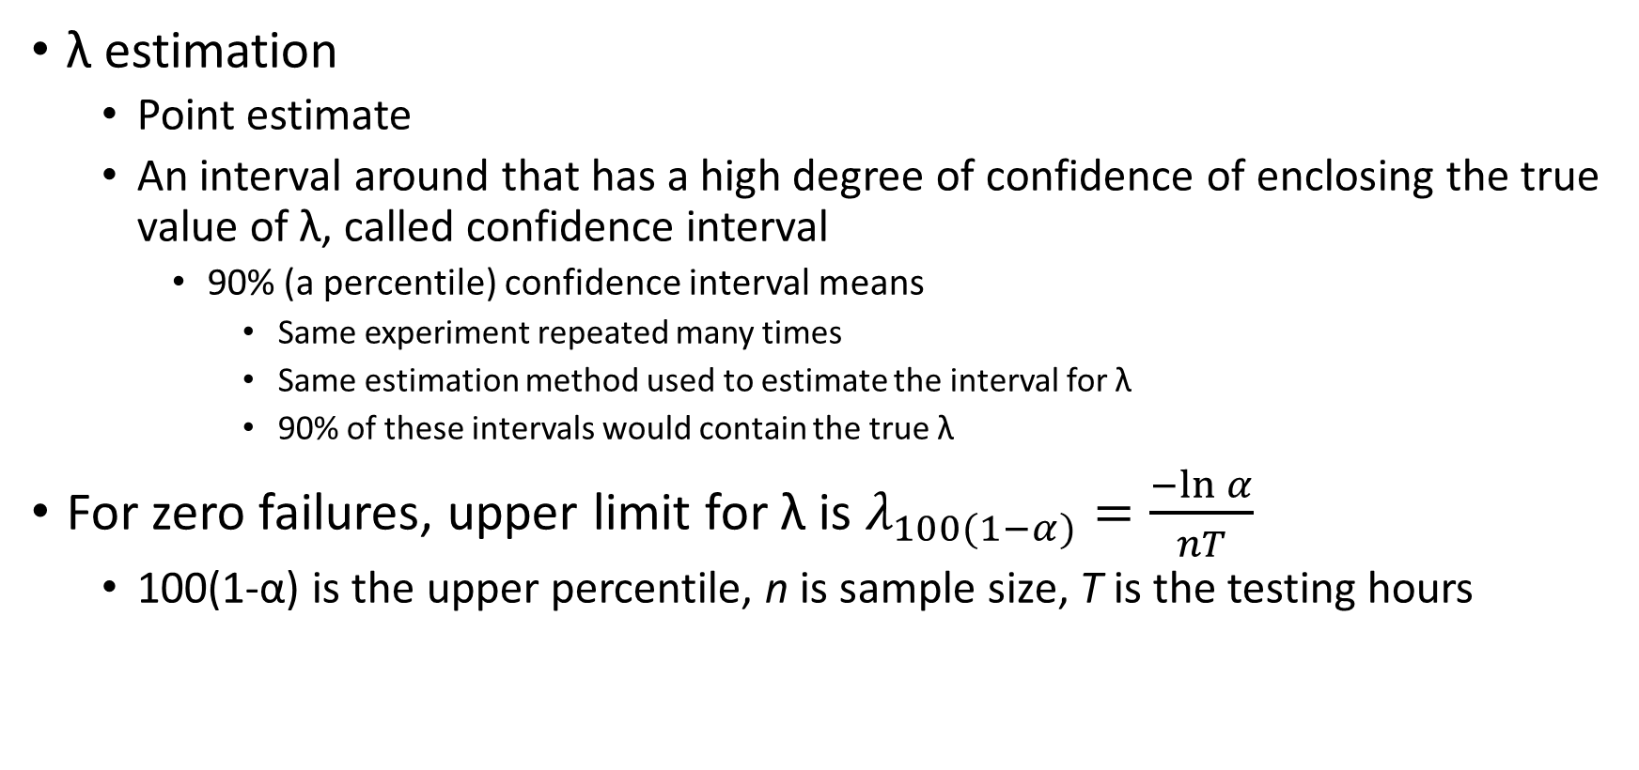
λ Estimation
λ estimation
Point estimate
An interval around that has a high degree of confidence of enclosing the true value of λ, called confidence interval
90% (a percentile) confidence interval means
Same experiment repeated many times
Same estimation method used to estimate the interval for λ
90% of these intervals would contain the true λ
For zero failures, upper limit for λ is $λ_{100(1−α)}=\frac{−ln⁡α}{nT}$
100(1-α) is the upper percentile, n is sample size, T is the testing hours

Slide 13
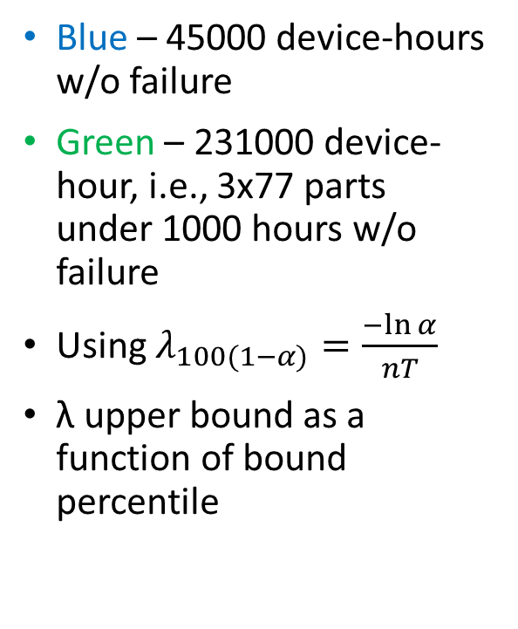
What a life test can demonstrate for λ?
Blue – 45000 device-hours w/o failure
Green – 231000 device-hour, i.e., 3x77 parts under 1000 hours w/o failure
Using $λ_{100(1−α)}=\frac{−ln⁡α}{nT}$
λ upper bound as a function of bound percentile

Slide 14
What a life test can demonstrate for lifetime or reliability?
Blue highlighted - 45000 device-hours w/o failure
Red numbers - MIL-PRF-38535 Appendix D Table D-I
45 parts - 90% confidence with < 5% defective allowable, i.e., at least 95% of parts will pass 1000 hours or 0.11 years.
22 parts - 90% confidence with < 10% defective allowable, i.e., at least 95% of parts will pass 2045 hours or 0.24 years
Green highlighted – 231000 device-hour, i.e., 3x77 parts under 1000 hours w/o failure

Slide 15
What a life test can demonstrate?
The answer to this question is associated with confidence level, reliability and an activation energy assumed.
The implementation of any life test plan is also associated with cost of the electronic parts as well as testing time needed.
When projects have different target mission life, different requirement on confidence level, reliability requirement and different restraints on cost and testing time, different life test plans are needed.

Slide 16
Example
Case I:
Confidence level =50%
Reliability level =50%
Target mission time =10 years at 55C
Case II
Confidence level =90%
Reliability level =50%
Target mission time =10 years at 55C
Case III:
Confidence level =90%
Reliability level =90%
Target mission time =10 years at 55C

Slide 17
Case I, II and III Shown as Green, Red and Blue Dots

Slide 18
Case I, II and III Shown as Green, Red and Blue Values

Slide 19
Volume Matters – from Statistic Perspective
Different philosophy
Low volume
screening is the key, assuming two separated statistical populations
High volume
large sample size for established reliability from qual, pre-qual, process control monitor, on-line reliability monitoring
Different processes
Process qualification, package qualification, product qualification, lot qualification
Process qualification, package qualification, product qualification, yield

Slide 20
New Terminology Defined - Established COTS Part
is produced using processes that have been stable for at least one year so there are enough data to verify the part’s reliability;
is produced in high volume. High volume is defined as a series of parts sharing the same datasheet having a combined sales volume over one million parts during the part’s lifetime;
is 100% electrically tested per datasheet specifications at typical operating conditions in production prior to shipping to customers. Additionally, the manufacturer must have completed multi-lot characterization over the entire set of operating conditions cited in the part's datasheet, prior to mass production release. Thus, production test limits are set for typical test conditions sufficient to guarantee that the parts will meet all parameters’ performance specifications on the datasheet;
is produced on fully automated production lines utilizing statistical process control (SPC), and undergoes in-process testing, including wafer probing for microcircuits and semiconductors, and other means appropriate for other products (e.g., passive parts). These controls and tests are intended to maintain process tolerances and eliminate defective parts at various stages of production; and
has demonstrated consistent yield trend appropriate for high volume commercial technologies at that technology node.

Slide 21
Summary
Comparison of life tests in MIL-STD and JEDEC Standards and their statistical meaning and implications
Low volume of MIL parts and large volume of commercial parts result in different philosophy and process to ensure reliability.

