Slide 1
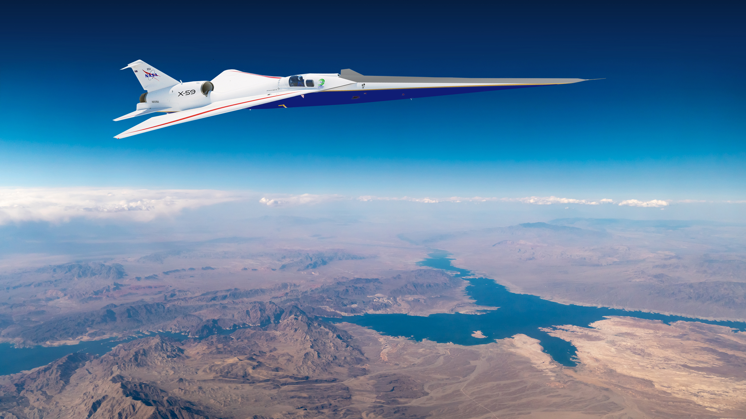

Dose-response data collection preparation for the NASA Quesst mission with the X-59
Aaron B. Vaughn
NASA Langley Research Center | IFAR ECN Virtual Seminar | July 12, 2023
www.nasa.gov

Slide 2
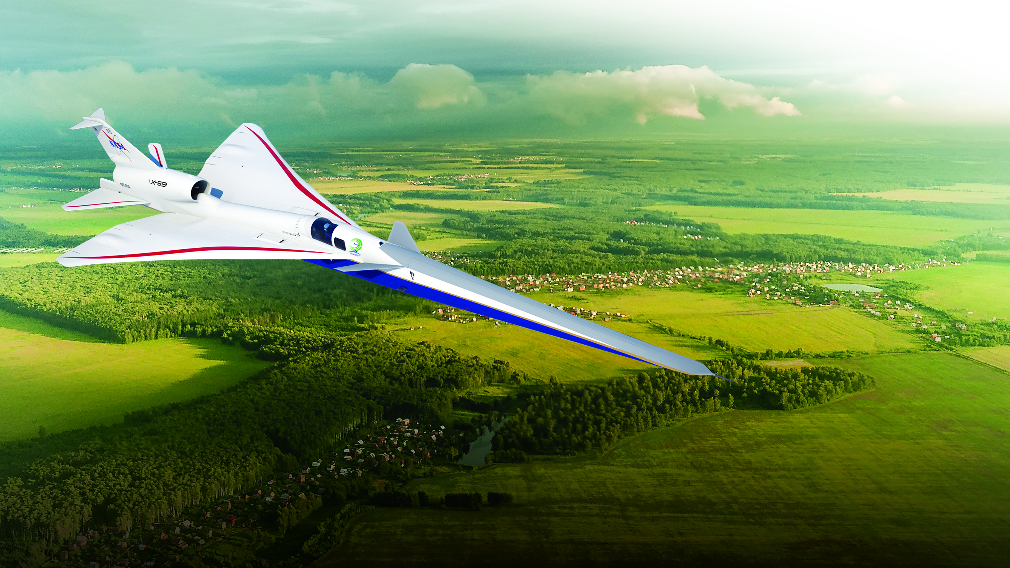
NASA wants to improve aviation by decreasing travel time
www.nasa.gov |
2

Slide 3
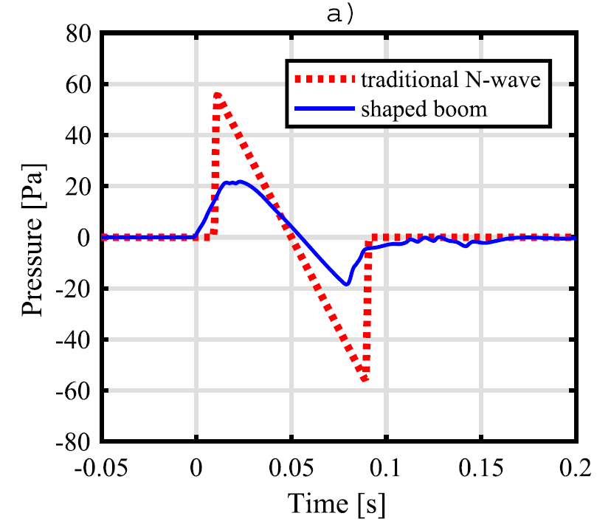
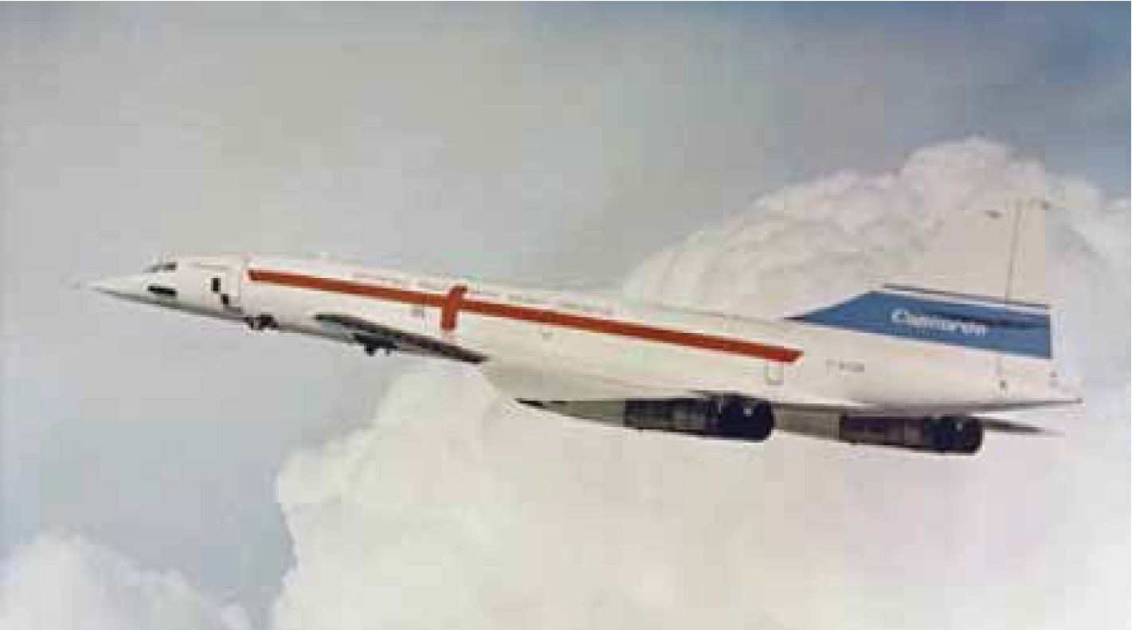
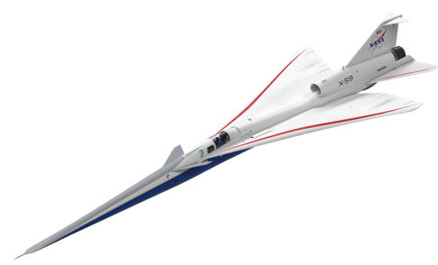
Aircraft shape is the key to reducing sonic boom noise levels
www.nasa.gov |
3

Slide 4
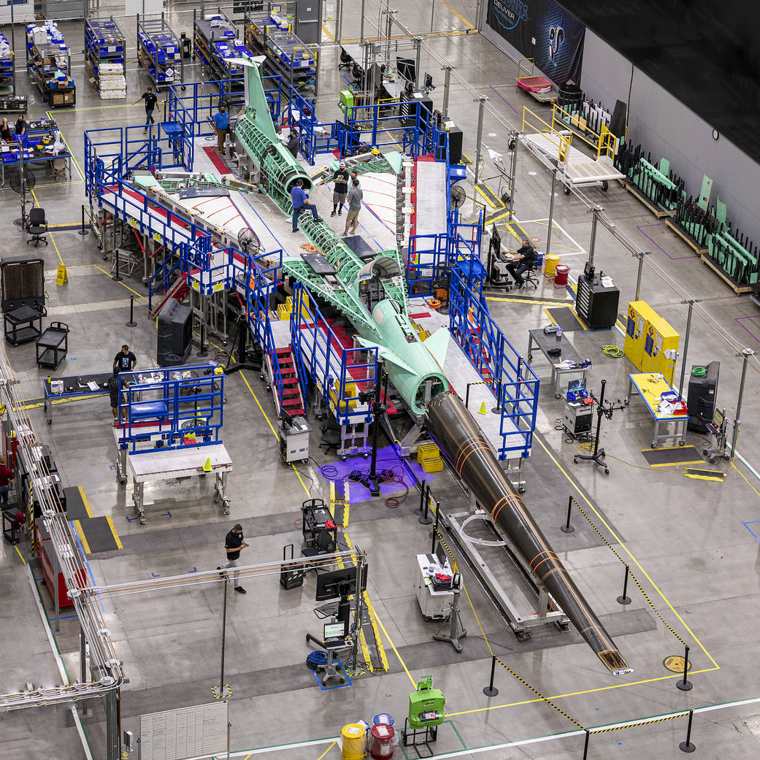
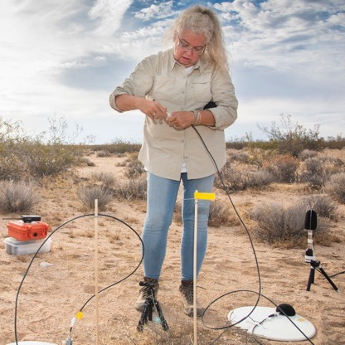

The NASA Quesst mission consists of three phases, culminating in the collection of community response data
Phase 1—Aircraft Development
Phase 2—Acoustic Validation
Phase 3—Community Response
www.nasa.gov |
4

Slide 5

The X-59 aircraft is being built under contract with Lockheed Martin
Total Length 30.4 m (99.7 ft)
Nose Length 11.6 m (38 ft)
Width 9.0 m (29.6 ft)
Cruise Altitude
16.76 km
(55,000 ft)
Cruise Speed
Mach 1.4
www.nasa.gov |
5

Slide 6
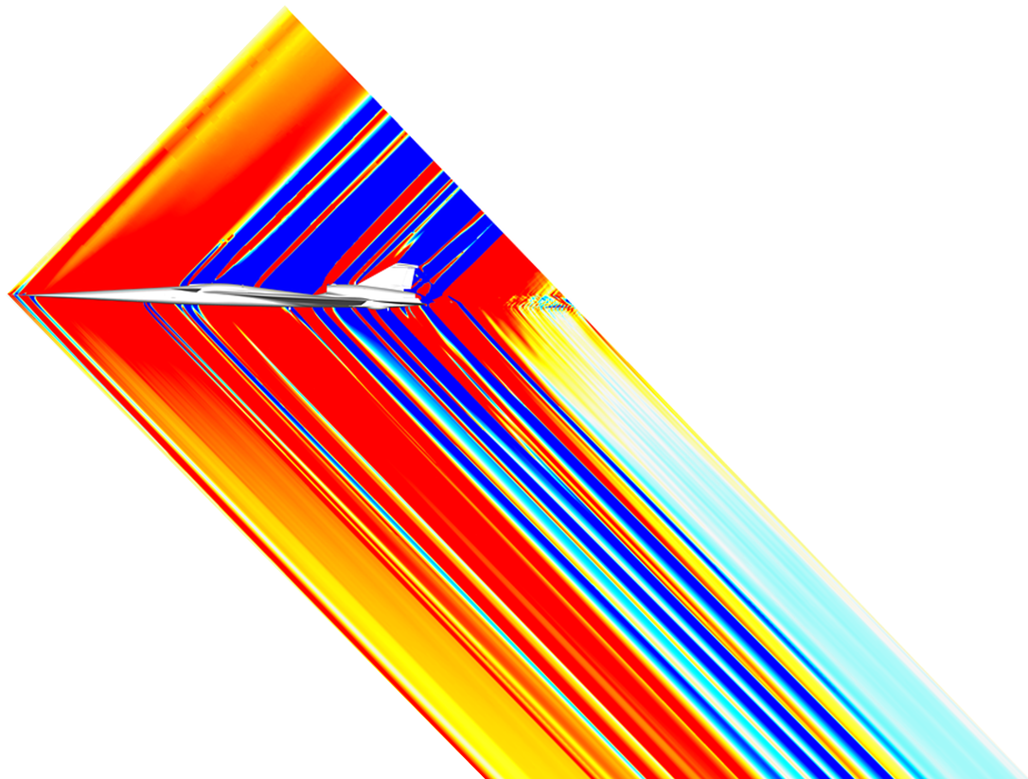
Acoustic validation consists of in-flight and ground measurements to prove the acoustic characteristics match design targets
www.nasa.gov |
6

Slide 7

The supersonic noise level of the X-59 will be comparable to the sound of distant thunder or car door slam down the street
PL (dB)
60
70
80
90
100
110
120
130
140
Car door slam
30 m (100 ft) away
Balloon pop
X-59
Basketball bounce
Nearby thunder
Concorde sonic boom
Distant thunder
Falcon 9 boom
Car door slam inside car
Car door slam
6 m (20 ft) away
Hand clap
Fireworks
Gunshot
www.nasa.gov |
7

Slide 8
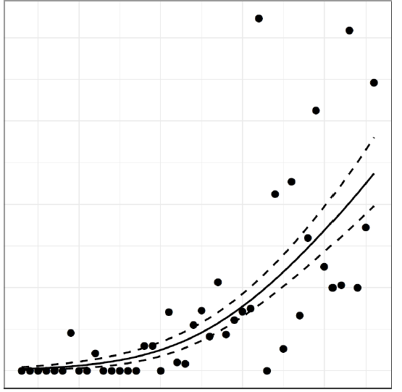
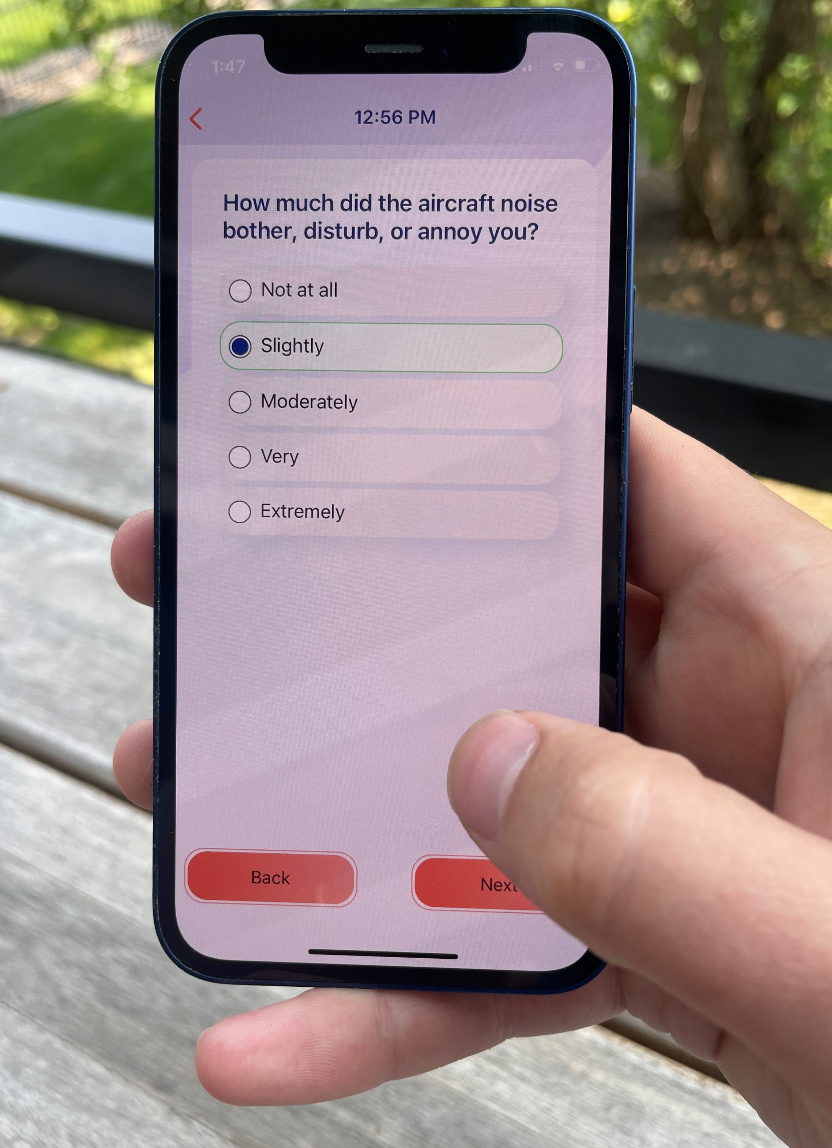
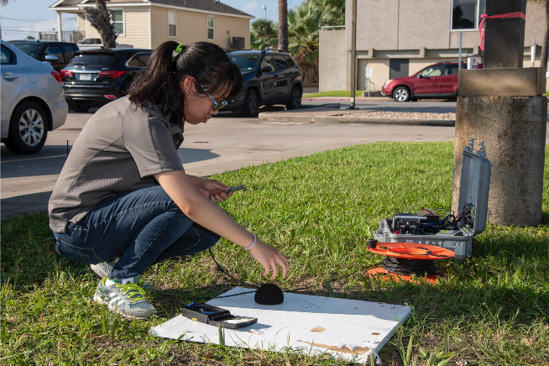
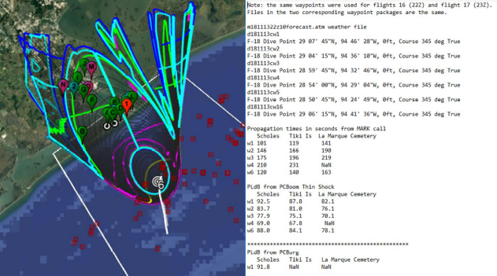
Community response data consist of noise dose and annoyance response
Annoyance
Not at all
Slightly
Moderately
Very
Extremely
Annoyance Response
Noise Dose
Measurements
Predictions
www.nasa.gov |
8

Slide 9
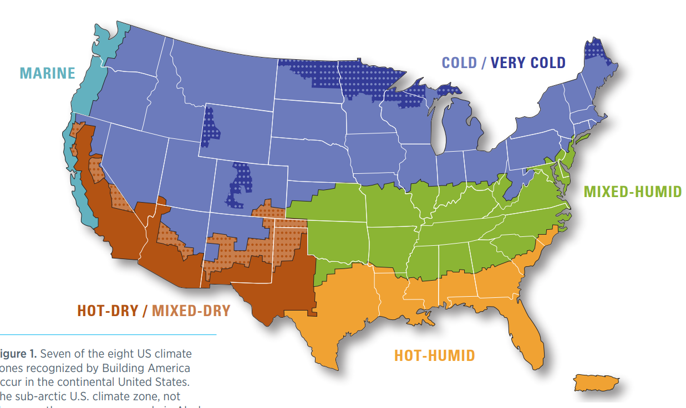
NASA plans to conduct five social surveys in different geographic regions of the United States
Candidate Airfield
www.nasa.gov |
9

Slide 10
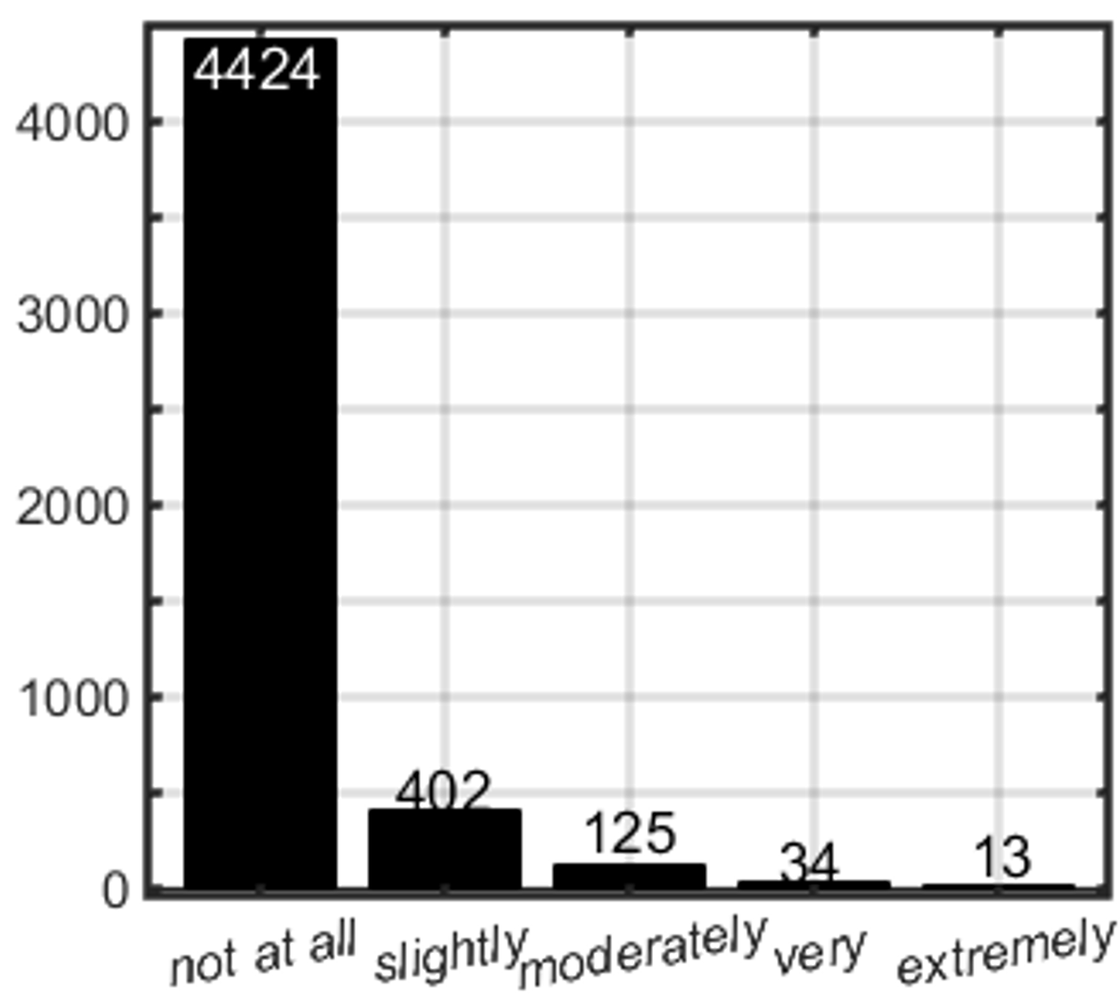
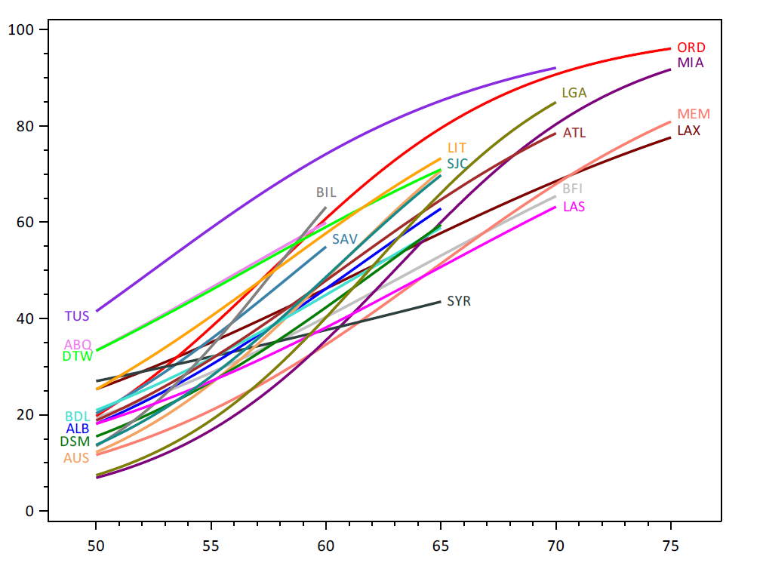
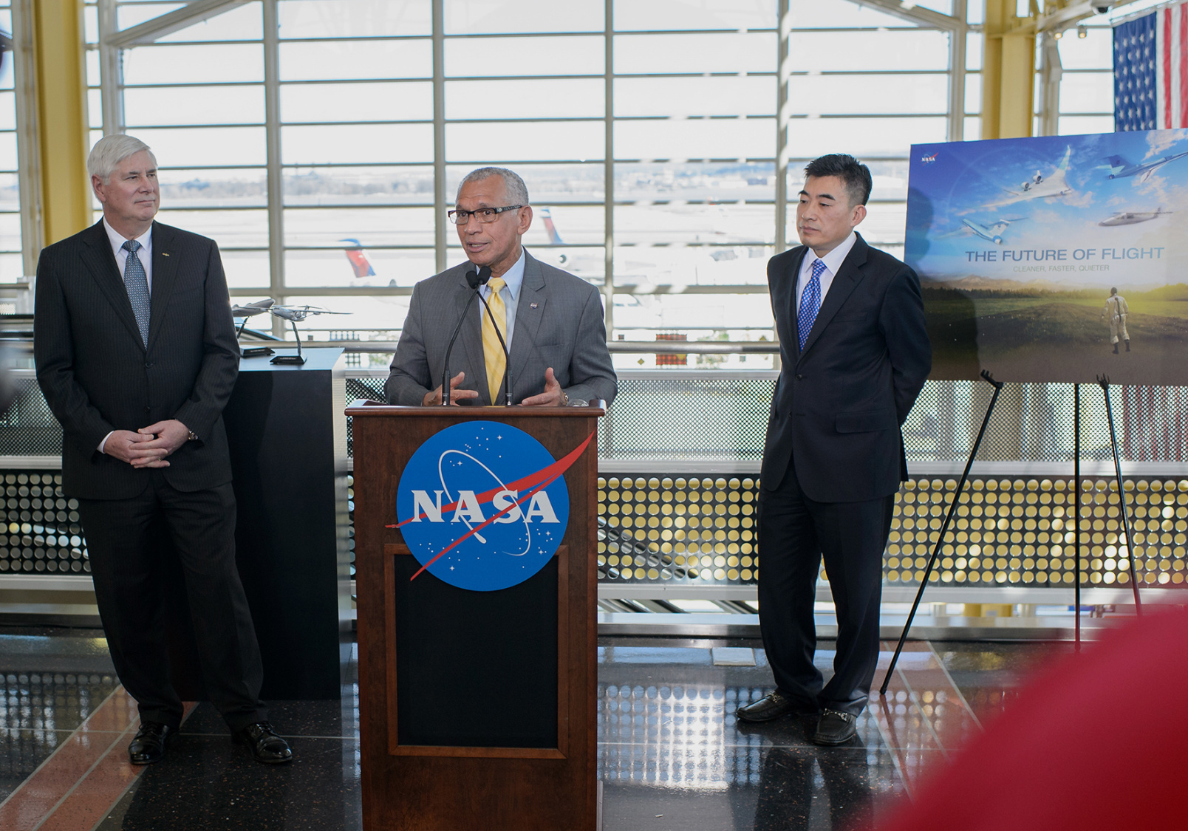
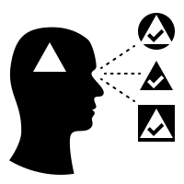
Several key potential challenges may need to be mitigated to produce a representative dose-response relationship
Sparse observations
of high annoyance
Dose-response variability between communities
Communication without introducing bias
Counts
Percent Highly Annoyed
Annoyance Rating
Noise Dose (DNL, dB)
(Neighborhood Environmental Survey by US FAA)
www.nasa.gov |
10

Slide 11
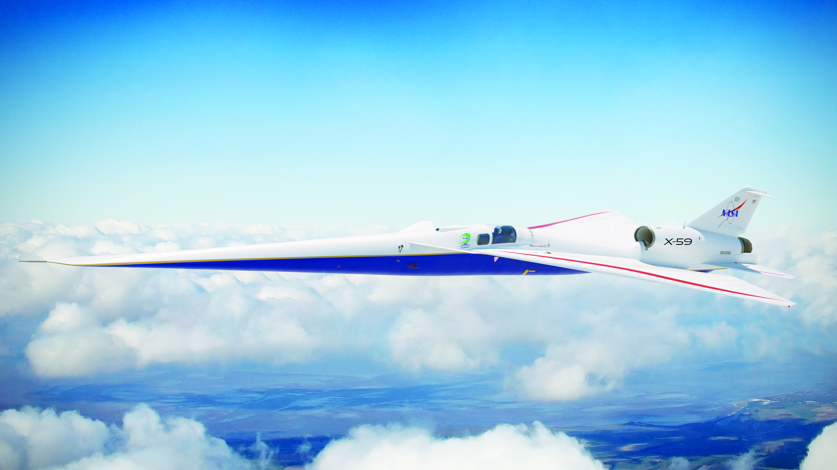
Quesstions?
In summary, NASA will collect dose-response data to support new standards for low noise supersonic overflights
The goal of commercial supersonic flight is decreased travel time
The X-59 aircraft will demonstrate quiet supersonic flight
Dose-response relationships for annoyance data are the focus
www.nasa.gov |
11
aaron.b.vaughn@nasa.gov

