Slide 1



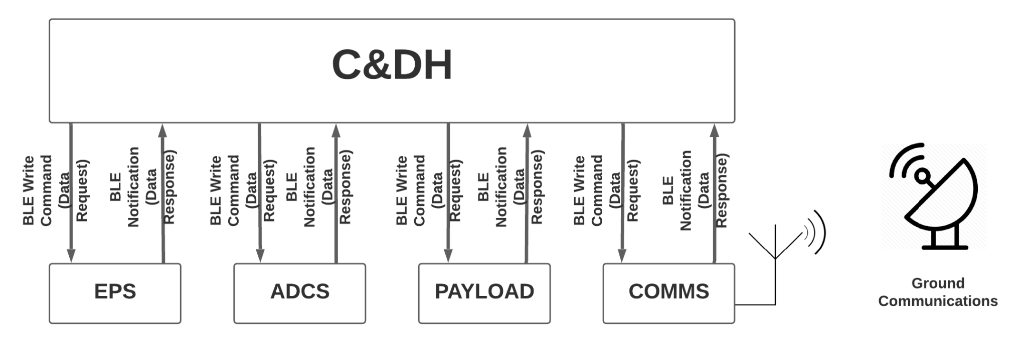
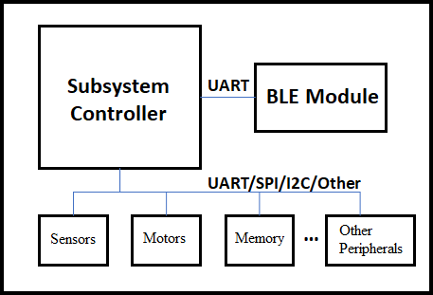
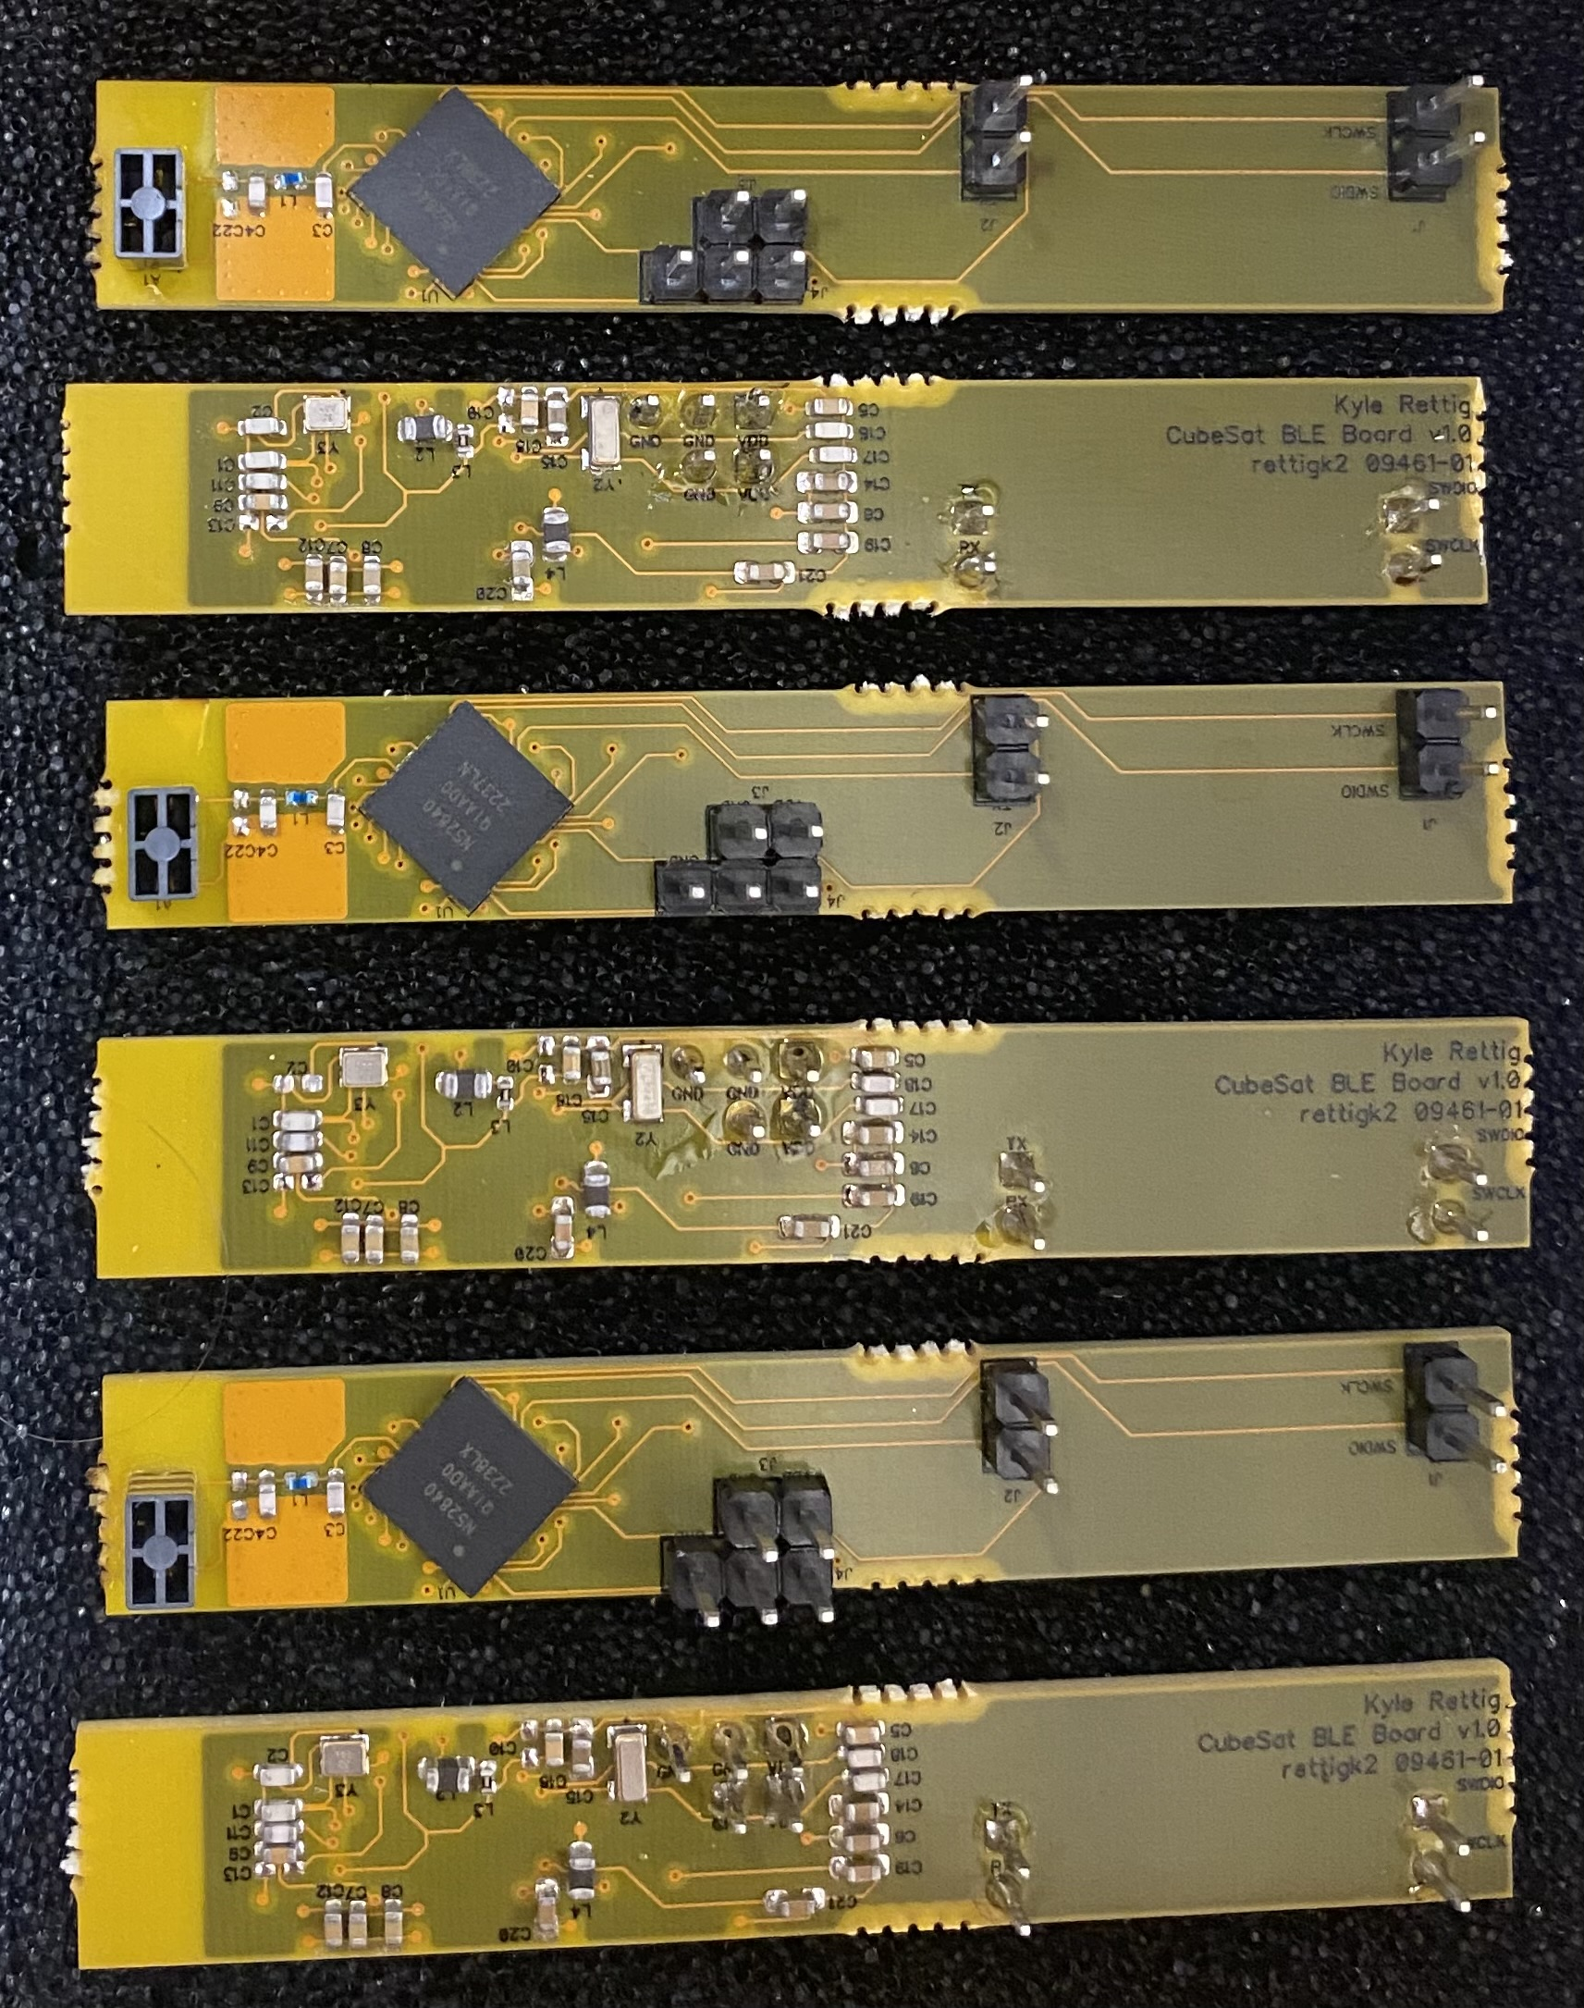
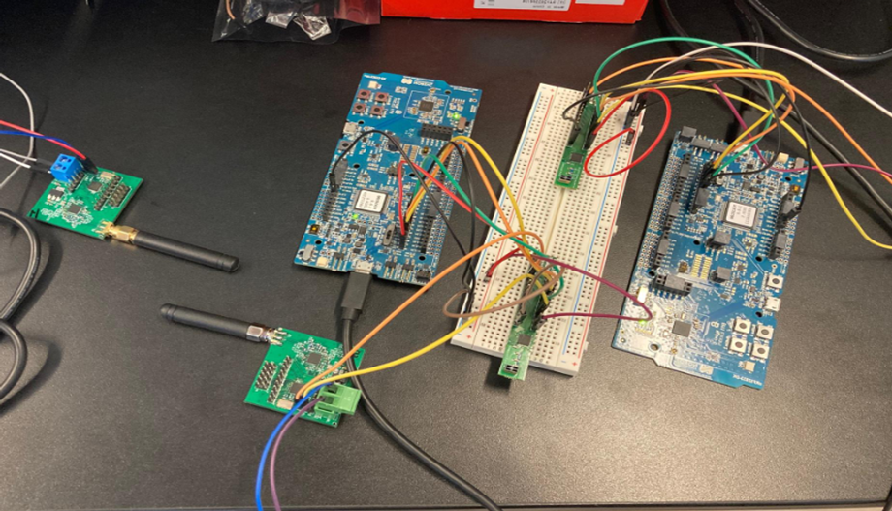
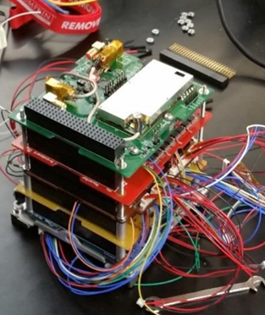
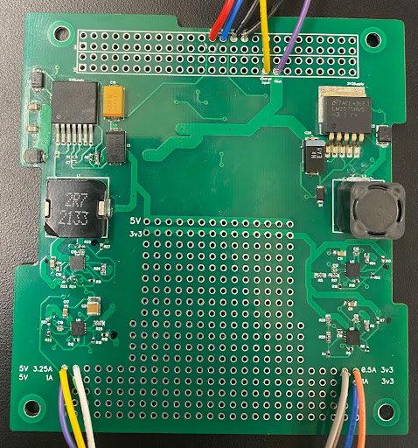
Wireless Interconnect CubeSat using Bluetooth Low Energy (BLE)
Department of Electrical and Computer Engineering, Rowan University
Undergraduates: Adam Kinsley, Michelle Frolio, Seth Freni, Benjamin Busler
Faculty: Adam Fifth, Dr. Schmalzel
NASA Collaborator/Technical Officer: Darren Boyd, Marshall Space Flight Center
Overview
The Bluetooth Low Energy (BLE) subsystem controls the communication between boards on the CubeSat. It will replace wired Universal Asynchronous Receiver-Transmitter (UART) connections between Command and Data Handling (C&DH) and each subsystem. It allows us to only use one UART channel and reduces the length of commands sent to the subsystems.
Operational Setup: Top Level
Command and Data Flow
C&DH acts in Client role distributing commands
to proper subsystems and storing data for future
downlink to the ground station
All other subsystems act in server role operating
independently and storing data until C&DH
requests data transfer
Setup consisted of main microcontroller unit (MCU) and separate BLE controller
Offload processing to subsystem MCU maximizing
BLE controller performance
Able to be integrated with Commercial Off The Shelf (COTS) designs
Subsystem to BLE controller communication via UART
BLE Assembly and Testing
  Assemble and test version 7 of the BLE board that was redesigned in Fall 2022
  Programmed FOX 1 part profile for NRF52840 (Ball Grid Array (BGA))
  Fully integrated BLE Panels (Minimum 3 Printed Circuit Boards (PCBs))
  Sent and received UART data
  Confirmed ability to disconnect from a peripheral board and connect to another
Current Issues with Wired Interconnect
CubeSats utilize a wired interconnect to facilitate communication and power delivery between subsystems in the form of a PC/104 standardized header
  De Facto standard in CubeSat platforms
  Low Cost
Potential Problems:
  Extensive pre-planning and assembly
  Potential failure points with cold/broken solder connections
  Limited post-launch reconfiguration
  Fixed board spacing, can't change size of header
  Large volume requirement relative to total CubeSat volume
.
BLE and Subsystem Testing Data
BLE Wireless Interface Technology
Throughput found to be 1200Kbps,
close to theoretical max of 1400Kbps
Power consumption 1.3% of total power
budget, far below 5% expected
Minimal latency at 3.2ms, compared to
previous years 7.1ms using
ESP32 & BLE 4.2
Low PER (1.89%)
COMMS:
Two pairs of Half-Duplex transceivers
confirmed to TX/RX at 420 MHz
Successfully tested with BLE
Prototype_v6 boards
Packets sent, received, then sent over BLE
Power:
Two 5V and two 3.3V rails
Provides readings to C&DH
Voltage and current readings of each rail
Temperature readings of battery,
microcontroller, and ambient
Which power rail is in use for each subsystem
.
Future Work
Electrical Power System (EPS) V2 with a microcontroller
Attitude Determination and Control System (ADCS) subsystem prototype
Communication subsystem integration and testing
Command and Data Handling updates and prototype
Update solar panel component and PCBs for side panels
Utilizing BLE to Make a Wireless Interconnect System
Bluetooth-based wireless CubeSat interface technology to replace all copper-based communication
Removes required PC/104 communication lines and headers
Can be designed to save board space and CubeSat volume
Streamlines prelaunch assembly
Reduces risk of data loss from mechanical failure
Minimizes subsystem software integration across multiple platforms
.

