Slide 1

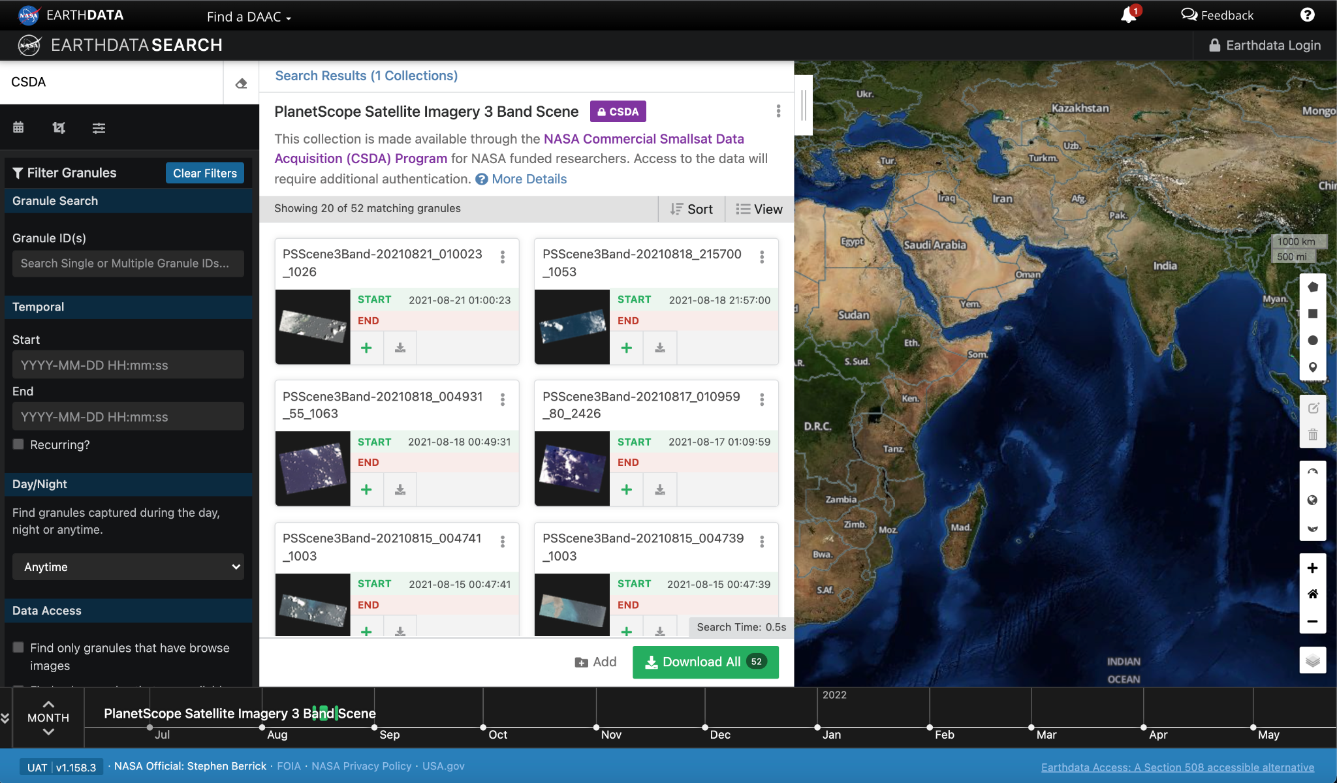
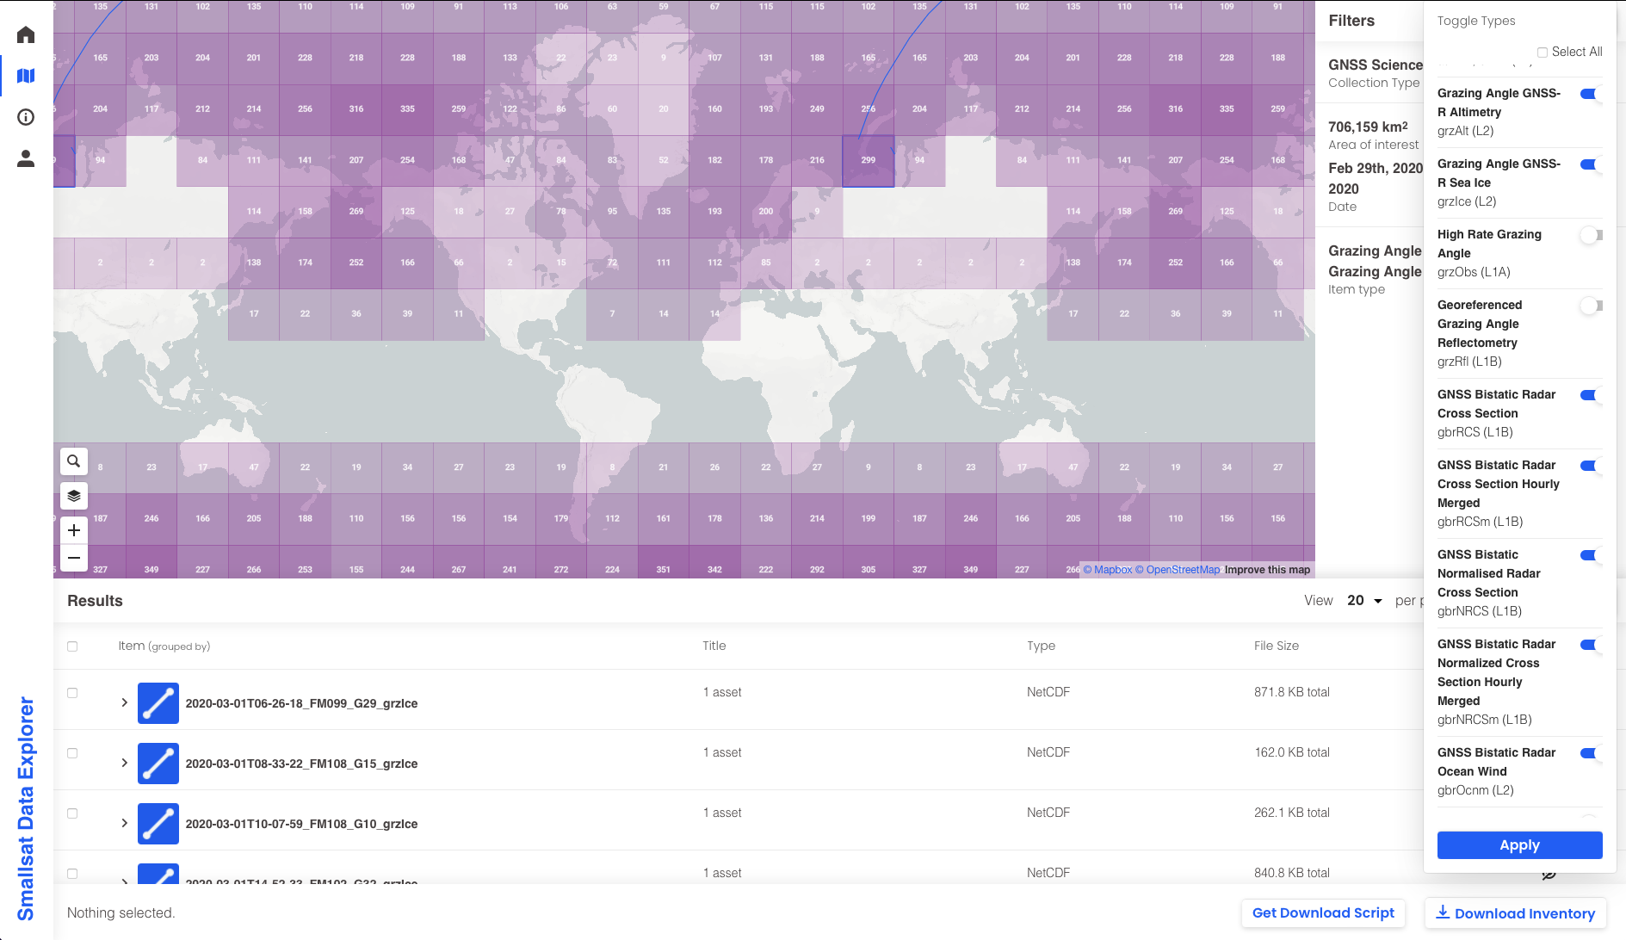
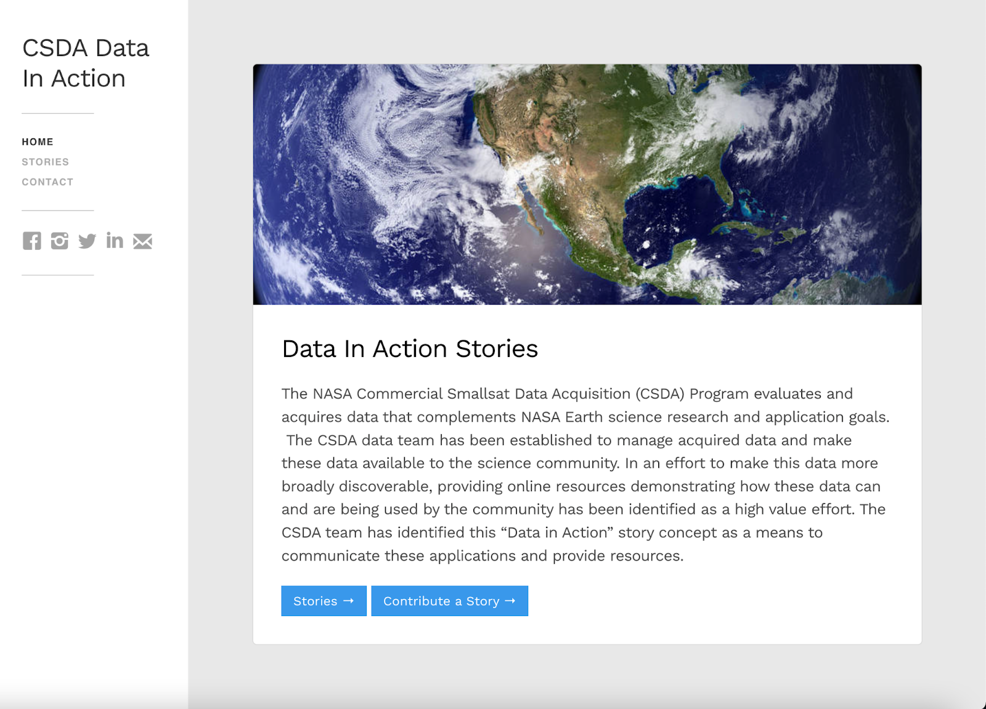
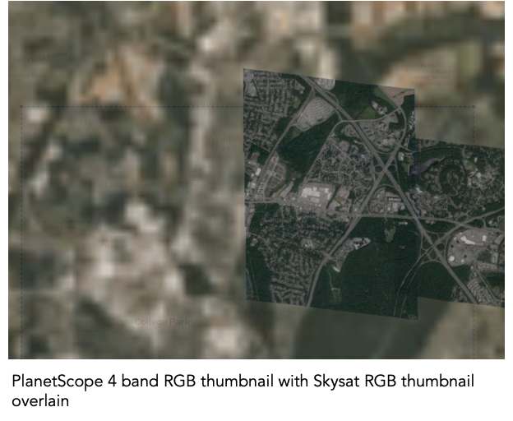
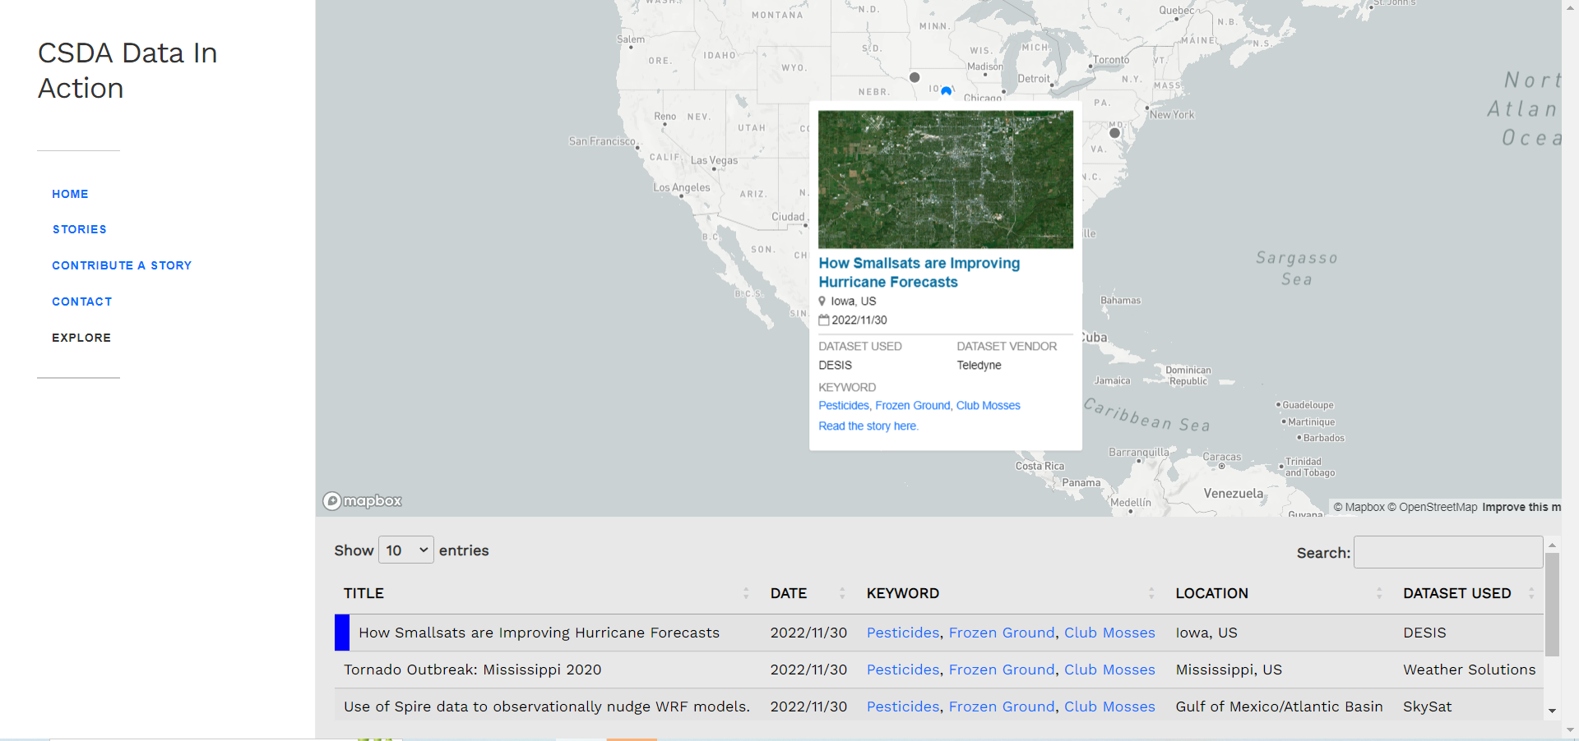
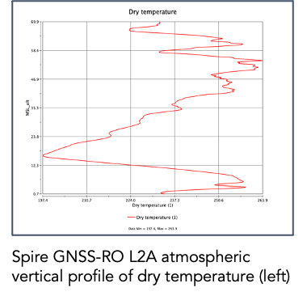
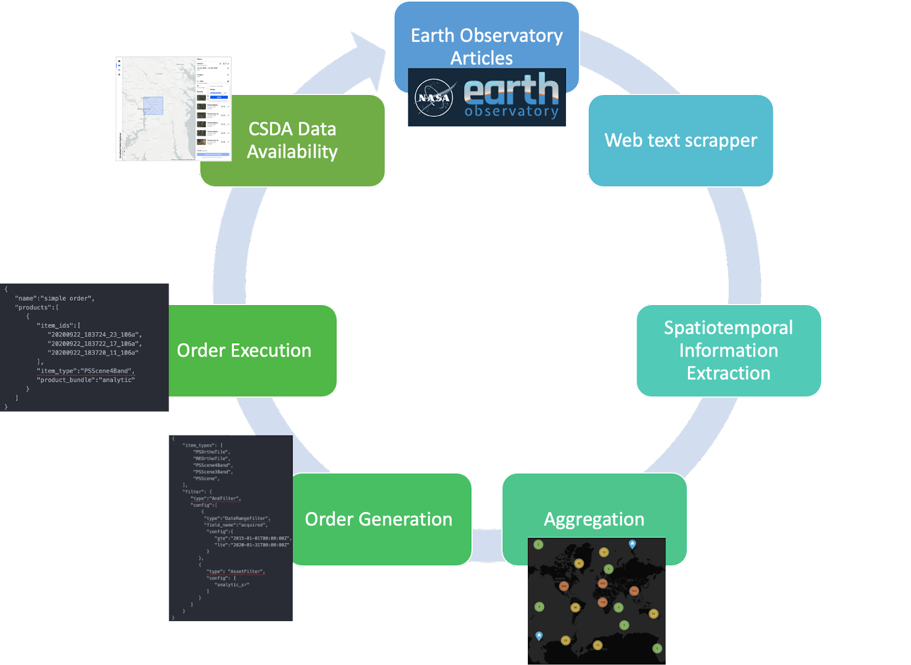
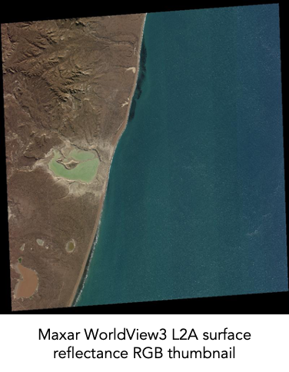
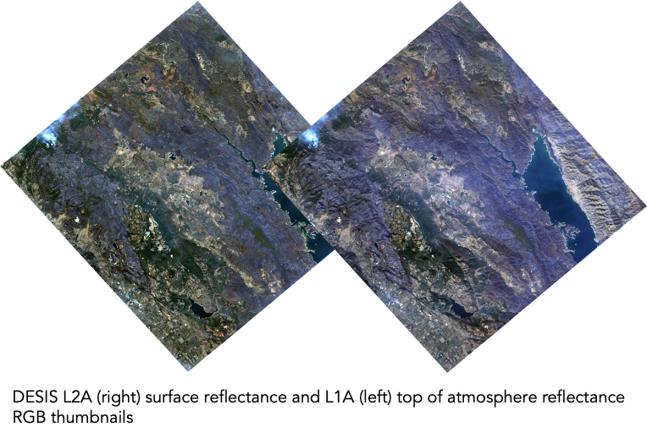
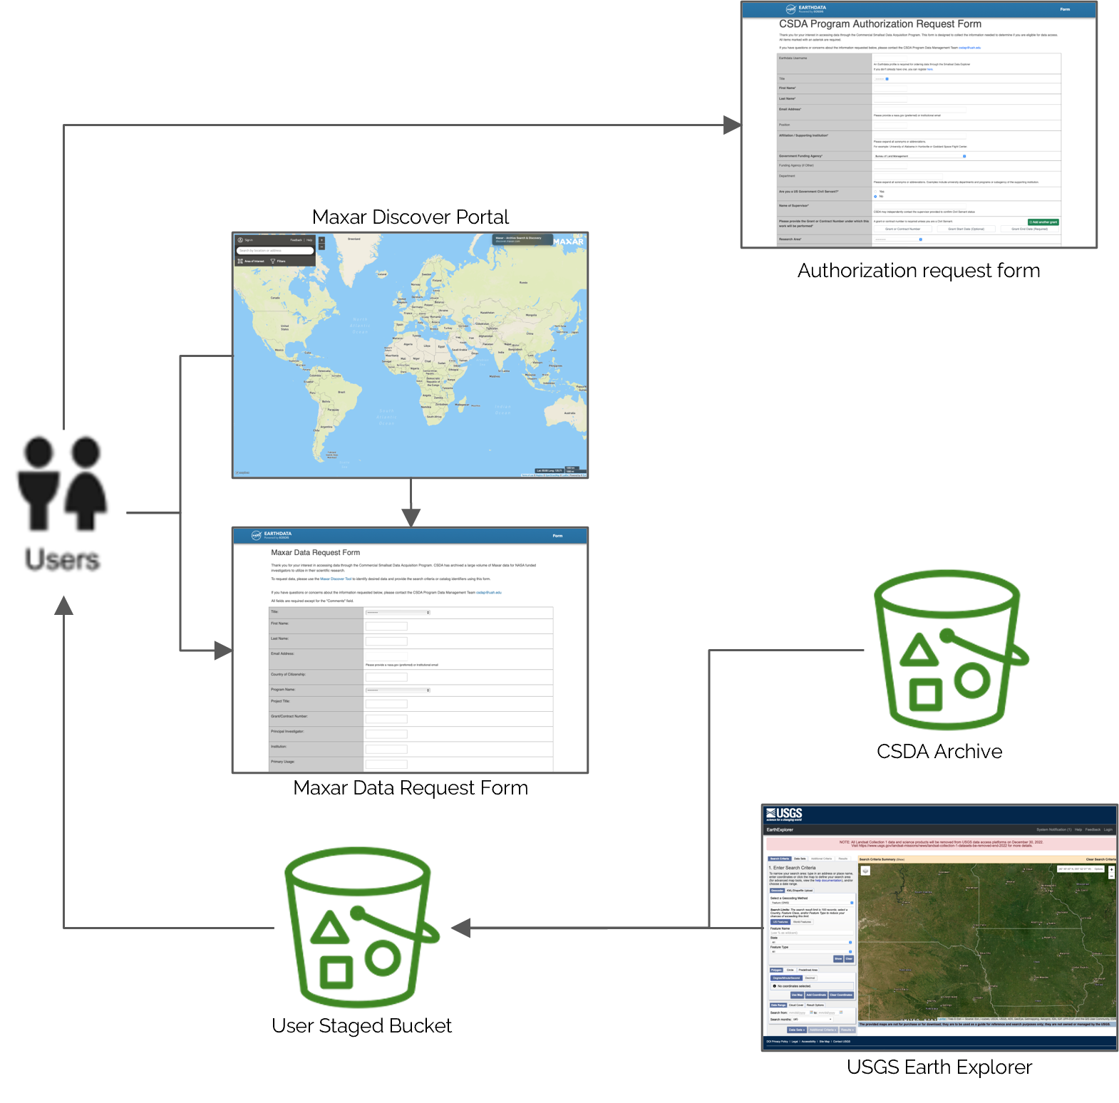
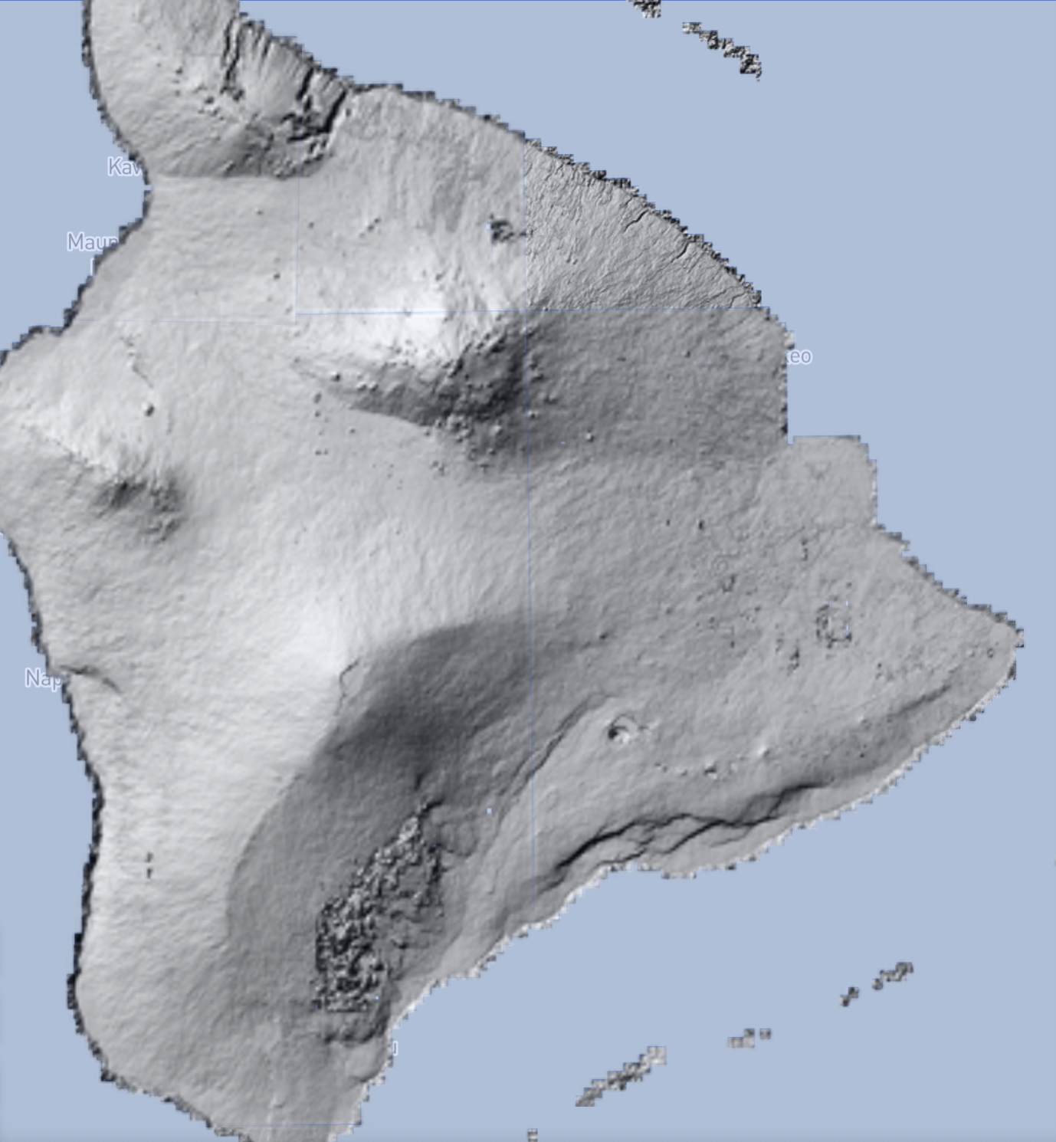
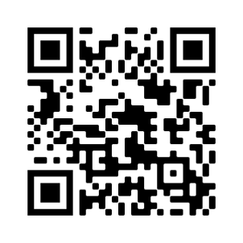


NASA’s Commercial Smallsat Data Acquisition (CSDA) Program Data System
The CSDA Program was established to identify, evaluate, and acquire data from commercial satellite companies that support and complement NASA’s Earth sciences missions and research goals.
Overview of CSDA Data System
New Available Data Products
NASA EOSDIS Integration
New product evaluations of vendors since the Pilot Program
Spire Global Inc. (download available)
GNSS Bistatic Radar Cross Section, GNSS Bistatic Radar Normalized Cross Section, Ocean Winds (track and hourly merged)
Sea Ice, Altimetry
Soil Moisture
Planet Labs, Inc. (SDX search only; download available from vendor)
PSScene (8-band product)
Goal: Publish NASA acquired commercial data alongside NASA Earth Science standard data products.
Objectives
Cloud native data publication utilizing enterprise tools
Data discoverable and downloadable (Maxar only) in NASA’s Common Metadata Repository (CMR) and Earthdata Search
Establish continuous and repeatable processes to on-ramp new commercial data vendors and evaluate data for their potential to advance NASA’s Earth science research and applications activities
Enable the sustained use of purchased data for broader use and dissemination by the Earth scientific community
Ensure long-term data preservation through the establishment of data management processes and systems to support rapid evaluation, access, and distribution of purchased data and long-term access to purchased data for scientific reproducibility
Coordinate with other U.S. Government agencies and international partners on the evaluation and scientific use of commercial data
Building a Knowledge Ecosystem
Vendor and Data Product Overview
Goal: Employ Data in Action concept to communicate availability of and lower the barrier to science using commercial data through stories and open-source code
Community contributed content
    wide range of data processing and application information
central repository of open source code
citable web resource
Prototype unique story search and discovery
traditional story list
map-based application search
influence Network
Vendor / Producer | Constellations/ Products | Available Dates | Spatial Resolution | Spectral Characteristics | Sample
Planet Labs, Inc | PlanetScope (3band, 4band, PSScene), RapidEye | 12/31/2005 - Present | 3 - 6.5 meters | RGB, NIR (440-860 nm), Panchromatic
 | SkySat | 3/10/2015 – 12/12/2019 | < 1 meter | RGB, NIR (450-900 nm), Panchromatic
Spire Global, Inc | GNSS Radio Occultation, GNSS Grazing Angle Reflectometry, Satellite Precise Orbit Determination (POD) and Satellite Attitude, Total Electron Content, Ionospheric Profiles, Scintillation, Magnetometer, Raw IF, GNSS Bistatic Radar Cross Section, GNSS Bistatic Radar Normalized Cross Section, Ocean Winds, Soil Moisture, Sea Ice, Altimetry | 9/24/2018 - Present (variable)
Maxar Technologies | Worldview 1-4, GeoEye-1, QuickBird, IKONOS | 10/24/1999 - Present | 0.31 - 4.0 meters | Multispectral and Panchromatic (400 - 2245 nm)
Teledyne Brown Engineering, Inc. | DESIS L1B, L1C, and L2A | 11/21/2018 - Present | 30 meters | 235 channels, 2.5nm from 402 to 1000 nm
Polar Geospatial Center - EarthDEM | individual strips and mosaics | 2009 - Present | 2 meters
Includes copyrighted material of Planet Labs Inc. All rights reserved.
Smallsat Data Explorer Enhancements
Web application for search, discover, and download of commercial data
Heatmap
      Promote discovery of spatially and temporally discontinous data
Pre-aggregated for high responsiveness
Simplified subsetting
          Spatial grids
    Temporal histogram
Quota-based data download
Users manage downloads
Direct download button (individual files)
Download script (large orders)
New layout
emphasizes results
Expanding Data Availability
Goal: Contribute to building a valuable data archive by utilizing NASA resources to identify and acquire data from areas of interest
Utilize existing science stories and recent events to identify high value targets
Leverage machine learning to automatically extract and generate vendor orders
Publish data through standard processes
Includes copyrighted material of Spire Global Inc. All rights reserved.
Includes copyrighted material of Maxar. All rights reserved.
Maxar for NASA Funded Investigators
Transition from CAD4NASA to CSDA Data Management Team
~10 PB archive at NCCS to AWS Cloud storage
Implement request process similar to CAD4NASA process
Ongoing Activities
Includes copyrighted material of Teledyne Brown Engineering Inc. All rights reserved.
Data Request Process
Request authorization for access
Identify data with the Maxar Discover Tool
Place data request using online form
Data staged for download
Archived data available in 2-5 business days
New data / tasking request available after 2-3 weeks
Onramp #3: Onramp of qualified vendors from third RFI (December 2020) underway
Sole source synopsis posted for Capella Space, ICEYE US, Inc, GeoOptics, Inc, and GHGSat, Inc. in November 2021.
Selection of PIs for evaluation via ROSES 2022 (A.43)
Evaluations underway
Data management activities
Continued process and tool refinement based on requirement and end-user feedback
Focus on archiving data in Earthdata Cloud
Make Airbus US and BlackSky (Onramp 2) data available as evaluations are completed
Contact Us
EarthDEM mosaics for Hawaii
Includes copyrighted material of Maxar. All rights reserved.
Program related questions
Alfreda Hall @ alfreda.a.hall@nasa.gov
Data Management
Manil Maskey @ manil.maskey@nasa.gov
Science related questions
Frederick Policelli @ frederick.s.policelli@nasa.gov
Authors:
Helen Parache¹,
Aaron Kaulfus¹,
Manil Maskey¹
¹NASA MSFC
Learn More!

