Slide 1




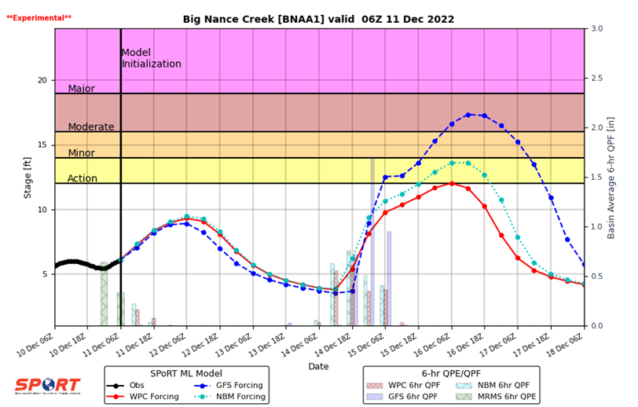
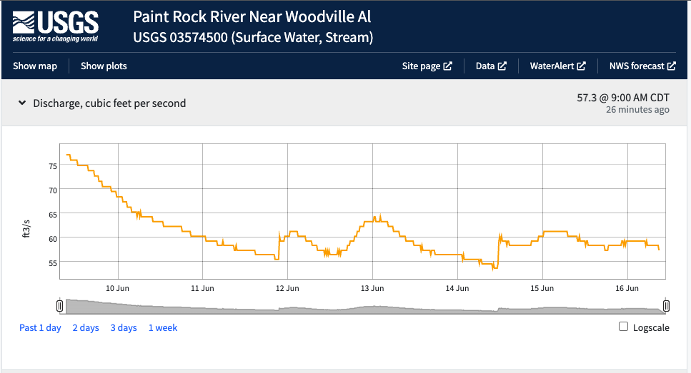
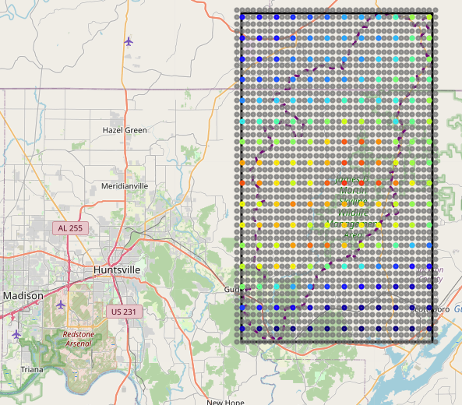
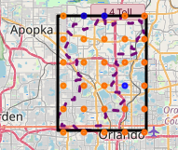
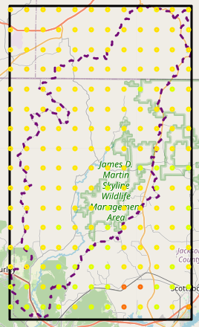
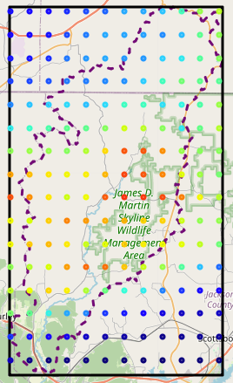
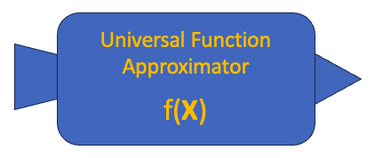
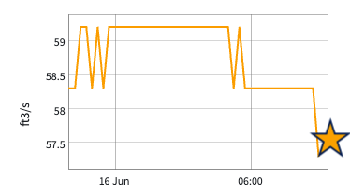
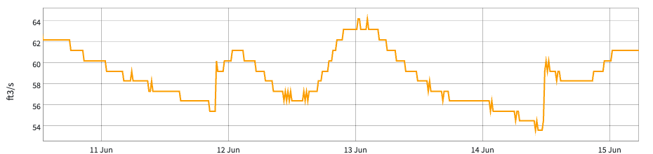
Hourly Stream Heights – A Short-term Deep Learning Prediction Model
Michael Antia¹, Andrew T. White², Roger Allen¹, Christopher R. Hain³, Kristopher D. White⁴
1 - JACOBS / NASA SPoRT, Huntsville, AL
2 - University of Alabama in Huntsville/NASA SPoRT, Huntsville, AL
3 - NASA Marshall Space Flight Center, Huntsville, AL
4 - National Weather Service Huntsville/NASA SPoRT, Huntsville, AL
ABSTRACT
ABSTRACT
River flooding can have a detrimental impact on a community by causing loss of life, loss or damage to property, and damage to infrastructure. Having the capability to forecast flooding events can prevent the loss of life and mitigate damage to property. A programmatic, data-driven approach using deep learning to forecast a stream’s gauge height every 6 hours has been developed by NASA’s Short-term Prediction Research and Transition Center (SPoRT) and is currently in operation. Based on our end user engagement and feedback, this medium-term product has been successfully adopted by several National Weather Service (NWS) Forecast Offices and River Forecast Centers (RFC). SPoRT is currently researching and developing a short-term hourly deep learning model which will be useful in forecasting flash flood events..
Introduction
Current State
Data Inputs: Gauge Height
Our short-term model will use current precipitation, soil moisture, and observed stream height data, as well as past hours of data, as inputs to the model, and then predict the stream height for the following hour. The following dataset will be used to create the following inputs: Land Information System (SPoRT-LIS) for relative soil moisture, Multi-Radar Multi-Sensor quantitative precipitation estimate (MRMS QPE) for precipitation, and U.S. Geological Survey's (USGS) Stream Gage Height data. Two potential model architectures will be developed and evaluated: 1) a LSTM based model, 2) a LSTM network coupled with a ConvLSTM network.
Currently the Short-term Prediction Research and Transition Center (SPoRT) has a model that makes stream height predictions on a medium-term outlook, that is, it makes a prediction for the t + 6 hour given t – 30 through t – 0 hours of data. Model had been in production until a recent outage and has been well received by end users. The colored bands are used for guidance for decision makers so they can be informed as to the severity of the potential flooding. All 3 lines are predictions from our deep learning model. Each one uses a different precipitation forcing (blue- Global Forecast System precipitation, red - Weather Prediction Center precipitation, cyan - National Blend of Models precipitation.
Graphic shown is for the Big Nance Creek at Courtland, AL.
Gauge Height for Paint Rock River. The y-axis contains the gauge height in feet, the x-axis contains the timestamp when the measurement was taken.
Data Inputs: Precipitation
CONCLUSIONS
Data Inputs: Soil Moisture
Hypothesis
Relative soil moisture for the Little Wekiva River area near Altamonte Springs, FL. Blue data points correspond to low relative soil moisture, orange areas correspond to high soil moisture.
Relative Soil Moisture – for all levels.
Precipitation data.
Predict Gauge Height for the next hour.
Hypothesis: By using hourly data we should be able to make hourly forecasts. By using spatial point-based precipitation and soil moisture measurements (as opposed to basin averages), the deep learning model should make more fined tune predictions based on distance of passing storm relative to stream.
Soil moisture levels used as inputs reflect data for the following depths: 0 – 10cm, 10 – 40 cm, 40 – 100cm, and 100 – 200 cm. Image depicted is for the 100 – 200cm level.
Re-grided MRMS Precipitation data for Paint Rock River (Huntsville Area). Data has been re-gridded from 1km to 3km. Reds and oranges are indicative of higher precipitation; blues are indicative of lower precipitation. Data timestamp is from March 02, 2023 storm.
Past Gauge Height measurements.
CHALLENGES & FUTURE WORK
REFERENCES
Biased data: there are more cases when there is no flooding than when there is flooding. There is a concern that this can bias the predictions.
No global model for all basins, each basin has its own model.
Consider exploring reduction of feature input space.
Build model and train it.
Optimize Hyper-parameters.
Evaluate model.
Consider and implement alternative deep learning architectures.
Explore PINNs and ViT (for spatial context awareness)
Deploy model to production.
White A. T., K. D. White, C. R. Hain, J. L. Case and K. K. Fuell, 2023: Medium-Range River Flood Forecasts Using a Long Short-Term Memory Network. 37th Conference on Hydrology, Amer. Meteor. Soc., 3B.5.
White K. D., A. T. White, C. R. Hain, and J. L. Case, 2023: Using Artificial Intelligence to Produce River Gauge Height Forecasts: Evaluation, Development, and Transition in the NWS Operational Environment. 37th Conference on Hydrology, Amer. Meteor. Soc., Poster 18.
.
ACKNOWLEDGEMENTS
We would like to thank NASA SPoRT, JACOBS, UAH, NWS and all the contributors on this project for making this work possible. We would like to also thank the NASA Center for Climate Simulation (NCCS) for granting us access to computing resources such as GPUs.
.

