Slide 1
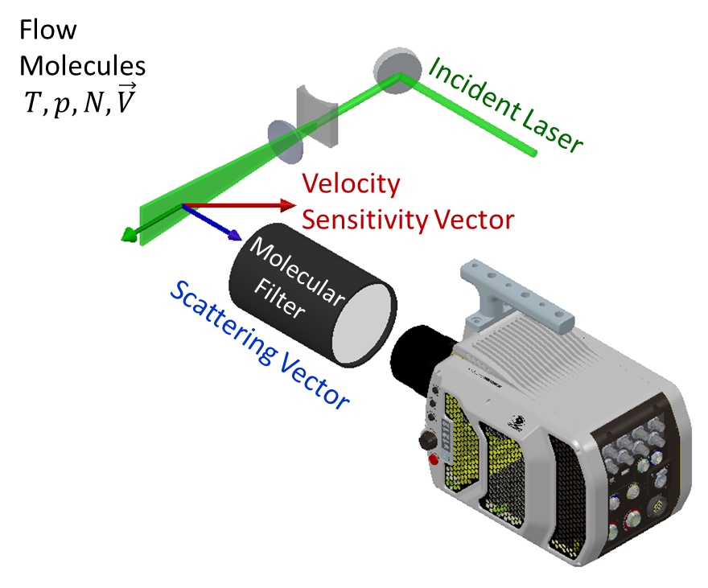
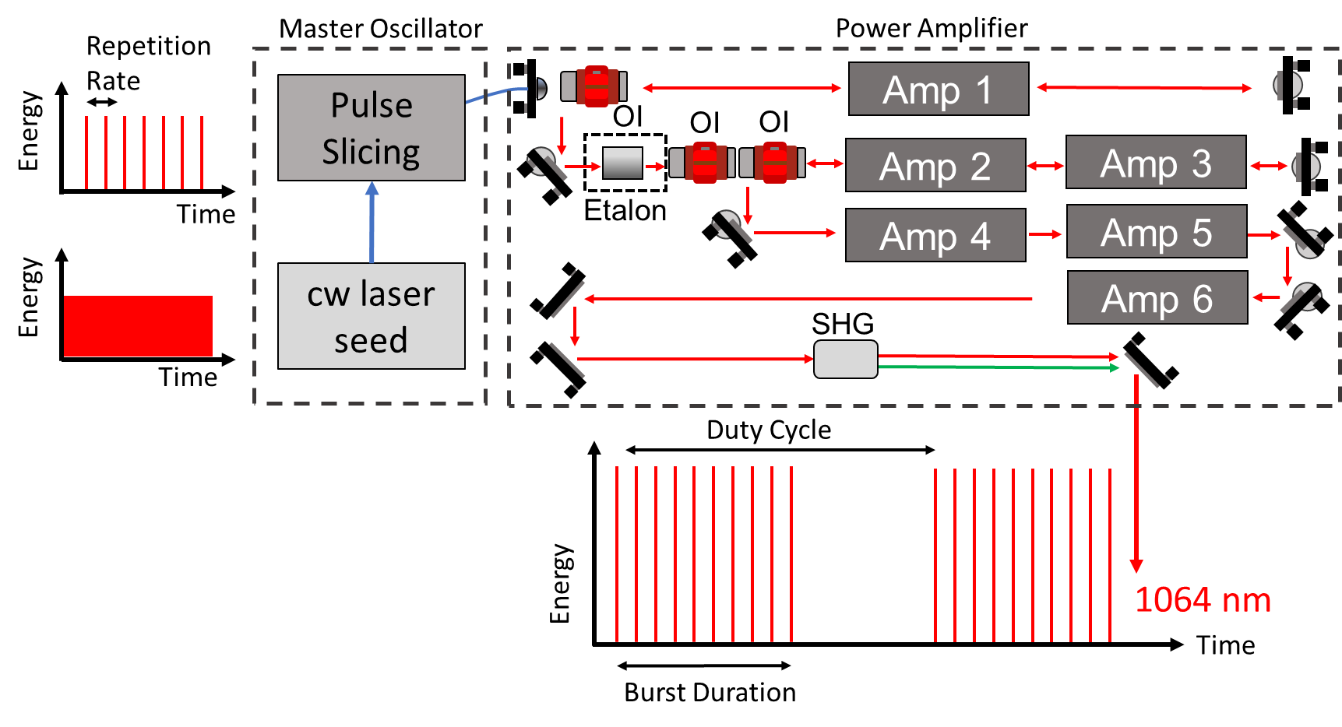
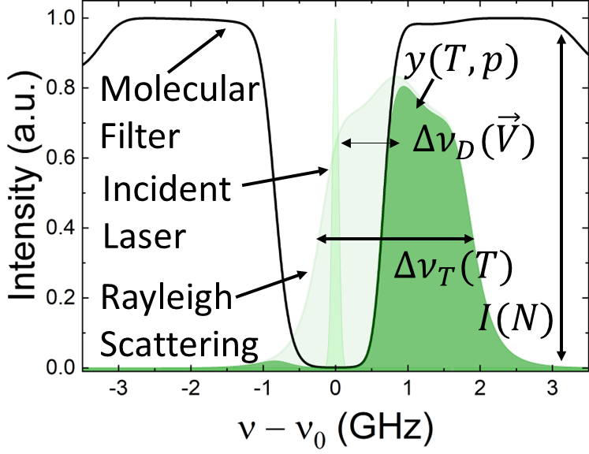
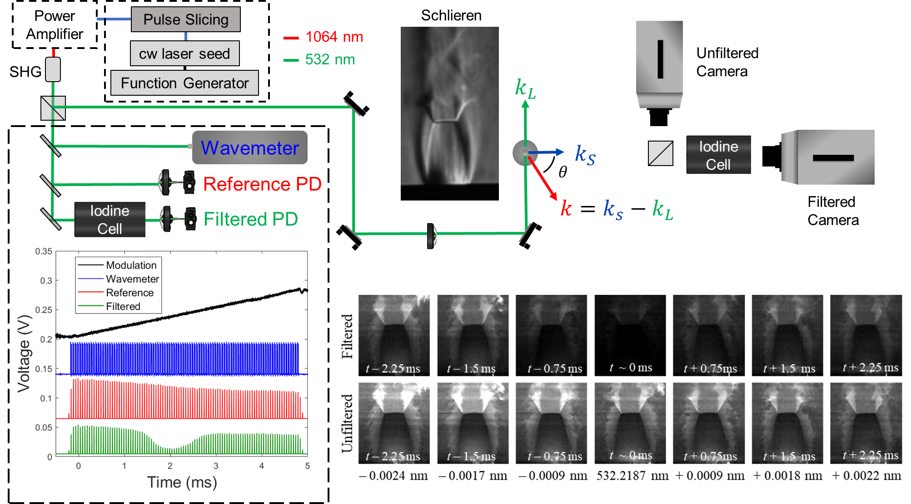
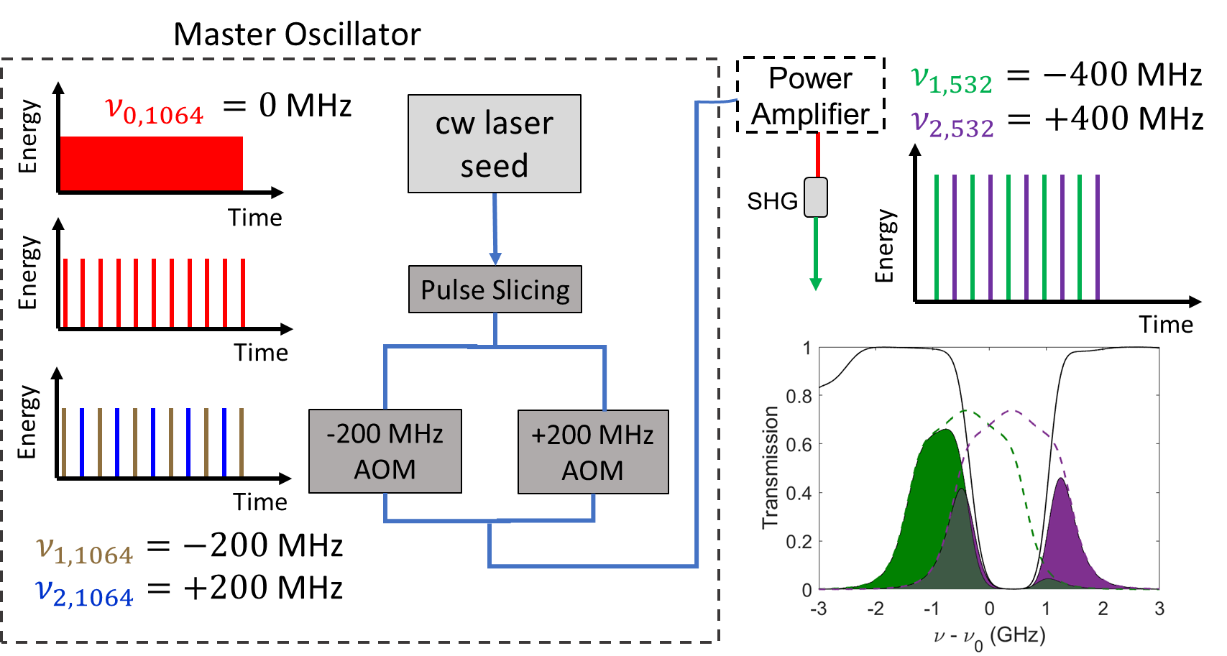
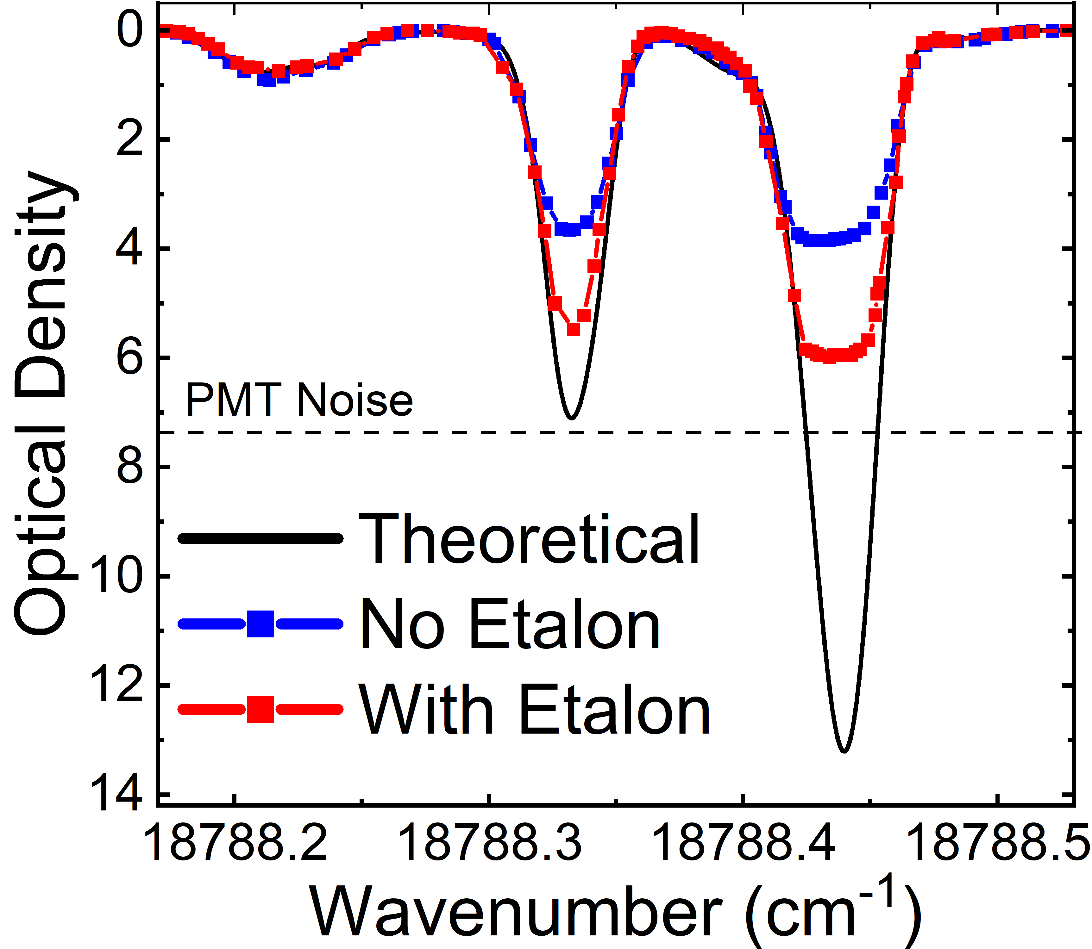
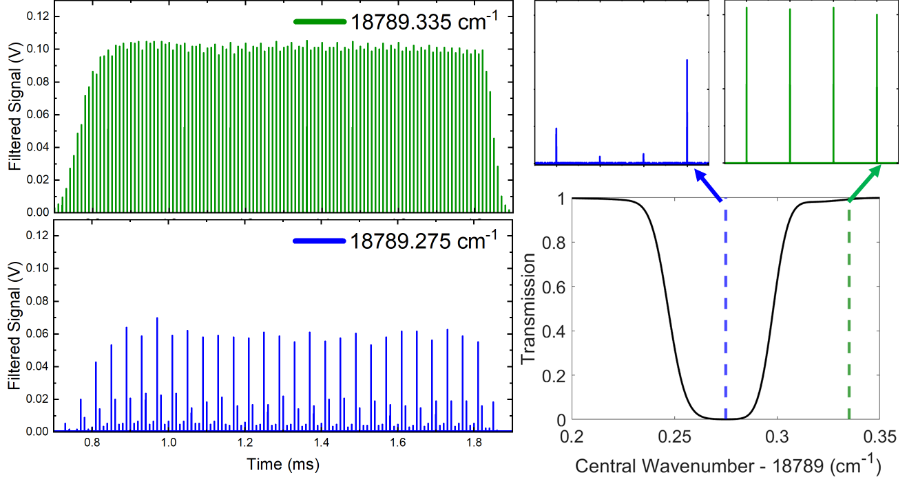
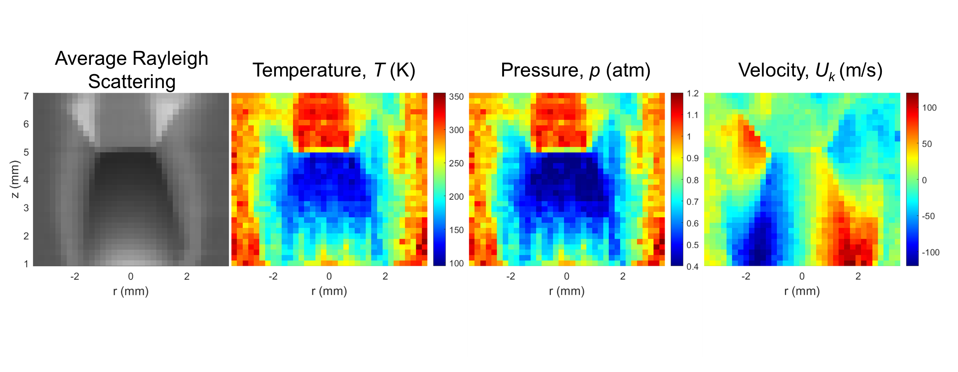
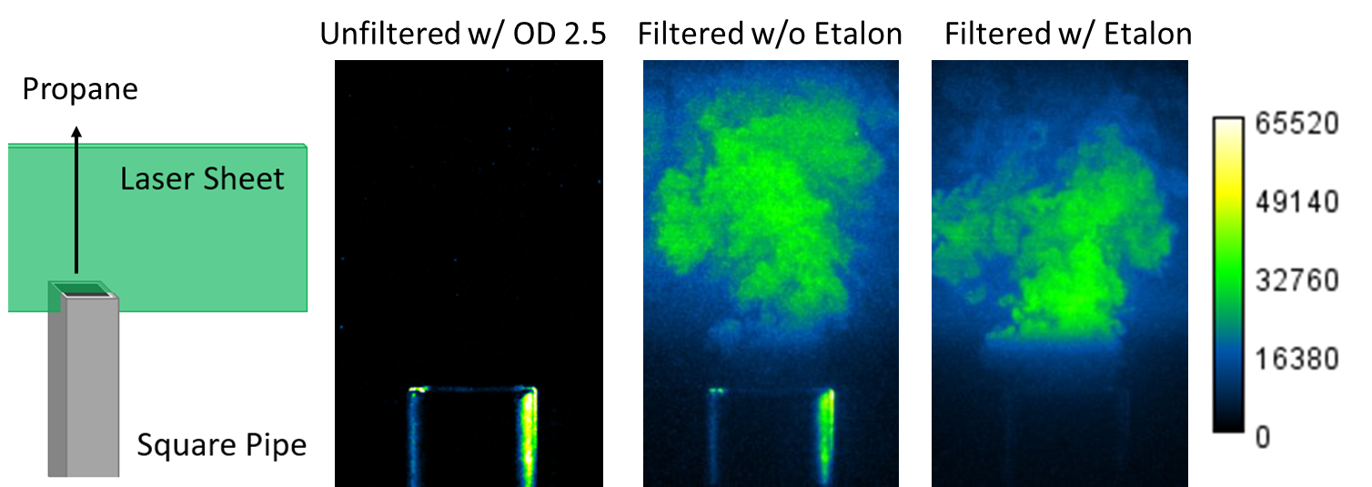
Advancements in Burst-Mode Filtered Rayleigh Scattering
for High-Speed Gas-Phase Multi-Parameter Measurements
Propane
Filtered w/o Etalon
Filtered w/ Etalon
Amanda M. Braun¹, Mikhail N. Slipchenko^{1,2}, Jason Leicht², Neil S. Rodrigues³, Paul M. Danehy³, Sukesh Roy², and Terrence R. Meyer¹
¹Purdue University, School of Mechanical Engineering, West Lafayette, Indiana 47907, USA
²Spectral Energies, LLC, 4065 Executive Dr, Beavercreek, Ohio 45430, USA
³Advanced Measurements and Data Systems Branch, NASA Langley Research Center, Hampton, Virginia 23681, USA
Challenges
Filtered Rayleigh scattering (FRS) overview
Burst-mode laser principles
FRS Signal Intensity
Low signal levels
Strong background interferences
Multiple cameras and/or molecular filters to spectrally resolve the signal
$$I_{FRS}≈I_{L}∙ε∙N∙LΔΩ ∙ \sum_{j}{χ_{j}\frac{dσ_{j}}{dΩ}}\int_{−∞}^{∞}{R\left(ν−ν_{0}−Δν_{D}(\vec{V}), p, T, θ\right)⋅F\left(ν−ν_{0}\right)dν}$$
$I_{L}−$ Laser intensity
$R(ν−ν_{0}−Δν_{D}, p, T, θ)−$ Rayleigh lineshape profile
$ε−$ Optics efficiency
$Δν_{D}−$ Doppler shift
$N−$ Number density
$\vec{V}−$ Velocity
$L−$ Probe length
$p−$ Pressure
$ΔΩ−$ Solid collection angle
$T−$ Temperature
$χ_{j}−$ Mole fraction of species, j
$θ−$ Angle between scattering and incident laser vectors
$dσ_{j}/dΩ−$ Rayleigh cross-section of species, j
$F(ν−ν_{0})−$ Filter transmission profile
Improved Spectral Purity
Wavelength-Agility for Multi-Parameter Measurements
The FRS laser source must have a spectral linewidth that is much narrower than the absorption line of the molecular filter to ensure that the background scattering will be fully absorbed.
To deconvolve the effects of pressure, temperature, and velocity, multiple incident laser frequencies can be used to quasi-spectrally resolve the signal [2-5].
Current modulation of the burst-mode laser seed wavelength [6-8] across an iodine absorption band allowed for a measurement bandwidth of up to 1 kHz.
Acousto-optic modulators were used to create discrete, frequency-shifted pulses during the burst [9].
Outside Absorption Band
Inside Absorption Band
Spectral purity of burst-mode laser was increased from ~0.9998 to ~0.999999 with the addition of an etalon inside the amplification stage [1].
Basic design for two frequency-shifted pulses
FRS signal taken at 100 kHz for four frequencies (-600 MHz, -200 MHz, +200 MHz, +600 MHz) for two different central frequencies
Increased spectral purity gives additional attenuation of stray scattering.
Preliminary temperature, pressure, and radial velocity maps of an underexpanded jet with ambient temperature air as the working fluid
Potential for N, $Χ_{j}$Measurement
Potential for 100’s of kHz V, p$,$T Measurement
Potential for ~MHz V, p$,$T Measurement
[1] A. M. Braun, M. N. Slipchenko, J. Leicht, T. R. Meyer, P. M. Danehy and S. Roy, “Methods to improve burst-mode laser spectral purity for high-speed gas-phase filtered Rayleigh scattering,” Accepted to Opt. Lett. (2023).
[2] J. N. Forkey, N. D. Finkelstein, W. R. Lempert, and R. B. Miles, “Demonstration and characterization of filtered Rayleigh scattering for planar velocity measurements,” AIAA J. 34(3), 442–448 (1996).
[3] M. Boguszko and G. S. Elliott, “Property measurement utilizing atomic/molecular filter-based diagnostics,” Prog. Aerosp. Sci. 41(2), 93–142 (2005).
[4] U. Doll, G. Stockhausen, and C. Willert, “Endoscopic filtered Rayleigh scattering for the analysis of ducted gas flows,” Exp. Fluids 55(3), 1690 (2014).
[5] U. Doll, G. Stockhausen, and C. Willert, “Pressure, temperature, and three-component velocity fields by filtered Rayleigh scattering velocimetry,” Opt. Lett. 42(19), 3773 (2017).
[6] T. W. Fahringer, R. A. Burns, P. M. Danehy, P. M. Bardet, and J. Felver, “Pulse-Burst Cross-Correlation Doppler Global Velocimetry,” AIAA J. 58(6), 2364–2369 (2020).
[7] N. S. Rodrigues, P. M. Danehy, N. Jiang, P. Hsu, J. Leicht, and S. Roy, “100 kHz High-Spectral-Resolution NO-PLIF Measurements for Compressible Flows,” in AIAA SCITECH 2023 Forum (2023)
[8] R. A. Burns, T. W. Fahringer, and P. M. Danehy, “Velocity measurements across an oblique shock using pulse-burst cross-correlation DGV,” in AIAA Scitech 2021 Forum (2021).
[9] A. J. Saltzman, K. T. Lowe, and W. F. Ng, “250 kHz three-component Doppler velocimetry at 32 simultaneous points: a new capability for high speed flows,” Meas. Sci. Technol. 31(9), 095302 (2020).
This work was funded by a NASA Space Technology Graduate Research Opportunity Fellowship

