Slide 2
Open-Source NDE Simulation and Data Processing Tools from NASA
Elizabeth Gregory
Bill Schneck
NASA Langley Research Center

Slide 3
Goals for Open-Source Software
Human Readable Inputs with XML
Easy editing
Easy sharing
Procedurally generated via outside tools
Easily Buildable Problems
Modular approach
Problem agnostic
Robust Tool for Long Use Life
Robust Testing with Test Driven Development
Unit and case testing
Test during development
Automatic Testing
Sharable Outputs with VTK
Easy data visualization
Already optimized parallel output
Self documenting output files
Trade names and trademarks are used in this report for identification only. Their usage does not constitute an official endorsement, either expressed or implied, by the National Aeronautics and Space Administration.

Slide 4
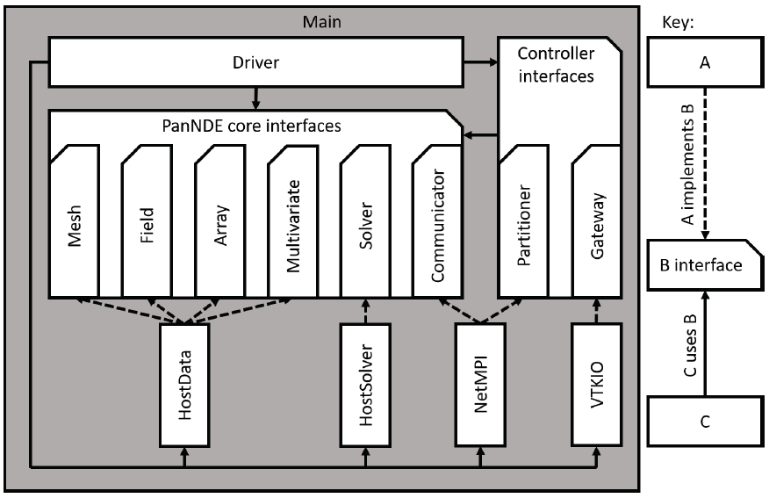
PanNDE: Open-Source Toolbox for NDE Simulation
Emphasis on^{1,2}
  delineation between components (e.g. single responsibility principle)
  interconnection between components (dependency inversion)
Influence of modularization:
  Extensibility (e.g. physics solved is ‘just another module’)
  Maintenance of independent components
  Reduction in technical debt
During development:
  Encapsulation of MPI reduced overhead of testing and maintenance
  Insulation from I/O library allowed pivoting from CGNS to VTK
  Modularization allowed porting mesh and I/O modules to another project
1. R. Martin, Clean Architecture: A Craftsman's Guide to Software Structure and Design, Prentice Hall, 2018.
2. O'Connell, Matthew, et al. "Application of the Dependency Inversion Principle to Multidisciplinary Software Development." 2018 Fluid Dynamics Conference. 2018.https://doi.org/10.2514/6.2018-3856
Simplified architectural diagram
PanNDE elastodynamic simulation software

Slide 5
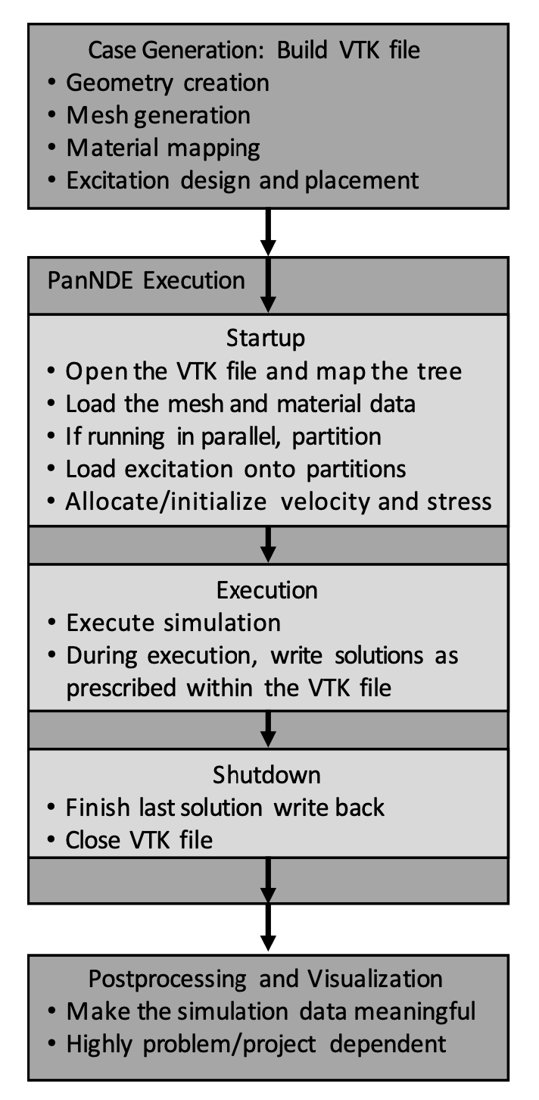
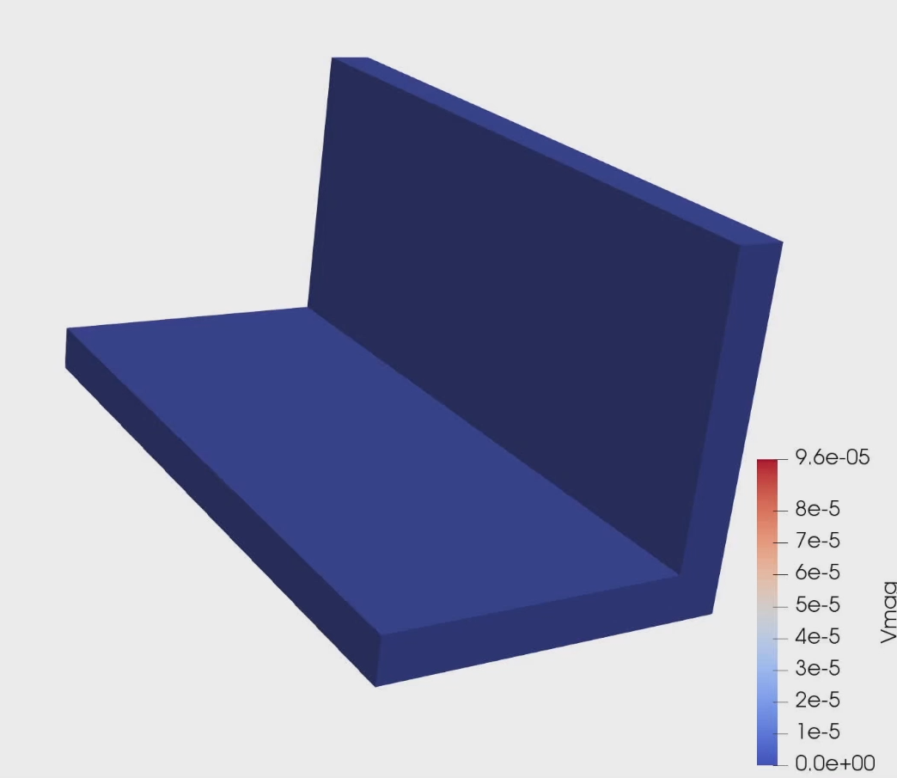
Example Simulation

Slide 6
PanNDE 2.0 Additions/Changes
Groups: Easy creation and selection of subsets of geometry. Allows users to:
  Easily implement their own boundary conditions.
  Save output for only Regions of interests.
Dakota Hooks for meta-analysis.
Thermal Model Solver Example.
New UT Source Examples.
New Included Python Tools
  Case makers for fast creation of input files.
    Metallic
    Composite
  Post processing scripts
  Example for the python VTK bindings.
Better Data Handling
General Refinement

Slide 7
Groups – A infinitely sized plate with a Perfectly matched Layer Boundary Conditions
Blue Group - Normal Computational region
Orange Group PML for X direction.
Green Group PML for Y direction
Yellow Group PML for X & Y directions

Slide 8
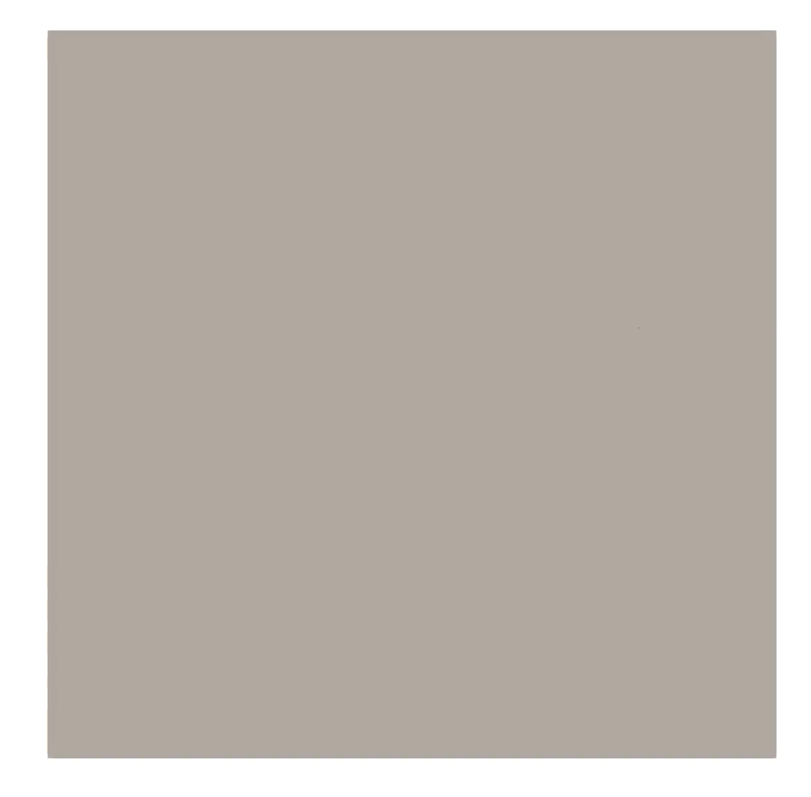
Composite Laminate Example with transducer input
Example for
  python case maker
  material property rotations
  transducer input

Slide 9
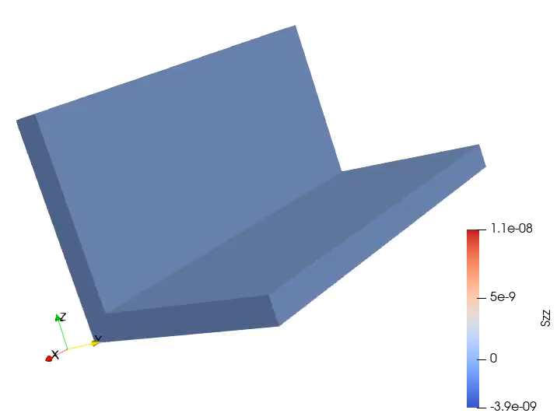
Aluminum Angle Bracket
Example for
  python case maker
  Lamé parameters
  6x6 stiffness matrix
  Water column input

Slide 10
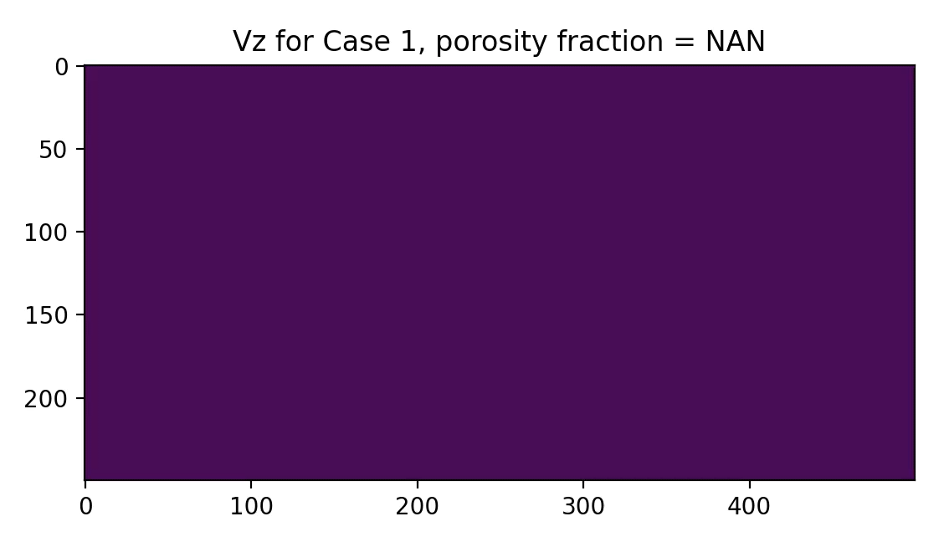
Example: Porosity in Additively Manufacture Parts
Porosity is randomly generated. Size and location.
Uniform pulse source.
Compared attenuation.
NDE&T Article is forthcoming.

