Slide 1
Computationally Efficient Method for Predicting Tip Clearance Effects on the Natural Frequency of Submerged Discs and Inducers
Cody Langston
Mentors: Andy Brown, Tim Wray NASA-MSFC

Slide 2
Introduction & Motivation
RS-25 rocket engines powering SLS 1st Stage combust oxygen and hydrogen, stored as liquid (LO2 and LH2).
Inducer in low-pressure fuel pump takes LH2 at tank pressure & increases several hundred psi.
As with any inducer, cavitation exists, but additional high-frequency, “higher-order cavitation (HOC)” generated here.
  causes acoustic wave emanating upstream & downstream at frequency of 6.4-6.7 engine speed.
  magnitude high enough to potentially cause high resonant response on impinging structures such as inducer blades.
RS-25 is upgraded SSME, which had >1M sec of testing, but RS-25 has different operating conditions causing significantly more time in HOC.
Structural dynamic assessment therefore required.
Natural frequency of excitable modes have large uncertainty, though, due to many complicating factors.

Slide 3
Introduction & Motivation
Factors
  Large adjustment of E_{Ti} due to cryogenic operating temperature.
  Fluid-added mass (FAM) of LH2
  Magnification of FAM due to tight tip clearance.
  Effect of Structural-acoustic interaction with small compressibility.
  Multi-phase fluid density where liquid is cavitating.
Magnitude of effects initially estimated using some available test data and fundamental physics.
Uncertainties in each adjustment based purely on subject confidence level – “low, medium, or high”, which translated to arbitrary percentages.
Actual value of operating ω_{n} cannot be measured due to environment, expense of hardware.

Slide 4
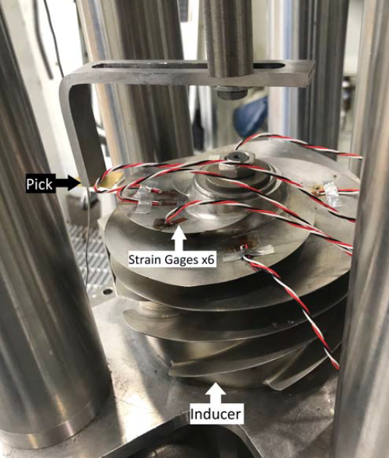
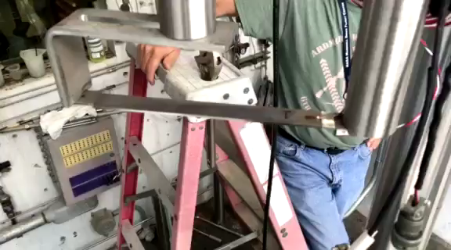
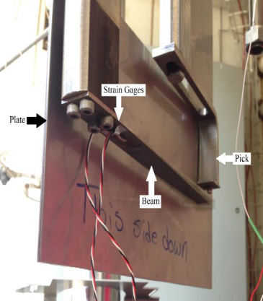
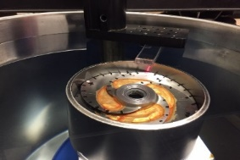
Introduction & Motivation
Ping tests in air and LH2 of cantilever beam (CBeam) made of the same Titanium alloy as the actual inducer.
Ping test of cantilever beam in LH2 with a tight tip clearance.
Modal test of stainless steel sub-scale (SS) inducer with medium tight tip clearance in water.
Modal test of SS inducer with open clearance in water, ping test in LH2.
Campaign quantified nominal adjustments and improved fluid/structure modeling techniques, yielding test/analysis errors from 0.8-3.7%.

Slide 5
Tight Tip Clearance
Fluid added mass decreases frequencies
Tight tip clearance
Restricts fluid’s ability to move out of the way
Increases effective volume of fluid affecting structure
Can be classified in 3 regions
Goal is to analytically predict phenomenon
  Minimum
  Intermediate
  Maximum

Slide 6
Analytical Model Uses
Inducers have tip clearances well within the intermediate region
In the design phase, tip clearance is set to optimize flow
An analytical prediction is sought after since it:
Solves meshing errors due to tight clearances
Solves runtime errors due to high element density
Avoids a full clearance sweep in design
Provides a sanity check for results
Compliments Pranav’s solutions and can be used for the upcoming LH2 test at 0.005in clearance

Slide 7
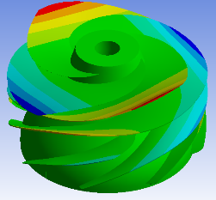
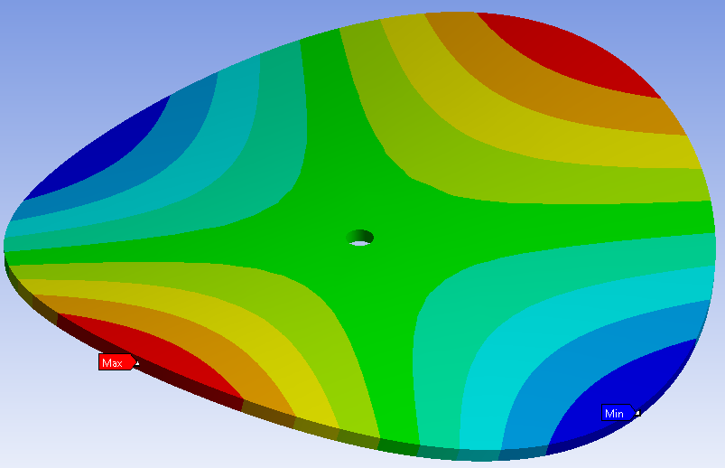
Investigation Method
Discs
  Normalizes perimeter/area ratio
  0-radial shapes are similar to inducers
Upper bound
  Frequency stays the same at increasing clearances
Lower bound
  Frequency stays the same at decreasing clearances
Inducer Shape
0-Radial, 2 Nodal
Upper Bound
Lower Bound

Slide 8
Intermediate Region
For discs, the intermediate region has a logarithmic relationship
This held true for all parameters
This relationship pinpoints the inflection point

Slide 9
Diameter Effects
An increase in diameter linearly increased the upper bound
This was normalized by Gap Area/Disc Area
Assume root occurs at ratio of 1.7:1
Increased volume of fluid displaced directly increases effective infinite volume
Increase in diameter has no effect on lower bound
Tip Clearance
Gap Area/Disc Area

Slide 10
Thickness Effects
An increase in thickness linearly increased the lower bound
This was normalized by Tip Clearance/Thickness
Assume root occurs at ratio of 525:1
Constricting cavity’s ability to equalize pressure adds effective stiffness to the system
Increase in thickness has no effect on upper bound
Tip Clearance
Clearance/Thickness

Slide 11
Mode Shape Effects
Both 0 and 1-Radial shapes were analyzed
Mode shape shifted upper bound
Analyzed the relationship between fluid volume displaced and effective mass increases
  Both follow a power rule but are inconsistent
Assume the upper bound of higher order radial modes does not change due to power rule
Tip Clearance
Both decreases share a power relationship

Slide 12

Fluid Density Effects
Shifted the frequency of the system up or down
The magnitude of this shift followed ω=$\sqrt{k/m}$
Density did not shift the upper or lower bound

Slide 13
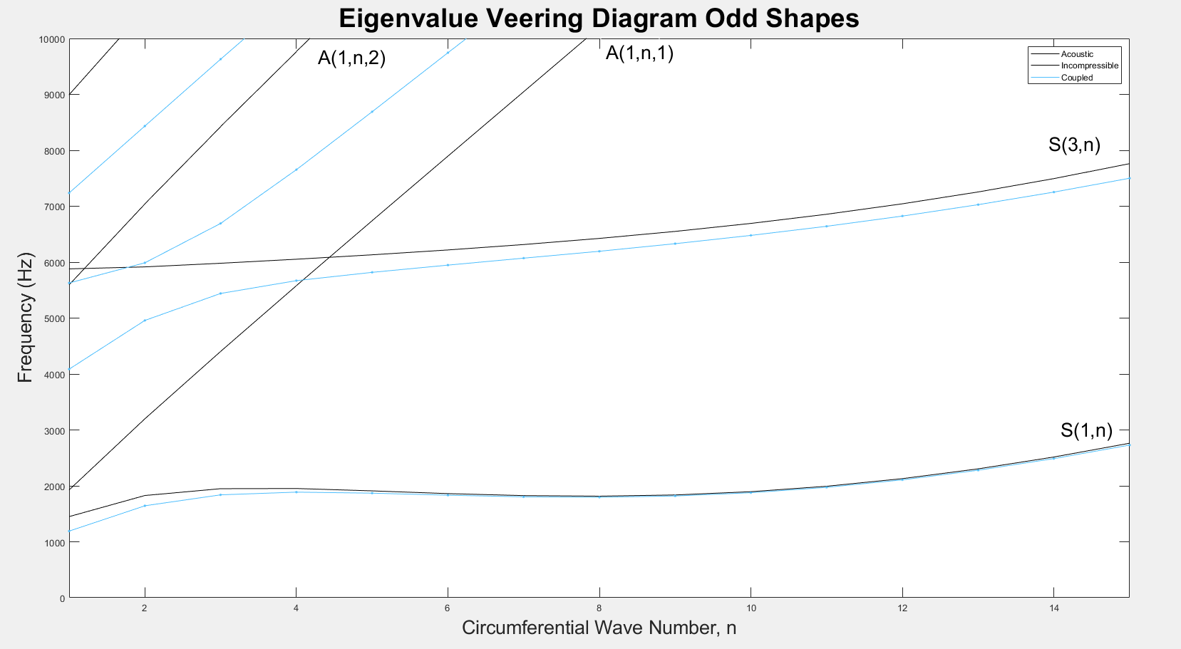
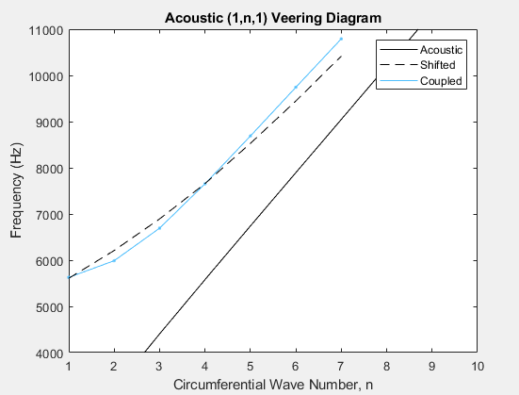
Fluid Density Effects
Decreases frequency for structurally dominated modes
Increases frequency for acoustically dominated modes

Slide 14
Characteristic
Lower Bound
Upper Bound
Important Notes
Diameter
Lower bound was unchanged
Upper bound was normalized by a Gap Area/Disc Area of 1.7
Volume of fluid displaced affects upper bound only
Thickness
Upper bound was unchanged
Lower bound was normalized by a Thickness/Clearance of 525
Inability to equalize pressure affects lower bound only
Fluid Density
Speed of Sound

Slide 15
Analytical Method
1
Assumptions:
A maximum and minimum frequency exist
The intermediate region relationship is logarithmic
The upper bound exists at a Gap Area/Disc Area of 1.7:1
The lower bound exists at a Thickness/Clearance of 525:1
Requires 2 ANSYS cases with clearance:
Above upper bound
The lowest clearance viable
  Needs to be lower than inflection point
525
1.7*Area = Area

Slide 16
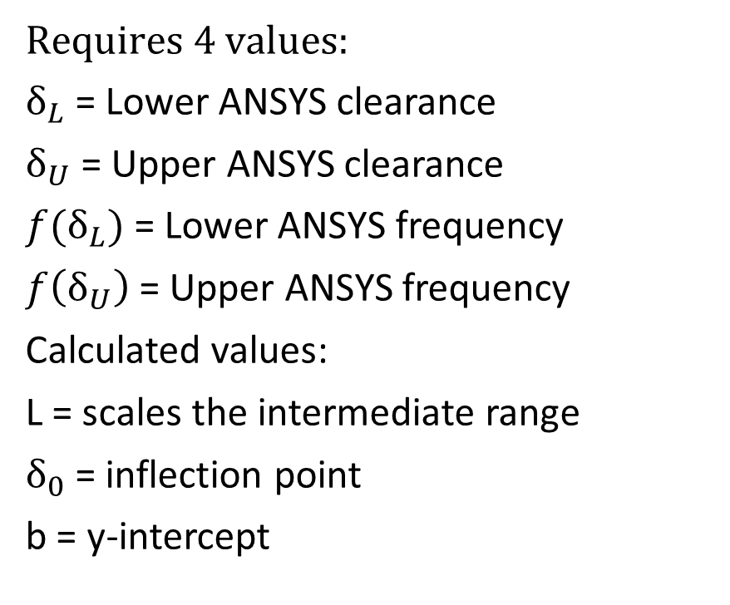
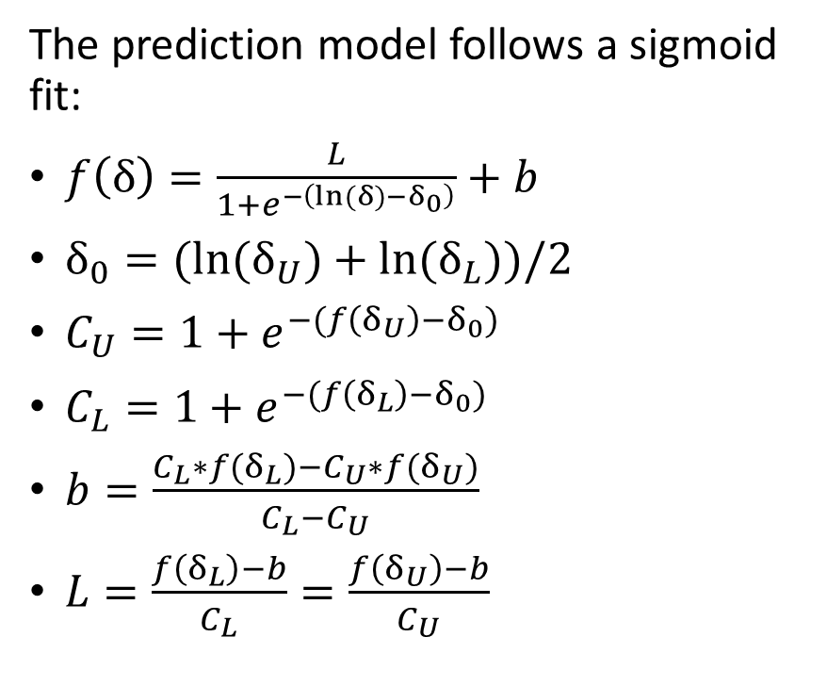
Analytical Model
The prediction model follows a sigmoid fit:
$f\left(δ\right)=\frac{L}{1+e^{−\left(ln⁡(δ)−δ_{0}\right)}}+b$
$δ_{0}={(ln(δ}_{U})+ln⁡(δ_{L}))/2$
$C_{U}=1+e^{−(f\left(δ_{U}\right)−δ_{0})}$
$C_{L}=1+e^{−(f\left(δ_{L}\right)−δ_{0})}$
$b=\frac{C_{L}∗f(δ_{L})−C_{U}∗f(δ_{U})}{C_{L}−C_{U}}$
$L=\frac{f\left(δ_{L}\right)−b}{C_{L}}=\frac{f\left(δ_{U}\right)−b}{C_{U}}$
Requires 4 values:
$δ_{L}$ = Lower ANSYS clearance
$δ_{U}$ = Upper ANSYS clearance
$f(δ_{L})$ = Lower ANSYS frequency
$f\left(δ_{U}\right)$ = Upper ANSYS frequency
Calculated values:
L = scales the intermediate range
$δ_{0}$ = inflection point
b = y-intercept

Slide 17
Mode Shape Effects
1-Nodal
2-Nodal
3-Nodal
4-Nodal
A change in mode shape does shift the upper bound
Difference in fluid displacement changes upper bound
  Inconsistent relationship
The upper bound converges for modes above 1-nodal
Assumed higher order modes all share the same upper bound

Slide 18
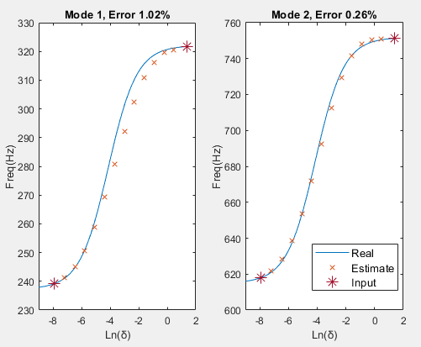

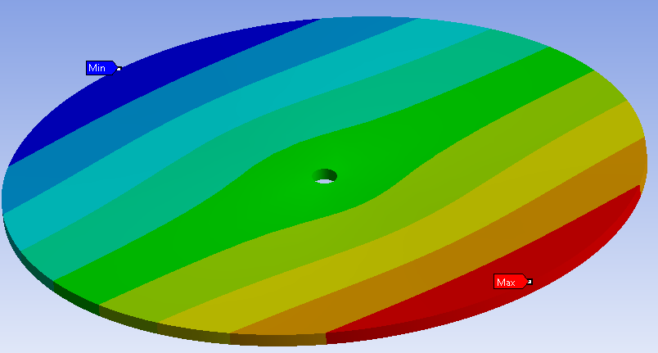
Disc Prediction
Overall results
Max Single Error: 6.97%
Max Average Error: 2.62%
Most of the error was due to issues with the upper bound at 1-nodal shapes
5-Nodal results
Max Single Error: 0.82%
Max Average Error: 0.31%

Slide 19
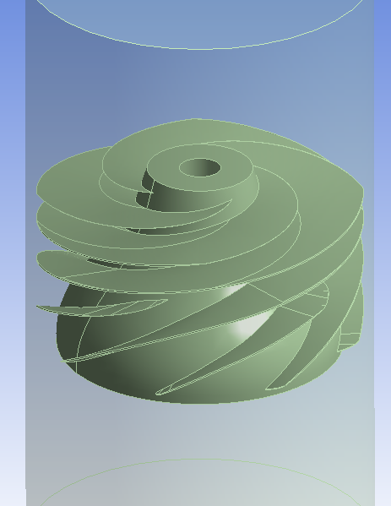
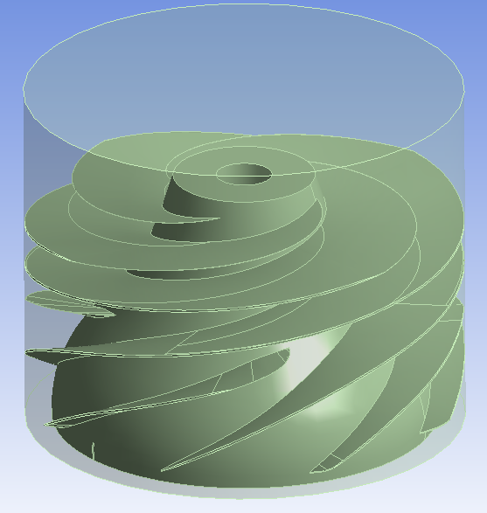
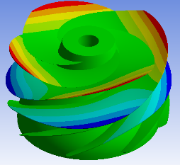
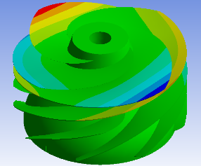
Inducer Model
Two inducer cases were analyzed using existing CAD
Inducer under an infinite condition cavity of water
Inducer with free surface on top
0-Nodal Diameter
1-Nodal Diameter
2-Nodal Diameter

Slide 20
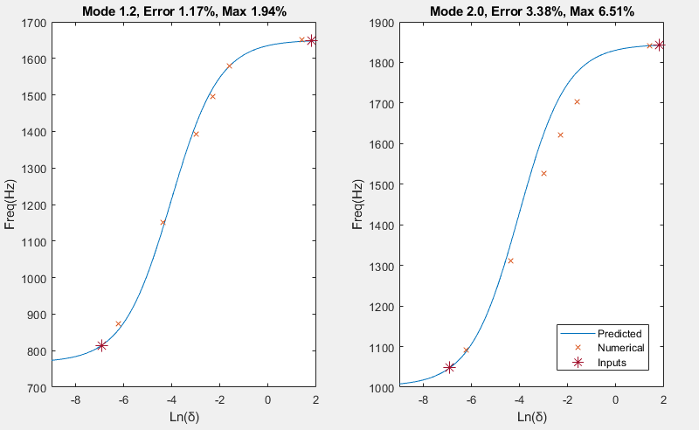
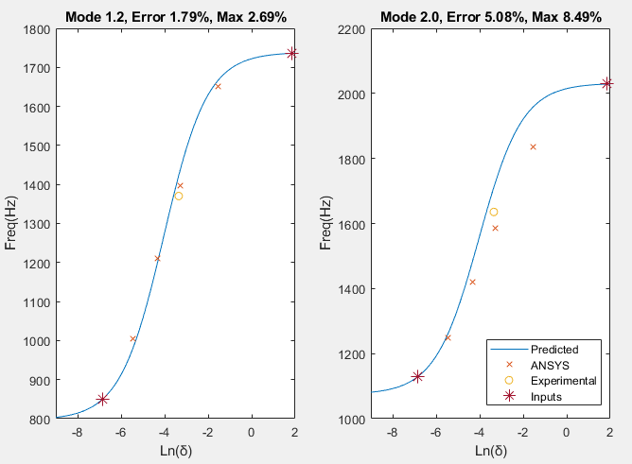
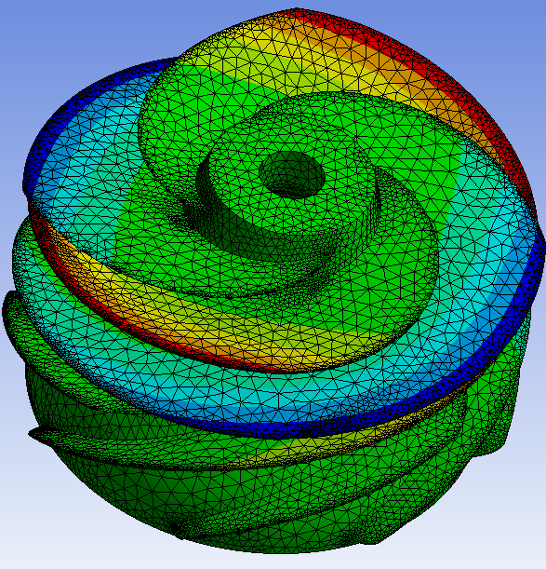
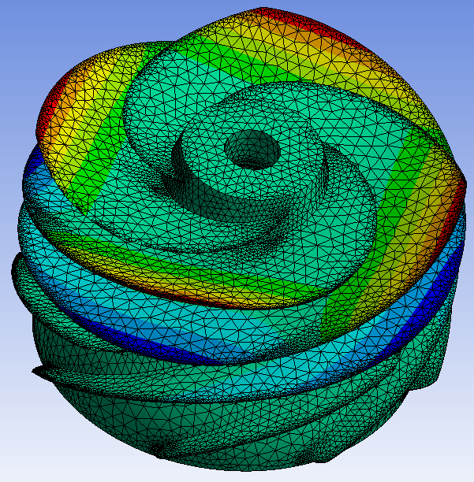
Inducer Predictions
Enclosed Average Error (Water):
0-ND: 3.38%
1-ND: 2.94%
2-ND: 2.81%
Test Case Average Error (Water):
0-ND: 6.81%
1-ND: 4.96%
2-ND: 2.48%
Experimental: 7.09%
Problematic upper bounds at 0-phase shapes

Slide 21
Tight Tip Clearance Conclusions
This analytical model can reliably predict higher n-order modes for discs
Most of the error exists with poor upper bound predictions due to mode shapes
The model can reliably predict 1-ND and 2-ND inducer shapes under large cavities of fluid
0-ND shapes had large error in the upper bound due to them displacing more fluid.
To improve the model, an analytical solution for how mode shapes affect the upper bound should be looked into

Slide 22
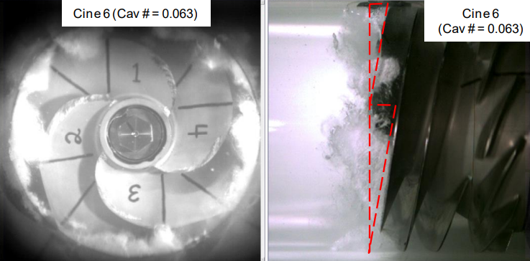
Inducer Background
Inducers are exposed to large forcing function due to flow and cavitation
If forcing frequency matches natural frequency, the part can break
Additional requirement of forcing and mode shape matching
Important to accurately predict both shape and frequency to avoid failure
Eigenvalue veering and tight tip clearances can change the response

Slide 23
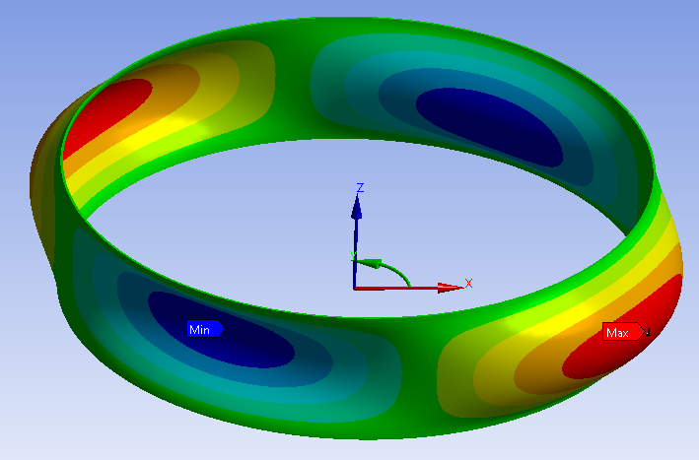
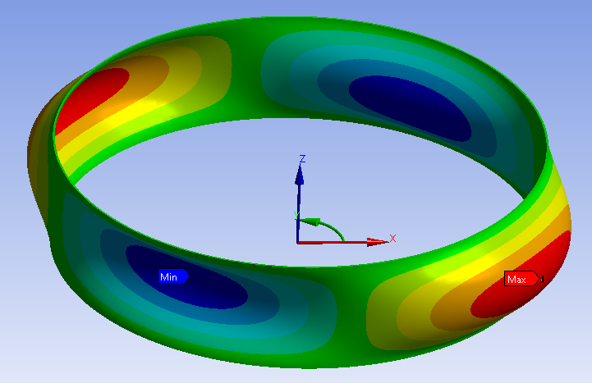
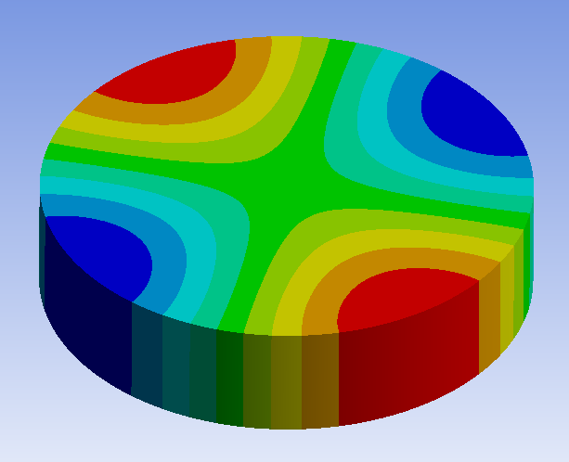
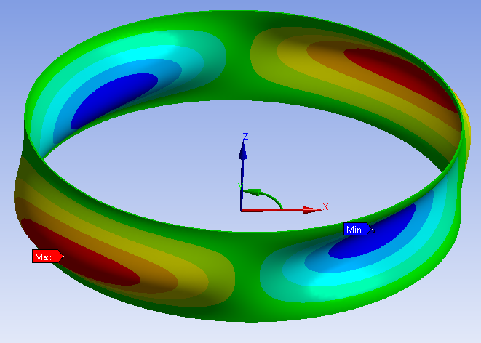
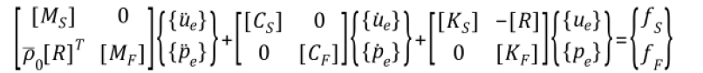
Modal-Acoustic Overview
Incompressible/Acoustic
Modal Acoustics
Acoustic
Solves standing waves assuming structure is a rigid body
Incompressible
Utilizes different fluid elements to approximate mass and viscosity affects
Modal Acoustics
Combines modal and acoustic analysis
Gains mode shapes at all incompressible and acoustic frequencies
Relatively new addition to ANSYS (2020)
Structurally Dominated: 2999.6 Hz
Acoustically Dominated: 5055.8 Hz

Slide 24
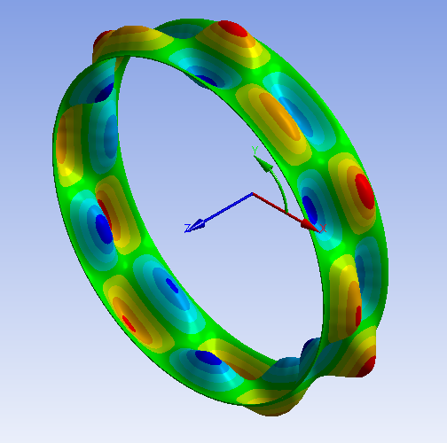
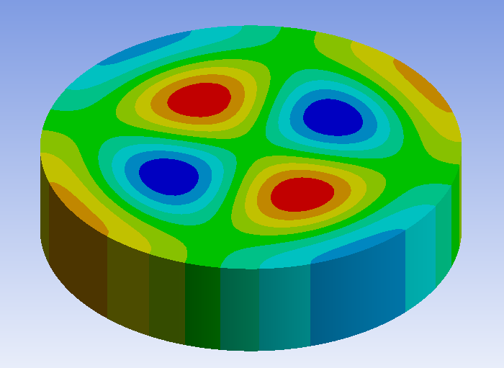
Mode Shapes
FEA recreation of analytical model from Davis’ work
Cylindrical structural shells:
m = axial half waves
n = circumferential/nodal waves
Cylindrical acoustic cavities:
m = axial half waves
n = circumferential/nodal waves
r = radial waves
Structural (m=2,n=6)
Acoustic (m=1,n=2,r=2)

Slide 25
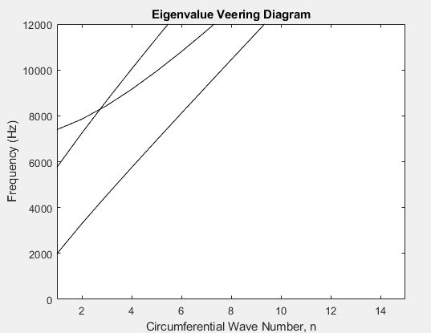
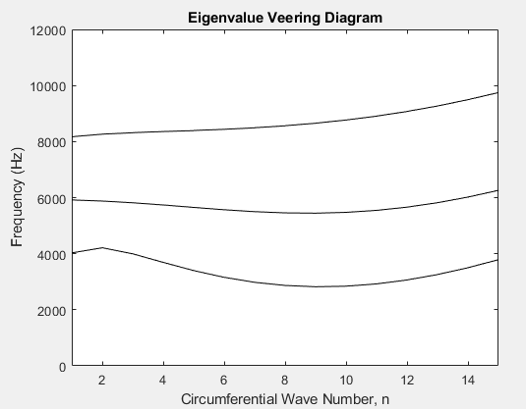
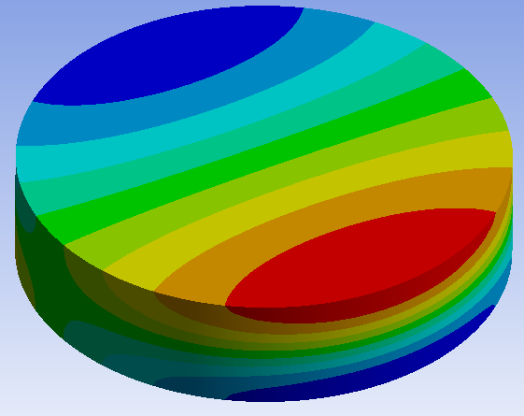
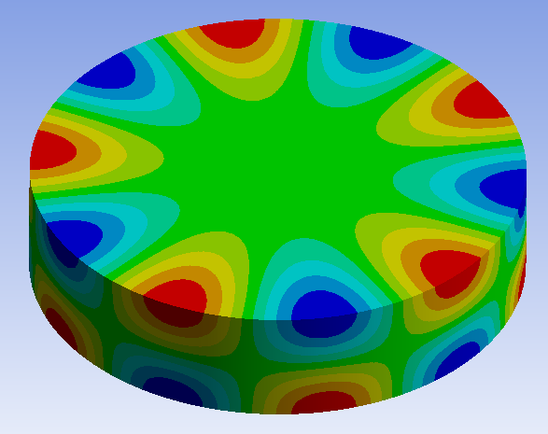
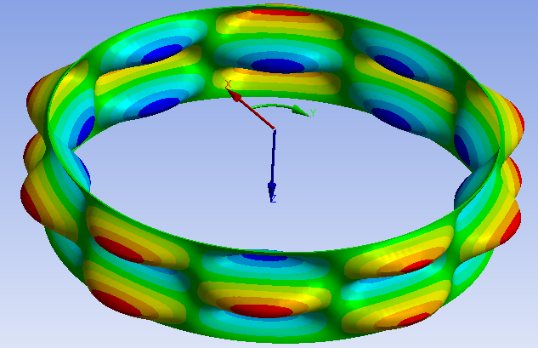
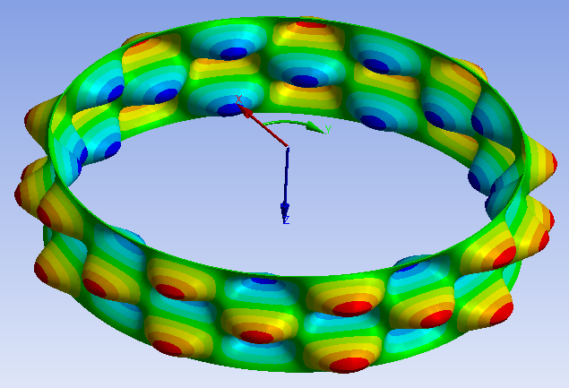
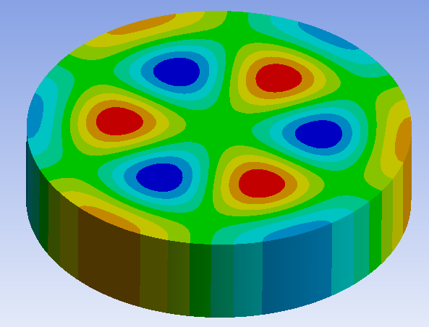
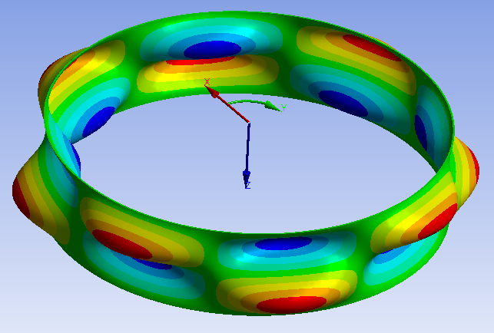
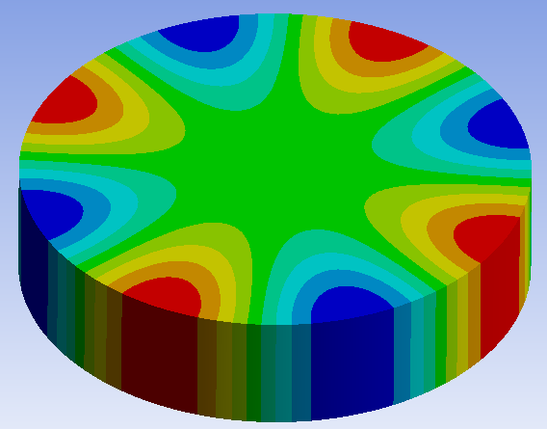
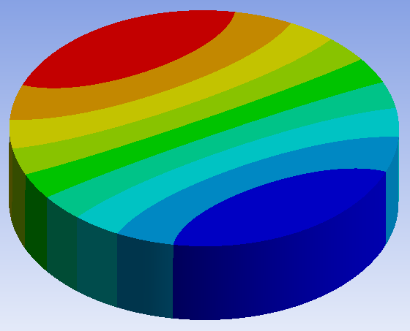
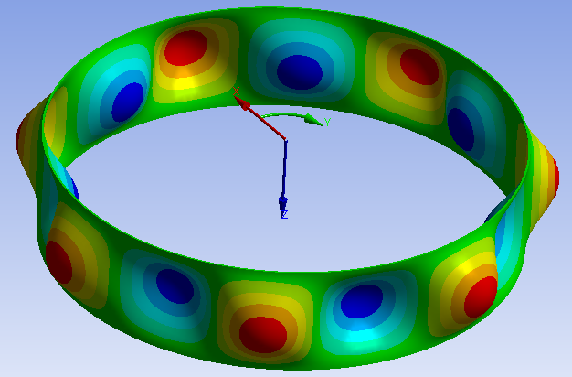
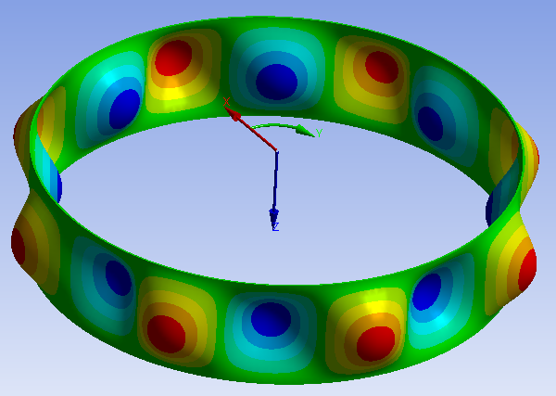
Acoustic
Incompressible

Slide 26
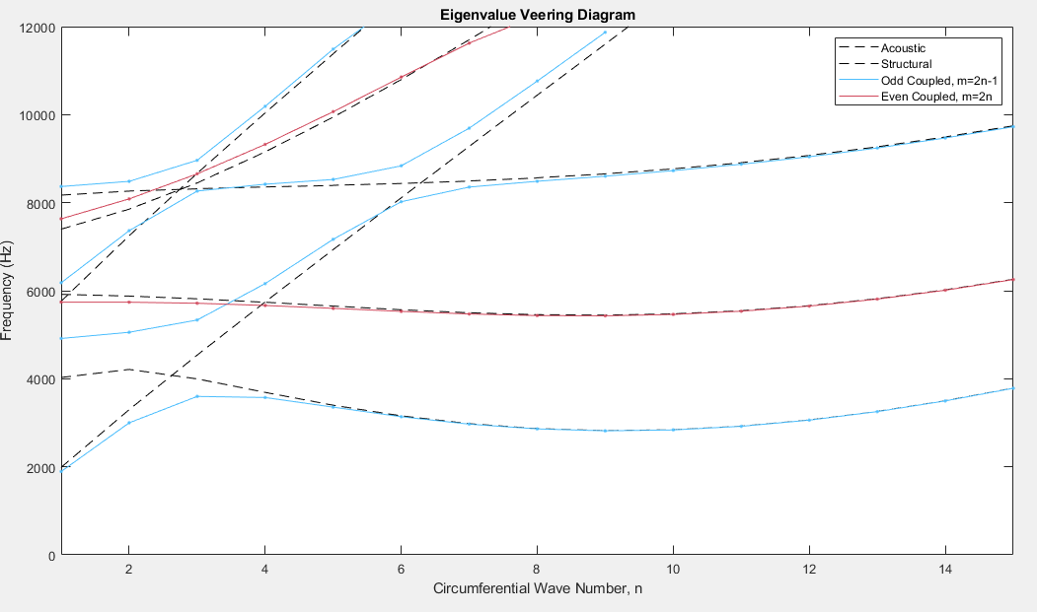
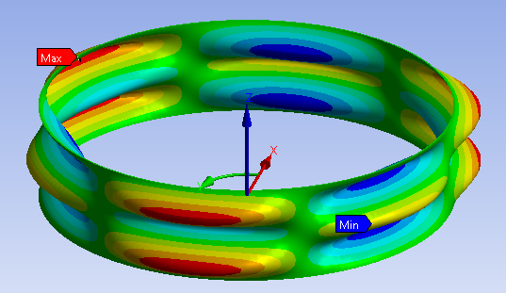
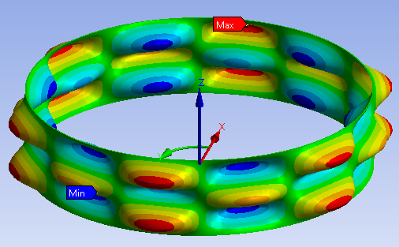
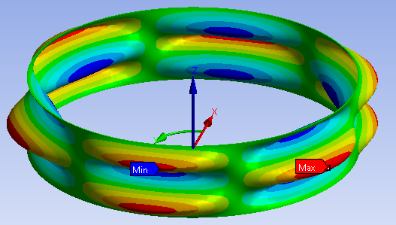
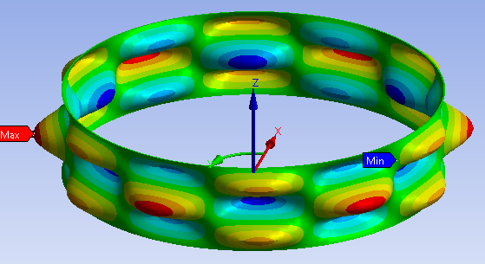
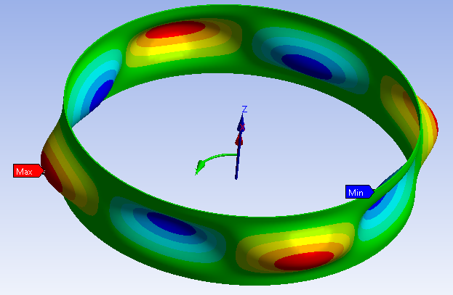
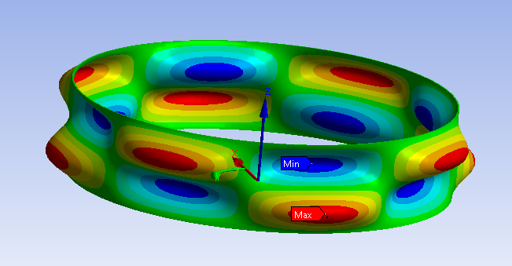
Similar axial symmetry (m) mode shapes will not cross frequencies

Slide 27
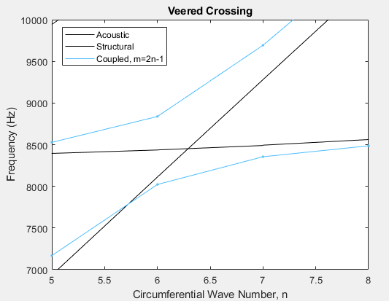
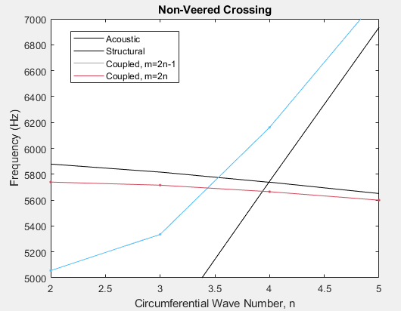
Symmetry
Require the same circumferential symmetry (n_{A}=n_{S})
Require odd/even axial symmetry (m_{A}=1 and m_{S}=3)
Easily tracked with Veering Diagrams
Veering Modes have the same shape
Non-veering Modes don’t have same shape

Slide 28
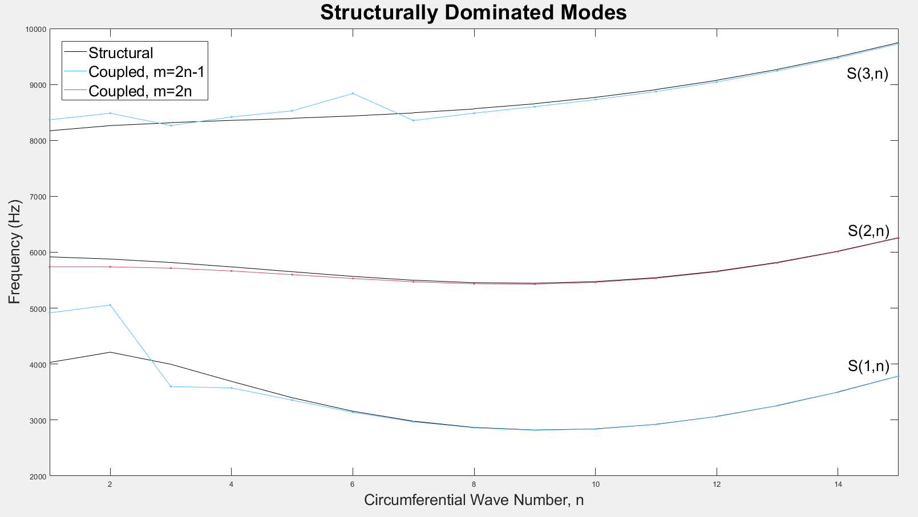
Natural Frequency Shifts
The frequencies veer away from symmetrical crossings
This veering results in large frequency shifts
Lower structural modes can shift upwards of 20%
This shift is not predicted in incompressible models

Slide 29




Same Axial Symmetry Shapes
If the acoustic and structure share even/odd symmetry:
The mode shape takes that of the closest structural
Usually ignores opposite symmetry shapes
+

Slide 30




Opposite Axial Symmetry Shapes
If the acoustic and structure don’t share even/odd symmetry:
The mode shape can shift to a lower axial order (lower m)
Can result in unique mode shapes
+

Slide 31
Eigenvalue Veering Conclusions
Eigenvalue Veering has the possibility to exist in inducers since:
LH2 density is low enough to put structural modes in the acoustic range
LOX shifts structural frequencies lower, so it only happens in higher order modes
These effects will not show up in incompressible analysis
Could result in misjudging a resonant frequency
New mode shapes expand what forcing profiles are problematic
Veering in inducers has different symmetry requirements
Veering is much less likely but can still happen
Important to keep note of due to its potentially catastrophic affects

Slide 32
Questions

