Slide 1
Empowering Open Science with the Science Discovery Engine
Emily Foshee¹, Kaylin Bugbee², Ashish Acharya¹, Carson Davis¹, Xiang Li¹,
Muthukumaran Ramasubramanian¹, Stephanie Wingo¹, and Rahul Ramachandran²
1: University of Alabama in Huntsville, 2: NASA Marshall Space Flight Center
Planetary Data Workshop
June 26, 2023

Slide 2
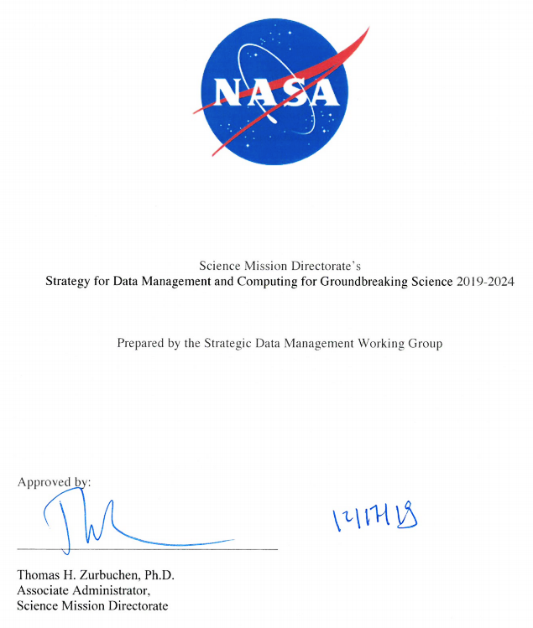
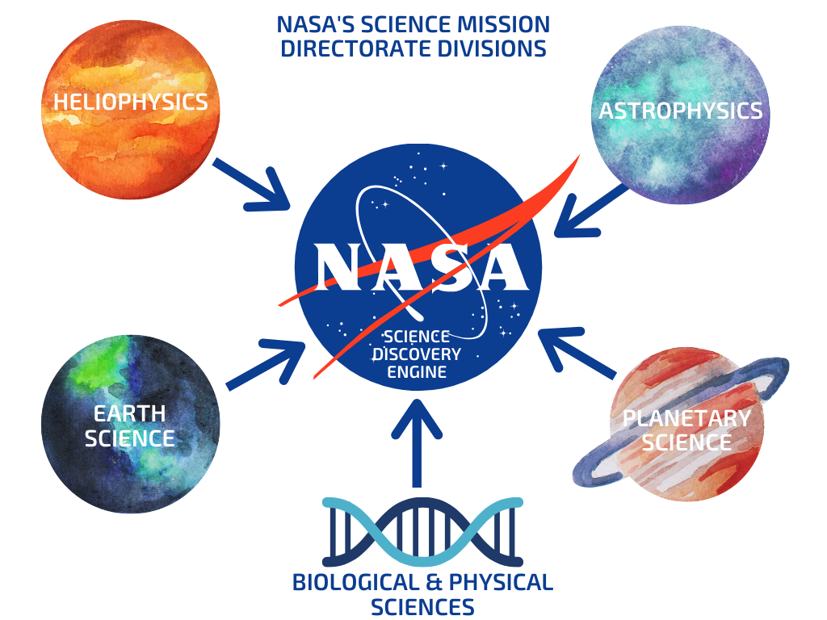
Meet the Science Discovery Engine (SDE)
Goal 1: Develop and Implement Capabilities to Enable Open Science
1.3: Develop and implement a SMD data catalog to support discovery and access to complex scientific data across divisions
Goals:
Enable rapid discovery of NASA’s science data, software, and documentation
Incorporate information from all SMD focus areas
Develop advanced search capabilities
Purpose:
2018 - NASA SMD Strategy for Data Management and Computing
Open Source Science Initiative (OSSI) - “commitment to building an inclusive open science community”
Origin
Approaches
Construction
Next Steps
Notes:
Goal 1 has four strategies, and the data catalog is number three of the four strategies

Slide 3
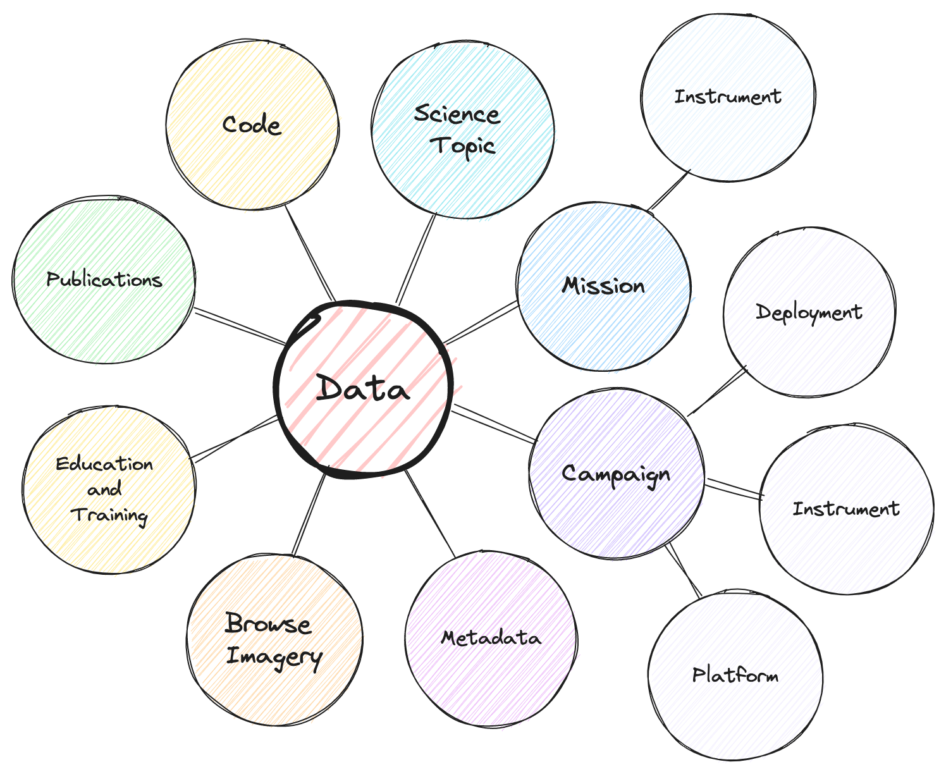
Meet the SDE: Challenges in Implementation
Bringing together heterogeneous topics into a single search environment
  Domain-specific schemas
  Different science concepts across the domains
    BPS: Experiments
    Everyone else: Observations/observatories/platforms
    Datasets versus catalogs
Identification and curation of dispersed content
  Where does all this data and information live?
  How do we know we have everything?
Accelerated development timeline
Origin
Approaches
Construction
Next Steps

Slide 4
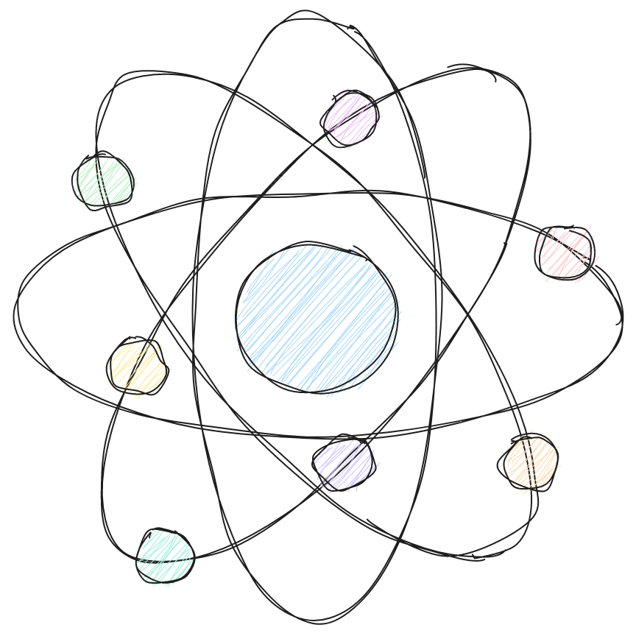
Meet the SDE - Initial Technology Assessment
Directly-Supervised
Options:
  Metadata aggregation (schema matching)
  Semantic mapping using ontologies and triple store
  Graph database
Positive:
  Allows structure and defined linkages
Negative:
  Need to align schemas
  Lengthy process to develop an ontology
  Build a UI from scratch
  Ontology or schema crosswalk maintenance
  Harder to integrate unstructured content
A More Refined Solution
Options:
  Insight Engine or Cognitive Search
Positive:
  Indexes both structured and unstructured data
  Structure can be added later via whitelists, UI -> Eliminates need for up front schema cross-walking and community agreement
  Commercial off-the-shelf application includes some out-of-the-box capabilities such as UI and API
Negative:
  Designed for enterprise search so curation workflows and use case customization required
  Still requires a lot of custom development
Origin
Approaches
Construction
Next Steps
Notes:
Gartner: Insight Engine, Forester: Cognitive Search

Slide 5

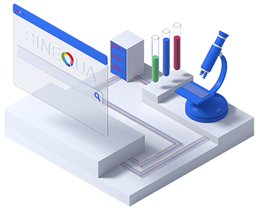
What is an Insight Engine?
For this project, we selected the Insight Engine approach. This decision was driven by the following needs:
  Ease of implementation
  Ease of operations
  Scalability
  Ability to incorporate unstructured information
Insight Engines apply relevancy methods to describe, discover, organize, and analyze data
  Capability that enables richer indexes, more complex queries, elaborated relevancy methods, and multiple touchpoints for the delivery of data (for machines) and information (for people)
Source: sinequa.com
Origin
Approaches
Construction
Next Steps
Notes:
High-level explanation. The next slides will walk through the development of the SDE using the Sinequa insight engine

Slide 6
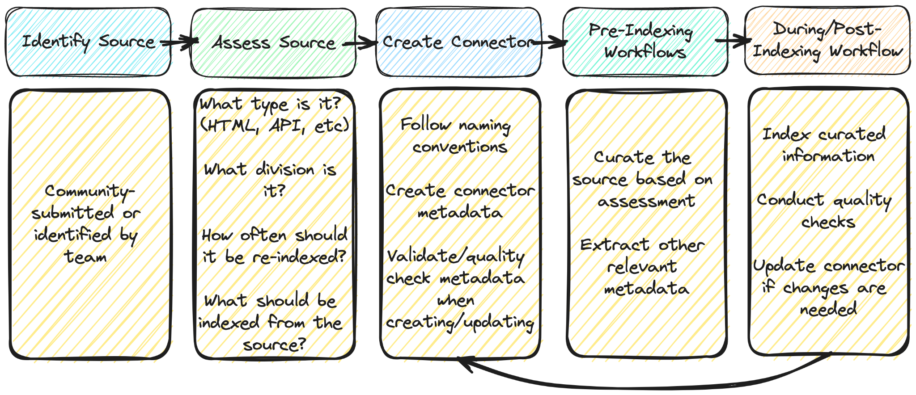
Information Management: Curation
Origin
Approaches
Construction
Next Steps

Slide 7
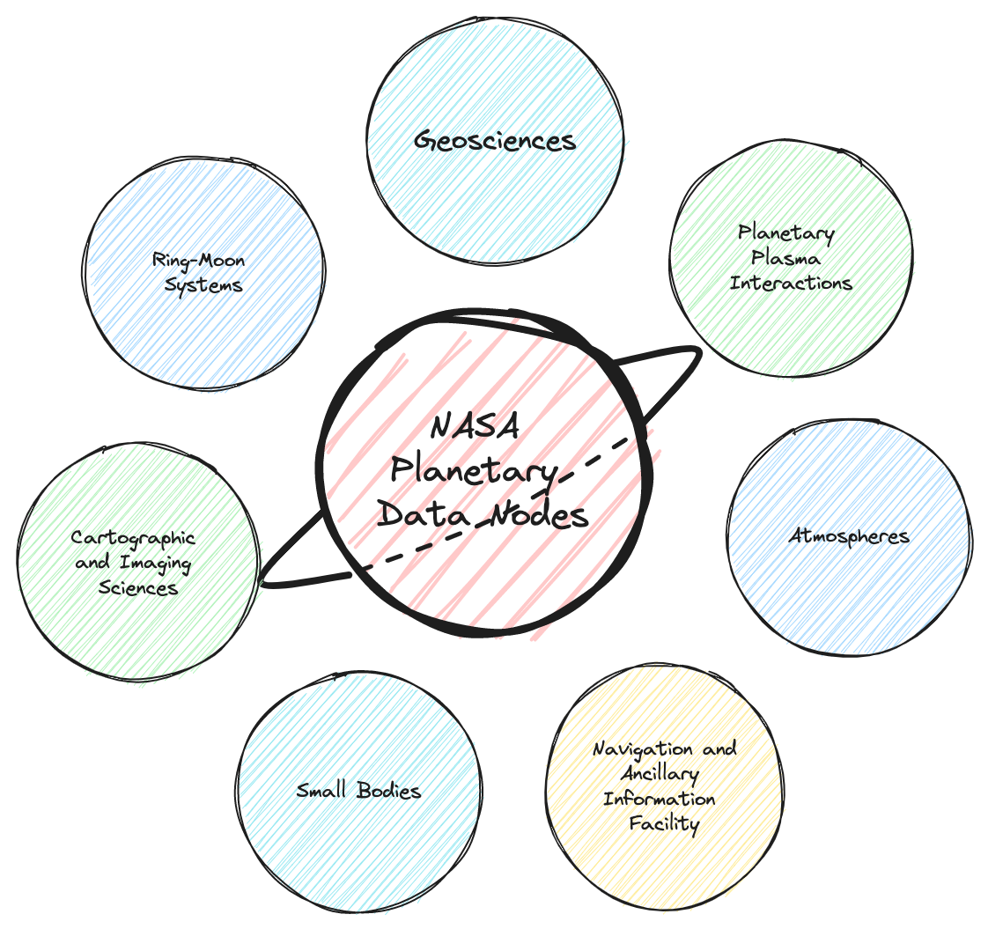
Planetary Science: Curation
Identified 150+ NASA-funded planetary science sources
  Unstructured Information Examples:
    Small Bodies Node Tools, PDS Image Atlas, Photojournal, Mars Exploration Program, and many more!
  Structured Information Example:
    PDS API
      Data from across all PDS Nodes
Assigned metadata to curated sources
  Document type
  Reindexing frequency
    How often a source is checked for updates
Origin
Approaches
Construction
Next Steps

Slide 8
Information Management: Curation
Origin
Approaches
Construction
Next Steps

Slide 9
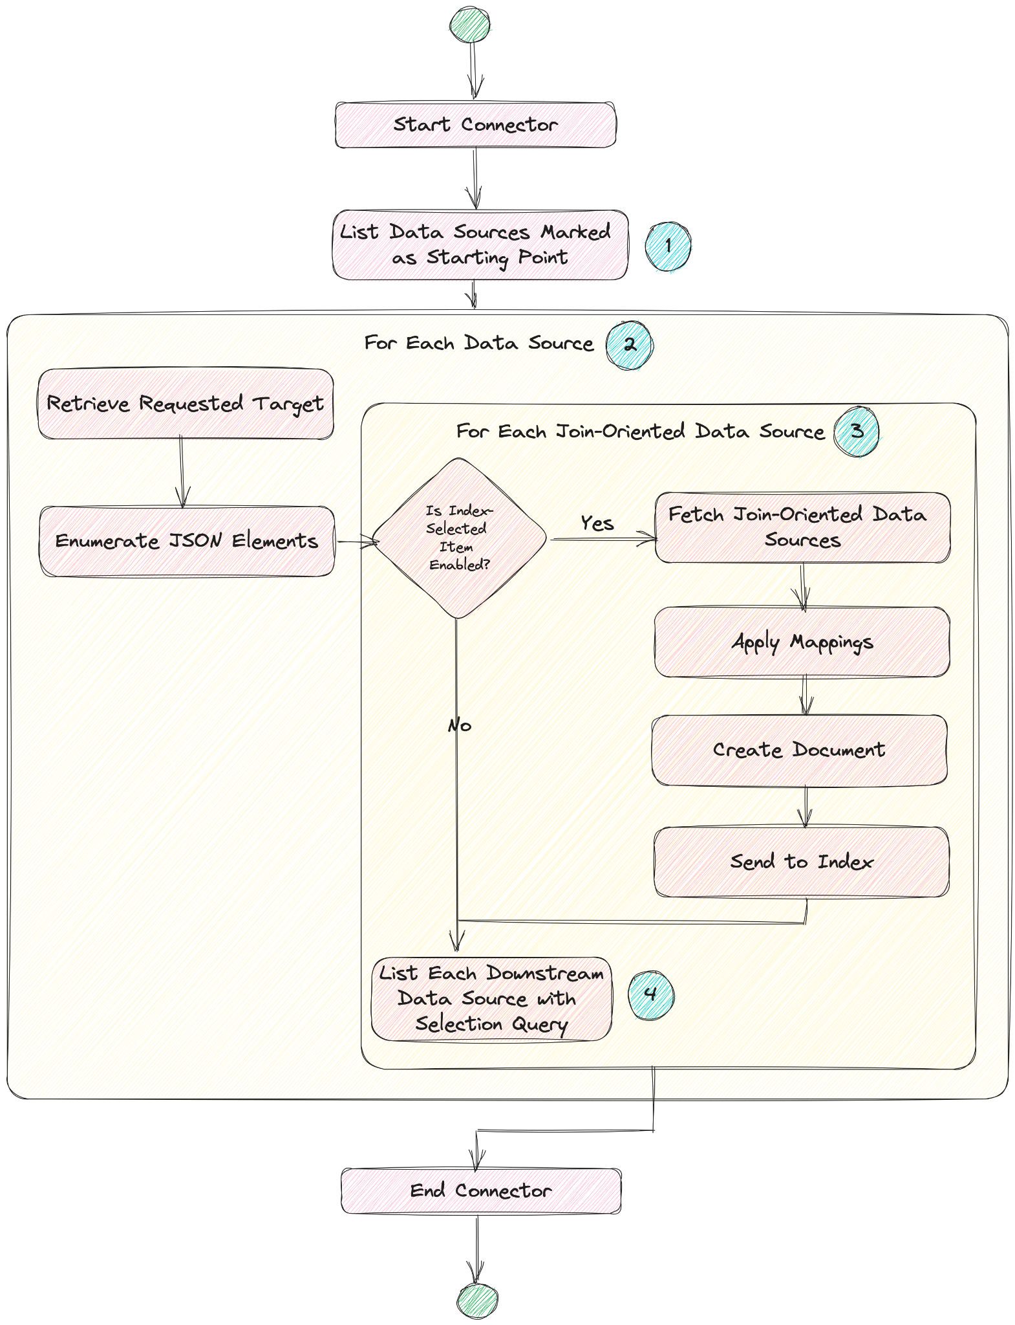

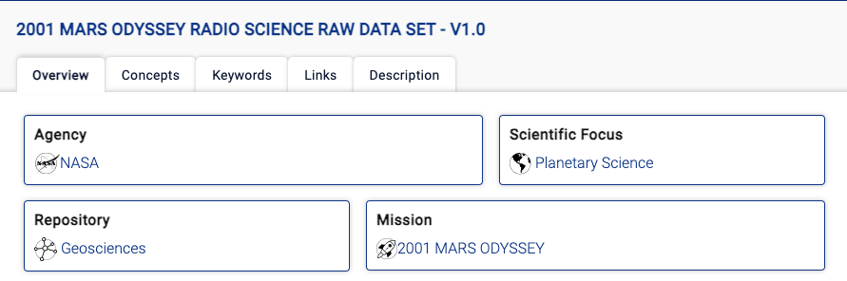
Planetary Science: Indexing Information -
Structured Connectors
Using the JSON v2 connector in Sinequa, we can call endpoints within APIs
  From PDS: bundles, collections, observationals, and documents were captured
Each JSON object is then converted to an HTML template to display its data
Origin
Approaches
Construction
Next Steps

Slide 10
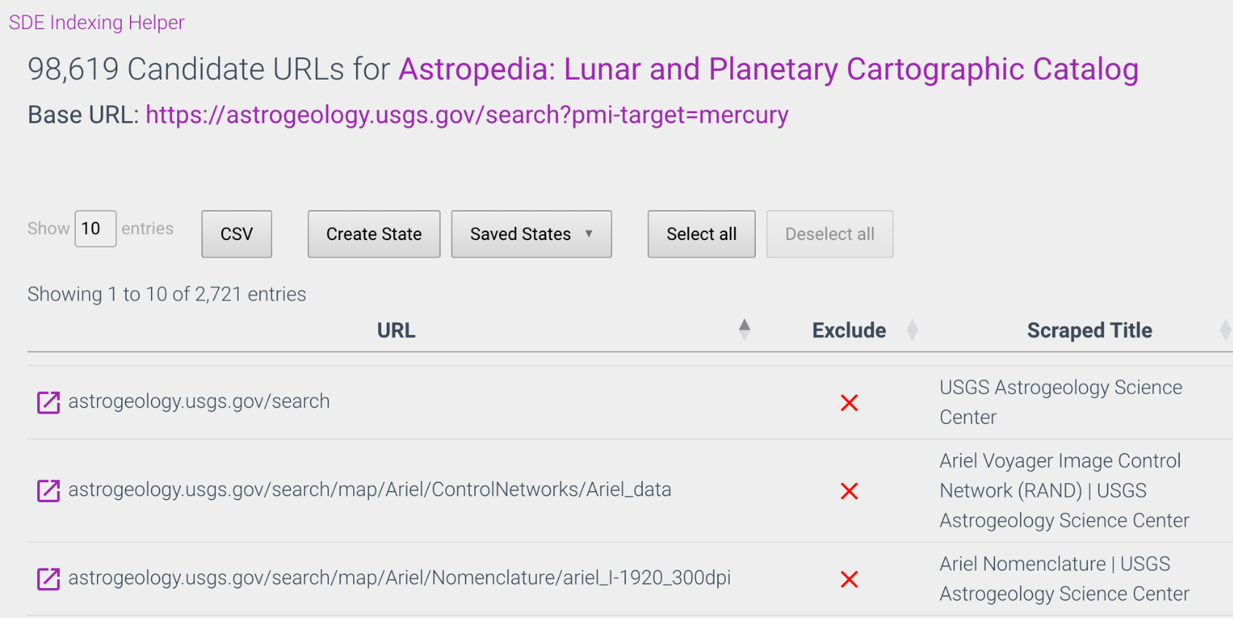
Planetary Science Indexing Information -
Unstructured Connectors
Sinequa has the capability to “scrape” websites to capture all links within a given source URL
The SDE team created a web app to manually review each link within a source
  Can make changes to website titles and document type
  Ability to apply patterns for exclusions, titles, etc
From the web app, a configuration file is generated and pushed to Github
The config files on Github are used to index all selected content into the SDE
Content is reviewed and further changes can be made
Origin
Approaches
Construction
Next Steps

Slide 11
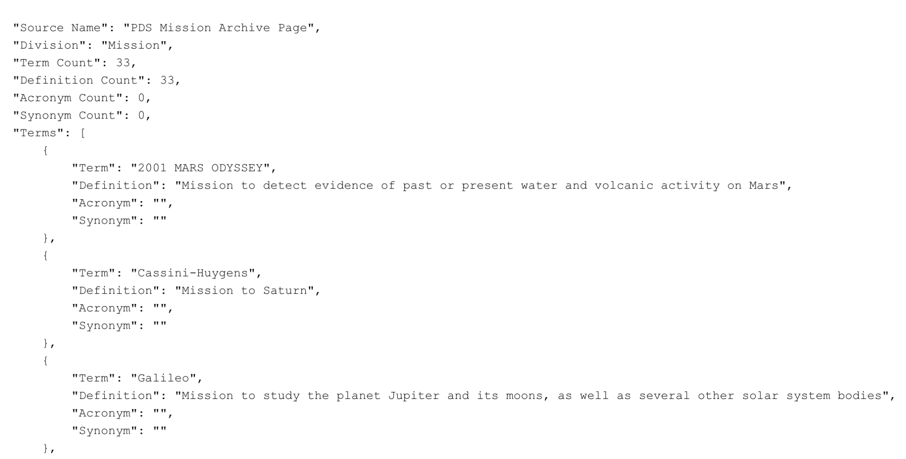
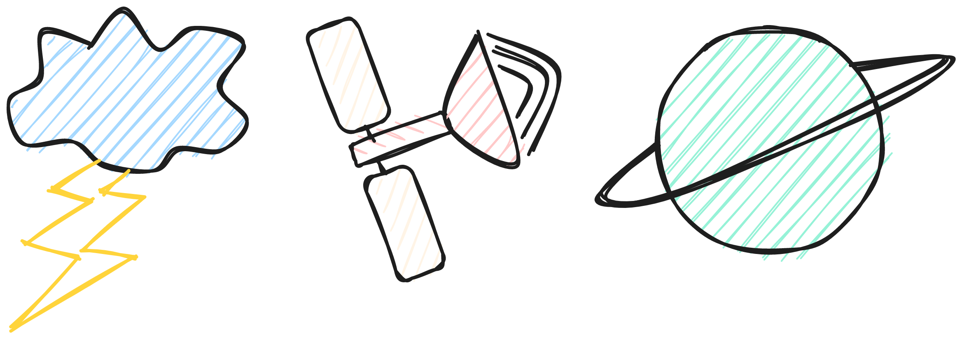
Planetary Science: Whitelists
Whitelists allow for further customization in the SDE
  Enables entity extraction from search results
  Makes facets possible
Team-Designed Whitelists:
  Data Repositories
  Science Concepts
  Platforms, Instruments, Missions (PIMs)
  Acronyms and Synonyms
Created from predefined lists found on the web as well as scraped terms from individual websites
  Creation of the “Superset”
    2 million terms of concepts and PIMS
Origin
Approaches
Construction
Next Steps

Slide 12
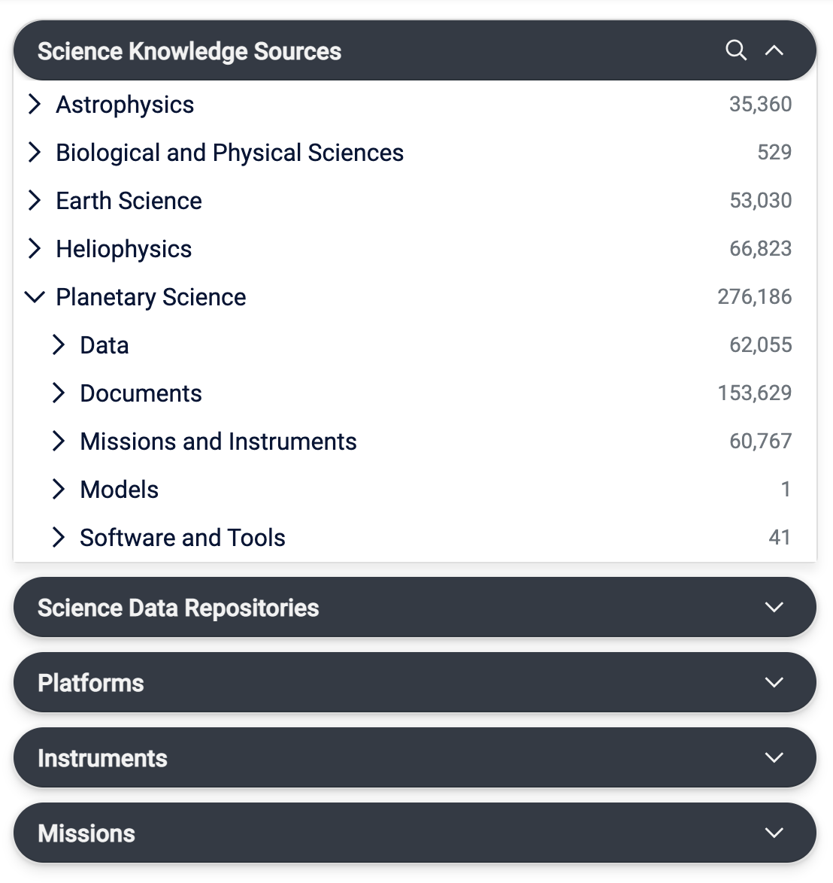
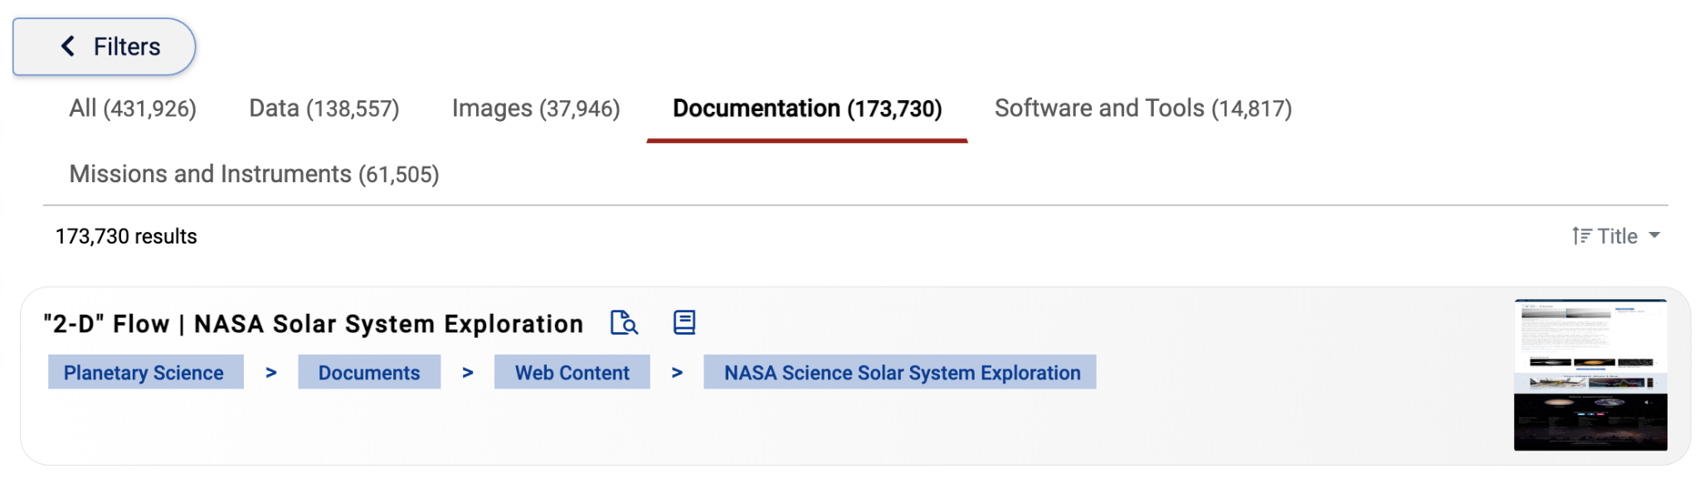
SDE: User Interface (UI)
Filter by:
  Science Discipline
  Platforms, Missions, and Instruments
  Document Type
Sort by title, relevance, and recently indexed info
  Relevance based on number of string matches
Preview
Bread Crumbs

Slide 13
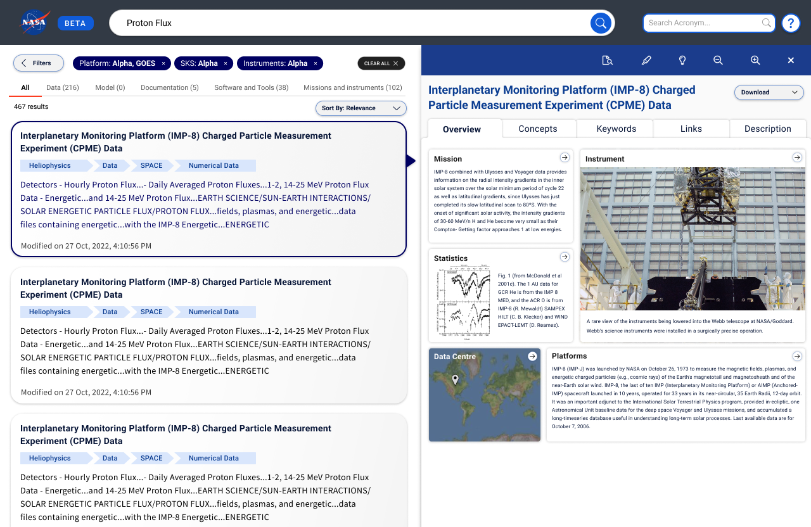
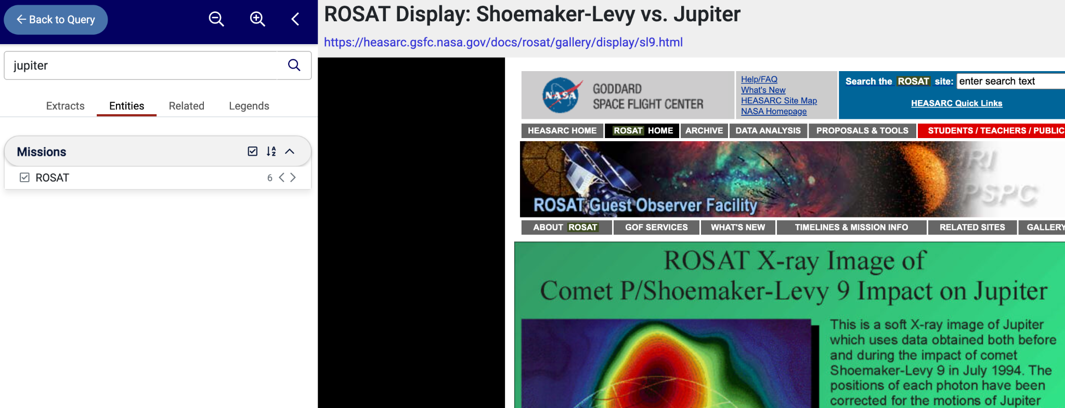
SDE: User Interface (UI)
Document Navigator
360 View (sneak preview)
Origin
Approaches
Construction
API
Next Steps

Slide 14
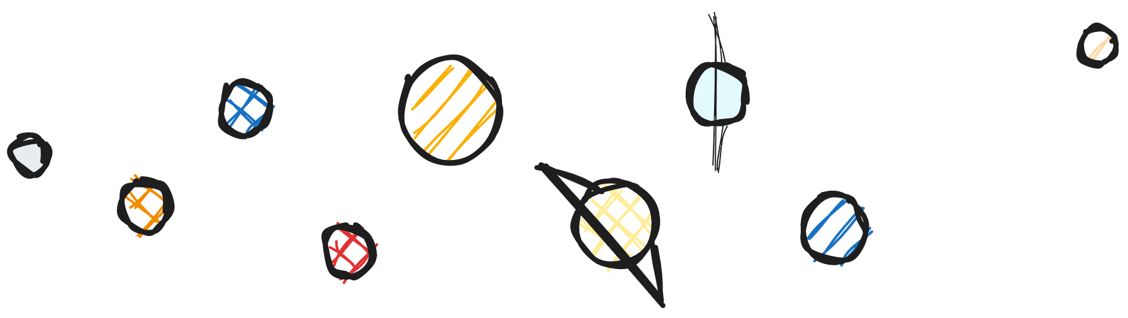
Planetary Science: Collaboration and Future Work
PDS Collaboration
Exploring innovative new technologies to enable PDS search and discovery
Deployed sandbox environment to assess Sinequa capability - focus on PDS metadata
Will layer in documentation and other content to assess relevance
Help tune results in the SDE
Future Work
Develop user documentation for the API
Implement 360 views and information cards
Prototype numerical search integration with SDE
Continue to incorporate new content
Investigate emerging NLP techniques

Slide 15
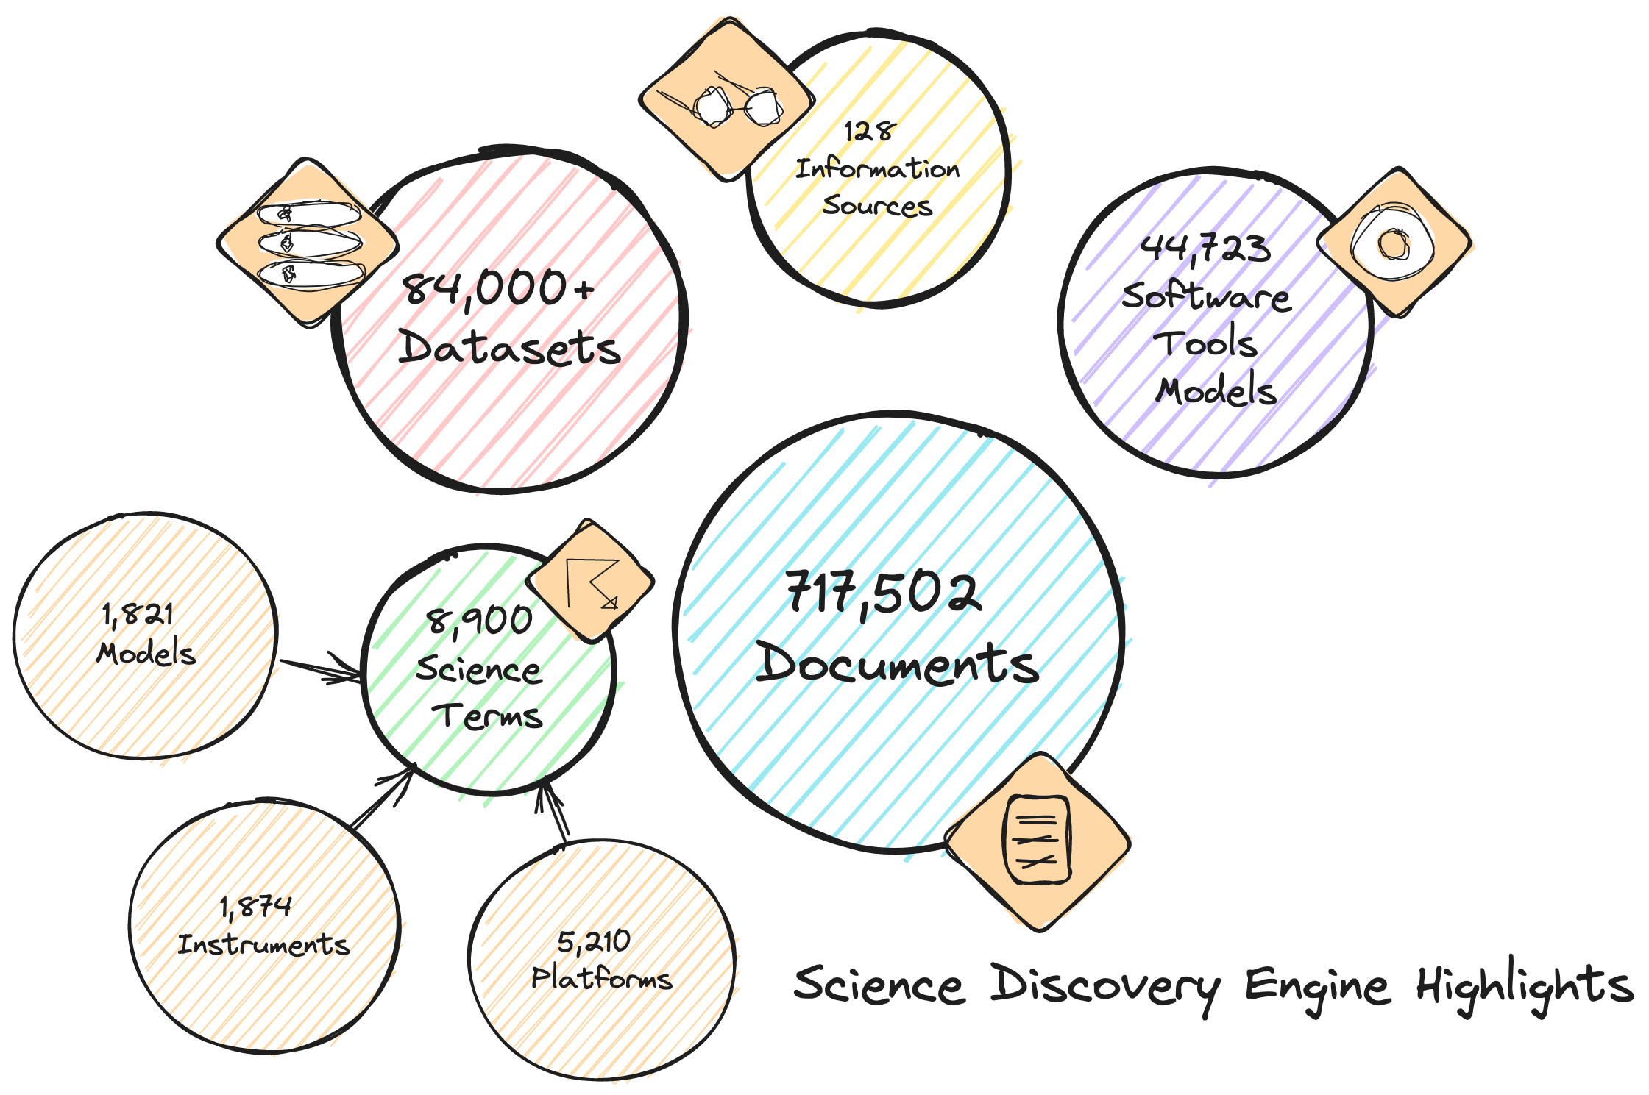
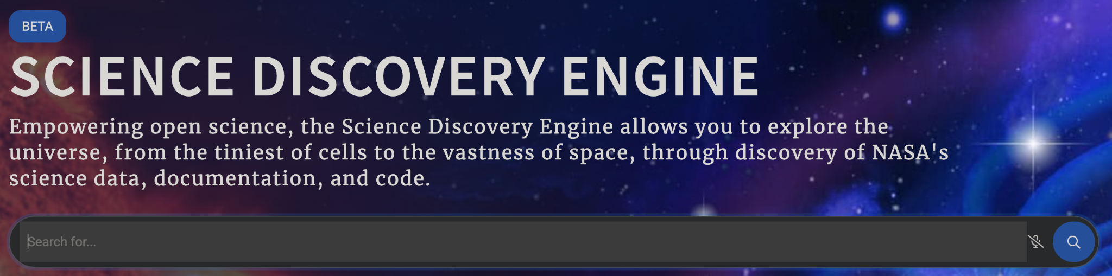
What Did You Learn? And How Can You Help?
Introduction to SDE
Your content is in the SDE
You can help!
  Identify new content to be included
  Test and provide feedback
  Provide planetary science needs

Slide 16
Thank You to Our Project Team & Collaborators
SDE Team
Kaylin Bugbee (NASA MSFC)
Shawn Foley (MITS II)
Ashish Acharya (UAH)
Emily Foshee (UAH)
Carson Davis (UAH)
Rachel Wyatt (UAH)
Xiang Li (UAH)
Stephanie Wingo (UAH)
Muthukumaran Ramasubramanian (UAH)
SMD Working Group
Alan Smale (Astrophysics)
David Ciardi (Astrophysics)
Robert Candey (Heliophysics)
Brian Thomas (Heliophysics)
Samrawit Gebre (Biological & Physical Sciences)
Thomas Morgan (Planetary Science)
Steve Hughes (Planetary Science)
Jordan Padams (Planetary Science)
Erich Reiter (Earth Science)
Rahul Ramachandran (NASA)
Kartik Nagaraja (Left Right Mind)
Shravan Vishwanathan (Left Right Mind)
Nikita Balsara (Left Right Mind)
Justin Johns (Sinequa)
John Monroche (Sinequa)
NASA CIO and Enterprise Data Platform Teams
Corey Portalatin-Berrien (NASA)
Joe Foster (NASA)
Chris Bowerman (SAIC)
Melania Stewart (SAIC)
We also wanted to say thank you to the Astrophysics Data System (ADS) team for the collaborative, knowledge sharing discussions we have had to date.

Slide 17
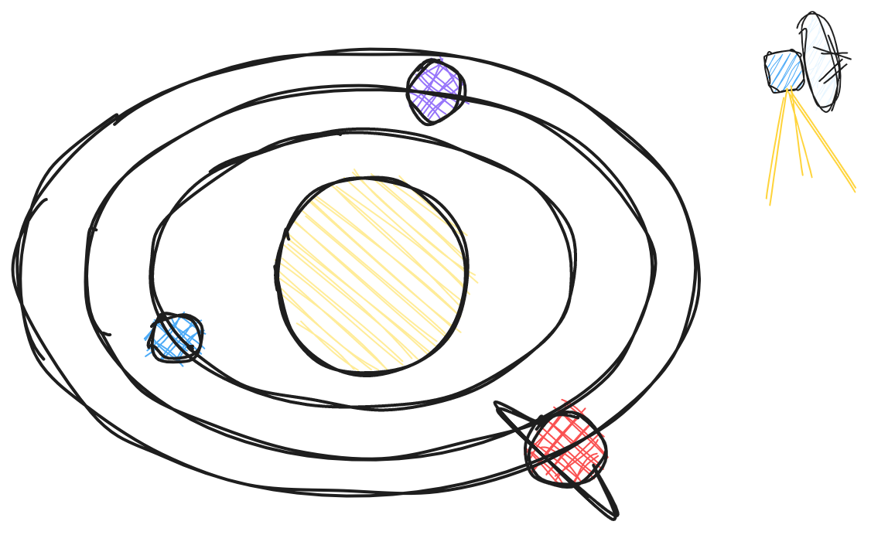
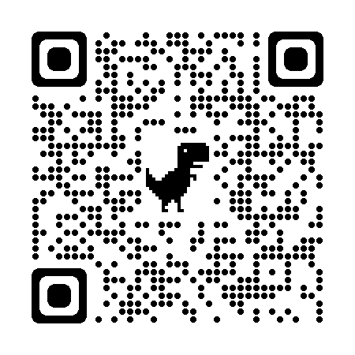
Thank You
Contact:
Dr. Emily Foshee
elf0005@uah.edu
sciencediscoveryengine.nasa.gov

