Slide 1
Hyperspectral Microwave Sounder Airborne Capability at 50 and 183 GHz for CoSMIR-H
Rachael Kroodsma
University of Maryland / NASA Goddard Space Flight Center
Ian Adams¹, Troy Ames¹, Matthew Fritts¹, Antonia Gambacorta¹, Priscilla Mohammed^{1,2}, Jeffrey Piepmeier¹, Paul Racette¹
¹NASA Goddard Space Flight Center, ²Morgan State University

Slide 2
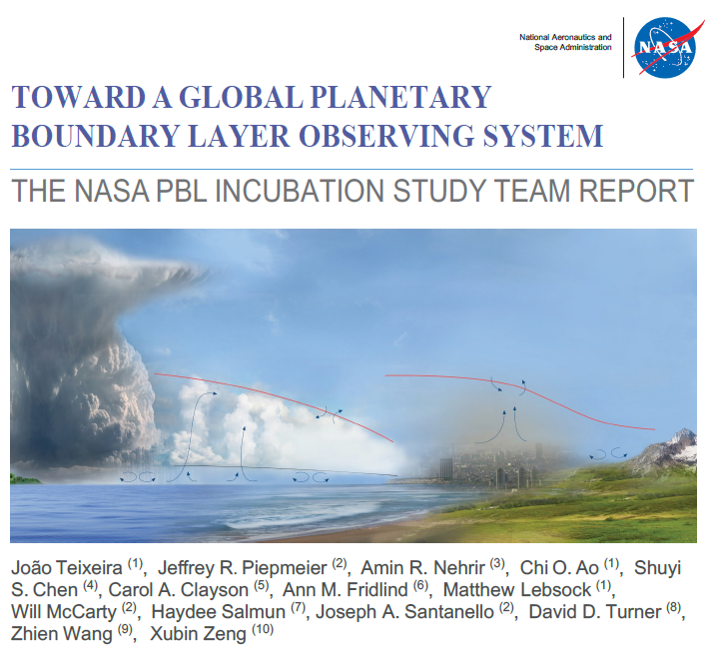
Introduction
Motivation:
PBL Study Team Report lists hyperspectral microwave (HMW) sensors as one of the “Essential Components” of a future global PBL observing system, to provide “accurate PBL and free tropospheric three-dimensional (3D) temperature and water vapor structure context”.
Objective:
Build an airborne HMW sensor and collect observations to demonstrate capability of HMW sounding, especially in the PBL. Enhance the airborne CoSMIR instrument with hyperspectral receivers (renamed CoSMIR-H) by utilizing ASIC spectrometers to give full spectrum coverage at 50-58 GHz and 175-191 GHz and conduct test flights to collect data.
https://science.nasa.gov/earth-science/decadal-pbl

Slide 3
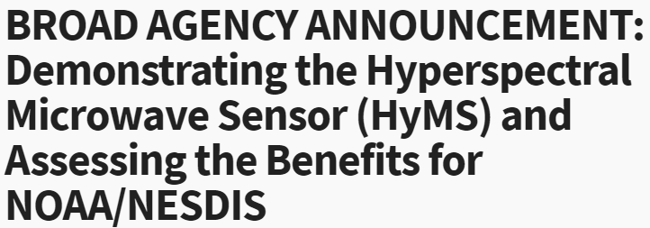
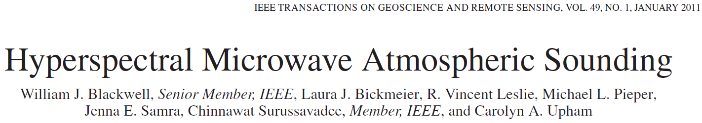

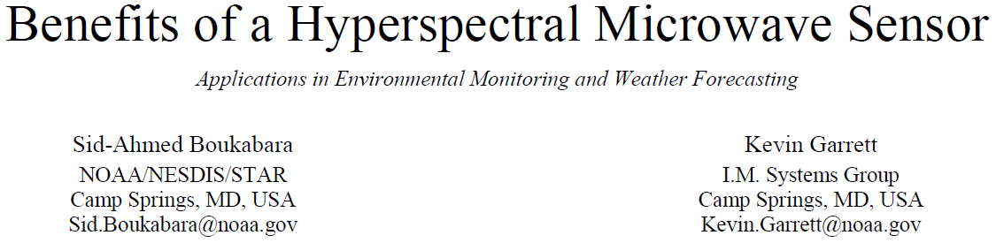

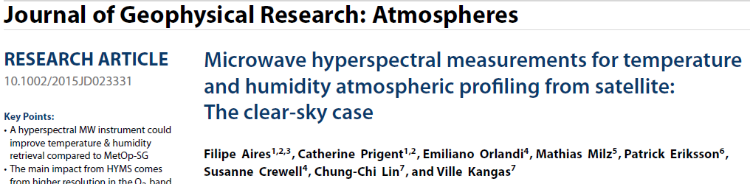
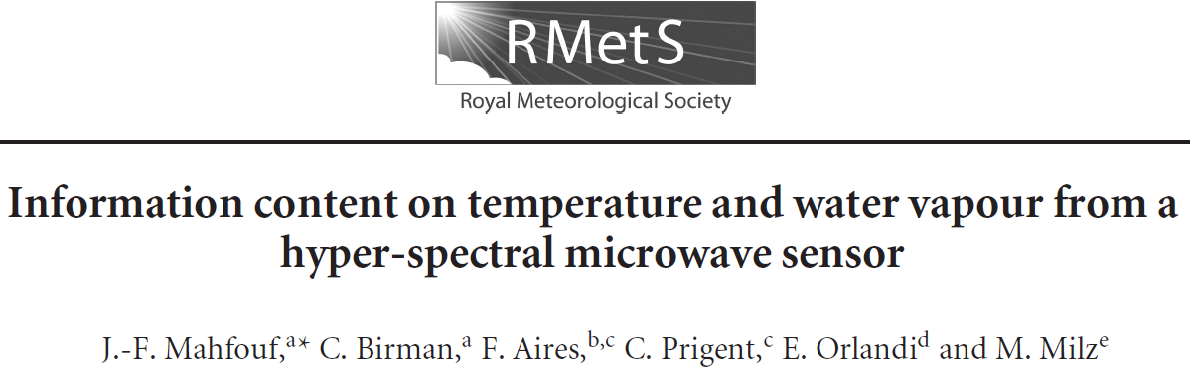
What is Hyperspectral Microwave?
Sampling of Papers: 2010-2015
NOAA BAA 2022
IGARSS 2023 Special Session
How many channels are needed to be considered “hyperspectral”?
Infrared Atmospheric Sounding Interferometer (IASI) = 8461 channels
Microwave = >100 channels

Slide 4
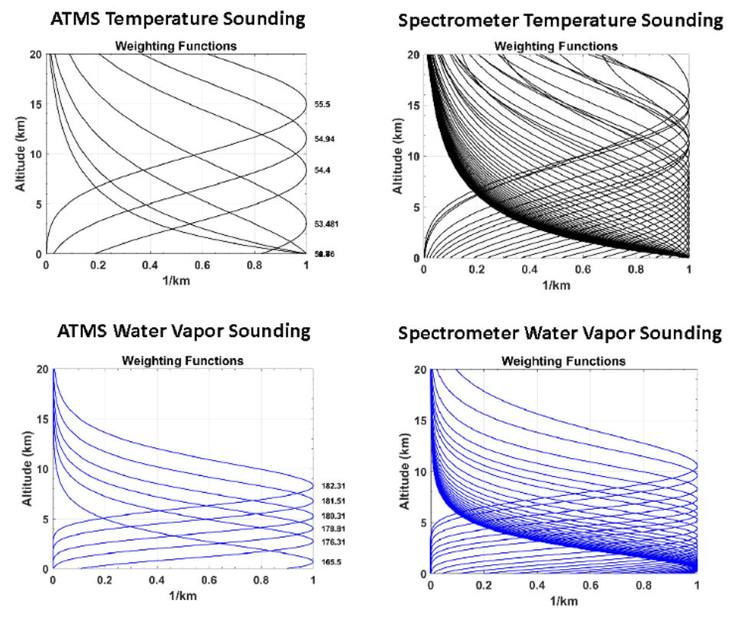
Current Microwave Sounding Standard
ATMS | TMS | CoSMIR-H
23.8 | -- | --
31.4 | -- | --
50-58 (13 channels) | -- | 50-58 (thousands)
88.2 | 91.655 | 89v/h
-- | 114-118 (7 channels) | --
165.5 | -- | 165v/h
183±7-183±1 (5 channels) | 184-190 (3 channels) | 175-191 (thousands)
-- | 204.8 | --
Teixeira, J., et al., 2021: Toward a Global Planetary Boundary Layer Observing System: The NASA PBL Incubation Study Team Report, NASA PBL Incubation Study Team, 134 pp.
CoSMIR-H will have 4-MHz spectral resolution for both 50-GHz and 183-GHz ranges.

Slide 5
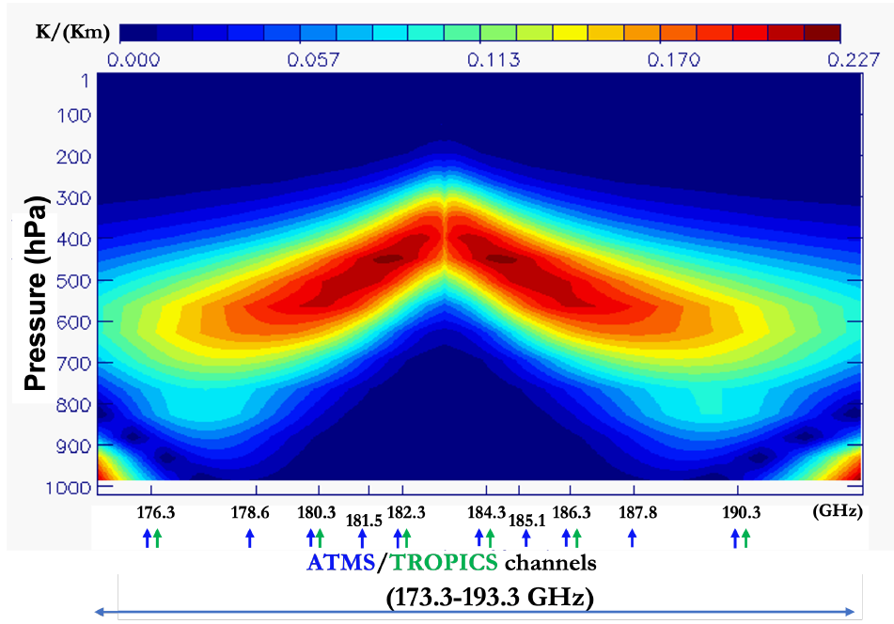
Hyperspectral Microwave Sounding Capability
CoSMIR-H covers a broad spectral range (pink box) to retrieve temperature and water vapor profiles, filling in gaps left by current spaceborne sounder capabilities.
Temperature sounding
Water vapor sounding
Gambacorta, A., et al., “Advancing Atmospheric Thermodynamic Sounding from Space using Hyperspectral Microwave Measurements,” IEEE J. Sel. Topics Appl. Earth Observ. Remote Sens., 2023.

Slide 6
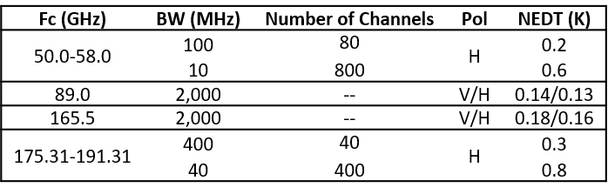
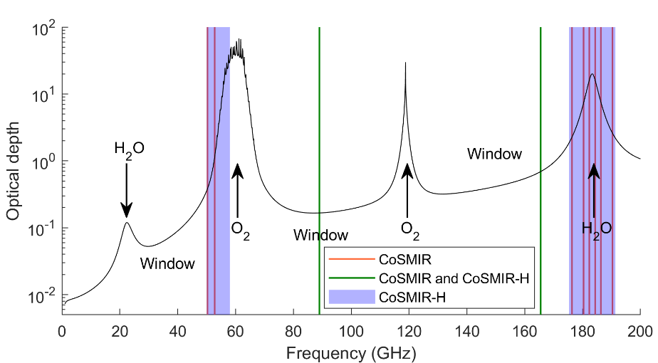
CoSMIR-H DSI Proposal
Modify the current CoSMIR 50/52 and 183 GHz channels with new hyperspectral receivers (ASIC spectrometers) to achieve three main objectives:
Enable hyperspectral measurements from an airborne platform at 50-58 GHz and 175-191 GHz
Demonstrate the capability of hyperspectral microwave sounding for improved measurement of the PBL thermodynamic (temperature and water vapor) vertical structure
Provide a viable pathway to space by advancing the field of digital spectroscopy for microwave radiometers

Slide 7
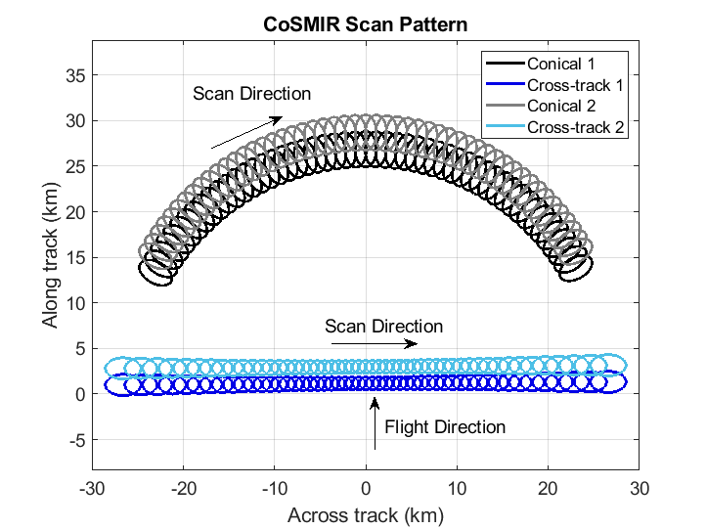
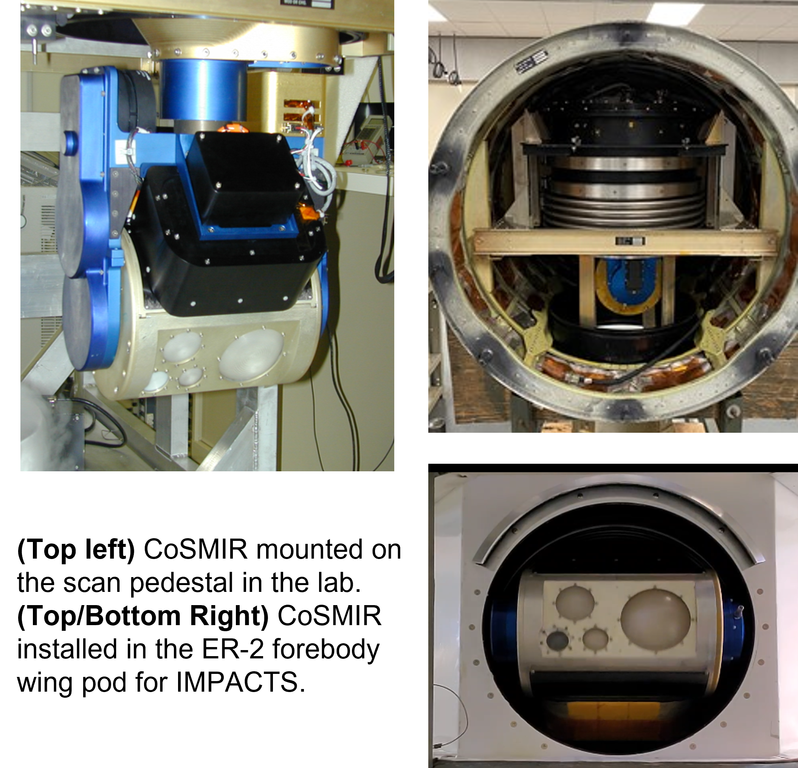
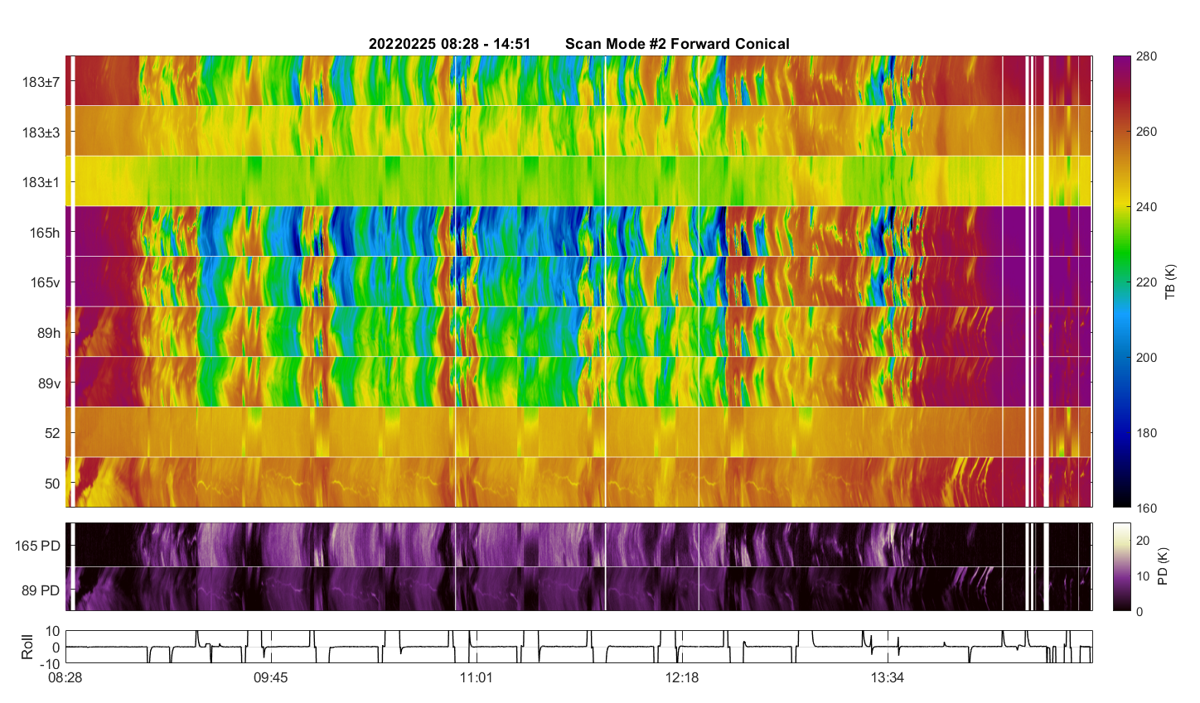
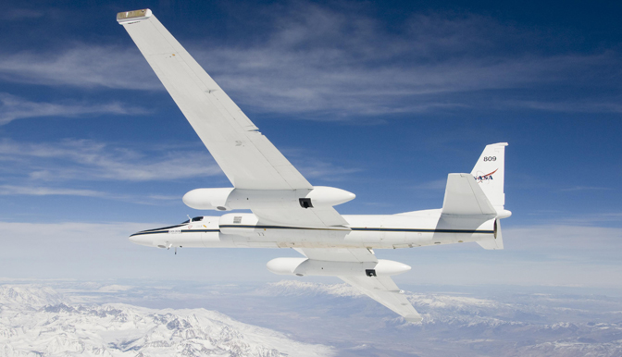
Conical Scanning Millimeter-wave Imaging Radiometer (CoSMIR)
CoSMIR | GMI
50.3h | --
52.8h | --
89.0v/h | 89.0v/h
165.5v/h | 166v/h
183.31±1h | --
183.31±3h | 183.31±3v
183.31±7h | 183.31±7v
CoSMIR flies in the NASA ER-2 forebody wing pod
CoSMIR has the unique ability to scan in various modes: fore/aft conical and cross/along-track.

Slide 8
Three Year Schedule: June 2022-2025
First year of project focused on hardware development. We are on-schedule for CoSMIR-H test flights on the NASA ER-2 aircraft in July 2024.
 | Jul 23 Q1 | Oct 23 Q2 | Jan 24 Q3 | Apr 24 Q4 | Jul 24 Q1 | Oct 24 Q2 | Jan 25 Q3 | Apr 25 Q4
Hardware Development
Ground Software Development
Chamber Test and Airborne Demonstration
Science Investigation
Integration of ASICs, new data system, and supporting electronics into CoSMIR-H
CoSMIR-H brightness temperature calibration
Level 1 software complete
High altitude chamber test
Flight tests with CoSMIR-H
Determination of optimal channel set and BW requirements for hyperspectral sounding

Slide 9
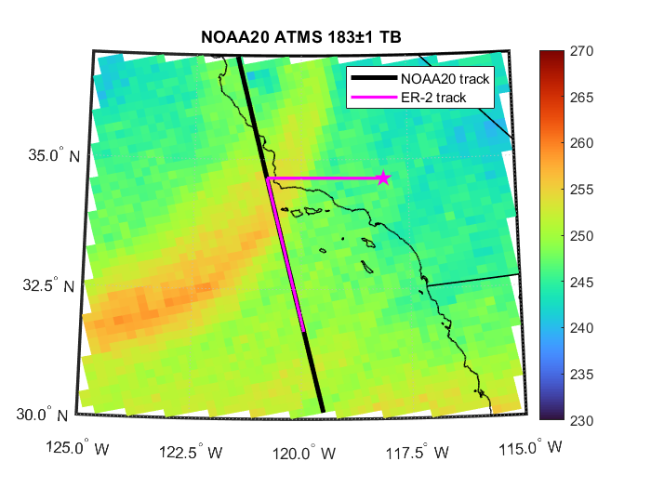
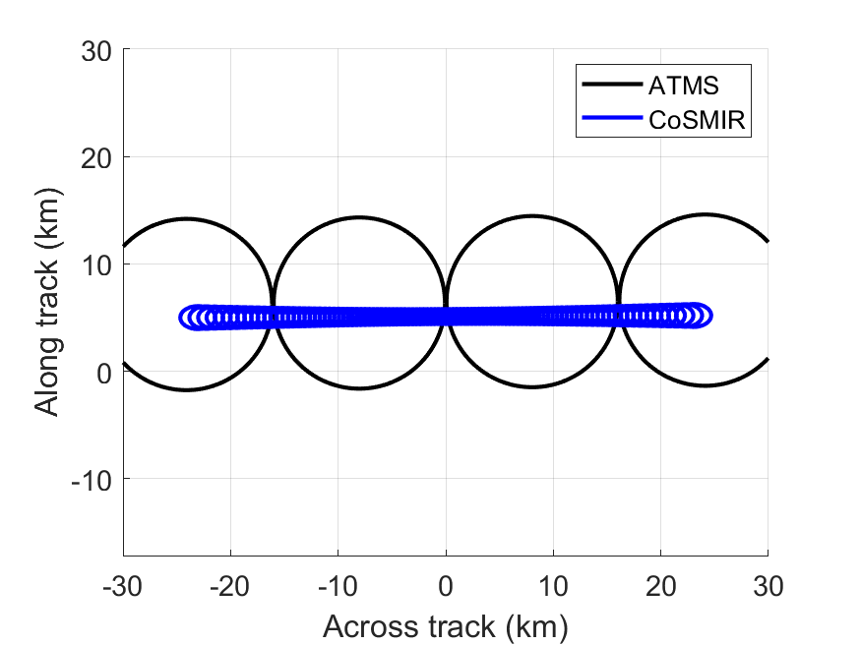
Check Flights and Campaign
Range rings of the ER-2 (assuming an 8 hour flight)
Example ER-2 satellite underpass flight (350 km, ~30 min overlap)
CoSMIR-H ground track compared with ATMS
ATMS 183 GHz nadir: 15 km
CoSMIR-H nadir: 1.4 km
In addition to the engineering check flights funded under the DSI in July 2024, we have funds from NOAA to do a full 6-week campaign in Oct/Nov 2024 to collect a more robust HMW dataset over a variety of atmospheric and surface conditions.

Slide 10
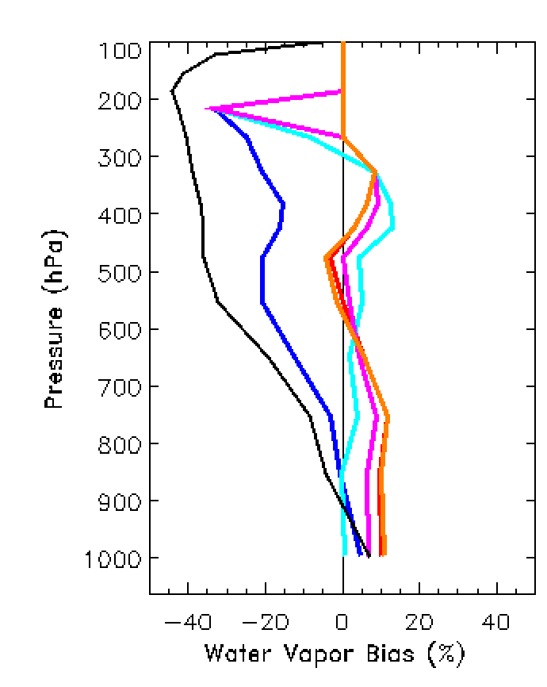
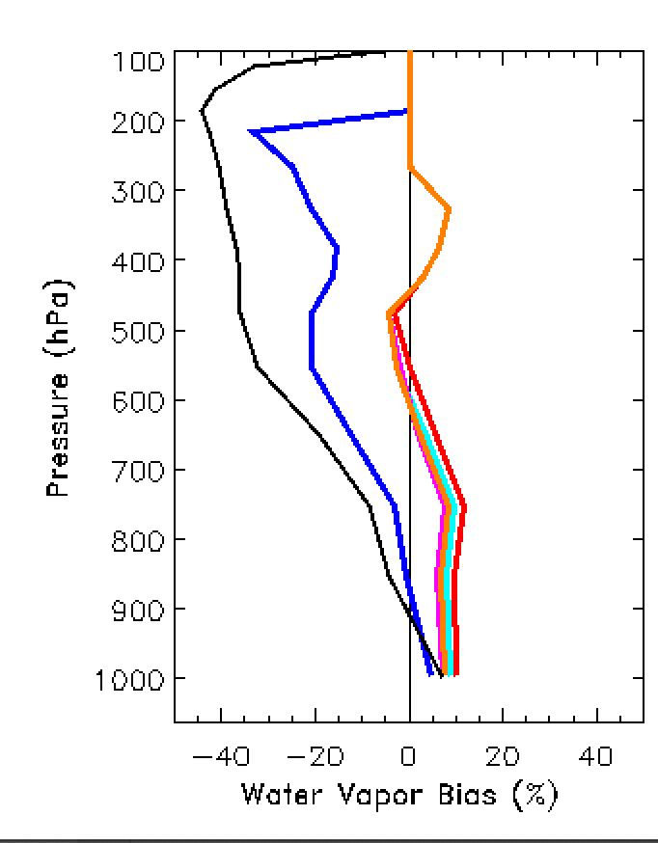
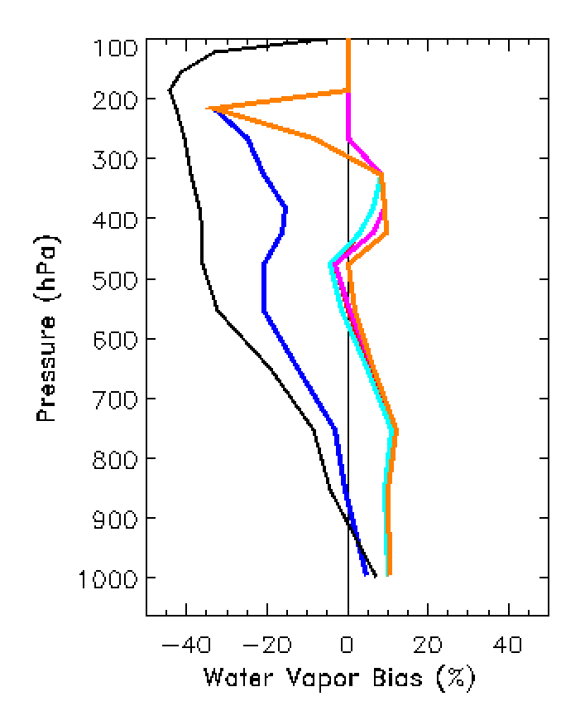
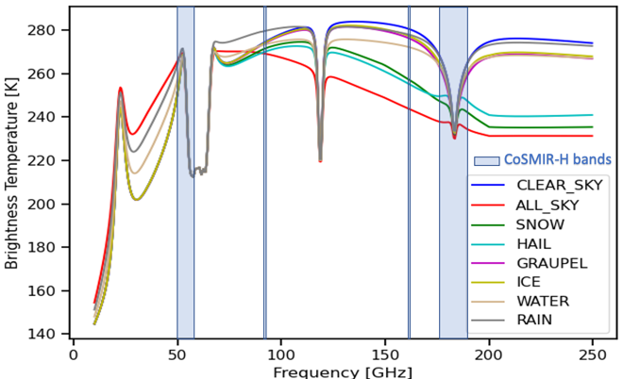
Science Investigation: 183 GHz Trade Studies
Where to place the 16-GHz band at the 183 GHz water vapor line? CoSMIR-H will have it centered at 183.31 GHz, but it is an interesting exercise to see how moving this band changes the water vapor profile retrieval.
First Guess
ATMS
CoSMIR-H: 175.3 – 191.3
Test 1: 167.3 to 183.3
Test 2: 169.3 to 185.3
Test 3: 171.3 to 187.3
First Guess
ATMS
CoSMIR-H 175.3 – 191.3
Test 4: 173.3 to 189.3
Test 5: 175.3 to 191.3
Test 6: 177.3 to 193.3
First Guess
ATMS
CoSMIR-H: 175.3 – 191.3
Test 7: 179.3 to 195.3
Test 8: 181.3 to 197.3
Test 9: 183.3 to 199.3

Slide 11
Science Investigation: 183 GHz Trade Studies Results
Proposed to place the 16-GHz hyperspectral band at 175.31-191.31
  Covers the bands measured by current spaceborne sensors (e.g. ATMS)
Wanted to see if we could get more sensitivity to the PBL by shifting to the left or right of the line center
Trade studies show a slight improvement in PBL water vapor retrieval when shifted to the left
  Comes at the expense of worse retrieval in the upper atmosphere
Plan is to keep the band centered at 183.31 GHz
  Better for radiative transfer validation and calibration comparison with ATMS

Slide 12
Summary
We are developing an airborne hyperspectral microwave sensor with 4-MHz spectral resolution at 50-58 GHz and 175.31-191.31 GHz
  Modifying the CoSMIR sensor with ASIC spectrometer receivers (CoSMIR-H)
  Will give us thousands of channels to test the impact of HMW on temperature and water vapor profile retrievals
CoSMIR-H is on schedule to do engineering check flights on the NASA ER-2 aircraft in July 2024
We are excited to get CoSMIR-H data in-hand to assess the benefits of hyperspectral microwave observations

