Slide 1
LEARNing about petitSat
Presenter: Luis Santos, Jonathon Smith
Date: 2023-06-28

Slide 2
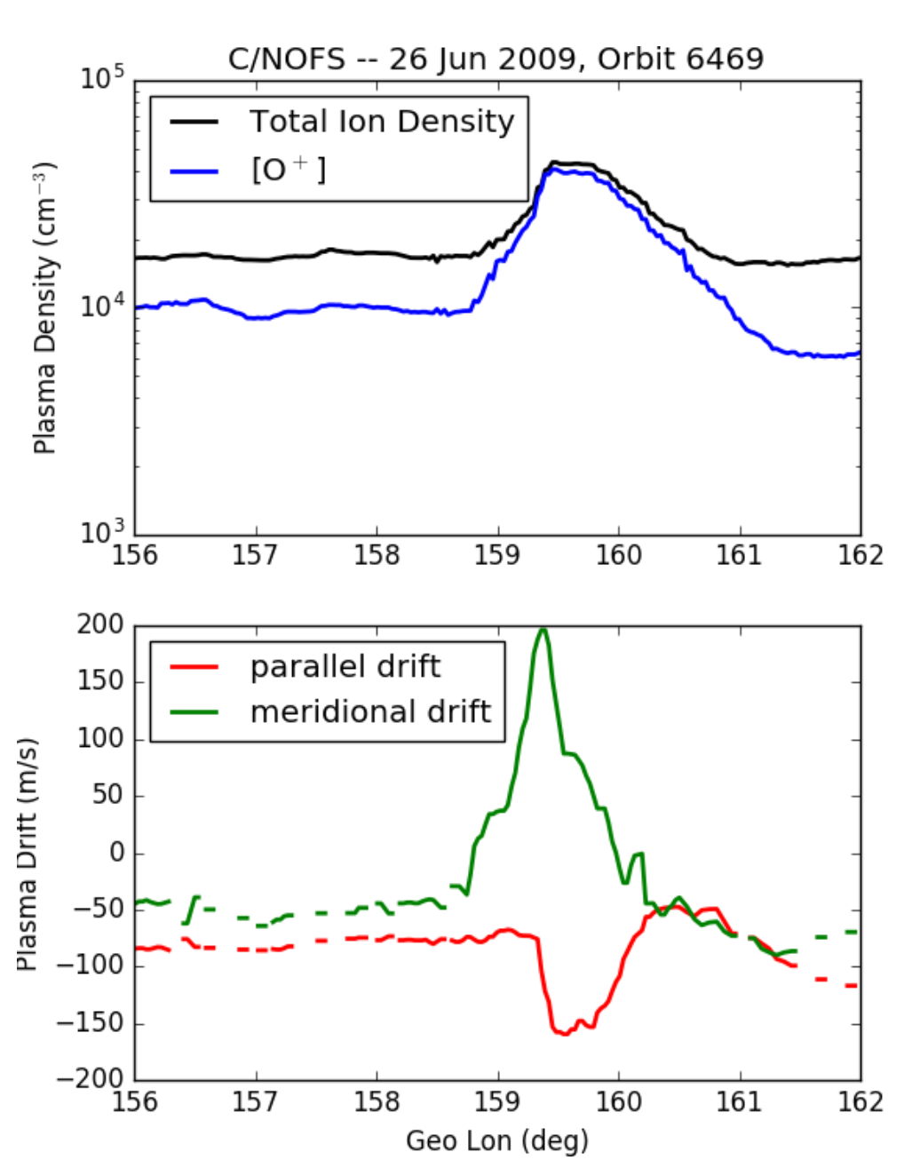
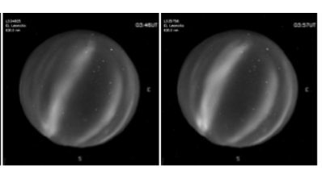
Overview
Mission Objectives
PetitSat was developed to identify and classify ionospheric plasma density enhancements
Those observations combined with ground-based observations would be used to quantify the contribution of MSTIDs to the generation of the enhancements
SFF RPA an IDM plasma sensor and Ionizing mass spectrometer would be used to make in-situ plasma measurements
Key Parameters (current best estimate)
Form Factor | # Spacecrafts | Orbit | Altitude (perigee/apogee) | Inclination | Launch Date
6U | 1 | ISS | 422/413 (initial) | 51.6 | 12-29-22
Mass | Dispenser or Interface | Mission Duration | Comm Licensing Status | Cost | Current Phase/Activity
10.17 kg | Nanoracks | 100 days | Approved |  | Re-entered
Example In-Situ
Ground-Based

Slide 3
Team Composition
Management | Principal Investigator | Project Manager | Mission Systems Engineer | Deputy PI
Team Member Name | Jeff Klenzing | Jeff Klenzing/Bob Moss | Bob Moss | Alexa Halford
Organization | NASA GSFC | NASA/GSFC | NASA GSFC | NASA GSFC
Payload & Bus | Instrument #1 | Instrument #2 | Tech Demo | Spacecraft Bus
Title/Acronym | INMS | GRIDS | ICS | LEO Bus
Organization | NASA GSFC | VT/USU | NASA GSFC | NASA GSFC
Data Systems | Mission Operations Center | Science Operations Center | Ground Station/Network | Data Repository
Title/Acronym | N/A | N/A | Near Space Network | SPDF
Organization | GSFC | GSFC | NASA | NASA GSFC

Slide 4
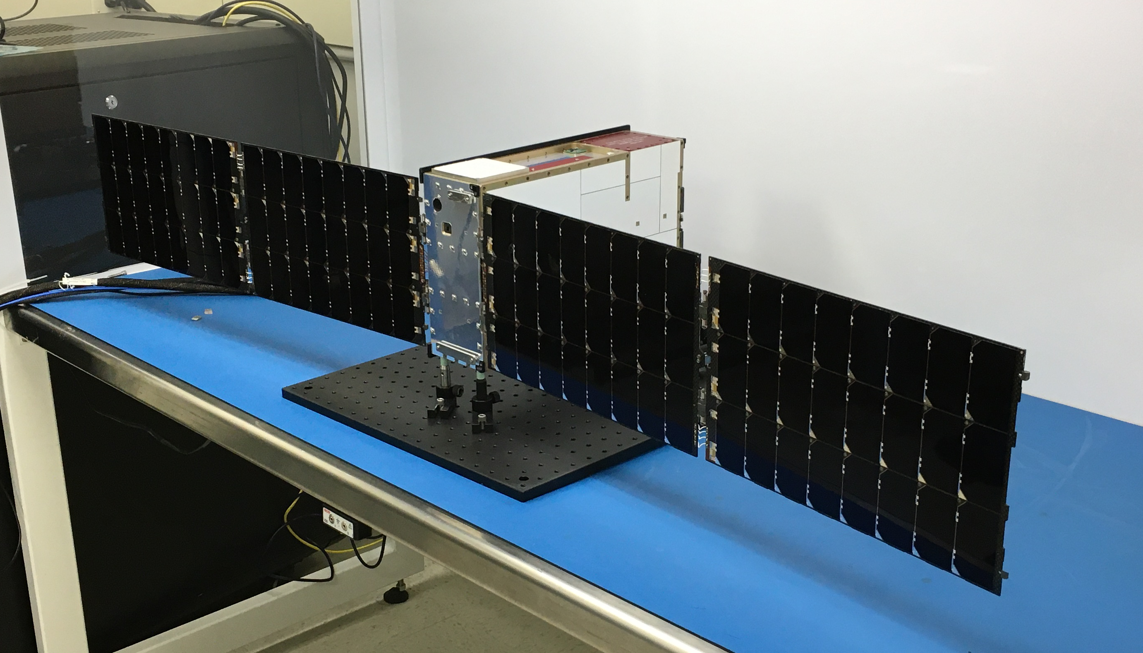
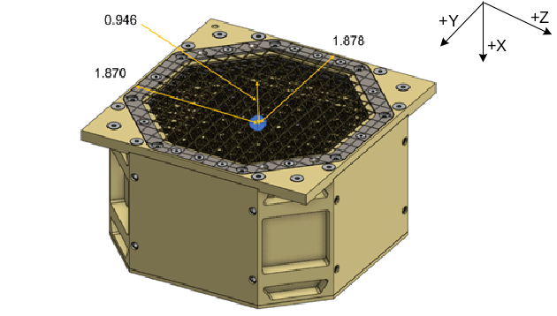
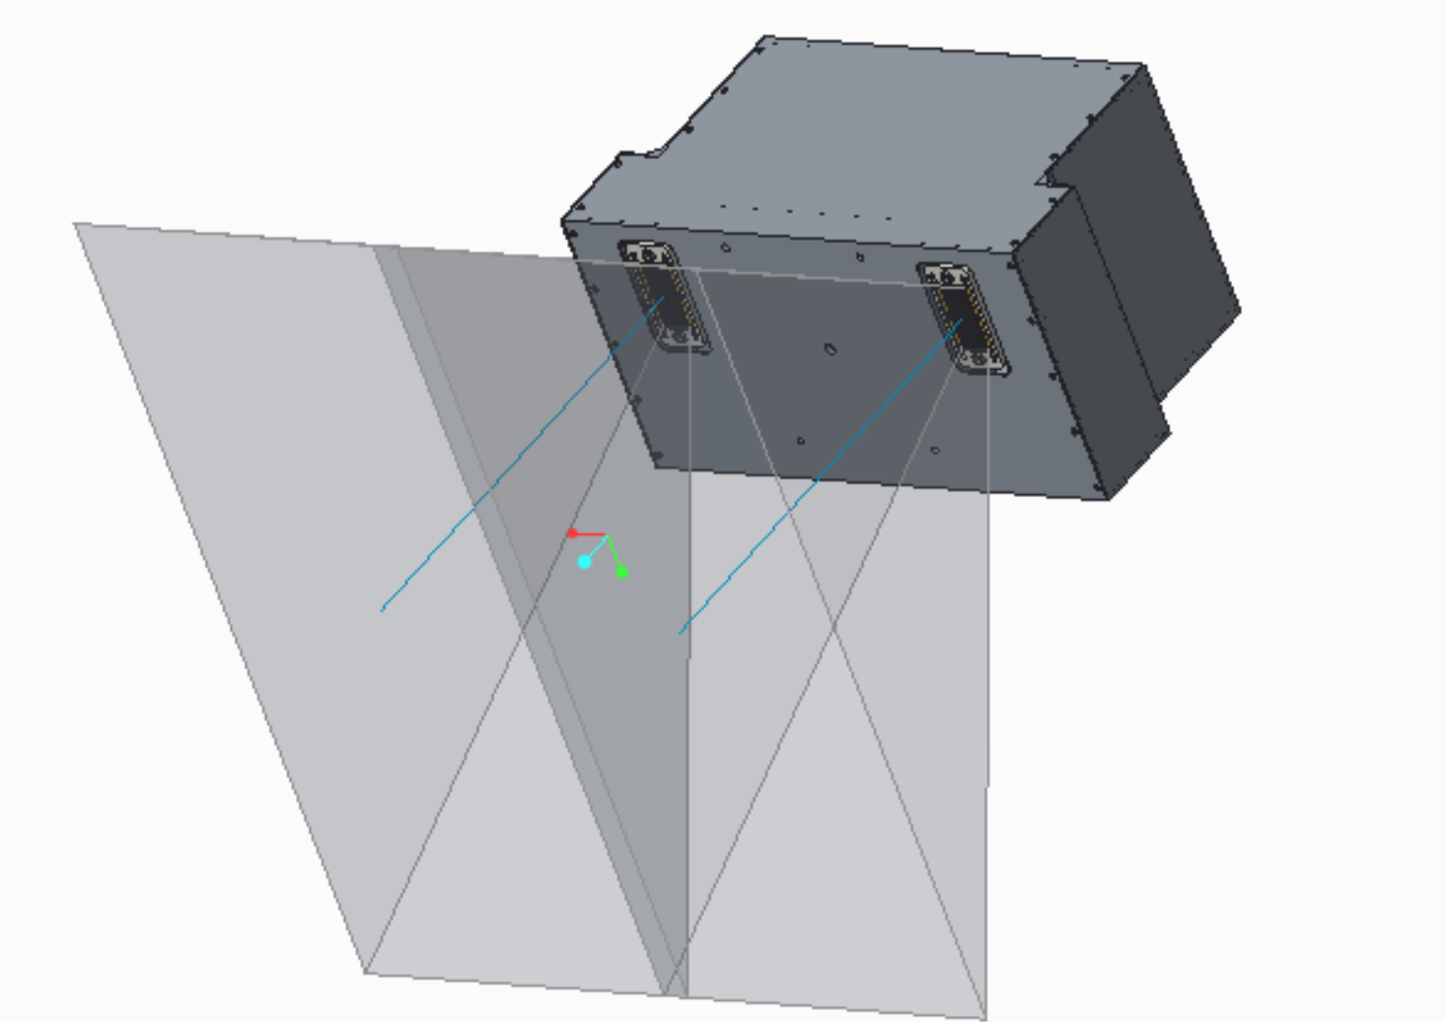
Spacecraft

Slide 5
petitSat Key Components
Subsystem | Description | Vendor | Subsystem | Description | Vendor
Instrument #1 |  |  | Bus GN&C
Detector | Ionizing Mass spec. | GSFC | Reaction Wheels | CubeWheel 1.13 | Cube Space
Instrument #2 |  |  | Magnetorquers | Aerotorquer coils | GSFC
Detector | Ion-trap | VT/USU | Star Tracker | ST200 | Clyde Space (Hyperion)
Tech Demo |  |  | Fine Sun Sensor | NanoSense FSS | GOM Space
Ion Control System | Impulse Control | GSFC | IMU | STIM300 | Safran (Sensonor)
Bus C&DH |  |  | Bus Power
Processor | SpaceCube Mini-Z | GSFC | EPS | 150W | Cubic Aerospace
Data Storage | SpaceCube Mini-Z | GSFC | Batteries | 90 Whr ISS-rated | Cubic Aerospace
Bus Comm |  |  | Solar Array | Four 6U panels | Blue Canyon Tech
Radio | S-Band | Vulcan Wireless | Propulsion
Antenna | S-Band | Vulcan Wireless | N/A

Slide 6
Mission Timeline – What we know
12/29/2022 – Launched from ISS (~10:00AM)
After 01/08/2023 – drag coefficient increased significantly (solar array deployment)
04/09/2023 – Re-entered
01/18/2023 – First daytime pass attempt (4:45 PM)
12/30/2022 – First pass attempt (6:30AM), pass attempts averaged 2 passes per day
02/03/2023 – Evidence showing petitSat tumbling, 118-second period (~3.05 deg/sec)
02/24/2023 – Evidence showing petitSat tumbling, 110-second period (3.27 deg/sec)
01/12/2023 – Evidence showing petitSat tumbling, 115-second period (~3.13 deg/sec)

Slide 7
Anomaly Statement
The petitSat commissioning team has been unable to establish any type of communication with the petitSat spacecraft after it was launched from ISS
No Communication
Satellite
Ground System

Slide 8
Fishbone Diagram
1.5.2.1 Bdot Phasing (P)
1.5 GNC Issues (P)
1.1 Critical Component Damaged (G)
1.5.2.2 Bdot Algorithm (P)
1.1.3.1 Electrical Short (G)
1.5.3.1 Sun-Acq Phasing (B)
1.5.1 Failed Mag Torquer (G)
1.1.3.2 Survival/Operational Temp (G)
1.1.1 Space Debris Hit (G)
1.5.3.2 Sun-Acq Algorithm (B)
1.5.2 Bdot Issues (P)
1.4 Software Issues (Y)
1.1.2 Mechanical Environment (G)
1.5.3.3 CSS Off-Axis Performance (B)
1.5.3 Sun-Acq Issues (B)
1.1.3 Thermally-Induced Failure (G)
1.5.4 Stuck at Bdot Mode (B)
1.4.1 Radio Reset (G)
1.1.4 Radiation Effects (G)
1.5.5 Boot-Up Sequence ACS Implications (P)
1.4.2 Thoroughness of FSW V&V (Y)
1.1.5 Ground Handling (G)
1 Satellite
1.3.1.1 Inhibits Damaged (B)
1.3.1 Power Inhibits (B)
1.2.1 Radio Misconfiguration (G)
1.3.1.2 Incorrect Configuration (B)
1.2.2 Antenna Switch (G)
1.3.2 Solar Panel Issues (O)
1.2.3 Radio Lock (G)
1.3.2.1.1 Rel. Mech. Malfunction (G)
1.3.2.1 Undeployed Array (O)
Rating
(B) Ruled Out
(G) Unlikely
(P) In Review
(O) Possible Cause or Contributor
(R) Likely Cause
(Y) Unable to Rule Out
1.3.2.2 Connectivity Issue (B)
1.2.4 CI App Crash (G)
1.3.2.1.2 30-Min Timer Not Expired (O)
1.3.2.3 Unable to Charge Batt. (G)
1.2.5 RF Power Output (G)
1.2.6 Tumbling Unstable Antenna Pattern (B)
1.3.3 Tumbling Low-Power State (G)
1.2.7 Radio In-Rush (G)
1.3.4 Battery Capacity Issues (R)
1.2.8 Radio Reset Functionality (B)
1.3.4.1 Over-discharge during I&T (R)
1.2.9 Antenna/Radio Flight Connection (B)
1.3.4.2 Recharging Batt at Low Temp. (R)
1.3.4.3 Higher than Expected Leak Rate (B)
1.3.4.4 Batt. Low Capacity at Vendor Delivery (B)
1.3 Power Issues (R)
1.2 Communication Issues (G)

Slide 9
Fishbone Diagram
2.2 MOC Configuration (B)
2.1 Ground Station Configuration (G)
2.1.1 Uplink Configuration (G)
2.3 MOC-GS Connectivity (B)
2.1.2 Downlink Configuration (B)
2 Ground System (G)
Rating
(B) Ruled Out
(G) Unlikely
(P) In Review
(O) Possible Cause or Contributor
(R) Likely Cause
2.4 Ground Antenna Pointing (G)
2.5 Incorrect Commands (B)
2.6 MOC Operator Error (B)

Slide 10
Proximate Cause
Proximate cause: insufficient charge in the PetitSat battery at launch from the International Space Station
  Battery capacity was significantly degraded (loss of >50%) early in spacecraft I&T
  Given the estimated capacity after degradation, spacecraft would only be powered for about 10 minutes
Contributing cause: the spacecraft design precluded the autonomous acquisition of the sun after depletion of the battery
  Attitude Control System (ACS) disabled at low battery voltage
  ACS only re-enabled by ground command
  The spacecraft likely ran through multiple on-off cycles where the system went below survival temperature, further degrading the batter
Additional concern: single ground station only allowed passes around eclipse time

Slide 11
Lessons Learned: Battery Health
Make sure the battery performance is acceptable for the mission as close to delivery as possible
  Measure the existing capacity in the battery
  Perform long discharge late in the I&T flow
  Measure voltage and current out of the battery and compare to expectations
  Measure and record self-discharge of battery after long storage periods
  Verify inhibits and other GSE are in place overnight and over the weekend to prevent over-discharge

Slide 12
Lessons Learned: Sufficient Energy for Early ConOps
Make sure you have sufficient energy at the time of deployment to perform necessary activities to be safe
  Revise power budget for initial sun acquisition
  Make sure required battery state of charge (SOC) at ejection is calculated
  Make sure SOC provides sufficient time, with margin, to deploy the array and acquire the sun, assuming no array power in
  Make sure final capacity measurement is consistent with required SOC, given measured self-discharge prior to launch from carrier
  Revise strategy for recovering from an undervoltage protection
    Sufficient energy at the time of deployment may or may not be possible
    Undervoltage situation can stress the battery, especially if it reaches cold temperatures
    Make sure under voltage recovery strategy is sound

Slide 13
Lessons Learned: Early Telemetry
Consider strategies to provide telemetry during the initial sun acquisition​
  The strategy must consider the impact on the initial acquisition power budget​
  Determine what key information you like to see (minimize it as much as possible)

Slide 14
Lessons Learned: Early Operations Ground Coverage
Consider options to nominally have a geographic diversity of ground stations during early orbits
  Many missions may not know the exact orbit information until close to launch/ejection
  Enables more communication options over the course of a day

Slide 15
Lessons Learned: Early Orbit Knowledge
Verify method for obtaining early operations orbital parameters is adequate for the Mission Concept of Operations
  Nominal operations may rely on GPS data not yet available in early ConOps
  Nominal operations may rely on tracking services that may take days to identify and track your satellite
  Make sure antenna beamwidth works with the uncertainty of the orbital determination approach​

Slide 16
Lessons Learned: Failure Detection and Correction
Review early operations including evaluation of off-nominal cases and assess risk
  Review Fault Detection triggers and how they interact
  Mission may opt for simplicity over optimization when it comes to FDC and off-nominal cases

Slide 17
Lessons Learned: Test EPS Solar Panel Inputs
A bench power supply in voltage-limit mode is often used to provide GSE power during I&T but does not simulate the current-voltage (I-V) curve of a solar array
  Projects should consult with the manufacturer of the spacecraft power system electronics and determine a recommended method to verify the solar array input and charge-control circuitry​
  Projects should consider options for doing a test that properly simulates the I-V curve of a solar array in order to verify the power system operates correctly in the configuration it will be flown​
  Operating bench power supply in current-limit mode will cause power system to oscillate

Slide 18
Lessons Learned: Power Generation
Review the maximum battery current setting on the power supply to ensure it is correct for the mission​
  There is a setting to control the maximum current flow to the battery​
  Power balance needs to take this max current into consideration—the spacecraft may not be able to use all the power available from the array​

