Slide 1

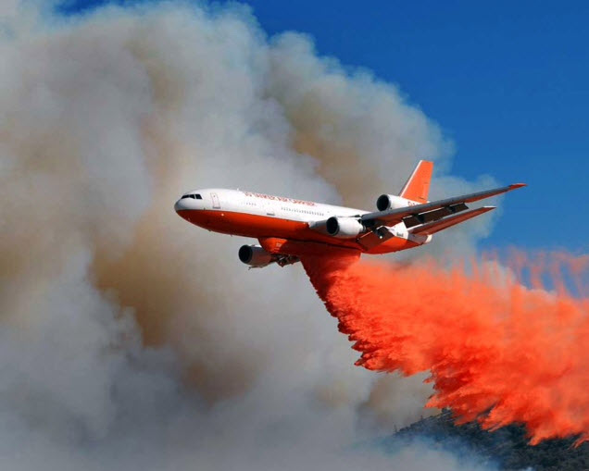
Responsible AI Framework for Air Traffic Management
Parimal Kopardekar, PhD
Director, NASA Aeronautics Research Institute
1

Slide 2
Outline
OUTLINE
Evolution Airspace Operations Future
Key Proposal
Responsible AI Framework
Use Cases
Collaboration and Harmonization

Slide 3
Hypothesis: Role of Automation
Future system will require increased levels of automation to address increased diversity, density, environmental considerations resulting in higher complexity
Historical basis for this hypothesis

Slide 4


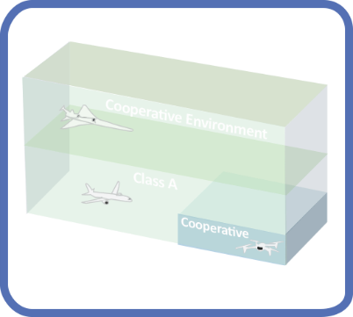
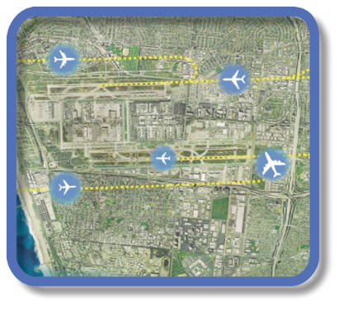

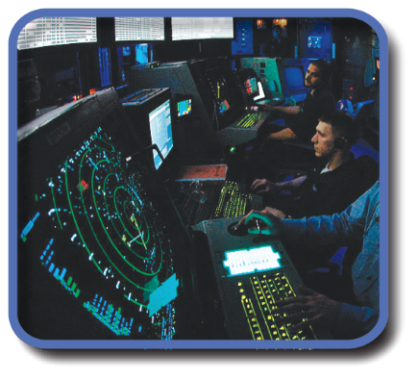
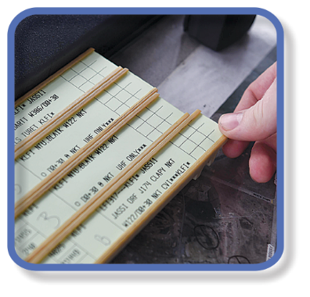




Evolution of Airspace Operations and Safety
+ Complexity, scalability,
and dynamic adaptation
+ Service oriented
architecture for
tailored mission
oriented services
+ Efficiency and
proactive planning
+Density
Safety
S-curves
Highly-Automated
ML/AI – based dynamic, robust
performance and safety
Trajectory
Know & exchange
current and planned a/c positions
Collaborative
Connected,
performance-based,
collaborative ATM
Radar
Know the current and estimate planned a/c positions
Machine-to-machine
interactions and humans collaborate
Procedural
Estimate the current and planned a/c positions
Introduces 3rd-party
service providers
Digital Transformation of ATM
Human-centered safety monitoring, assessment and mitigation
Automated in-time safety
monitoring and alerting services
Integrated predictive risk
mitigation across domains
Automatically-assured adaptive
in-time safety threat management
Human-centered safety monitoring, assessment and mitigation
Epoch 1
Epoch 2
Epoch 3
Epoch 4
(~2035)
Epoch 5
(~2045)

Slide 5
Transition to UTM-inspired Airspace Traffic Management
Current ATM
UTM-inspired-ATM
All services are provided by FAA
Services are provided FAA and third-parties
Human address off-nominal situations and contingencies to ensure safety
Automation addressed off-nominal situations and contingencies to ensure scalability while maintaining safety
Very little interaction among users and third parties
Users collaborate/cooperate for efficiency, preferences for flights into constraints resources
Human at the epi-center of information integration
Every data for every vehicle moves through FAA systems
Management by clearances
Each change is focused on domain-specific FAA system
Automation at the epi-center of information integration
New paradigm: Digital, connected ecosystems, outside applications
Movement towards management by exceptions
Each change is focused on trajectory optimization
Research Needed: Architecture, data exchanges, service allocation/roles/responsibilities, rules of engagement, performance requirements for aircraft and airspace system technologies, automation for contingency management and disruption handling, machine learning environment and algorithms for continuous improvement, safety assurance/certification/acceptance approaches, and technology transfers.

Slide 6
Key Question
Will automation be able to manage off-nominal, non-normal, unexpected, contingency situations?

Slide 7
Proposal
Type 1: Decisions that are reversible, strategic, or impact only efficiency, capacity, sustainability but do NOT impact safety of operation directly
Type 2: Decisions that are irreversible, tactical, and COULD impact safety of operation directly including other measures of performance

Slide 8
Responsible AI Framework: Factors Particularly for Type 2 Decisions
Explainability
Transparency
Visibility in Learning – external validation before implementation
Security
Safety
Trustworthiness
Stay within the rules of behavior

Slide 9
Behavior Rules
Every system or subsystem must have clear “system behavior” rules to ensure compatibility and harmonization with rest of the universe
Example, Asimov’s Rules
First law is that a robot shall not harm a human, or by inaction allow a human to come to harm.
Second law is that a robot shall obey any instruction given to it by a human, and
Third law is that a robot shall avoid actions or situations that could cause it to come to harm itself.
Challenge with Asimov’s rules were not easily testable

Slide 10
Example Behavior Rules
Flow management System
Demand should not exceed capacity in any given time
Conflict management system
No two aircraft should ever come closer than minimum separation
Surface management system
Two aircraft should not occupy the same runway at the same time

Slide 11
Responsible AI Framework: A Process
AI based concept, algorithms, and technology
AI based concept, algorithms, and technology
Build a model for services
Identify a set of ATM Services (e.g., traffic synchronization)
Select and Focus on a Service at-a-time
Identify a set of behavior rules
Identify nominal scenarios and corner cases – Train model
Real Situation
Identify a set of test conditions and success criteria
Independent Safety Monitor (non-AI, e.g., In-time Aviation Safety Management System)
Test model against behaviors and success criteria

Slide 12
Safety Monitor - Proposal
Not human
Layer of deterministic automation
Not intended to duplicate same capabilities such as AI-based approaches for total system performance
Safety monitor – manages for safety! One function.
Like humans do today – safe, expeditious, and orderly flow in that sequence
We have precedence – Traffic Collision Avoidance System (TCAS)
Architecting a new system is key
System-level “digital twin” running in the background

Slide 13
Use Cases

Slide 14
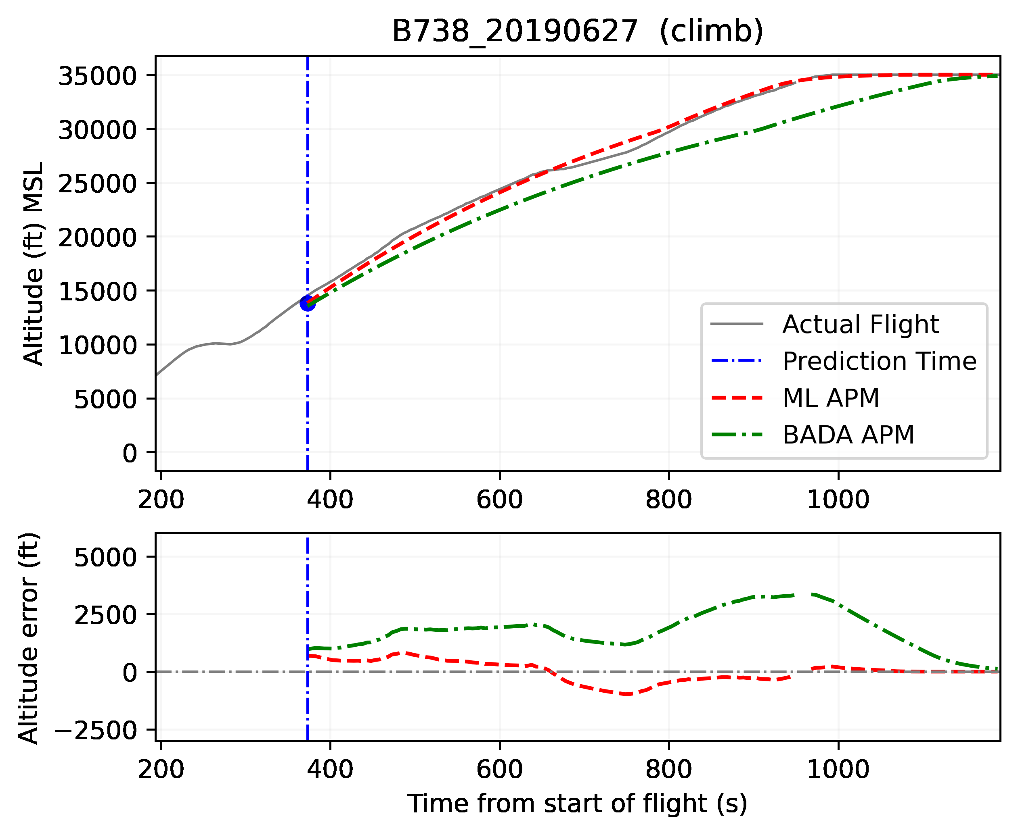
ML based trajectory prediction
Goal: Improve ETA predictions by providing accurate ML derived aircraft performance model (APM) parameters
Approach:
Collected and processed data from thousands of historical flights
Used physics-based approach (ODE-fitting) to obtain best APM coefficients for each flight
Trained ML model to capture relationship between characteristics of flights and ‘best’ APM coefficients
Challenges: Highly coupled parameters, proprietary values, no ground truth (labels) available.
ML-based method shows significant improvement in trajectory prediction compared to traditional model parameters
Example result

Slide 15
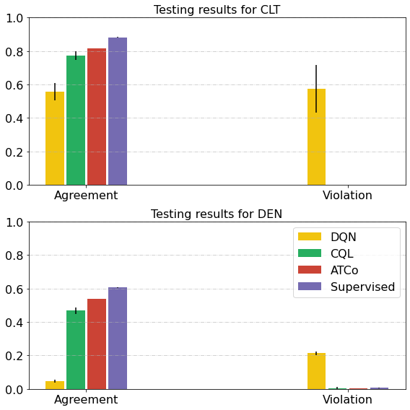
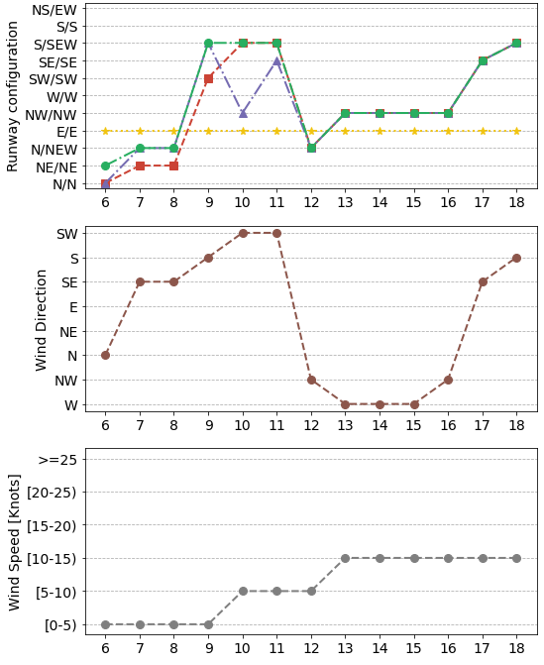
Runway Configuration Assistance (RCA)
Goal: Create an AI/ML tool to predict/recommend optimum time frame for runway configuration changes based on historical data and weather/traffic forecasts, without access to simulators
Approach:
Processed traffic and weather data from FAA’s ASPM, NASA’s Sherlock and NOAA’s LAMP
Developed supervised learning to mimic the controllers (ATCo)
Developed offline model-free reinforcement learning (CQL) to enhance decision-making of the ATCo
Validation metrics:
Agreement with historical decisions
Violation of obvious configuration scenarios
Feb 5, 2019, at 6AM
RCA tool and supervised learning show significant performance in CLT and especially in DEN, despite its complexity of runway configurations
Visualization dashboard:
Prediction of the configuration changes given the scheduled traffic and forecast of weather conditions.
Can be used by ATCo to identify optimum time-interval for configuration changes.

Slide 16
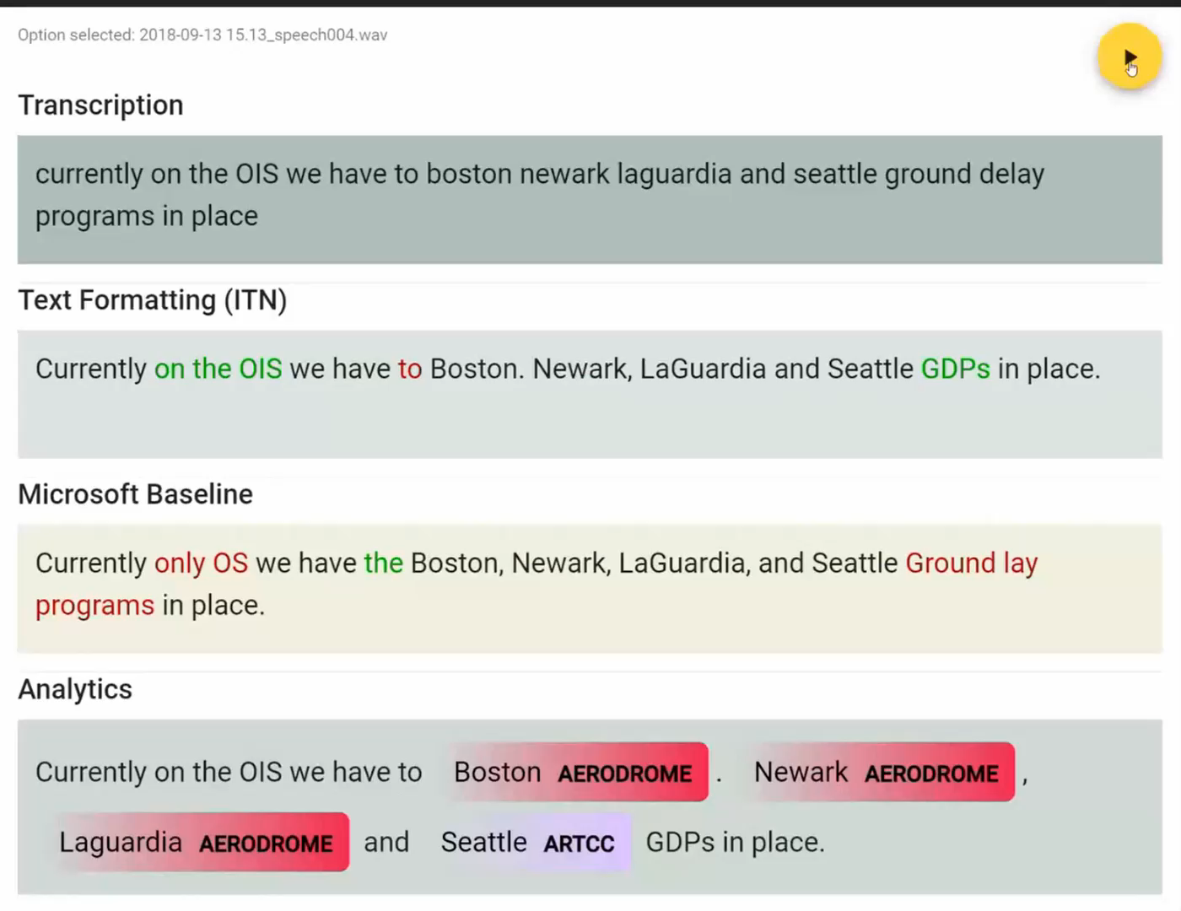
ML Models:
Speaker Diarization: Split speaker segments from long audio
Speech2Text: Convert audio into text transcriptions.
Audio-Lexical Inverse Text Normalization: Add text formatting, punctuation, and capitalization to raw text.
Named Entity Recognition: Used to extract key words and phrases from text transcriptions.
ATCSCC Webinar transcription
Goal: Utilize recent trends in AI/ML to provide automated transcriptions of ATCSCC webinar audio and extract relevant information from the transcript to help specialists.
Challenges: Unstructured audio data, highly domain-specific. Creating manual transcriptions takes time.
ATCSCC Webinar Speech2Text
Digital Information
Outcomes
More efficient review
Computable analytics
Collect and preprocess
Provide downstream information extraction and text processing
Automatically create text-based transcriptions
Digital TMIs
Notes:
There are neural network models associated with each one of these steps

Slide 17
Collaboration and Harmonization
Factors for Responsible AI
Behavioral rules for ATM enterprise
Basic architecture – safety monitor construct
AI-based technology will be secret sauce but set of test conditions and success criteria does not have to be

Slide 18
Embracing Innovation in Aviation while Respecting its Safety Tradition
Parimal.H.Kopardekar@nasa.gov

